Slide 1
Slavery issues prior to 1820

Slide 2
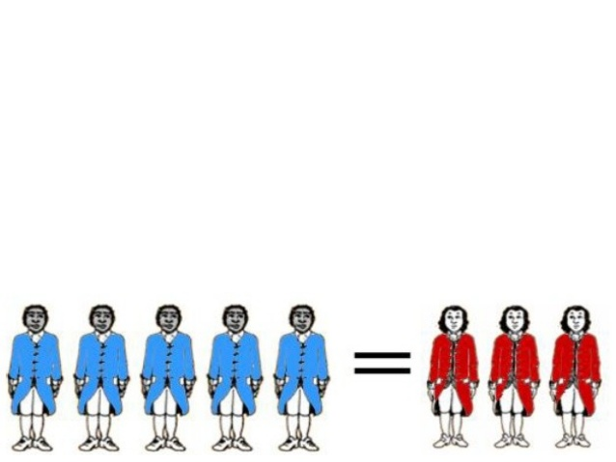
3/5 Compromise - 1787
The compromise between southern and northern states helped insure ratification of the Constitution. Counting slaves as 3/5 of a person would be used to determine the distribution of taxes and the number of members each state was allowed in the House of Representatives.
Effect: Led to increasing sectionalism

Slide 3
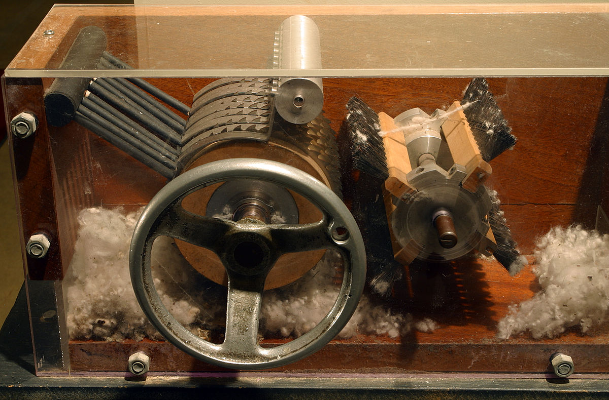
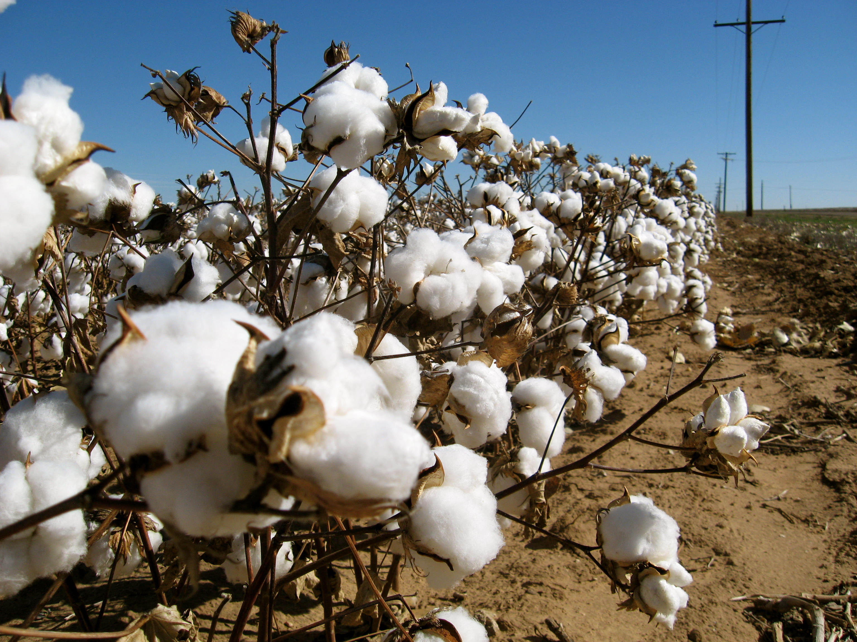
Invention of the Cotton Gin
1793
Eli Whitney's invention of the cotton gin revolutionized the cotton industry in the U.S.
Removal of cotton seeds became 50 times faster.

Slide 4
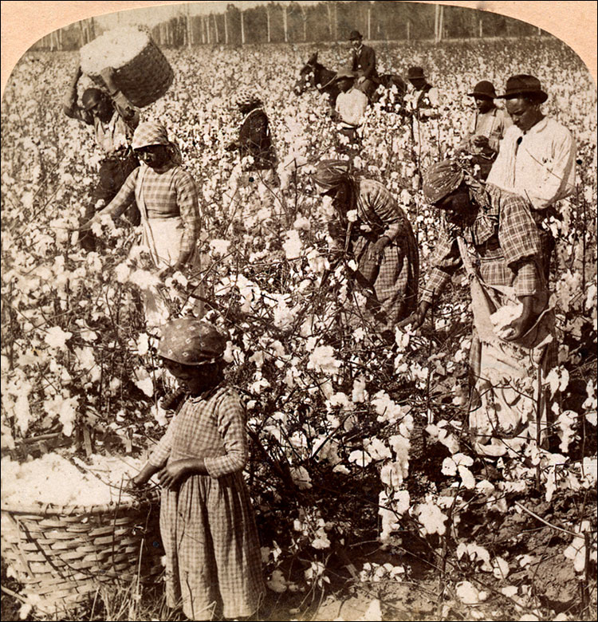
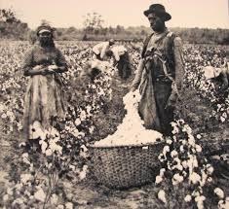
Invention of the Cotton Gin
1793
Effect: Increased the demand for slave labor

Slide 5
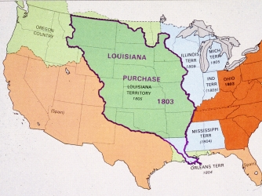
Louisiana Purchase - 1803
After the Louisiana Purchase in 1803, the United States doubled in size. This purchase gave the United States control of the vast lands west of the Mississippi.

Slide 6
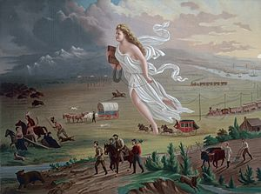
Westward Expansion
Manifest Destiny principle spurred Westward Expansion and the fight over slavery
Manifest Destiny
the 19th-century doctrine or belief that the expansion of the US throughout the American continent was both justified and inevitable.
“American Progress” by John Gast (1872)

Slide 7
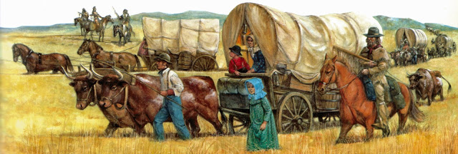
Louisiana Purchase
Westward Expansion
Manifest Destiny
Effect: As Americans pushed west, the issue of slavery came to the forefront. Would the new territories of the United States be slave or free?

Slide 8
Chapter 1
Toward Civil War
1840-1861

Slide 9
Section 1
Slavery in the West

Slide 10
Missouri Compromise of 1820
ISSUES:
Many settlers brought slaves with them to Missouri
When Missouri applied to be a state the state constitution allowed slavery

Slide 11
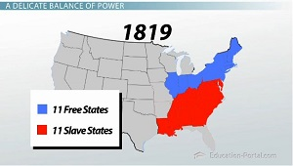
Missouri Compromise of 1820

Slide 12
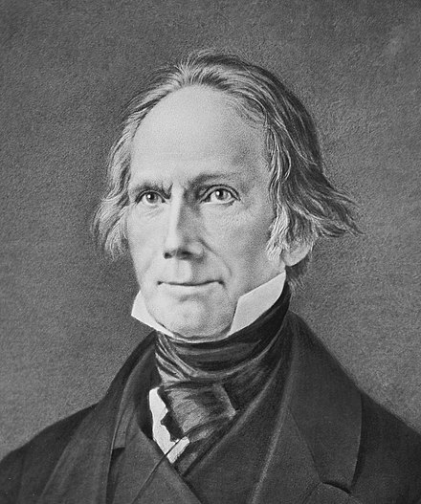
Missouri Compromise of 1820
HENRY CLAY
Speaker of the House
from Kentucky
“The Great Compromiser”

Slide 13
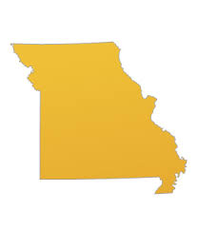
Missouri Compromise of 1820
Admit Missouri as a Slave State
Admit Maine as a Free State
Ban Slavery in the Louisiana Purchase North of 36°30’

Slide 14
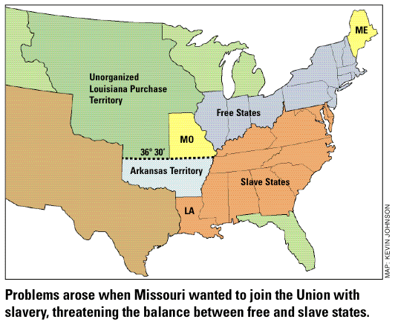
Missouri Compromise

Slide 15
DEBATE OVER SLAVERY CONTINUES
David Wilmot, Pennsylvania
“Wilmot Proviso” – Ban slavery in lands that might be acquired during Mexican War
SECTIONALISM!!!!!
John C. Calhoun, South Carolina
Congress nor any territory has the authority to ban, regulate or control slavery

Slide 16
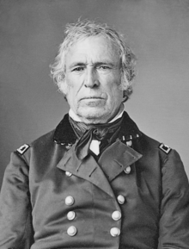
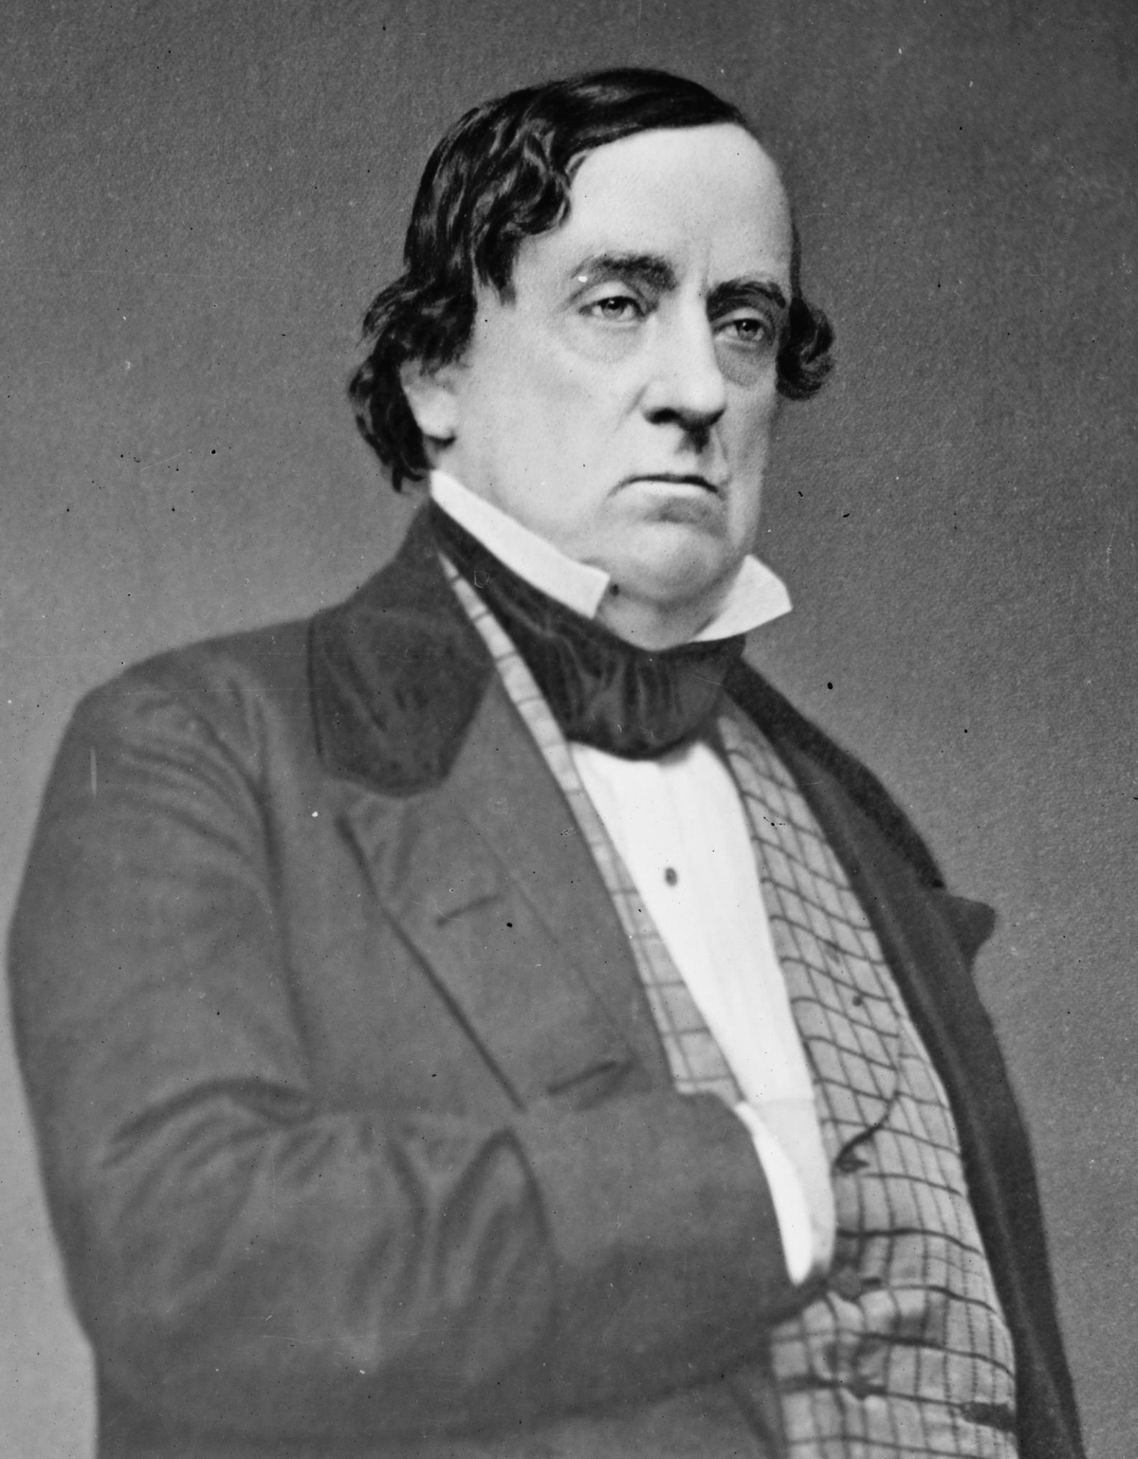
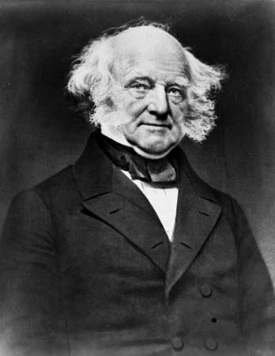
Zachary Taylor
Whig Party
Lewis Cass
Democratic Party
Election of 1848
Martin Van Buren
8th President 1837-1841
Free-Soil Party
Taylor and Cass ignored the issue of Slavery
Led to the formation of the Free-Soil Party

Slide 17
Free-Soil Party
Martin Van Buren
Opposed extension of slavery into the territories
Received no electoral votes but did win 10% of the popular vote
Free-Soil Party gained several seats in Congress

Slide 18
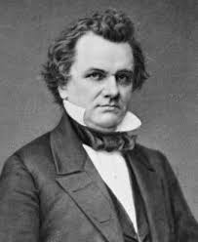
Compromise of 1850
Issue: Balance of Power in the U.S. Senate
or Free states vs. Slave States
Henry Clay
“The Great Compromiser”
Stephen A. Douglas
Illinois Senator
“South threatens to secede”

Slide 19
Compromise of 1850
Texas – Slave (1845)
California – Free
Fugitive Slave Act
(National law requiring states to return runaway slaves)
D.C. Slave Trade Banned
(Slavery was still legal in Washington D.C.)
Popular Sovereignty

Slide 20
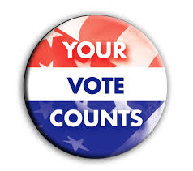
Popular Sovereignty
Popular = Commonly liked or approved
Sovereignty = Freedom from outside control

Slide 21
Section 2
A Nation Dividing

Slide 22
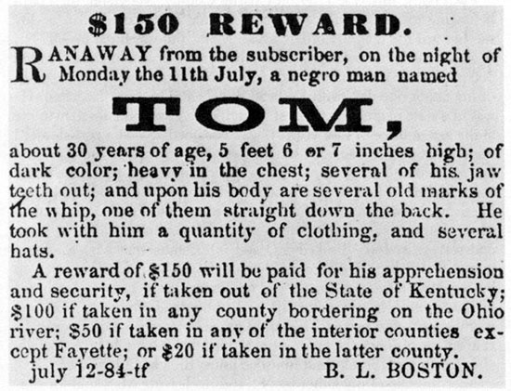
The Fugitive Slave Act
Required all citizens to help capture runaways.
Southerners thought the law would force the Northerners recognize their rights but instead the law made slavery seem even more wrong

Slide 23
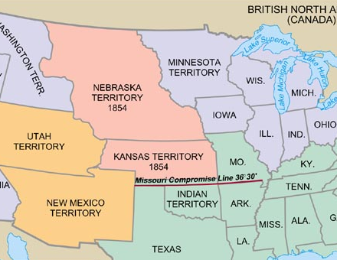
Kansas-Nebraska Act - 1854
Proposed by
Stephen A. Douglas
Popular Sovereignty would decide the issue of slavery

Slide 24
Kansas-Nebraska Act - 1854
Northerners upset because 36°30° line is repealed
Southerners expect Kansas to be settled by slaveholders

Slide 25
Kansas-Nebraska Act - 1854
Elections take place!! (Popular Sovereignty) - 1500 people in Kansas but 6000 vote?!?!?!?
Border Ruffians:
Armed Missourians who crossed the Kansas border to support slavery
By 1856 Pro-Slavery and Anti-Slavery governments existed.

Slide 26
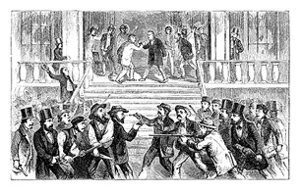
Kansas-Nebraska Act - 1854
Both sides armed...................
Bleeding Kansas:
Newspapers referred to the violence in Kansas
SECTIONALISM!!!!!

Slide 27
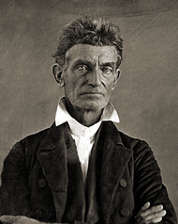
John Brown
abolitionist
“Believed God chose him to end slavery”
Vowed to strike terror in the hearts of pro-slavery people.......led a group that seized and killed five supporters of slavery

Slide 28
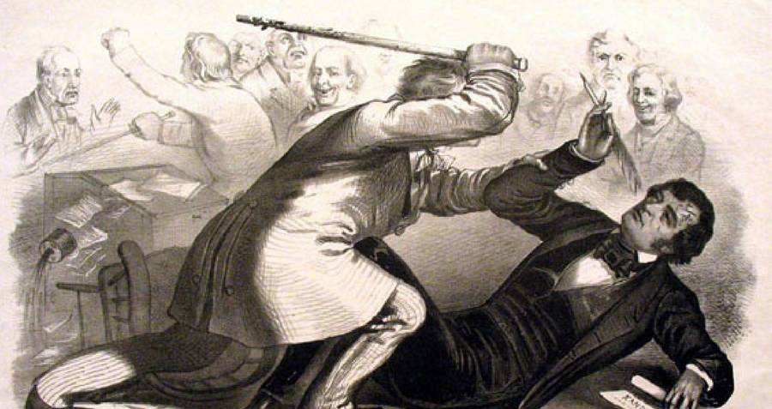
Violence in Congress
Representative Preston Brooks beats Charles Sumner with a cane on the Senate Floor over the slavery debate in Kansas
SECTIONALISM!!!!!

Slide 29
Section 3
Challenges to Slavery

Slide 30
REPUBLICAN PARTY
Main message was that the government should ban slavery in territories.
Support was from the North
SECTIONALISM!!!!!
Republicans win many seats in Congress

Slide 31
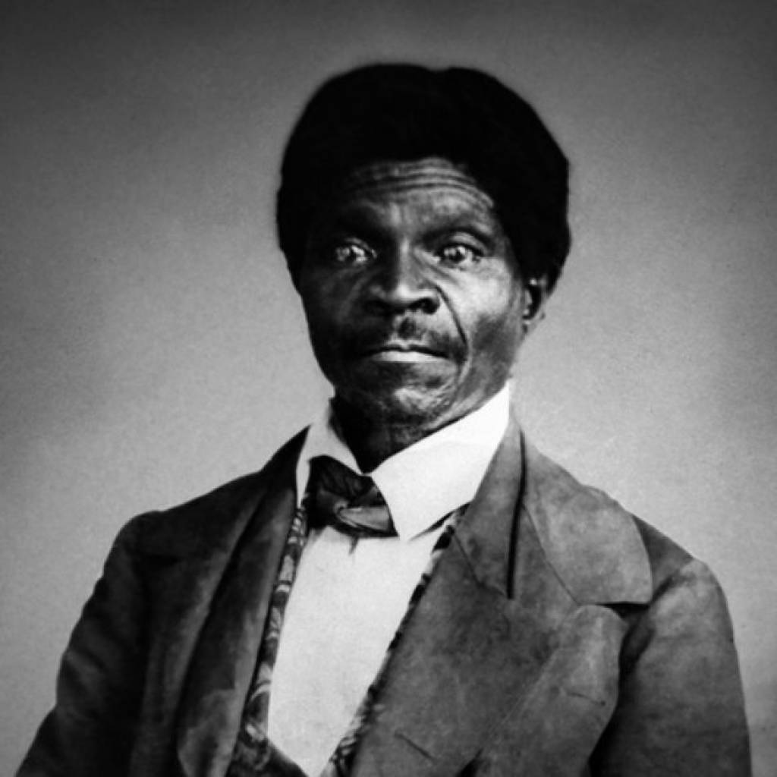
The Dred Scott Case
Dred Scott was a slave who claimed that because his master had taken him to the free territories of Illinois and Wisconsin, he should be free.
In 1846, with the help of anti-slavery lawyers, he sued for his freedom. It took 11 years for the case to get to the United States Supreme Court.

Slide 32
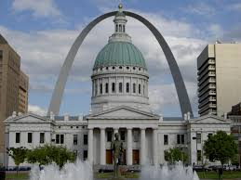
The Dred Scott Case
1. The court ruled that because Scott was not considered a citizen, but property, he could not file a lawsuit.
Dred Scott case was heard in the Old Courthouse in St. Louis
2. Since Scott was property, and the Fifth Amendment prohibits Congress from taking away property without “due process of law”
3. The Court also ruled that Congress had no power to decide the issue of slavery in the territories. This meant that slavery was legal in all the territories and the Missouri Compromise was unconstitutional.

Slide 33
The Dred Scott Case
The Court upheld what many in the South had always said – “Nothing could legally stop the spread of slavery”
SECTIONALISM!!!!!
The case also ruled that the main issue the Republican party was based on (limits on slavery in the territories) was unconstitutional.

Slide 34
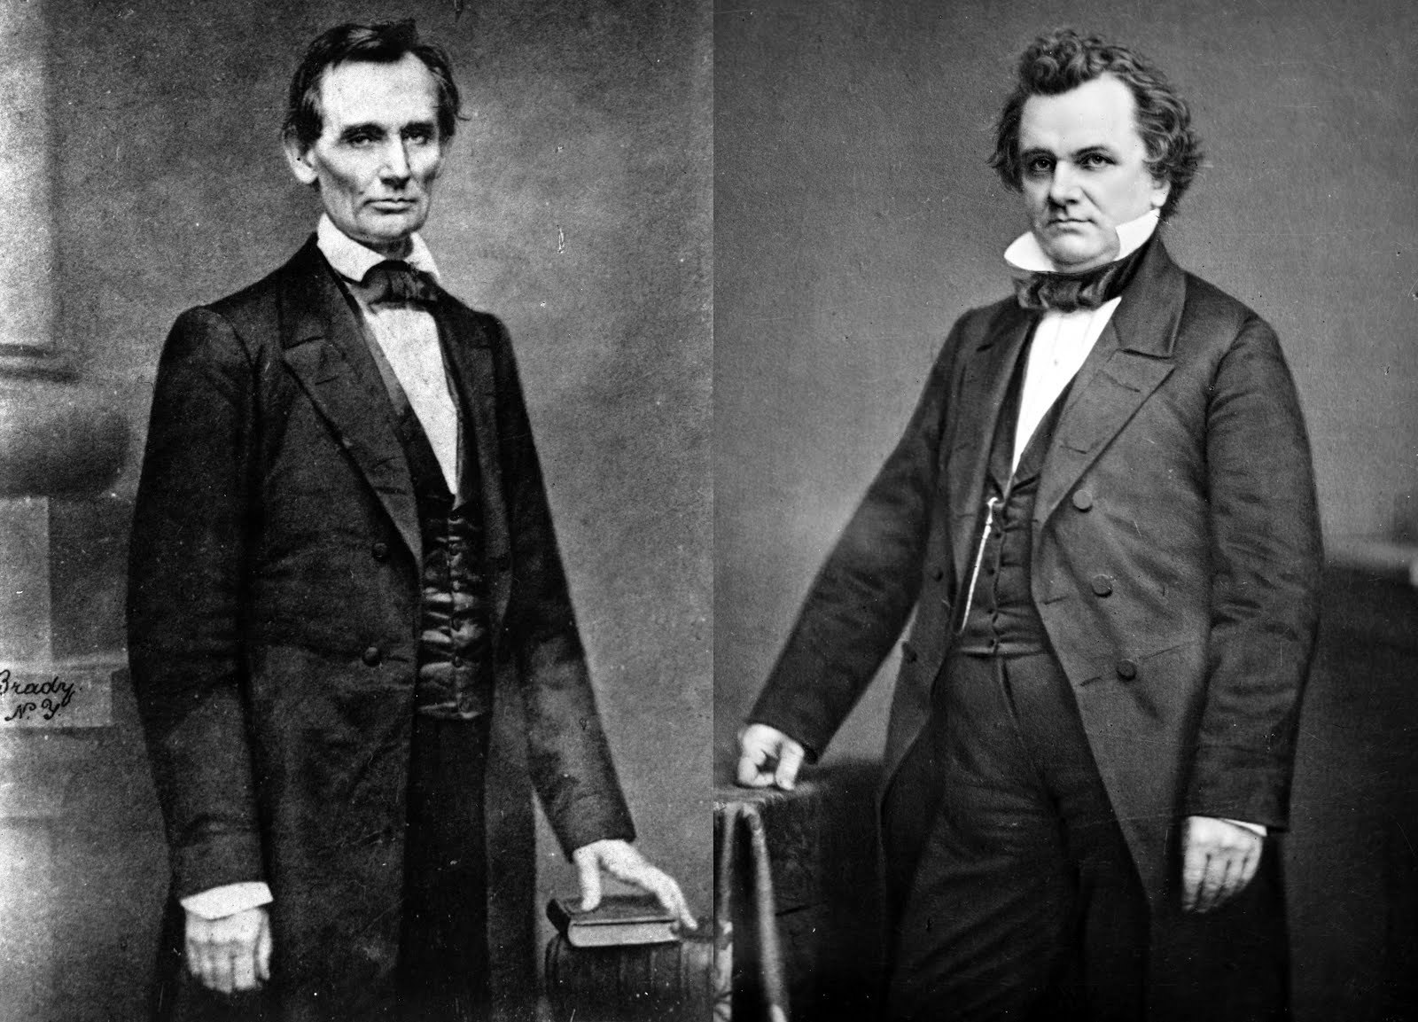
Race for United State Senator from Illinois - 1858
Abraham Lincoln vs. Stephan A. Douglas

Slide 35
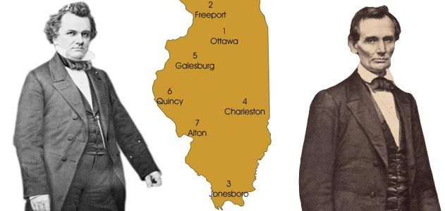
Lincoln-Douglas Debates
Topic – SLAVERY
Douglas – popular, well-known
Lincoln – unknown

Slide 36
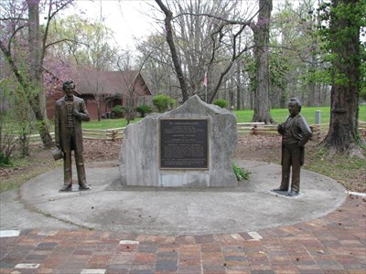
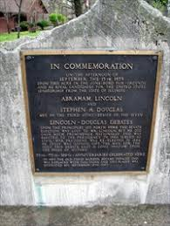
Lincoln-Douglas Debates
Debate #3 – Jonesboro, IL
September 15, 1858

Slide 37
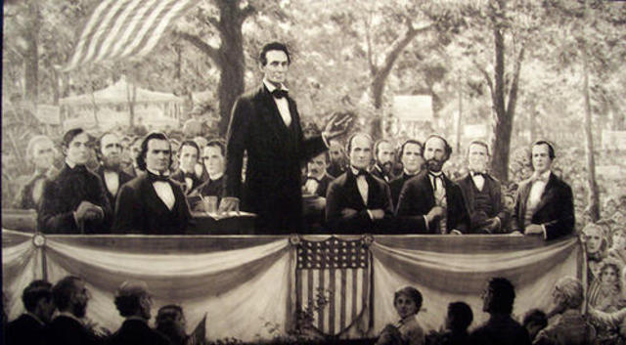
Lincoln-Douglas Debates
Douglass believed in deciding slavery by popular sovereignty.
Lincoln believed that slavery should NOT be allowed to spread into the territories.
Abraham Lincoln loses the Senate race to Douglas.............but he gains a national reputation and is the clear leader of the Republican Party

Slide 38
John Brown
abolitionist
“Believed God chose him to end slavery”
Fall – 1859
Leader of a raid on the Federal Arsenal in Harpers Ferry, Virginia

Slide 39
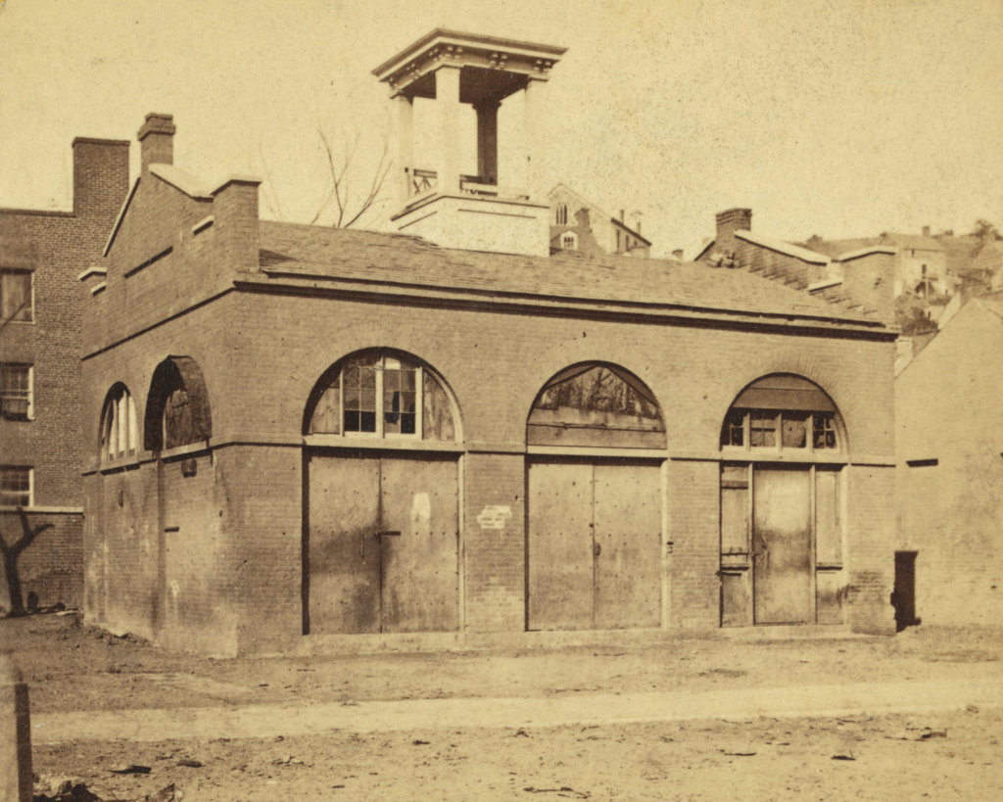
Harpers Ferry Arsenal
His hope was to start a slave revolt against slave owners!

Slide 40
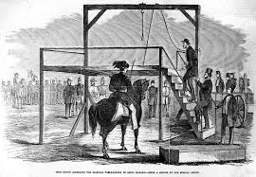
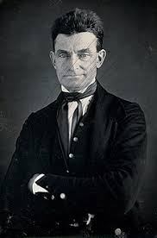
John Brown
Brown’s raid was easily defeated and he was convicted of treason and murder.

Slide 41
John Brown
North
Martyr = person who dies for a great cause
North
Use of violence was wrong
North
Rallied Abolitionists

Slide 42
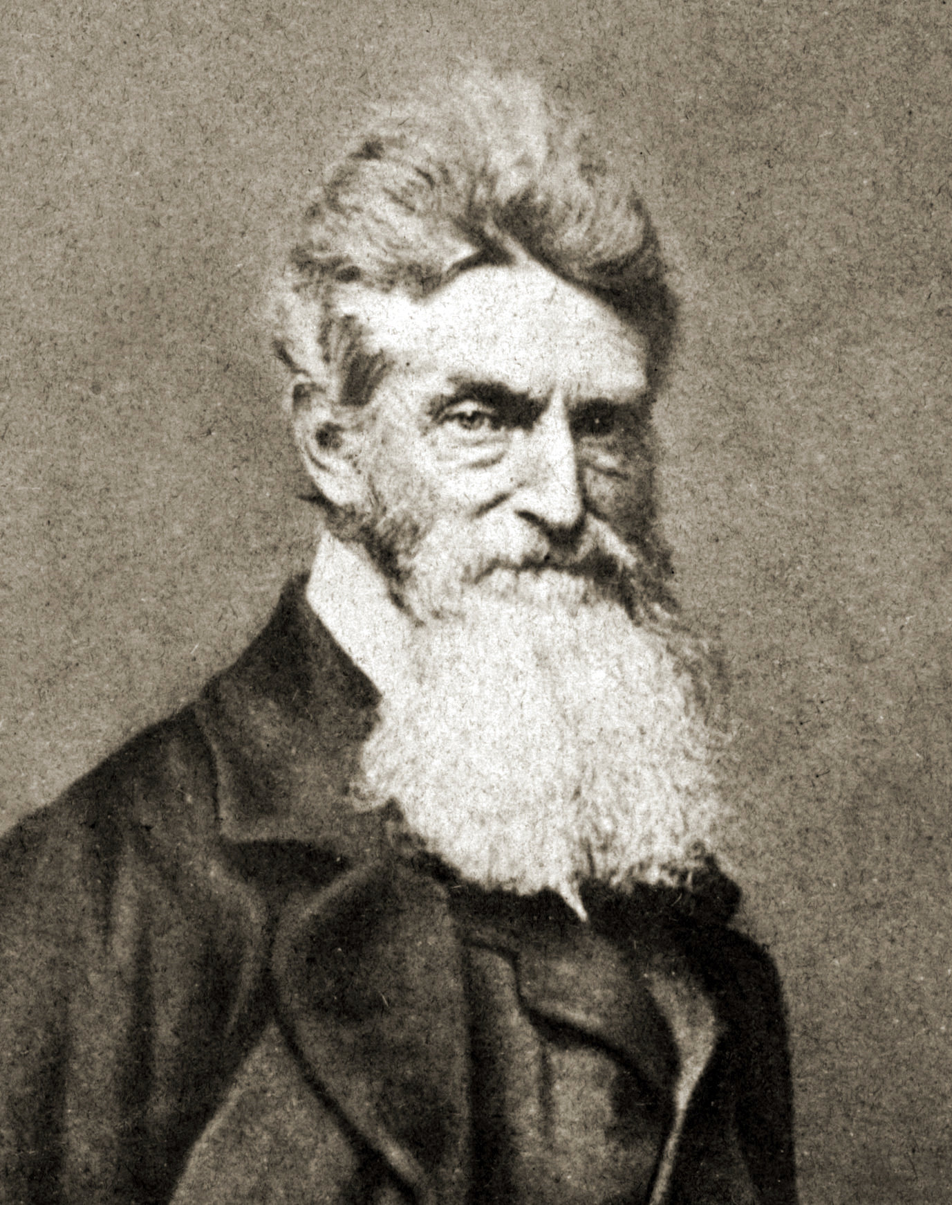
John Brown
South
All Abolitionist are like him........CRAZY
SECTIONALISM!!!!!
South
North has a conspiracy against the South

Slide 43
Section 4
Secession and War

Slide 44
1860 Presidential Election

Slide 45
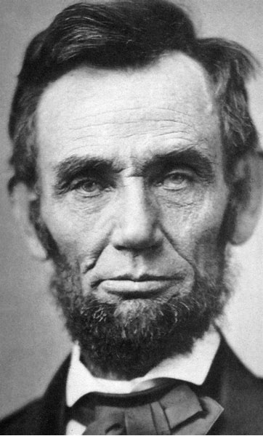
Attempt at Compromise
Republican Party Platform
1) Leave slavery alone where it exists (South)
2) Exclude slavery from any new territories

Slide 46
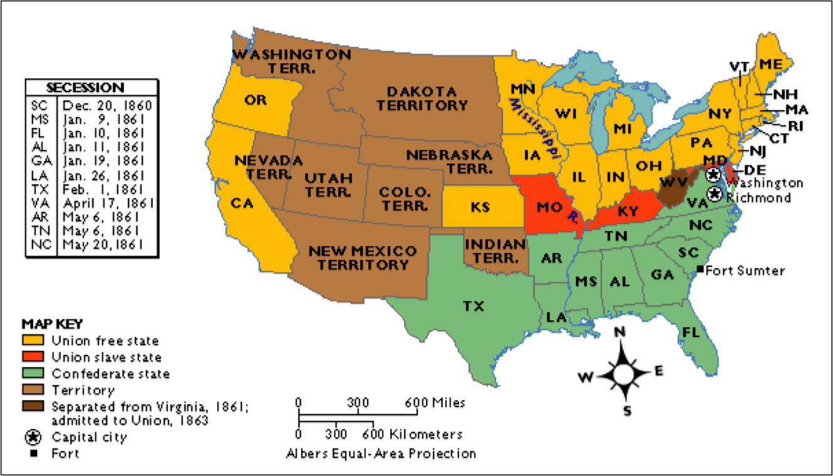
SECESSION!!!

Slide 47
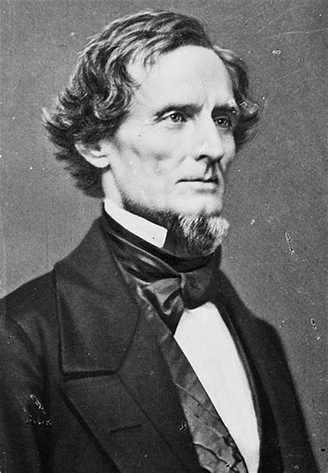
Confederate States of America
States’ Rights
The states volunteered to join the Union, therefore they had the right to leave.
Jefferson Davis

