Slide 1
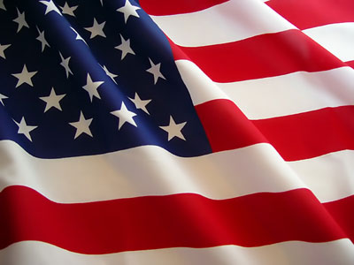
Chapter 12
America and World War II
1939-1945

Slide 2
Section 1
The Road to War

Slide 3
The Rise of Dictators
Communist Dictatorship (USSR)
Totalitarianism
In a Totalitarian country, individual rights are not viewed as important as the needs of the nation.
Military Dictatorship (Japan)
Fascist Dictatorship (Germany, Italy)
government characterized by militarism and racism

Slide 4
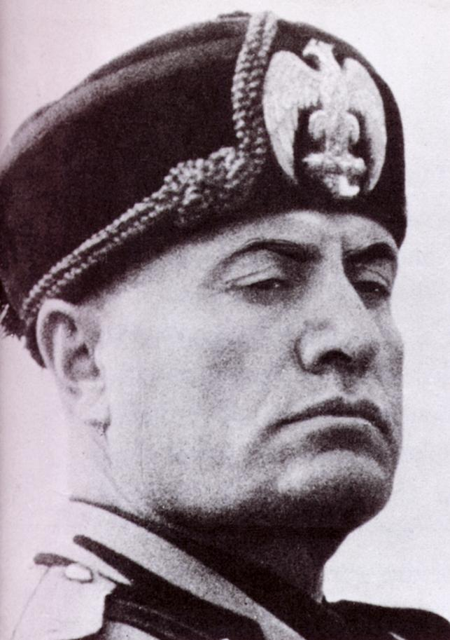

Benito Mussolini
Italy

Slide 5
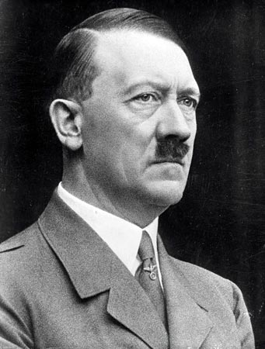
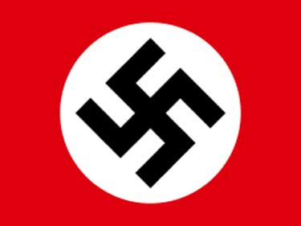
Adolf Hitler
Germany

Slide 6
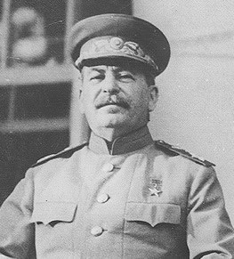
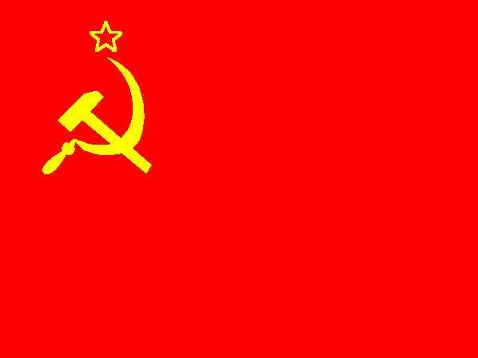
Joseph Stalin
Soviet Union

Slide 7
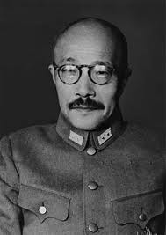
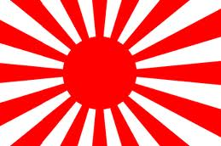
Hideki Tojo
Japan

Slide 8
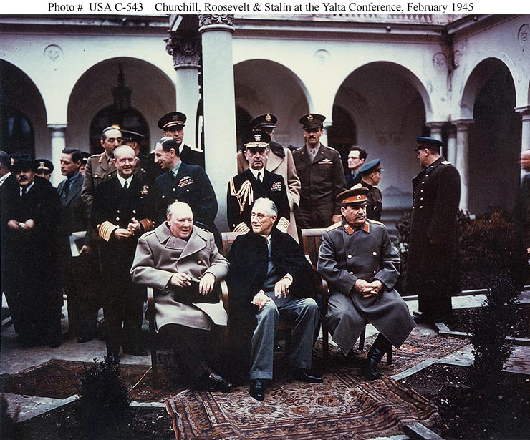

Slide 9
Neutrality Acts
Attempts to keep the United States out of war.

Slide 10
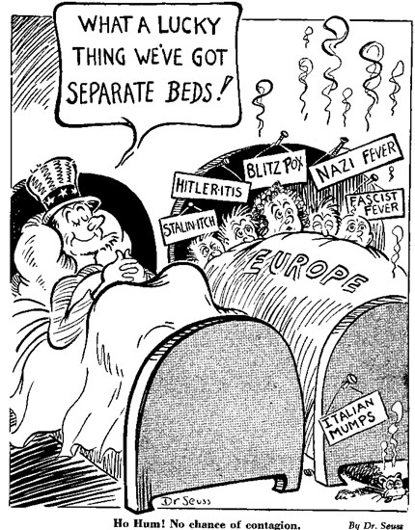
Appeasement
Britain and France gave in to the Germany demands to avoid war.

Slide 11
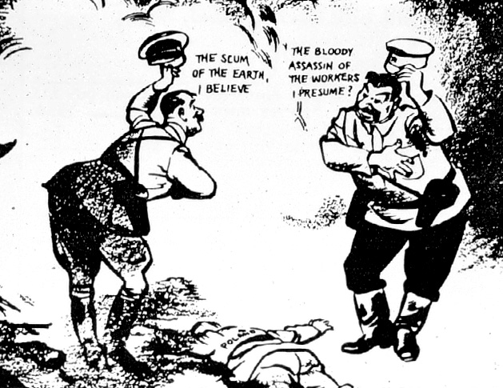
Soviet-German
Non-Aggression Pact
The non-aggression pact was surprising. Hitler and Stalin were seen as natural enemies.
Adolf Hitler
Joseph Stalin

Slide 12
Section 2
War Begins

Slide 13


Axis Powers
Germany
Italy
Japan

Slide 14


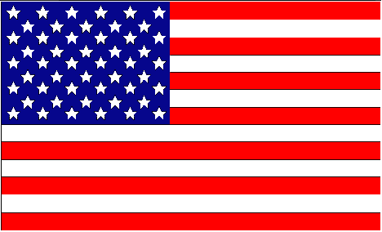


Allied Powers
Great Britain
Soviet Union
United States
France
China

Slide 15
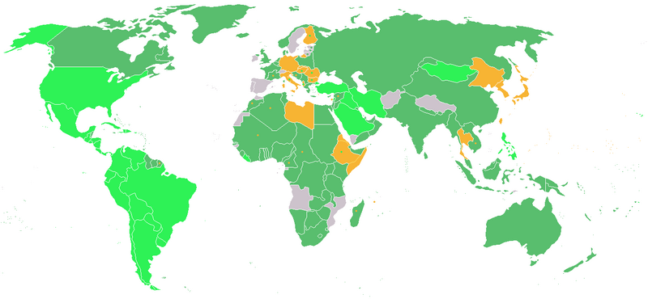
Countries who participated in Word War II
    Dark Green: Allies before the attack on Pearl Harbor, including colonies.
    Light Green: Allied countries that entered the war after the Japanese attack on Pearl Harbor.
    Orange: Axis Powers
    Grey: Neutral

Slide 16
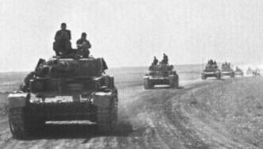
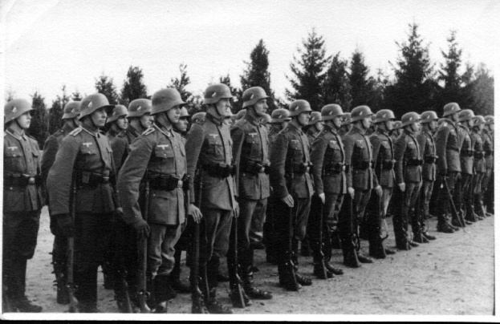
September 1939
Hitler invades Poland using a new method of war called a Blitzkrieg! (Lightning War)

Slide 17
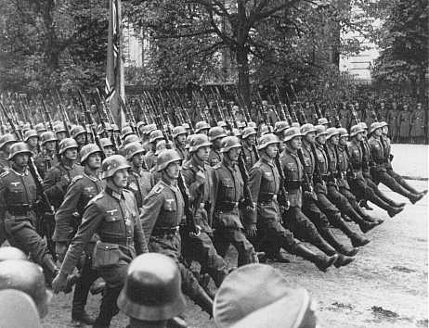
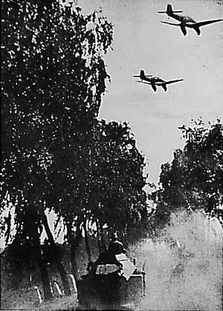
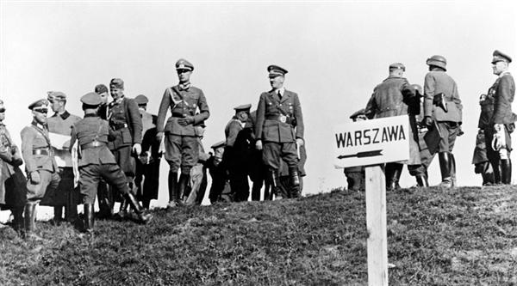
Two days after Hitler’s invasion of Poland, Great Britain and France declared war on Germany.

Slide 18
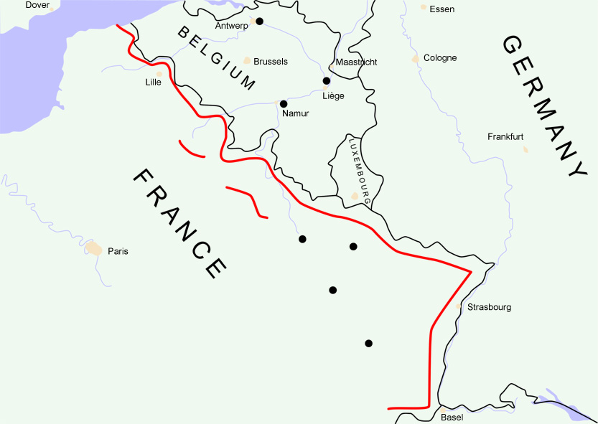
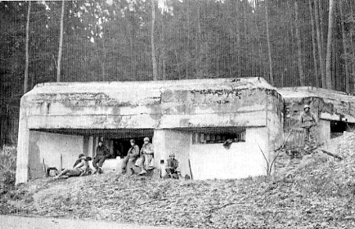
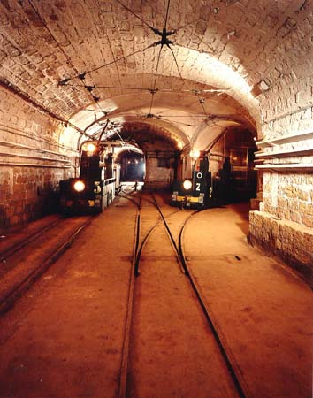
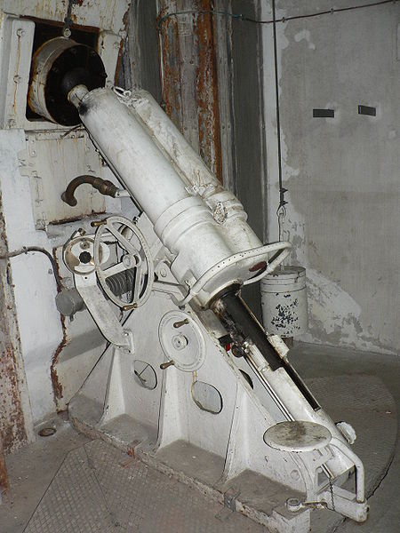
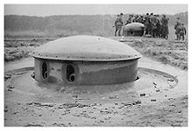
Maginot Line
France

Slide 19
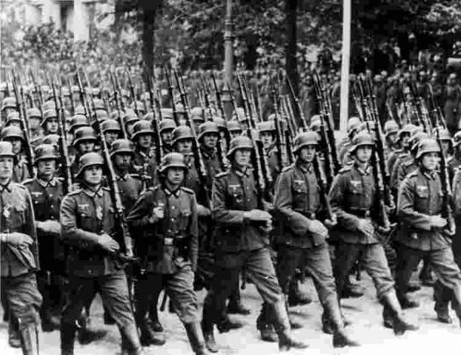
Germany turned west and invaded France and the Netherlands
May 1940
British and French forces settled in at the Maginot Line, a string of steel and concrete bunkers along the German border. Using the Blitzkreig - British and French troops were forced to retreat.

Slide 20
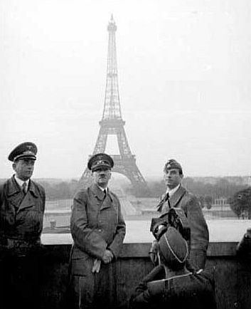
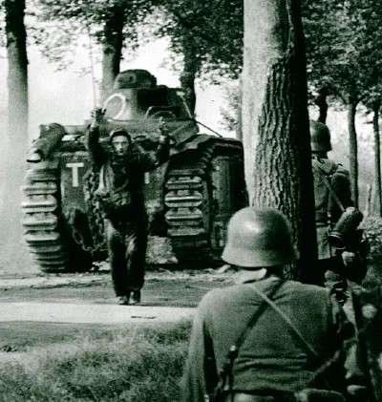
On June 22, 1940, barely six weeks after the invasion, France surrendered in Paris. The fall of France to shocked the world.
June 22, 1940
Hitler in Paris after the surrender

Slide 21
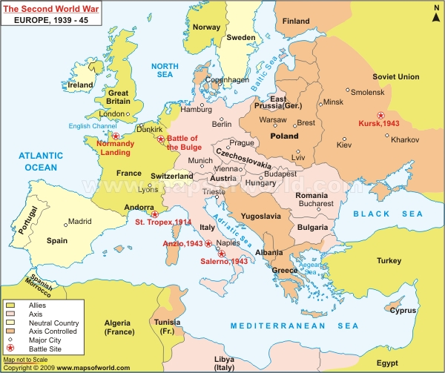
Germany turns toward
Great Britain

Slide 22
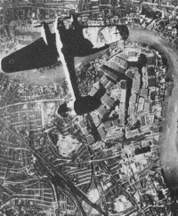
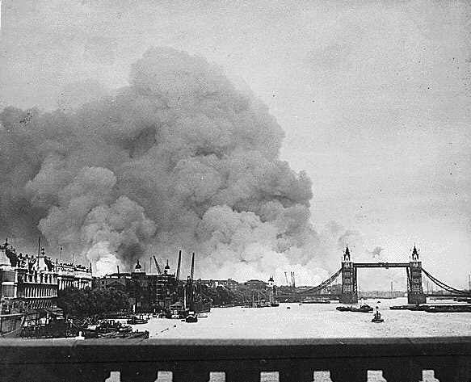
September 1940 to May 1941
“The BLITZ”
For nine months, the German Air Force (Luftwaffe) launched repeated bombing raids on British towns and cities.

Slide 23
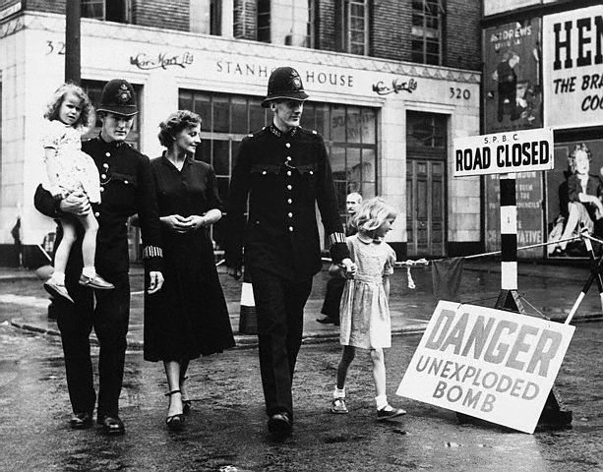
Battle of Britain - Summer, 1940

Slide 24
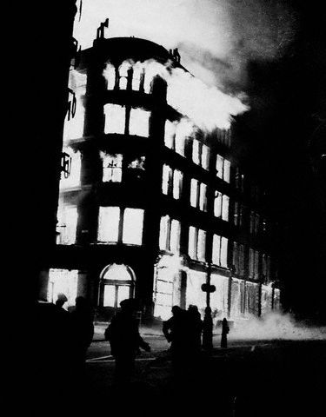
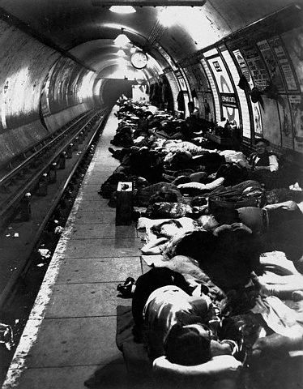
Battle of Britain - Summer, 1940

Slide 25
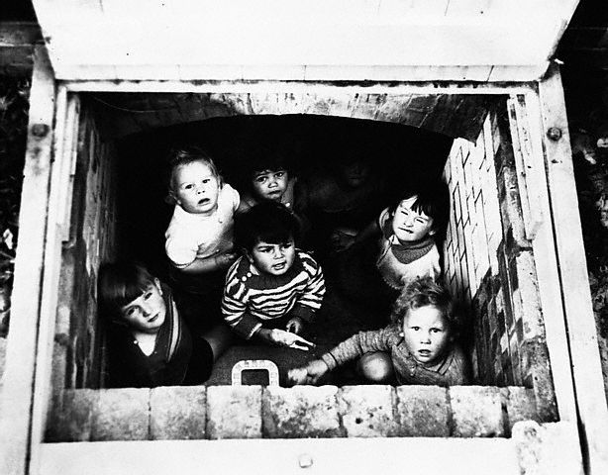
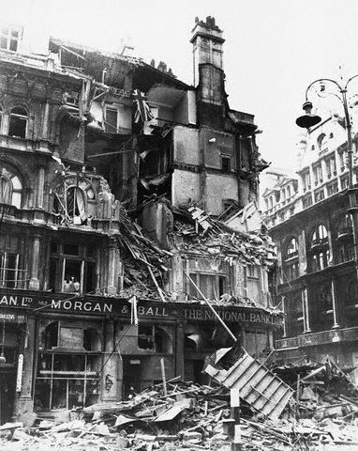
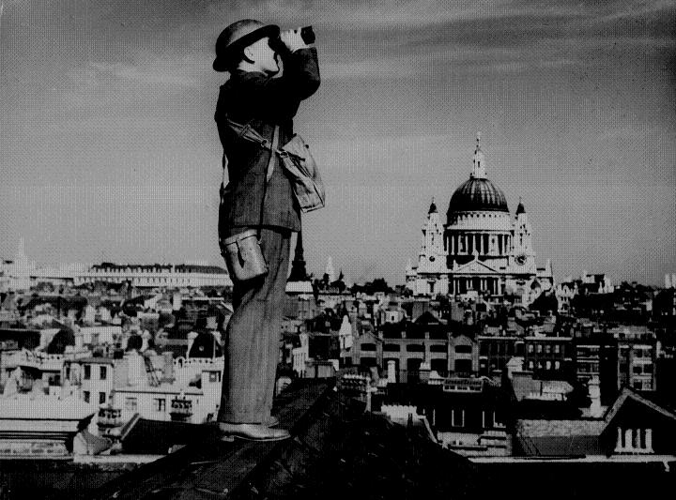
Battle of Britain - Summer, 1940

Slide 26
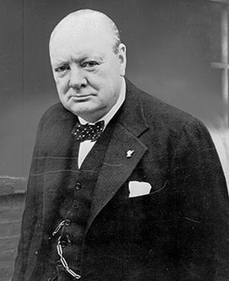
'We shall fight on the beaches ...‘,
June 4, 1940
'... We shall go on to the end, we shall fight in France, we shall fight on the seas and oceans, we shall fight with growing confidence and growing strength in the air, we shall defend our island, whatever the cost may be, we shall fight on the beaches, we shall fight on the landing grounds, we shall fight in the fields and in the streets, we shall fight in the hills; we shall never surrender ...'
Winston Churchill, British Prime Minister

Slide 27
Germany turns toward
the Soviet Union

Slide 28
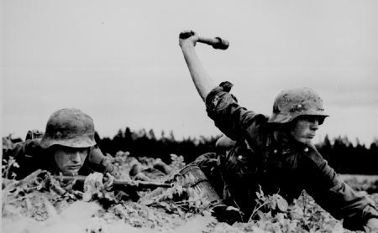
June 1941
Operation Barbarossa
Unable to defeat the British, Hitler decided that Germany needed the resources of the Soviet Union. Germany attacked in June of 1941. This broke the promise of the Soviet-German non-aggression pact.

Slide 29
America and the War
Cash and Carry
Lend-Lease Act

Slide 30
U.S. Lend-Lease Act -1941
Great Britain $31 billion
Soviet Union $11 billion
France $3 billion
China $1.5 billion
Other European $500 million
South America $400 million
The amount totaled: $48,601,365,000

Slide 31
America and the War
Strengthen the Army and Navy
Peacetime Draft

Slide 32
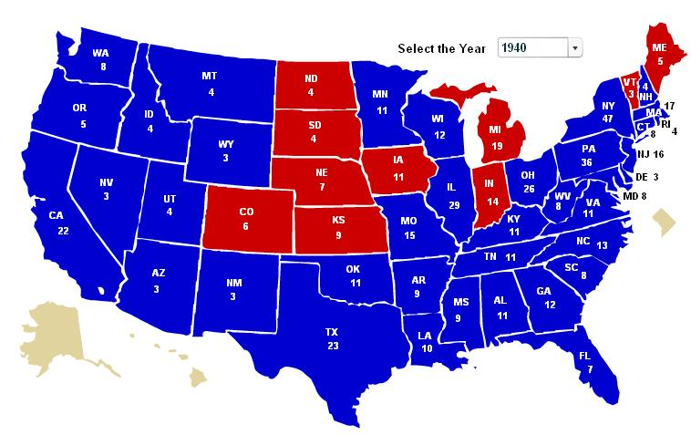
1940 Presidential Election
Third Term for FDR

Slide 33
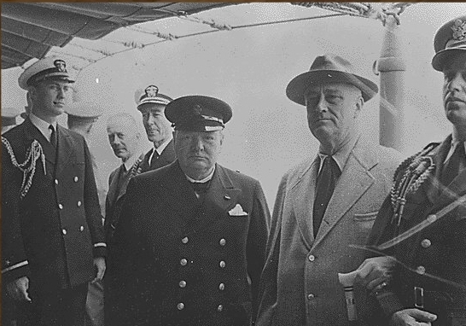
Atlantic Charter
Roosevelt and Churchill signed the to Atlantic Charter which set goals for the post war world. Both leaders pledged not to seek any territory from the war.
August 1941

Slide 34
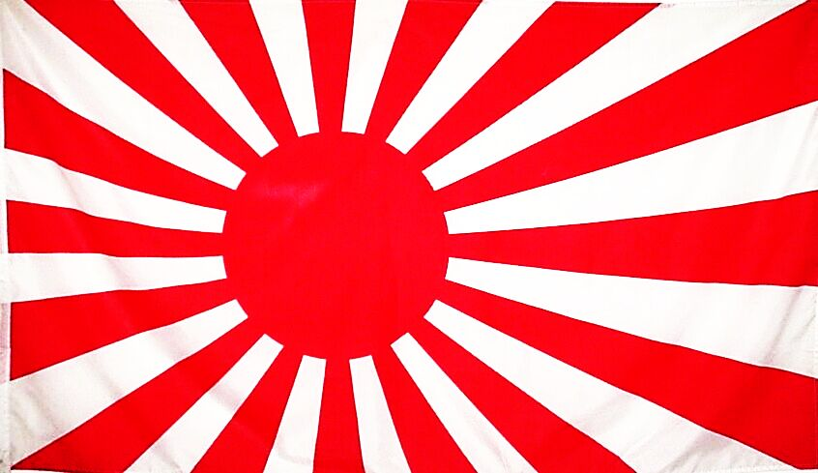
Japan extended its empire in the East – seizing land including China and Philippines
The Japanese Threat
America responds with economic pressure:
Stopped sale of oil. gas, and other resources
Froze Japanese funds in American banks

Slide 35
December 7, 1941
7:55 A.M.

Slide 36
On Sunday morning, December 7, 1941, the American Pacific fleet was peacefully anchored at Pearl Harbor, Hawaii. Suddenly, Japanese planes swept through the sky. In less than two hours, they sank or seriously damaged nineteen American ships, destroyed almost 200 planes, and killed about 2,400 people.

Slide 37
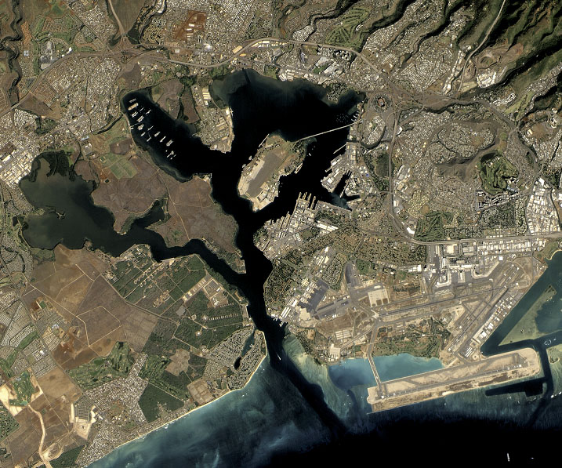
Pearl Harbor

Slide 38
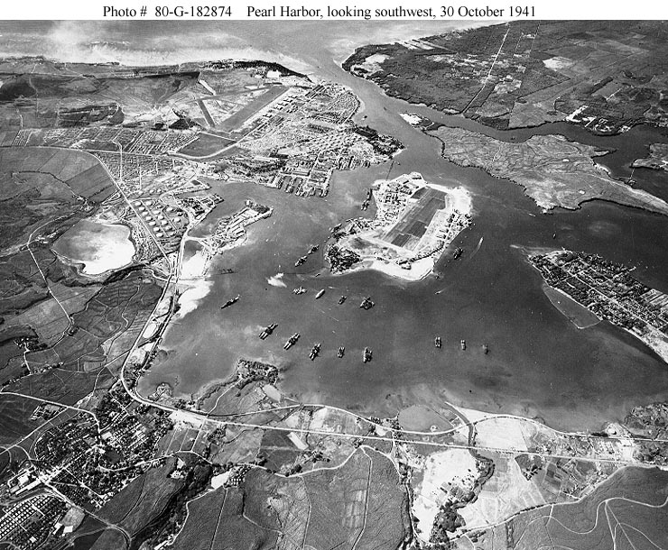

Slide 39
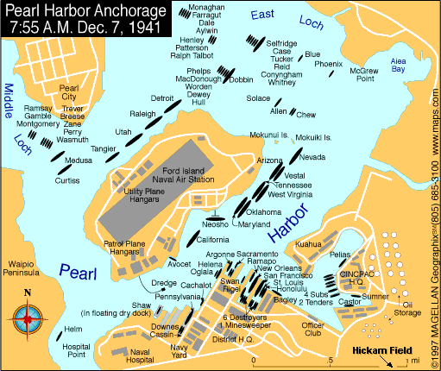

Slide 40
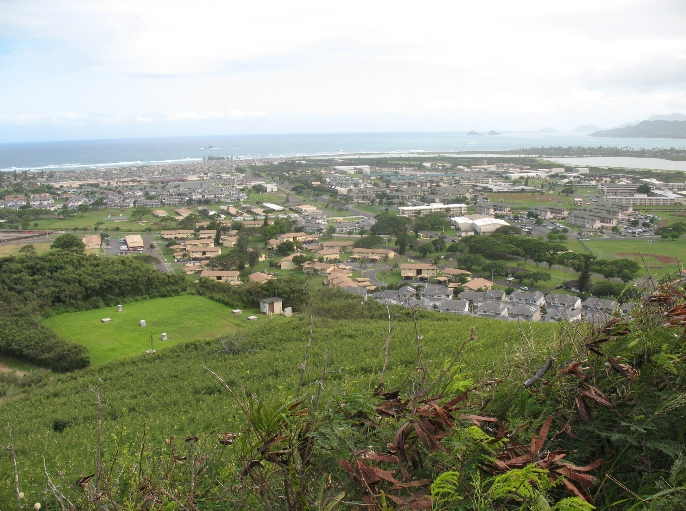

Slide 41
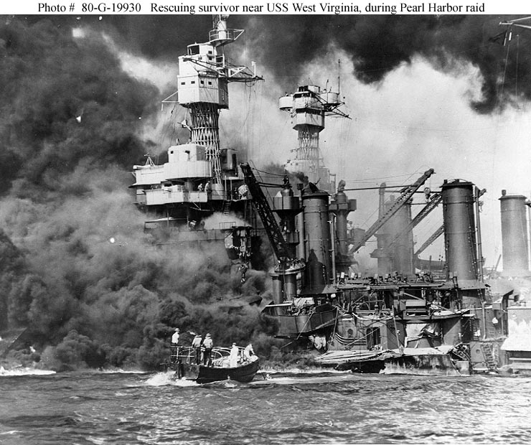

Slide 42
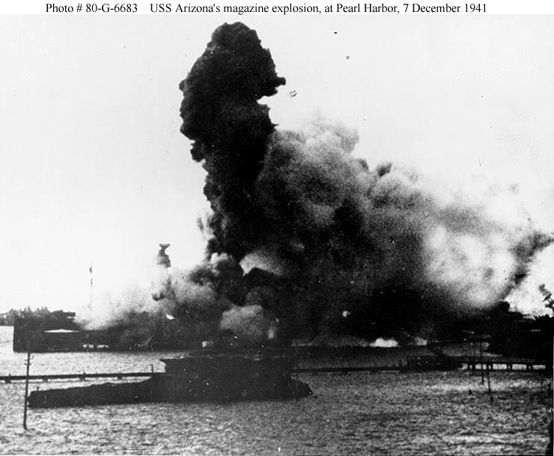

Slide 43
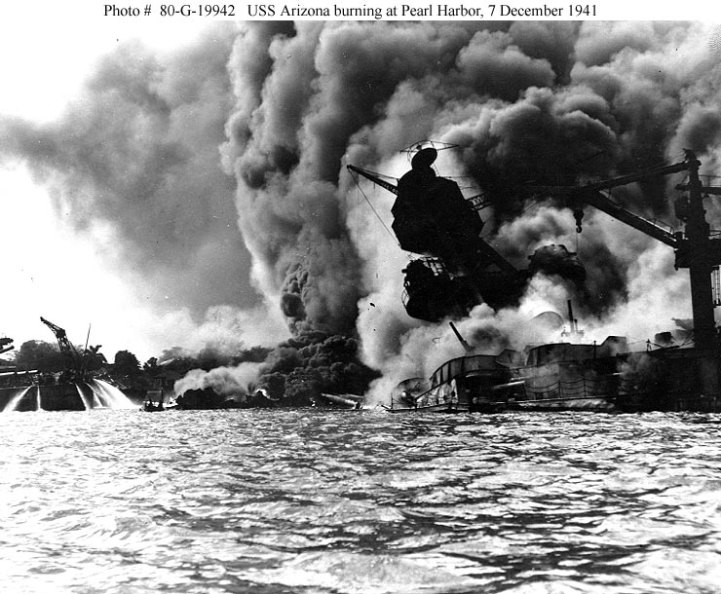

Slide 44
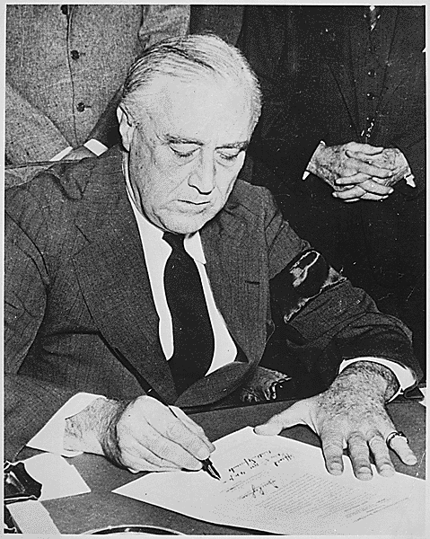
FDR signs the
declaration of War on Japan
“a date which will live in infamy”

Slide 45
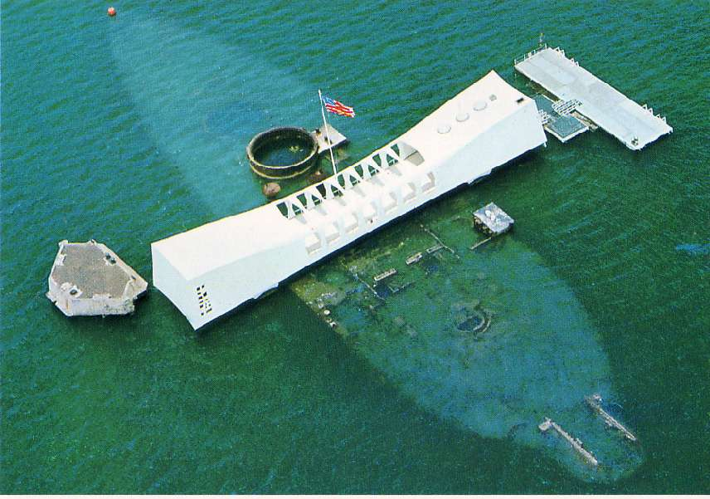
USS Arizona Memorial
The USS Arizona is the final resting place for many of the ship's 1,177 crewmen who lost their lives on December 7, 1941.

Slide 46
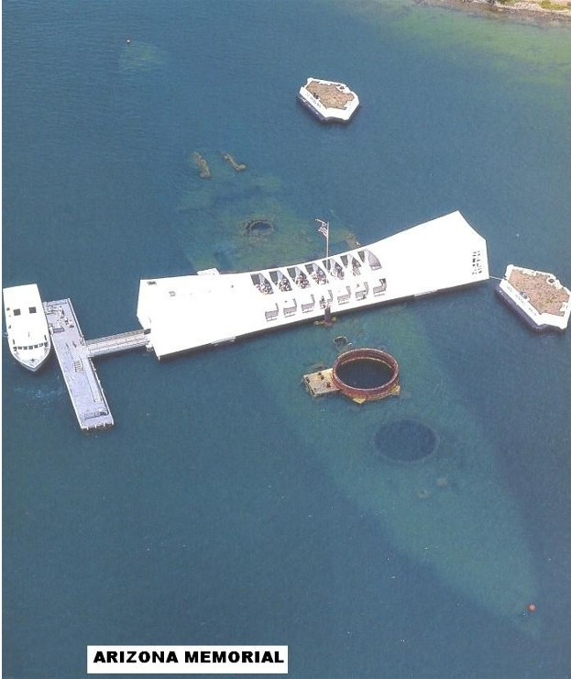

Slide 47


Slide 48


Slide 49


Slide 50


Slide 51
Section 3
On the
Home Front

Slide 52

Building an Army
War Production
$$ - Bonds, Taxes, Loans
New government agencies
15 million people drafted or joined
250,000 women served (clerical, nurses)

Slide 53



Slide 54



Slide 55



Slide 56



MAKING SACRIFICES
Americans faced shortages in consumer goods during the war

Slide 57



Ration Coupons

Slide 58



Civil Defense

Slide 59


Women outside the home
Women responded to the war effort by replacing men in their regular jobs at home. Women kept the factories running. Some welded and ran huge cranes. Others became bus drivers and gas station attendants.

Slide 60


African Americans
About one million African Americans served during WWII. At first they served in segregated units but were integrated in 1942.
The 332nd Fighter Group known as the Tuskegee Airmen were African American fighter pilots who destroyed more than 200 enemy aircraft

Slide 61


Benjamin Davis, Jr.
Commander of 332nd Fighter Group (Tuskegee Airmen) and the first African American General in the Air Force.

Slide 62


Dorie Miller
Dorie Miller, an African American sailor served as a cook on the battleship West Virginia. During the attack on Pearl Harbor, Miller dragged several wounded soldiers to safety and fired at Japanese aircraft from a machine gun. Miller was awarded the Navy Cross for his actions on December 7th.

Slide 63

Native Americans
Thousands of Native Americans left reservations to work in defense industries and join the armed forces. The most famous group of Native Americans to serve during World War II are the “code talkers”. They used a special code based on the Navajo language to send messages – a code that the Japanese never broke.

Slide 64

Japanese Americans
After the attack on Pearl Harbor many Japanese Americans were moved to relocation camps, which were located mostly in deserts and were crowed and uncomfortable. Many stayed for three years. In 1988, almost 50 years after the war the United States government issued a formal apology and gave each survivor $20,000 as a token of the nations regret.

Slide 65


Slide 66

Internment camp in Manzanar, California

Slide 67


Corporal Charles D. Bonds
Auto Equipment Operator
8th Army Air Force
Served March 18, 1943 to October 16, 1945

Slide 68



446th
Bombardment Group
704th Bomb Squad

Slide 69


Slide 70


Slide 71




Slide 72
Section 4
War in Europe and Africa

Slide 73



Slide 74
Allied War Strategy
Defeat Hitler first before focusing on Japan – attack on the edges of the German Empire
#1 – Invade North Africa
#2 – Invade Southern Europe
#3 – Attack Germany from the West
(Two Fronts)

Slide 75


Dwight D.
Eisenhower
George
Patton

Slide 76
The Eastern Front
VS.
During the time of the North African campaign, the Soviets and Germans were fighting on Soviet Territory. German defeats at the battles at Leningrad, Moscow and Stalingrad prevented the Germans from advancing in the Soviet Union.

Slide 77


The Western Front
Operation Overlord
June 6, 1944
D-Day

Slide 78

June 6, 1944 D-Day

Slide 79

Documentary
June 6, 1944 D-Day

Slide 80


Slide 81

V-E Day
May 8, 1945
By April of 1945, American and Soviet troops were closing in on Berlin.
Adolf Hitler committed suicide on April 30, and Germany officially surrendered on May 7.

Slide 82

Churchill waves to crowds in Britain.

Slide 83

V-E Day Celebrations in New York City, May 8, 1945.

Slide 84

1944 Presidential Election
Fourth Term for FDR

Slide 85

In April 1945 just three months after the start of his fourth term FDR dies. He complained of a headache when his portrait was being painted. Hours later he died. After twelve years the nation now has a new leader.

Slide 86

Harry S. Truman
33rd President
Truman spoke to reporters and said, "...I don't know whether you fellows ever had a load of hay fall on you, but when they told me yesterday what had happened, I felt like the moon, the stars, and all the planets had fallen on me."

Slide 87
The Holocaust

Slide 88




Star of David,
symbol of Judaism

Slide 89

Mistreated, starved prisoners in the concentration camp

Slide 90

Slave Labor at Buchenwald

Slide 91

Bones are visible in the crematoria in the concentration camp at Weimar, Germany. April 14, 1945.

Slide 92

Crematoria at Majdanek

Slide 93

Entrance to Auschwitz: Work Makes You Free

Slide 94

Mass Graves at Bergen-Belsen

Slide 95
Section 5
War in the Pacific

Slide 96

Japanese Invasion of the Philippines
Began air raids on Dec. 8th, 1941
Shortly after that they landed troops in the Philippines
Quickly captured the capital city of Manila

Slide 97



The Fall of the Philippines
“I shall return!”
General
Douglas MacArthur
“I have returned!”

Slide 98


Bataan Death March
78,000 prisoners moved to a POW camp about 65 miles away.
Approximately 650 Americans and 5,000 to 10,000 Filipinos died on the march.

Slide 99
Allied War Strategy
in the Pacific
Island Hopping
*Battle of Midway*
(Four Japanese Carriers destroyed and hundreds of planes)

Slide 100

The Advance on Japan
April 1945 – Iwo Jima and Okinawa secured
Mt. Surbachi
Iwo Jima

Slide 101




Kamikazes
USS Essex, November 25, 1944

Slide 102



The Manhattan Project
1939
Project approved by FDR
1942 Chicago, IL
First nuclear reactor built
July, 1945 Los Alamos, NM
Bomb tested
Little Boy
Fat Man

Slide 103

August 6, 1945
Bomb dropped on Hiroshima, Japan – three days later another bomb was dropped on Nagasaki

Slide 104

Before photo of downtown Nagasaki.

Slide 105
After photo of downtown Nagasaki.

Slide 106

The aftermath of the bombing of Nagasaki

Slide 107

Japanese Surrender
V-J Day – August 16, 1945

Slide 108

The Nuremberg War Trials:
Crimes Against Humanity

Slide 109

Historians believe that anywhere from 30 million to 60 million people died as a result of World War II.

