Slide 1
Chapter 5
The Industrial Age
1865-1914

Slide 2
Section 1
Railroads Lead
the Way

Slide 3
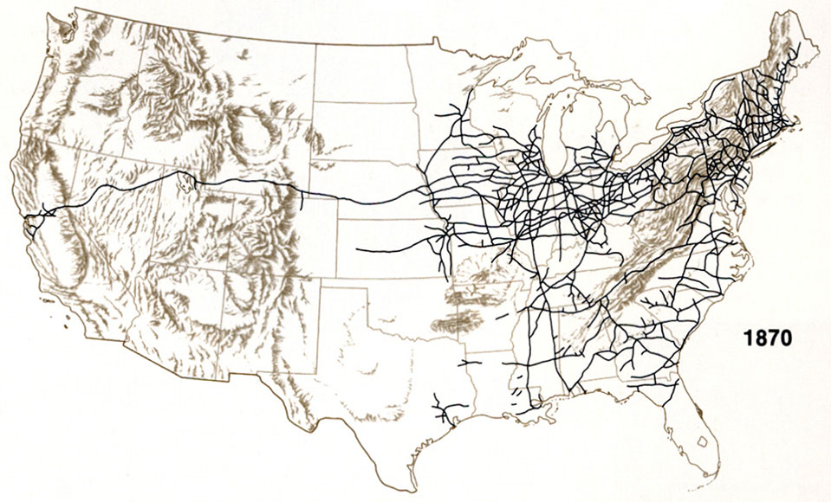
Railroad Expansion
After the Civil War the railroad system grew rapidly .

Slide 4
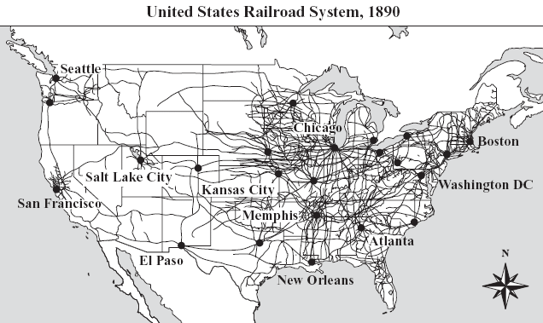
Railroad Expansion
After the Civil War the railroad system grew rapidly .

Slide 5
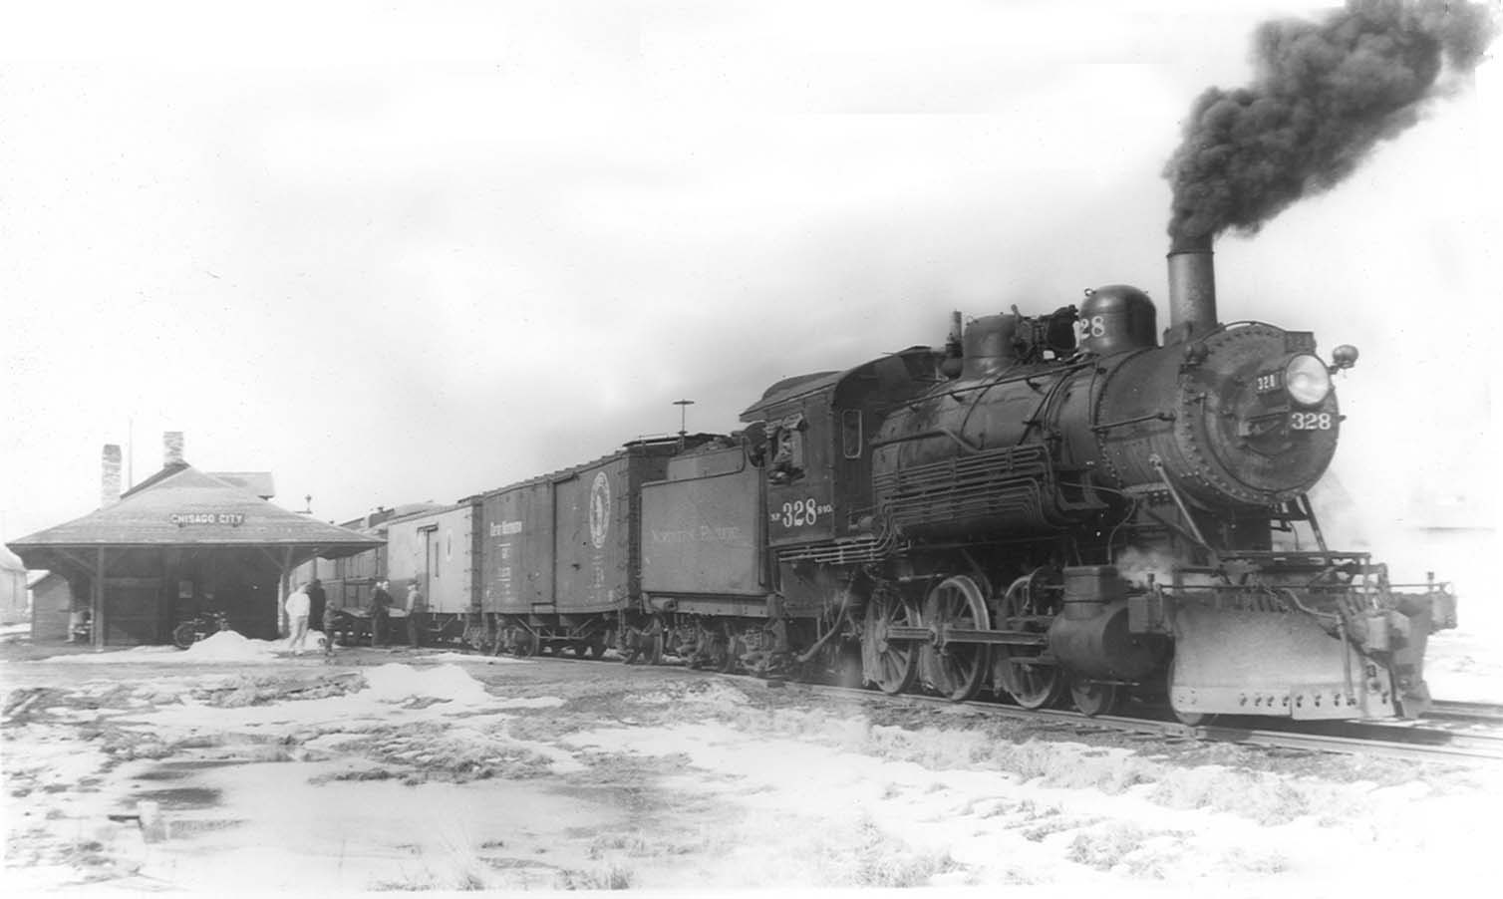
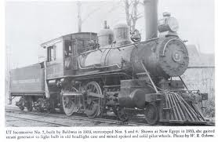
I’ve Been Working on the Railroad

Slide 6
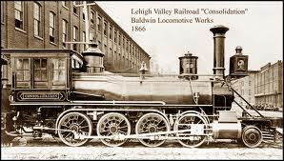
Railroad Expansion
Consolidation: Large companies buying smaller companies or drove them out of business

Slide 7
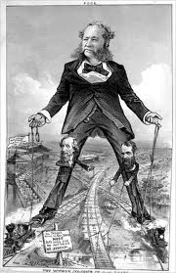
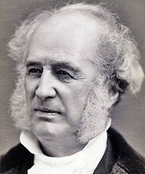
Railroad Barons
Cornelius
Vanderbilt

Slide 8
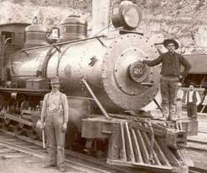
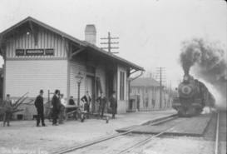
Railroad Expansion
Drove the economic growth of the United States.

Slide 9
What is it?
Flow of Money

Slide 10
How does
it work?
Buying and Selling
products or services

Slide 11
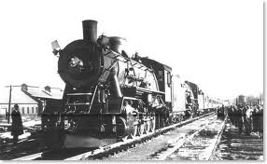
Railroads Stimulate the Economy
Carried raw materials, manufactured goods,
and farm products
Steel industry
Coal Industry
Jobs
Jobs
Lumber Industry
Iron mining

Slide 12
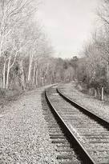
Standard
Gauge

Slide 13
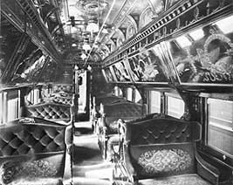
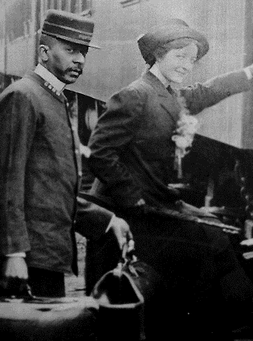
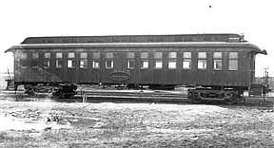
Pullman Cars
Luxury railcar with seats
that converted to beds
A Pullman Porter

Slide 14
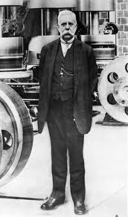
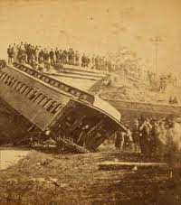
Air Brakes
George Westinghouse

Slide 15
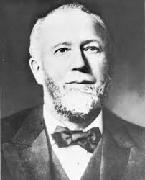
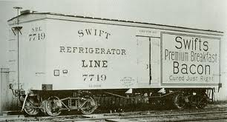
Refrigerated
railcars
Gustavus Swift

Slide 16
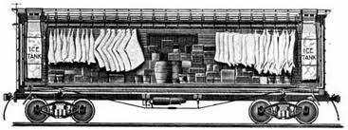
Refrigerated railcars

Slide 17
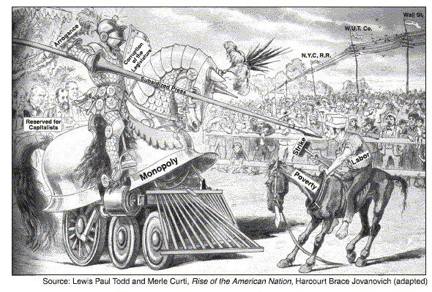
Competing for Customers
Rebates-Secret discounts
Pools-Dividing business and setting rates

Slide 18
Section 2
Inventions

Slide 19
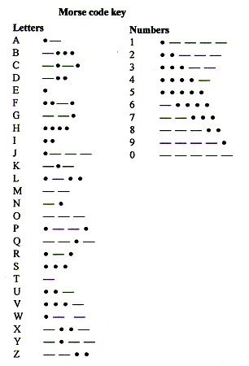
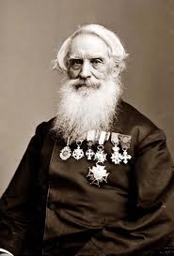
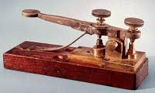
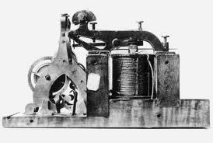
Samuel
Morse
Telegraph

Slide 20
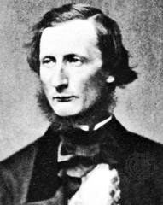
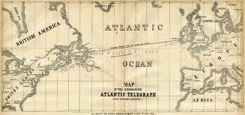
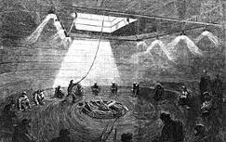
Transatlantic
Telegraph
Cyrus Field

Slide 21
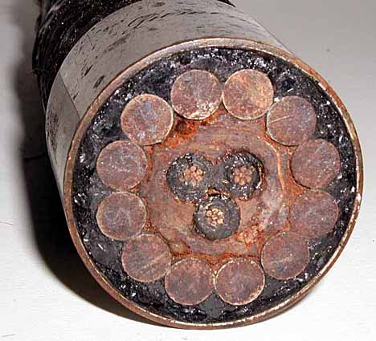
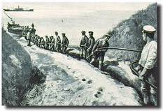
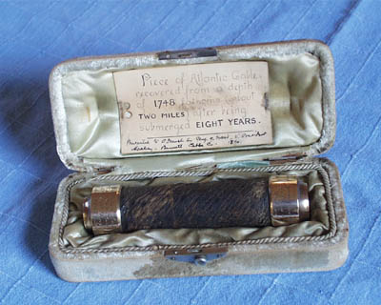
Transatlantic
Telegraph

Slide 22
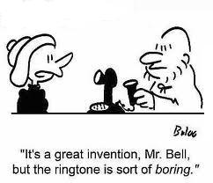
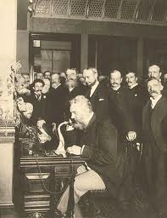
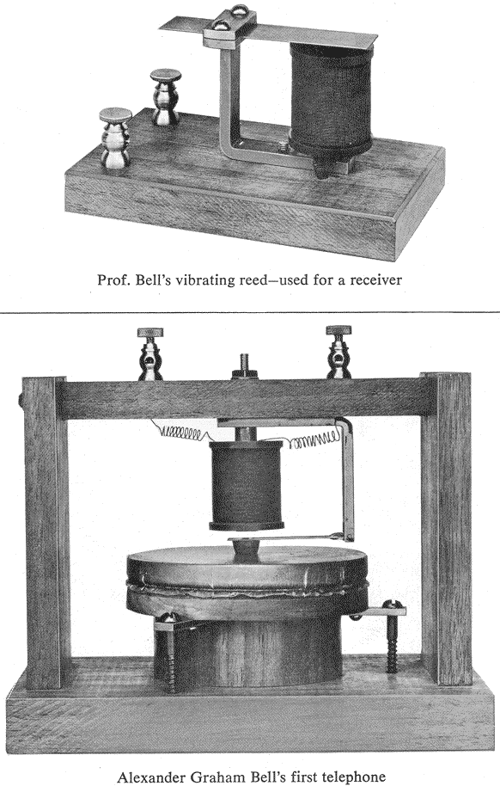
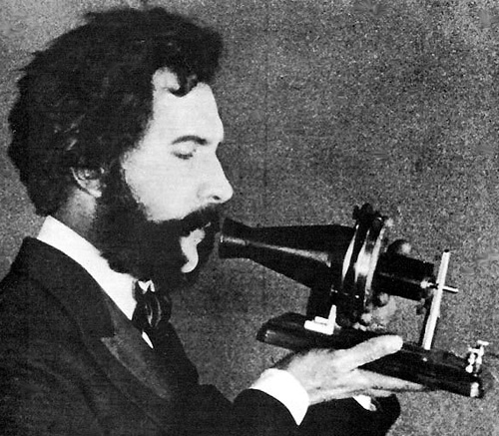
Alexander Graham Bell
Telephone
“Mr. Watson, come here. I want you.”

Slide 23
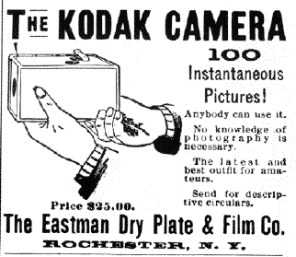
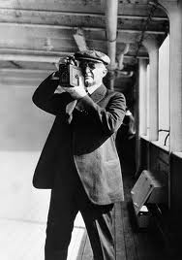
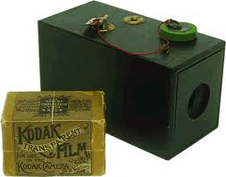
George Eastman
“the Kodak”

Slide 24
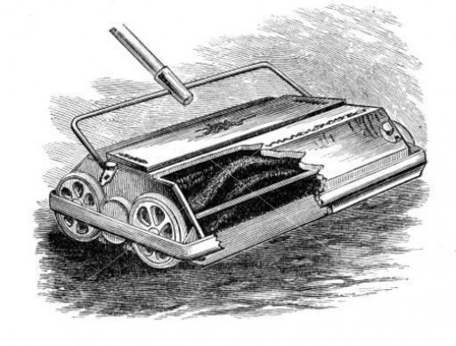
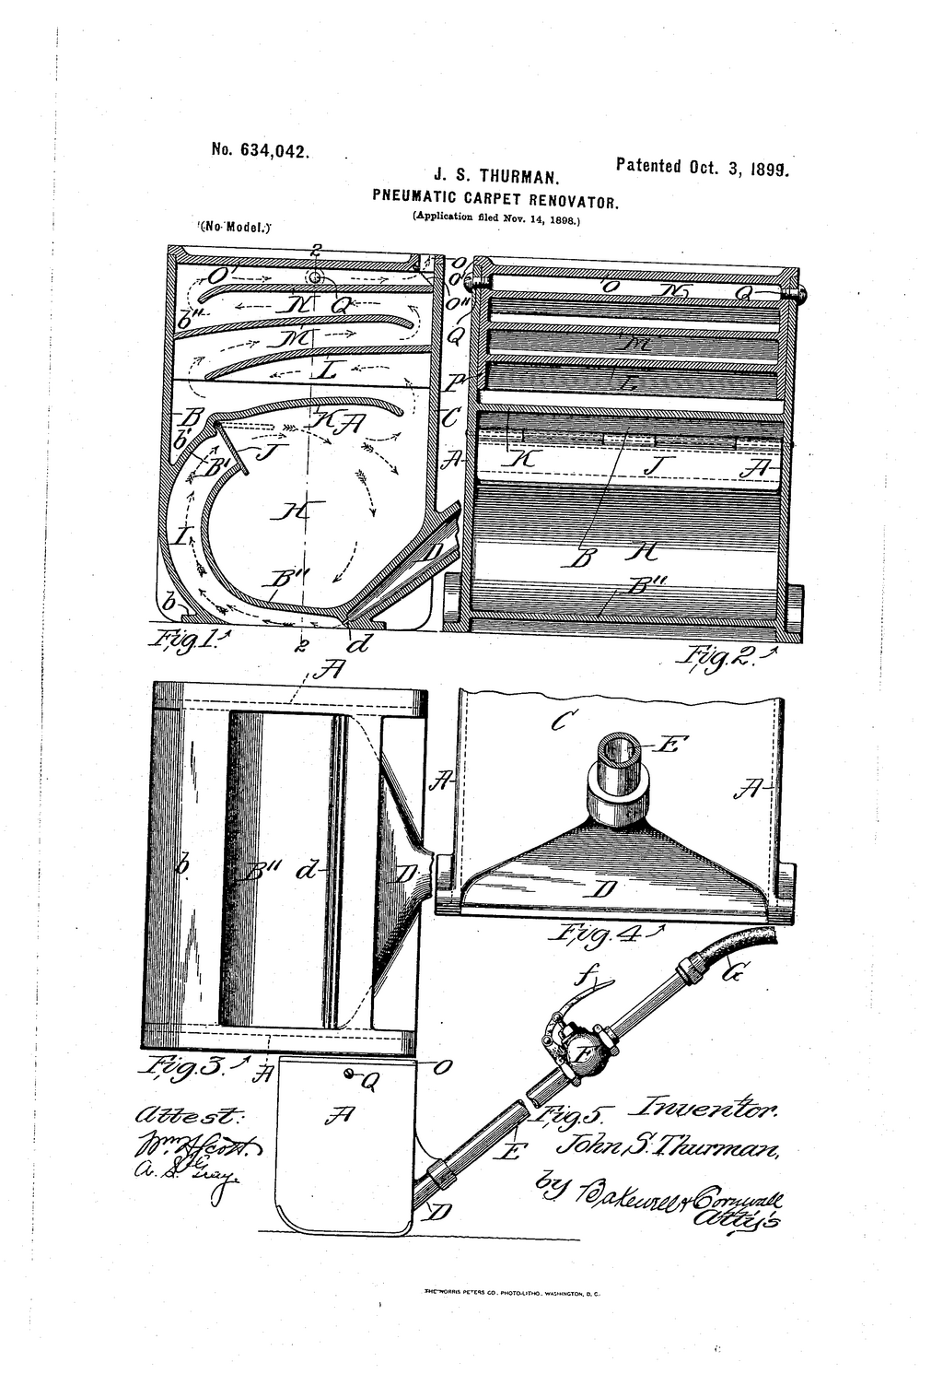
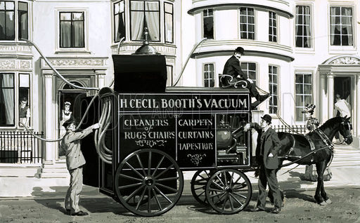
John Thurman
Vacuum Cleaner

Slide 25
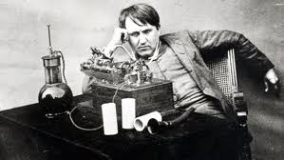
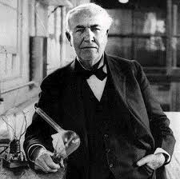
Thomas Edison
“The Wizard of Menlo Park”
Phonograph
Motion Picture Projector
Telephone Transmitter
Storage Battery

Slide 26
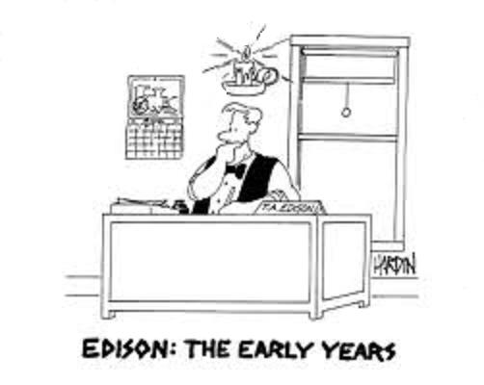
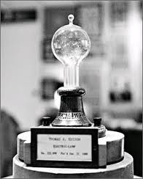
Electric Light Blub
1879

Slide 27
Built electric
transformers to send electricity over long distances.
Remember
this person?
George Westinghouse

Slide 28
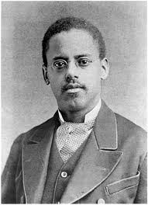
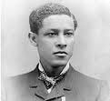
African American Inventors
Lewis Latimer
Improved wire in the light bulb
Jan E. Matzeliger
Shoe-making machine

Slide 29
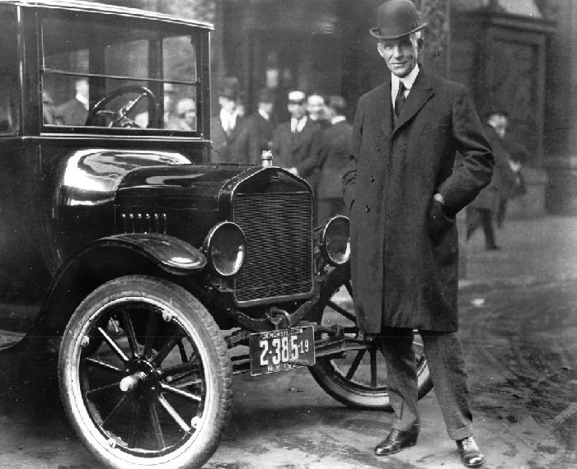
Henry Ford

Slide 30
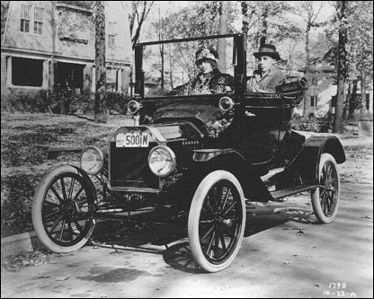
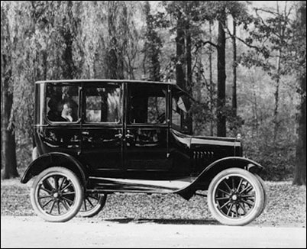
Model T
Henry Ford:
“You can paint it any color you like, as long as it is black.”

Slide 31
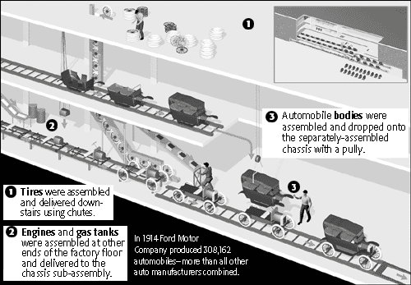
Assembly Line

Slide 34
Selling Goods
Mail order businesses

Slide 35
Selling Goods
Specialized in everyday household and
personal items
CHAIN STORES
Woolworths

Slide 36
Section 3
An Age of
Big Business

Slide 37
Factors of Production
#1. Land and Natural Resources

Slide 38
Factors of Production
#2. Labor (Workers)

Slide 39
Factors of Production
#3. Capital
Manufactured Products used to make other goods

Slide 40
Factors of Production
#1. LAND AND NATURAL RESOURCES
#2. LABOR (WORKERS)
#3. CAPITAL

Slide 41
RAISING CAPITAL
LOANS FROM BANKS
BECOME A CORPORATION

Slide 42
RAISING CAPITAL
Stock - shares of ownership a
company sells in its business.

Slide 43
RAISING CAPITAL
Shareholder - buys stock in a
business and is a partial owner

Slide 44
RAISING CAPITAL
Dividend - cash payment to the shareholder from the
corporations profit

Slide 45
The Oil Business

Slide 46
STANDARD OIL
John D. Rockefeller 1839-1937

Slide 47
STANDARD OIL
HORIZONTAL INTEGRATION
Purchasing of competing companies in the same industry.

Slide 48
STANDARD OIL
Horizontal
Integration

Slide 49
STANDARD OIL
Monopoly – total control
of an industry by a single producer

Slide 50
STANDARD OIL

Slide 51
The Steel Business

Slide 52
The Steel Business
Bessemer Process made steel production affordable and could be made in large quantities.
Railroad Tracks
Bridges

Slide 53
The Steel Business
What city do the Steelers play in?
Pittsburgh, Pennsylvania

Slide 54
The Steel Business

Slide 55
The Steel Business
Andrew Carnegie 1835-1919

Slide 56
The Steel Business
VERTICAL INTEGRATION
Acquiring companies that provided the equipment and services at all levels of production.

Slide 57
PHILANTHROPISTS
A person who uses their money to benefit the community.
John D.
Rockefeller
Andrew
Carnegie

Slide 58
PHILANTHROPISTS
Andrew
Carnegie
CARNEGIE HALL
NEW YORK
Created more than 2,000 libraries

Slide 59
PHILANTHROPISTS
Andrew
Carnegie

Slide 60
PHILANTHROPISTS
John D.
Rockefeller
University of Chicago
New York Institute for Medical Research

Slide 61
Sherman Antitrust Act -1890
Against monopolies
and trusts
Without competition there was no reason to improve or keep prices low.

Slide 62
Section 4
Industrial Workers

Slide 63
WORKING CONDITIONS
10 to 12 hour work days

Slide 64
WORKING CONDITIONS
6 days a week

Slide 65
WORKING CONDITIONS
Fired anytime any reason

Slide 66
WORKING CONDITIONS
Unsafe and unhealthy

Slide 67
WORKING CONDITIONS
WOMEN AND CHILDREN

Slide 68
WORKING CONDITIONS
WOMEN
Earned about 1/2 of what men did for the same work.

Slide 69
WORKING CONDITIONS
CHILDREN
Child-Labor Laws: at least 12 years old 10 hours a day.

Slide 70
WORKING CONDITIONS
1911 Triangle Shirtwaist Company Fire

Slide 71
WORKING CONDITIONS
1911 Triangle Fire
150 workers died – mostly women because the company locked the doors to prevent employees from leaving early.

Slide 72
GROWTH OF LABOR UNIONS
Workers organized into groups called LABOR UNIONS
Better Pay
Better Working Conditions

Slide 73
GROWTH OF LABOR UNIONS
KNIGHTS OF LABOR
Meetings in secret
Special handshakes
Recruited non-traditional workers
Terence V. Powderly

Slide 74
GROWTH OF LABOR UNIONS
American Federation of Labor
(AFL)
GOAL
Collective Bargaining
Samuel Gompers

Slide 75
Unions Act
STRIKES
Sometimes strikes led to violence

Slide 76
Unions Act
Haymarket Square
Chicago 1886
McCormick Harvester workers were protesting the killing of four strikers the pervious day. When the police ordered the crowd to break up a bomb was thrown killing a police officer.

Slide 77
Unions Act
Andrew Carnegie’s steel plant managers hired nonunion workers and 300 armed guards to protect the nonunion workers. A riot breaks out killing a least 10 people. Pennsylvania Governor sends in Militia to restore order.
Homestead Strike
Pennsylvania 1892

Slide 78
Unions Act
Pullman Strike
Chicago 1894
Workers strike in response to a cut in wages. Pullman responds by closing the plant. Eventually other railroad unions refuse to handle Pullman cars and rail traffic stops.

Slide 79
Unions Act
Pullman Strike
Chicago 1894
Pullman and the other railroad barons with the help of the United States government obtain an INJUNCTION or court order to stop the union from “obstructing the railways and holding up the mails”.

Slide 80
Unions Act
Many Americans associate Unions
with terrorism and disorder.
State and Federal governments often
broke up striking workers.
Despite setbacks from the strikes workers
continued to fight for better working
conditions and higher wages.

