Slide 1
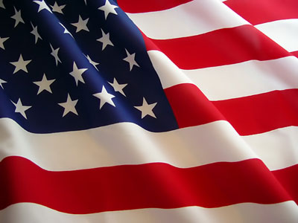
Chapter 4
Opening the West
1858-1896

Slide 2
Section 1
The Mining Booms

Slide 3
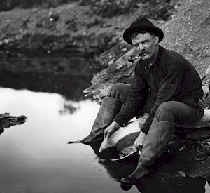
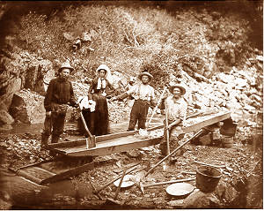
California Gold Rush
January 1848
Sutter’s Mill
300,000 - People traveled by land and sea to California in 1849. (49ers)

Slide 4
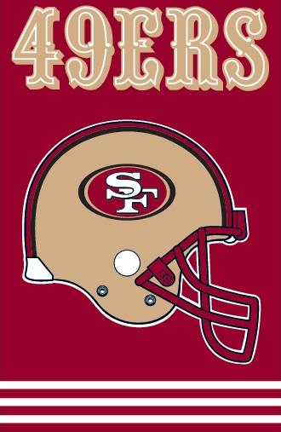
What city does
this professional football team play in?
San Francisco

Slide 5
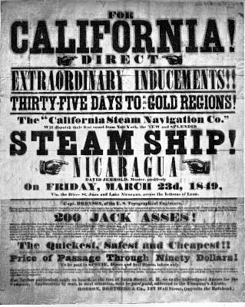
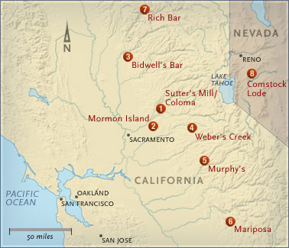
California Gold Rush

Slide 6
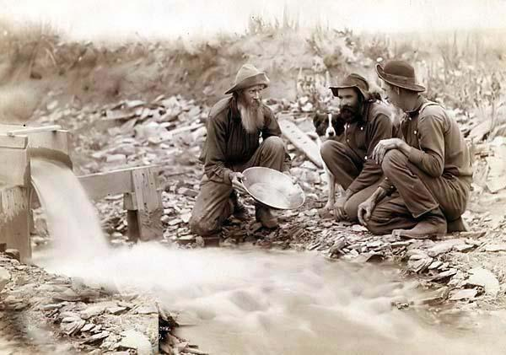
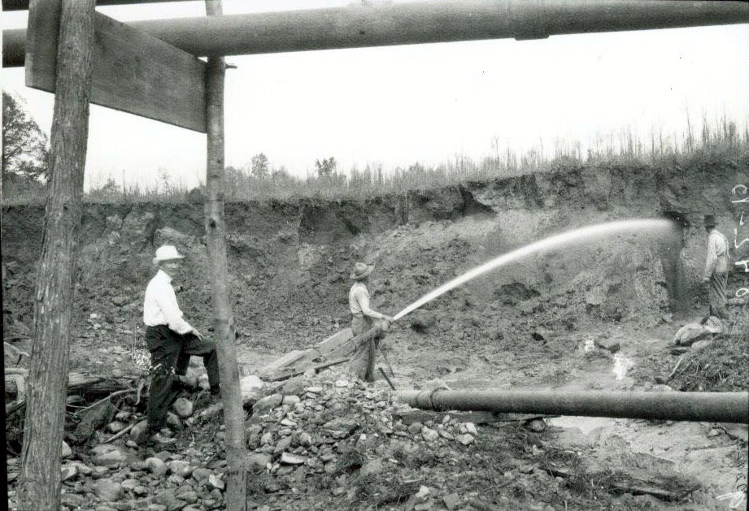
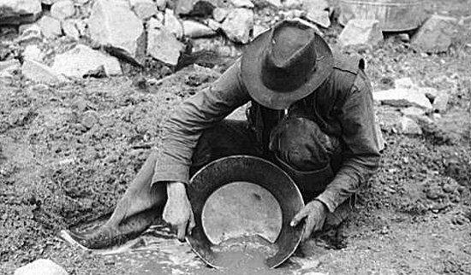
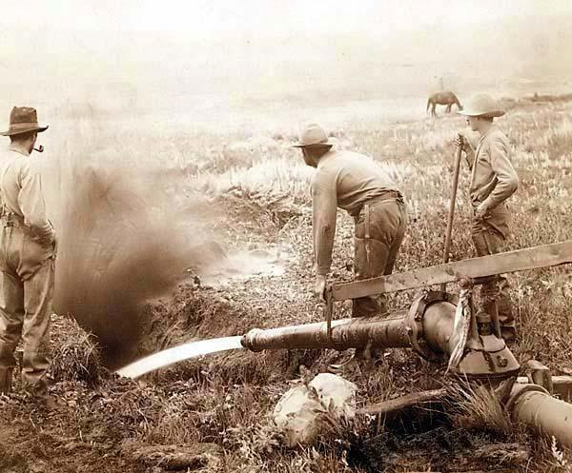
Hydraulic Mining
Panning for gold

Slide 7
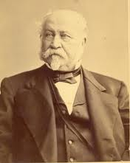
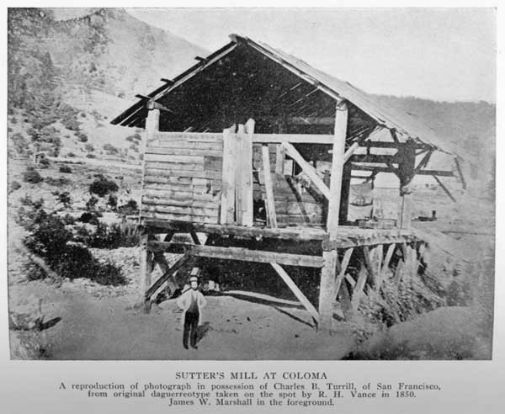
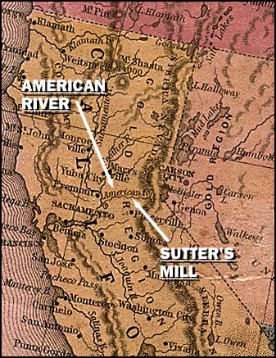
John Sutter
Wanted to keep discovery of gold secret to protect his agriculture empire.
Notes:
Action button links to United Streaming video re: discovery of gold at Sutter’s mill.

Slide 8
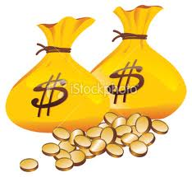
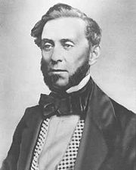
Sam Brannan
Bought all mining tools in the area.
Announced gold was found.
Made a fortune selling tools, then other necessities, to miners.
Became a millionaire.

Slide 9
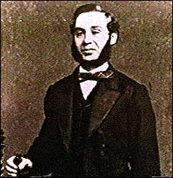
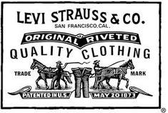
Levi Strauss
Ran a successful dry goods store
Patented canvas pants with riveted pockets

Slide 10
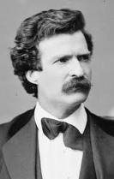
Mark Twain
Born Samuel Clemens
Headed West for the Gold Rush
Became a famous writer of his experiences
Notes:
Action button links to United Streaming video re: Twain and chronicles of experiences

Slide 11
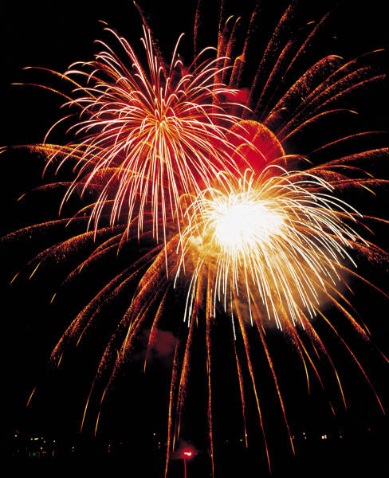
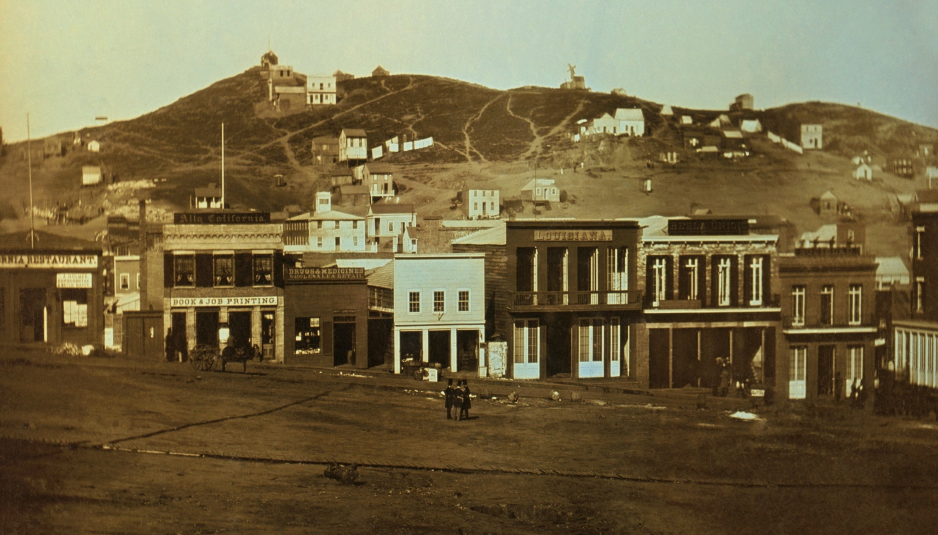
Boom Towns

Slide 12
Boom Towns
Near Gold strikes
Lawless Places
Vigilantes
Gambling

Slide 13
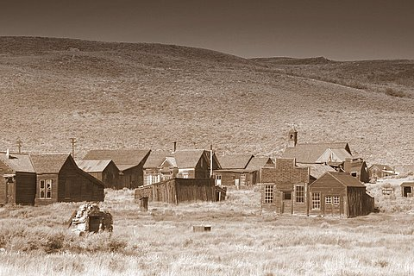
Ghost Towns

Slide 14
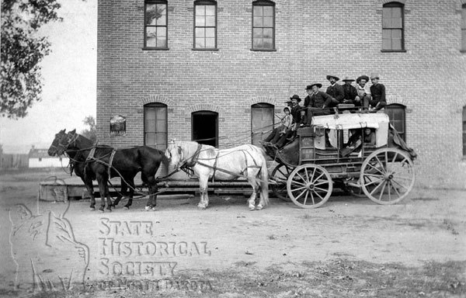
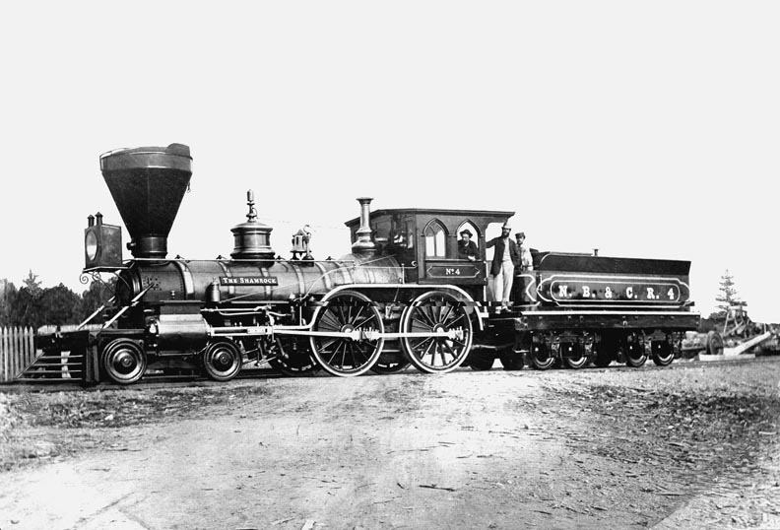
Which of these
would be faster?
Stagecoach
or
Locomotive

Slide 15
Railroads connect
East and West
Transportation played
a vital role in mining

Slide 16
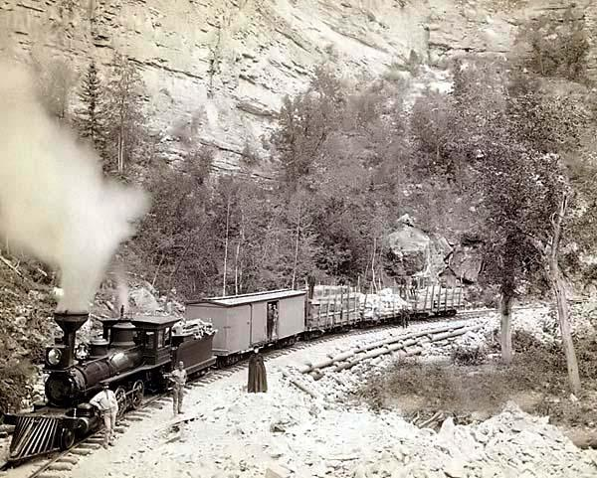
Government subsidies provided
financial aid and land grants to
the railroad companies.

Slide 17
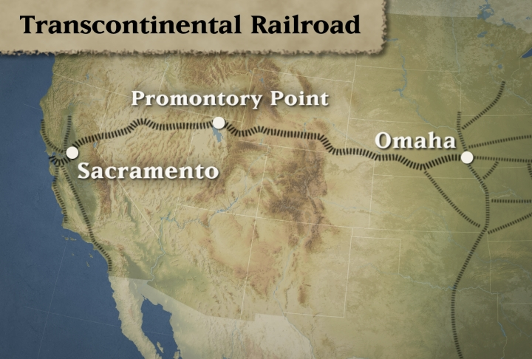
Transcontinental Railroad
Linked the Western U.S. to the Eastern U.S.

Slide 18
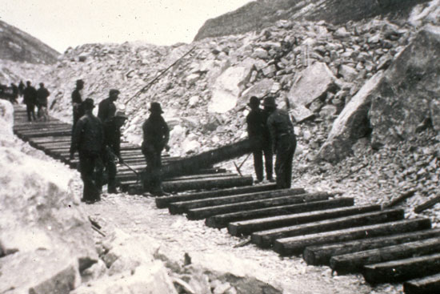
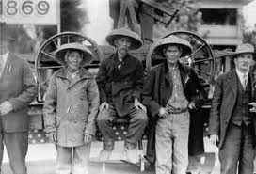
Union Pacific worked West from Omaha, Nebraska
Central Pacific worked East from Sacramento, California

Slide 19
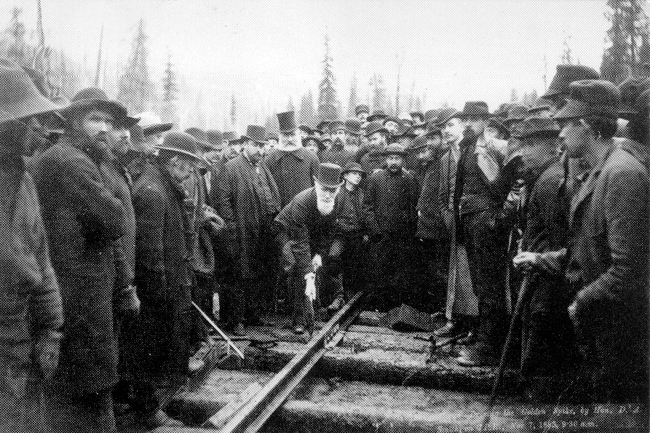
Driving the last spike in Promontory, Utah (1869)

Slide 20
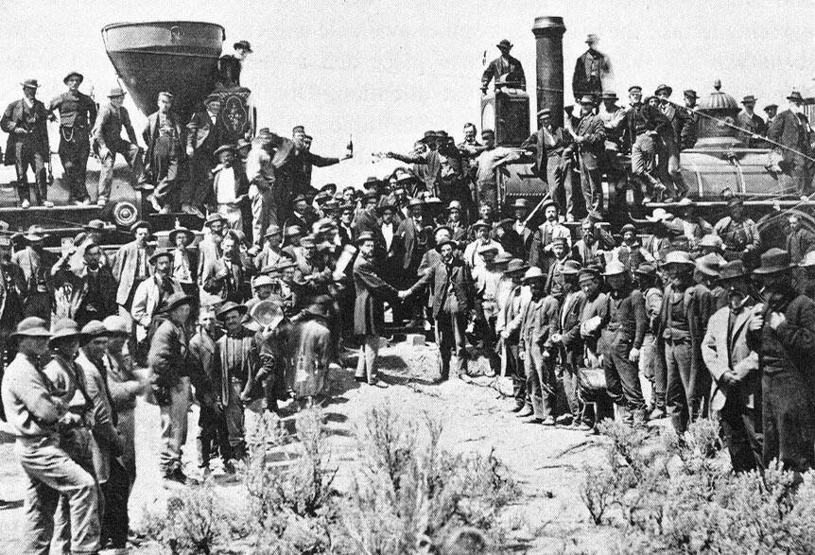

Slide 21
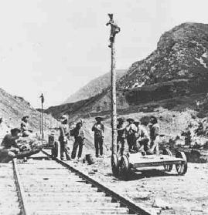
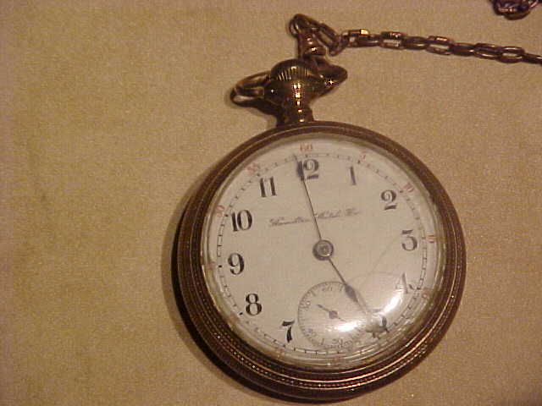
Impact of the Transcontinental Railroad
Telegraph lines were built along the rail
A system of time was developed with four time zones – eastern, central, mountain and pacific time. Every place within the same time zone observed the same time.
United States
got smaller!

Slide 22
Section 2
Ranchers and
Farmers

Slide 23
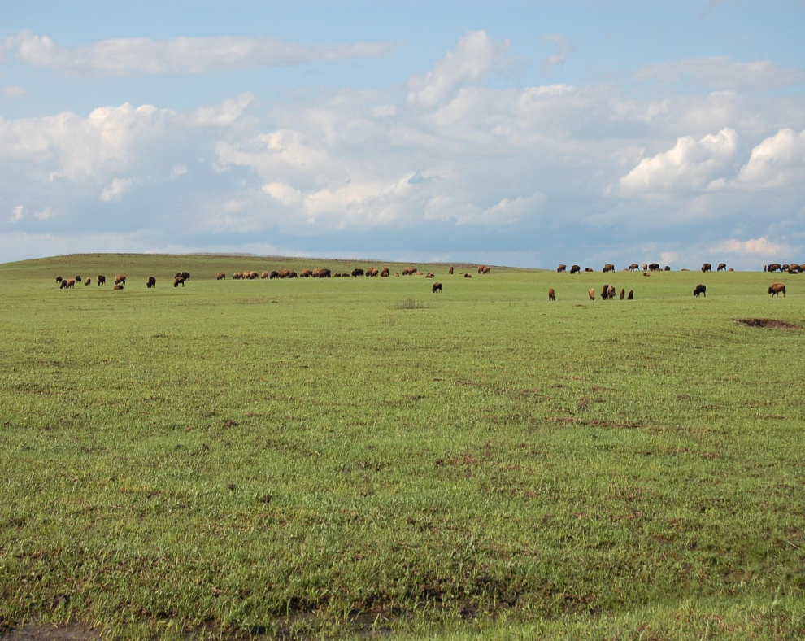
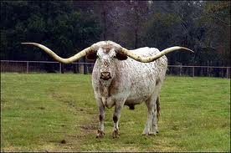
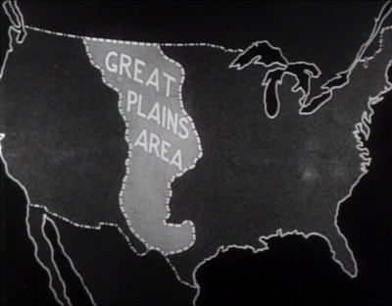
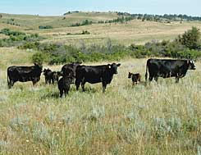
Cattle on the Plains

Slide 24
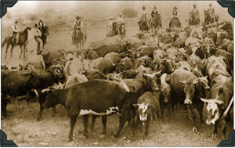
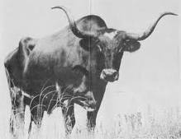
Cattle on the Plains
Value for cattle increased when railways reached Kansas and Missouri which allowed ranchers to sell cattle to the Northern and Eastern Markets.

Slide 25
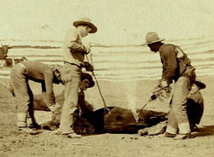
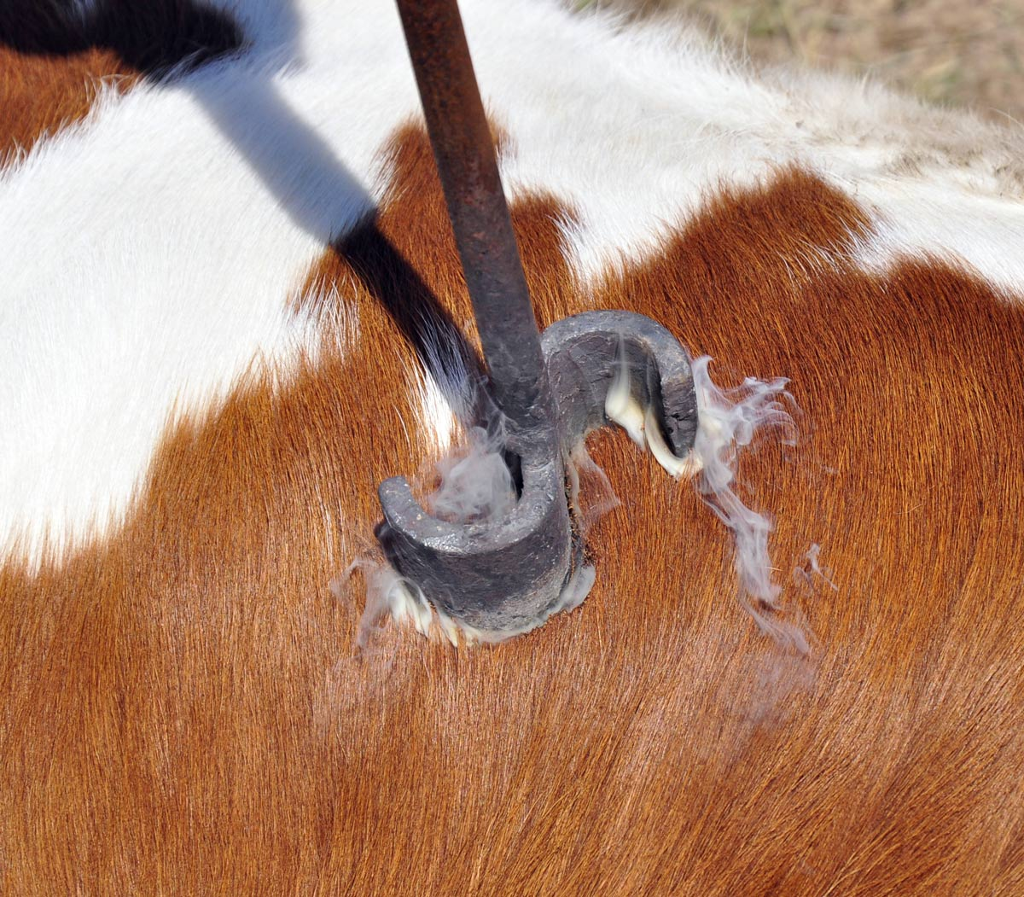
Cattle was branded
to show who was the owner
-Open Range-
Not fenced or divided

Slide 26
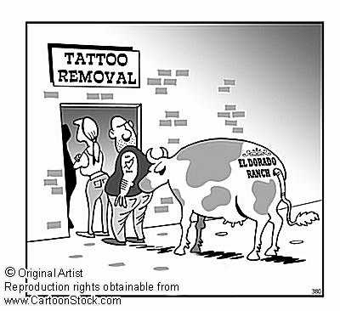

Slide 27
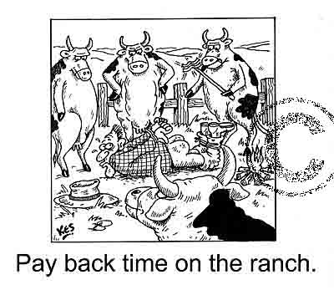

Slide 28
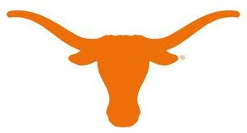
What college mascot is shown in the picture below?
Texas
Longhorns

Slide 29
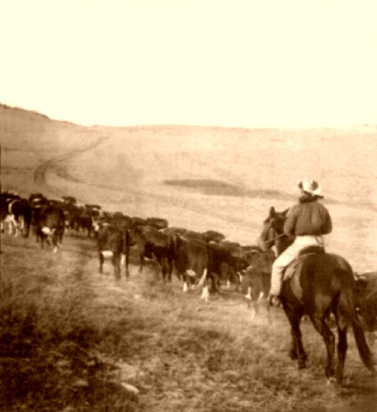
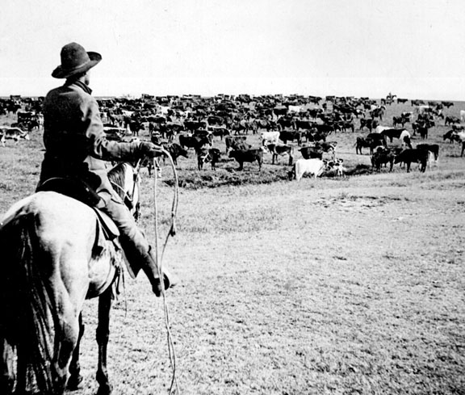
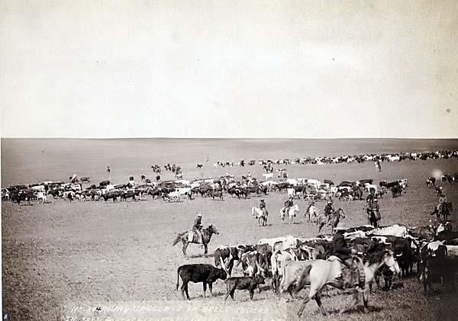
Long Drive
Herding of cattle to meet a railroad (cow town) , often very far away

Slide 30
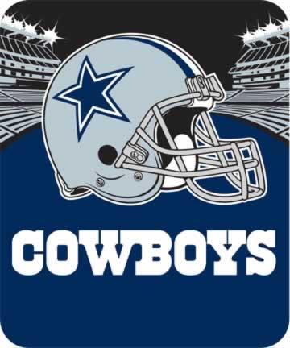
In what city and state are the Cowboys located in?
Dallas, Texas

Slide 31
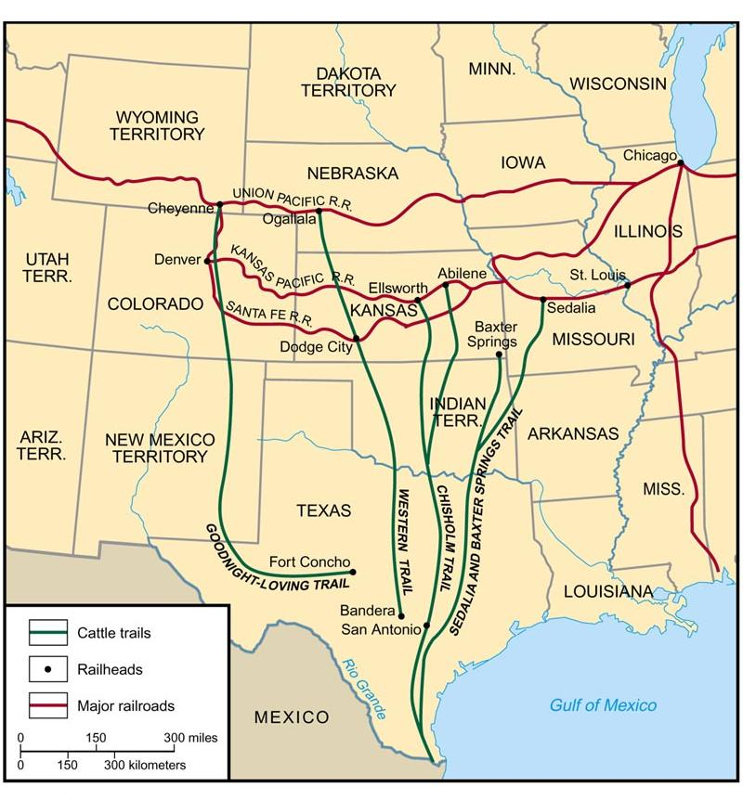
Long Drive

Slide 32
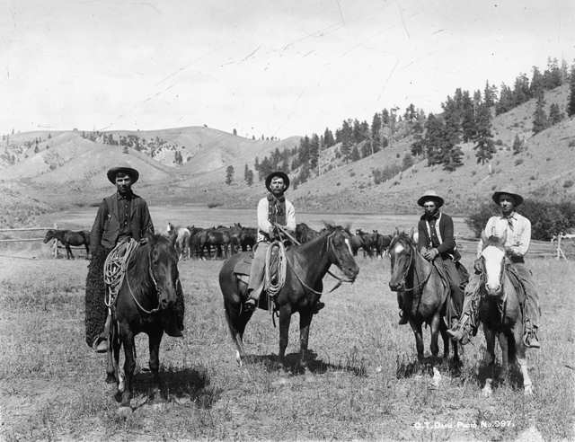
Life on the Drive
Long Hours
Weather
Stampedes
Rustlers

Slide 33
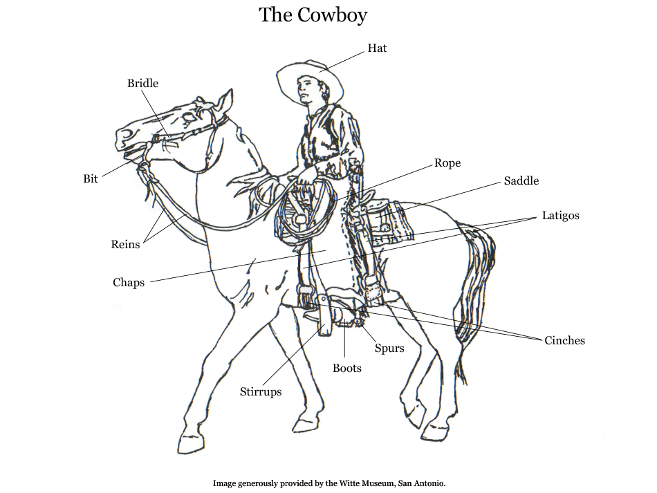

Slide 34
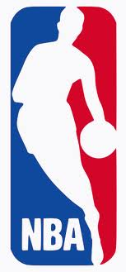

What NBA team is located San Antonio, Texas?

Slide 35


Cow Towns
Developed near railroads, offered cowhands hotels, saloons, and restaurants
Chisholm Trail
Texas to Kansas
Caldwell, Kansas
Abilene, Kansas
Dodge City, Kansas
Wichita, Kansas
Sedalia, Missouri
Cheyenne, Wyoming

Slide 36


“Cattle Kingdom Ends”
Overgrazing and Overproduction
Ranching slowly replace cattle drives
Fences - Barbed Wire

Slide 37
Farmers Settle the Plains
“wilderness” to farmland
Factors
Railroads
Free land

Slide 38

Homestead Act of 1862
U.S. Government gives away 160 acres
of free land to each settler.
Ten Dollar Fee (about $275 today)
Live there for five years

Slide 39


Farming Challenges

Slide 40


Slide 41






Sod Busters

Slide 42


Slide 43


Gaje Westphal?

Slide 44


Oklahoma Land Rush 1889
Land region of the plains to be settled
Oklahoma was originally “Indian Territory”
What is the University of Oklahoma’s mascot?
Boomers and Sooners

Slide 45
Section 3
Native American Struggles

Slide 46


Following the buffalo
Native American
Grocery Store

Slide 47

Native America uses of the buffalo

Slide 48

Plains Indians
Most lived a
nomadic life
Main source of food
was the buffalo
Usually lived in
groups of about 500
Men hunted, traded,
and performed
military tasks
Women raised the
children, cooked, and
prepared hides

Slide 49
White hunters used buffalo to feed the railroad crews building the transcontinental railroad
Buffalo hides were popular in the East
Railroad companies did not want the massive herds to block the railroads
Buffalo Disappear

Slide 50


Slide 51


Slide 52


Slide 53


Slide 54


Slide 55


Slide 56


Conflict with Native Americans
During the 1860’s, many armed clashes between Indians and whites took place
1867 – Government says: set aside land for Native Americans (Reservations)

Slide 57

Conflict with Native Americans
U.S. Army given the authority to deal with any groups that would not move
Reservations were located on poor land and the government didn’t deliver on promises to the Indian Tribes

Slide 58



Crazy Horse
Sitting Bull
Geronimo
Famous Native Americans Leaders

Slide 59
Little Bighorn (Custer’s Last Stand)
Who: U.S. Army, Sioux and Cheyenne tribes
What: Decisive victory for the Sioux and Cheyenne
When: June 25 and 26 , 1876
Where: Black Hills of Dakota Territory near the Little Bighorn River
Why: White trespassing on reservation land

Slide 60

Little Bighorn (Custer’s Last Stand)
With orders to force the large Indian army back to the reservations, the Army sent Lt. Colonel George Custer and the Seventh Cavalry to the Dakotas.
They spotted a Sioux village about fifteen miles away along the Rosebud River on June 25, Custer also found a nearby group of about forty warriors.
Lt. Colonel George Custer

Slide 61

Little Bighorn (Custer’s Last Stand)
Ignoring orders to wait, Custer decided to attack before they could alert the main party.
He did not realize that there were about a thousand warriors in the village.

Slide 62

Little Bighorn (Custer’s Last Stand)
As the Indians closed in, Custer ordered his men to shoot their horses and stack the carcasses to form a wall, but they provided little protection against bullets and arrows.
In less than 30 minutes, Custer and almost all of his 210 men were killed. The defeat shocked the nation.

Slide 63

A Changing Culture
Factors
Movement of whites onto their land
Slaughter of the buffalo
U.S. Army attacks
Reservation policies of the government

Slide 64


Ghost Dance
Native American ceremony that hoped for a day when the settlers would disappear and the buffalo would return.

Slide 65


Ghost Dance
As the Ghost Dance spread white officials became alarmed and banned the practice of the Ghost dance on the reservations.
Believing Sitting Bull led the movement, police tried to arrest him. During the scuffle they shot and killed him.
After his death, several hundred Sioux gathered at a creek call Wounded Knee.

Slide 66

Wounded Knee
The Army was sent in to the camp to collect any weapons. When a shot rang out the Army opened fire.
More than 200 Sioux and 25 soldiers were killed.
The “massacre” at Wound Knee marked the end of armed conflict between the U.S. government and Native Americans.

Slide 67
Section 4
Farmers in Protest

Slide 68


Farmers Organize
As farming grew, so did the amount of crops
grown, such as wheat. The price of wheat dropped
because there was too much wheat available to sell.

Slide 69

Farmers Organize
Resented the railroad companies, which charged farmers more to ship crops than they charges manufacturers to ship goods.
They were angry at eastern manufactures, who charged high prices for their products.
Resented bankers, who charged high interest rates for necessary items such as seed and farm equipment.

Slide 70
National Grange and
Farmers’ Alliances
Mass political movement
Created cooperatives – cash only stores for farmers
Encouraged economic self-sufficiency

Slide 71


Republican Party

Slide 72


Democratic Party

Slide 73

Populist Party
“Formed by the common person”
Reforms
Abandon the gold standard
Eight hour workday
Income tax
Secret ballot
Direct election of senators

Slide 74


1896 PRESIDENTAL ELECTION
William Jennings Bryan
Democratic Presidential Candidate
“Average American”
William McKinley
Republican Presidential Candidate
“Great Speaker”

Slide 75


William McKinley Wins

