Slide 1
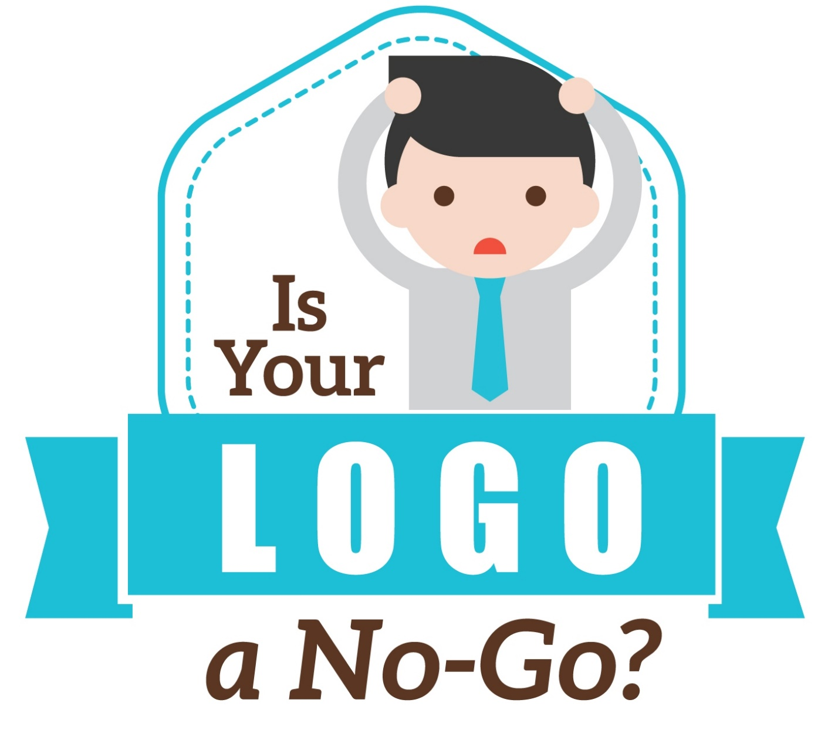
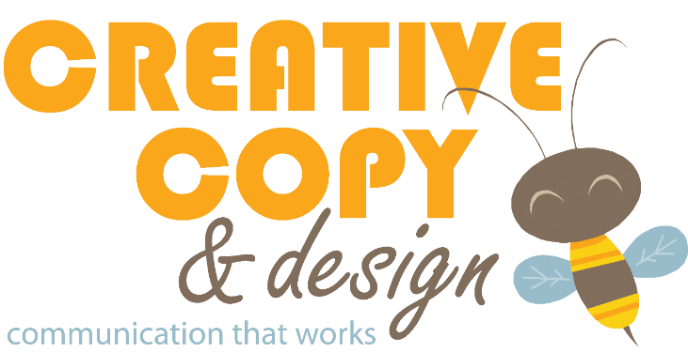
By Melissa James
Notes:
Sometimes small businesses get a little scared off by talking so directly about money.
For a lot of people, the emotion they attach to their family business can get in the way of making objective business decisions.
Too often, small businesses have logos that reflect their personal tastes, such as their daughter’s favorite color or their dog, rather than what would be most effective for increasing sales.
In an act of do as I say and not as I do, my own logo features a honeybee in part because my name means honeybee. But more important, bees are hard workers and they create something delicious. The many curves and angles in my design, rather than straight lines, connote artistry and creative thinking, as well as movement and action. The gold catches your attention.

Slide 2
“You’ve heard the saying about how we get only one chance to make a good first impression. For a small business, branding is that opportunity. And more often than not, it’s a missed opportunity...
In my opinion, roughly 95 percent of small businesses have a poor logo.”
– Dan Antonelli
Entrepreneur, January 2016

Slide 3
Key Takeaways Today
To understand:
Why a strong logo is critical to business success
Qualities of a good logo
What might be lacking in your current logo
How to prepare for a new logo
What to expect from the logo design process
How to use your logo effectively

Slide 4
True or False
?
Logo and Brand are the Same Thing

Slide 5
What is a Brand?
Brand = others’ perception of your business
A brand is everything—tangible and intangible—that represents a business and gives its logo meaning. Your brand identity is the culmination of people’s interactions, experiences & opinions relating to your business.
Notes:
Brand is in the eye of the beholder!

Slide 6
What is a Brand?
Brand is in the eye of the beholder!
Notes:
When I see this, I think of the UNC bell tower, and the scent of old classrooms, the prestige of education, the history of the nation’s oldest public university.
When you see it, you might be thinking, “Ugh, the enemy of my Virginia college!” The LOGO does not change from person to person, but the brand perception does.
If I think my brand connotes creativity and edginess, but everyone else on the Peninsula thinks of my work as amateurish and boring, then THAT is my brand.

Slide 7
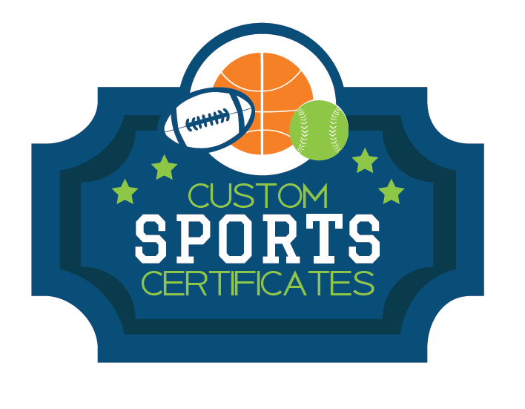
What is a Logo?
Logo = a quick, visual representation of your brand’s message
A symbol or other design adopted by an organization to identify its product/service
Easily recognizable & reproducible
Usually has both text and graphic component
Notes:
All logos I show today are ones I created, unless I otherwise specified (the examples of bad logos are not mine, of course!)! That way, if you have questions about its purpose or how it was created, I can give you that information firsthand.

Slide 8
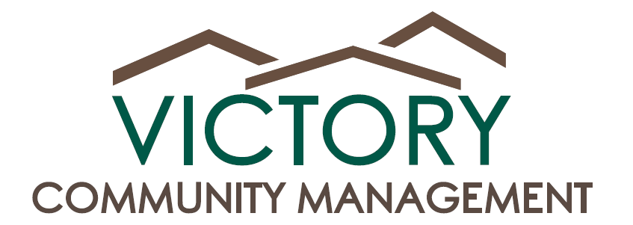
Logo Elements
Graphic
Name
Tagline
A Smarter Way to Run Your HOA
Notes:
Name is essential!
Graphic strongly recommended; stylized word still done sometimes, but much more memorable and versatile with graphic
Tagline (industry term; you might know it as a slogan) is optional. If nothing else, I recommend when name itself not clear what it does.
Here, if you don’t know what “Community Management” is, you get to see it is for running HOAs
I like to think of taglines as the “why”
Even if not a tagline, you can put in a definition (Business called “Bounce Time!” should say “Inflatables Rental” below, even if it’s not your official name. It makes sure wherever it’s shown, people can identify not only who you are, but what you are.
No more about taglines today for sake of time.

Slide 9
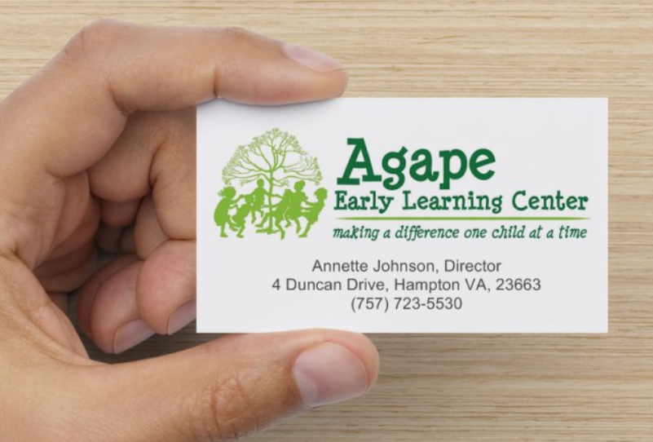
If Nothing Else, Get a Logo!
A good logo can overshadow other weaknesses! Makes a huge impact on any material you create, no matter how basic.
Notes:
This business card is just basic centered text with a logo above it. But it’s attractive and compelling, simply because it has a good logo!
A study conducted by branding firm Siegel+Gale found that memorable logos are 13% more likely to get consumer attention and 7% more likely to make them want to learn more about the brand.

Slide 10
See the Difference?
4 Duncan Drive Hampton, VA 23663
757.723.5530 Annette H. Johnson, Director
Notes:
Even without a graphic designer to make something fancier, just changing this out to an updated logo with basic text looks night-and-day different.

Slide 11
8 Qualities of a Good Logo
1. Targeted
2. Attractive
3. Simple
4. Memorable
5. Distinct
6. Understandable
7. Versatile
8. Up to date
Notes:
(I’ve done more logos for early childhood programs than any other industry, so those will be well represented today!)
Targeted = appeals to your intended audience. Something aimed at teens should not look same as aimed at retirees. Something for bikers different feel than a dance studio.
Attractive = we all like to look at pretty things!
Simple = K.I.S.S. Too many details are hard to digest at a glance
Memorable = making a brand impression and increasing chance they will do business with you
Distinct = don’t look the same as your competitors. Don’t want customers to go to them by mistake.
Understandable – More on that in a moment
Versatile – More on that in a moment
Up to date – More on that in a moment.

Slide 12
Understandable Logos
No context needed to “get” what your company does!
Should be communicated through at LEAST one of these:
Name
Descriptor or Tagline
Graphic
???
Notes:
Big, recognized national companies can get away with just a name and abstract graphic.
But small and local businesses need to be crystal clear.
You can be creative AND clear!
And you can always use an abbreviated version of your logo if needed.
CLARITY before creativity (this logo is actually for a branding company, ha!) If this was on a T-shirt or sponsor banner, you would have no idea what they do.
Logo can serve as a self-standing advertisement

Slide 13
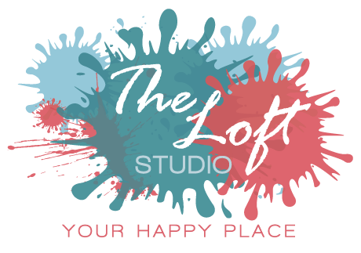
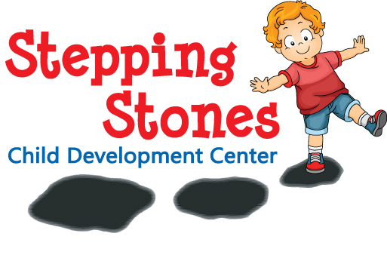
Understandable Logos
NAME
TAGLINE
GRAPHIC
Every logo should answer “what is it?”
DESCRIPTOR

Slide 14
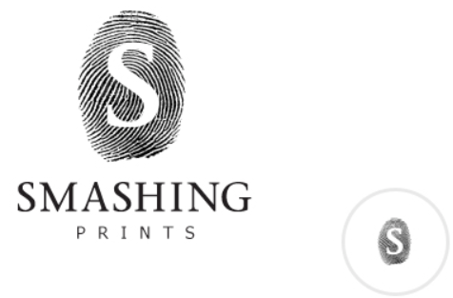
Versatility
Logo should be clear at any size, on any surface
No small or thin text
Only 1-2 fonts
Graphic should not be overly complex
Notes:
Sometimes logo will be shown at thumbnail size, or using thicker inks/fabrics and therefore blobby if highly detailed.:
- Screen-printed shirts and bags
- Embroidered shirts and bags, other fabric items
- Many promotional items like mugs, water bottles, decals, don’t pick up tiny details, or overly dense or thin fonts
Simple is still your best bet for ultimate versatility.

Slide 15
Versatility
Ideal logo can be configured both vertically and horizontally
Notes:
Really good to have a graphic element that can be used alone

Slide 16
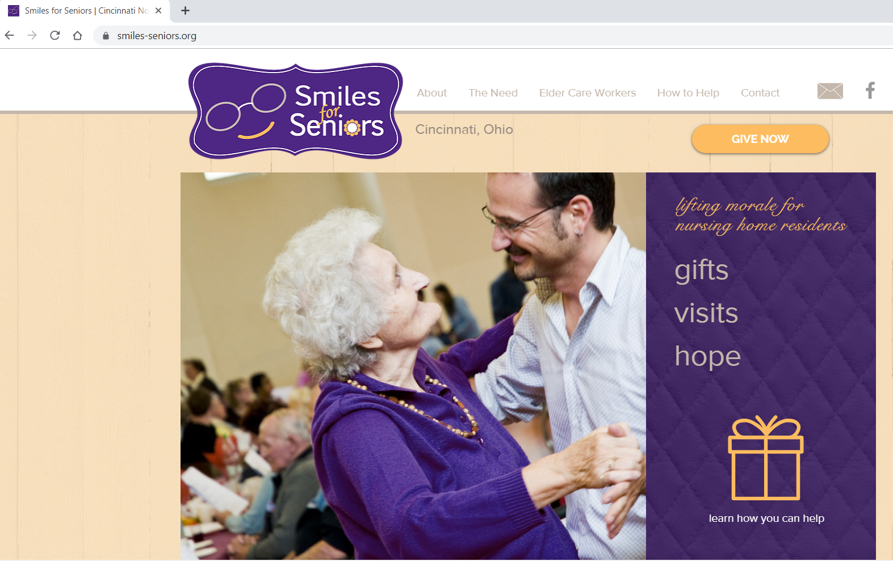
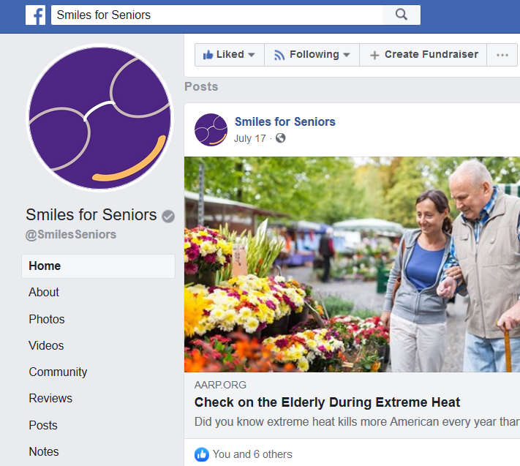
Versatility
Graphic element that can be used alone
Notes:
Really good to have a graphic element that can be used alone

Slide 17
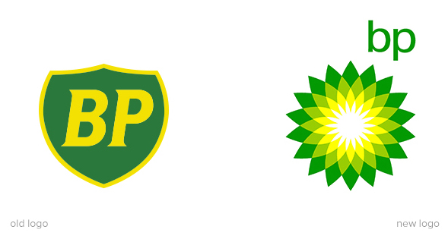
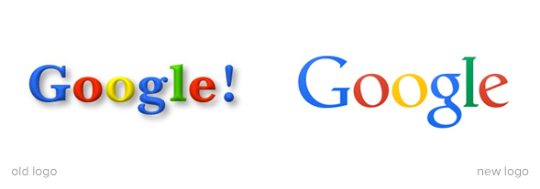
Getting Up to Date
Even keeping the “same” logo can involve refreshing it!

Slide 18
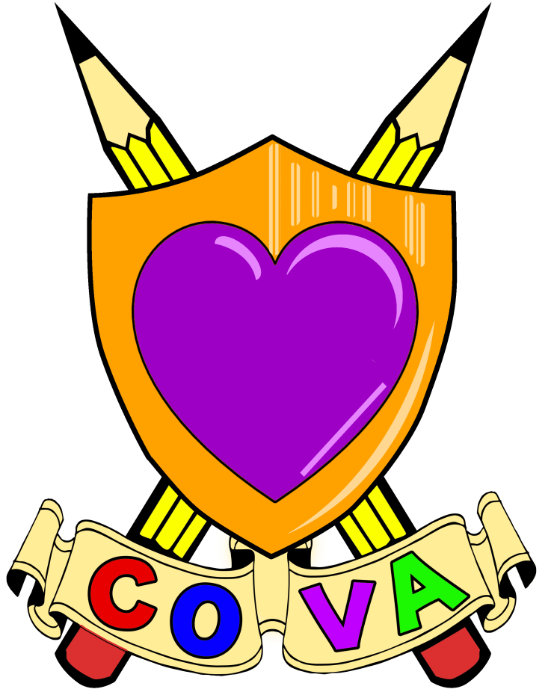
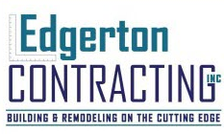
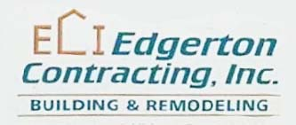
Getting Up to Date

Slide 19
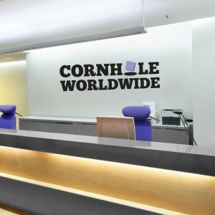
Color Counts!
Your logo color(s) should:
Match/complement your business space (brand consistency)
Reflect what attracts customers, NOT your personal taste
Be different than colors your competitors use

Slide 20
Color Counts!
33% use blue
95% of the top brands use only one or two colors in their logo
29% use red
13% use yellow/gold

Slide 21
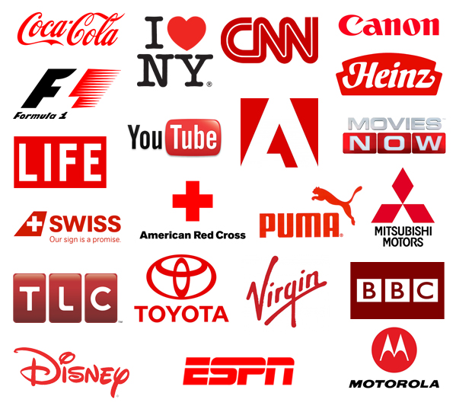
Color Counts!
RED is statistically most powerful color for a logo
Notes:
People more likely to notice and remember it.
Tied to increased sales.
However, should be used sparingly. Harsh visually as text, and also can have cultural connotations.
Known to make people hungry (good for restaurants!) but bad for medical businesses (blood!)

Slide 22
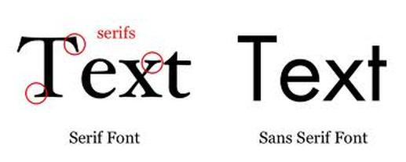
What the Font?
Serif fonts (with feet): more traditional & formal
Sans serif fonts (no feet): more modern & simple
Current design favors sans serif

Slide 23
What the Font?
Script: can work well if used sparingly

Slide 24
What the Font?
Comic Sans: the ultimate sign of clueless design!

Slide 25
Before Starting a New Logo
1. Make a file of likes and dislikes
Write down colors to include, avoid
Take pictures/screenshots of logos with the look you’re going for
2. Establish what you’re willing to pay
$250 minimum for custom logo
Online stock logos $100+ but not unique, targeted
Fivrr custom logos $15+ but likely language barriers, culture discrepancies
Notes:
Pre-made logos can't properly reflect your brand and you'll quickly notice thousands of other companies with nearly identical logos. It's a total waste of money

Slide 26
Before Starting a New Logo
3. Define the message of your logo
What do you want your customers to do?
What is the vibe you want to give off?
What problems are you trying to overcome?
4. Decide which words are most important
Are you the:
DELICIOUS Treats Bakery
DELICIOUS TREATS Bakery
Delicious Treats BAKERY

Slide 27
Before Starting a New Logo
Long names especially need to be broken up into digestible “bites”
Notes:
Companies with long names (I once worked for Downtown Hampton Child Development Center” should break them up so that the most important ones stand out… the most memorable ones. If your name has what you are in it, make the unique name part stand out from what it is.

Slide 28
Before Starting a New Logo
5. Select a project leader
This lets you avoid decision-by-committee
Choose 2-3 people who will be consulted during the logo process (including 1 customer)
Remind them to look for big issues, not nitpicking based on personal preference
Consider their input, but leader makes final decision
Notes:
One person should ‘own’ this process and be able to make the final decision.
The committee process leads to a litany of compromises over the final look and feel of a logo, often producing a brand identity that is bland and predictable. You want a design that is memorable.
Pick a group of 2 or 3 people whose opinions you trust, whether in-house or not. In fact, people outside your company can often be better at this than insiders. Get their input, weigh it against your own thoughts. Then make your decision.”
I’ve had clients spend hundreds of dollars in revisions because the first group agreed on a “final,” then showed it to another department, who tore it up, and so on and so on. It ends up where the “committee” ends up dictating every detail, so that the final design that basically THEY designed is not something that looks remotely professional or compelling.

Slide 29
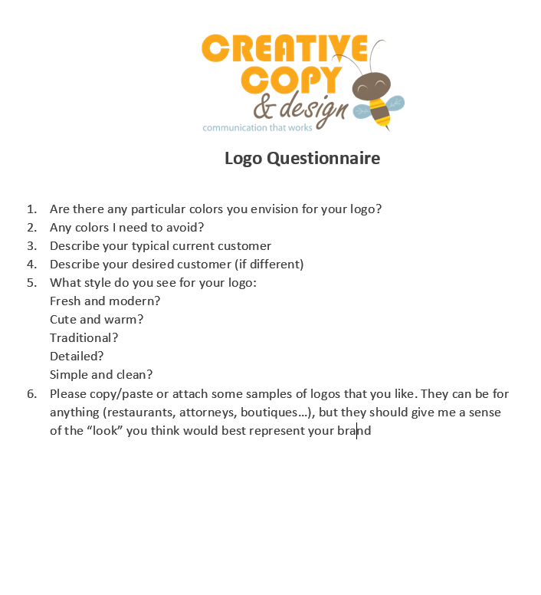
What to Expect in Design Process
1. Phone call or meeting
Discussion of your business, needs & preferences
2. Receive & complete logo form
3. Designer starts research Getting handle on your industry, competitors, brand presence & reputation online
Notes:
I research them online (and in person if local), to get a feel for what their business looks like, their typical customers, their style, etc. Why do I do this when I already had them fill out a form? Sometimes we are our own worst judges. A business might tell me their customers are people who respond “traditional” and “old-school,” but I might see by their social media following that their average customer is an upper-middle-class soccer mom. That demographic will be more drawn to a look that’s modern or preppy. Your logo should not simply be what YOU like, but what your target customer will connect with. You are in business to make money! I run into this a lot though, also with website design.

Slide 30
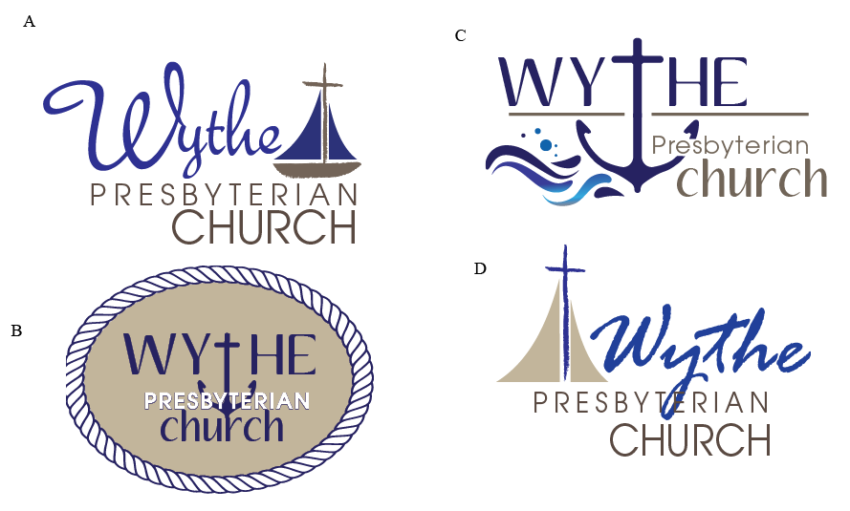
What to Expect: Design Process
4. Receive comp sheet
A comparison of 4-6 logo ideas
5. Client indicates favorite options
Fonts, colors and graphics can be mixed & matched between options

Slide 31
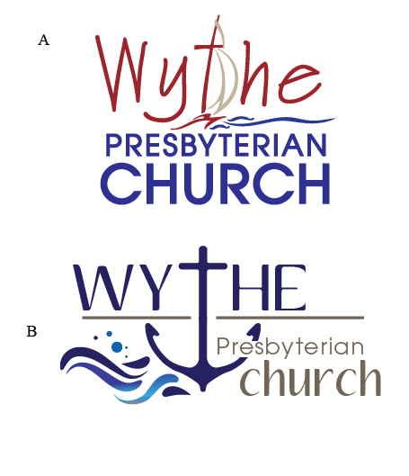
What to Expect: Design Process
6. Designer provides revised set of options
7. Client makes final editing requests
8. Final proof sent for client approval

Slide 32
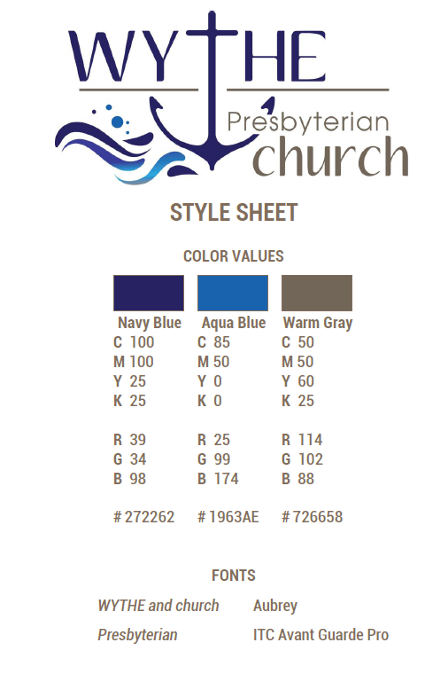
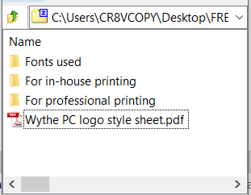
What to Expect: Design Process
9. Client approves design
10. Designer submits package of logo files & style sheet

Slide 33
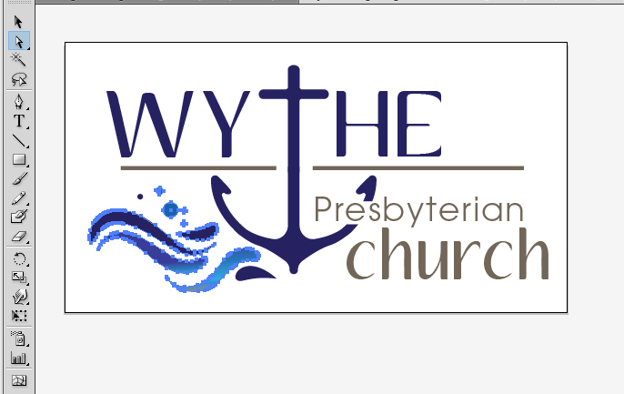
Ensuring You Get the Right Files
The designer should provide you with “vector art” of your logo
Can be resized without becoming blurry
Ends in .ai, .eps, or .svg
If you can’t open the logo file on your computer, it’s probably the file you want!
Notes:
Designer can go back later and change various elements for you if needed, because each piece is selectable.

Slide 34
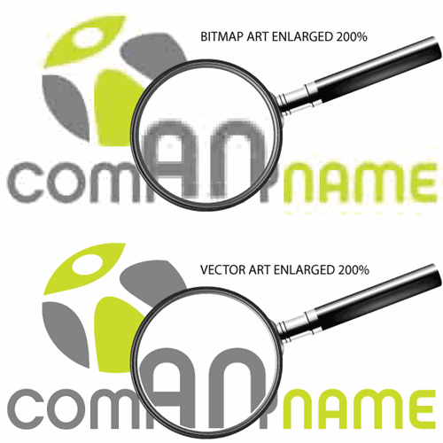
Professional Printing
Send vector for any commercial print job:
Signs & banners
Brochures
Sponsorships
T-shirts
Promo mugs
Decals

Slide 35
Using Your Logo
Designer should also provide you with:
JPEG (photo of your logo)
PNG (transparent logo)
Your logo should go on EVERYTHING!
Stick to color palette from your logo (and/or complementary colors) for your print materials & website

Slide 36
Using Your Logo
Be careful resizing in Word, Publisher, Powerpoint, etc., so you don’t stretch or distort your logo

Slide 37
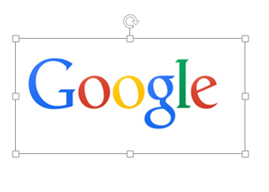
Using Your Logo
Be careful resizing in Word, Publisher, Powerpoint, etc., so you don’t stretch or distort your logo

Slide 38
Questions?
(757) 660-3889 | cr8vcopy@gmail.com

