Slide 1
LECTURE 2 DATABASE SYSTEM CONCEPTS AND ARCHITECTURE

Slide 2
What is a Data Model?
A collection of concepts that can be used to describe the structure of a database
Structure of a database - data types, relationships, and constraints that apply to the data.
Relatively simple representations, usually graphical, of complex real-world data structures

Slide 3
The Importance of Data Models
Data models;
Facilitate interaction among the designer, the applications programmer, and the end user

Slide 4
Categories of Data Models
Data models can be categorized according to the types of concepts they use to describe the database structure.
High-level or conceptual data models provide concepts that are close to the way many users perceive data
Entity-Relationship model is a popular high-level conceptual data model.
Low-level or physical data models provide concepts that describe the details of how data is stored on the computer storage media.

Slide 5
Categories of Data Models (cont’d)
Representational (or implementation) data models which provide concepts that may be easily understood by end users but are not too far removed from the way data is organized in computer storage.
Representational or implementation data models are the models used most frequently in traditional commercial DBMSs. These include the widely used relational data model, network and hierarchical models.

Slide 6
Data Model Basic Building Blocks
Conceptual data models use concepts such as entities, attributes, and relationships.
Entity - anything about which data are to be collected and stored
Attribute - a characteristic of an entity
Relationship - describes an association among entities
One-to-one (1:1) relationship
One-to-many (1:*) relationship
Many-to-many (*:*) relationship
Recursive or involute relationship
Constraint - a restriction placed on the data

Slide 7
Data Model Basic Building Blocks (cont’d)
Cardinality of a Relationship
One-to-one (1:1) relationship
An occurrence of the first entity type is related to a maximum of one occurrence of the second entity type, and each occurrence of the second type to a maximum of one of the first.
Eg: One MP is elected to one Constituency; one Constituency has one MP elected to it.
One-to-many (1:*) relationship
An occurrence of the first entity may be related to several occurrences of the second, but each occurrence of the second is related to a maximum of one occurrence of the first.
Eg: One Teller serves several Customers; one Customer is served by one Teller
Notes:
Note: Relationships are bidirectional

Slide 8
Data Model Basic Building Blocks (cont’d)
Many-to-many (*:*) relationship
An occurrence of the first entity type may be related to several occurrences of the second and vice versa
Eg: One Student takes many Courses; one Course can be taken by several Students
NB: All *:* relationships can be decomposed into two 1:* relationships
Recursive or involute relationship
Entity occurrences relate to other occurrences of the same entity
Eg: One employee (a manager) manages one or more employees; one employee is managed by one employee (manager)
Notes:
As a general rule, to properly identify the relationship type, you should ask two questions:
How many instances of B are related to one instance of A?
How many instances of A are related to one instance of B?

Slide 9
The Evolution of Data Models
File System
Hierarchical
Network
Relational
Entity relationship
Object oriented (OO)
XML

Slide 10
The Hierarchical Model
Developed in the 1960s to manage large amounts of data for complex manufacturing projects
Basic logical structure is represented by an upside-down “tree”

Slide 11
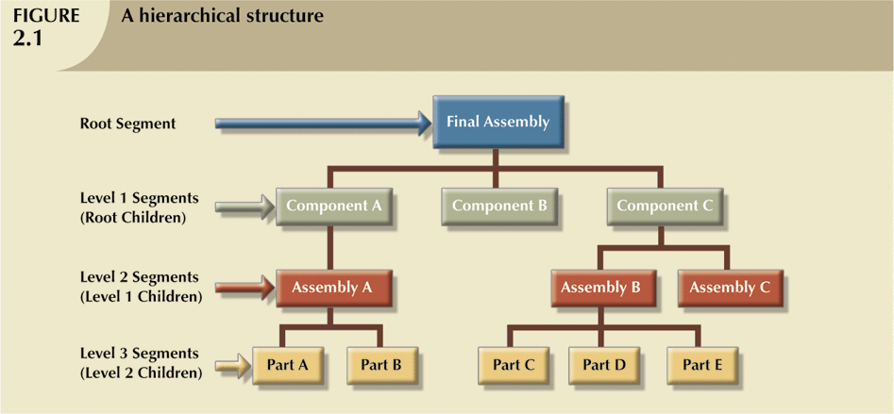
Hierarchical Structure

Slide 12
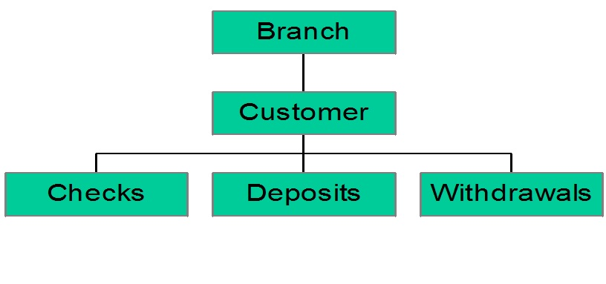
Bank Hierarchical Database

Slide 13
Hierarchical Structure (cont’d)
The hierarchical structure contains levels, or segments
Depicts a set of one-to-many (1:*) relationships between a parent and its children segments
Each parent can have many children, but each child has only one parent

Slide 14
Advantages of the Hierarchical Model (compared to the file system)
It promotes data sharing
Parent/child relationship promotes conceptual simplicity
Database security is provided and enforced by DBMS
Parent/child relationship promotes data integrity
It is efficient with 1:* relationships
It exhibits data independence

Slide 15
Disadvantages of the Hierarchical Model
Complex implementation requires knowledge of physical data storage characteristics
Difficult to manage
Lacks structural independence
Implementation limitations (no multiparent or *:* relationships)
No ad hoc query capability
Lack of standards

Slide 16
The Network Model
Created to
Represent complex data relationships more effectively
Improve database performance
Impose a database standard
Conference on Data Systems Languages (CODASYL)
Database Task Group (DBTG) – define standards and specifications for an environment that would facilitate database creation and data manipulation

Slide 17
Network Model (cont’d)
Network Schema
Conceptual organization of entire database as viewed by the database administrator
Network Subschema
Defines database portion “seen” by the application programs that actually produce the desired information from data contained within the database
Data Management Language (DML)
Defines the environment in which data can be managed

Slide 18
Network Model (cont’d)
Schema Data Definition Language (DDL)
Enables database administrator to define schema components
Subschema DDL
Allows application programs to define database components that will be used
DML
Works with the data in the database

Slide 19
Network Model (cont’d)
Resembles hierarchical model – user perceived the network database as a collection of records in 1:* relationships
Set
Composed of at least two record types
Owner - Equivalent to the hierarchical model’s parent
Member - Equivalent to the hierarchical model’s child
A set represents a 1:* relationship between the owner and the member

Slide 20
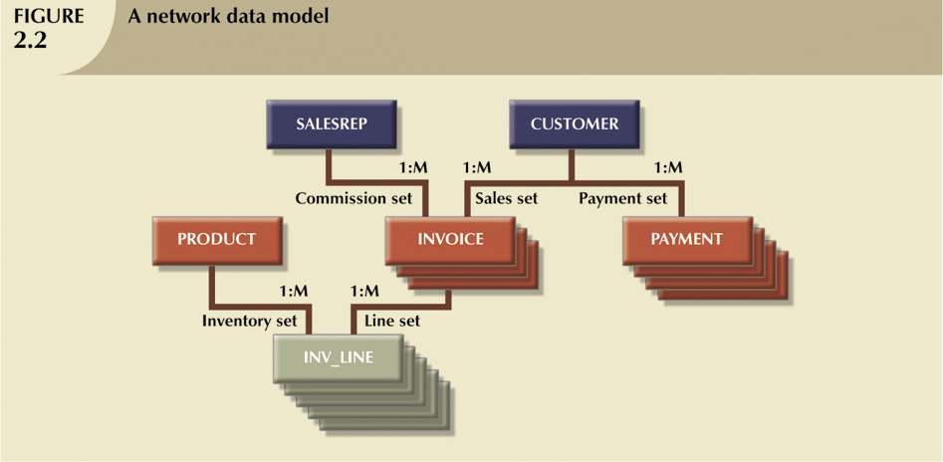
Network Model of a typical sales organization

Slide 21
Advantages of the Network Model
Conceptual simplicity
Handles more relationship types
Data access flexibility
Promotes database integrity
Data independence
Conformance to standards

Slide 22
Disadvantages of the Network Model
The lack of ad hoc query capability put heavy pressure on programmers
Any structural change in the database could produce havoc in all application programs that drew data from the database
Too cumbersome

