Slide 1
CSC 351 FUNDAMENTALS OF DATABASE SYSTEMS

Slide 2
TEXT AND COURSE MATERIAL
MAIN TEXT: Fundamentals of Database Systems, 6/e by Ramez Elmasri and Shamkant B. Navathe
OTHER REFERENCES:
Database Systems: Design, Implementation & Management, International/e by Peter Rob, Carlos Coronel and Keeley Crockett
Database Management Systems by Patricia Ward and George Dafoulas
Concepts of Database Management, 6/e by Philip J. Pratt and Joseph J. Adamski

Slide 3
LECTURE 1: INTRODUCTION TO DATABASES

Slide 4
Databases are an essential component of modern society.
Databases were developed as a result of the need to store and retrieve data, timely and accurately.

Slide 5
Types of Databases and Database Applications
Numeric and Textual Databases
Multimedia Databases
Geographic Information Systems (GIS)
Data Warehouses and OLAP systems
Real-time and Active Databases

Slide 6
Types of Databases (cont’d)
Databases can be classified according to:
Number of users
Database location(s)
Expected type and extent of use
Single-user database supports only one user at a time
Desktop database: single-user; runs on PC
Multiuser database supports multiple users at the same time
Workgroup and enterprise databases

Slide 7
Types of Databases (cont’d)
Centralized database: data located at a single site
Distributed database: data distributed across several different sites
Operational database: supports a company’s day-to-day operations
Transactional or production database
Data warehouse: stores data used for tactical or strategic decisions

Slide 8
Basic Definitions
Database: A collection of related data.
Data: Known facts that can be recorded and have an implicit meaning.
Mini-world or UoD: Some part of the real world about which data is stored in a database. For example, student grades and transcripts at a University.
Database Management System (DBMS): A collection of programs that enables users to create and maintain a database.
Database System: The DBMS software together with the database itself.

Slide 9
Typical DBMS Functionality
Defining the database : in terms of data types, structures and constraints
Construct or Load the Database on a secondary storage medium
Manipulating the database : querying, generating reports, updating
Concurrent Processing and Sharing by a set of users and programs – yet, keeping all data valid and consistent

Slide 10
Typical DBMS Functionality (cont’d)
Other features:
Protection (System or Security)
Maintenance

Slide 11
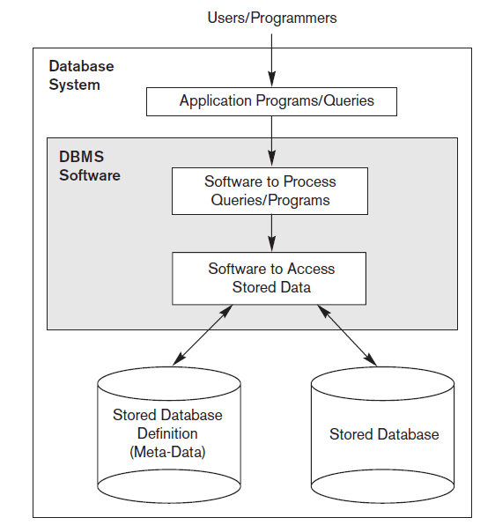
Simplified Database System Environment

Slide 12
Role of the DBMS
The DBMS receives all application requests and translates them into the complex operations required to fulfill those requests.
It hides much of the database’s internal complexity from the application programs and users.

Slide 13
Advantages of the DBMS
Improved data sharing
Better data integration
Minimized data inconsistency
Improved data access
Improved decision making
Increased end-user productivity

Slide 14
Evolution of File System Data Management
Reasons for studying file systems:
Complexity of database design is easier to understand
Understanding file system problems helps to avoid problems with DBMS software
Knowledge of file system is useful for converting file system to database system
File systems typically composed of collection of file folders, each tagged and kept in cabinet
Organized by expected use

Slide 15
Evolution of File System Data Management(cont’d)
Contents of each file folder are logically related
Manual systems
Served as a data repository for small data collections
Cumbersome for large collections
Computerized file systems
Data processing (DP) specialist converted computer file structure from manual system
Wrote software that managed the data
Designed the application programs

Slide 16
Evolution of File System Data Management (cont’d)
Computer file systems resembled manual systems
As number of files increased, file systems evolved
Each file used its own application program to store, retrieve, and modify data
Each file was owned by individual or department that commissioned its creation

Slide 17
Problems with File System Data Management
Even simple file system retrieval task required extensive programming in 3GL
Ad hoc queries impossible
Changing existing structure difficult
Security features difficult to program therefore are often omitted in file system environments

Slide 18
Summary of file System Limitations
Requires extensive programming
Cannot perform ad hoc queries
System administration is complex and difficult
Difficult to make changes to existing structures
Security features are likely to be inadequate

Slide 19
Structural and Data Dependence
Structural dependence: access to a file is dependent on its own structure
All file system programs must be modified to conform to a new file structure
Structural independence: change file structure without affecting data access
Data dependence: data access changes when data storage characteristics change
Data independence: data storage characteristics do not affect data access

Slide 20
Data Redundancy
File system structure makes it difficult to combine data from multiple sources
Vulnerable to security breaches
Organizational structure promotes storage of same data in different locations
Islands of information
Data stored in different locations is unlikely to be updated consistently
Data redundancy: same data stored unnecessarily in different places

Slide 21
Data Redundancy (cont’d)
Data inconsistency: different and conflicting versions of same data occur at different places
Data anomalies: abnormalities when all changes in redundant data are not made correctly
Update anomalies
Insertion anomalies
Deletion anomalies

Slide 22
Contrasting database and file systems

Slide 23
The Database System Environment
Database system: defines and regulates the collection, storage, management, use of data
Five major parts of a database system:
Hardware
Software
People
Procedures
Data
Hardware: all the system’s physical devices
Software: three types of software required:
Operating system software
DBMS software
Application programs and utility software

Slide 24
The Database System Environment (cont'd)
People: all users of the database system
System and database administrators
Database designers
Systems analysts and programmers
End users
Procedures: instructions and rules that govern the design and use of the database system
Data: the collection of facts stored in the database

Slide 25
The database system environment

