Slide 1
LECTURE 3 THE RELATIONAL DATABASE MODEL

Slide 2
Origins of the Relational Data Model
It was developed by E.F. Codd in the early 1970s
Commercial systems based on the relational model appeared in the late 1970s
Currently, there are several relational DBMSs and most computer vendors support ‘relational’ software
Eg: Oracle, DB2, MySQL, MS.SQL Sever, MS Access etc.

Slide 3
Some Terminologies
The model uses terminology taken from mathematics, particularly set theory and predicate logic
Users perceive data to be stored as tables or relations
Table
Has advantages of structural and data independence
Resembles a file from conceptual point of view
Easier to understand than its hierarchical and network database predecessors

Slide 4
Some Terminologies (cont’d)
A relation – a two dimensional structure composed of rows and columns
A tuple – each table row. i.e., a single entity occurrence within the entity set and must be distinct. Duplicate rows are not allowed in a relation
An attribute – a named column of a relation and it must be distinct
A domain – the set of allowable values for one or more attributes

Slide 5
Properties of Relations
Relation and attribute names are distinct
Cell values of a relation are atomic (i.e. single valued)
All values in a column must conform to the same data format
Duplicate tuples are not allowed
Both tuples and attributes are unordered
Each table must have an attribute or combination of attributes that uniquely identifies each row

Slide 6
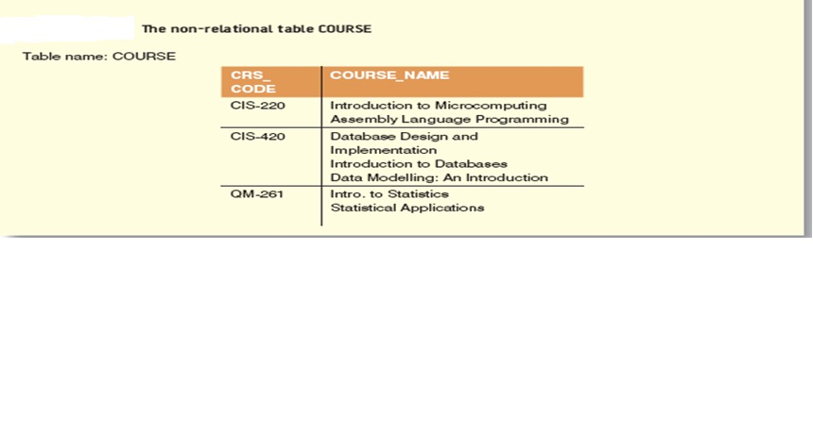
Example of a relation and non-relation

Slide 7
Relational Schema
Applying the concepts of relations to database models allows us define a relational schema for each entity
A relational schema is a textual representation of the database tables, where each table is described by its name followed by the list of its attributes in parentheses.
A relational schema R can be formally defined as
R={a1, a2,...,an} where a1 … an are a set of attributes belonging to the relation.

Slide 8
Degree and Cardinality
The degree of a relation – the number of attributes it contains
The cardinality of a relation – the number of tuples it contains
Eg; A relation with N columns and M rows is said to be of degree N and cardinality M
The product of a relation’s degree and cardinality is the number of attribute values it contains (N*M)

Slide 9
Degree and Cardinality of the DEPARTMENT relation

Slide 10
Keys
Very often it is required to be able to identify each of the different instances of relations in a database
A key consists of one or more attributes that determine other attributes
Eg; an invoice number identifies all of the invoice attributes, such as invoice date and customer name
A key’s role is based on a concept known as determination.
Eg; In database, the statement ‘A determines B’ (A B)indicates that if you know the value of attribute A, you can look up (determine) the value of attribute B
If A determines B, C and D, you write A B, C, D

Slide 11
Example
Table name: STUDENT
STU_NUM | STU_LNAME | STU_FNAME | STU_DOB | STU_CLASS | STU_GPA | DEPT_CODE | STU_PHONE | LECT_NUM
321452 | Bowser | William | 12-Feb-1975 | UG3 | 2.84 | BIOL | 2134 | 205
324257 | Smithson | Anne | 15-Nov-1981 | UG2 | 3.27 | CIS | 2256 | 222
324258 | Brewer | Juliette | 23-Aug-1969 | UG3 | 2.26 | ACCT | 2256 | 228
324269 | Oblonski | Walter | 16-Sep-1976 | UG2 | 3.09 | CIS | 2114 | 222
324273 | Smith | John | 30-Dec-1958 | PG | 2.11 | ENGL | 2231 | 199
324274 | Katinga | Raphael | 21-Oct-1979 | PG | 3.15 | ACCT | 2267 | 228
324291 | Robertson | Gerald | 08-Apr-1973 | PG | 3.87 | EDU | 2267 | 311
324299 | Smith | John | 30-Nov-1986 | UG1 | 2.92 | ACCT | 2315 | 230

Slide 12
Example(cont’d)
STU_NUM STU_LNAME
In fact , the STU_NUM value in the STUDENT table determines all of the student’s attribute values.
STU_NUM STU_LNAME, STU_FNAME, STU_DOB, STU_CLASS, STU_GPA, DEPT_CODE, STU_PHONE, LECT_NUM
In contrast, STU_NUM is not determined by STU_LNAME because it is quite possible for several students to have the last name Smith.

Slide 13
Keys (cont’d)
The principle of determination is very important because it is used in the definition of the relational database concept known as functional dependence
We say the attribute B is functionally dependent on A if A determines B or more precisely;
The attribute B is functionally dependent on the attribute A if each value in column A determines one and only one value in column B

Slide 14
Keys (cont’d)
From the STUDENT table, it is appropriate to say that STU_PHONE is functionally dependent on STU_NUM.
Eg; STU_NUM value 321452 determines the STU_PHONE value 2134.
On the other hand, STU_NUM is not functionally dependent on STU_PHONE because the STU_PHONE value 2267 is associated with two STU_NUM values: 324274 and 324291.
In this case, the functional dependence can be defined as ; Attribute A determines attribute B (i.e., B is functionally dependent on A) if all of the rows in the table that agree in value for attribute A also agree in value for attribute B.

Slide 15
Types of Keys
Primary key (PK) is an attribute (or a combination of attributes) that uniquely identifies any given entity (row)
In the STUDENT table, STU_NUM is the primary key
A key may be composed of more than one attribute; such a multi-attribute key is known as a Composite Key
In the STUDENT table, the student’s last name would not be sufficient to serve as a key because it is possible to find several students whose last names are the same

Slide 16
Types of Keys (cont’d)
However, the combination of last name, first name and home phone is very likely to produce unique matches for the remaining attributes.
Given the possible existence of a composite key, the notion of functional dependence can be further refined by specifying full functional dependence:
If the attribute (B) is functionally dependent on a composite key (A) but not on any subset of that composite key, the attribute (B) is fully functionally dependent on (A)

Slide 17
Types of Keys (cont’d)
Superkey is any key that uniquely identifies each row
The superkey functionally determines all of the row’s attributes.
In the STUDENT table, the superkey could be any of the following;
STU_NUM
STU_NUM, STU_LNAME
STU_NUM, STU_LNAME, STU_PHONE
STU_NUM, with or without additional attributes, can be a superkey even when the additional attributes are redundant.

Slide 18
Types of Keys (cont’d)
Candidate key is any key that uniquely identifies each row without redundancies (i.e., a superkey without redundancies OR that does not contain a subset of attributes that is itself a superkey)
Eg; The composite key, STU_NUM, STU_LNAME is a superkey but it is not a candidate key because STU_NUM by itself is a candidate key
NB:
The primary key is the key chosen to be the unique identifier of a row
Incidentally, a primary key is a superkey as well as a candidate key

Slide 19
Example

Slide 20
Types of Keys (cont’d)
A Foreign key (FK) is an attribute whose values match primary key values in a related table
The VEN_CODE is the primary key in the VENDOR table and it occurs as a foreign key in the PRODUCT table.

Slide 21
Types of Keys (cont’d)
A Secondary key is a key used strictly for data retrieval purposes
Suppose customer data are stored in a CUSTOMER table in which the customer number is the primary key. Do you suppose that most customers will remember their number?
Data retrieval for a customer can be facilitated when the customer’s last name and phone number are used. i.e., the 1⁰ Key = customer number and the 2⁰ key = the combination of customer last name and phone number
NB: A secondary key does not necessary yield a unique outcome
A secondary key’s effectiveness in narrowing down a search depends on how restrictive that secondary key is.

Slide 22
Integrity Rules
Within a table, each primary key value must be unique to ensure that each row is uniquely identified by the primary key. In that case, the table is said to exhibit entity integrity.
To maintain entity integrity a null ‘value’ (i.e., no data entry at all) is not permitted in the primary key.
Nulls can never be part of a primary key and should be avoided even in other attributes too.
Eg; One of an EMPLOYEE table’s attributes is likely to be EMP_INITIAL. However, not all employees have a middle initial. Therefore, some of the EMP_INITIAL ‘values’ may be null.
Even if nulls cannot always be avoided, they must be used sparingly.

Slide 23
Integrity Rules (cont’d)
Nulls if improperly used create problems because they have many deferent meanings. A null can represent;
An unknown attribute value
A known, but missing, attribute value
A “not applicable” condition
Nulls can create;
problems when functions such as COUNT, AVERAGE, and SUM are used
logical problems when relational tables are linked

Slide 24
Integrity Rules (cont’d)
Referential integrity means that if a FK contains a value, that value refers to an existing valid tuple (row) in another relation. i.e., if the FK contains either matching values or nulls, the table(s) that make(s) use of that FK is (are) said to exhibit referential integrity.
Referential Integrity is maintained between the PRODUCT and VENDOR tables

Slide 25
Integrity Rules (cont’d)

Slide 26
Controlled redundancy
Tables within the database share common attributes that enable the tables to be linked together
Multiple occurrences of values in a table are not redundant when they are required to make the relationship work
Redundancy exists only when there is unnecessary duplication of attribute values
Eg; The PRODUCT and VENDOR tables share a common attribute, VEND_CODE.
The PRODUCT table’s VEND_CODE values 232 and 235 occur more than once.
Because the PRODUCT table is related to the VENDOR table through these VEND_CODE values, the multiple occurrence of the values is required to make the 1:* relationship between VENDOR and PRODUCT work

Slide 27
Keys and the Relational schema
The primary key attribute(s) is (are) underlined with the schema
Eg;
VENDOR (VEND_CODE, VEND_CONTACT, VEND_AREACODE, VEND_PHONE)
PRODUCT (PROD_CODE, PROD_DESCRIPT, PROD_PRICE, PROD_ON_HAND, VEND_CODE)

Slide 28
Unified Modeling Language (UML)
Since we will be using UML notations in modeling our relationships it is worth pointing out that UML is a language that describes a set of diagrams and symbols that can be used to model a system graphically

Slide 29
Unified Modeling Language (UML) cont’d
Different terminologies are used when representing relationships amongst entities
In UML relationships are known as associations and associations have several characteristics:
Association name: Each association has a name and its normally written over the association line
Association direction: Associations also have directions, represented by an arrow ( ) pointing to the direction in which the relationship flows

Slide 30
Unified Modeling Language (UML) cont’d
Role name: The participating entities in a relationship can role names instead of association names. A role name expresses the role played by a given class in the relationship.
Eg; APAINTER paints a PAINTING, and each PAINTING is_painted_by a PAINTER
Multiplicity: this refers to the number of instances of one entity (class) that are associated with one instance of a related entity (class)
Eg; One (and only one) PAINTER generates one to many PAINTINGs, and one PAINTING belongs to one and only one PAINTER

Slide 31
Relationships within the Relational Database
1:* relationship
This is the relational modeling ideal and therefore, should be the norm in any relational database design
1:1 relationship
Should be rare in any relational database design
*:* relationships
Cannot be implemented as such in the relational model
*:* relationships can be changed into two 1:* relationships

Slide 32
The 1:* Relationship
Modeling a 1:* relationship
PAINTER paints PAINTING example

Slide 33
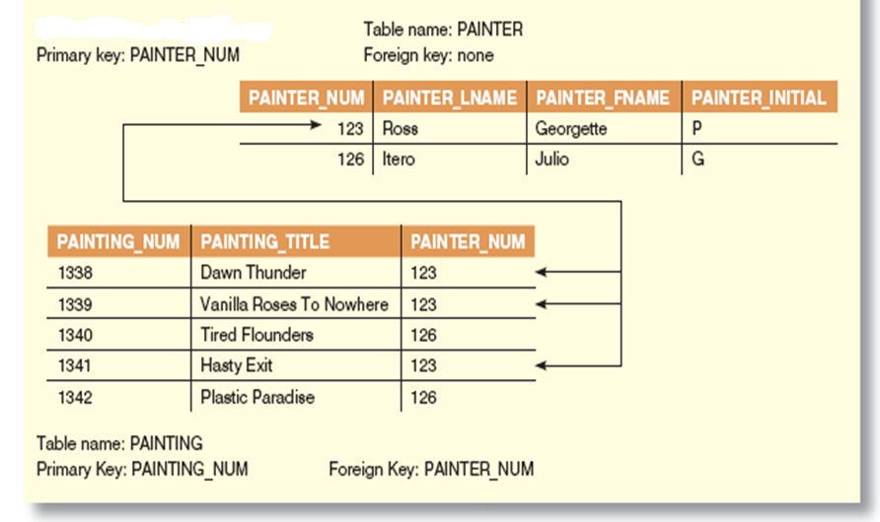
1:* Relationship (cont’d)
Implementation of 1:* relationship between PAINTER and PAINTING

Slide 34
The 1:1 Relationship
One entity can be related to only one other entity, and vice versa
As rare as 1:1 relationships should be, certain conditions absolutely require their use

Slide 35
1:1 Relationship (cont’d)
1:1 relationship between LECTURER and DEPARTMENT

Slide 36
1:1 Relationship (cont’d) Implementation of LECTURER chairs DEPARTMENT

Slide 37
1:1 Relationship (cont’d)

Slide 38
1:1 Relationship (cont’d)
The 1:1 LECTURER chairs DEPARTMENT relationship is implemented by having the EMP_NUM FK in the DEPARTMENT table
NOTE:
The 1:1 relationship is treated as a special case of the 1:* relationship in which the ‘many’ side is restricted to a single occurrence. i.e., DEPARTMENT contains the EMP_NUM as FK to indicate that it is department that has a chair
The LECTURER table contains the DEPT_CODE FK to implement 1:* DEPARTMENT employs LECTURER relationship
A good example of how two entities can participate in two (or even more) relationships simultaneously

Slide 39
The *:* Relationship
*:* relationships can be implemented by breaking it up to produce a set of 1:* relationships
Eg;
Each CLASS can have many STUDENTs, and each STUDENT can take many CLASSes
There can be many rows in the CLASS table for a given row in the STUDENT table, and there can be many rows in the STUDENT table for any given row in the CLASS table

Slide 40
*:* Relationship (cont’d) Implementation of STUDENT and CLASS

Slide 41
*:* Relationship (cont’d) Implementation of STUDENT and CLASS
The *:* implementation for the STUDENT and CLASS example should not be implemented because;
The tables create redundancies and these redundancies can lead to anomalies
Given the structure and contents of the two tables, the relational operations become very complex and are likely to lead to system efficiency errors and output errors

Slide 42
*:* Relationship (cont’d) Implementation of STUDENT and CLASS
These problems inherent in the *:* relationship can be avoided by creating a composite entity or bridge entity
Such a table is used to link tables that originally were related in a *:* relationship
The composite structure include – as FKs – at least the PKs of the tables that are to be linked.

Slide 43
*:* Relationship (cont’d) Implementation of STUDENT and CLASS

Slide 44
*:* Relationship (cont’d) Implementation of STUDENT and CLASS
Changing the *:* relationship to two 1:* relationships

Slide 45
Indexes
An index is an orderly arrangement used to logically access rows in a table
Conceptually, an index is composed of an index key and a set of pointers
An index key is the index’s reference point that points to a data location identified by the key
An index key can have multiple attributes (composite index)

Slide 46
Indexes (cont’d) - Components of an index

Slide 47
Indexes (cont’d)
DBMS use indexes for;
Retrieving data efficiently
Retrieving data ordered by a specific attribute or set of attributes
Indexes play an important role in DBMS for the implementation of PKs. When a table’s PK is defined, the DBMS automatically creates a unique index on the PK column(s) declared.

Slide 48
Indexes (cont’d)
A Unique index is an index in which the index key can have only one pointer value (row) associated with it
A table can have many indexes but each index is associated with only one table

