Slide 1
Turning Glowing Text into Animated Glowing Text
Using Animation Shop

Slide 2
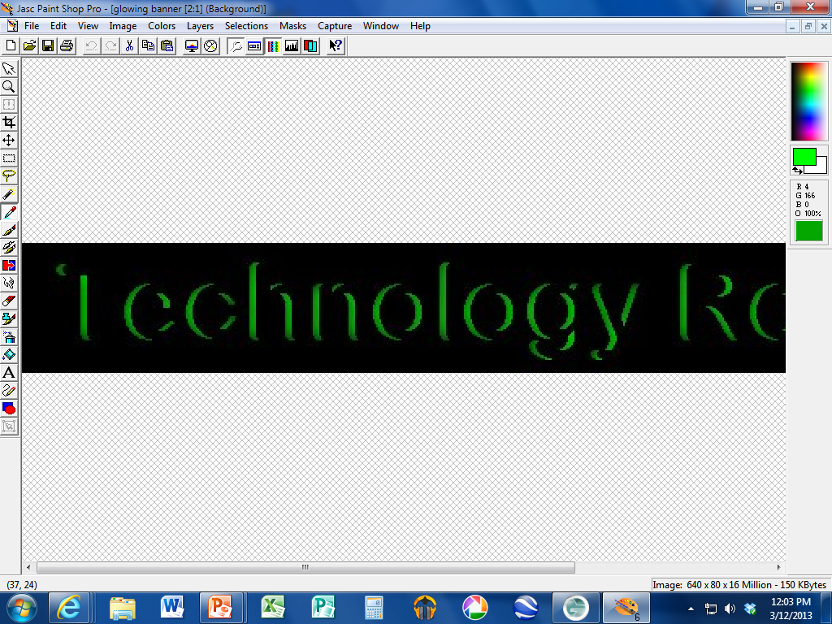
Open your glowing text NAME file.
Use the dropper tool to select the exact glowing color.

Slide 3
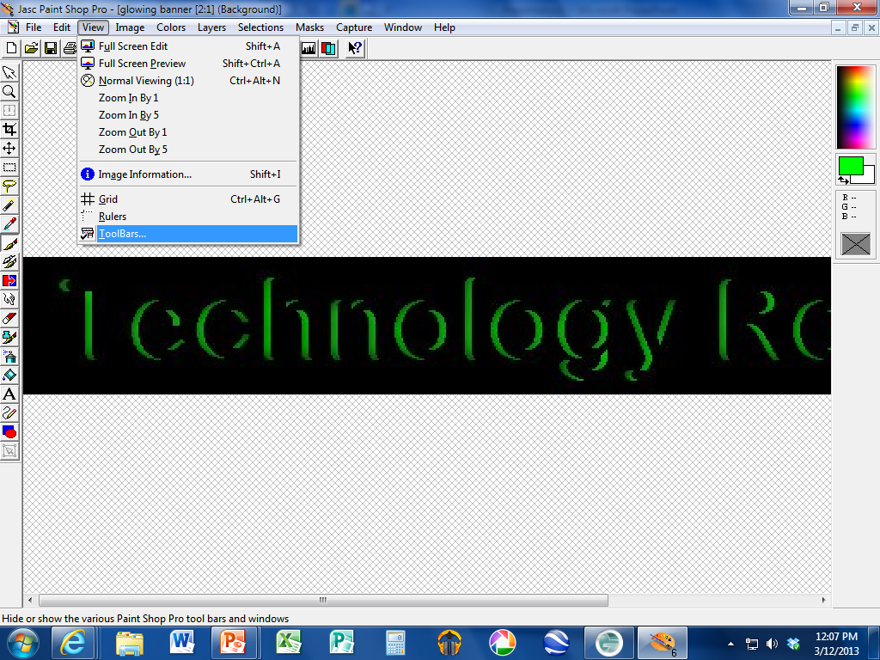
Switch to the BRUSH tool.
Choose View → Toolbars

Slide 4
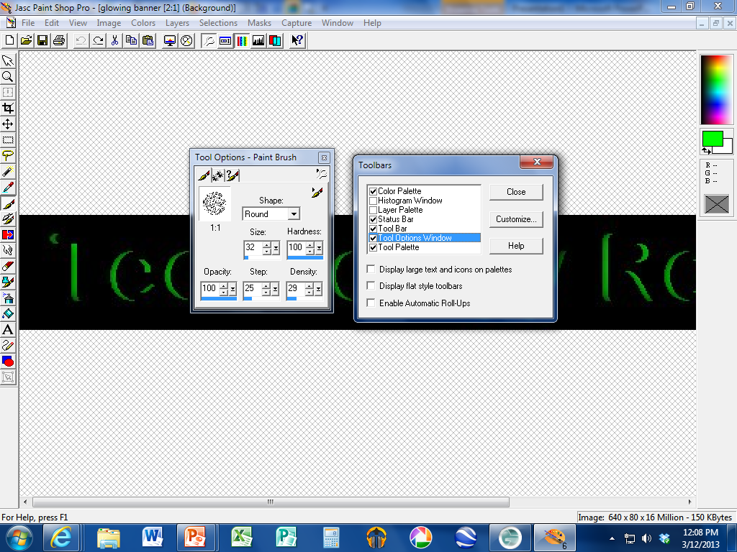
Then check the box for “Tool Options Window”.
This allows you to adjust the brush.

Slide 5
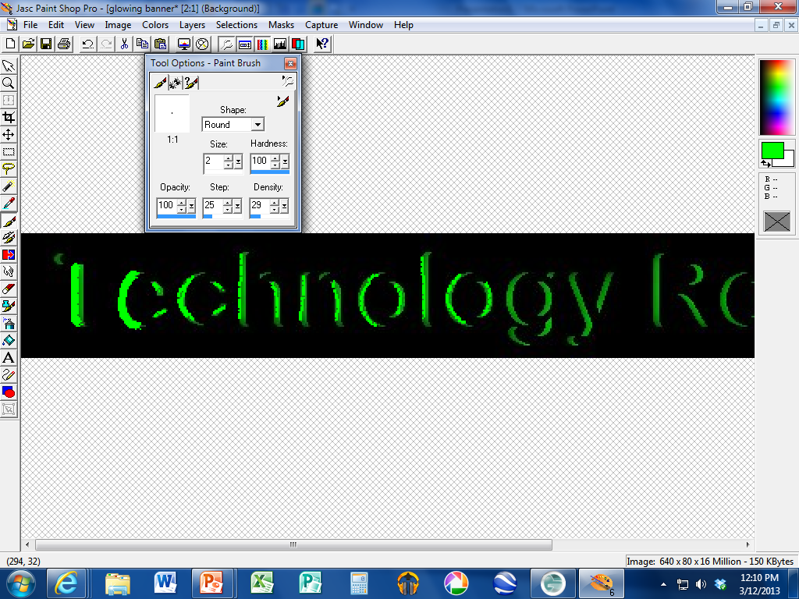
Change the brush size to 1-5.
Color the highlight color and make it just a little big bigger.

Slide 6
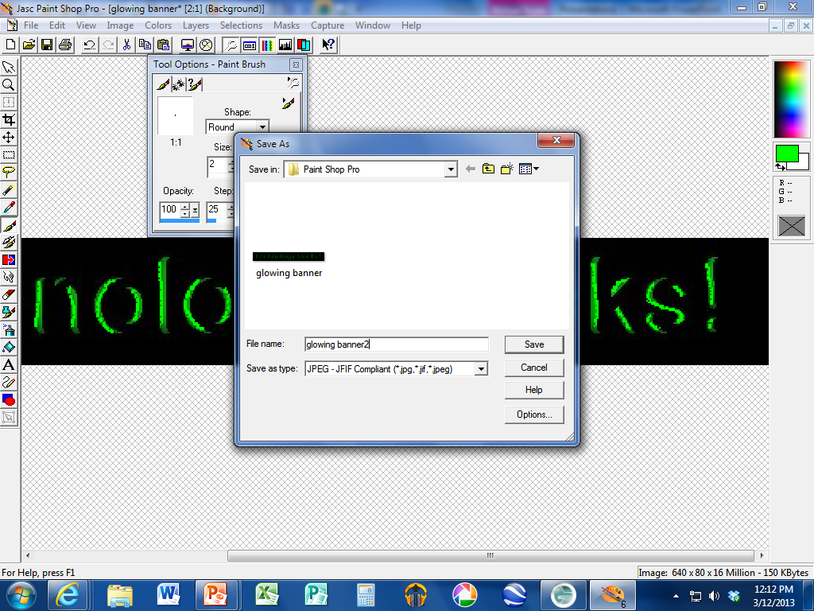
Finish painting and save as with the number “2” after it.
Mine is called “glowingbanner2”.jpg

Slide 7
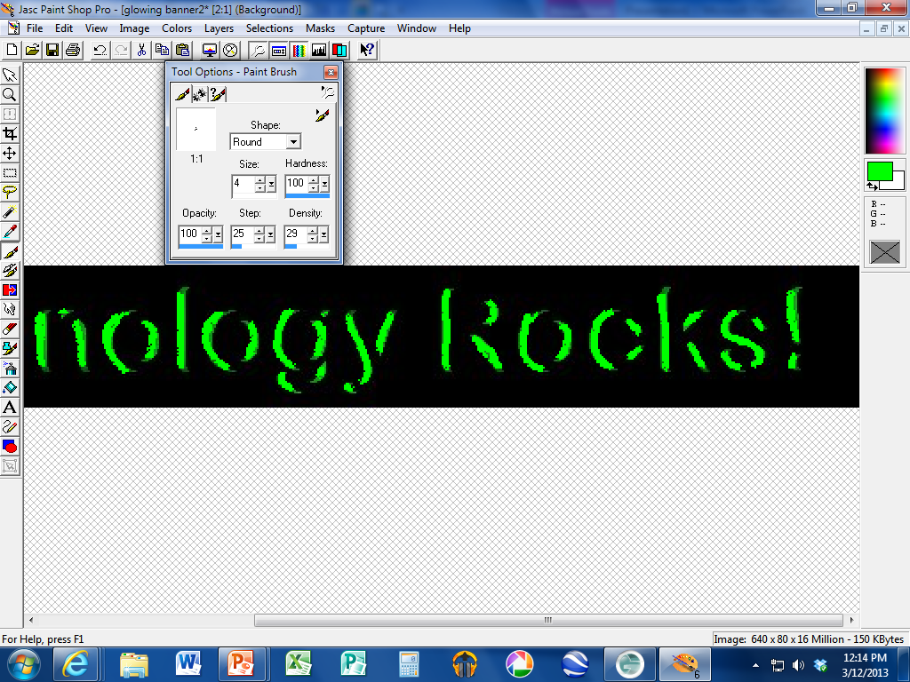
Increase the brush size by 2-4 and paint the glow a little larger!

Slide 8
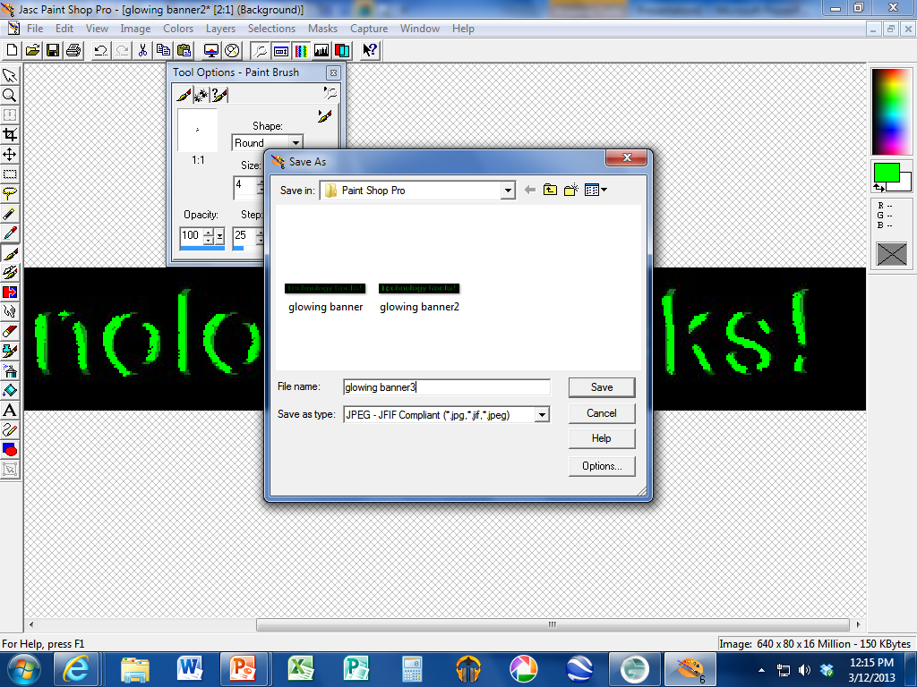
Save as “filename3”

Slide 9
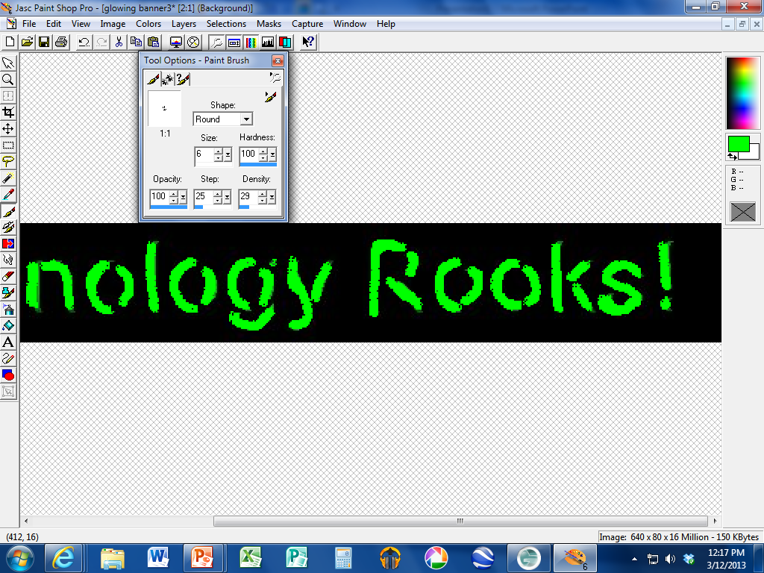
Increase the brush size another 2-4 sizes and paint larger

Slide 10
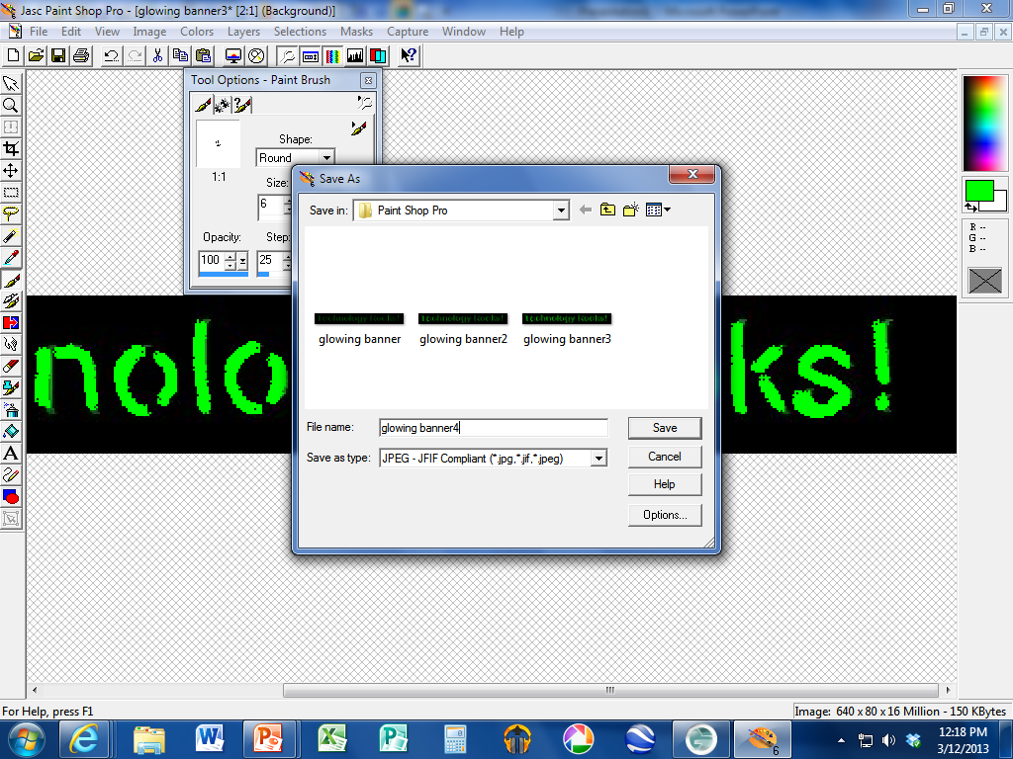
Save as “filename4”

Slide 11
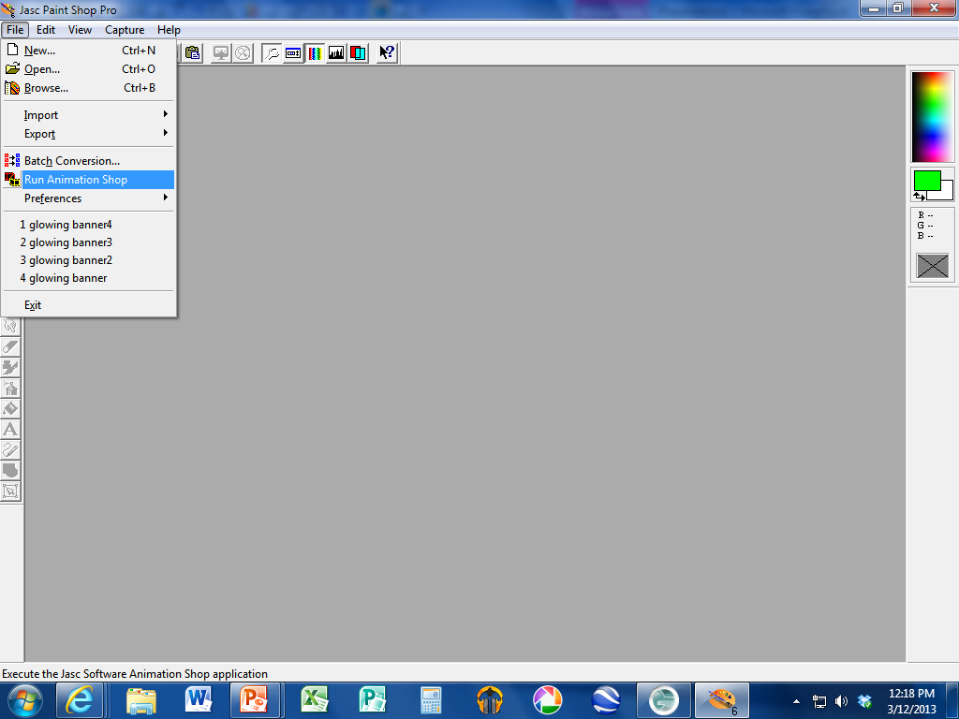
Close your image and go to FILE and RUN ANIMATION SHOP

Slide 12
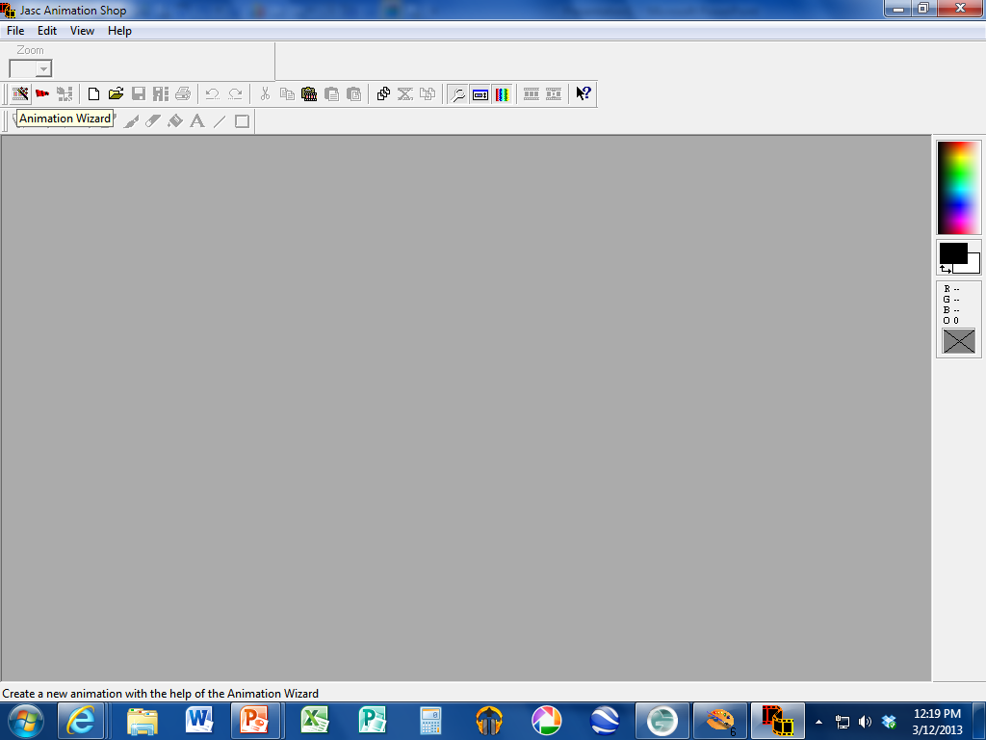
Select Animation Wizard

Slide 13
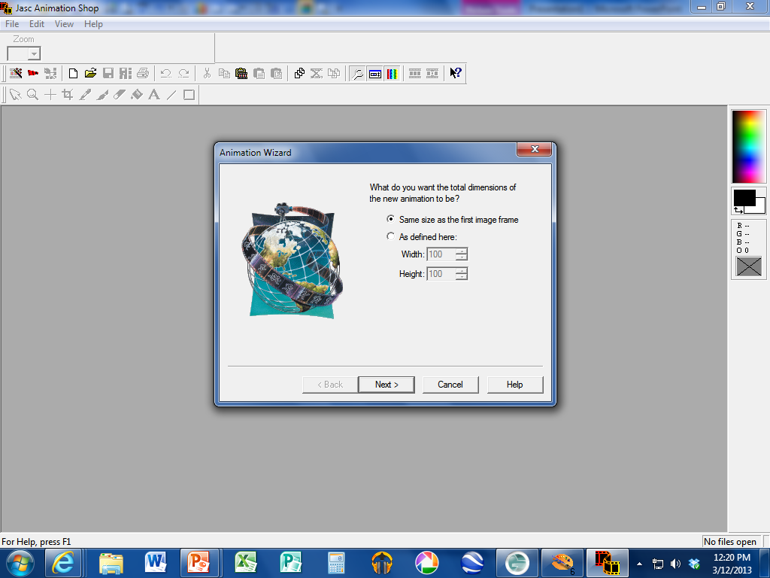
Click NEXT until you see the window on the next slide….

Slide 14

Stop when you get here.

Slide 15
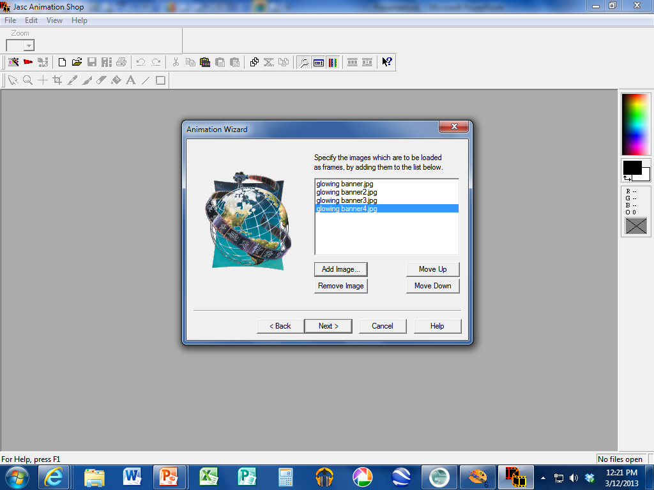
Add each glowing text image you created, including the original one.
Make sure they are in order!

Slide 16
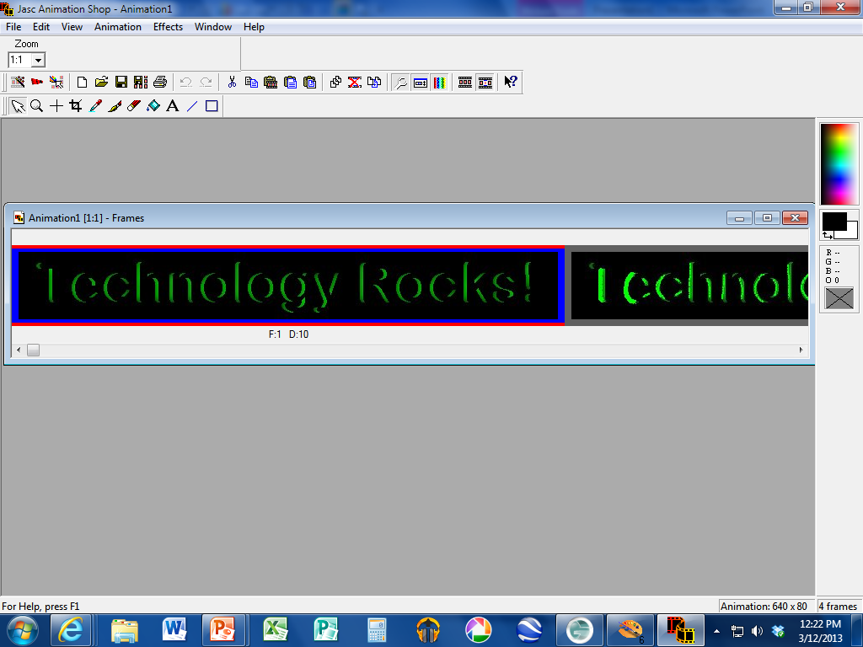
Click NEXT and FINISH until you see a screen that looks like this one

Slide 17

Click the “View Animation” button!

Slide 18


