Slide 1


The Internet
Its History, Usefulness, and Problems
The Inter-WHAT?

Slide 2


Life Before & After the Internet
If you were born after 1991 you have never experienced life before the Internet.
Society existed for (roughly) 1,991 years without the Internet and 21 years with it.

Slide 3
Early History of the Internet
In 1969 four California universities connected their computers together to share information. It was called the Arpanet.
In 1974 the term “Internet” was first used to describe computers internetworked together.
The Internet became available to the general public in 1991 and websites were text only.

Slide 4
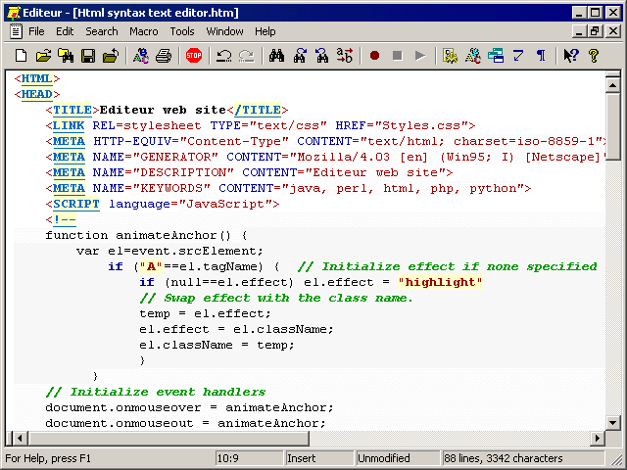
More History…
Before 1993 webpages could only be created by people who knew the HTML (hypertext markup language) programming language.

Slide 5
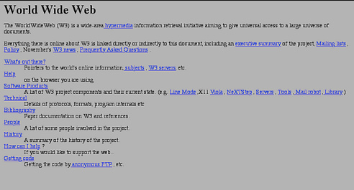
The First Web Page

Slide 6
PICTURES???
In 1993 the Mosaic web browser was developed and website could display graphics!
The Internet became a source for not only text information but photos of far off people and places.

Slide 7
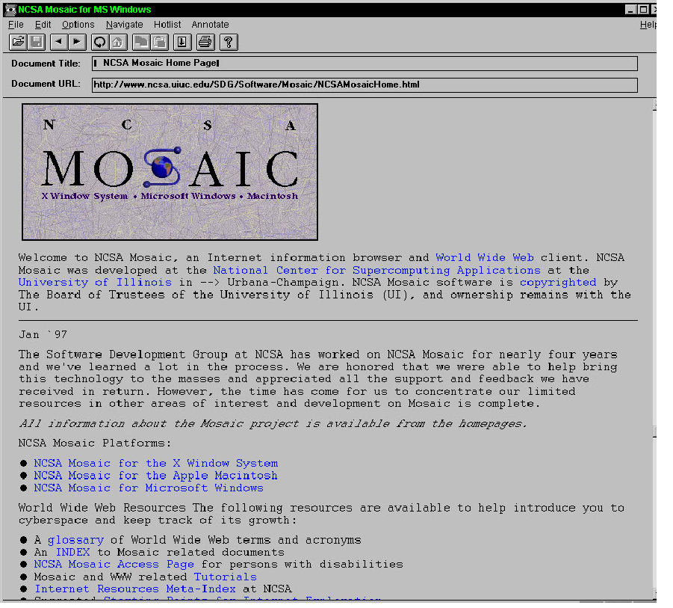

Slide 8
Search Engines
1993 Lycos
1994 Webcrawler
1994 Yahoo
1995 Alta Vista
1998 Google
2009 Bing

Slide 9
Accessing the Internet
Until just recently, users had to connect to a telephone line and use a MODEM to dial a phone number to access the Internet.
Dial up Internet took minutes, or longer, just to connect to the Internet. If there were pictures on a website it would slow down or freeze. It was common just to give up.

Slide 10
Broadband Internet
In the early 2000’s dial up modems were replaced with broadband connections.
These connections were not only hundreds ot times faster, but once connected to the Internet it was possible to stay on for not just hours, but 24 hours a day! (Gasp!)
These new connections allowed streaming video, unlimited pictures, and multiplayer gaming.

Slide 11

Communication B.I. (Before Internet)
Letters
Face to face conversations
Phone calls from house phones
Distant friends and family could only see photos of you and your family if you paid to print and mail photos to them.

Slide 12
Communication A.I. (After Internet)
Chat “rooms”
Instant messaging
Email
Cell phones for calls, but used mostly for texting
Photos are shared via phone, digital camera, or online photo sharing site
It is possible to meet and chat with anyone from anywhere in the world
Webcams make it possible to see the people you are talking to.

Slide 13

Schoolwork & Research B.I.
Trips to libraries that may or may not have a book on your topic and books may likely be outdated.
Encyclopedias
Purchase
books at a
bookstore

Slide 14
Schoolwork & Research A.I.
Libraries are still valuable for finding books but are not as useful for research anymore.
Large, expensive encyclopedia sets are replaced by free online information sites such as Wikipedia.com, Worldbook.com, and Encyclopedia.com
Ebooks are outselling printed books but both can be purchased online from sites like Amazon.com

Slide 15
File Sharing B.I.
Movies, music, documents, photos, and videos had to be copied onto DVDs or CDs and hand-delivered or mailed to friends and family.

Slide 16

File Sharing A.I.
Files can be shared both legally and illegally online by uploading and downloading.
In 1999 Napster became known for being a site for downloading illegal songs and the government began going after individuals downloading a large number of illegal songs.
Documents can be worked on by groups of people using tools such as Google Docs.

Slide 17

Multiplayer Gaming B.I.
Board games played in person.
Certain games were played by mail, like chess.

Slide 18
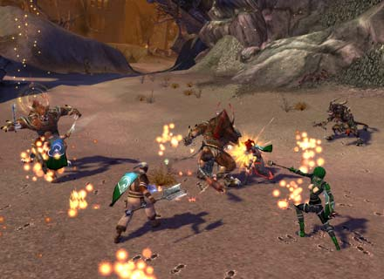
Multiplayer Gaming A.I.
Massive Multiplayer Online Games (MMOGs), like Guild Wars and World of Warcraft are hugely popular and can include people from any country and any age.
A billion dollar a year industry.
Your generation is growing up playing games with other people you’ve never met or seen.

Slide 19
Buying Stuff B.I.
Orders were done by calling a phone number in a catalog or visiting the store personally.

Slide 20


Buying Stuff A.I.
Little local stores are going out of business because they can’t compete with online companies.
We can find nearly anything, anytime online and order it with a credit card and click of the mouse button.
Sites like Ebay allow sellers to compete for customers – and customers to bid on items and hope to get it for a steal.

Slide 21

Crime B.I.
Criminals had to take bills
out of your mailbox to steal
your identify and use your
credit cards.
Stalkers, molesters, and murderers had to physically see you and decide to follow and/or take you.

Slide 22
Crime A.I.
Criminals now have unlimited targets and have the technical knowledge to hack into personal accounts to steal credit card and bank account numbers.
Stalkers, molesters, and murderers can find you online – in chat rooms, online gaming environments, and social media sites like Facebook – and can ask a few easy questions to find out where you go to school or live.

Slide 23
Bullying & Abuse B.I.
Bullies had to come face to face with people they believed they could intimidate.
Mean words were said face to face, in notes, or “behind someone’s back”.

Slide 24
Bullying & Abuse A.I.
Bullies can now scare and hurt people emotionally without having to do it face to face when no one is watching.
Mean words are said on Facebook and in text messages that can be quickly shared with thousands of people.
Embarrassing photos are used to bully, scare, and harass others.

Slide 25

Inappropriate Material B.I.
Pornography, violence, and criminal activities were found only in certain magazines and videos, if at all.
Most people were not exposed to inappropriate material and most kids were not able to find it.

Slide 26

Inappropriate Material A.I.
Currently anyone can take and post photos and videos of anything to the Internet.
Pornography can be found for free or more graphic pornography for a fee.
Crimes and violence are videotaped and shared online.
Sites like YouTube have made it possible (and popular) to share and view the most horrible and graphic videos imaginable.

Slide 27
How Can YOU Do What’s Right?
Set your browser’s security level to HIGH to block most offensive and inappropriate material.
Don’t have a computer in a bedroom – keep them out where everyone can see what websites are being visited.
Don’t agree to view inappropriate material on a phone or computer.
Don’t laugh at something you don’t think is funny. Speak up.
Don’t give out any personal information to people you only know online.

