Slide 1

Cloud Storage
The Future is Now

Slide 2
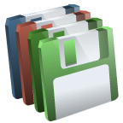



Old School Data Storage

Slide 3
Problems with “Old School” Storage
Network drives crash.
Portable devices break.
Portable devices get lost.
Technology changes (floppy, zip, CD, DVD, USB)
Burning software is required for CD/DVDs.
Files are always left at home or school.
FRUSTRATING!!!!

Slide 4
BENEFITS OF CLOUD STORAGE
Free
Online
Accessed from phones, laptops, PCs, macs, etc.
Accessed from anywhere
Start a document at school and finish it at home!

Slide 5
NEGATIVES OF CLOUD STORAGE
Free accounts have a storage limit, usually around 5GB.
Smaller services could close and delete your files.
You don’t physically “have” your files.

Slide 6
CLOUD STORAGE SERVICES
iCloud
Amazon Cloud Drive
Dropbox
Google Drive
Microsoft Skydrive

Slide 7
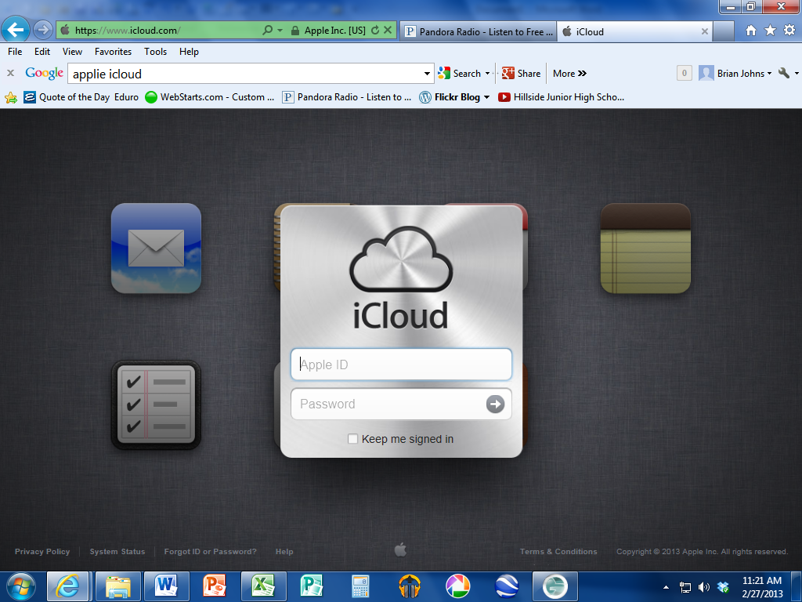

Slide 8
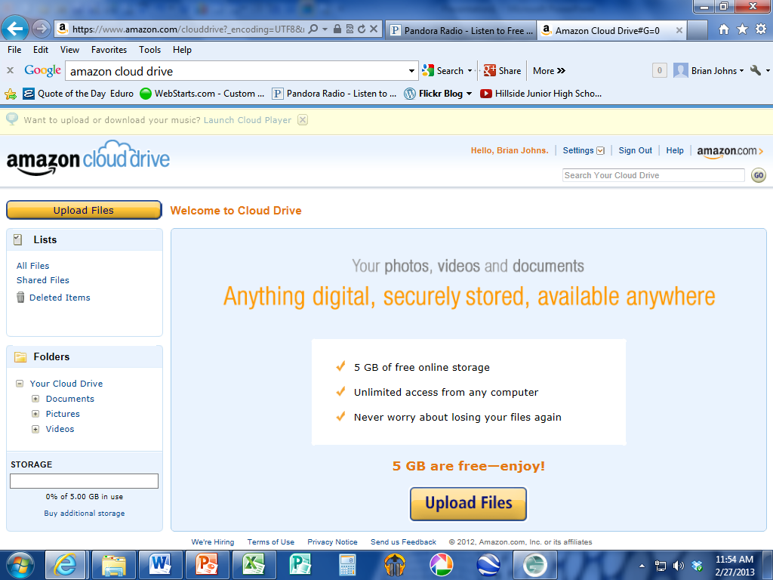

Slide 9
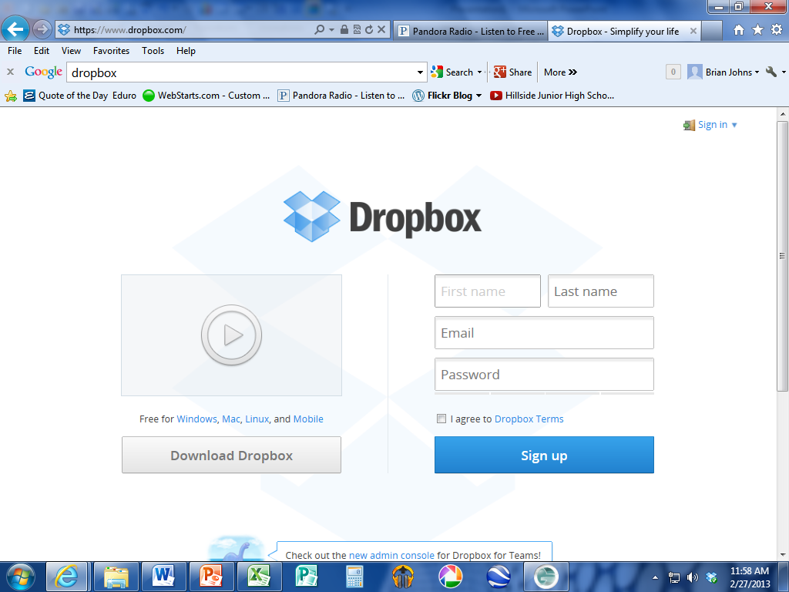

Slide 10
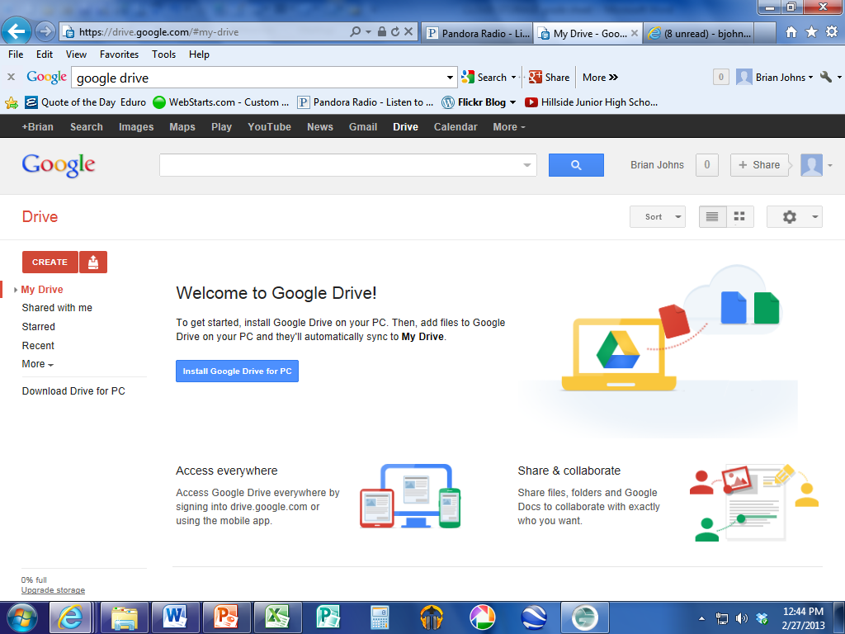

Slide 11
