Slide 1
My Top 10 Fave Pokemon

Slide 2
#10

Slide 3

Scizor
He has sharp claws
Looks cool
And really powerful

Slide 4
#9

Slide 5
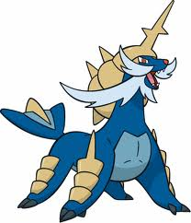
Samurott
It Can learn Hydro Cannon
It’s arms and legs are like razor sharp blades
It’s really big! (and cool)

Slide 6
#8

Slide 7

Mew
Can learn any move
Can learn the move transform by leveling up
It’s so cute!

Slide 8
#7

Slide 9

Zorua
Very tricky
Has the ability Illusion
Very quick

Slide 10
#6

Slide 11
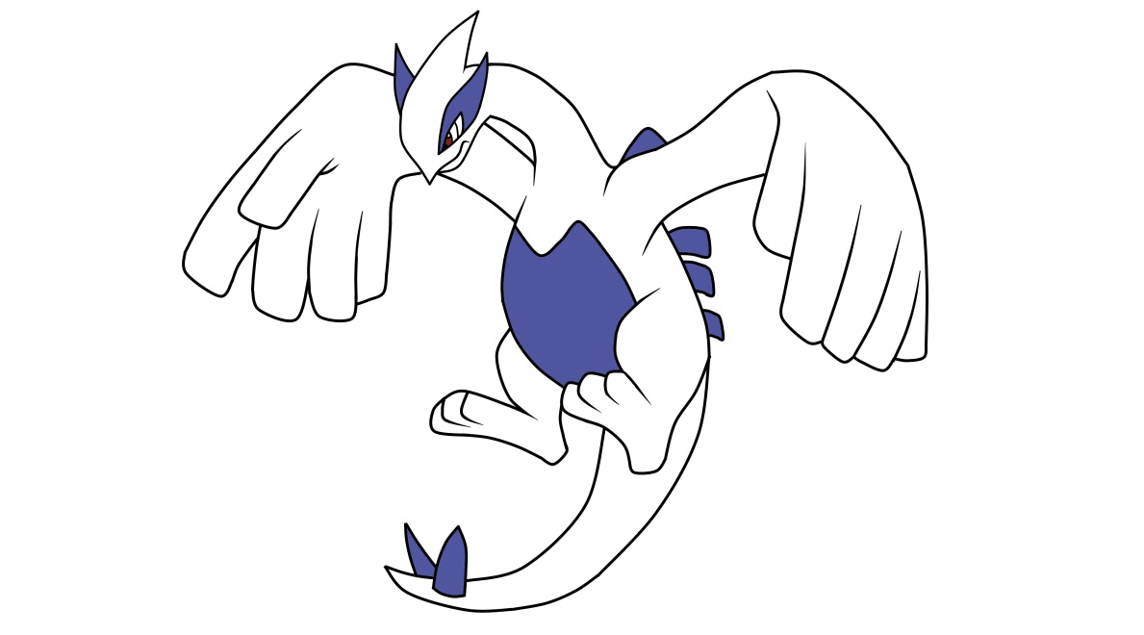
Lugia
Big wings- great for flying
Water type (my fave type)
One flap of it’s wings can create a 40 day storm

Slide 12
#5

Slide 13
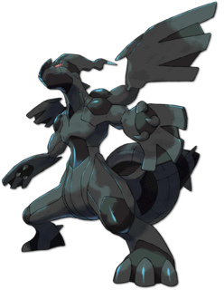
Zekrom
He’s a dragon and electric(pretty good combo)
One of the most powerful dragons
As strong as Kyurem and Resharam (but cooler)

Slide 14
#4

Slide 15
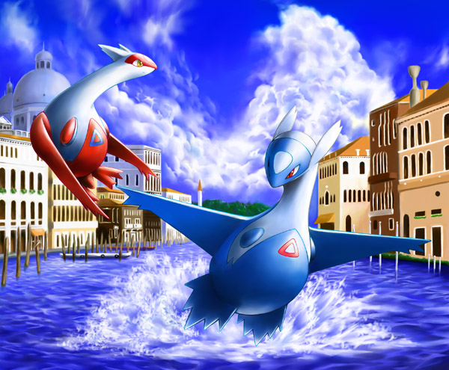
Latios and Latias
A powerful twin duo
Lugia’s children
Can turn invisible, or turn into people, and can show you what they see.

Slide 16
#3

Slide 17
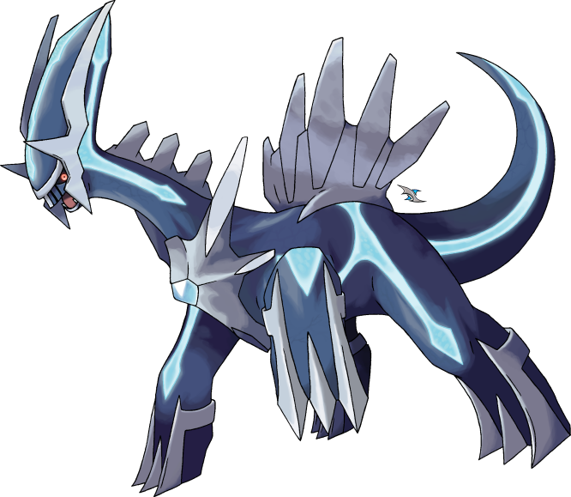
Dialga
POWERFUL!!!
Ruler of time!
Very wise and… AWESOME!!!!!!

Slide 18
#2

Slide 19
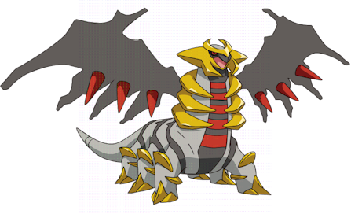
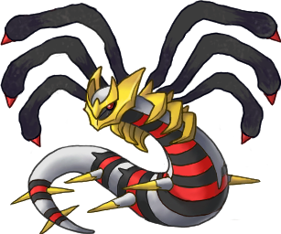
Giratina
The ruler of the reverse world. The reverse world holds our world together, for without it, NO, LIFE,EXISTS!
Can open portals to different dimentions
Has 2 different awesome forms

Slide 20
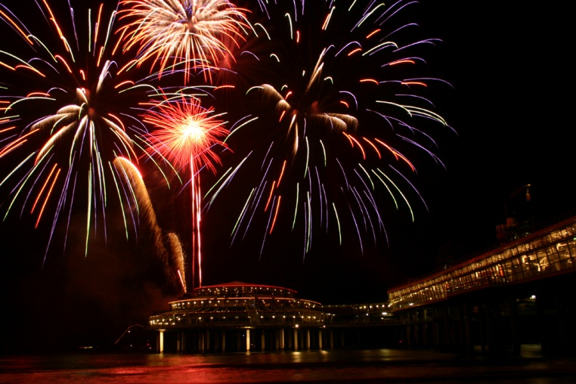

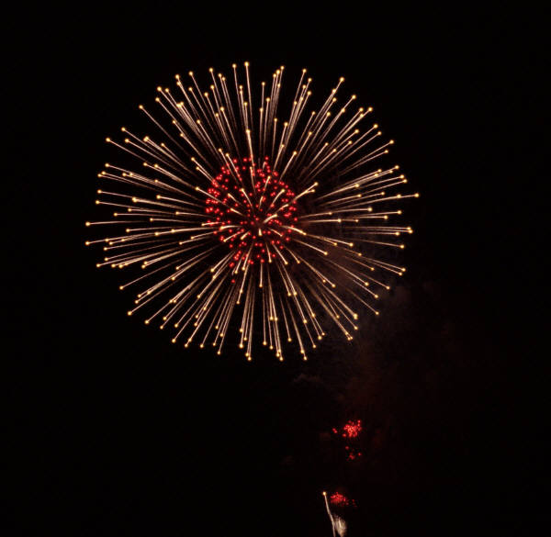

#1

Slide 21
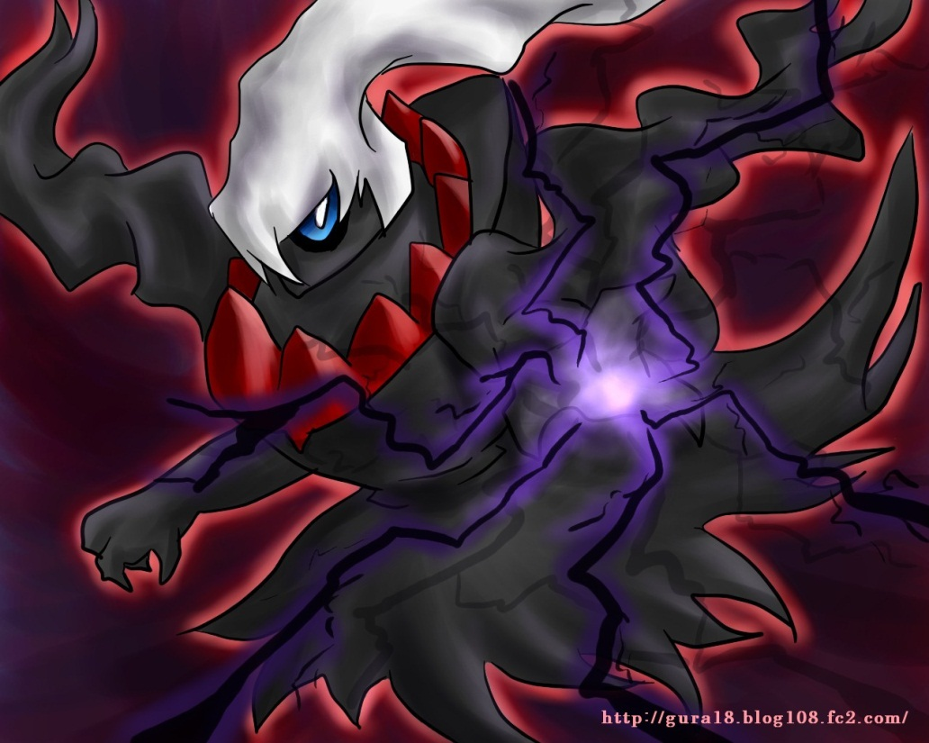
Darkrai
He is the shadow pokemon
He shows human feelings
He sacrifices himself for others
He is the AWSOME……

