Slide 1
Rocket Project
Day 1- Please Sign-in on your smartphone or at one of the computers
or online at http://goo.gl/4InXbF
Super Duper Top Secret Code: C

Slide 2
Today’s Agenda
About the Project
Scoring
Schedule
Questions

Slide 3
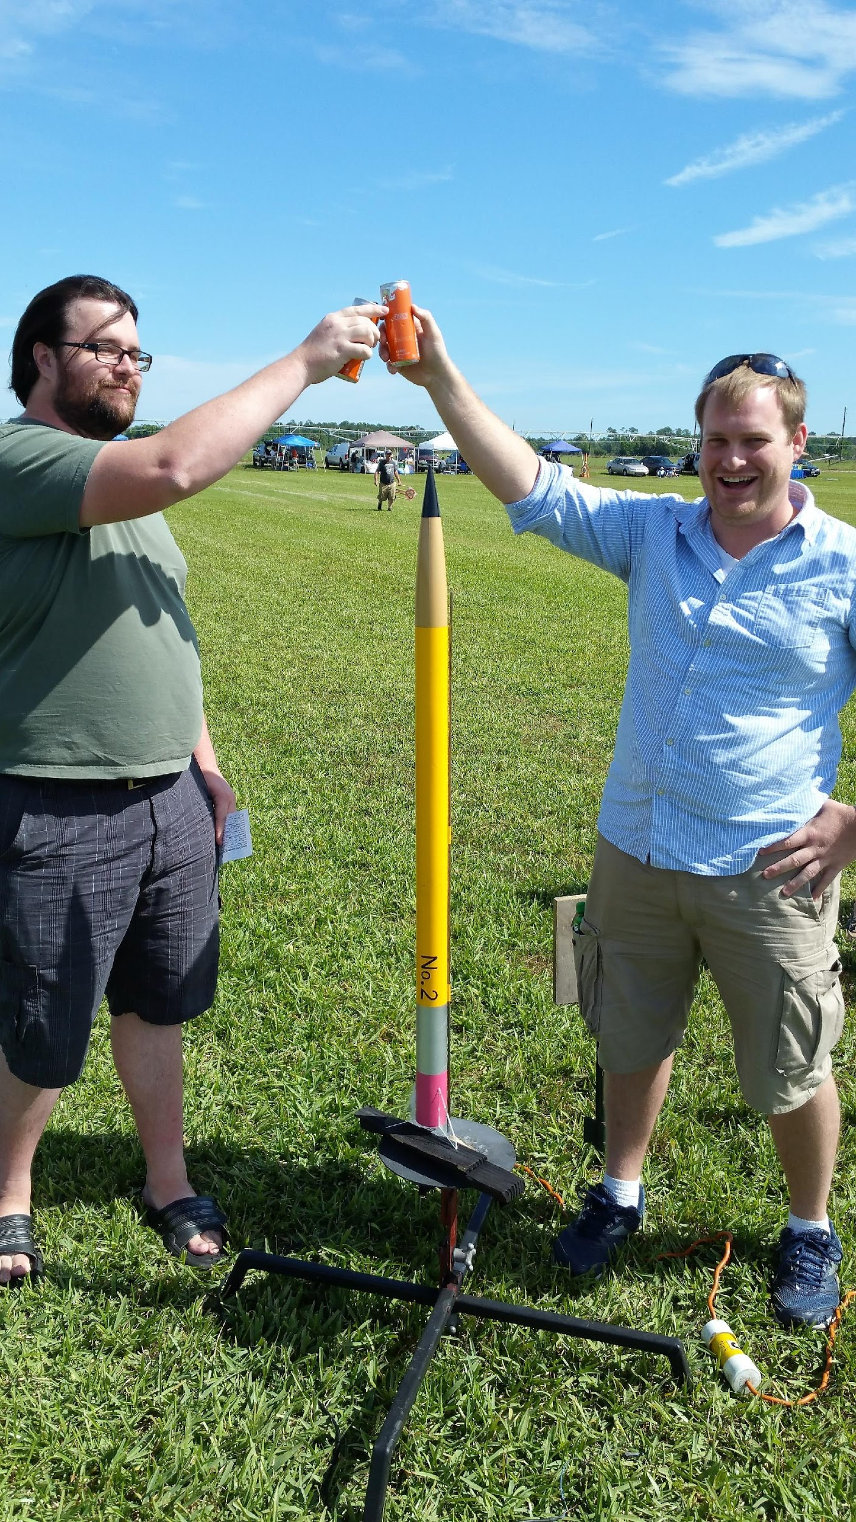
About Us
Roger Allen
Mechanical Engineering Major
Engineering Student Assistant to The Office of The Assistant Vice President of Facilities and Safety and Director of Sustainability Initiatives
AIAA UCF Rocket Lead
Spring 2016 Rocket Design Champ
ucf.aiaa+rockets@gmail.com

Slide 4
About Us
Carson Mills
Mechanical Engineering Major
AIAA UCF Rocket Lead
Spring 2016 Rocket Design Champ
ucf.aiaa+rockets@gmail.com

Slide 5
Rocket Assistant Lead Position
Apply at
http://goo.gl/252gm7

Slide 6
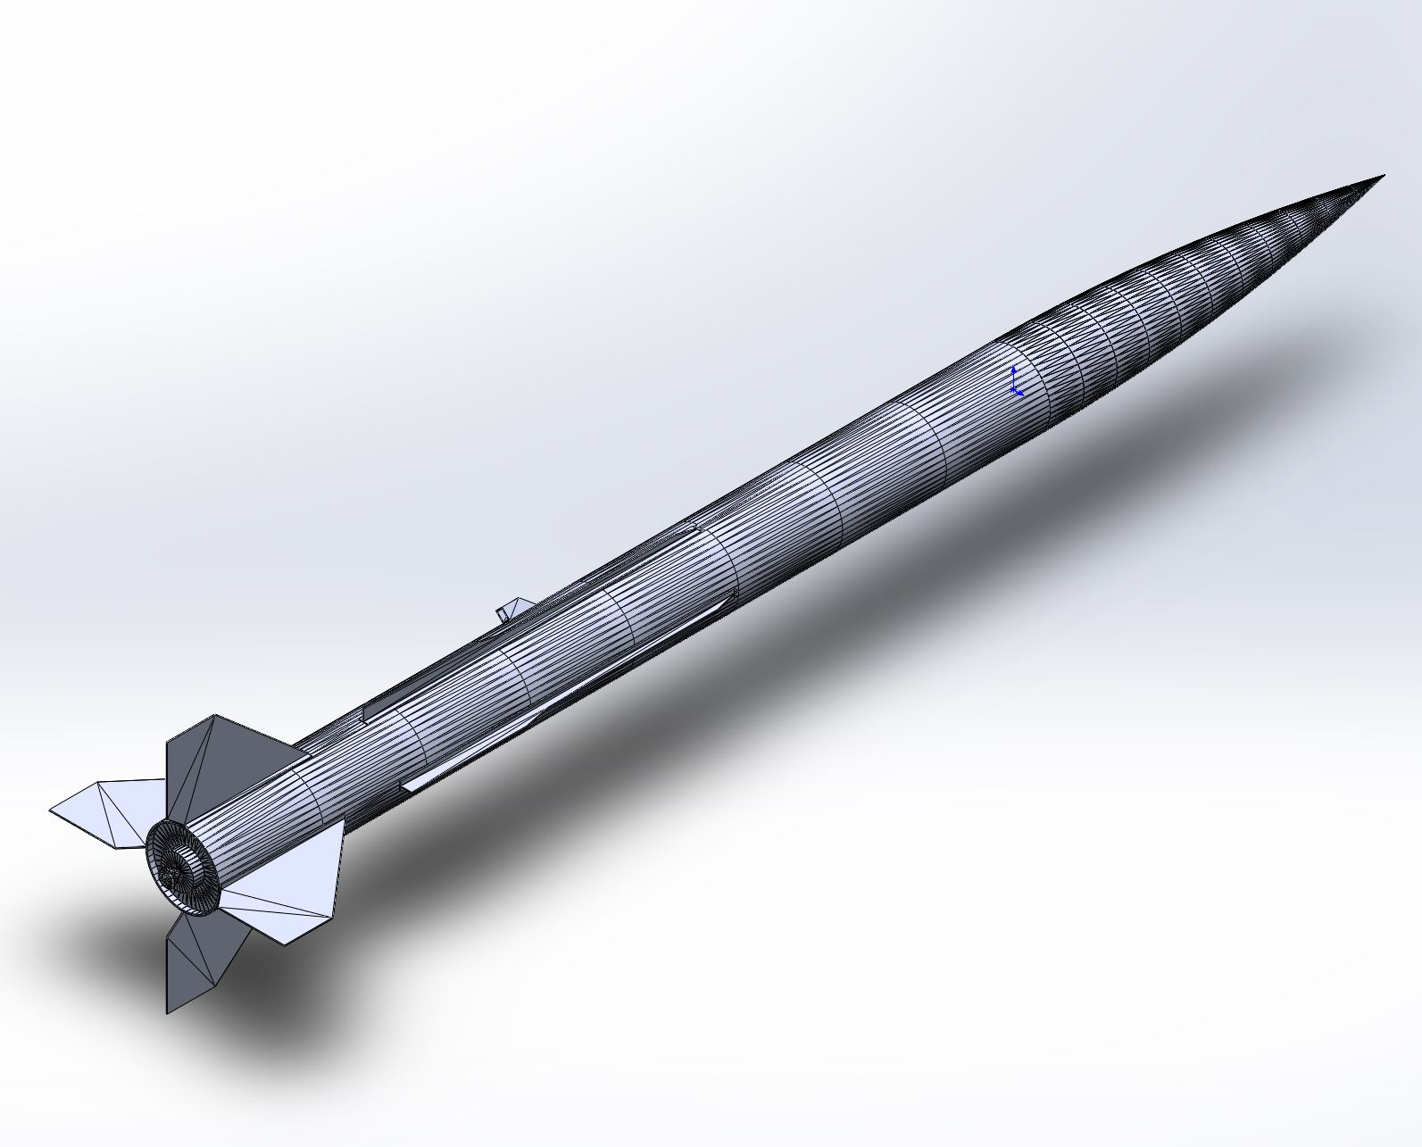
About the Project
9 Week Project
Learn fundamentals of rocket science
Learn CAD skills using SolidWorks
Work in teams to design and build a rocket that must reach max apogee.
Team with the highest adjusted apogee WINS!

Slide 7
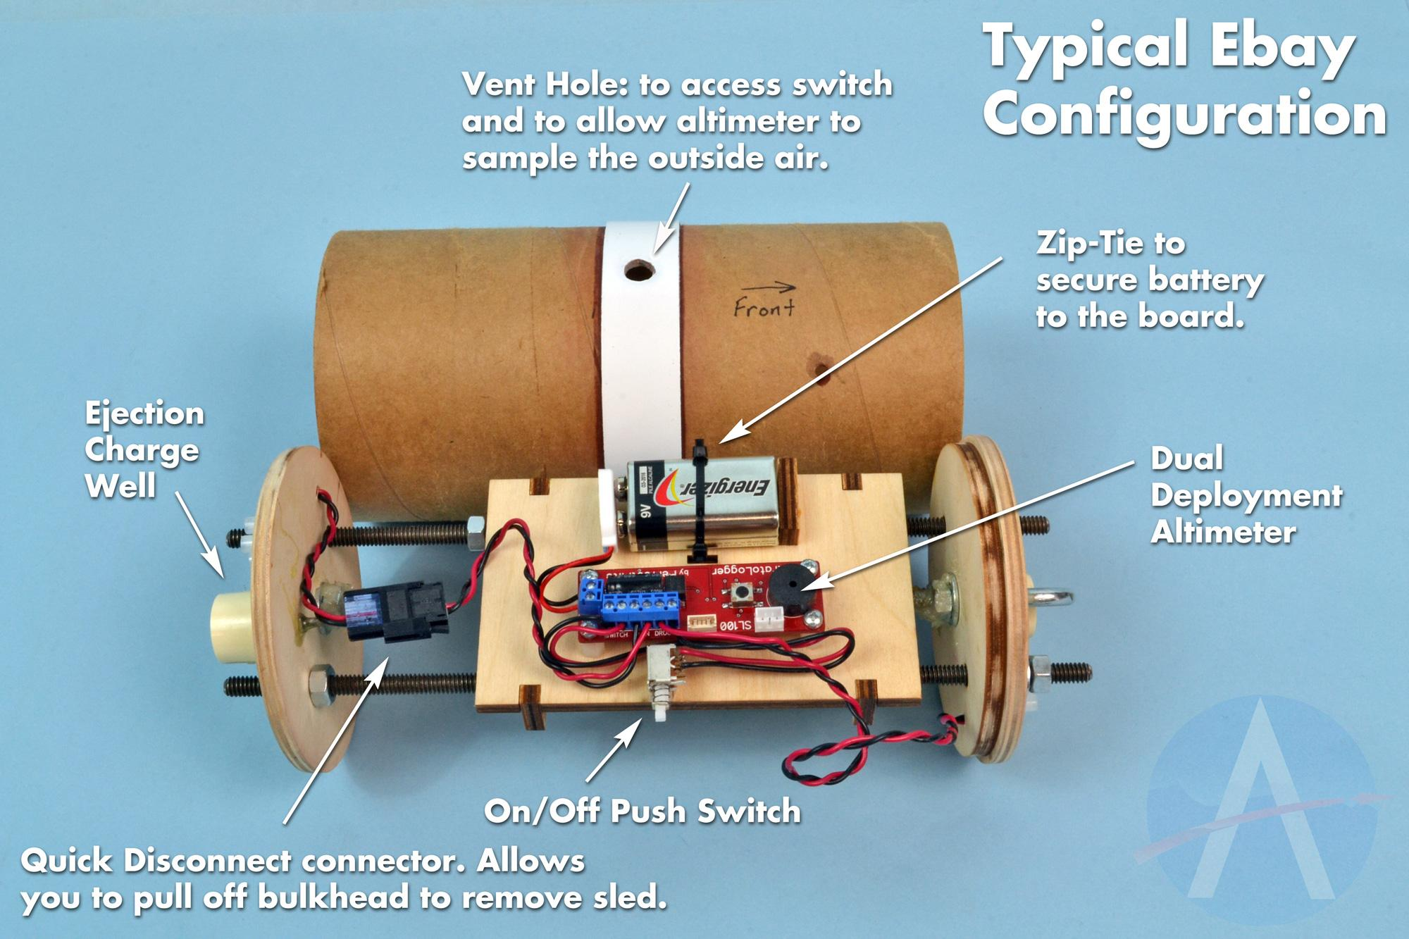
New to the Project
- Electronic Bay with altimeter
- Active parachute deployment
- Payload bay
- Fragile payload MUST SURVIVE

Slide 8
Scoring
15ft penalty per day for missed due dates
10ft Bonus
-FlowSIM
-Stress analysis
-Closest height prediction
Highest adjusted apogee with surviving payload will win

Slide 9
Tentative Schedule (Subject to Change)
9/30 – SolidWorks Rocket Modeling & FlowSIM
10/3 – Construction Concepts
TBA – Field Professional Speaker
TBA – Rocket Development Office hours
TBA – Build Times
Meet Mondays & Fridays 6:00-7:00pm
9/12 – Meet n’ Greet/Expectation/Groups
9/16 – Fundamentals of Rocket Science
9/19 – Rocket Equations
9/23 – Stability
9/26 – OpenRocket & Fins in SolidWorks

Slide 10
Due Dates (Subject to Change)
Open Rocket File 10/7
SolidWorks & Fin Design 10/7
Apogee Calculations 11/11
Extra Credit
Flow Simulation 11/11
Stress Analysis 11/11
Closest Prediction 11/12
Physical Rocket & Payload Bay must be completed by 10:00 pm on November 11th.
Awards for 1st place
Award for Best in Show

Slide 11
Software
OpenRocket http://openrocket.sourceforge.net/
SolidWorks my.cecs.ucf.edu

Slide 12
Any Questions?

