Slide 1
Chap 6 Bones & Skeletal Tissue
Homework: Read Chap 6. Study all the bone markings (pg. 159) & labeling practices well. Review all notes.
Learning Objectives:
1.Compare & contrast the structure of the 4 bone classes and provide examples of each class.
2. Explain the functions of bones.
3. Describe the gross anatomy of bone. Indicate the locations and functions of red & yellow marrow, articular cartilage, periosteum, & endosteum.
4. Differentiate the histology between compact & spongy bone.
5. Discuss the chemical composition of bone.

Slide 2
PREDICT
How many bones in the human skeleton?

Slide 3
Brainstorming
Instructions: Working in small groups, without your book, name as many functions as you can in 2 minutes.
Question: What are all the things that our skeleton (or bone) does for us?
Note: There are at least 5 distinct things!

Slide 4
Functions of Bones
Support
Protection
Movement
Mineral storage
Blood cell formation

Slide 5
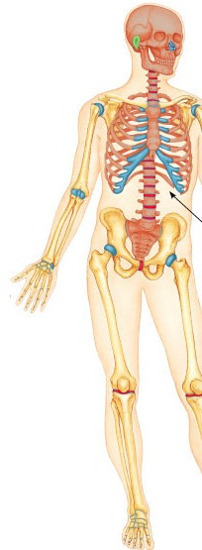
Review (Chap 4)
1. What kind of cartilage makes up the external ear?
A – Elastic cartilage
2. What is the name of the most prominent kind of cartilage found in the costal areas (ribs), nose, shoulders, elbows, etc.
A – Hyaline cartilage
3. What is the name of the thick, pad-like cartilage of the knee and discs between the vertebrae?
A - Fibrocartilage

Slide 6
How Are Bones Classified?
The skeleton is divided into 2 main groups:
a) axial (skull, vertebrae & ribs)
b) appendicular (limbs, shoulder, hip) areas.
From here, bones are further classified by their shape.

Slide 7
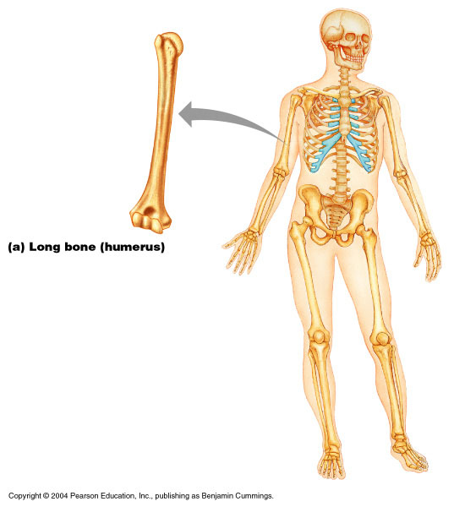
Shape - Long Bones
Long bones – longer than they are wide (e.g., humerus)

Slide 8
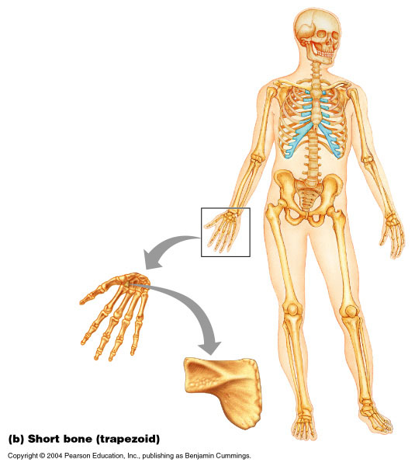
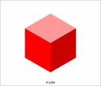
Shape - Short
Short bones
Cube-shaped bones of the wrist and ankle
Bones that form within tendons (e.g., sesamoid bones such as the patella)
patella

Slide 9
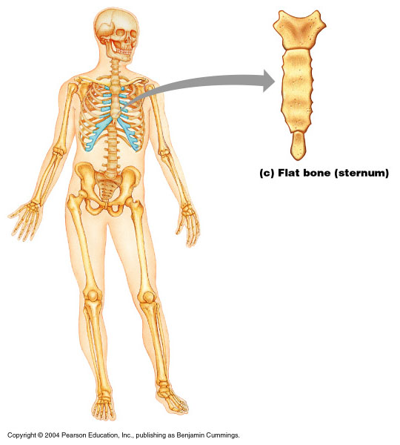
Shape - Flat
Flat bones – thin, flattened, and a bit curved (e.g., sternum, and most skull bones)

Slide 10
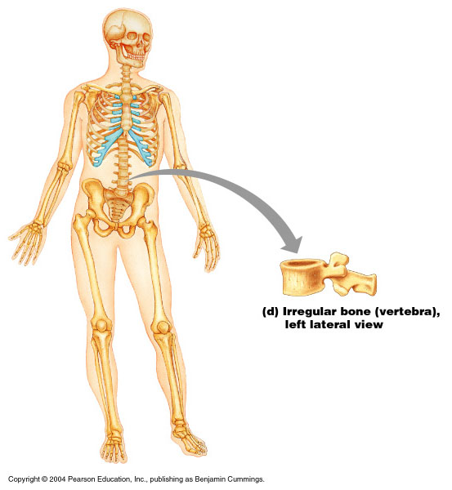
Shape - Irregular
Irregular bones – bones with complicated shapes (e.g., vertebrae and hip bones)

Slide 11
Gross Anatomy of Bones
Rarely smooth
Have projections, depressions, and openings called bone markings

Slide 12
Group Activity: Bone Markings
Instructions:
Work together in small groups of 3 to complete the information.
Goal: To become more familiar with bone markings (projections, depressions, openings)
Time Estimate: 30 minutes

Slide 13
Bones continued
Learning Objectives continued:
6. Identify & explain the anatomy of a long bone; understand all associated terms (pg 160)
7. Identify & explain the anatomy of a microscopic cross-section of bone; understand all associated terms (pg 163)
8. Discuss stress on bones & their response (page 170)
9. Explain the 6 common types of fractures (page 172)
Homework: Finish reading Chapter 6. Review all diagrams, notes, class activities, practices, etc. *Be sure you know Table 6.1 Bone Markings BEFORE going into the next chapter.

Slide 14
Warm-Up Activity
Bone Marking | Answer Choices
1. facet | a. An example is the femur – a bony expansion carried on a narrow neck
2. foramen | b. Air-filled cavity lined with a mucous membrane within a bone (as seen in the skull)
3. trochanter | c. Seen on femur – small rounded projection or process
4. process | d. As seen on a vertebrae – sharp, slender pointed projection
5. sinus | e. Seen on the mandible – an armlike bar of bone
6. crest | f. Seen on the pelvis – a narrow ridge of bone less prominent than a crest
7. head | g. Only seen on the femur – a blunt, irregularly shaped process
8. ramus | h. As seen in the ear canal – a canal-like passageway
9. tubercle | i. Rounded articular projection (typically seen on the femur)
10. tuberosity | j. Seen in the eye orbits – a narrow slitlike opening
11. fossa | k. Typically seen on the mandible – a round or oval opening through a bone
12. fissure | l. Seen on the femur – raised area on or above a condyle
13. meatus | m. Found where front teeth insert – a shallow basinlike depression in a bone
14. epicondyle | n. Seen on the costal area of the ribs – a furrow
15. line | o. Typically seen on the iliac – a narrow ridge of bone that is usually prominent
16. groove | p. Seen on the radius – large rounded projection; may be rough
17. spine | q. Typically seen on a vertebrae – a smooth, flat articular surface
18. condyle | r. Any bony prominence
Instructions: Working individually (within Chap 6), use your textbook to locate the correct answers.
Write just the letter of the answer)

Slide 15
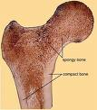
Bone Textures
Compact bone – dense outer layer
Spongy bone – honeycomb of trabeculae filled with yellow bone marrow (internal to the compact bone)

Slide 16
New ‘Long Bone’ Vocabulary
Instructions: Define each term now in your notes (reference pages 160 – 161; also glossary in book may be used if appropriate)
Diaphysis
Medullary cavity
Epiphyses
Epiphyseal line
Periosteum
Osteoblasts
Osteoclasts
Sharpey’s fibers
Endosteum
Diploe
Red marrow

Slide 17
Structure of Long Bones
Long bones consist of a diaphysis and an epiphysis
Diaphysis
Tubular shaft that forms the axis of long bones
Composed of compact bone that surrounds the medullary cavity
Yellow bone marrow (fat) is contained in the medullary cavity

Slide 18
Long Bone continued
Epiphyses
Expanded ends of long bones
Exterior is compact bone, and the interior is spongy bone
Joint surface is covered with articular (hyaline) cartilage
Epiphyseal line separates the diaphysis from the epiphyses

Slide 19
Bone Membranes
Periosteum – double-layered protective membrane
Outer fibrous layer is dense regular connective tissue
Inner osteogenic layer is composed of osteoblasts and osteoclasts
Richly supplied with nerve fibers, blood, and lymphatic vessels, which enter the bone via nutrient foramina
Secured to underlying bone by Sharpey’s fibers (tufts of collagen fibers)
Endosteum – delicate membrane covering internal surfaces of bone

Slide 20
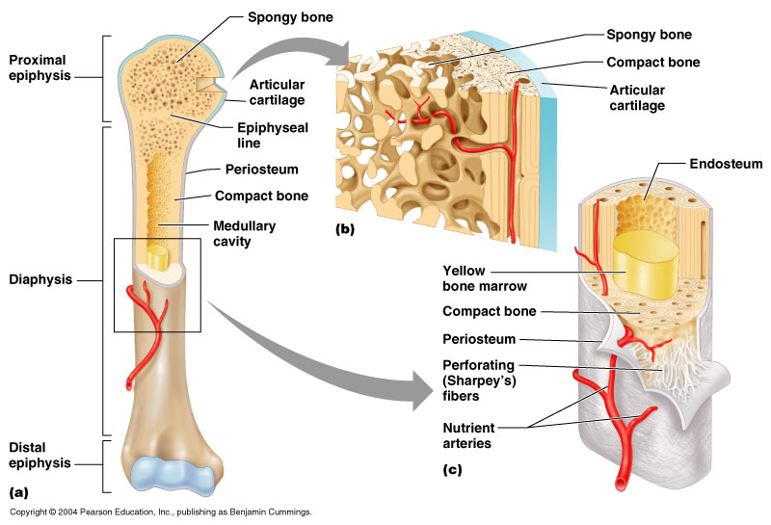
Structure of Long Bone, pg. 160
Practice: Label your diagram.

Slide 21
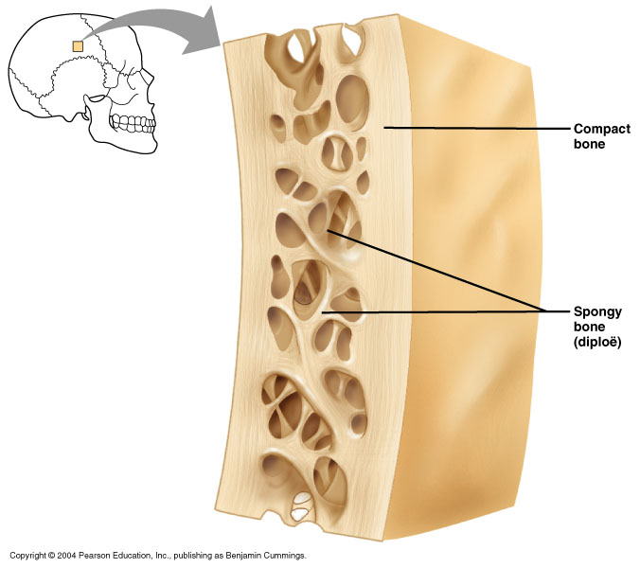
Structure of Short, Irregular & Flat Bones
Thin plates of periosteum-covered compact bone on the outside with endosteum-covered spongy bone (diploë) on the inside
Have no diaphysis or epiphyses
Contain bone marrow between the trabeculae

Slide 22
Where’s Red Marrow?
In infants
Found in the medullary cavity and all areas of spongy bone
In adults
Found in the diploë of flat bones, and the head of the femur and humerus

Slide 23
New Microscopic Bone Terminology
Instructions: Define each term now in your notes. Use pages 161 – 163 or the glossary as appropriate.
Osteon or Haversian system
Lamella
Central (Haversian) canal
Perforating (Volkmann’s) canals
Lacunae
Canaliculi
Interstitial lamellae
Circumferential lamellae

Slide 24
Compact Bone (Microscopic View)
Haversian system or osteon – the structural unit of compact bone
Lamella – weight-bearing, column-like matrix tubes composed mainly of collagen
Haversian, or central canal – central channel containing blood vessels and nerves
Volkmann’s canals – channels lying at right angles to the central canal, connecting blood and nerve supply of the periosteum to that of the Haversian canal

Slide 25
Compact Bone – continued
Osteocytes – mature bone cells
Lacunae – small cavities in bone that contain osteocytes
Canaliculi – hairlike canals that connect lacunae to each other and the central canal

Slide 26
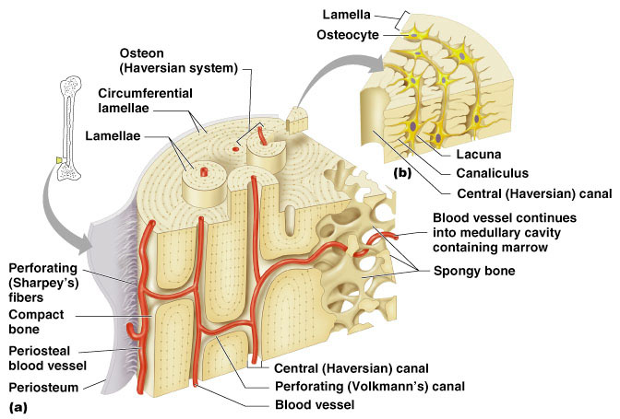
Compact Bone continued, pg 163
Label your practice diagram now.
More About Bone Structure:
http://youtube.com/watch?v=4qTiw8lyYbs

Slide 27
Bone Development
Osteogenesis and ossification – the process of bone tissue formation, which leads to:
The formation of the bony skeleton in embryos
Bone growth until early adulthood
Bone thickness, remodeling, and repair
Begins at week 8 of embryo development
http://www.youtube.com/watch?v=FUjlLIMbCiQ&feature=related

Slide 28
Hormonal Regulation of Bone Growth During Youth
During infancy and childhood, epiphyseal plate activity is stimulated by growth hormone
During puberty, testosterone and estrogens:
Initially promote adolescent growth spurts
Cause masculinization and feminization of specific parts of the skeleton
Later induce epiphyseal plate closure, ending longitudinal bone growth

Slide 29
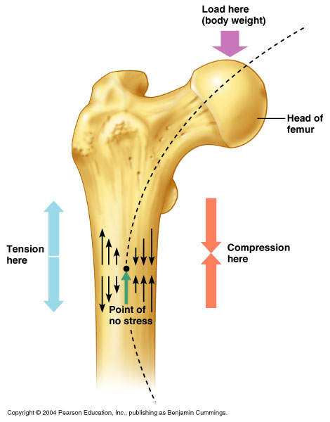
Bone Deposition & Mechanical Stress
Occurs where bone is injured or added strength is needed
Wolff’s law – a bone grows or remodels in response to the forces or demands placed upon it
Trabeculae form along lines of stress
Large, bony projections occur where heavy, active muscles attach
Observations supporting Wolff’s law include
Long bones are thickest midway along the shaft (where bending stress is greatest)
Curved bones are thickest where they are most likely to buckle
About Bone Breakage & Repair:
http://youtube.com/watch?v=qVougiCEgH8

Slide 30
Bone Fractures
Bone fractures are classified by:
The position of the bone ends after fracture
The completeness of the break
The orientation of the bone to the long axis
Whether or not the bones ends penetrate the skin
Practice Activity: Working individually and using Table 6.2 Common Types of Fractures, list and explain the 6 types of common fractures.
Estimated Time: 3 – 4 minutes

Slide 34
Activity: Bone Disorders
Instructions: Work in groups of 3 - 4
The various bone disorders are found on pages 173 – 175 in the 3rd edition. Pg 167 in the 4th edition.
The class will divide into groups. Groups will identify & discuss disorders (i.e., cause(s), symptoms, other pertinent information, etc.)
Disorders:
1. osteomalacia
2. rickets
3. osteoporosis
4. Paget’s disease
Know the disorders for you next test! I may ask a question or two over these.

