Slide 1
Ch 8 - Microbial Genetics, Part 2
Stephanie Lanoue
To better understand transcription and translation in both prokaryotic and eukaryotic cells.
Explore mutations.

Slide 2
Transcription is Next…
What is transcription?
A process that involves transcribing genetic information from DNA to ____
Why do we need transcription?
To produce _________ that are needed
Reminder: DNA is housed within the nucleus of a cell. It controls cellular activity by coding for the production of proteins.
The information in DNA is not directly converted to proteins but first must be copied into RNA (this ensures that the information contained within DNA does not become tainted.

Slide 3
Transcription Overview
It is the first stage of the expression of _________ into proteins.
A mRNA intermediate piece is transcribed from ____ of the strands of the DNA molecule.
The RNA is called mRNA because it carries the ‘message’ or genetic information from the DNA to the ribosomes (where the information is used to make proteins.

Slide 4
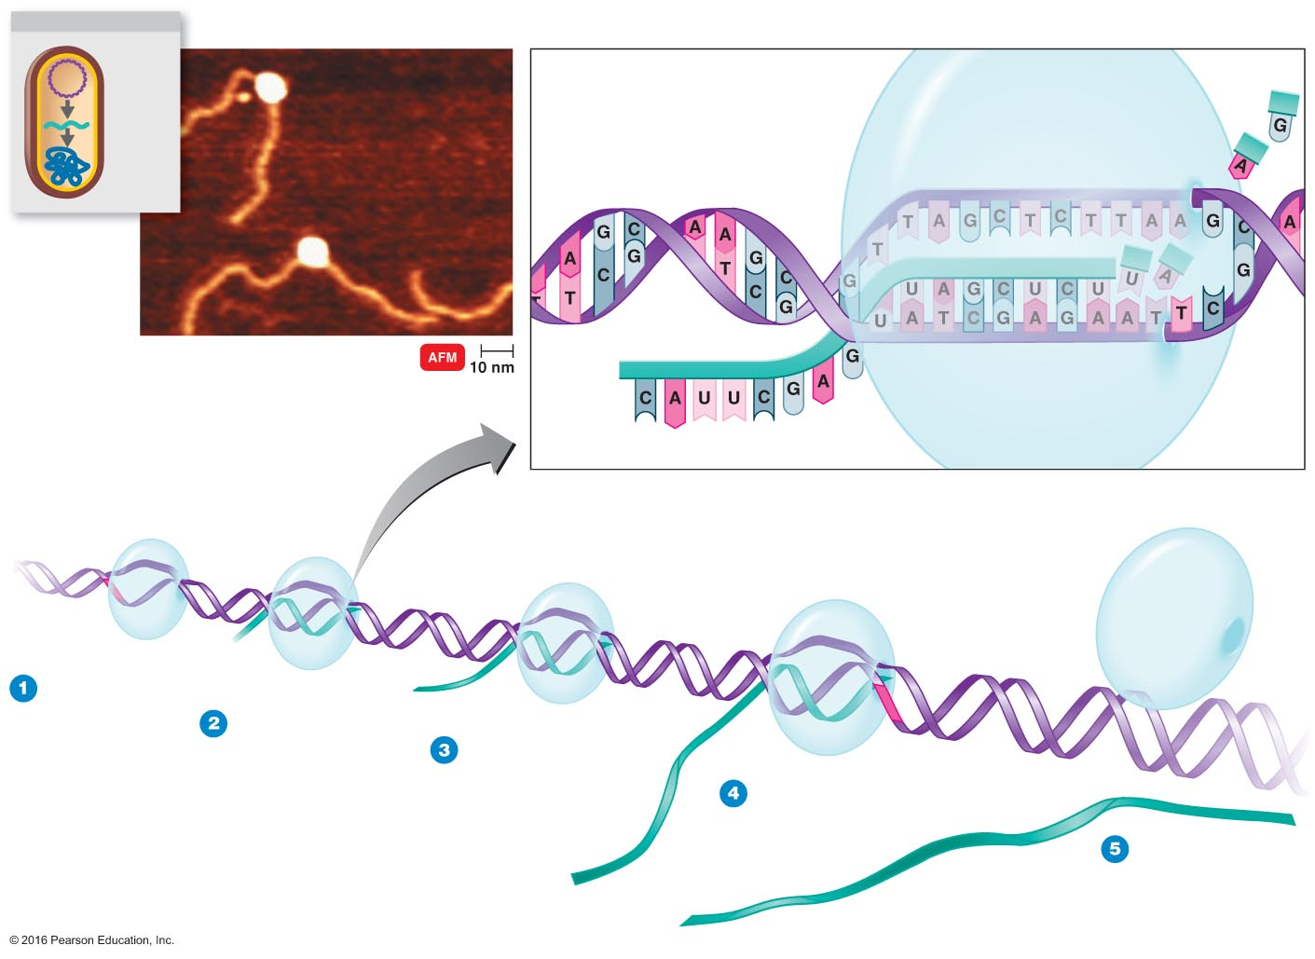
Transcription, cont.
There are __ main steps to DNA transcription.

Slide 5
Translation occurs next
Since proteins are constructed in the cytoplasm of the cell, mRNA must ______ the nuclear membrane to reach the cytoplasm.
Once in the cytoplasm, ribosomes and another RNA molecule called transfer RNA (tRNA) work together to translate mRNA into chains of amino acids (the building blocks of proteins).
This process is ________________.

Slide 6
Translation, cont
We have __________ known amino acids. And all proteins are made up of combinations of these 20 different amino acids. Here are some examples of specific amino acids. Have you ever heard of any of these?
Alanine Phenylalanine Lysine Proline
Threonine Aspartic acid Glycine Leucine
Glutamine Valine Glutamic acid
Trytophan Cysteine
Reminder: Watch video

