Slide 1
Ch 8 - Microbial Genetics, pgs 204 - 233
Stephanie Lanoue
Learning Objectives
8-1 Define genetics, genome, chromosome, gene, genetic code, genotype, phenotype, and genomics.
8-2 Describe how DNA serves as genetic information.
8-3 Describe the process of DNA replication.
8-4 Describe protein synthesis, including transcription, RNA processing, and translation.
8-5 Compare protein synthesis in prokaryotes and eukaryotes.

Slide 2
Genetics and Genes
_________, the study of what genes are, how they carry information, how that information is expressed, and how genes are replicated is very important science these days!
Even “bigger” science is studying ____________
So, have you heard of genomes? What exactly is it? Google now.
Genome – all the genetic information in a cell/ or even an organism
Understanding the genetic material in a cell can help us control cell growth/division, for example
And this could potentially help us control microorganisms more effectively
And possible cure cancers!

Slide 3
Genetics and Genes, cont. - prokaryotes
Biotechnology using genomes is being used right now with microbes!
Scientists can _____ a microorganism’s genome, adding genes that will produce proteins used in treating diseases.
________, used for the treatment of diabetes, is produced in this manner.

Slide 4
Genetics and Genes - Eukaryotes
The Human Genome Project completed in _____ _____ gave us the ability, for the first time, to read nature’s complete genetic blueprint for building a _______ being.
The genomes of any two people are more than 99% the same. Still, the tiny fraction that is different is very important! DNA variations are part of what makes each of us unique:
- color of your eyes, hair and skin
- your risk of disease
- your response to drugs, etc.

Slide 5
Genetics and Genes - Eukaryotes, continued
Your genome is contained in ___ tightly packed bundles (chromosomes) of DNA – 23 from your mother and 23 from your father.
These chromosomes enabled a ___-cell embryo (you) to develop into a 100 trillion celled adult. But DNA isn’t all about growth…
• it instructs cells throughout life telling them how to
respond to the foods you eat
• the germs you encounter
• and the pollutants you are exposed to
It ultimately influences how you age.

Slide 6
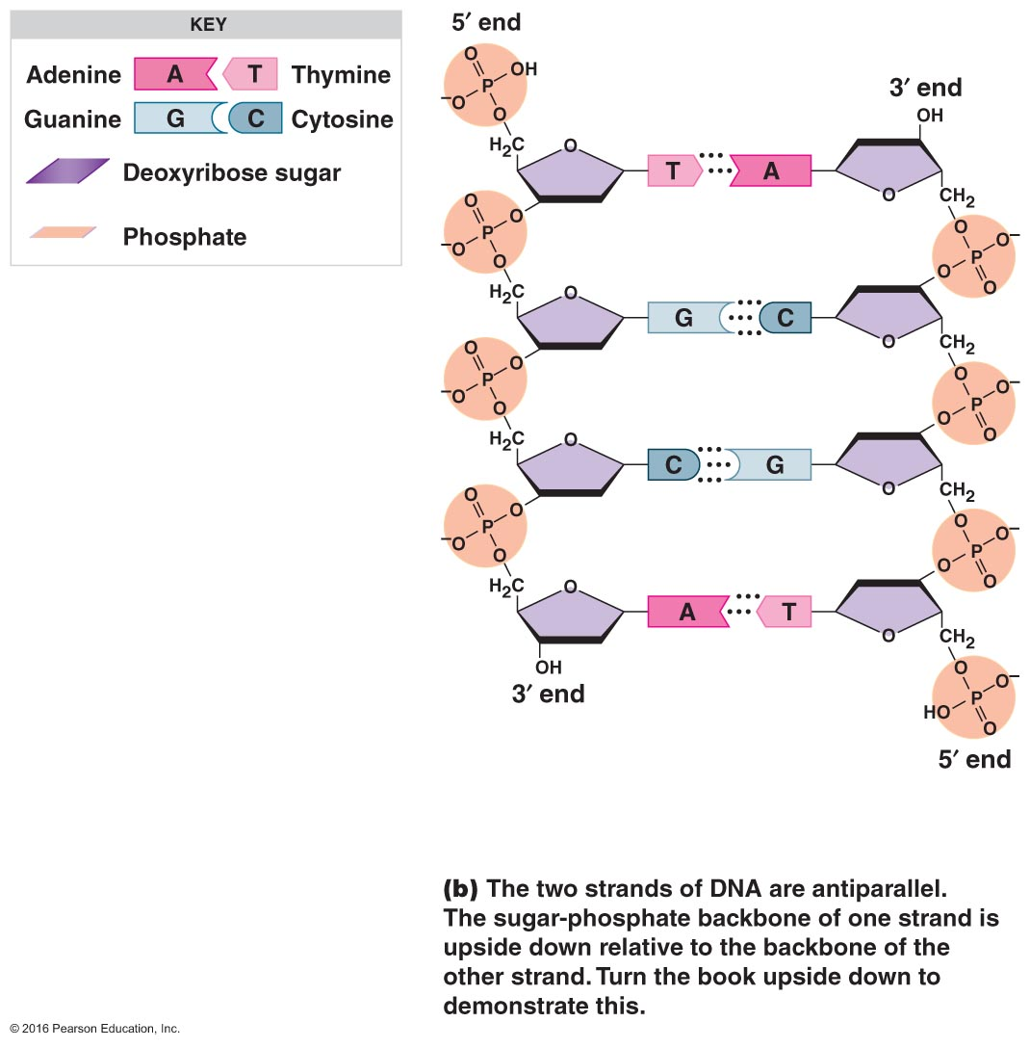
Genetics and Genes - Eukaryotes, continued
To understand DNA’s instruction manual, let’s look at it structure. If you unwind the DNA molecule, it looks like a twisted ________.
DNA is actually made up of ___ smaller molecules:
A ____ carbon sugar called deoxyribose
a phosphate molecule
And four different nitrogenous bases - adenine (A), thymine (T), guanine (G) and cytosine (C) called nucleotides make up the rungs of the ladder.
The backbone is a combination of deoxyribose and phosphate
And you may remember… adenine pairs with cytosine. And guanine with adenine.

Slide 7
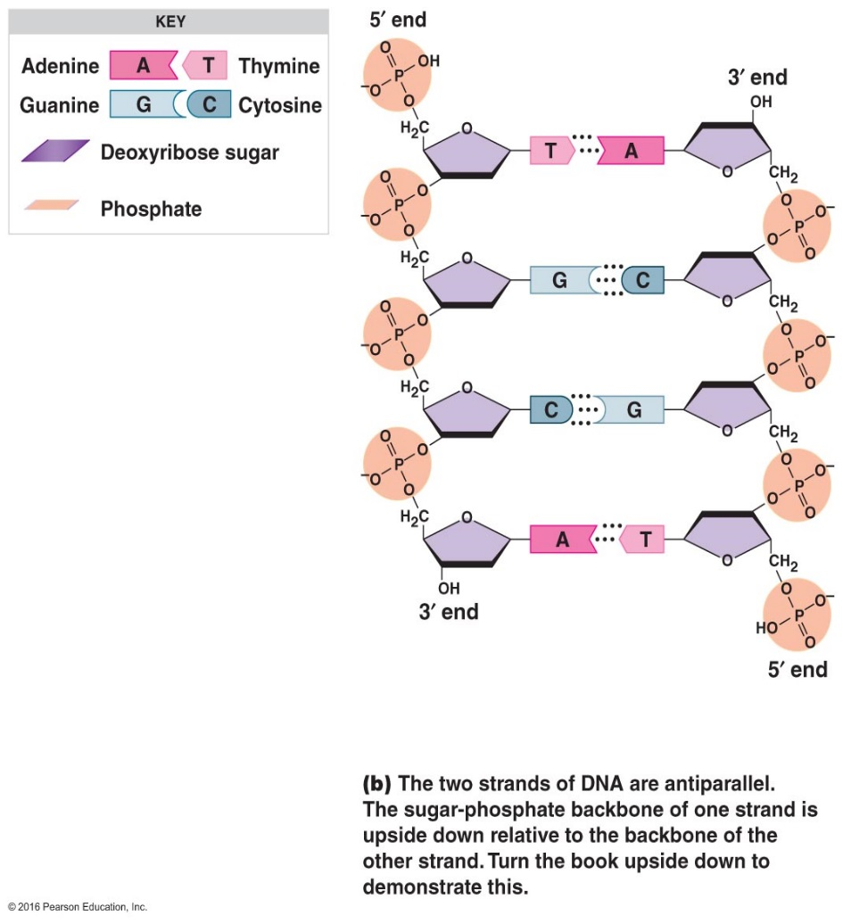
Genetics and Genes - Eukaryotes, continued
Depending on how many of these building blocks are stacked together and the order in which they are arranged, DNA can produce ______ different types of organisms.
It takes about 3 billion pairs of A, C, T and G’s to build a human.

Slide 8
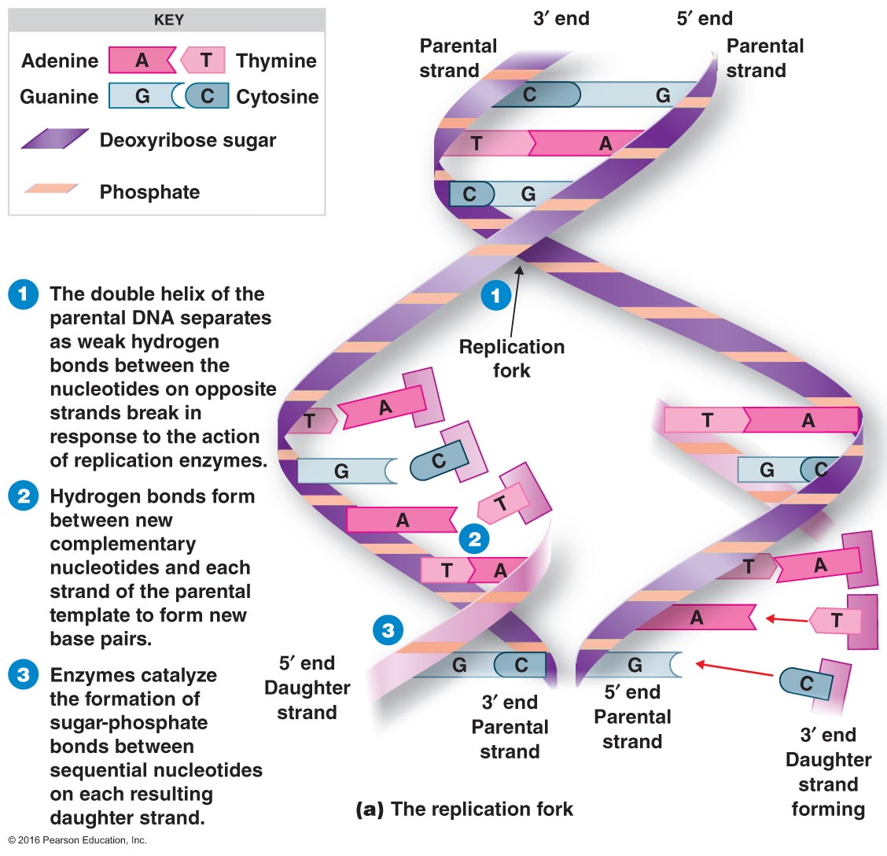
So How does DNA Replicate (Copy itself)?
One strand serves as a _______ for the production
of a second strand
Topoisomerase and gyrase relax the strands
Helicase separates the strands
A replication fork is created
DNA polymerase make new strand of DNA by adding a nucleotide
New strand is complementary strand (A=T and C=G)

Slide 9
Genetics and Genes – Eukaryotes, continued
DNA contains genes. Have you ever heard of genes? What are they? Google now.
Gene - a segment of DNA that encodes a functional product, usually a protein. Also known as traits (hair color, height, etc.)
So, an instruction manual isn’t worth much until it is read and actually used to make something. The same goes for your genome.
A string of DNA is broken down into ___ letter words (codons).
For example: ACG ATT GCC CTA
These words are strung together to make sentences (genes) which tells the cell how to make specific proteins. Because tens of thousands of proteins are needed to make a human, your genome contains about 20, 500 genes.

Slide 10
Genetics and Genes – Eukaryotes, continued
Speaking of proteins, how are proteins made then?
1. A gene’s _____ sequence is transcribed into a molecule called messenger RNA (mRNA).
2. This molecule leaves the ________ and enters the cytoplasm where it is “read” by ribosomes and the information is used to assemble building blocks (amino acids) into a protein.
Special note: RNA stands for ribonucleic acid. It is a single strand rather than a double like DNA.

Slide 11
The previous slide mentioned RNA…
What is it? How does it differ from DNA?
Ribonucleic acid
_______-stranded nucleotide
5-carbon ______ sugar
Contains uracil (U) instead of thymine (T)
So, these are the pairs in RNA:
A = U
G = C

Slide 12
3 Different types of RNA
Messenger RNA (mRNA): _________ coded information from DNA to ribosomes
Ribosomal RNA (rRNA): integral ______ of ribosomes
Transfer RNA (tRNA): transports amino acids during protein synthesis

Slide 13
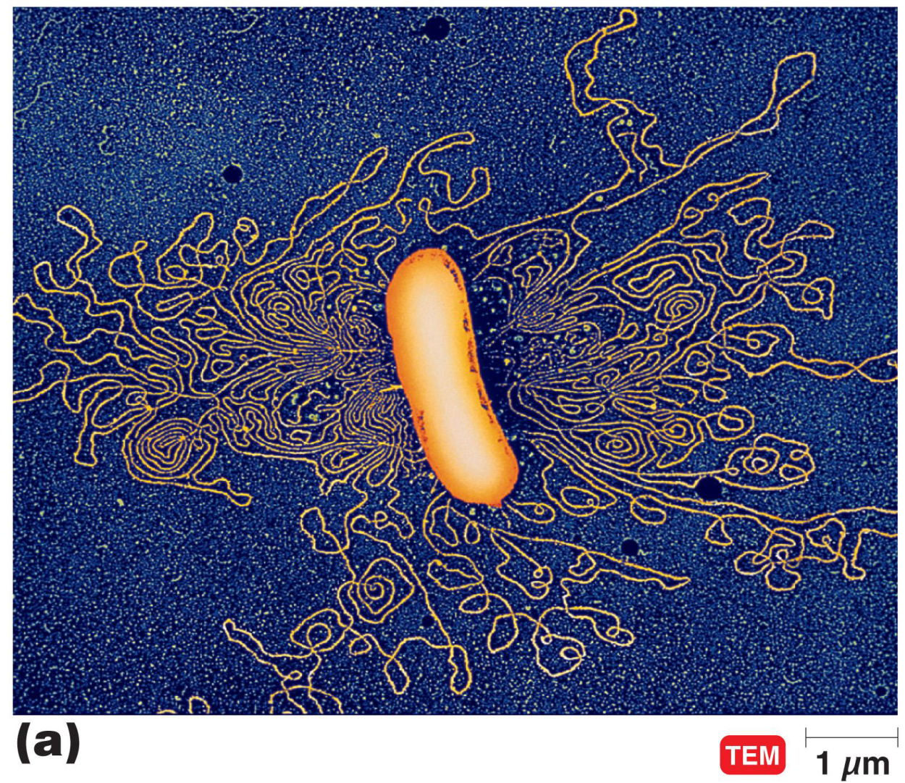
DNA and Chromosomes in Prokaryotes
Bacteria usually have a ________ circular chromosome made of DNA and associated proteins

Slide 14
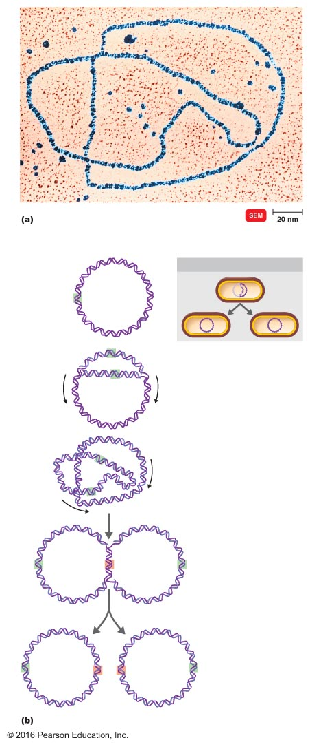
DNA Replication - prokaryotes
Replication fork
Most bacterial DNA replication is ___directional
Each offspring cell receives ____ copy of the DNA molecule
Replication is highly accurate due to the proofreading capability of DNA polymerase
Mistake 1 in every 10 billion bases
DNA polymerase, proofread
An E. coli chromosome in the process of replicating
REPLICATION
Origin of
replication
Parental
strand
Daughter
strands
Replication
fork
Replication
fork
Replication
fork
Termination
of replication
Bidirectional replication of a circular bacterial DNA molecule

Slide 15
Flow of Genetic Information
So, we have talked about replication which is the ______ of genetic information from one generation to the next. But there are two more processes we are going to explore.
1. Transcription, flow of genetic information into mRNA
2. Translation, flow of genetic information to proteins
Stay tuned for part 2…

