Slide 1
Ch 3 Microscopy and Identification of Microbes
Microbiology
Stephanie Lanoue
Objectives for first part of chapter 3:
List the units used to measure microorganisms.
Diagram the path of light through a compound
microscope.
3. Define total magnification and resolution.

Slide 2
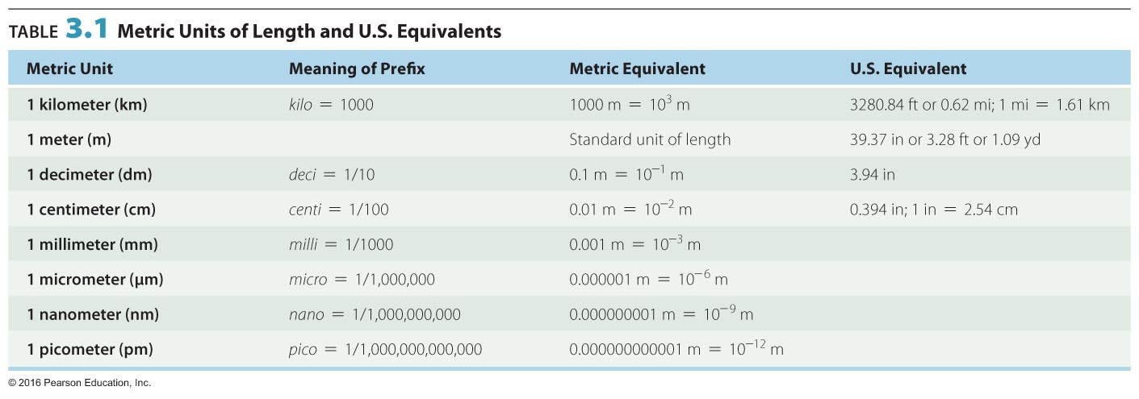
Do You Know The Metric System? Do You Recognize the Abbreviation µm?
__________________ are measured in micrometers (μm) and nanometers (nm)
1 µm = 10^{–6} m = 10^{–3} mm
1 nm = 10^{–9} m = 10^{–6} mm
1000 nm = 1 µm
0.001 µm = 1 nm

Slide 3
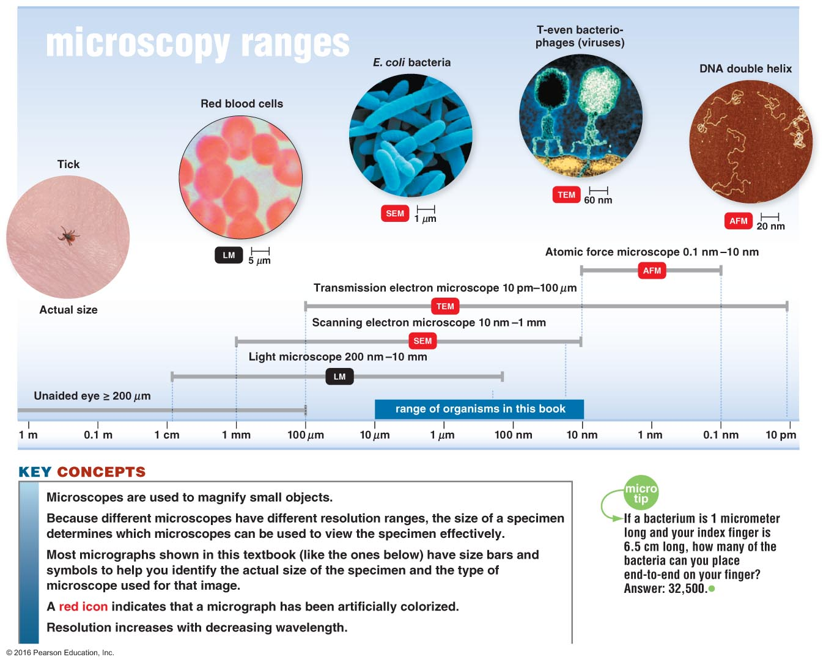
Figure 3.2 Microscopes and Magnification.

Slide 4
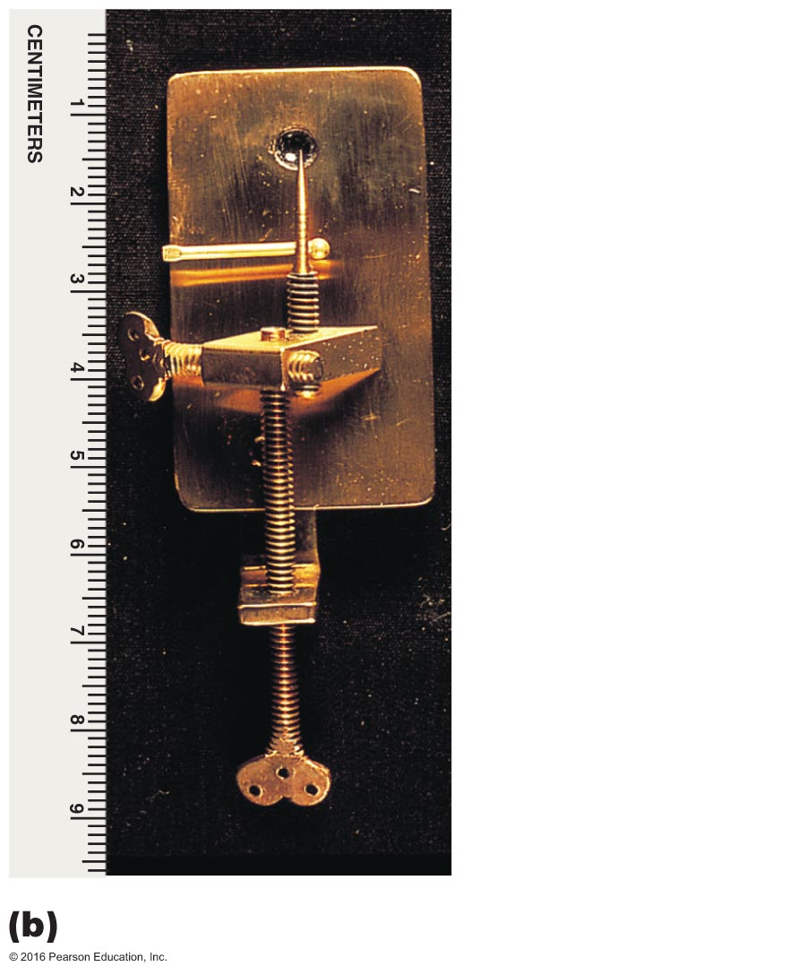
Figure 1.2b Anton van Leeuwenhoek's microscopic observations.
First microscope
Van Leeuwenhoek
A simple microscope
the light passes through only a single lens.
Lens
Location of
specimen on pin
Specimen-
positioning screw
Focusing control
Stage-
positioning screw
Microscope replica

Slide 5
Key Words
Resolution
Ability of ______ to distinguish fine detail and structure
A microscope with a resolving power of 0.4 nm can distinguish between two points at least 0.4 nm apart
Shorter wavelengths of light provide greater resolution
Magnification - making something look _______ than it is
Contrast
Differences in intensity between ____ objects, or between an object and background
Important in determining resolution
Staining increases contrast
Use of light that is in phase increases contrast

Slide 6
What does it mean when a microscope has a resolution of 0.2 nm?
A microscope with a resolving power of 0.2 nm can distinguish between ____ points at least 0.2 nm apart

Slide 7
Types of Microscopes
Light microscopy
uses visible ______ to observe specimens
Electron microscopy
Uses electrons

Slide 8
Types of Light Microscopy
Compound light microscopy
Darkfield microscopy
Phase-contrast microscopy
Differential interference contrast (DIC) microscopy
Fluorescence microscopy
Confocal microscopy
Compound Light Microscopes
Compound
Series of __________ for magnification
Light passes through specimen into objective lens
Oil immersion lens increases resolution
Total magnification = magnification of objective lens X magnification of ocular lens
Most have condenser lens
Direct light through specimen

Slide 9
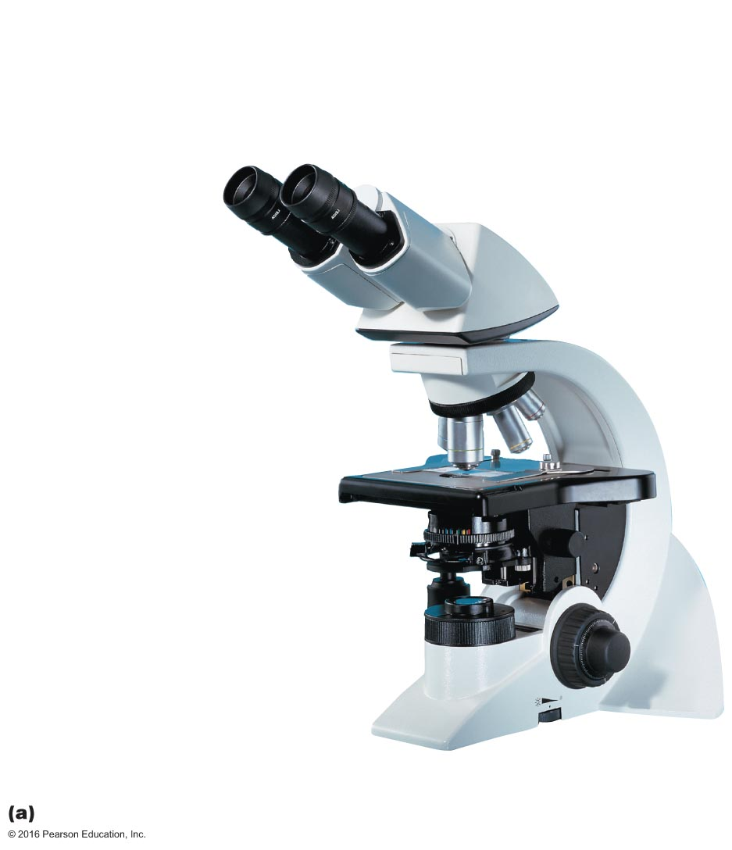
Figure 3.1a The compound light microscope.
Ocular lens
(eyepiece)
Remagnifies the
image formed by
the objective lens
Body tube Transmits
the image from the
objective lens to the
ocular lens
Arm
Objective lenses
Primary lenses that
magnify the specimen
Stage Holds the
microscope slide
in position
Condenser Focuses
light through specimen
Diaphragm Controls the amount
of light entering the condenser
Illuminator Light source
Coarse focusing knob
Base
Fine focusing knob
Principal parts and functions

Slide 10
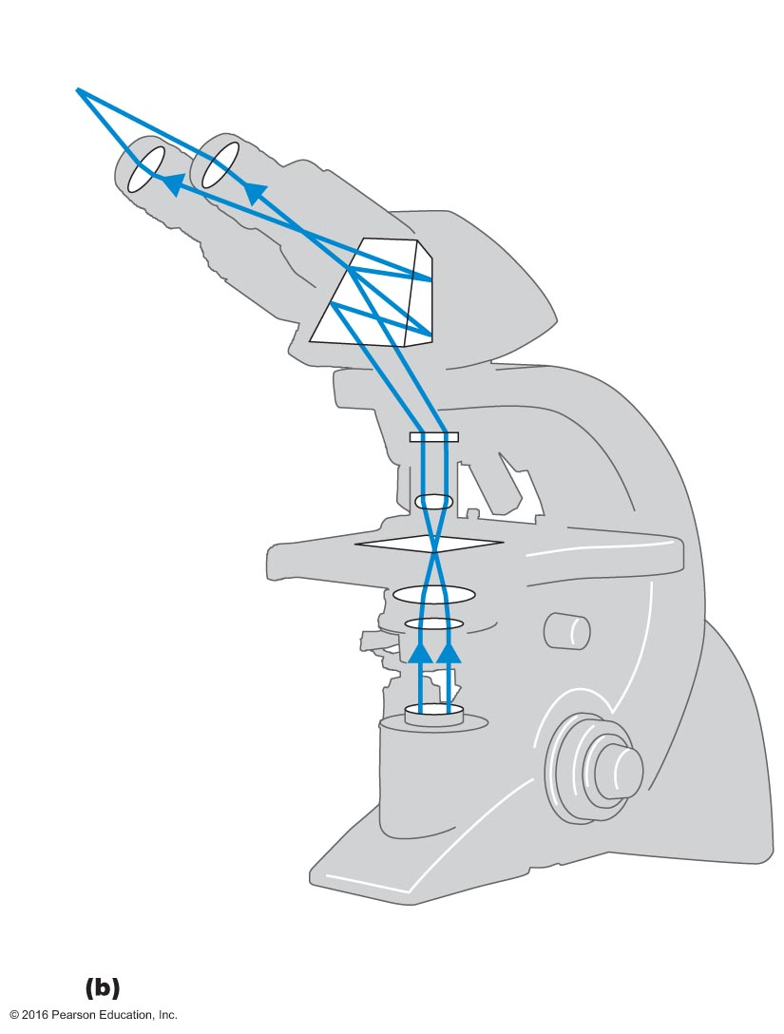
Figure 3.1b The compound light microscope.
Ocular lens
Line of vision
Path of light
Prism
Body tube
Objective
lenses
Specimen
Condenser
lenses
Illuminator
Base with
source of
illumination
The path of light (bottom to top)

Slide 11
Microscopy: The Instruments
Learning Objectives continued
4. Identify a use for darkfield, phase-contrast, differential interference contrast, fluorescence, confocal, two-photon, and scanning acoustic microscopy, and compare each with brightfield illumination.
5. Explain how electron microscopy differs from light microscopy.
6. Identify uses for the transmission electron microscope (TEM), scanning electron microscope (SEM), and scanned-probe microscopes.

Slide 12
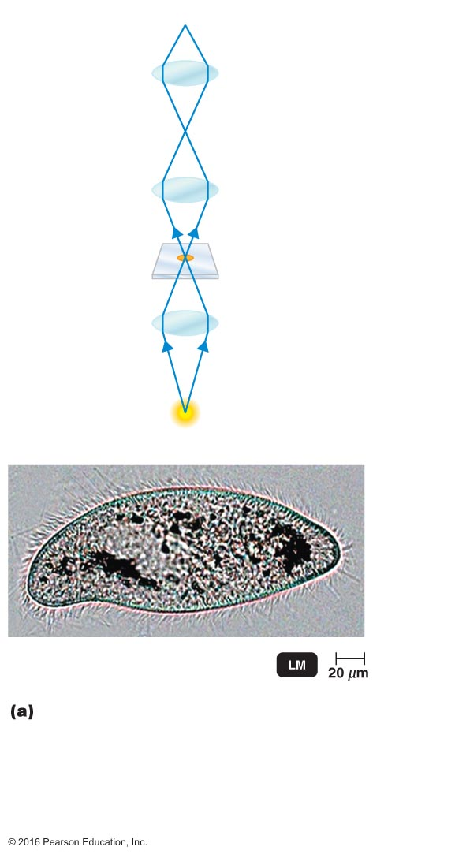
Compound Light Microscopes continued
Brightfield illumination
Dark objects are visible against a bright ________________
Light reflected off the specimen does not enter the objective lens
© 2016 Pearson Education, In.

Slide 13
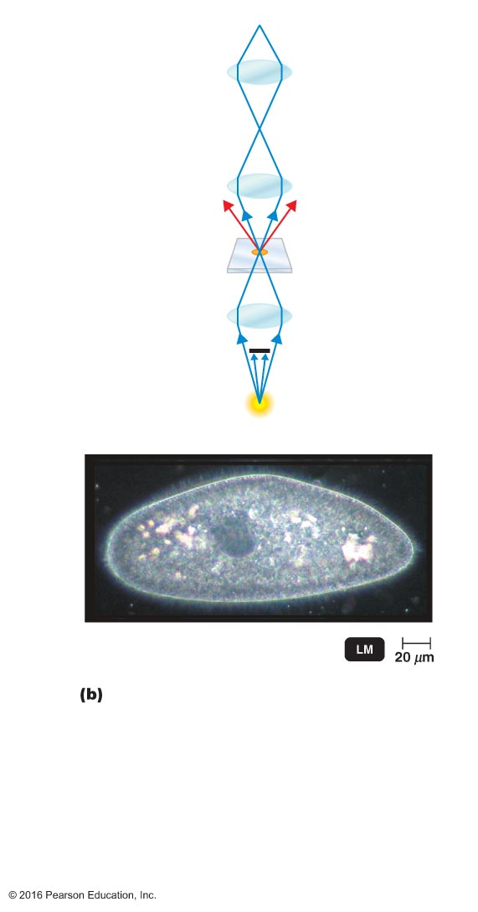
Compound Light Microscopes continued
Dark-field microscopes
Best for observing pale objects
Specimen appears _____ against dark background
Increases contrast and enables observation of more details
© 2016 Pearson Education, In.

Slide 14
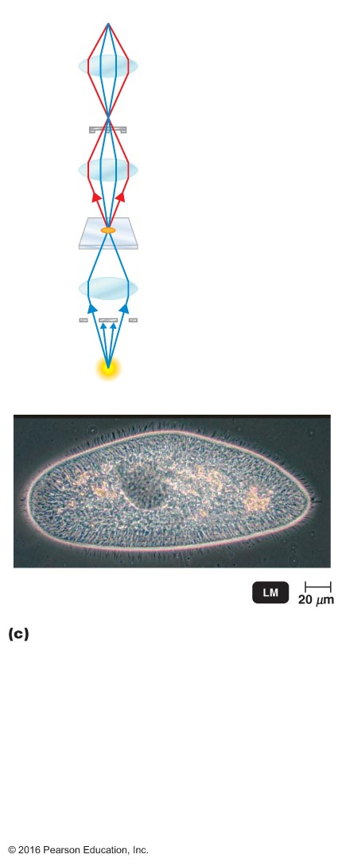
Compound Light Microscopes continued
Phase contrast microscopes
Internal structure of cells become sharply ___________
Examine living organisms
Specimens that would be damaged/altered by attaching them to slides or staining
Light rays in phase produce brighter image, while light rays out of phase produce darker image

Slide 15
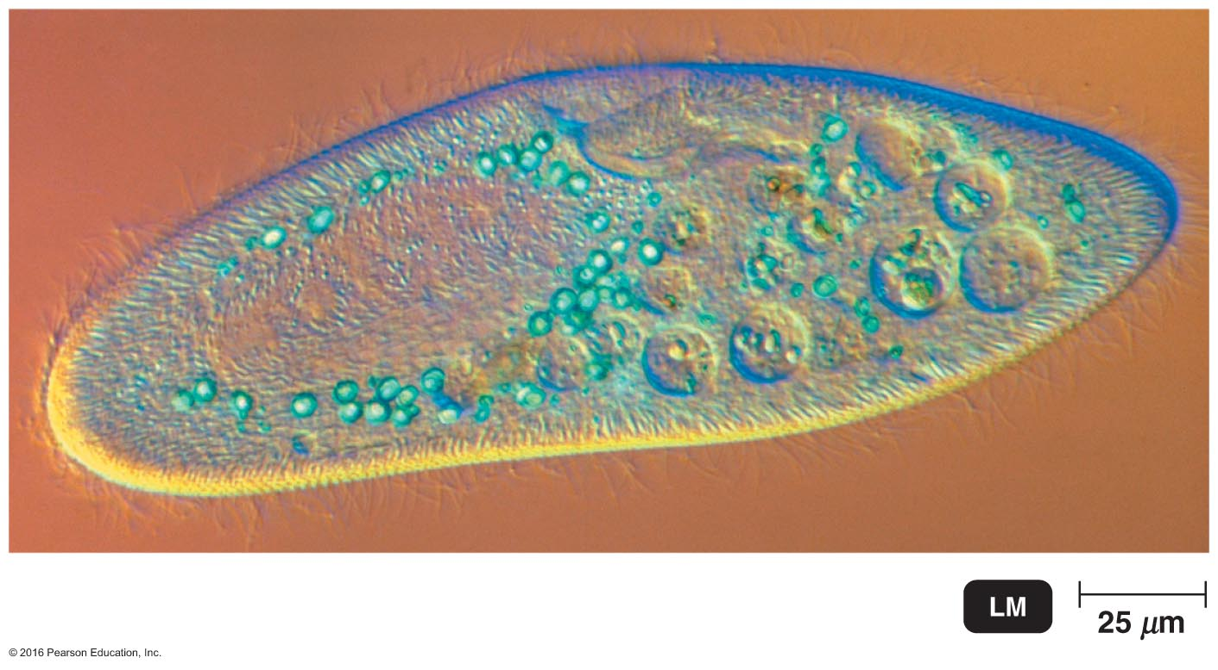
Compound Light Microscopes continued
Differential Interference Contrast (DIC) Microscopy
Similar to phase-contrast
Uses two light beams and prisms to split light beams, giving more contrast and _______ to the specimen
© 2016 Pearson Education, In.

Slide 16
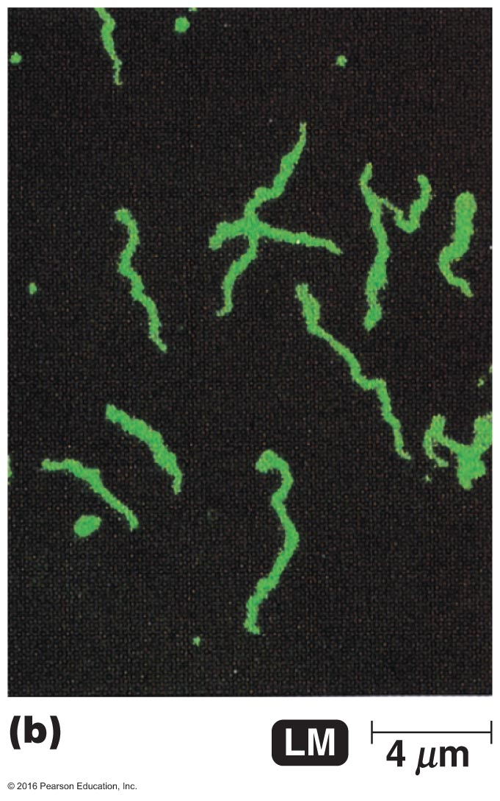
Compound Light Microscopes continued
Fluorescent microscopes
Direct ___ light source at specimen
Specimen absorb short wavelength
Specimen emit long wavelength, visible wavelength

Slide 17
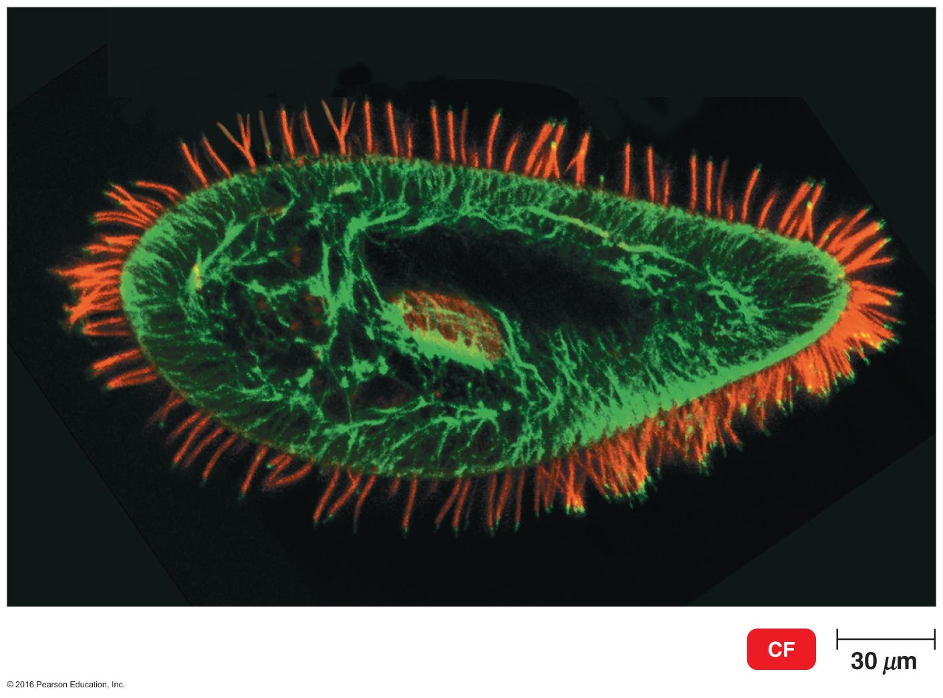
Compound Light cont.
Confocal microscopes
Stain with fluorescent _______
Use UV ______ to illuminate fluorescent chemicals in a single plane
Short-wavelength (blue) light is used to excite a single plane of a specimen
Each plane in a specimen is illuminated and a three-dimensional image is constructed with a computer
Resolution increased
Emitted light passes through pinhole aperture
3-D image from digitized images
© 2016 Pearson Education, In.

Slide 18
Electron Microscopes
Electron microscopy
Uses ________ instead of light
The shorter wavelength of electrons gives greater resolution
Two types
Transmission electron microscopes (TEM)
Chemicals containing heavy metals, staining
Scanning electron microscopes (SEM)
© 2016 Pearson Education, In.

Slide 19
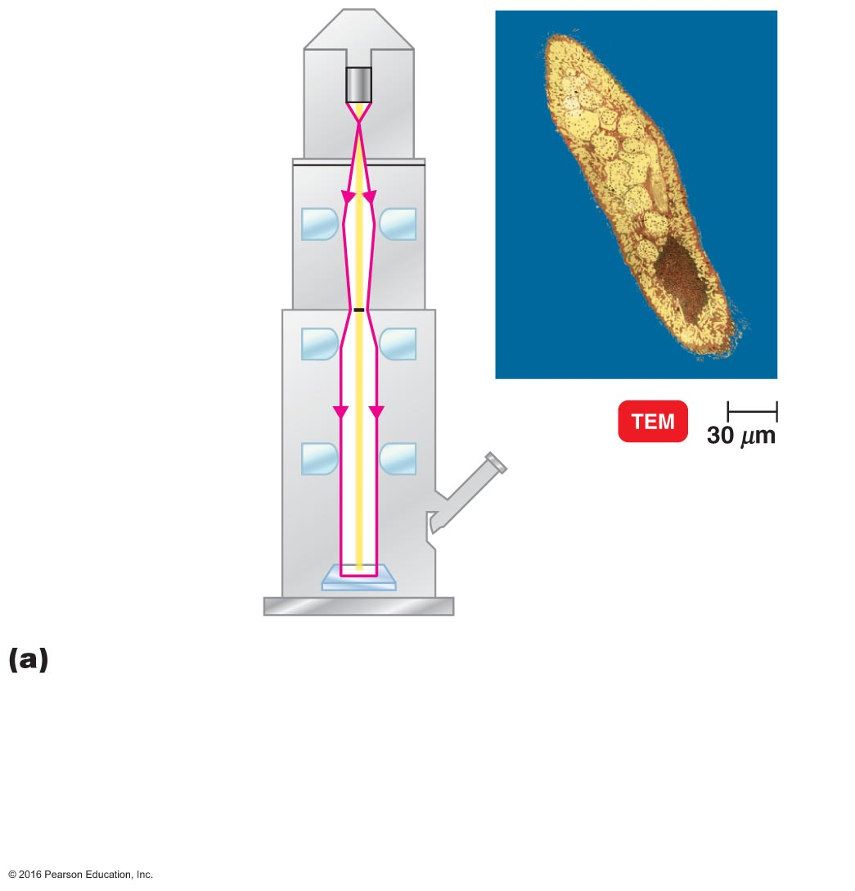
Figure 3.10a Transmission and scanning electron microscopy.
Electron gun
Electron beam
Electromagnetic
condenser lens
Specimen
Electromagnetic
objective lens
Electromagnetic
projector lens
Viewing
eyepiece
Fluorescent screen
or photographic
plate
Transmission. (Left) In a transmission electron microscope, electrons pass through the specimen and are scattered. Magnetic lenses focus the image onto a fluorescent screen or photographic plate. (Right) This colorized transmission electron micrograph (TEM) shows a thin slice of Paramecium. In this type of microscopy, the internal structures present in the slice can be seen.

Slide 20
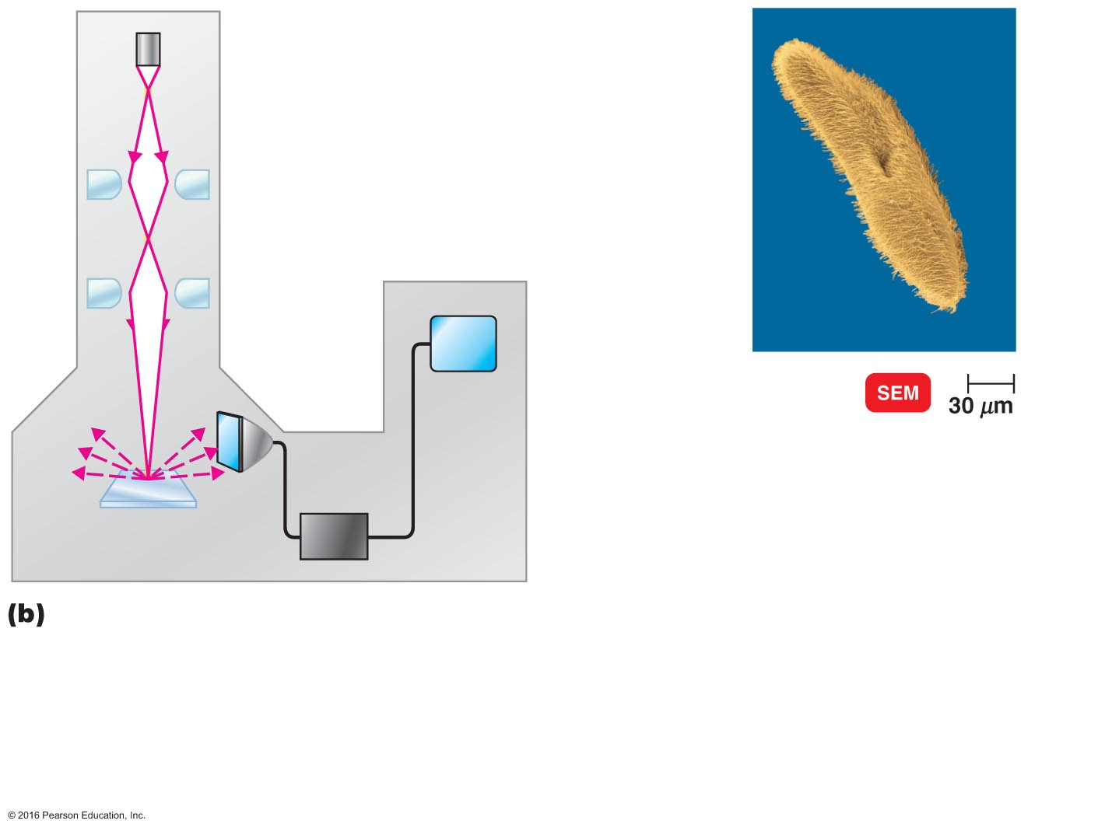
Figure 3.10b Transmission and scanning electron microscopy.
Electron gun
Primary electron beam
Electromagnetic lenses
Viewing
screen
Electron
collector
Secondary
electrons
Specimen
Amplifier
Scanning. (Left) In a scanning electron microscope, primary electrons sweep across the specimen and knock electrons from its surface. These secondary electrons are picked up by a collector, amplified, and transmitted onto a viewing screen or photographic plate. (Right) In this colorized scanning electron micrograph (SEM), the surface structures of Paramecium can be seen. Note the three-dimensional appearance of this cell, in contrast to the two-dimensional appearance of the transmission electron micrograph in part (a).

Slide 21
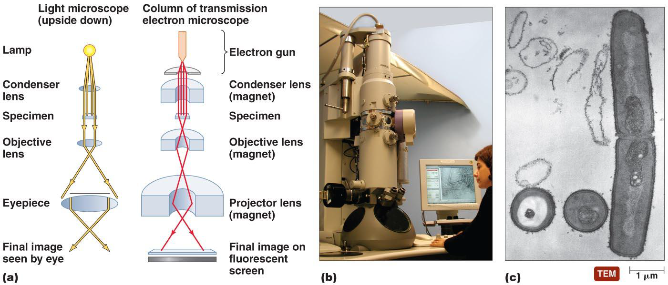

Slide 22
Scanning Electron Microscopy
Magnifies objects 1000 to 10,000×; resolution of ___ nm
Why do electron microscopes have greater resolution than light microscopes? The shorter wavelength of electrons gives greater resolution

Slide 23
Preparation of Specimens for Light Microscopy
Learning Objectives continued
7. Differentiate an acidic dye from a basic dye.
8. Explain the purpose of simple staining.
9. List Gram stain steps, and describe the appearance of gram-positive and gram-negative cells after each step.
10. Compare and contrast the Gram stain and the acid-fast stain.
11. Explain why each of the following is used: capsule stain, endospore stain, flagella stain.

Slide 24
Staining
Staining: coloring microorganisms with a _____ that emphasizes certain structures
Increases contrast and resolution by coloring specimens with stains/dyes
Smear: a thin film of a material containing microorganisms spread over a _______
Microorganisms are _______ (attached) to the slide, which kills the microorganisms

Slide 25
Preparing Smears for Staining
Stains consist of a positive and negative ions, one of which is _______ (chromophore)
In a basic dye, the chromophore is a cation (positive charges)
In an acidic dye, the chromophore is an anion (negative charges)
Staining the background instead of the cell is called ________ staining
© 2016 Pearson Education, In.

Slide 26
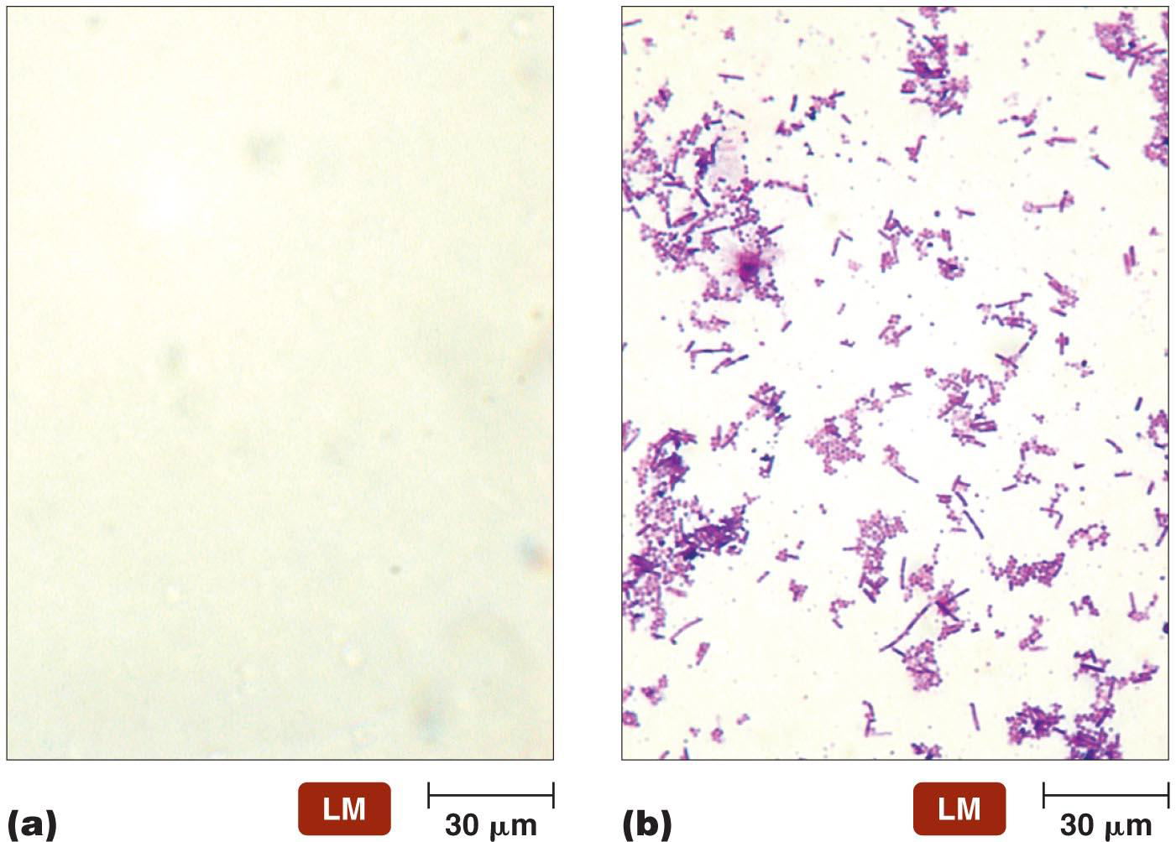
staining
Simple Staining
A _______ staining agent is used
EX. Single basic dyes are frequently used
dyes with positive charges
Ex. crystal violet, methylene blue, safranin, malachite green etc…
Differential Staining
______ than one staining agent is used
divides microorganisms into groups based on their staining properties
Gram stain
Acid-Fast stain

Slide 27
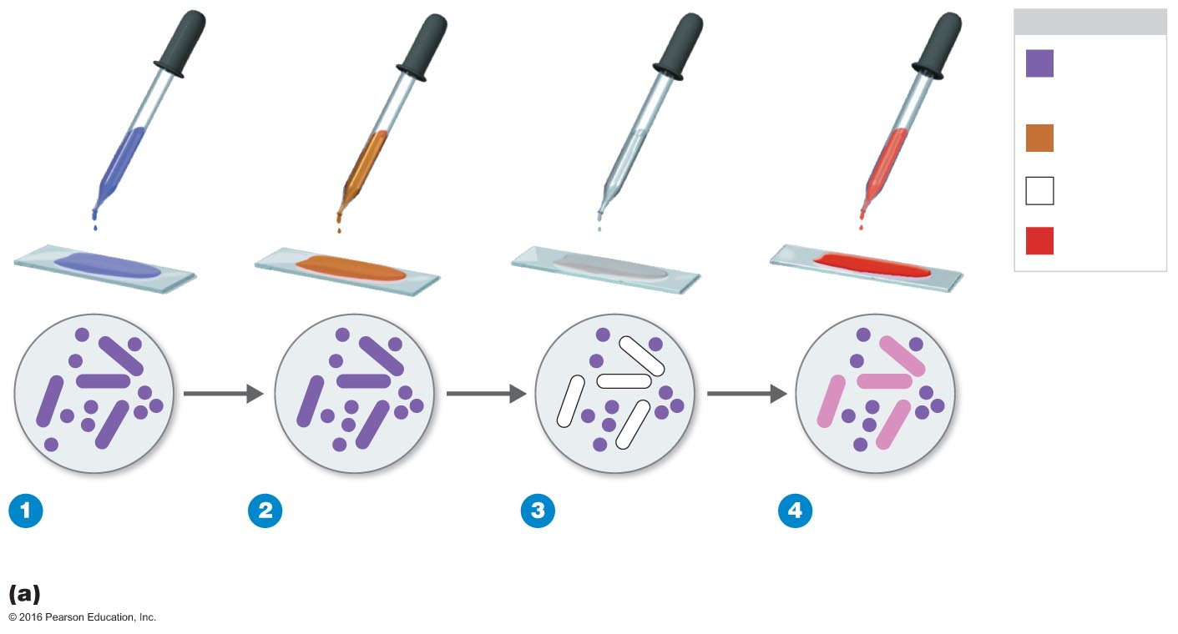
Gram Stain
Classifies bacteria into gram-positive or gram-negative
Gram-positive bacteria have _________ peptidoglycan cell walls
Gram-negative bacteria have ______ peptidoglycan cell walls and a layer of lipopolysaccharides
KEY
Crystal
violet
Iodine
Alcohol
Safranin
Gram-positive
Gram-negative
Application of
crystal violet
(purple dye)
Alcohol wash
(decolorization)
Application
of safranin
(counterstain)
Application of
iodine (mordant)

Slide 28
Acid-Fast Stain
Binds only to bacteria that have a ______ material in their cell walls, which is not decolorized by acid-alcohol
High ______ content in cell walls is responsible for their staining characteristics
Used for the identification of
Mycobacterium
e.g., Mycobacterium tuberculosis – causes tuberculosis
e.g., Mycobacterium leprae – causes leprosy
Nocardia
© 2016 Pearson Education, In.

Slide 29
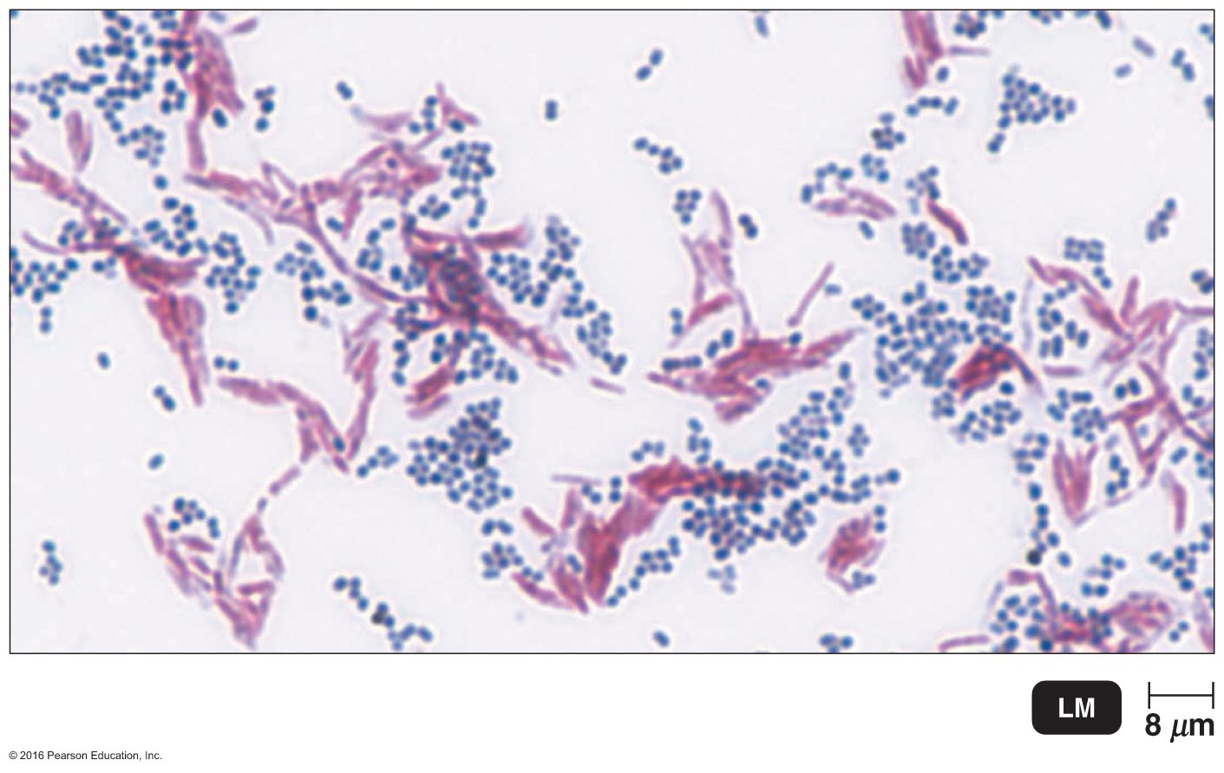
Acid-Fast Stain continued
 | Color of Acid-Fast | Color of Non–Acid-Fast
Primary Stain: Carbolfuchsin | _______ | Red
Decolorizing Agent: Acid-alcohol | Red | Colorless
Counterstain: Methylene Blue | Red | Blue

Slide 30
Special Stains
Used to distinguish ______ of microorganisms
Capsule stain
Endospore stain
Flagella stain

Slide 31
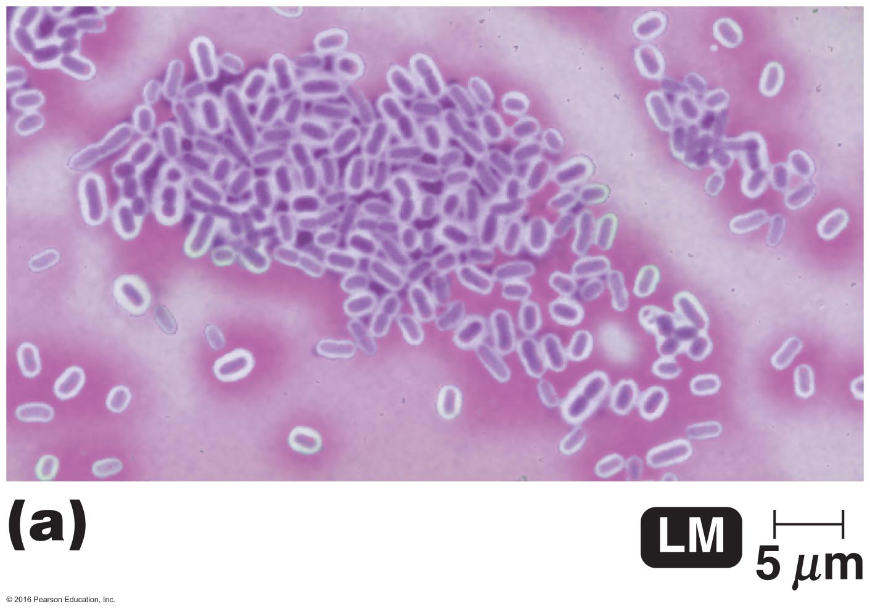
Negative Staining for Capsules
Capsules are a gelatinous covering that do ____ accept most dyes
Suspension of India ink or nigrosin contrasts the background with the capsule, which appears as a halo around the cell
capsule
© 2016 Pearson Education, In.

Slide 32
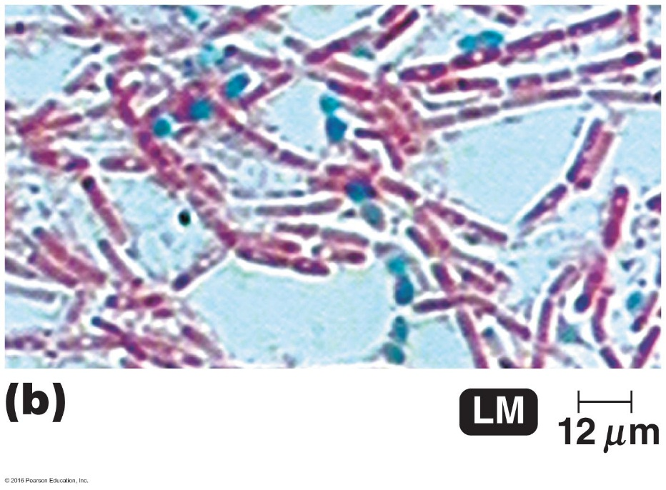
Endospore Staining
Endospores are __________, dormant structures inside some cells that cannot be stained by ordinary methods
Primary stain: malachite green, usually with heat
Decolorize cells: water
Counterstain: safranin
Spores appear green within red or pink cells
endospore
© 2016 Pearson Education, In.

Slide 33
How do unstained endospores appear? Stained endospores?

Slide 34
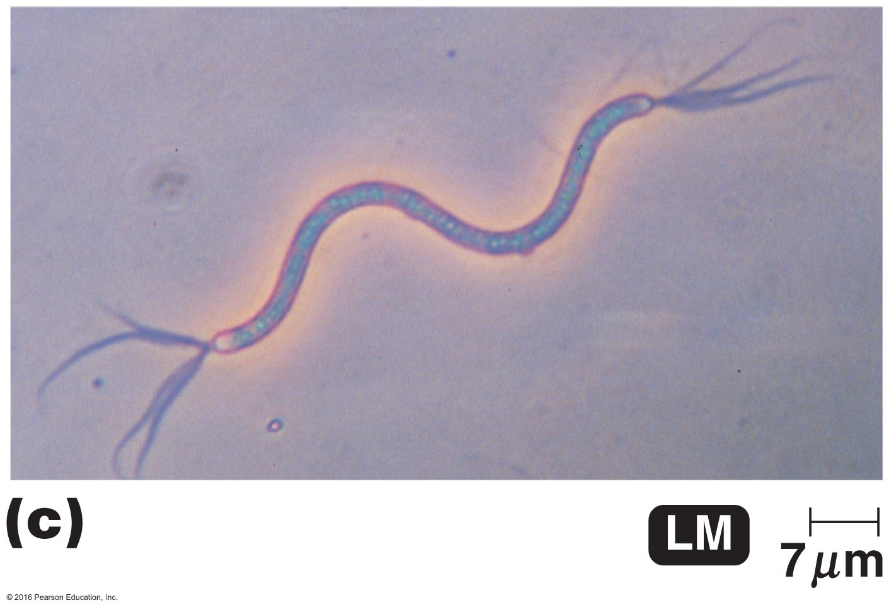
Flagella Staining
Flagella are structures of ______________
Uses a mordant and carbolfuchsin
flagellum
© 2016 Pearson Education, In.

