Slide 1
Ch 1 - Introduction to Microbes
Stephanie Lanoue
Learning Objectives:
1. Explain ways that microbes affect our lives.
2. Recognize the system of scientific nomenclature.
3. Differentiate the characteristics of each group of
microorganisms.
4. State the difference between a prokaryote and a
eukaryote.
5. List the three domains of life.
6. Discuss the brief history of microbiology
including the major discoveries and the
scientists responsible for them.

Slide 2
Opening Discussion Questions
How many of you have taken your kids for vaccinations? If you do not have children, what type of vaccinations have you had?
How many times you have taken antibiotics in the past few years?
Who knows someone who has had a really unusual infection?

Slide 3
ways in which microbes affect our lives
Maintain the ________ of our life in our environment
Industry (yogurt, cheeses, alcohol, vinegar, etc.)
Medical (___________, artificial insulin)
Food chain in oceans
In digestive system
Synthesis some vitamins (B, K)
Digestive flora (E. coli)
Photosynthesis
In soil
Break down waste
Recycling chemical elements

Slide 4
So What Exactly is Microbiology?
Deals with organisms too small to be seen with the ________ eye
smaller that 0.1 mm
Microorganisms (Microbes)
Microscopic organisms such as bacteria

Slide 5
Naming and Classifying of Microorganisms
In 1735, Carolus Linnaeus
Scientific name
Each organism ____ names, italicized
First name, the genus (genera)
Capitalized
Second name, the specific epithet (species)
___________ organism
Staphylococcus aureus (skin)
Staphylo-, clustered arrangement
-coccus, shaped like spheres
Aureus, golden
Honor a researcher
Eschericha coli (colon or large intestine)

Slide 6
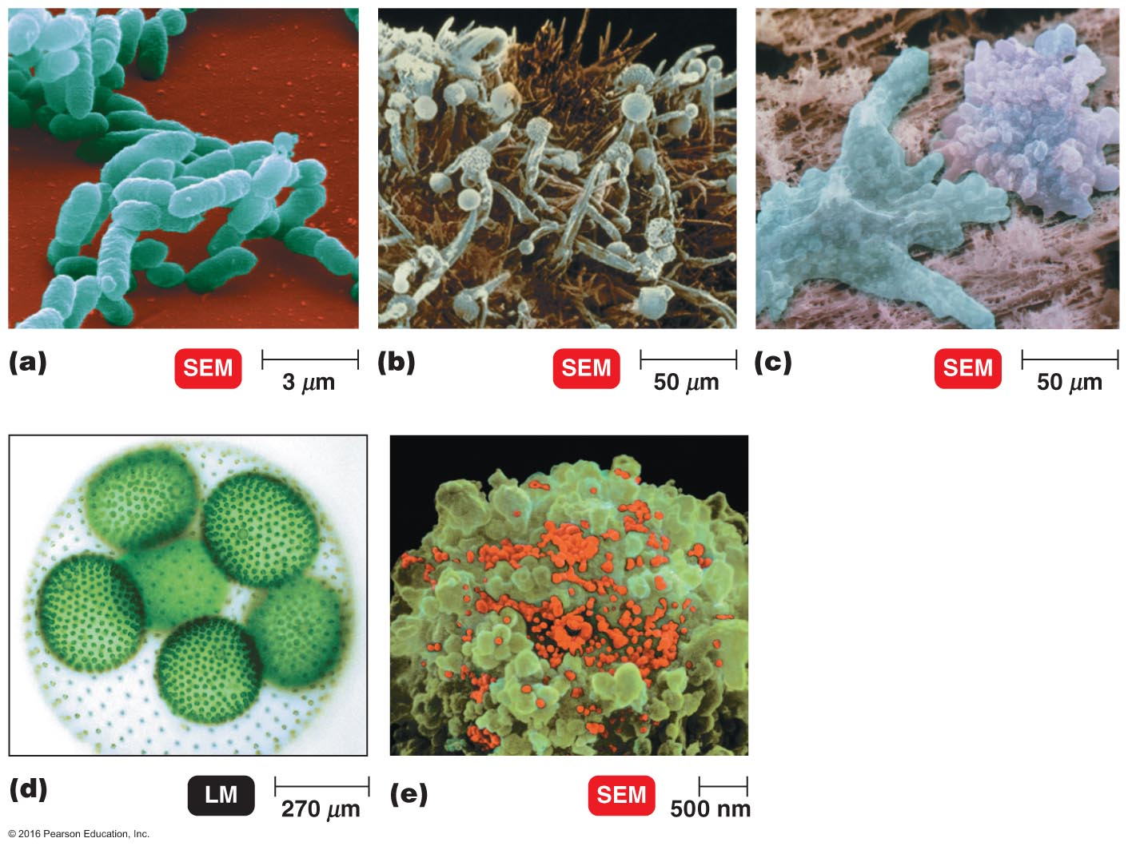
Types of Microorganisms
Bacteria
Archaea
________
Protozoa
________
Viruses
Multicellular Animal Parasites
© 2016 Pearson Education, In.

Slide 7
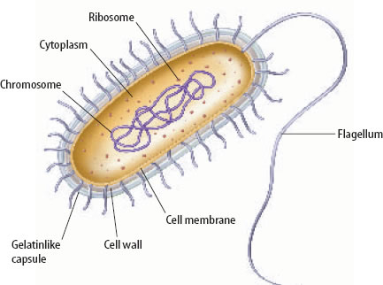
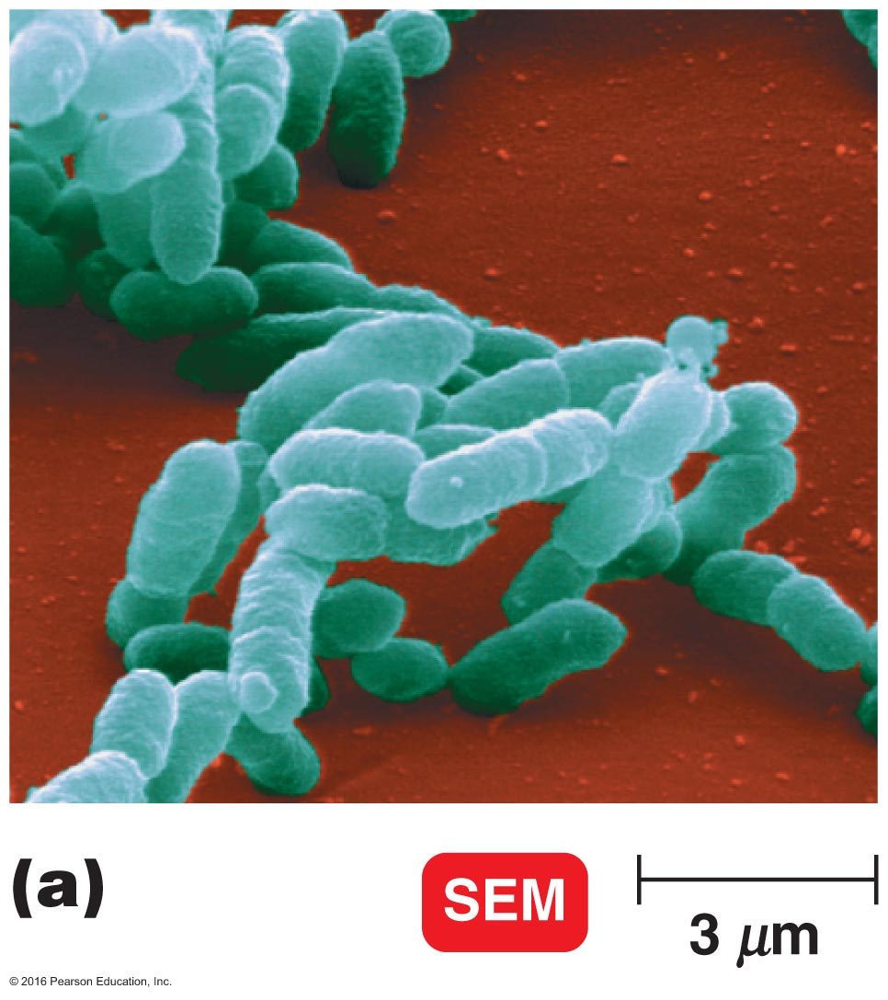
Bacteria
Prokaryotes
“Prenucleus”
_________-celled
Peptidoglycan cell walls
Bacteria reproduction
Divide via binary fission (Dividing into equal cells)
Nutrition
Most bacteria use organic chemical from dead or living organisms
Some bacteria do photosynthesis
Movement
Flagella and cilia
Flagella, a long moving appendage
Cilia, short and high in number

Slide 8
Bacteria Types
Bacteria (singular: bacterium)
Single-celled (unicellular)
Prokaryote
genetic material is ______ enclosed in a special nuclear membrane
Shape
Bacillus (_______ like)
Coccus (spherical or ovoid)
Spiral (crockcrew or curved)
Star shape or square
Arrangement
Pairs
Chains
Clusters
Cell wall
Composed of carbohydrate and protein complex (peptidoglycan)

Slide 9
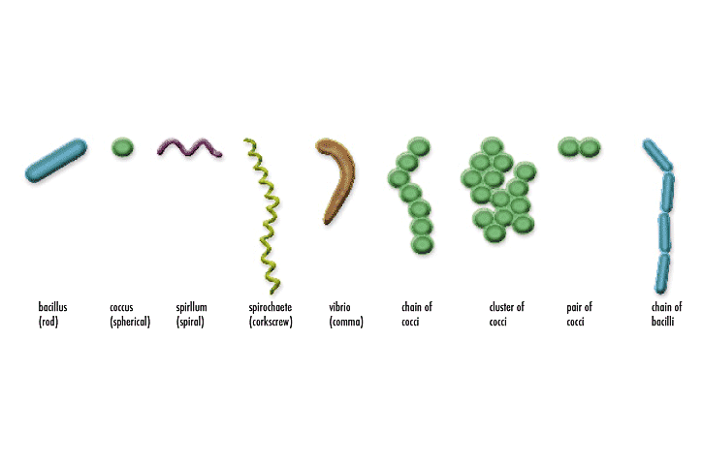
Strepto Staphylo Diplo
http://www.microbiologyonline.org.uk/themed/sgm/img/slideshows/3.1.2_bacteria_1.png

Slide 10
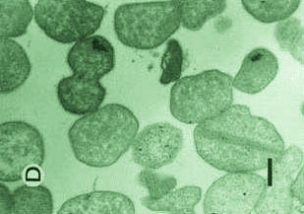
Archaea
Prokaryotes
______ peptidoglycan cell walls
Often live in __________ environments
Three main groups
Methanogens
In respiration, produce methane as a waste
Extreme halophiles (halo = salt, philic = loving)
Salty environment such as Great Salt Lake and Dead Sea
Extreme thermophiles
Hot sulfurous water such as Yellowstone National Park
http://sgugenetics.pbworks.com/f/1301842539/archaea(1).jpg
© 2016 Pearson Education, In.

Slide 11
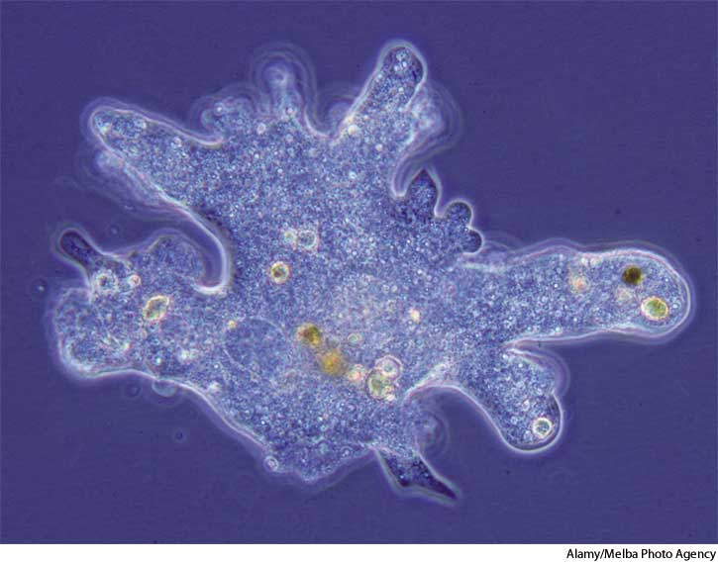
Protozoa
_____cellular
Eukaryote
_______ or ingest organic chemicals
May be Mobile
Pseudopods, extensions of their cytoplasm (amebae)
Flagella
Cilia, shorter appendages
Live
Entities
Parasites
Derive nutrition from living host
Euglena
Photosynthetic
Reproduction, sexually or asexually
http://cf.ydcdn.net/1.0.1.59/images/main/A5amoeba.jpg

Slide 12
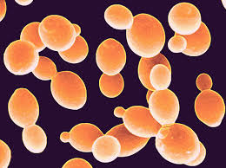
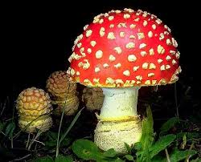
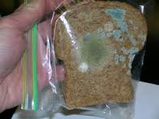
Fungi
Eukaryotes
Have a ________ nucleus containing genetic
material (DNA) surrounded by nuclear
membrane
Cell ______
Chitin (pronounced Ki-tin)
Kingdom fungi
Unicellular
Yeast
Oval microorganisms larger than bacteria
Multicellular
Mushroom or
mold

Slide 13
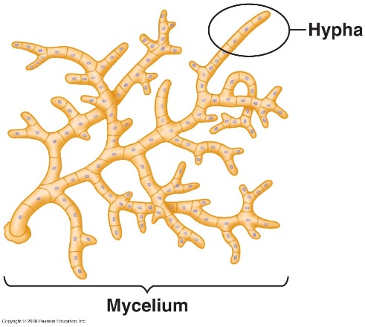
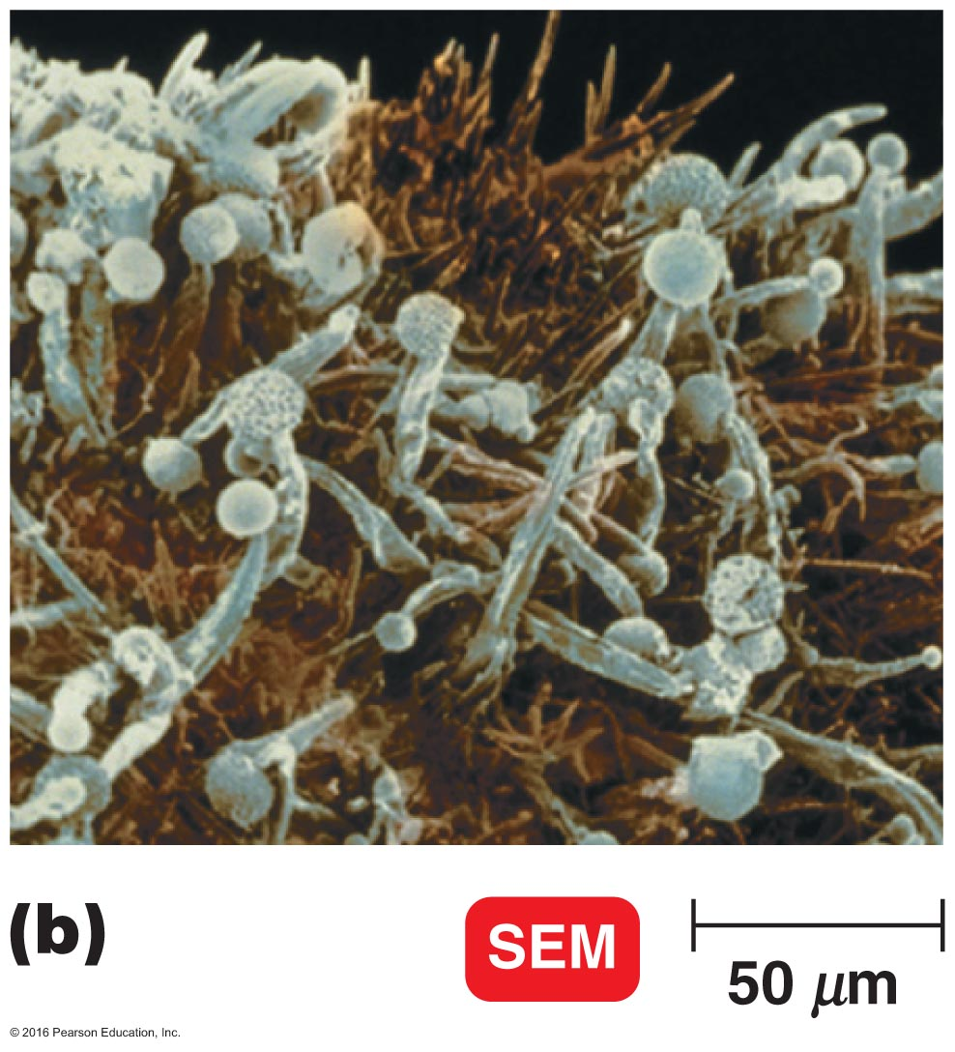
Fungi (cont’d)
Typical fungi
______
Molds consist of masses of mycelia, which are
composed of filaments called hyphae
Cannot carry out photosynthesis
Reproduction
Sexually
Asexually
Nutrients
Organic material from environment
Soil
Water
Animal host
Plant host

Slide 14
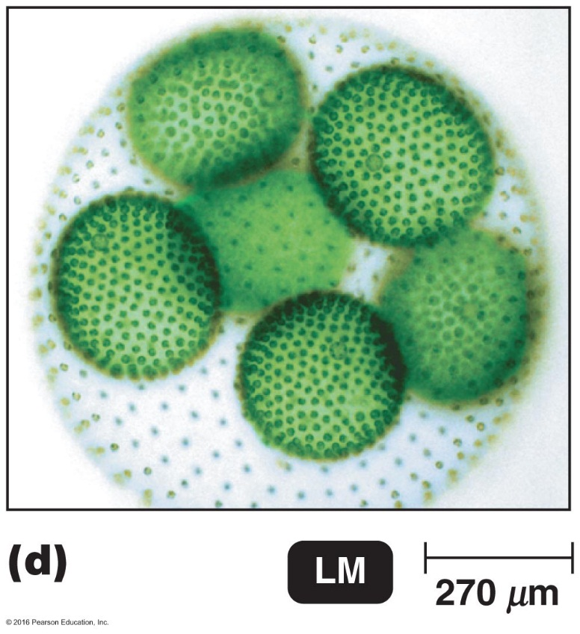
Algae
Photosynthetic (energy)
Found in ______water, saltwater, and soil
Produce ______ and carbohydrates
Eukaryote
Reproduction
Sexually
Asexually
Cell wall
Cellulose (carbohydrate)
Balance of nature
Figure 1.1d Types of microorganisms.

Slide 15
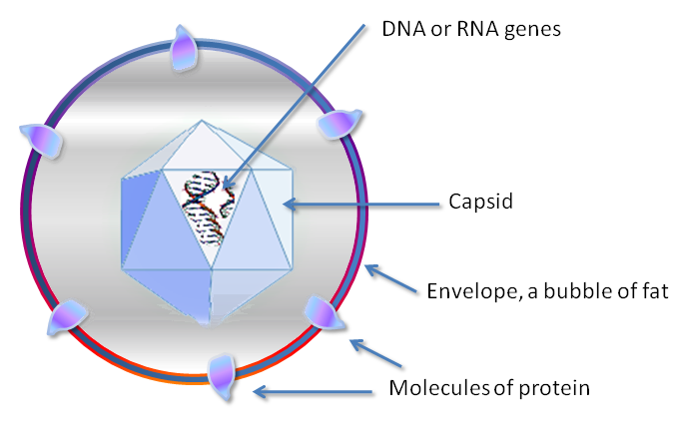
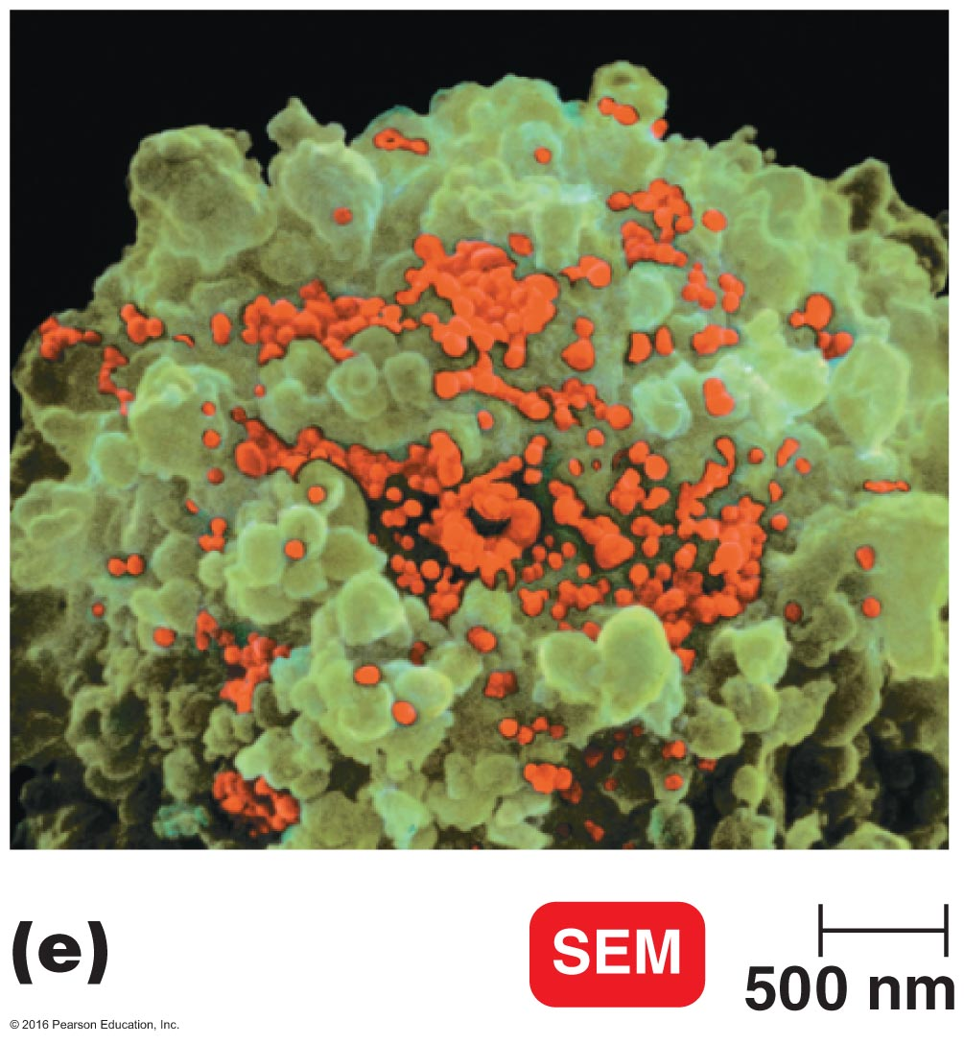
Viruses
So small, need _______ microscope
__cellular (not cellular)
Contains
Core, one type of nucleic acid (DNA or RNA)
Is surrounded by protein coat
Sometimes encased by lipid membrane (envelope)
Reproduction
Are replicated only when they are in a living host cell
Cellular machinery or other organisms
Considered living organisms within host cells

Slide 16
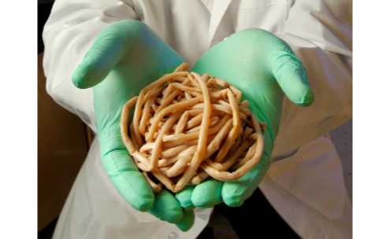
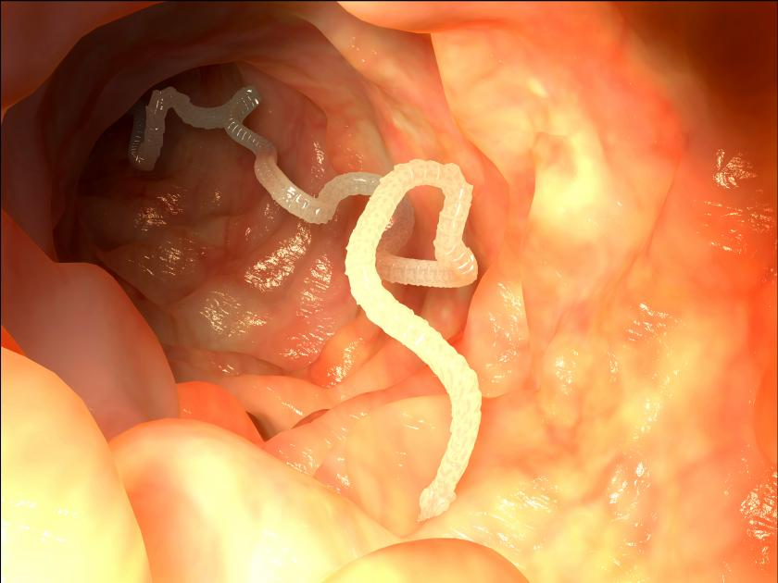
Multicellular Animal Parasites
Eukaryotes
______cellular animals
____ strictly microorganisms
Parasitic flatworms and roundworms are called helminths
Some microscopic stages in their life cycles
© 2016 Pearson Education, In.

Slide 17
Classification of microorganisms
Before microbes discovery only:
Animal kingdom
Plant kingdom
In 1978, Carl Woese, _______ domains based on cellular organization (NOTE: see graphic next screen)
Bacteria (cell wall contains peptidoglycan)
Archaea (cell wall, if present, lacks peptidoglycan)
Eukaryote
Protists (Protozoa, and Algae)
Fungi (yeast, mold and mushroom)
Plants (flowering plant, …)
Animal(insect, …)

Slide 18
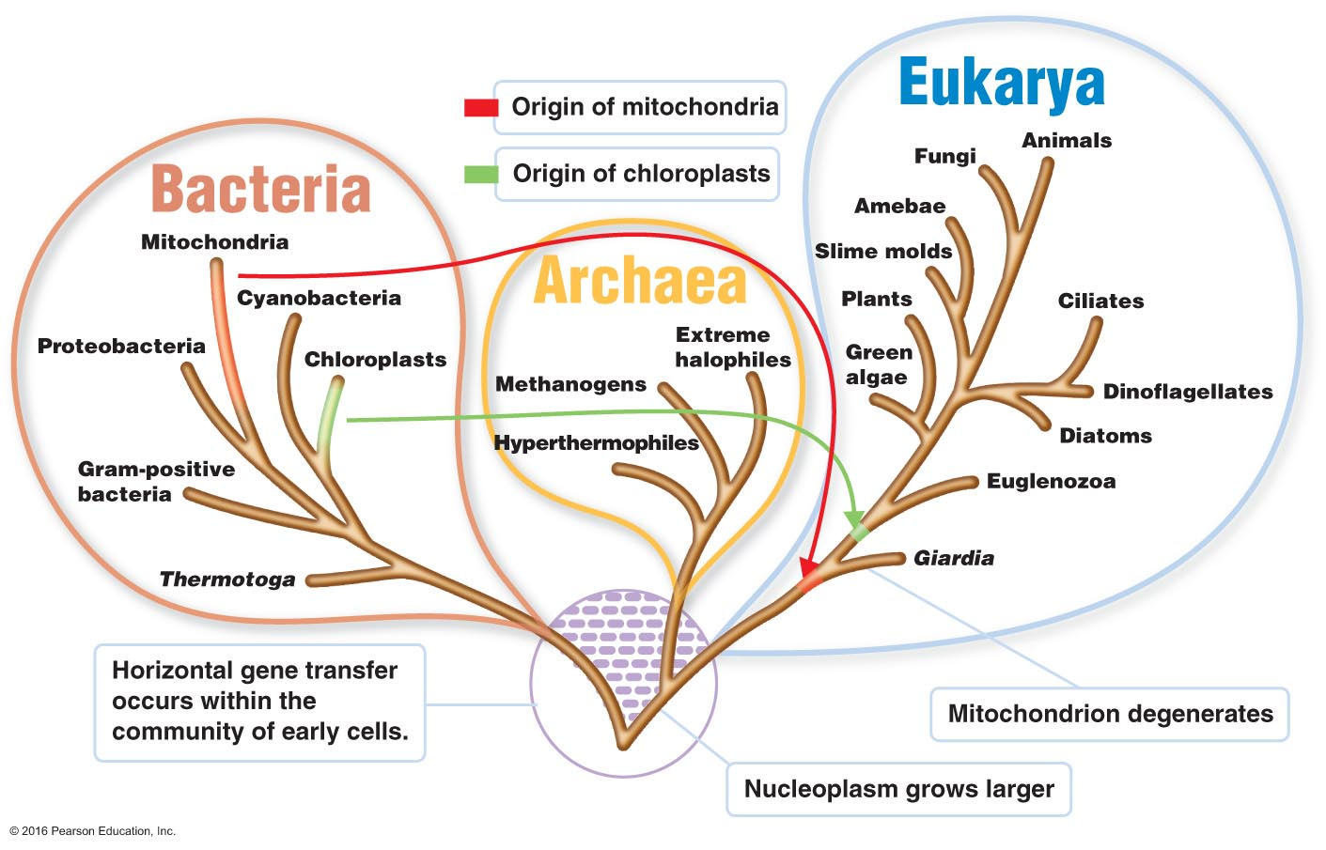
Three-Domain System

Slide 19
History Timeline of the Golden Age of Microbiology

Slide 20
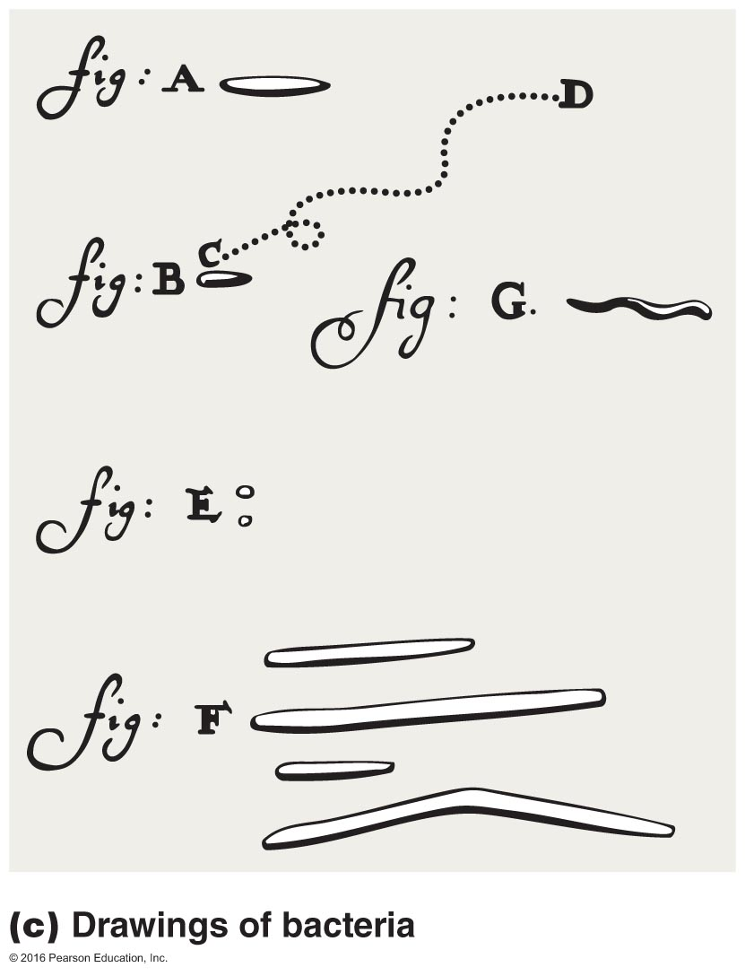
History of Microbiology
The ______ observation
In 1665, Robert Hooke reported life’s smallest structure units (little boxes) (_______)
Cell theory (What is cell theory?)
Invisible world of microorganisms:
In 1723, Van Leeuwenhoek made details drawing of bacteria and protozoa
rainwater
material from teeth
feces

Slide 21
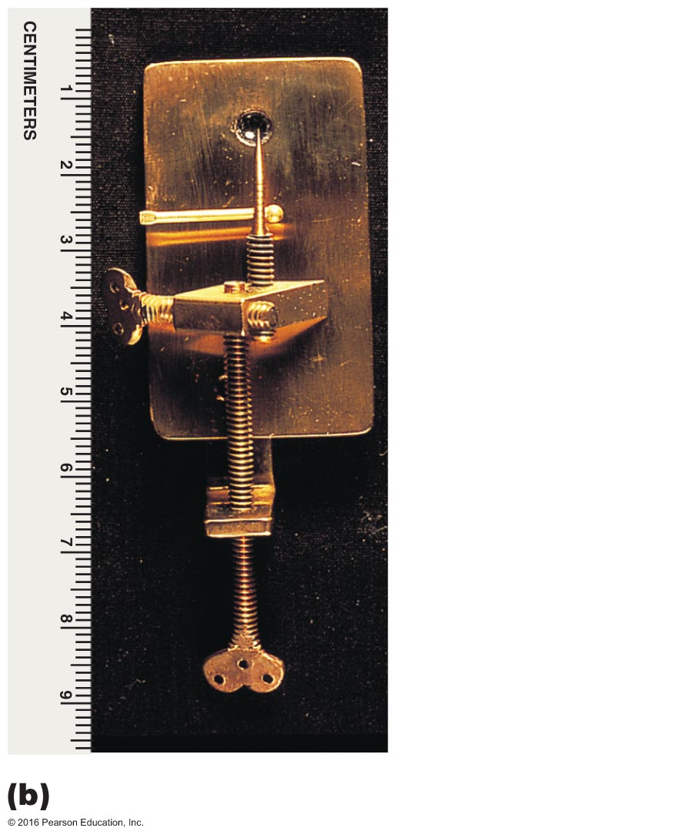
The First Observations
1665: Robert Hooke reported that living things are composed of little boxes, or "cells"
Marked the beginning of cell theory: All living things are composed of ______
The first microbes were observed from 1623–1673 by Anton van Leeuwenhoek
"Animalcules" viewed through magnifying lenses
© 2016 Pearson Education, In.

Slide 22
The Debate over Spontaneous Generation
Spontaneous generation: the hypothesis that ____ arises from nonliving matter; a "vital force" is necessary for life
Biogenesis: the hypothesis that living cells arise only from preexisting living cells
© 2016 Pearson Education, In.

Slide 23
History of Microbiology
The ______ Age of Microbiology
Discover agents of diseases and role of immunity to prevent and cure diseases
Study chemical activities of microorganisms
Culturing microorganisms
Performing microscopy technique
Fermentation
Pasture, yeast ______ sugar to alcohol in the absent of air
Pasteurization
Heat beer and wine just enough to kill most of bacteria that caused the spoilage
Notes:
Kill potentially harmful bacteria in milk

Slide 24
The Golden Age of Microbiology
Pasteur's work, discoveries included the ___________ between microbes and disease, immunity, and antimicrobial drugs
Pasteur showed that microbes are responsible for fermentation
Fermentation is the microbial conversion of sugar to alcohol in the absence of air
Microbial growth is also responsible for spoilage of food and beverages
Bacteria that use air spoil wine by turning it to vinegar (acetic acid)
© 2016 Pearson Education, In.

Slide 25
The Golden Age of Microbiology
Pasteur demonstrated that ‘spoilage’ bacteria could be killed by ____ that was not hot enough to evaporate the alcohol in wine
Pasteurization is the application of a high heat for a short time to kill harmful bacteria in beverages
© 2016 Pearson Education, In.

Slide 26
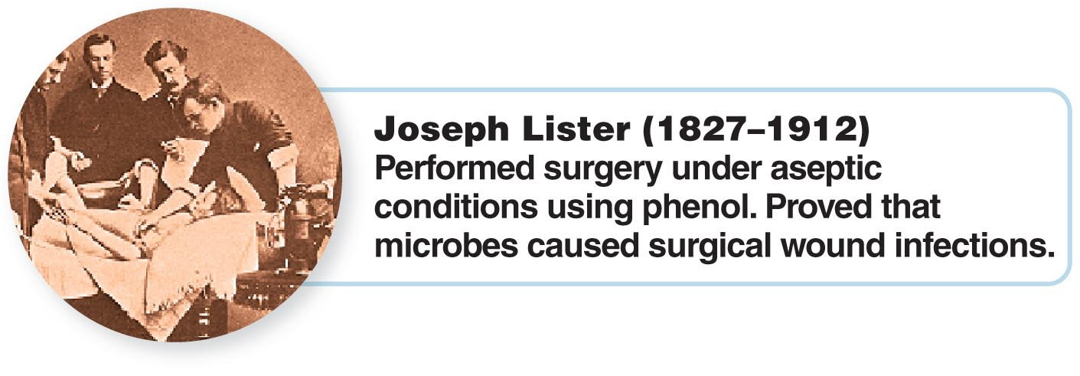
The Germ Theory of Disease
1860s: Applying Pasteur's work showing that microbes are in the ___, can spoil ____, and cause animal diseases, Joseph Lister used a chemical antiseptic (phenol) to prevent surgical wound infections
© 2016 Pearson Education, In.

Slide 27
History of Microbiology continued
Germ theory of ___________
Robert Koch, bacteria cause disease
Vaccination
Edward Jenner protected people from smallpox by ______, a milder disease
1796: Edward Jenner inoculated a person with cowpox virus, who was then immune from smallpox
Vaccination is derived from the Latin word vacca, meaning cow
The protection is called ______________.
Pasture found why vaccinations work
First synthetic of drug (antibiotic)
Chemotherapy, treatment a disease by using chemical substances
Antibiotic, bacteria and fungi produce chemicals against other microorganisms
Synthetic drugs, chemical against microorganisms that prepared in the laboratory

Slide 28
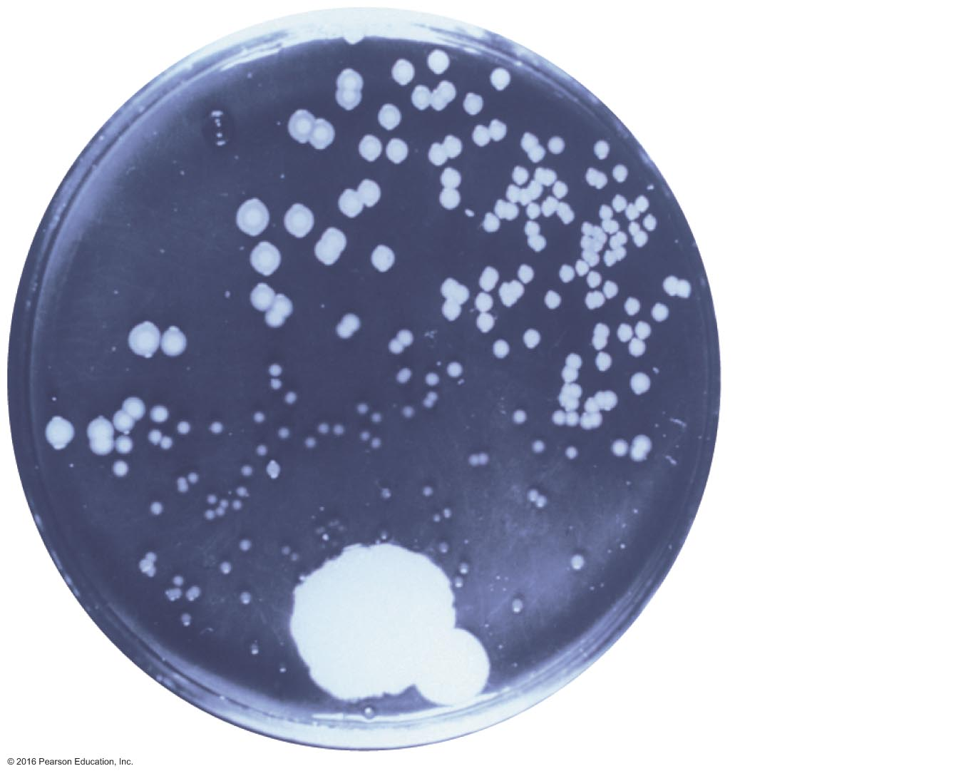
A Fortunate Accident—Antibiotics
1928: Alexander Fleming discovered the first ________ (by accident)
Fleming observed that Penicillium fungus made an antibiotic, penicillin, that killed S. aureus
1940s: Penicillin was tested clinically and mass-produced
Normal
bacterial
colony
Area of
inhibited
bacterial
growth
Penicillium
colony
© 2016 Pearson Education, In.

Slide 29
Modern Developments in Microbiology
Learning Objectives
1-12 Define bacteriology, mycology, parasitology, immunology, and virology.
1-13 Explain the importance of microbial genetics and molecular biology.
© 2016 Pearson Education, In.

Slide 30
History of Microbiology
Modern development in microbiology
Nobel prizes awarded for discovery in microbiology
Techniques for producing antibiotics
Bacteriology
Mycology
Parasitology
Immunology
Vaccines and interferons are used to prevent and cure viral diseases
Virology
Recombinant DNA technology
Insert recombinant DNA into bacteria to make large quantity of a desired protein

Slide 31
Microbes and Human Welfare
Learning Objectives
1-14 List at least four beneficial activities of microorganisms.
1-15 Name two examples of biotechnology that use recombinant DNA technology and two examples that do not.
© 2016 Pearson Education, In.

Slide 32
Recycling Vital Elements
Microbial ecology is the study of the relationship between microorganisms and their ______________
Bacteria convert carbon, oxygen, nitrogen, sulfur, and phosphorus into forms used by plants and animals
© 2016 Pearson Education, In.

Slide 33
Modern Biotechnology and Recombinant DNA Technology
Biotechnology is the use of microbes for practical applications, such as producing _____ and chemicals
Recombinant DNA technology enables bacteria and fungi to produce a ________ of proteins, vaccines, and enzymes
Missing or defective genes in human cells can be replaced in gene therapy
Genetically modified bacteria are used to protect crops from insects and from freezing
© 2016 Pearson Education, In.

Slide 34
Microbes and Human Benefit
Photosynthesis
Recycle _________
Clean up pollutants
_______ pest control
Biotechnology and recombinant DNA technology

Slide 35
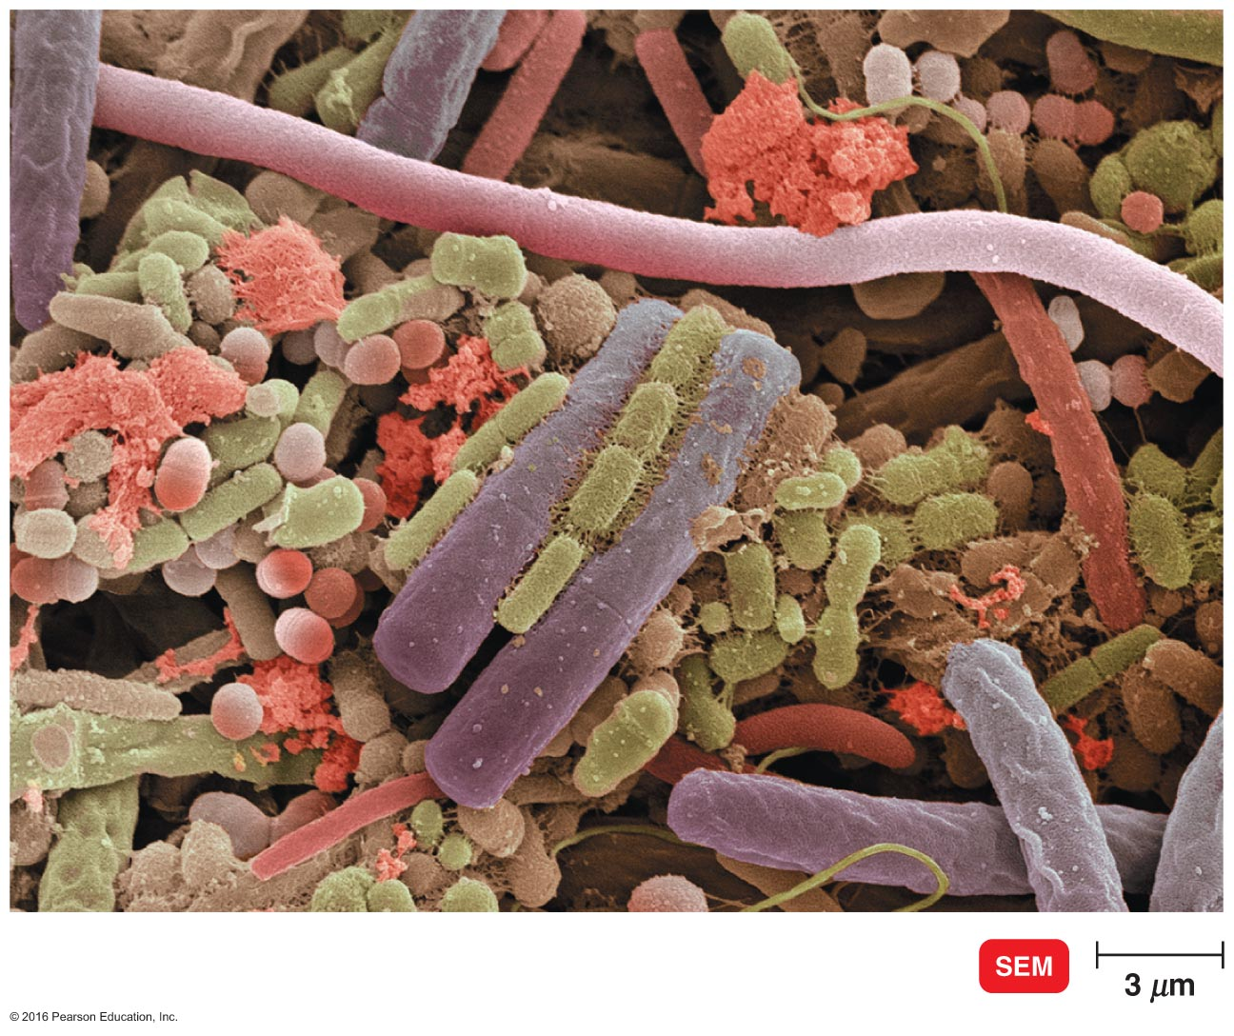
Microbes and Human Disease
Normal microbiota, flora,
Variety of microorganisms live on and inside of our body
Normal microbiota
_______ us against harmful disease
Prevent growth of bacteria
Produce vitamin K and B
Under some condition normal microbiota can make _________
If normal microbiota leave their habitat they make disease
Normal microbiota on the human tongue

Slide 36
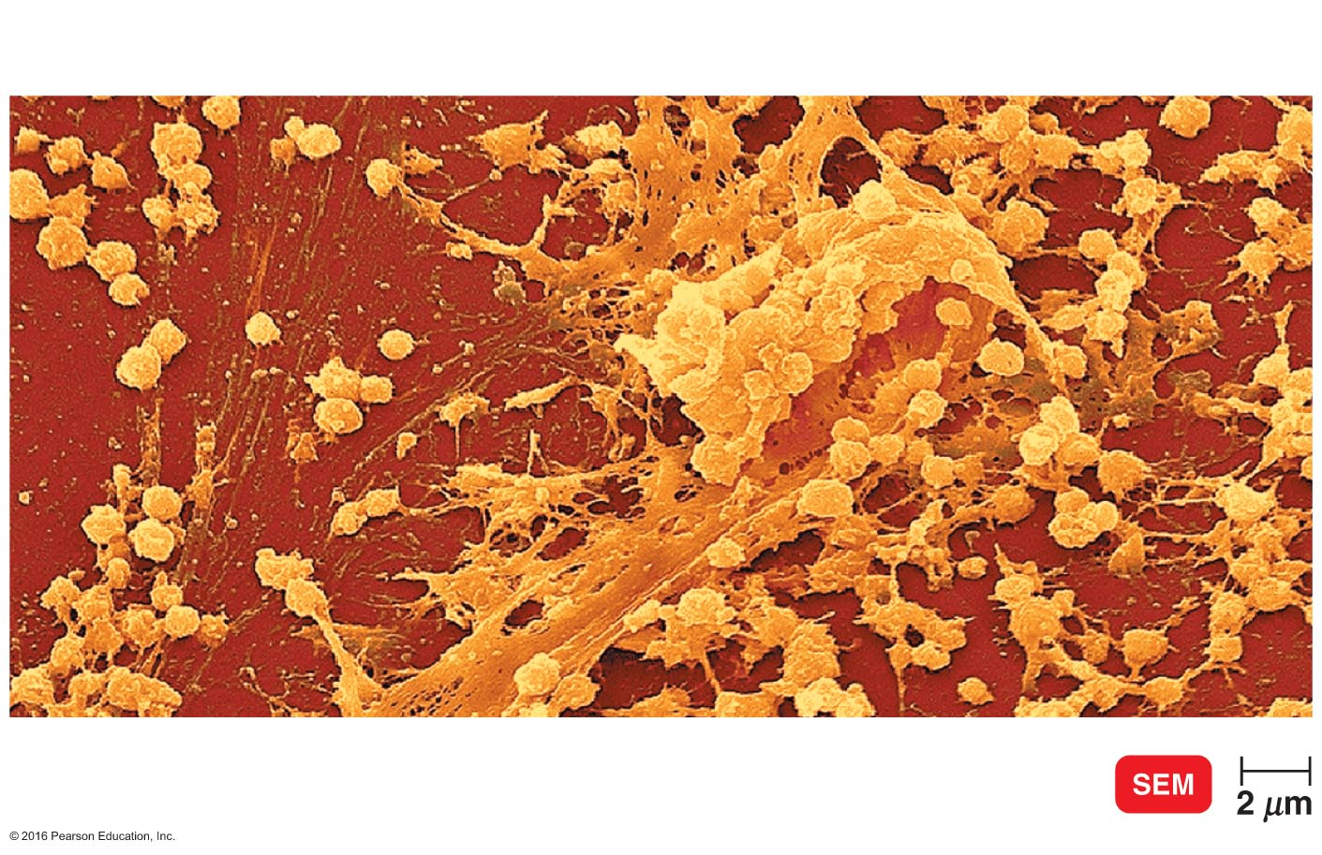
Biofilm
Microbes ______ to solid surfaces and grow into masses
They will grow on rocks, pipes, teeth, and medical implants
Biofilms can cause _____________ and are often resistant to antibiotics
Protect mucous membrane from harmful disease
A slime covering a rock in a lake
is important food for aquatic animals
Block water pipes
Block catheters on medical implants and cause infections
Resistant to antibiotic because they the biofilm offers a protective barrier
Biofilm of Staph. Aureus on a catheter

Slide 37
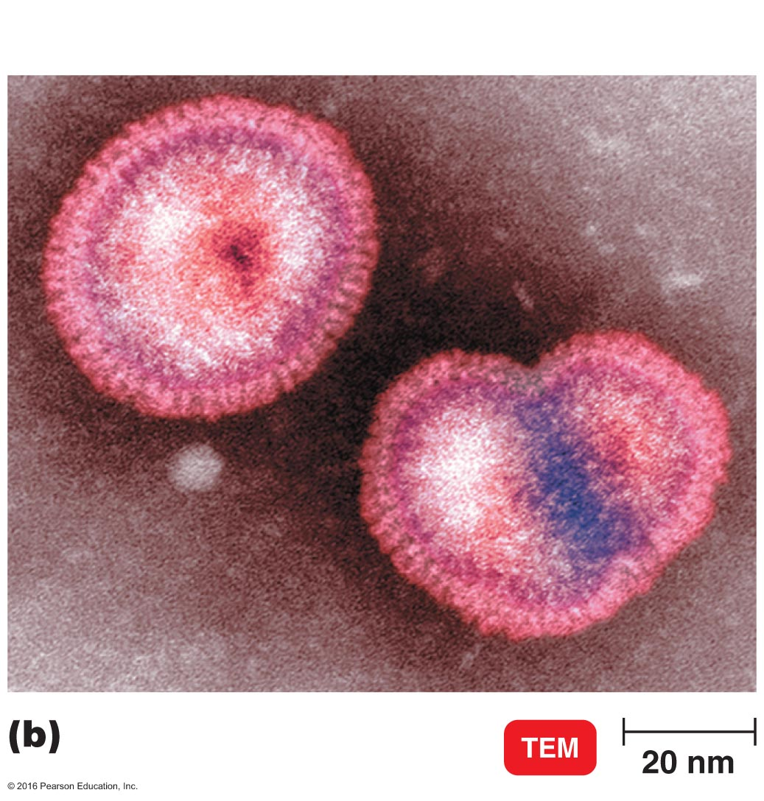
Microbes and Human Disease
Infectious disease
When a pathogen invades a host and overcomes the host's resistance, _______ results
Emerging infection disease
Infectious disease is not disappearing but emerging and _____________
Flu
H1N1 flu
MRSA
Avian influenza A (H5N1)
Influenza A virus
Primarily in waterfowl and poultry
Sustained human-to-human transmission has not yet occurred

