Slide 1
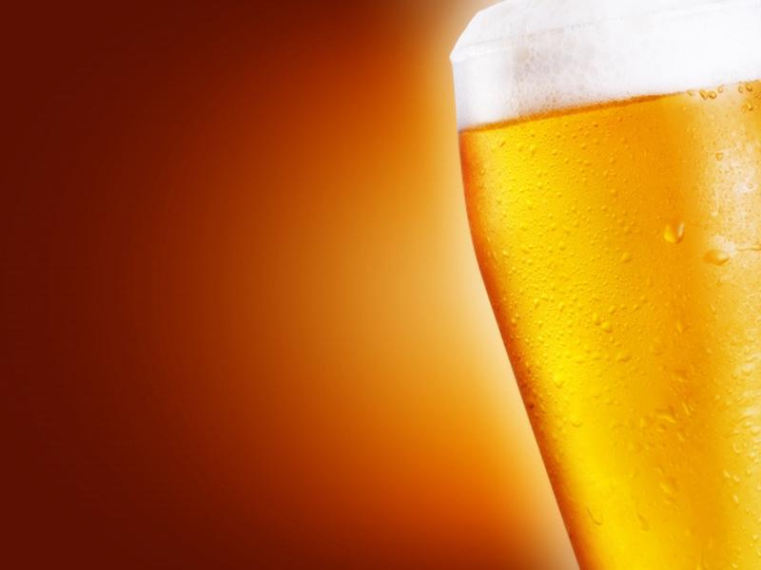
SCMer’s Brewing Company:
A Green Supply Chain

Slide 2
Company Overview
Mission Statement
“SCMer’s Brewing Company is committed to providing our customers with the highest quality, best tasting beer, while maintaining an environmental stewardship in our community. We are dedicated to being environmentally responsible in our brewing practices, while still being able to serve our customers with a satisfying, flavorful beer.”
Notes:
James

Slide 3
Our Product
Three flavorful beers:
light beer
medium-bodied beer
dark beer
Each type is produced in a sustainable manner
All ingredients are organic
Notes:
Emelie

Slide 4
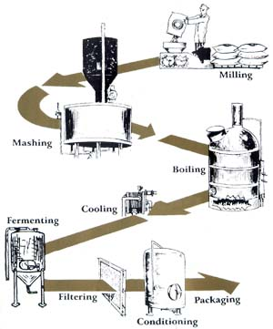
Our Office: The Brewery
Notes:
Emelie

Slide 5
The ‘Go Green’ Way
Sustainable products are good for the environment and the consumer
Integrate sustainability into core operations
Transportation, operations, raw material selection, and packaging
Past: Follow government regulations
Present: Save money by going green and become environmentally friendly
Notes:
Meagan

Slide 6
Green Supply Chain Framework
Operational Alignment - strategy
Business Partner Collaboration – suppliers with same goals
Business Capabilities – Don’t push it
Metrics and Measurement – ensure heading in intended direction
Notes:
Meagan

Slide 7
Sustainability Initiatives
Ecological Footprint
compares the environmental impact of production activities to the consumption of the Earth’s resources
calculates the amount land, water, and energy
Notes:
JH/Emelie

Slide 8
Sustainability Initiatives
Triple Bottom Line
People – Planet - Profit
ESOP
Low turnover rate
Fair labour treatment
Open book managing
Philanthropy
Accounting
Greenwashing

Slide 9
Where The Green Beer Grows
Location
Factors | Weight | New Facility | Vacated Facility
Cost | 3 | 3 | 2
Renovation Cost | 1 | 0 | 1
Operating Cost | 1 | 1 | 2
Time | 2 | 3 | 1
Energy Efficient | 3 | 1 | 2
Ecological Footprint | 3 | 2 | 1
TOTAL |  | 25 | 20
Notes:
JH

Slide 10
Beneficial Re-Use Of Waste Material
Grain—Spent Mash
Byproduct of brewing is grain stripped of its carbohydrates and sugars.
It is mostly protein
Give to farmers for feed
Triple Bottom Line
Economical
No waste
Supports Community
Notes:
James

Slide 11
Beneficial Re-use Of Waste Material
Yeast
Brewing propagates yeast yielding a surplus that cannot be consumed on site.
Yeast is bad for water treatment process and should not be dumped down a drain.
Yeast can be given to local bakeries who need a steady supply for their product.
Triple Bottom Line
Notes:
James

Slide 12
Beneficial Re-use Of Waste Material
Spent Hops and Trub
Mucky pudding-like substance left in kettle
Not good for animal feed
Great for compost
Can be used in local growing efforts
Notes:
James

Slide 13
Water Conservation
Industry Standard Water Use Efficiency
6 Gallons of water per 1 gallon of beer
Total Water consumption
20% goes into beer
80% is used for cleaning
Recapture water lost as boil off using condenser.
Store water heated in the process of cooling wort kettle for use the next day
Notes:
James

Slide 14
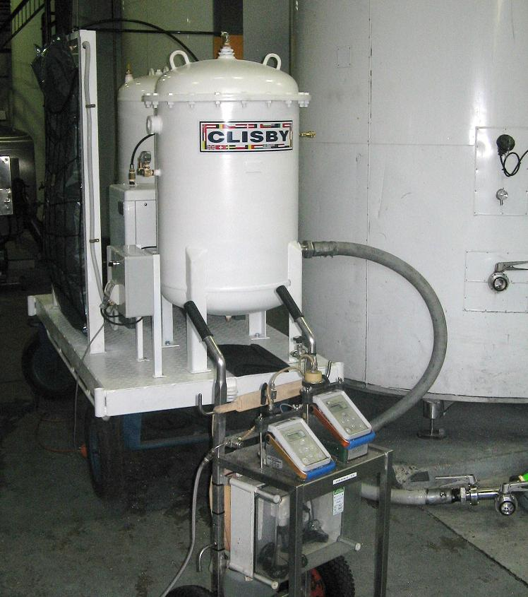
Carbon Dioxide Recovery
Fermentation releases carbon dioxide
CO₂ can be captured and used instead of being released into the atmosphere
Recovery systems can capture and store CO₂ released in fermentation
Notes:
CO₂ from fermenters flows through a foam separator and a gas scrubber to a compressor, and then through filters and driers to a storage vessel.

Slide 15
Long Term Projects
Solar Cells and Wind Turbines are great
However
Lack of sun and wind can inhibit their usefulness
Look into fuel cell technology
Look into on-site water treatment facility
Notes:
James

Slide 16
Our ‘Go Green’ Helpers
Transportation – Local Suppliers
Suppliers – Organic (closest possible)
Water – Natural, Local
Bottles – Owens Illinois
Energy – DTE in Detroit, MI (85% wind and 15% biomass energy)
Notes:
Meagan

Slide 17
Where The Green Beer Flows
Transportation
Great Lakes Brewery – biodiesel trucks
Waste oil from restaurants
Full truck loads – 75% plus
Distribution
OH, MI, IN
Notes:
JH

Slide 18
The Green Office
Printers – both sides, recycled
Toners and Cartridges – recycled
Recycling Bins
Automatic Setback Thermometers
Office Equipment – Sleep mode, turn off
Replace lighting with florescent lamps
Staff Member
Notes:
Meagan

Slide 19
Marketing A Green Idea
79% of consumers would rather purchase products from a sustainable company
Expected to rise to 89% within the next year
35% of consumers are willing to pay premium prices
Good indication of expanding green initiatives
Notes:
Emelie

Slide 20
Community Involvement
Sustainability of Community
Reclaim Abandoned Land
Community Gardens
Toledo GROWS
“Beautifying neighborhoods, Connecting urban dwellers back to the land and nature, Providing wholesome, nutritious, and economical food, Reducing crime and blight, and Promoting the creation and use of green space
Strengthen Image
Strengthen Employee Commitment
Notes:
Meagan

Slide 21
The Third Line: Profit
SCMer’s Brewery is a differentiator, not a cost leader.
Craft beer is generally more expensive so our target market is beer aficionados
Pursue obvious cost saving sustainable projects from start up
Consider capital intensive projects and their feasibility as company becomes viable
Notes:
Emelie

Slide 22
But Until then…
Sierra Nevada
New Belgium
Great Lakes

Slide 23
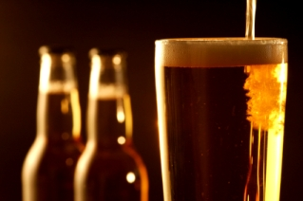
Any Questions???

