Slide 1
Effective Performance Appraisals
Written By. Clinton O. Longenecker, Ph.D.
Presented By. Meagan Frances Ayers

Slide 2
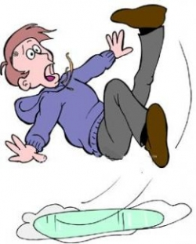
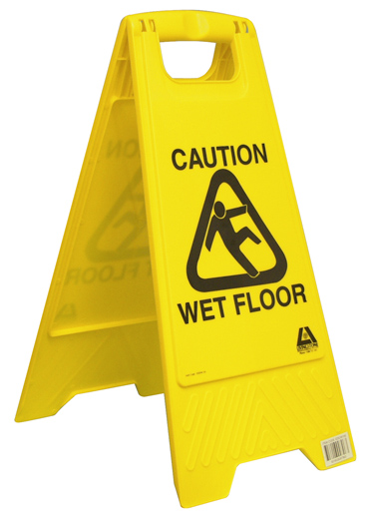
When Do We Care?
“The ironic part about appraising managers is that it doesn’t get a lot of attention in most organizations until appraisal time or unless there is a problem, which is ironic given the importance we place on them (appraisals).” – A Senior HR Manager’s Observation
Prevention → → →

Slide 3
Why Are Appraisals Important?
When properly used, the formal appraisal process has been found to be a potentially effective device for:
Performance planning and goal setting
Providing performance feedback and coaching
Linking pay to performance
Employee development, counseling, and planning
Linking performance to compensation and promotion decisions

Slide 4
Research Article
Purpose
To help HR executives, managers, and professionals to better understand managerial appraisals and what can be done to make them more effective
Qualitative Research Project
175 managers from
33 large US organizations
All organizations currently had Performance Appraisals in place
Asked 3 questions

Slide 5
Question 1: Why Do Organizations Conduct Formal Performance Appraisals?
Top 6 Reasons:
Basis for Compensation Decisions
Performance Improvement
Clarifying Performance Expectations
Provide Performance Feedback
Career Planning & Development
Goal Setting

Slide 6
Question 2: What Factors Cause Performance Appraisals To Be Ineffective?
Top 10 Reasons:
Unclear Performance Criteria/Bad Rating Instrument
Poor Working Relationship with Your Boss
Lack of Ongoing Performance Feedback
Superior Lacks Information on Actual Performance
Perceived Political Reviews
Weak Link to Reward System
Lack of Focus on Management Development
Review Process Lacks Structure/Consistency
Overly Negative Review
Superior Lacks Rating Skills/Motivation

Slide 7
Unclear Performance Criteria/Bad Rating Instrument
You will need:
Established performance criteria by which to judge performance
Effective two way communication
Appropriate rating device (must capture what the job actually entails)
Lesson 1: For managerial appraisals to be effective, performance planning is critical and must be supported by an appropriate performance rating device.

Slide 8
Poor Working Relationship With Your Boss
You will need:
Trust and confidence between employee and manager
Mutual respect
Commitment to each other
If you lack these, you will see doubt and suspicion
Lesson 2: Without a solid working relationship between the two parties, the managerial review process will be suspect.

Slide 9
Lack Of Ongoing Performance Feedback
You must implement ongoing performance feedback throughout the year
Do not spring “surprises”
Without this, your credibility is called into question.
Lesson 3: Ongoing performance feedback, both positive and negative, throughout the year makes for more effective managerial performance and more meaningful performance appraisal.

Slide 10
Superior Lacks Information On Actual Performance
Managers questioned said:
They had limited knowledge of actual performance
When this happens, the usefulness of the process is called into question
Lesson 4: Those who rate performance need to possess actual hands-on information of employees’ actual contribution to the organization and how these results were achieved.

Slide 11
Perceived Political Reviews
Mangers have a negative reaction to the process if they PERCIEVE politics in the review process
Factors that can create this perception:
Unclear Performance Standards
Poor Working Relationships
Lack of Knowledge of Subordinates Job/Performance
Lesson 5: Perceived political performance ratings damage the credibility of the appraisal process and can be unintentionally created by ineffective rating practices.

Slide 12
Weak Link To Rewards Systems
In Theory: The better the performance, the greater compensation increase.
Problems:
When this is the primary factor for compensation decisions
Underestimated employee contribution
Merit does not correlate with perceived contribution
Organizations will control salary costs by keeping ratings low
Lesson 6: Linkages between appraisal ratings and corresponding organizational rewards are difficult to achieve, thus limiting the effectiveness of appraisals in reinforcing high levels of performance.

Slide 13
Lack Of Focus On Development & Improvement
Problem: Superiors are quick to criticize but reluctant to create a plan of action to enhance performance.
Managers must be a “coach” to employees
Lesson 7: When management development planning is not part of the appraisal process, employees feel short-changed and a performance improvement opportunity is lost.

Slide 14
Review Process Lacks Structure & Substance
Written phase is rushed and fails to provide detailed examples
Face-to-Face review can be seen as:
The “Non-Review Review”
The “Rush Job”
The “I’ve Got More Important Things To Do Review”
Employees and managers want structured, formal performance reviews that evaluate performance in an objective fashion. Otherwise, cynicism, frustration, and tension follow.
Lesson 8: Managers performing unstructured and ambiguous work want a structured and substantive appraisal of their performance.

Slide 15
Overly Critical/Second Guessing Reviews
Little or no feedback throughout the year leads to:
Overly negative performance reviews
An event to be dreaded
Defensiveness, bitterness, bad attitudes, and frustration
Feedback is not always appreciated unless it comes from someone the employee trusts
Lesson 9: When raters of managerial performance consistently provide overly negative and/or second guessing reviews, the employee’s response will almost always be negative.

Slide 16
Superior Lacks Rating Skills Or Motivation
Skills Needed:
Performance Planning
Goal-Setting
Coaching
Decision Making
Interviewing
Conflict Resolution
Must desire to conduct an effective performance review!
Lesson 10: Managers conducting formal appraisals must possess both the skill and motivation to perform effectively if the process is to have positive outcomes.

Slide 17
Question 3: Consequences Of Ineffective Managerial Appraisals
Top 10 Reasons:
Stifles Performance Improvement
De-Motivates and Frustrates Employees
Breeds Cynicism/Loss of Confidence
Causes a Loss of Managerial Focus
Causes Pay for Performance Systems to Break Down
Sets a Poor Example
Damages Development Efforts
Creates Tension in Working Relationships
Causes Ineffective Performance Planning/Goal-Setting
Managers Develop a Second Guessing Mentality

Slide 18
Effective Performance Appraisals
When appraisals are done well, they are an effective tool for guiding, enhancing, and rewarding employees and managers
Managers are the key to running an effective business and their performance is CRITICAL!
The responsibility falls on managers as well as HR leaders alike

Slide 19
Any Question?

