Slide 1
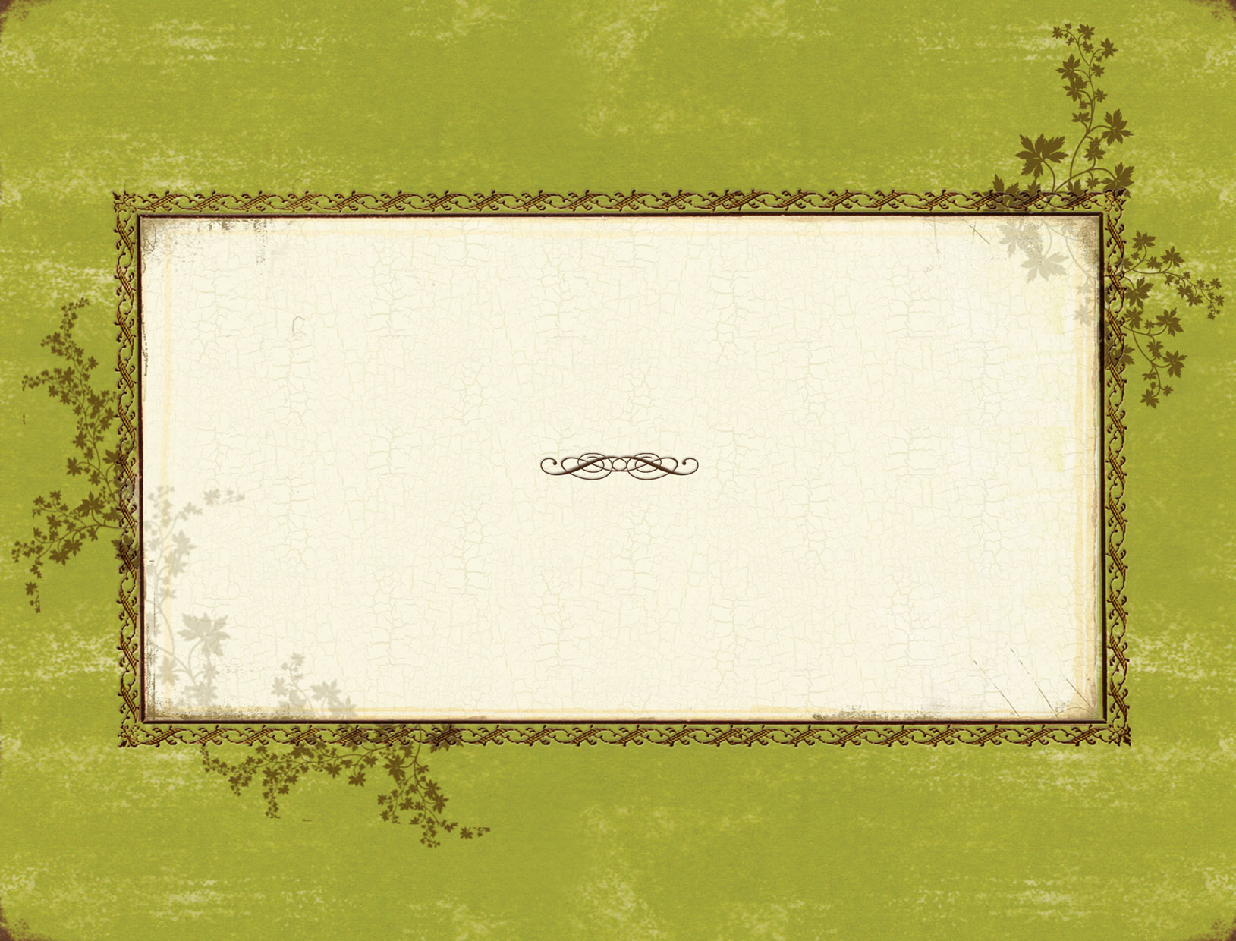
Eco-Home
Completing the recycling loop
By Lisa and Nhi

Slide 2
The SAVE House
A National Award-winning Environmental Demonstration Home
Built by the members of SAVE from Souderton Area High School
Souderton, Pennsylvania

Slide 3
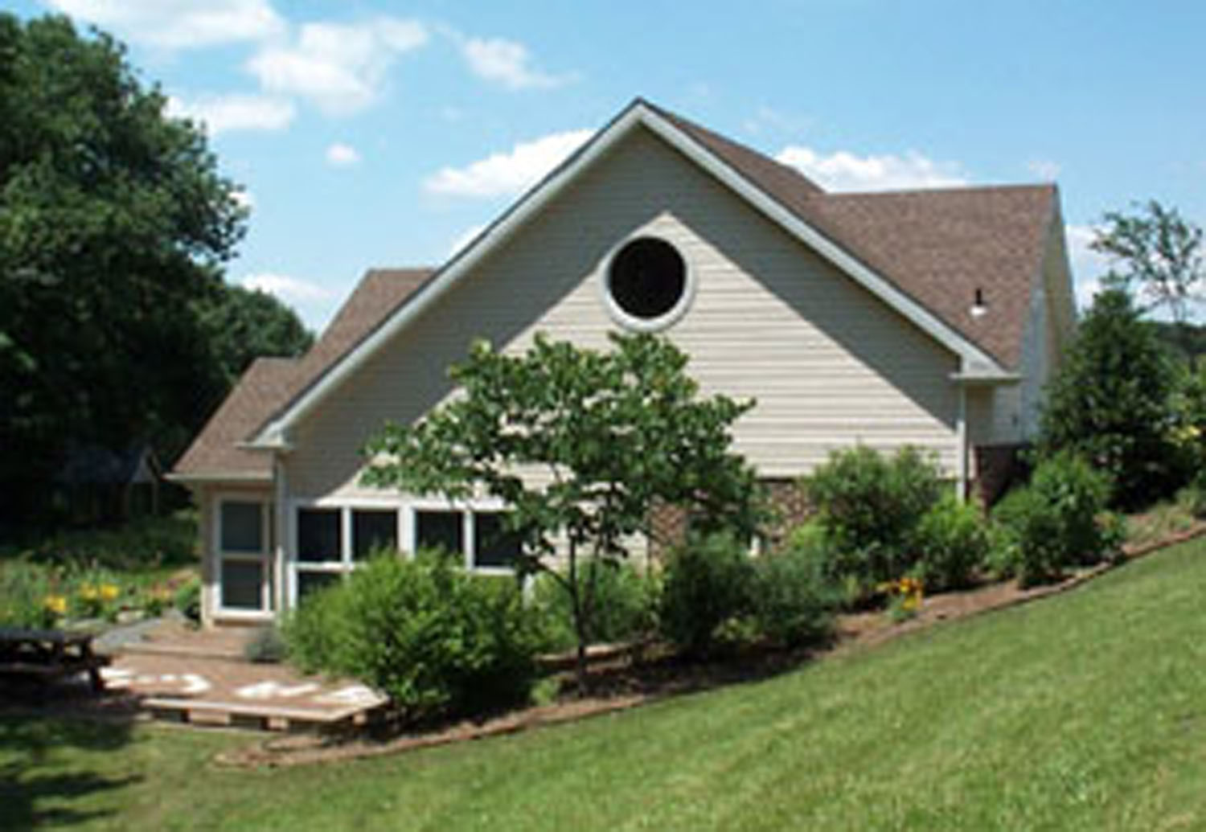

Slide 4
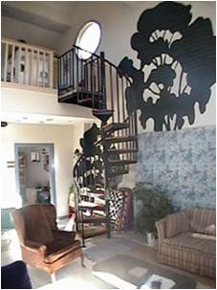
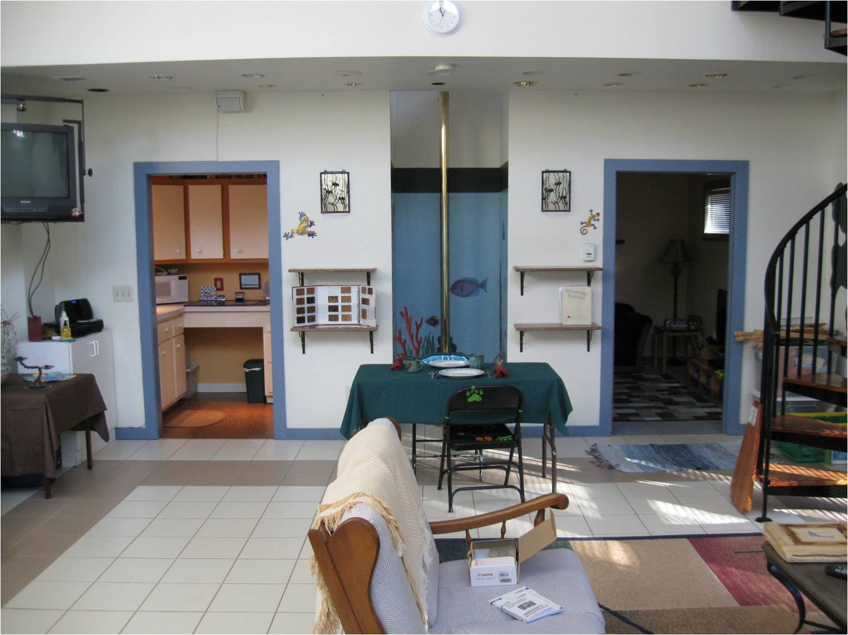

Slide 5
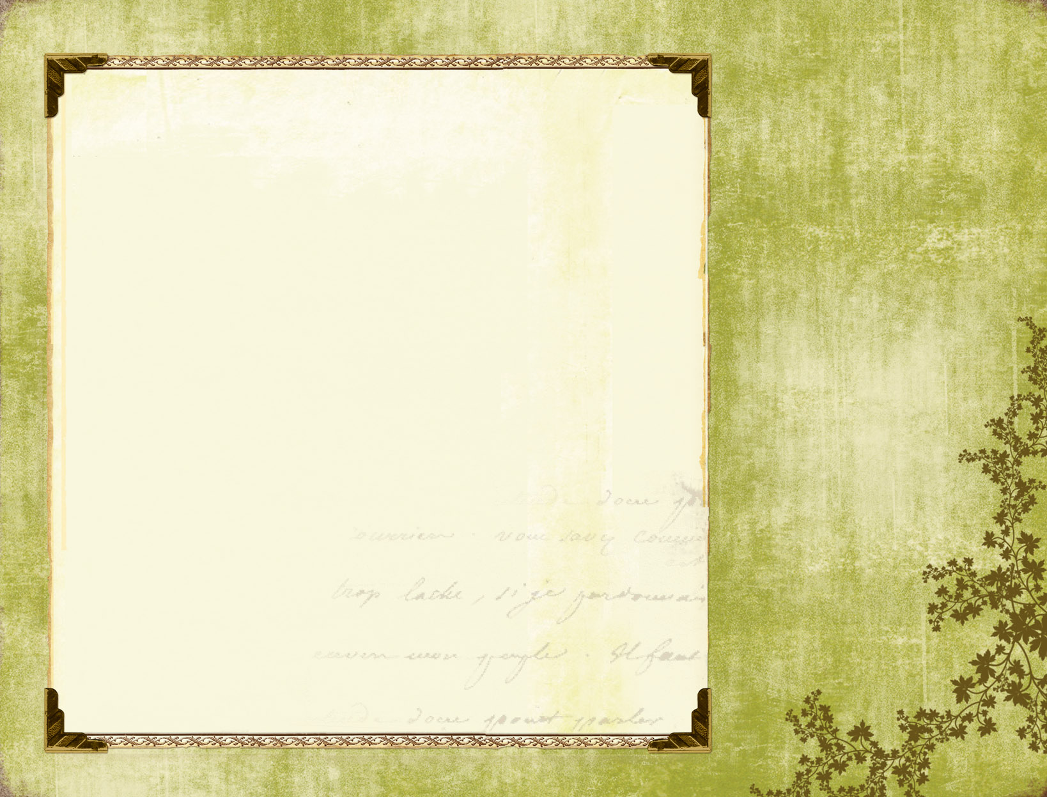
Take a tour…
And see all the household items made from recycled materials

Slide 6
Recycled Paper

Slide 7
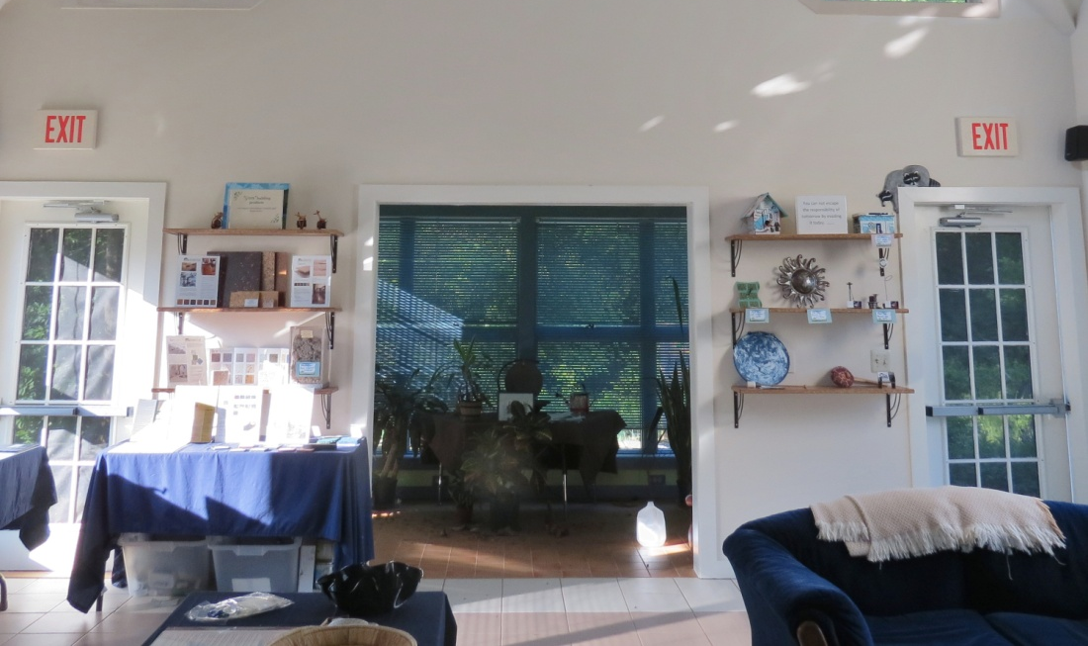

Slide 8
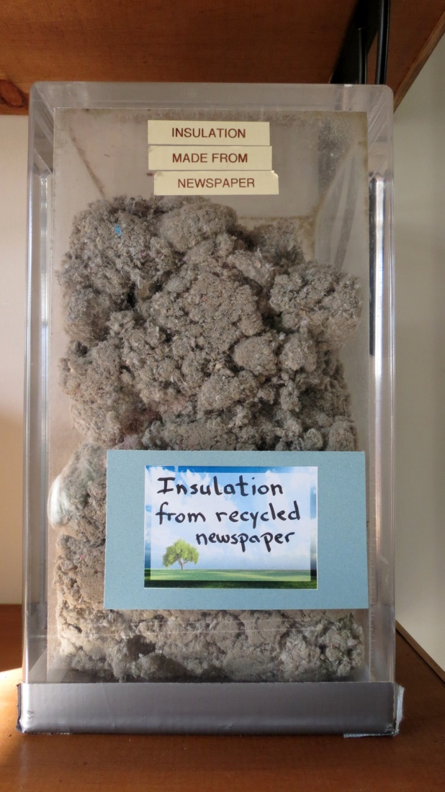
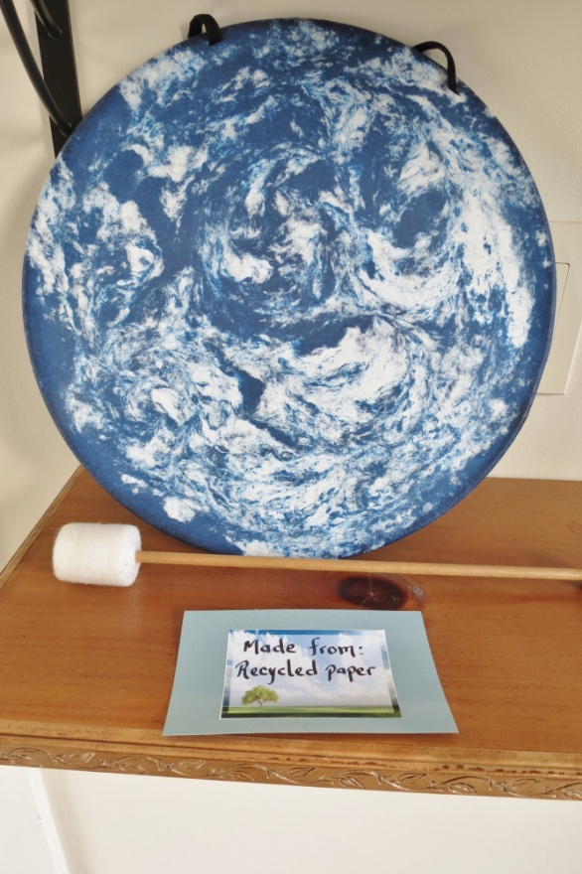
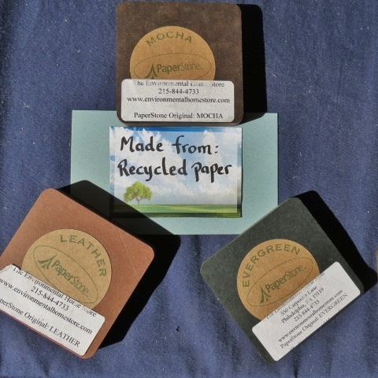
Insulation
Decorations
Countertop

Slide 9
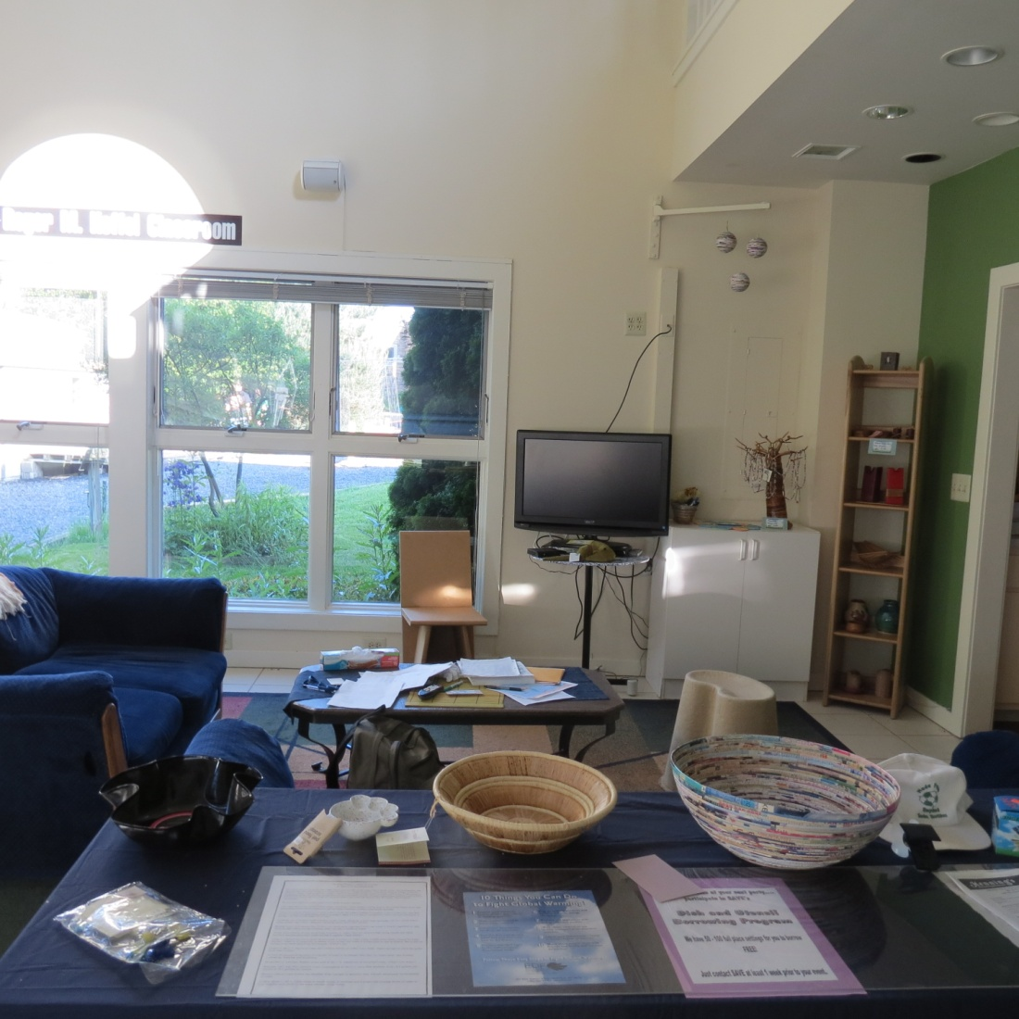

Slide 10
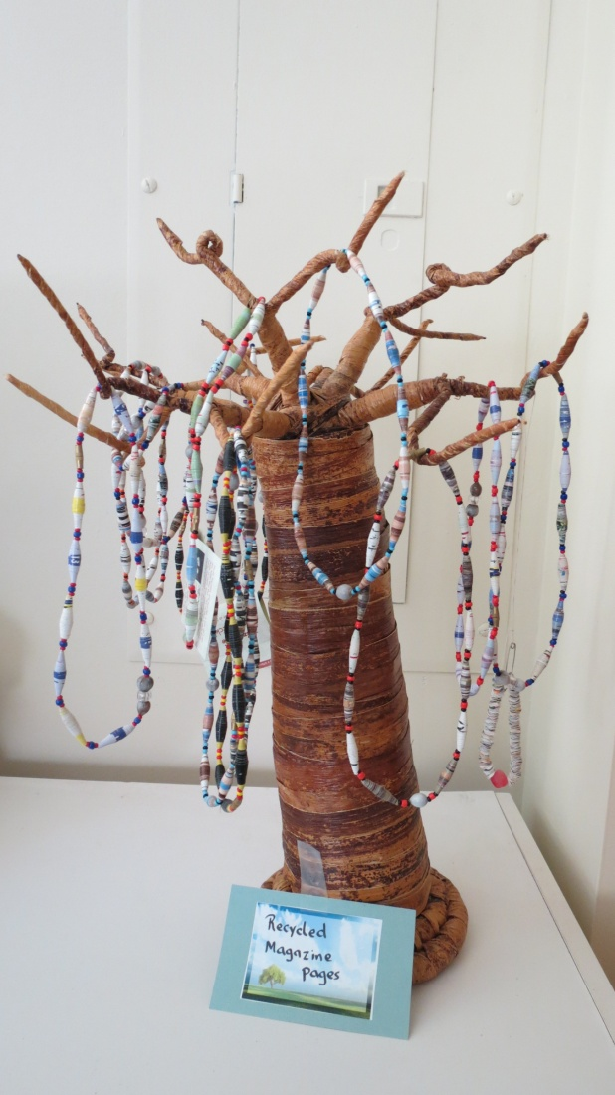
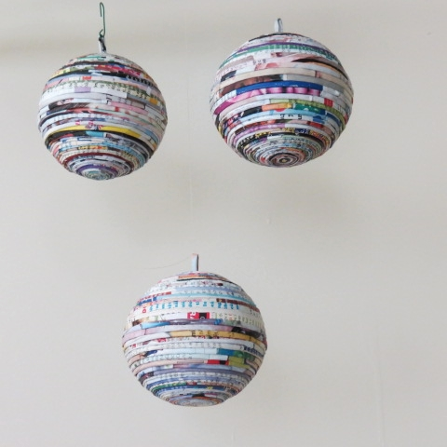
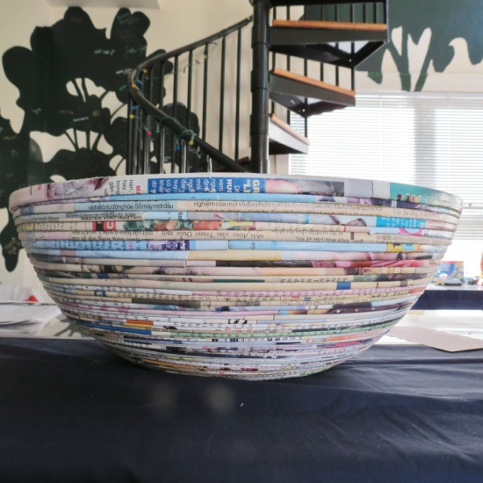
Necklaces
Decorations
Bowl

Slide 11
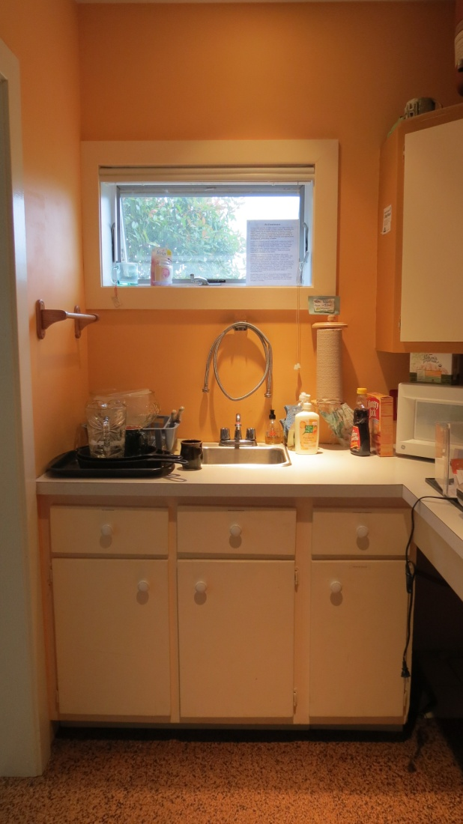
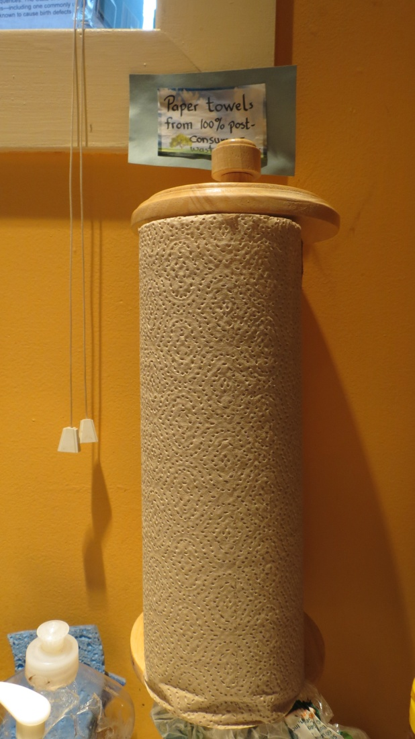
100% Post-consumer waste
paper towels

Slide 12
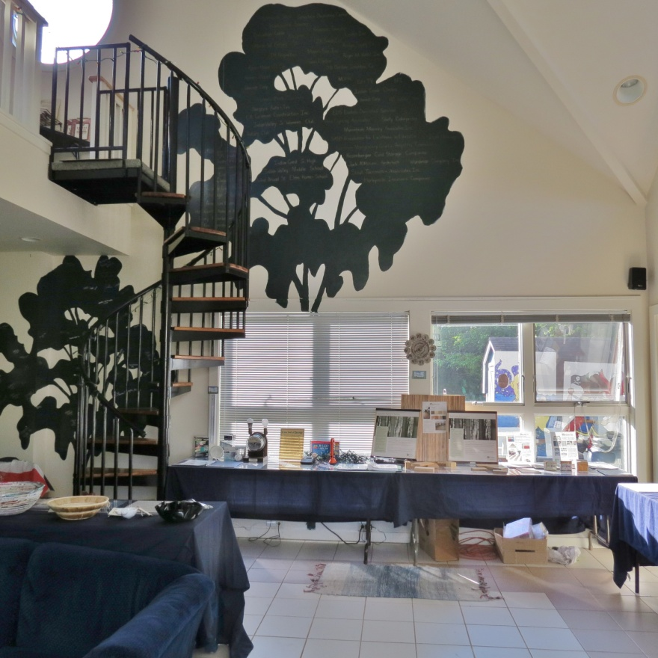
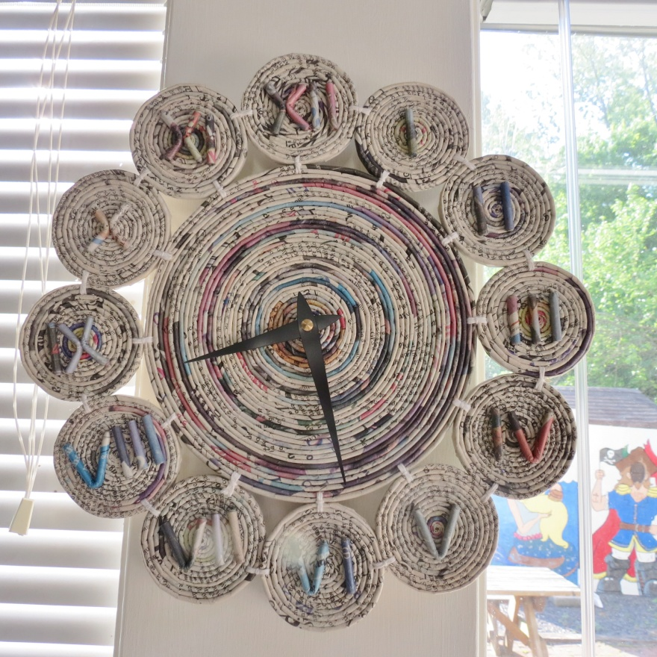

Slide 13
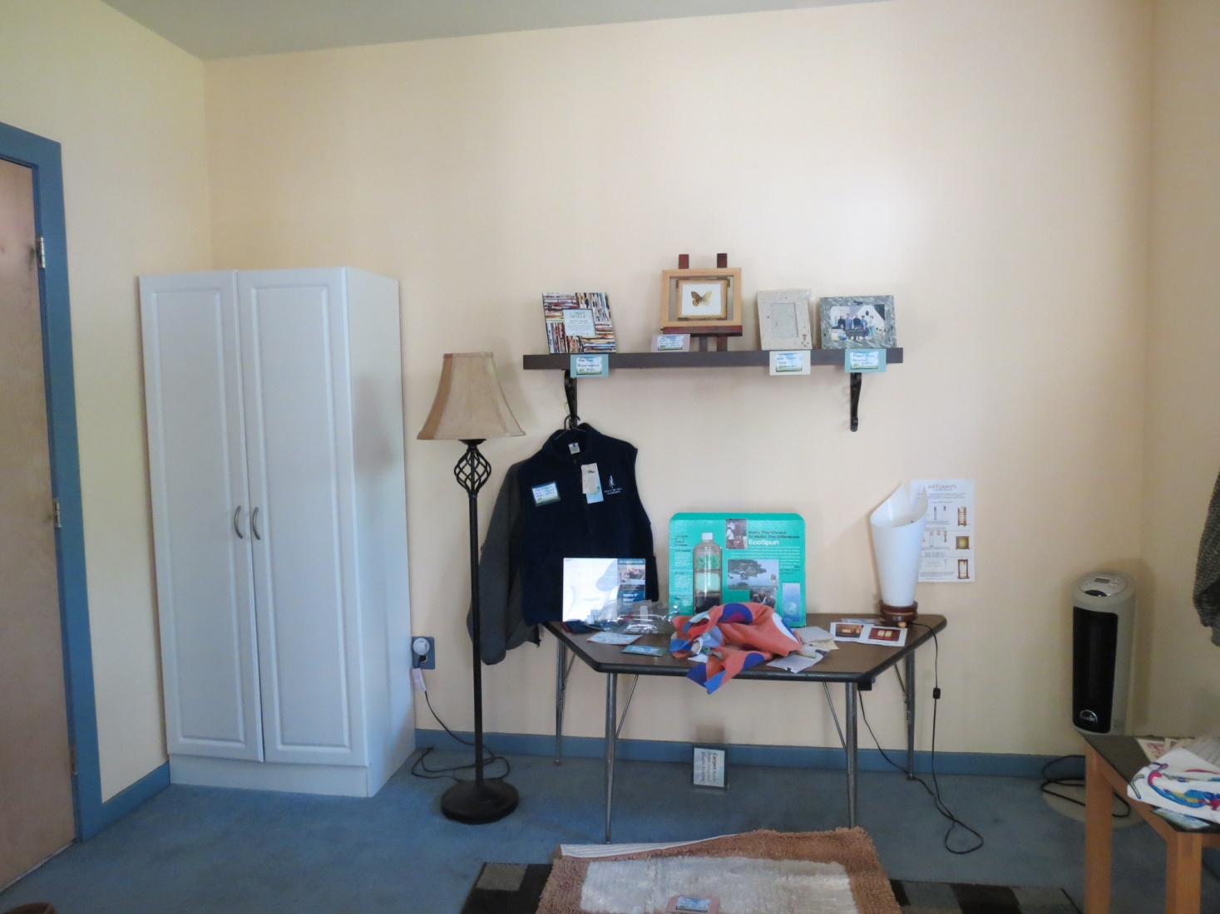
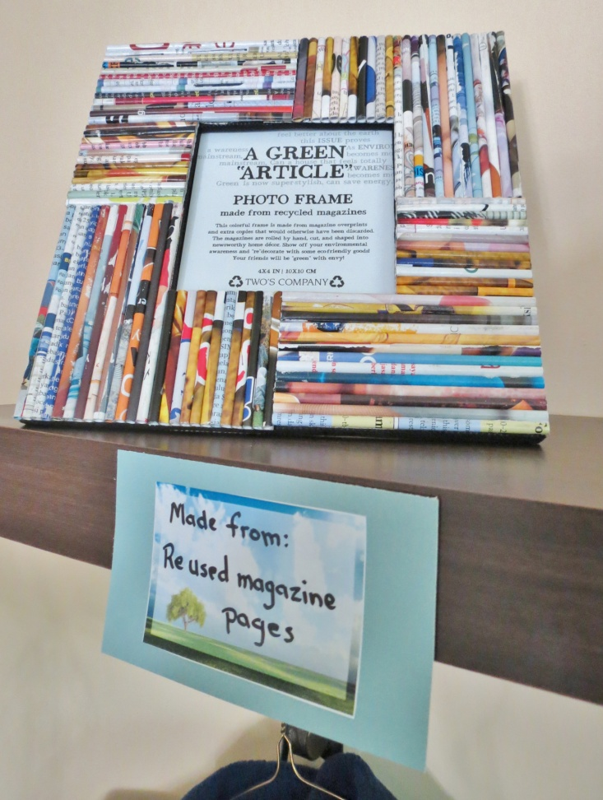

Slide 14
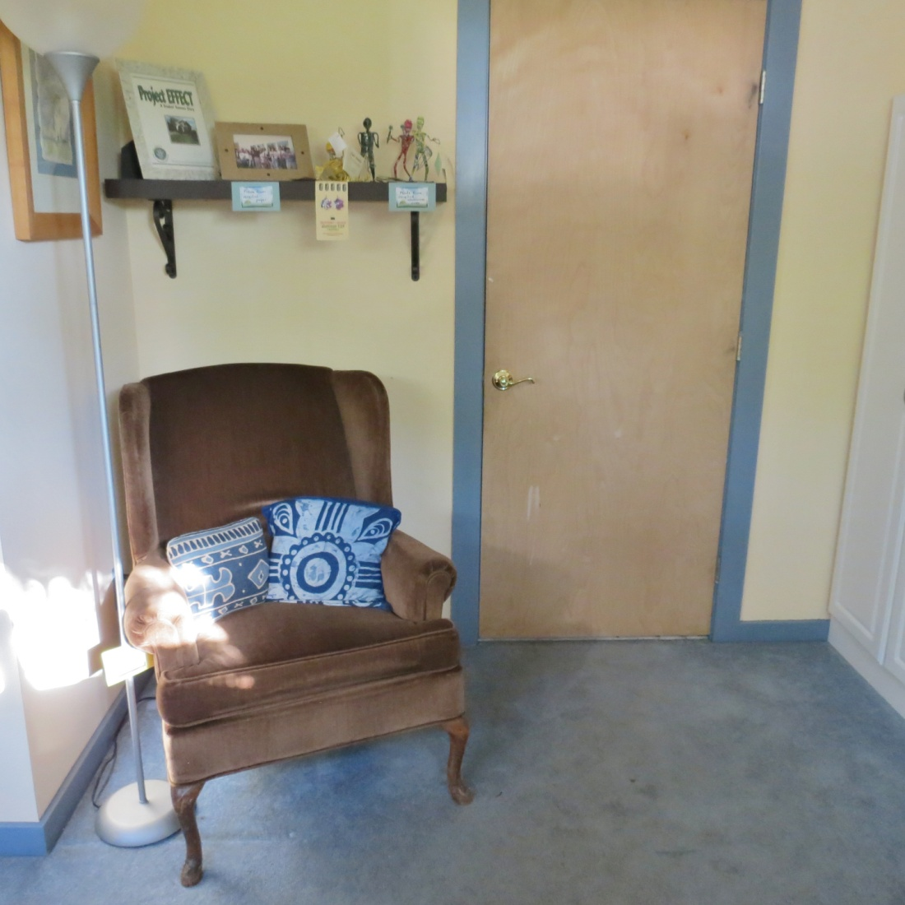
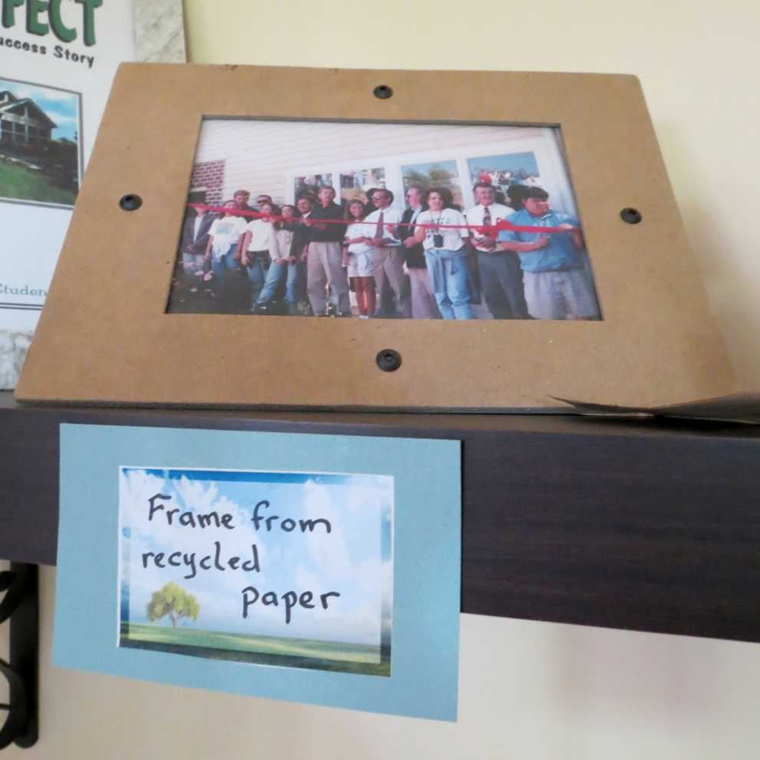

Slide 15
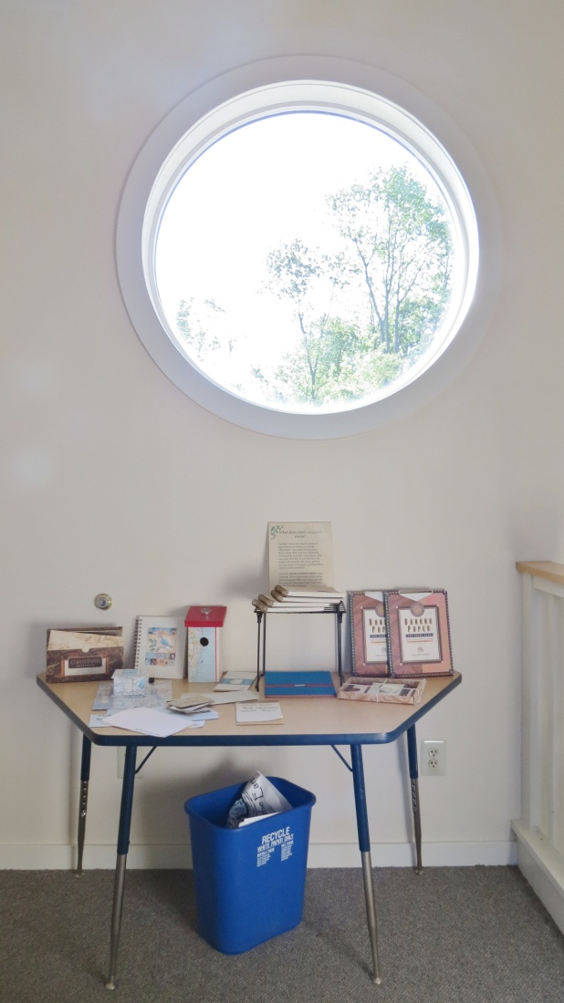
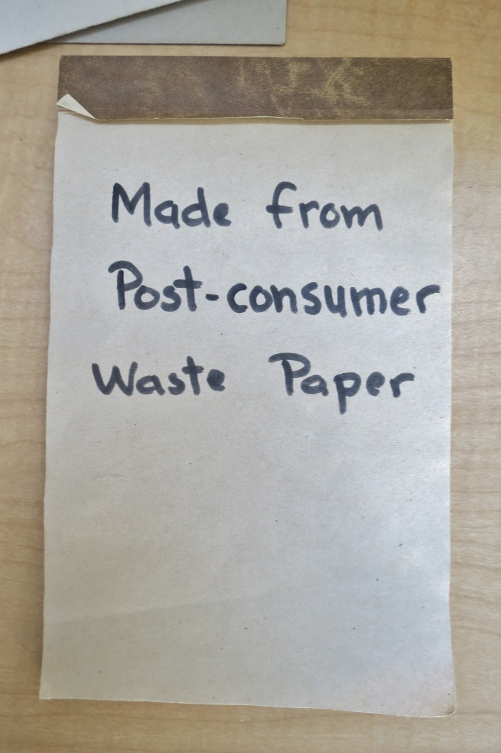

Slide 16
Recycled
Plastic

Slide 17
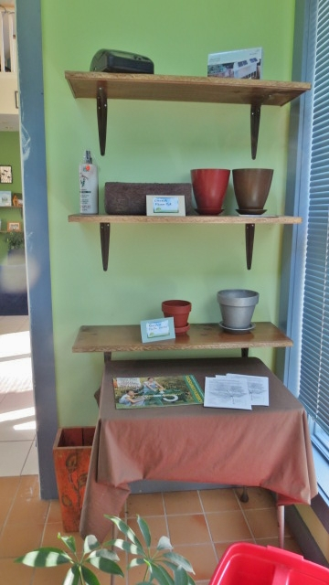
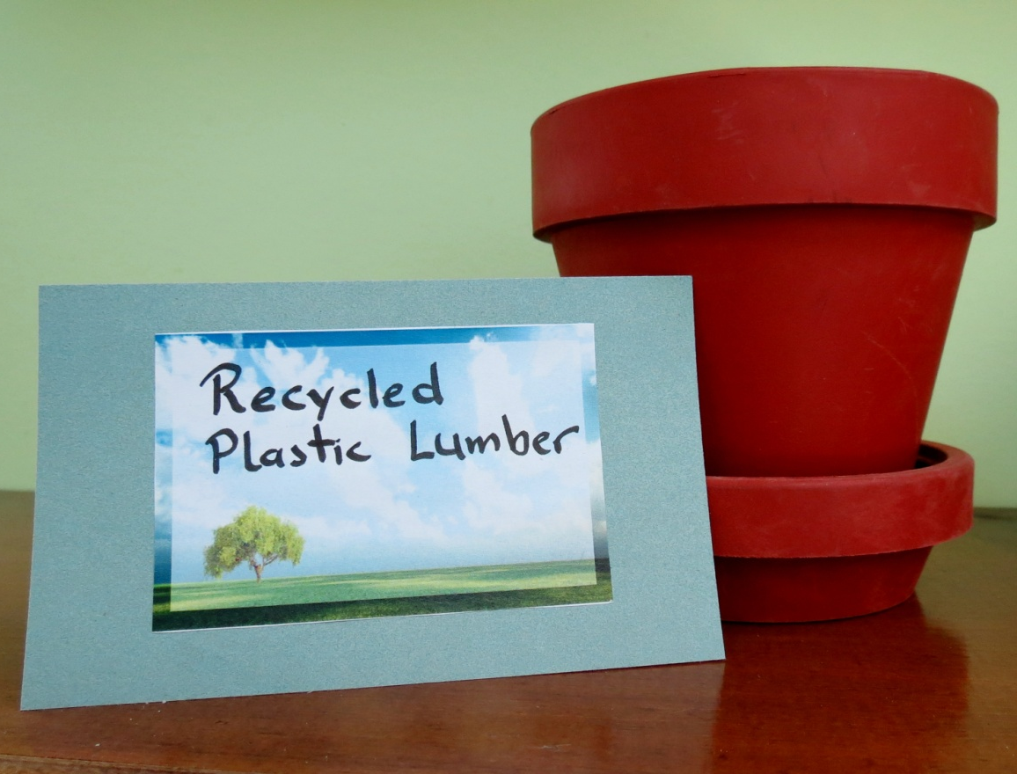

Slide 18
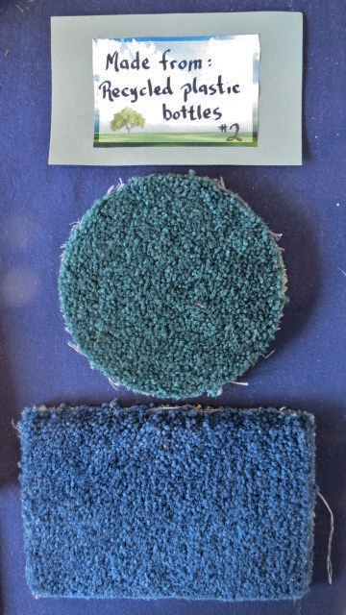
All Carpets

Slide 20
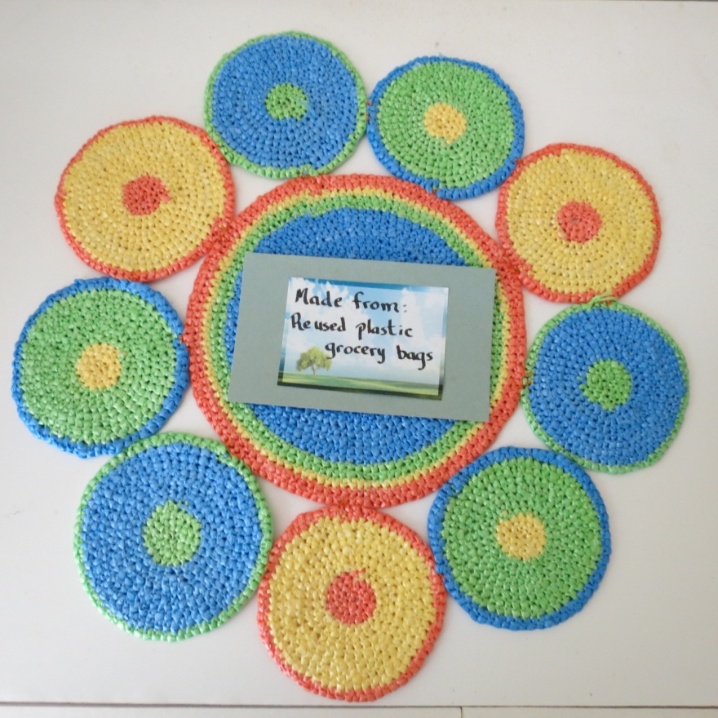
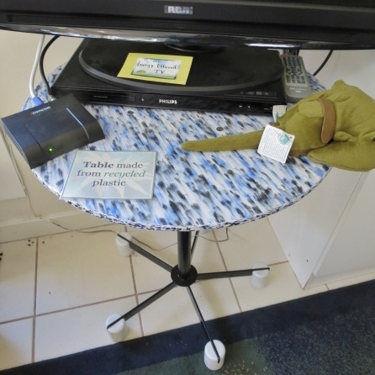
Table made from plastic bottles

Slide 21
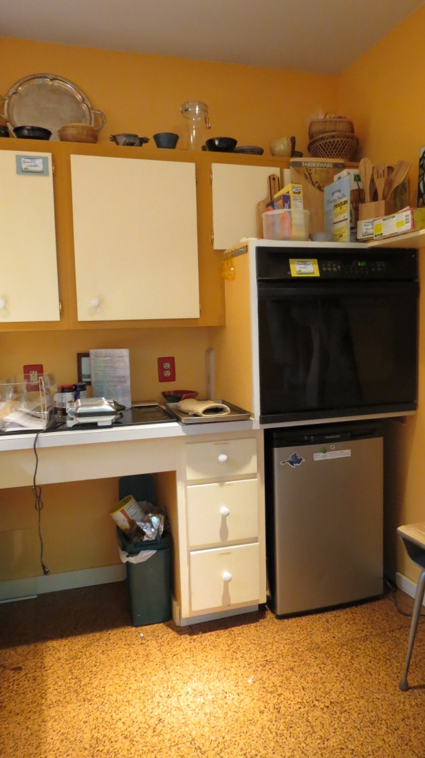
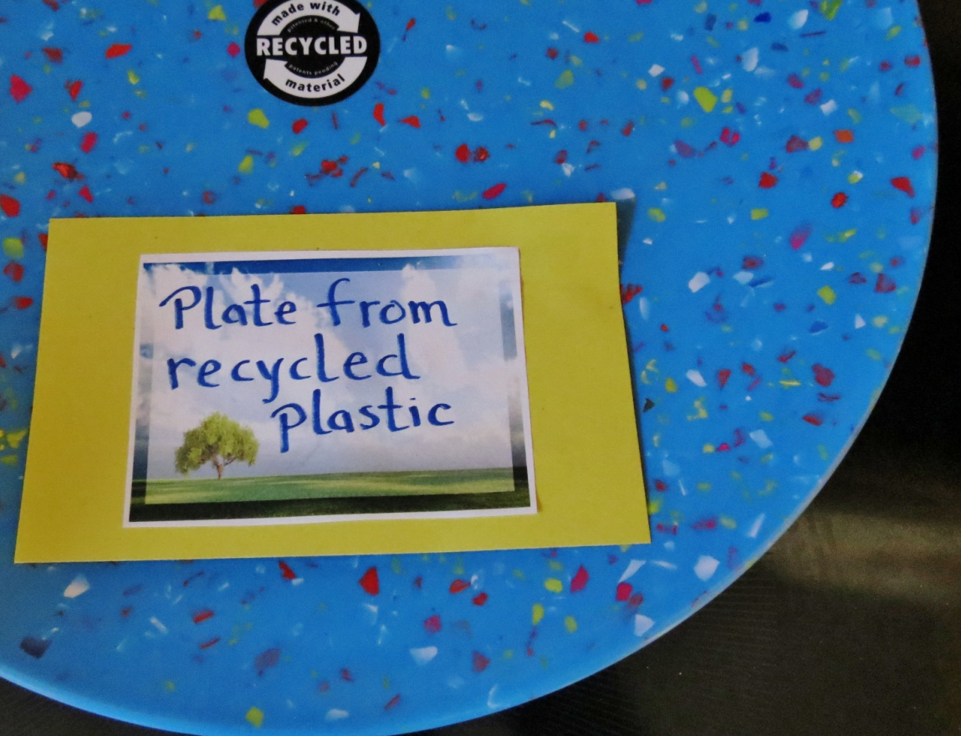

Slide 22
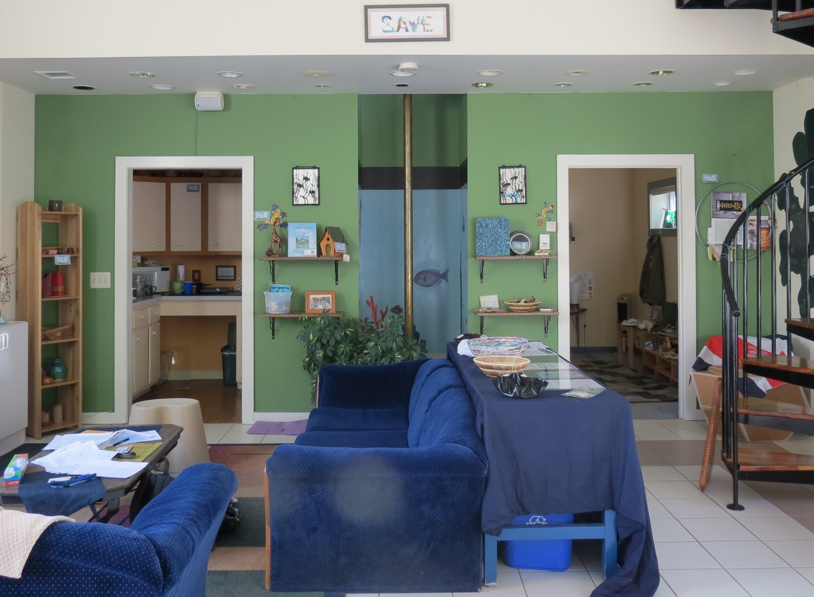

Slide 23
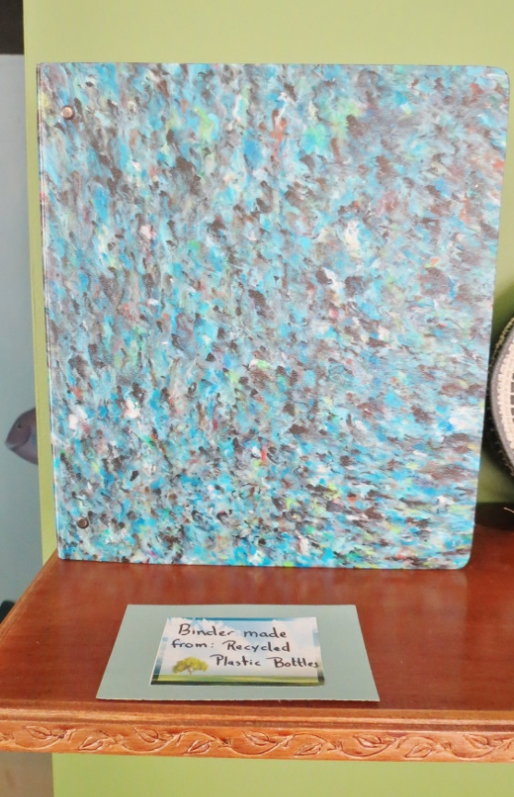
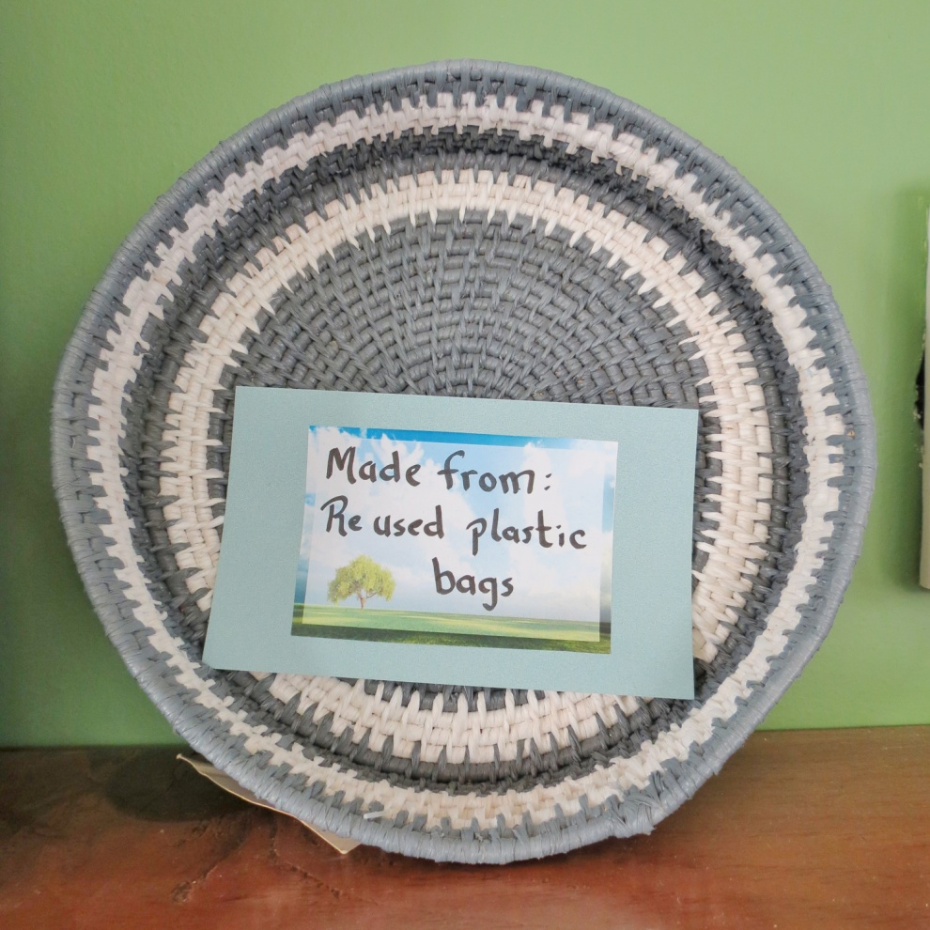
Recycled plastic notebook

Slide 25
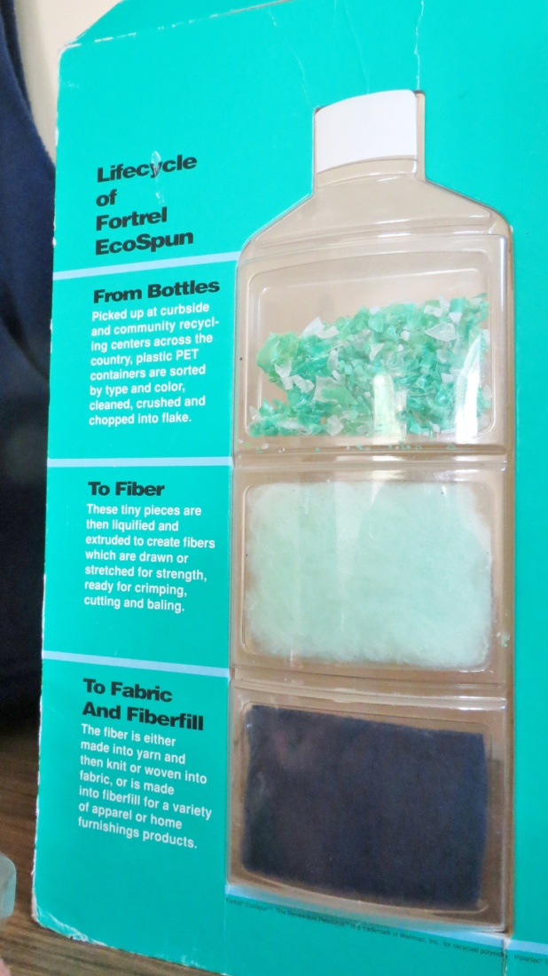
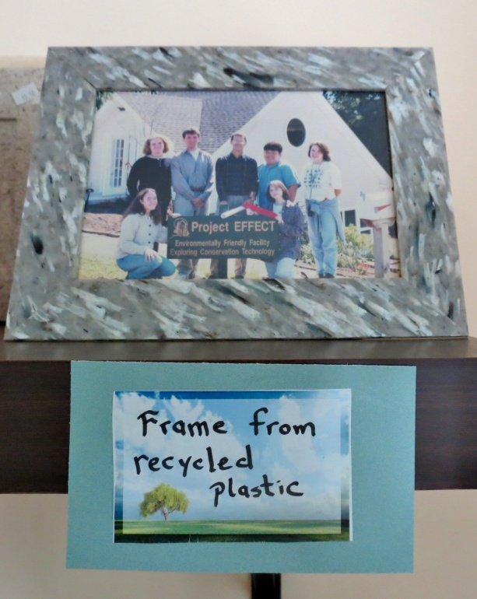
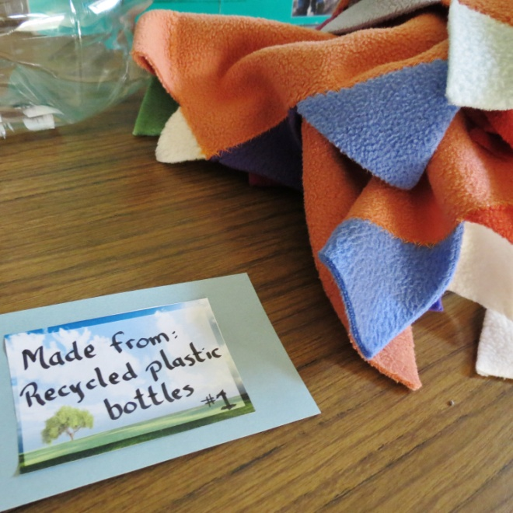

Slide 26
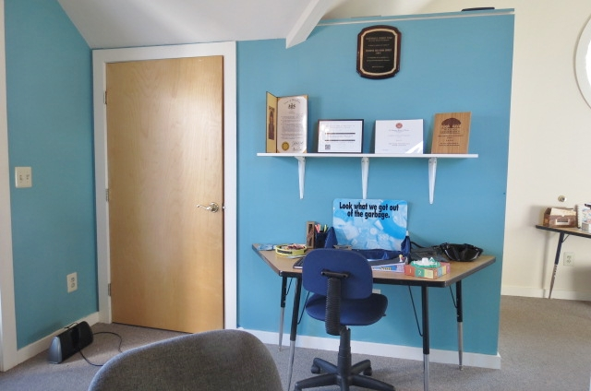

Slide 27
Recycled
Aluminum

Slide 28
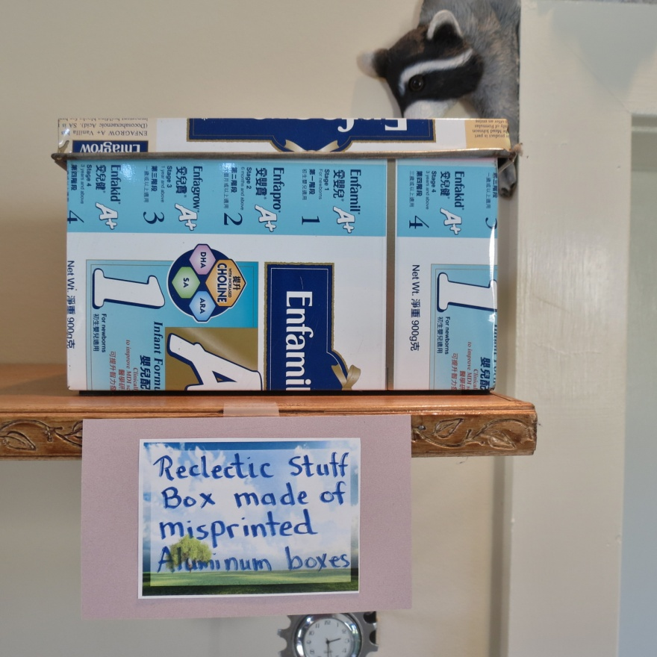

Slide 30
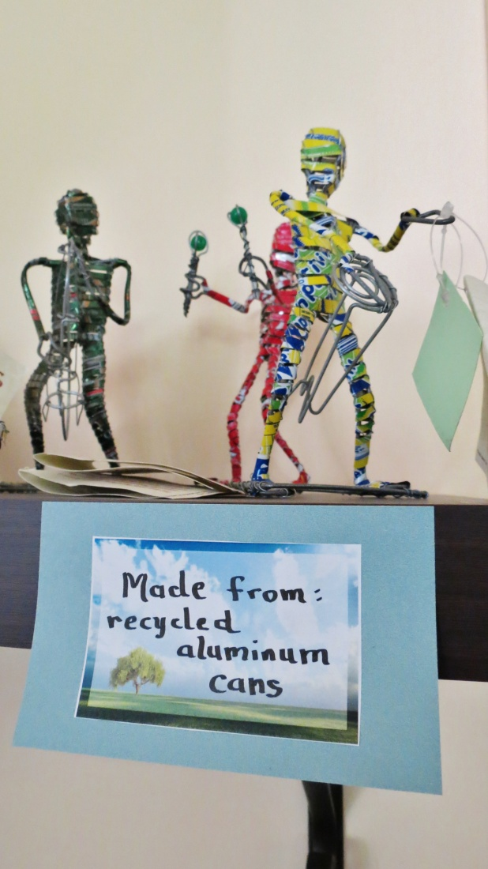
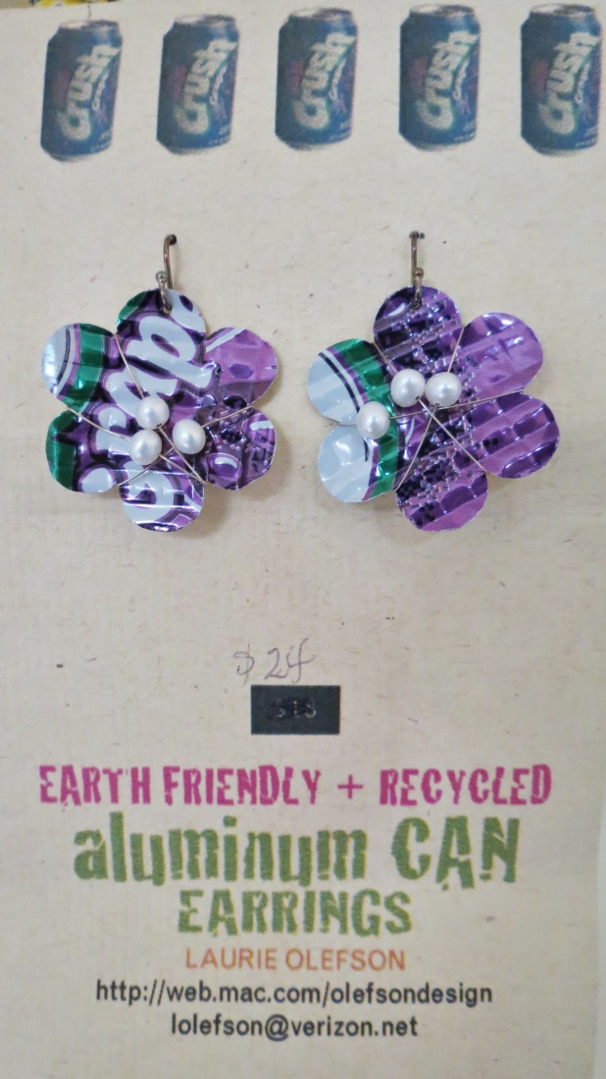

Slide 31
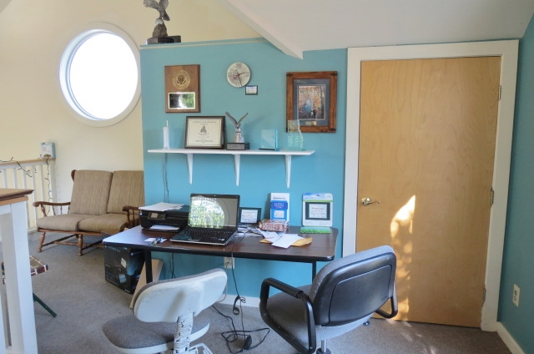
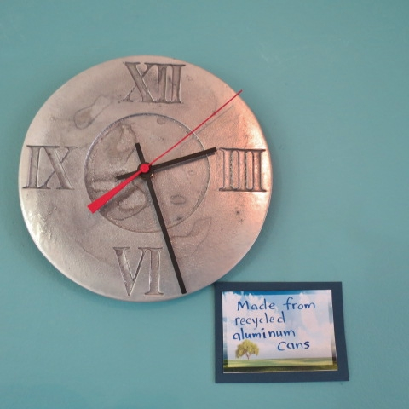

Slide 32
Recycled
Glass

Slide 33
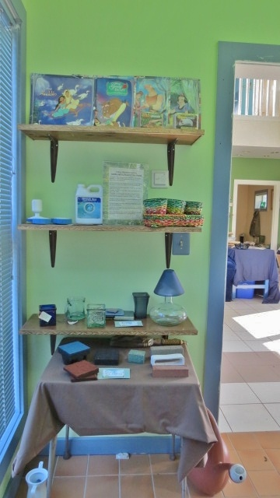
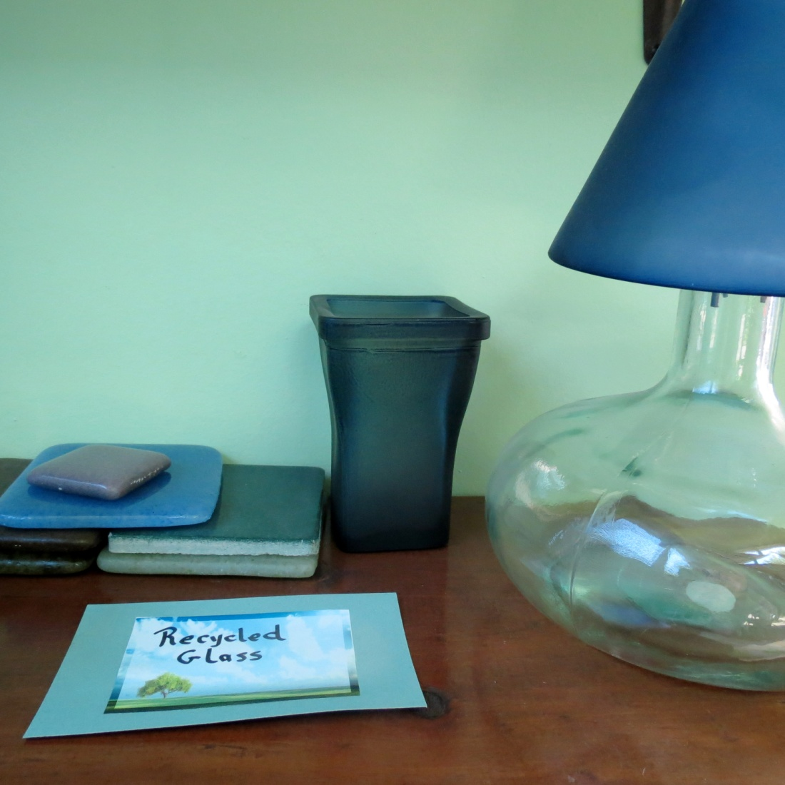
Recycled glass tile, cup and lamp

Slide 34
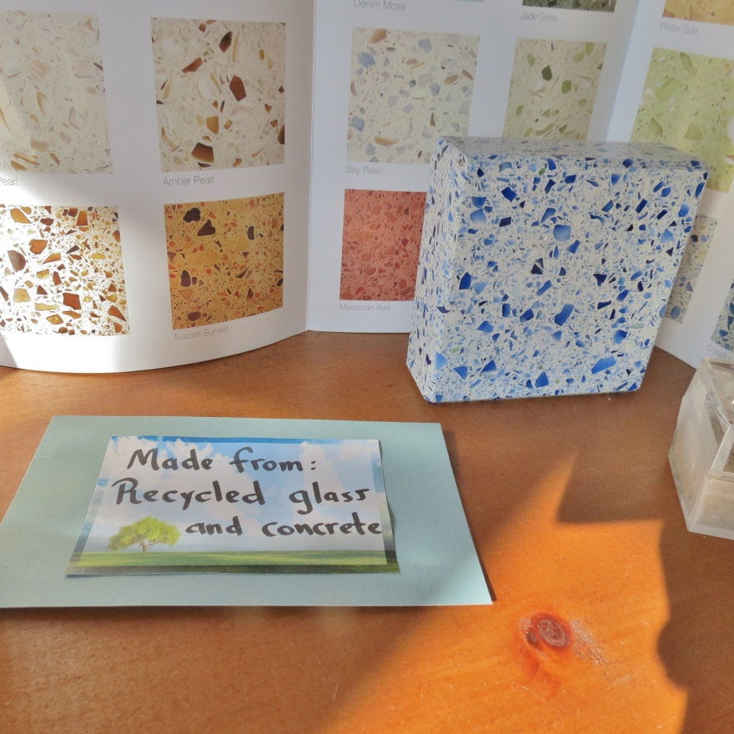

Slide 35
Recycled
Steel

Slide 36
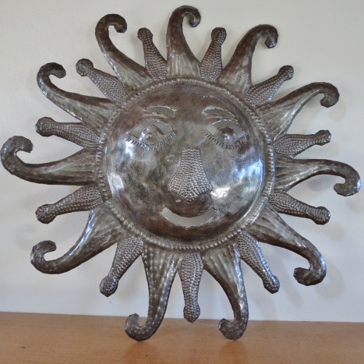

Slide 37
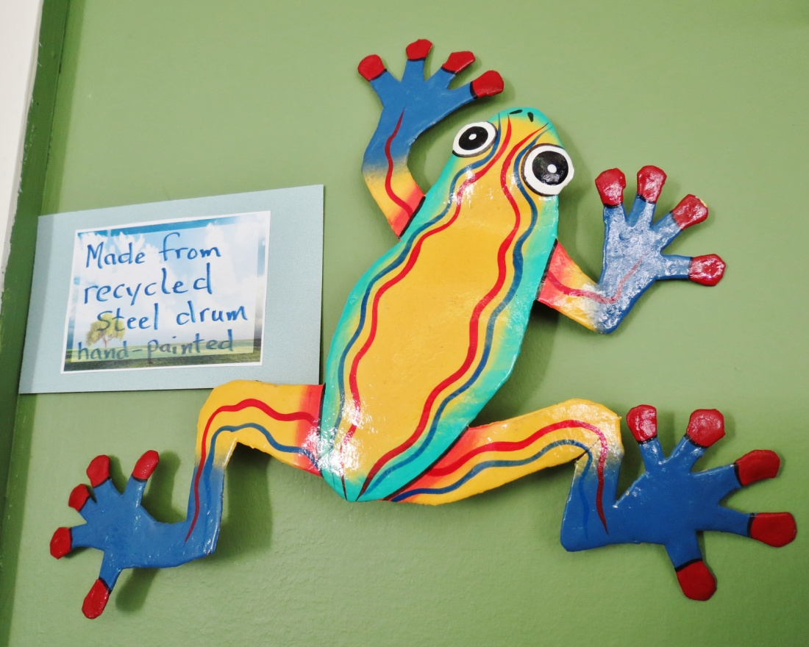

Slide 38
Recycled
Tires

Slide 39
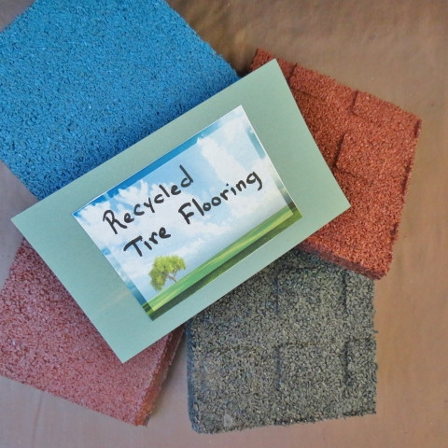

Slide 40
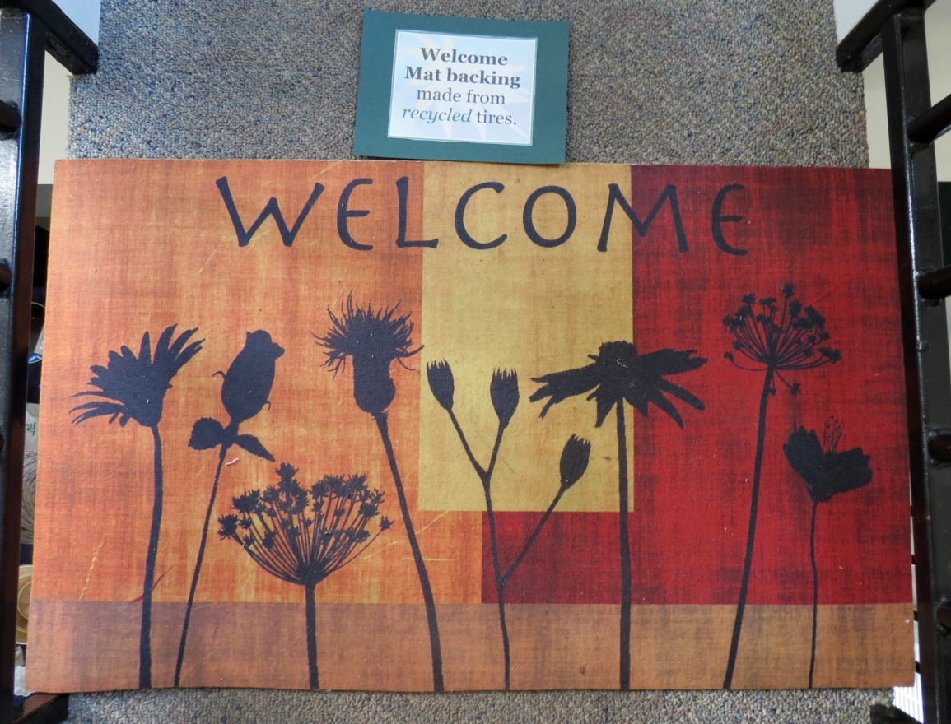
Recycled tire welcome mat

Slide 41
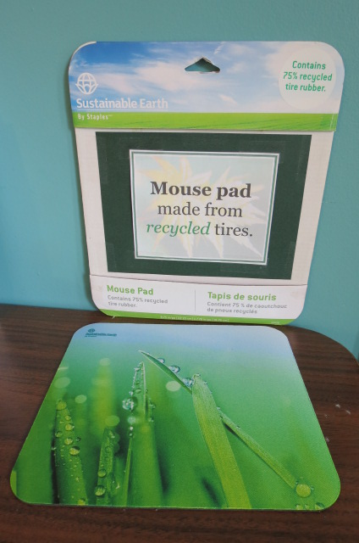

Slide 42
Recycled
Other

Slide 44
Recycled Clothing and Shoes

Slide 46
Recycled cloth bag and candle holder made from bicycle parts

Slide 48
Recycled Crayons
Notebook made from recycled paper and computer keyboard

Slide 55
Alternative Materials
Paper

Slide 57
Coffee Paper, Banana Tree Paper, and other natural fiber papers

Slide 60
Alternative Materials
Wood

Slide 64
Cardboard

Slide 67
Is it
Organic?

Slide 68
Is this?

Slide 69
Is this?

Slide 70
Yes!

Slide 71
Not this!

Slide 72
Reclaimed
Wood

Slide 74
Steps made from reclaimed wood

