Slide 1
SAVE Basics

Slide 2
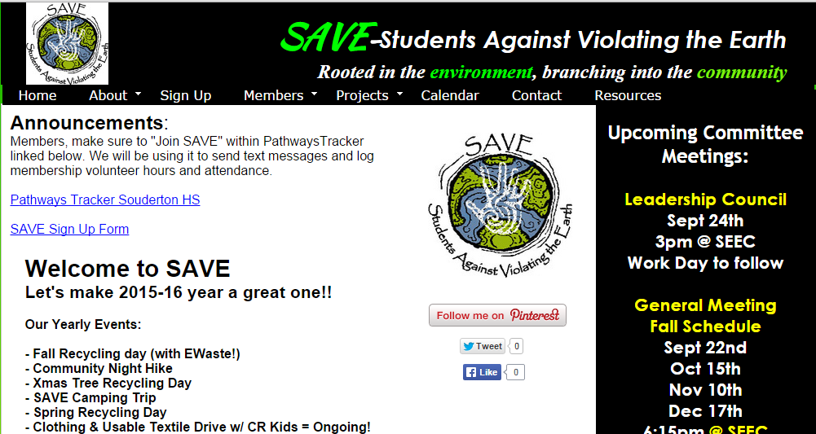
SAVE’s Website

Slide 3
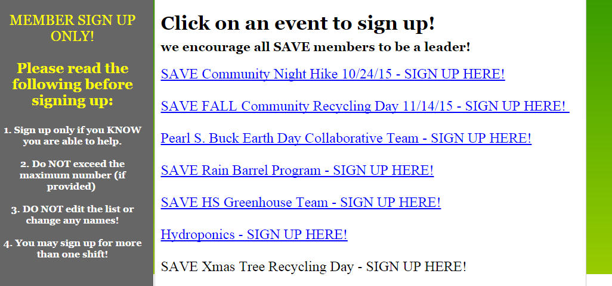

Slide 4
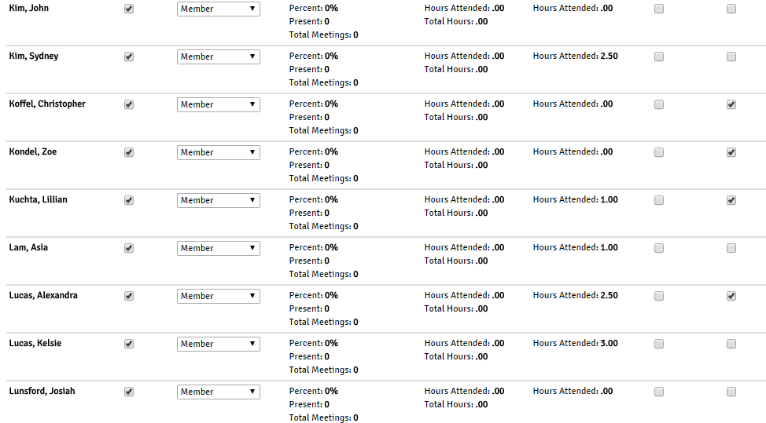
Pathways Tracker – Click “Join SAVE”

Slide 5
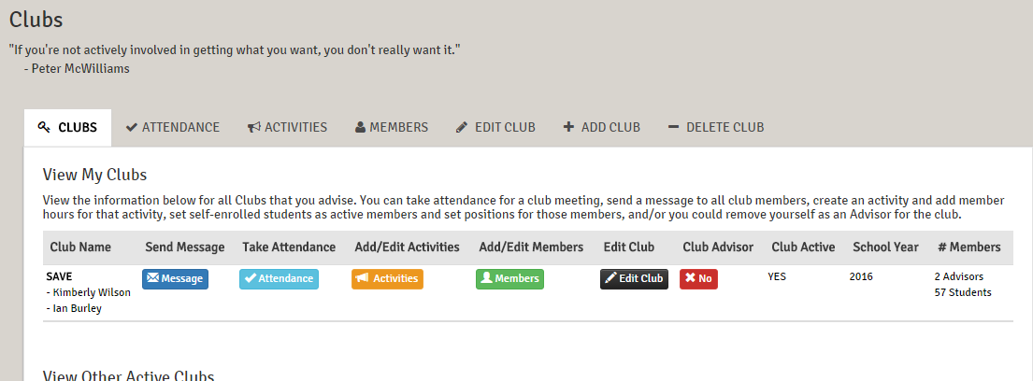
Pathways Tracker – Click “Join SAVE”

Slide 7
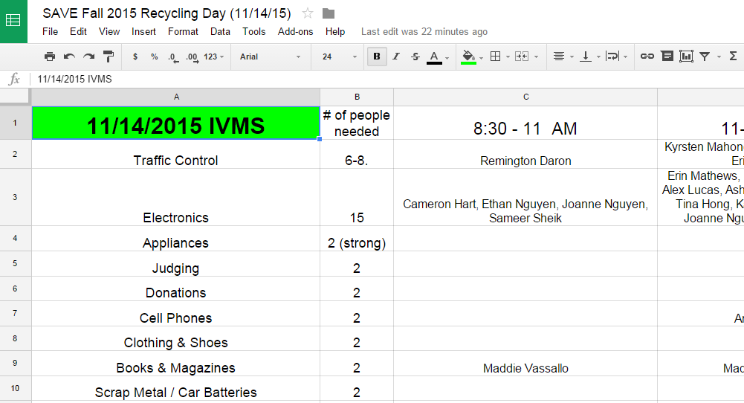
Tires
Bulbs

Slide 8
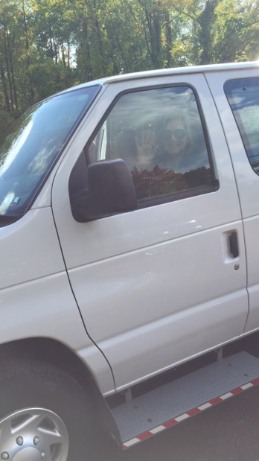
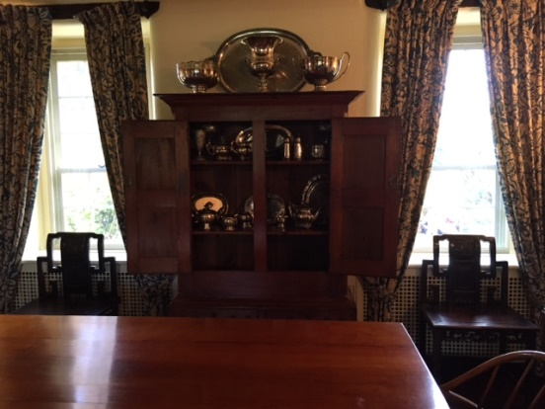
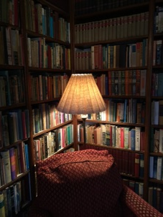
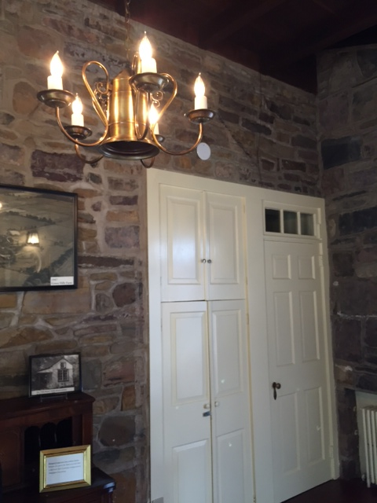
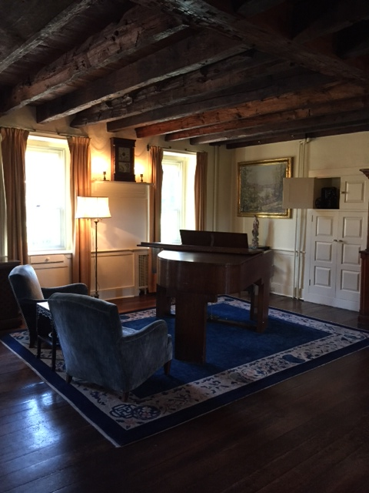
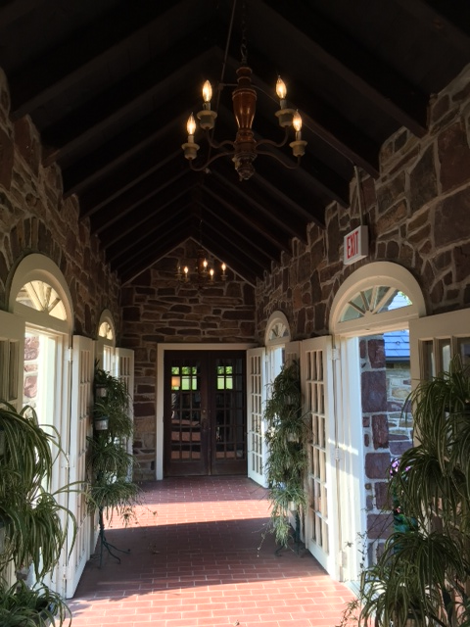
Pearl Buck House Tour-- October 2015

Slide 9
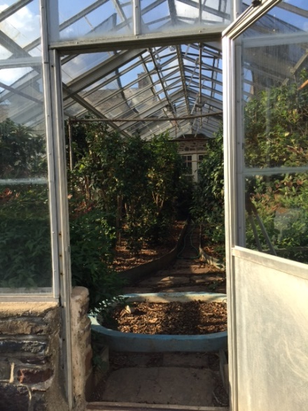
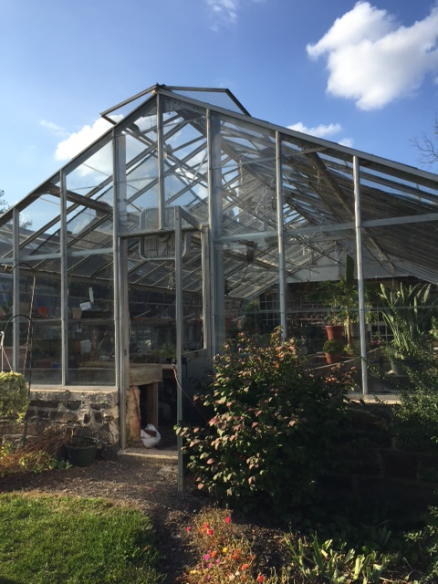
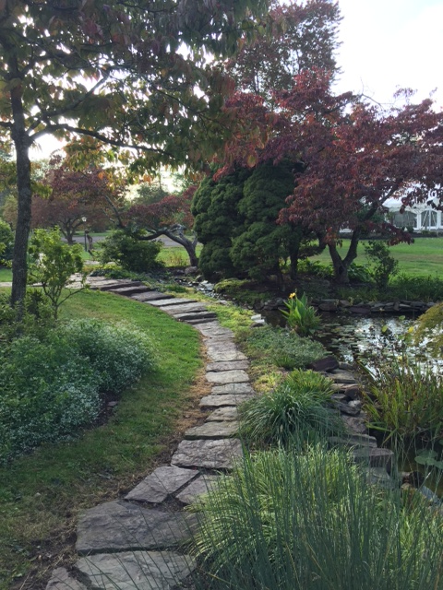
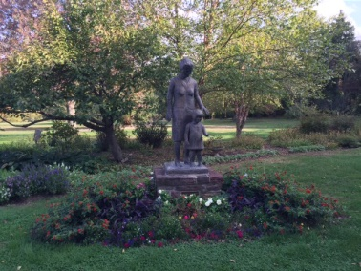
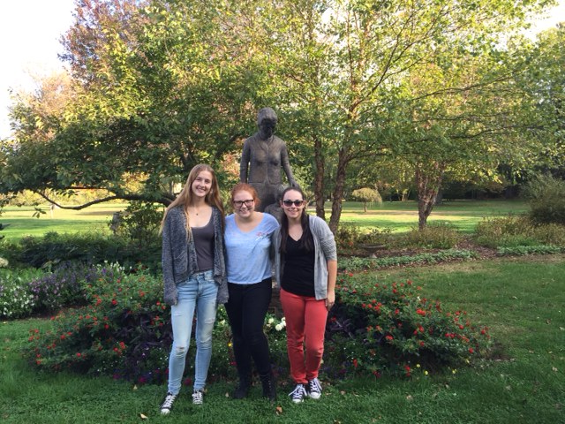

Slide 10
DelVal University Trip
Greenhouse and Aquaponics Team

Slide 11
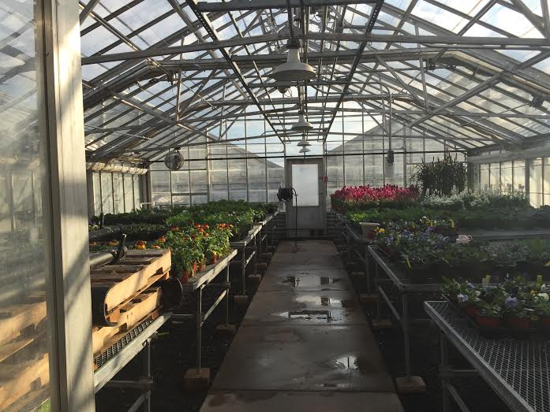
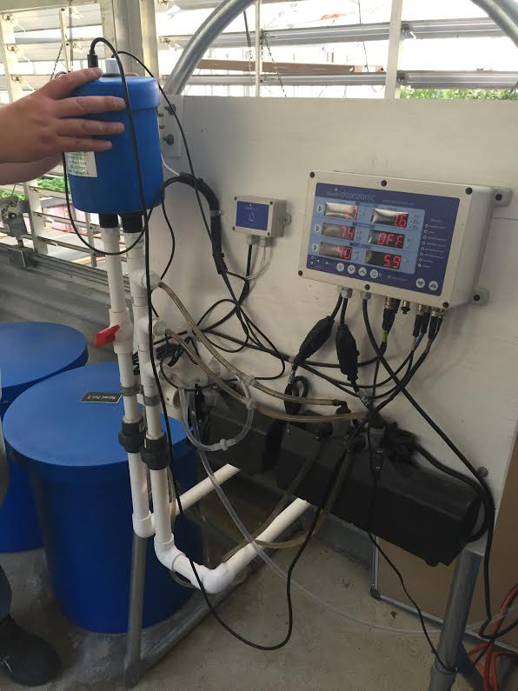

Slide 12
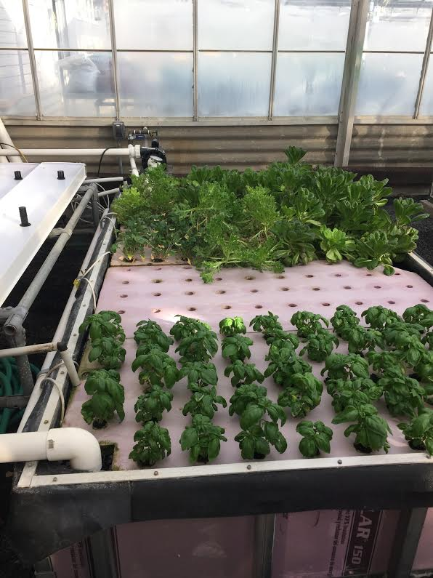
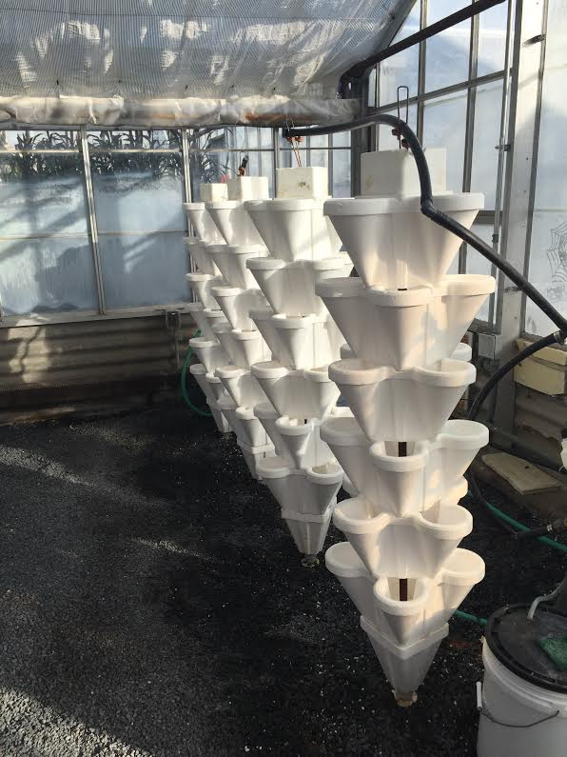
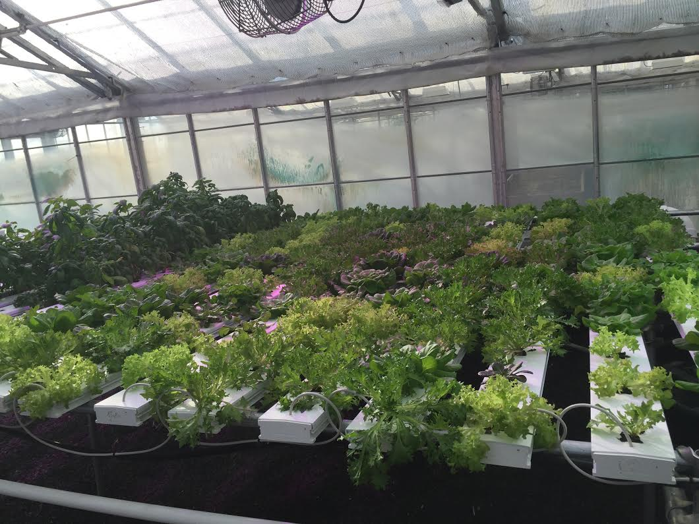
Different Aquaponics Systems
Nutrient Film Technique(NFT)
Deep Water Culture(DWC)

Slide 13
Get Involved!
Next Greenhouse meeting:
Wednesday, October 21, 3-4 pm, SAVE House
- Designs and logistics for installing a greenhouse
Looking for Leaders!!
Decide on structure, characteristics, placement, next steps.

Slide 14
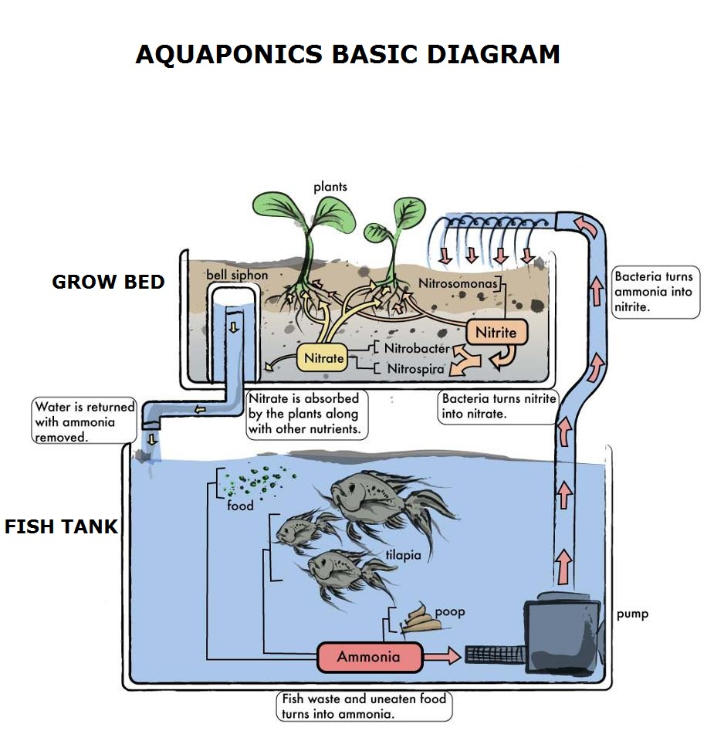

Slide 15
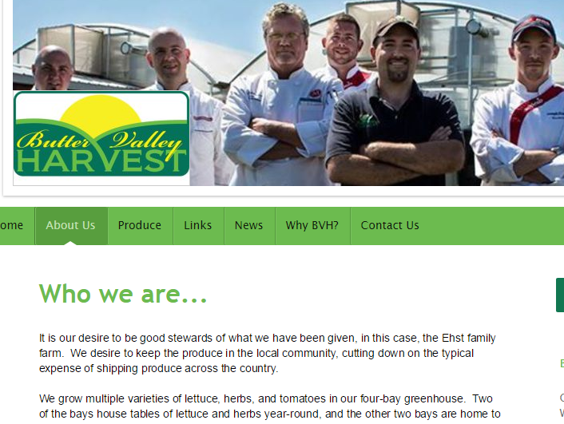

Slide 16
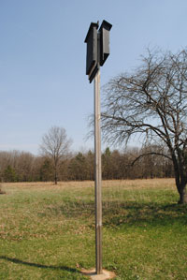

Slide 17
Butterfly Garden Update
What we did:
Soil was prepared for planting
Plants purchased and planted
Mulched
Remaining tasks:
Create signs of explanation with QR codes
Audio recording of garden details

Slide 18
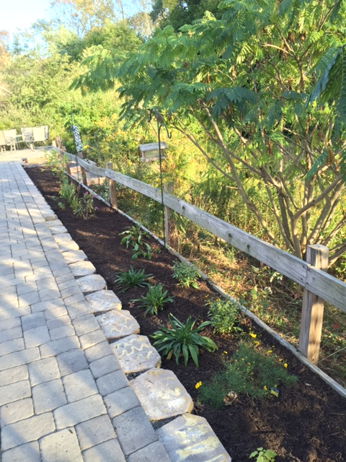
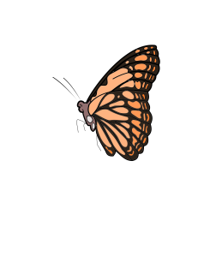
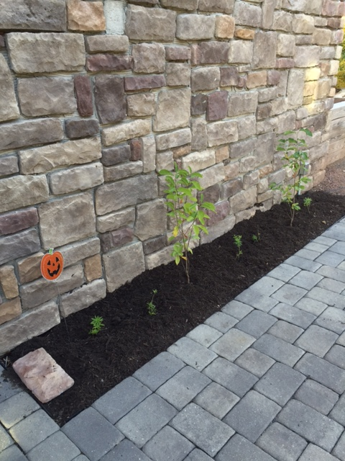
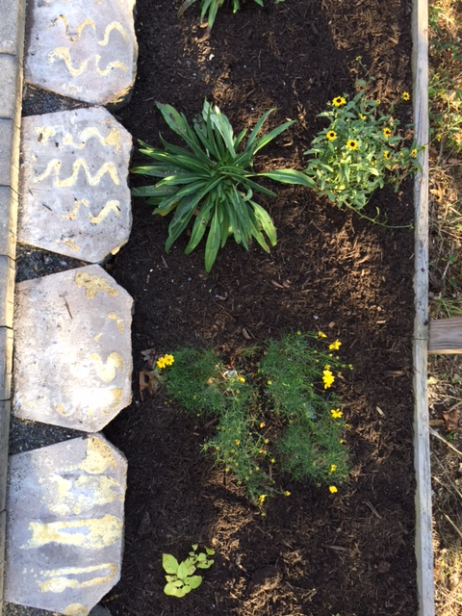

Slide 19
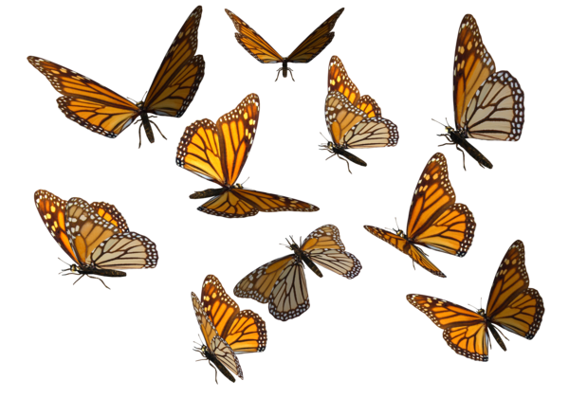
Welcome Guest Speaker!
Marc Radell
Master Gardener Volunteer
Certified by the Pennsylvania State University Extension of Montgomery County

Slide 20
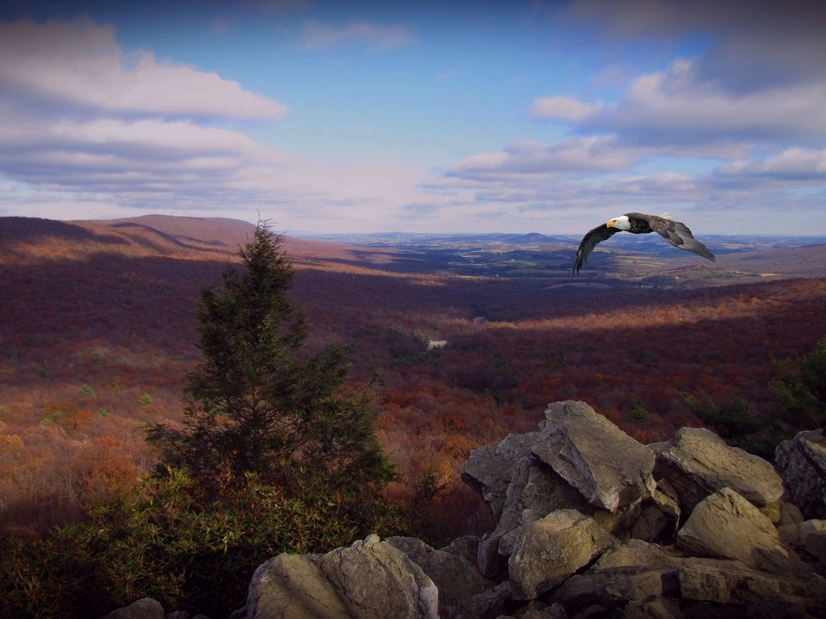
HAWK MTN – 10/31

Slide 21
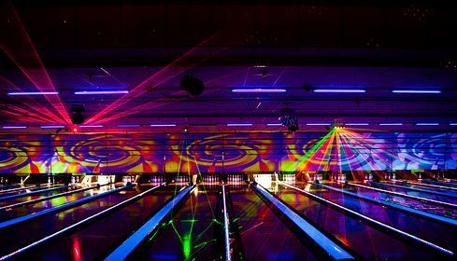
SAVE Rock-n-Bowl Social – December?

Slide 22
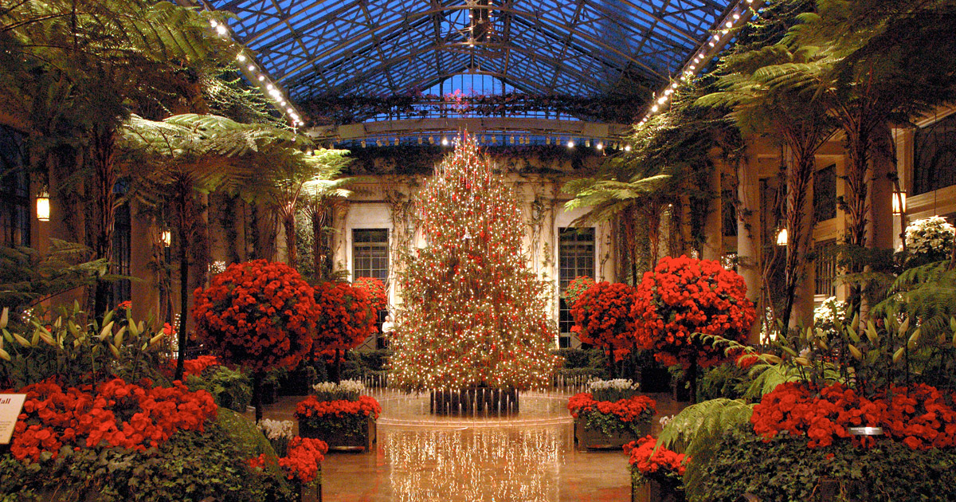

Slide 23
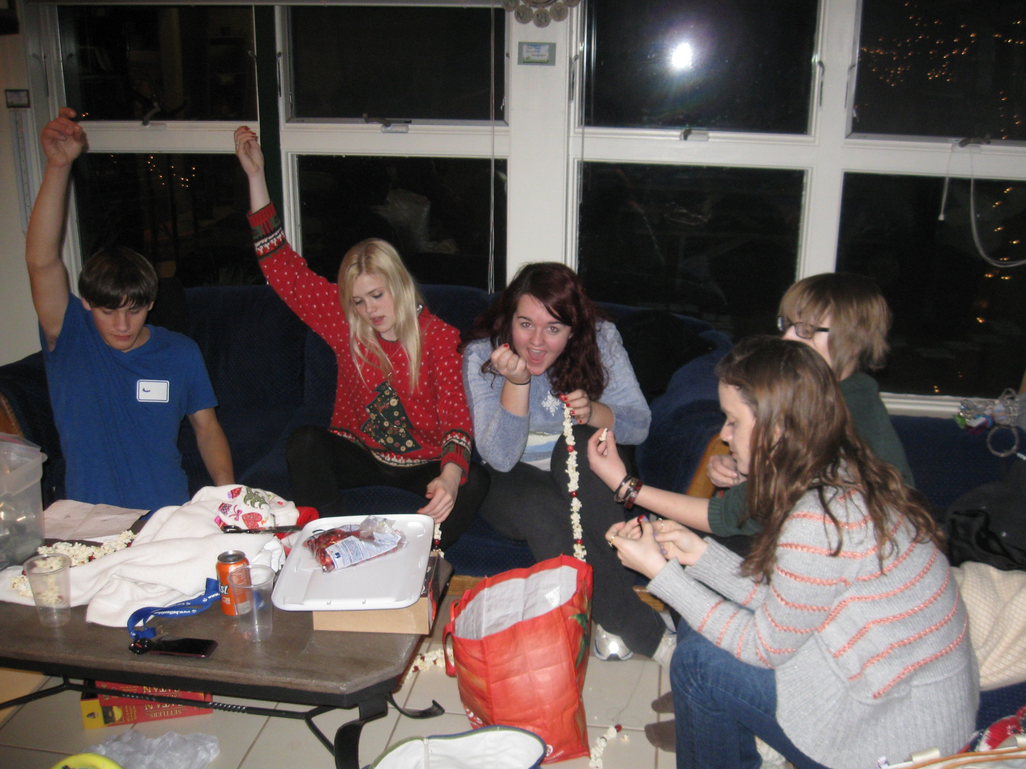
Holiday Party – Ugly Sweater with White Elephant

Slide 24
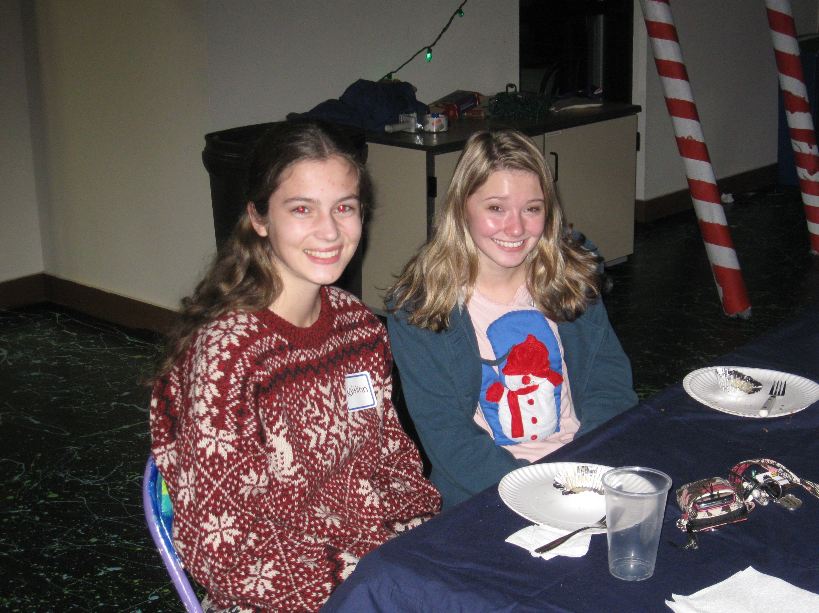

Slide 26
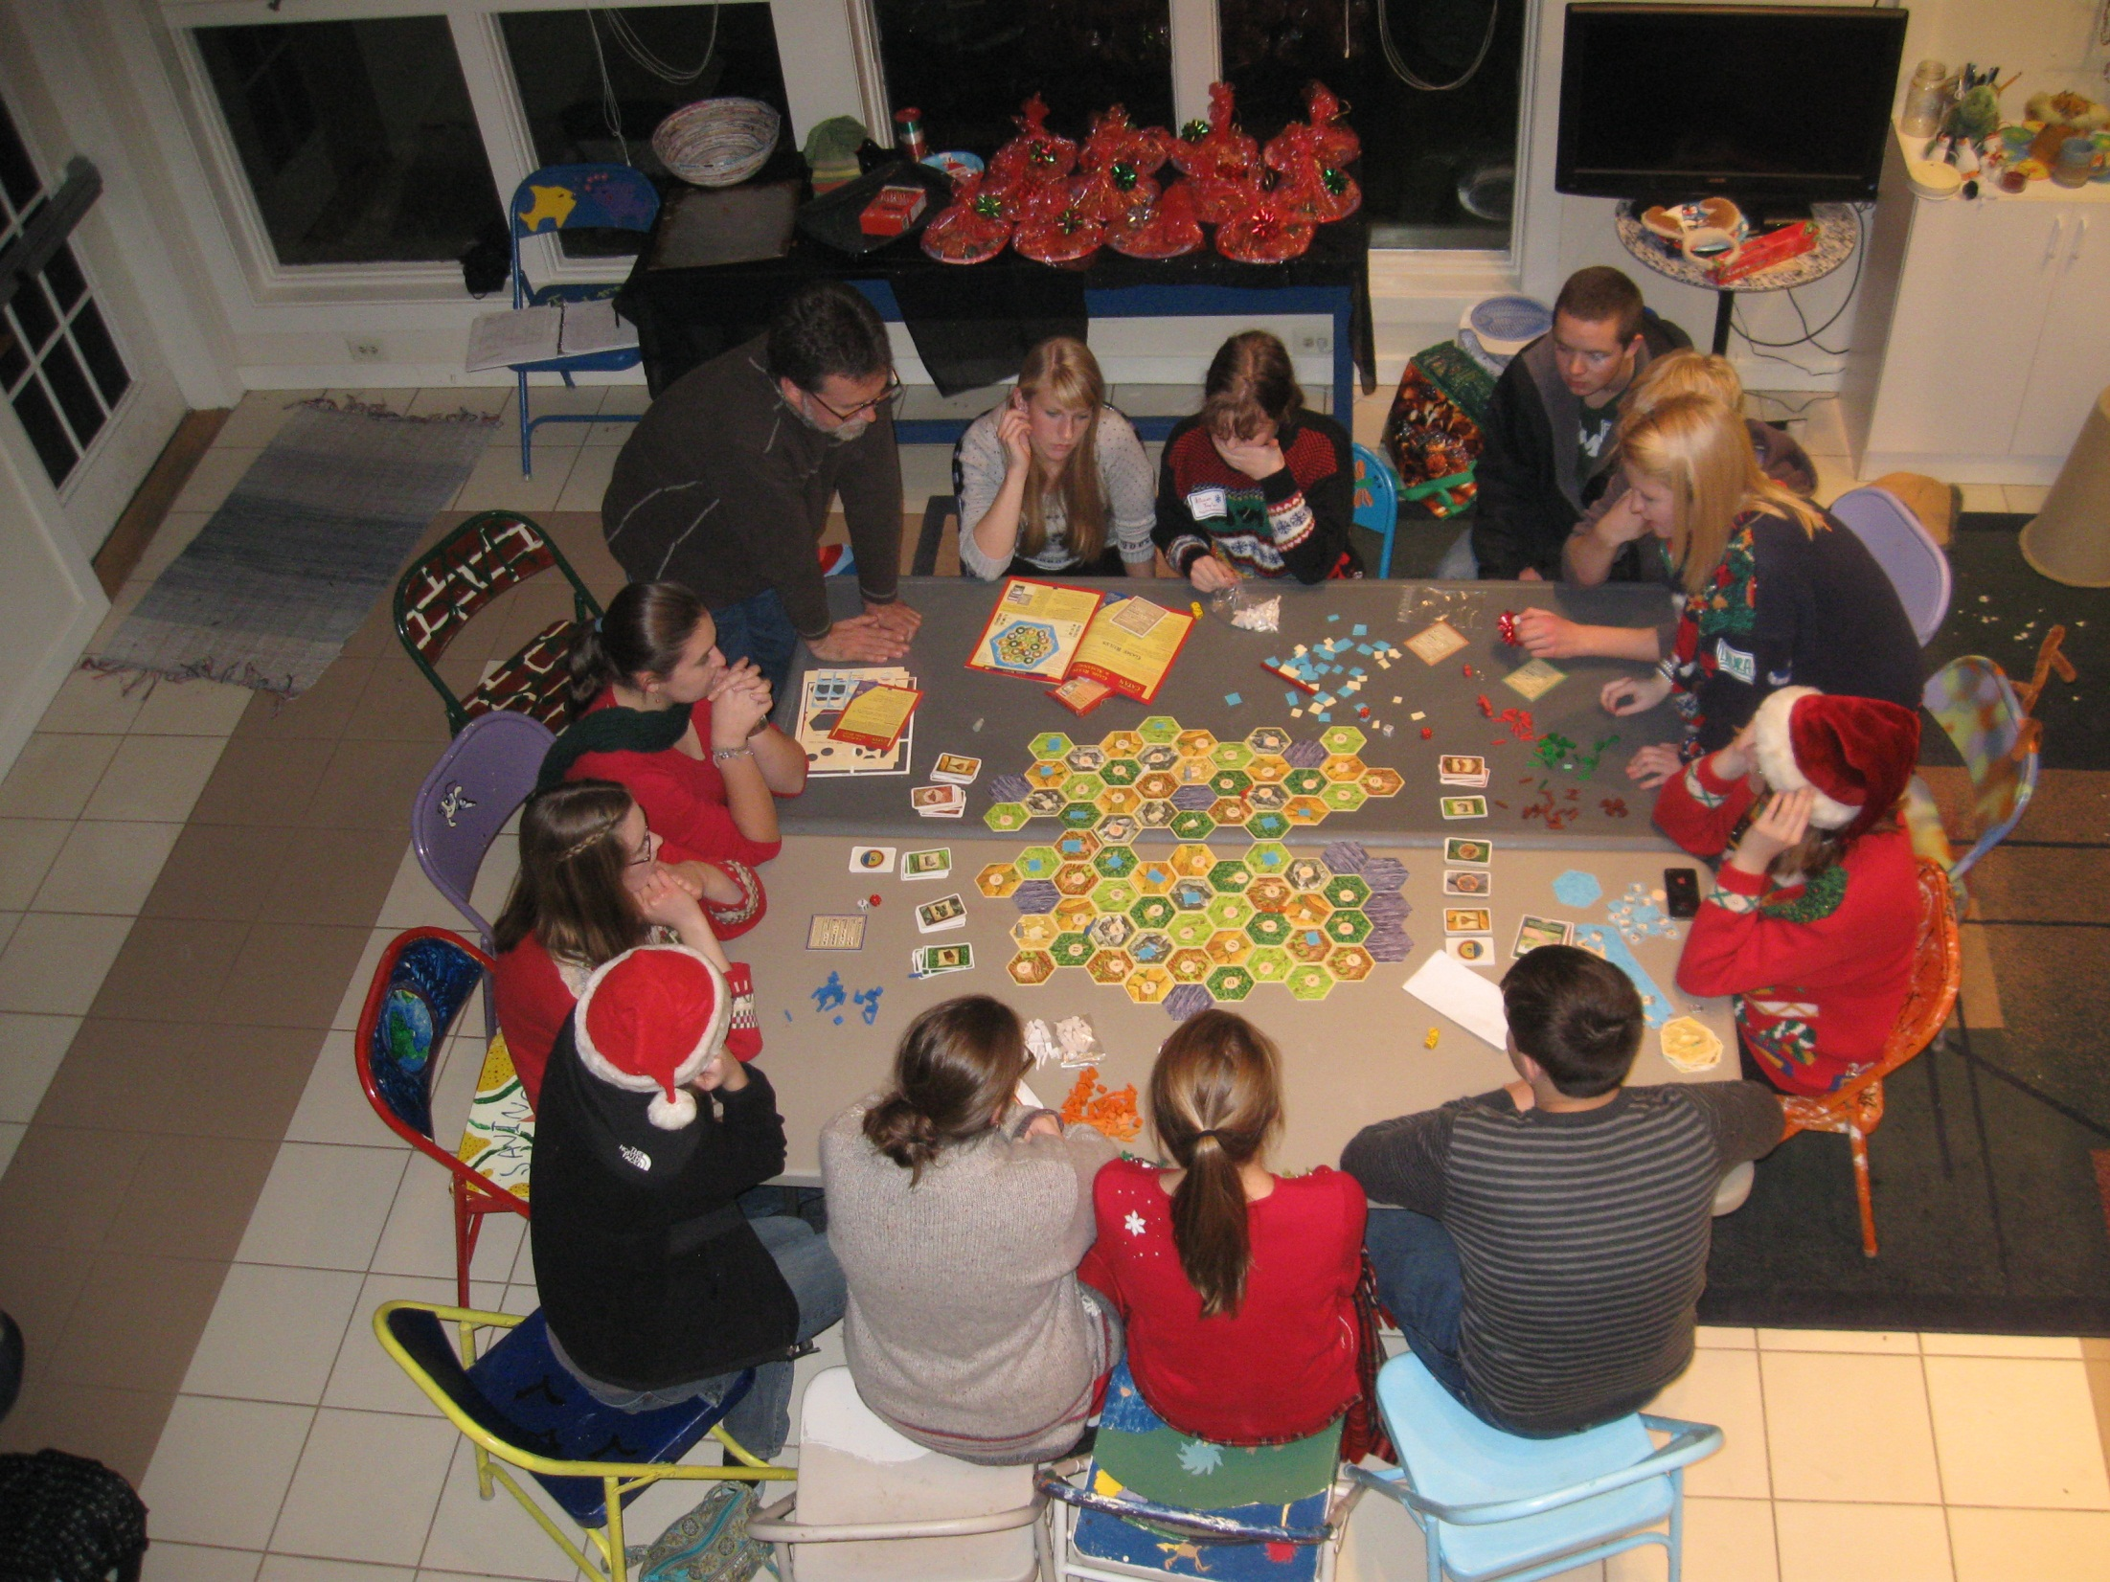

Slide 27
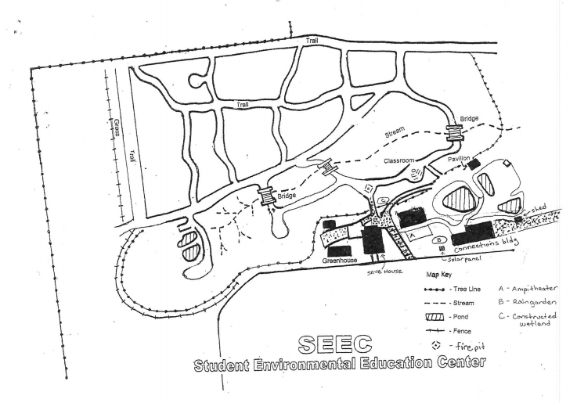

Slide 28
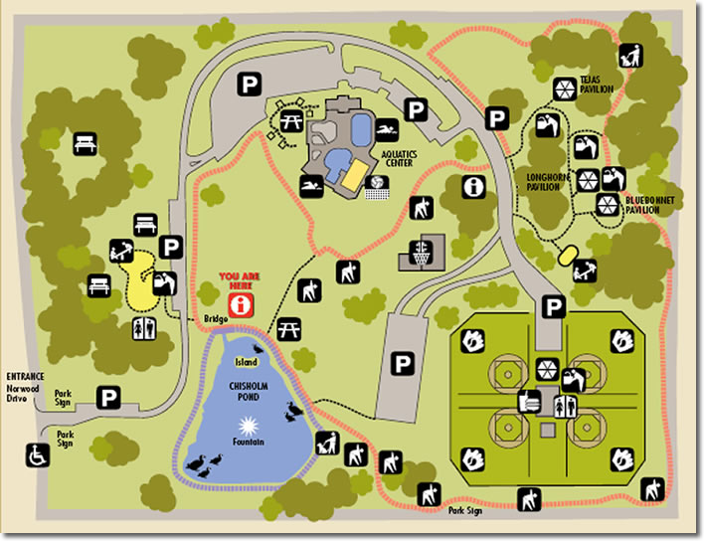

Slide 29
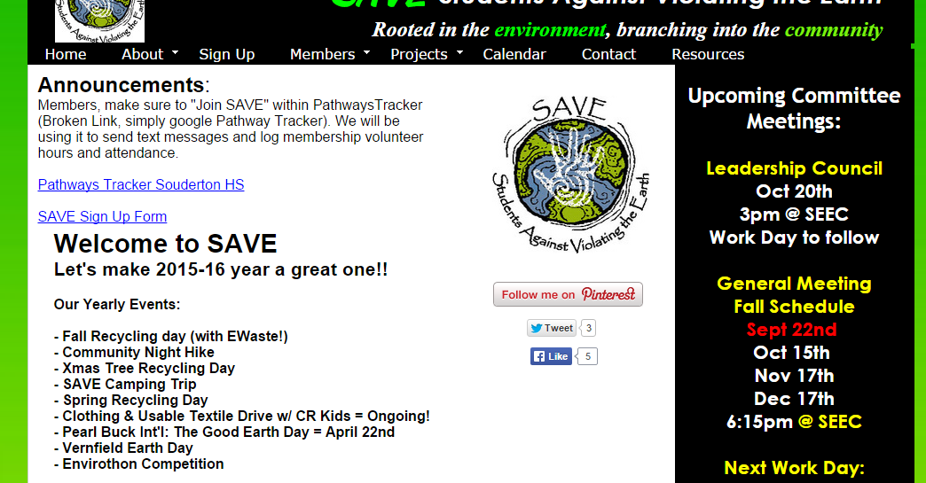

Slide 30
