Slide 1
SAVE Basics

Slide 2
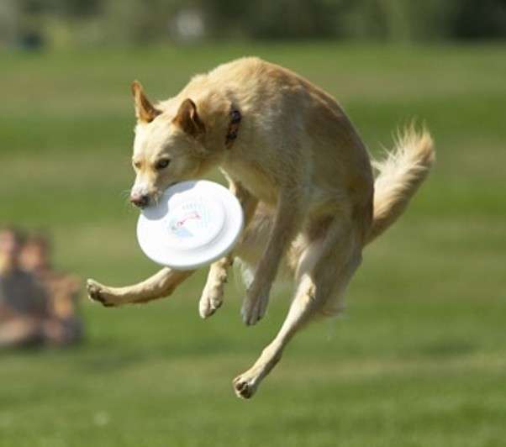
Let’s “Catch up” on 2015

Slide 3
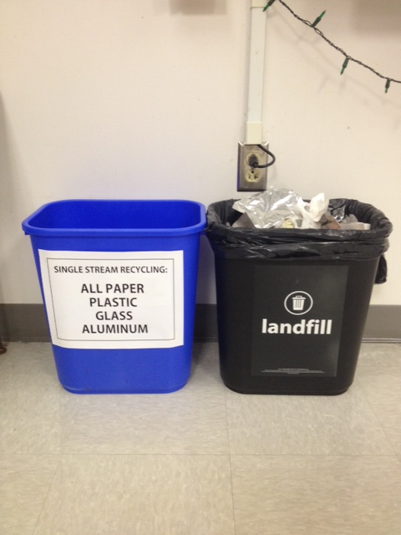
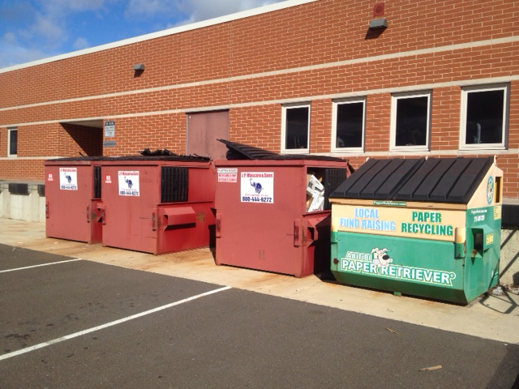
HS Recycling Program resurgence

Slide 5
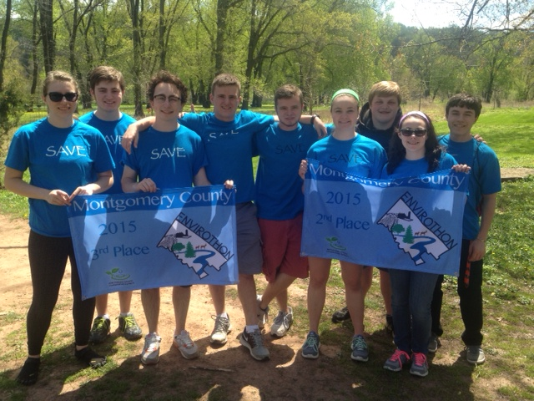
Envirothon

Slide 6
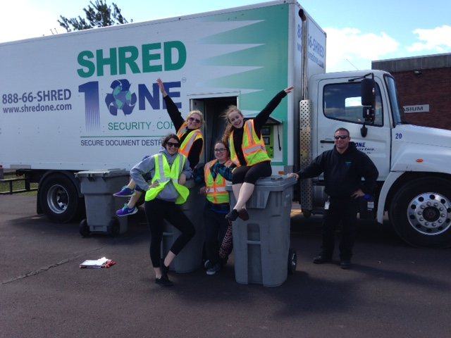

Slide 7
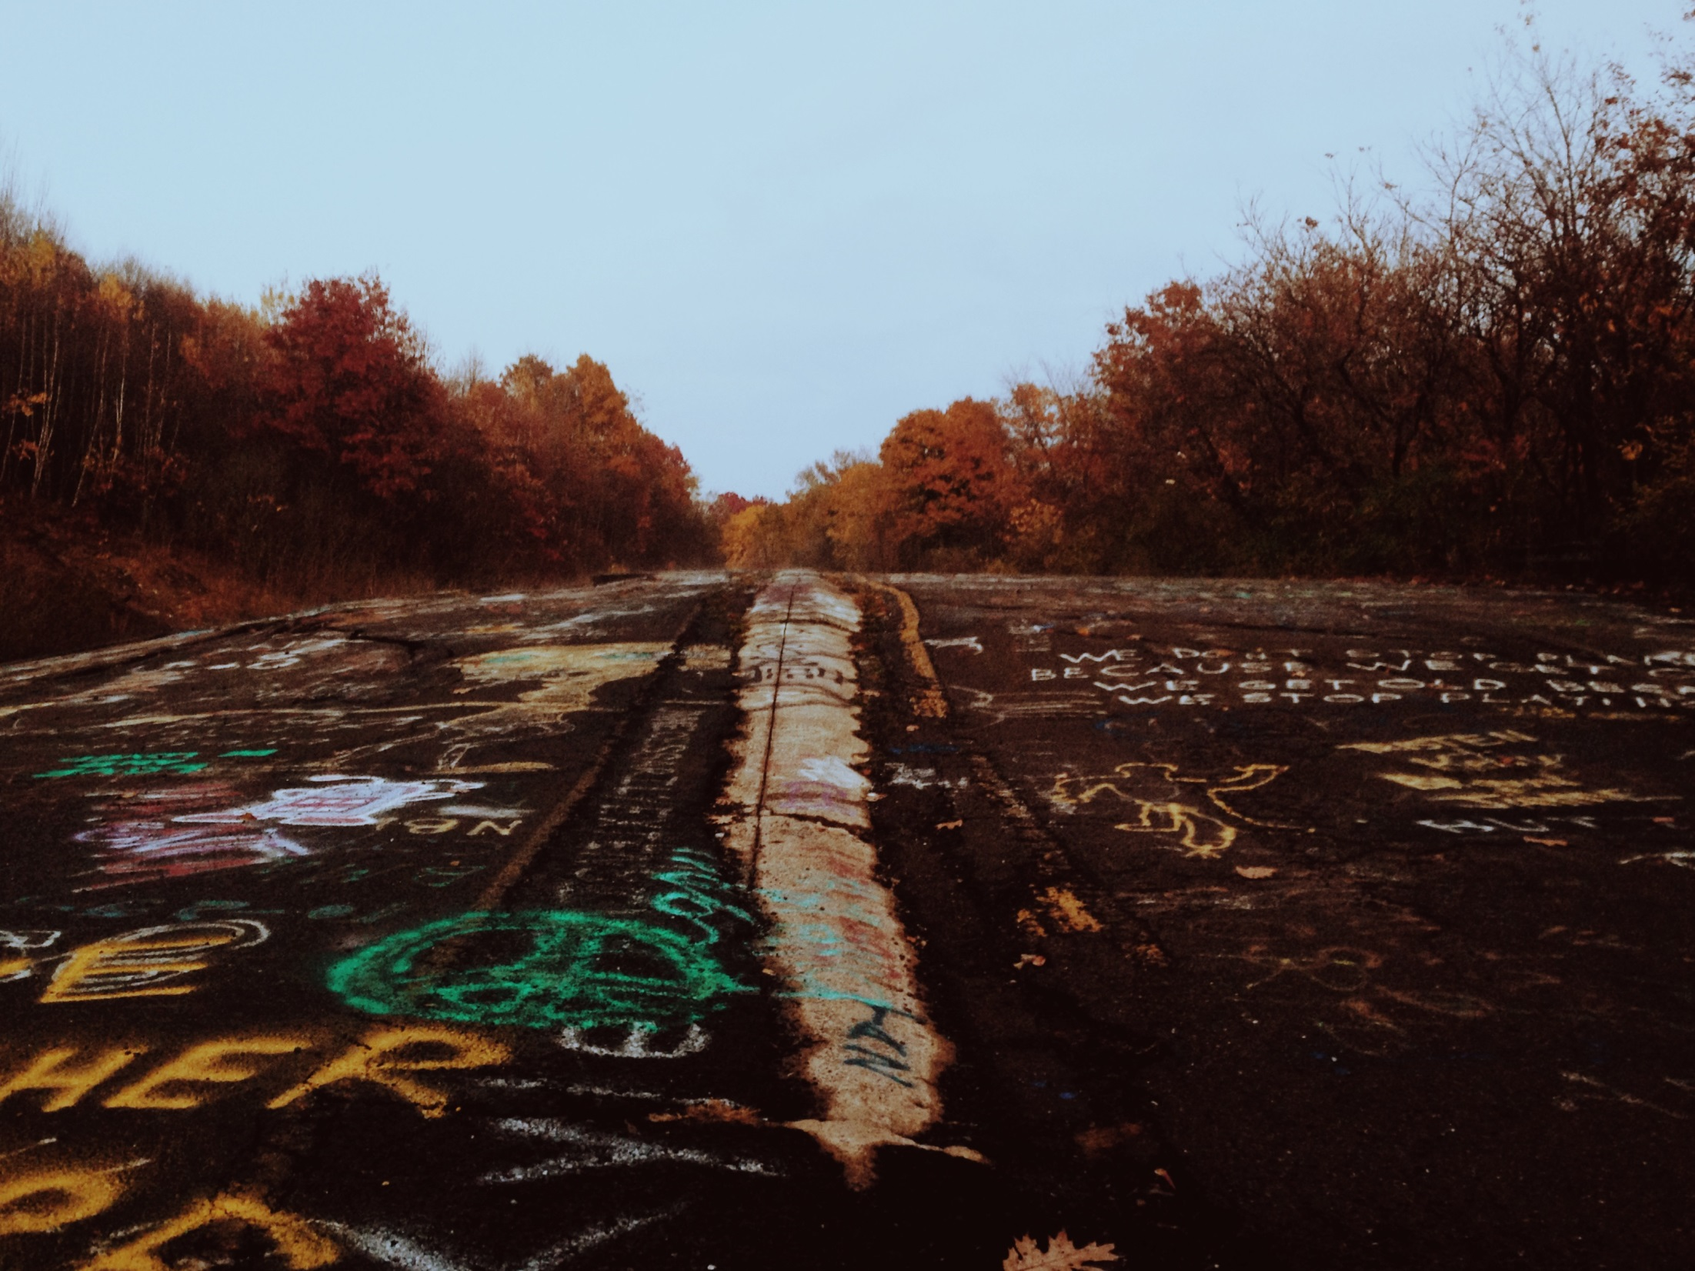

Slide 8
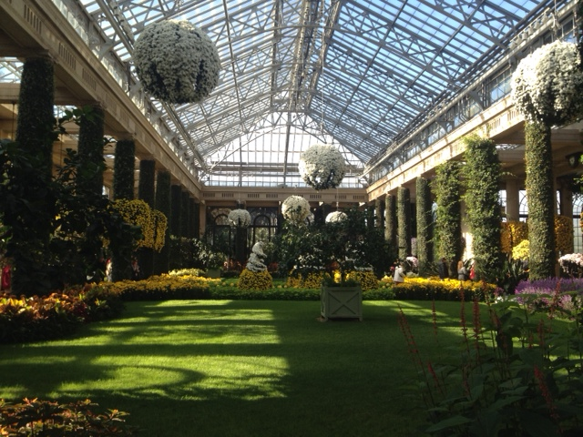

Slide 9
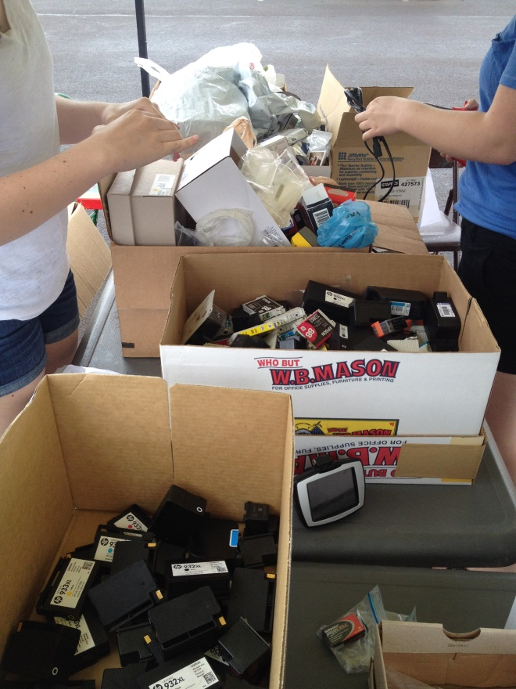
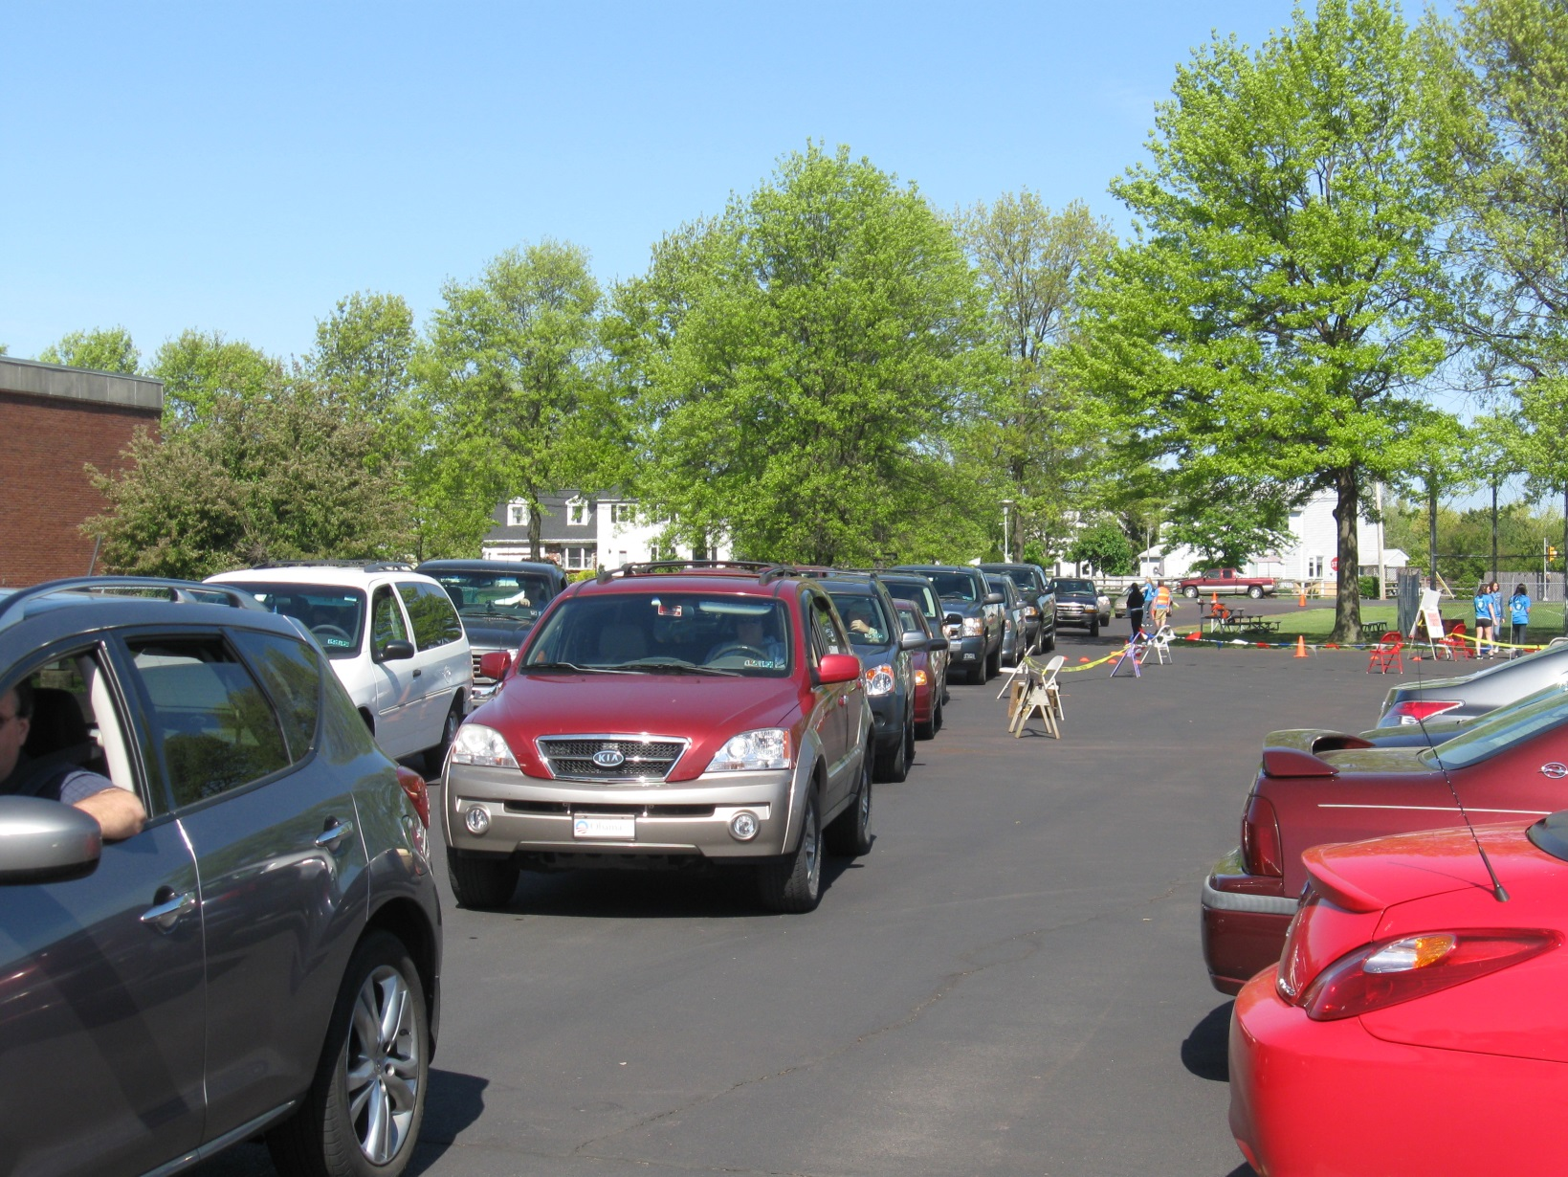

Slide 11
2015 Recycling Day Totals

Slide 12
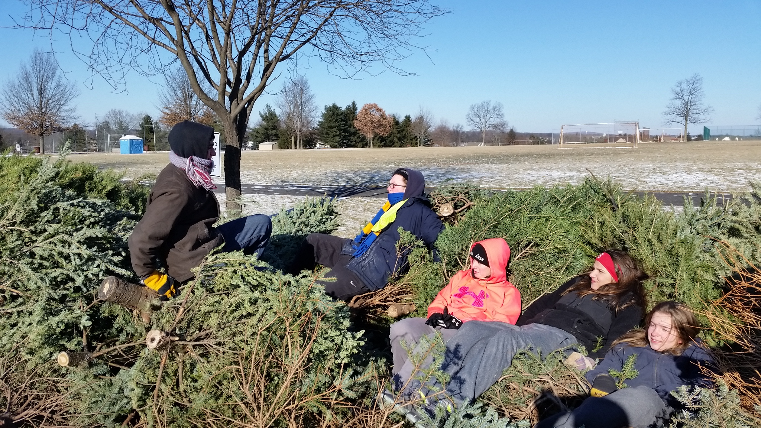

Slide 13
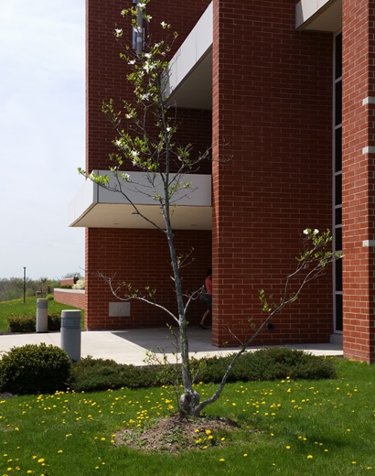

Slide 14
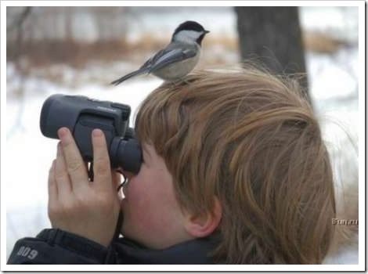
Let’s “Look Ahead”
to 2016

Slide 15
Introducing:
SAVE Officers for 2015-16
Zack Moyer – 12
Lizzie Wilson – 11
Sameer Sheik – 12
Sydney Kim – 12
Maddie Vassallo – 10
Alicia Bateman – 12

Slide 16
SAVE’s Website

Slide 17
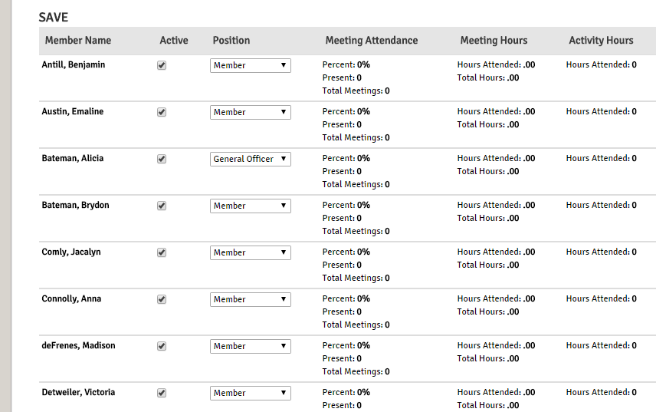
Pathways Tracker – Click “Join SAVE”

Slide 18
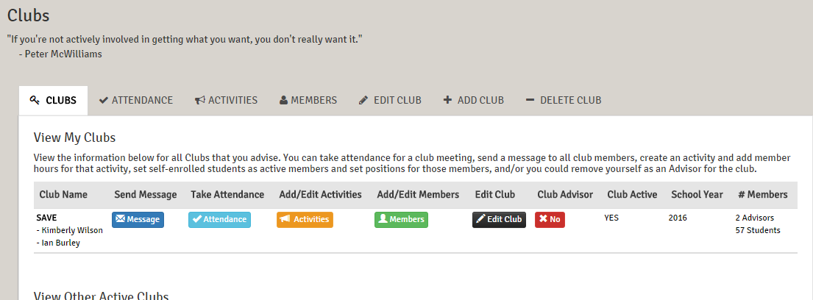
Pathways Tracker – Click “Join SAVE”

Slide 19
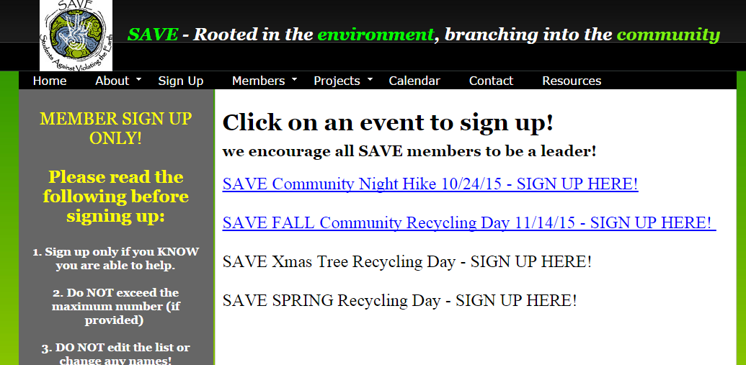

Slide 20
SAVE Night Hike Saturday October 24th – 6-9pm

Slide 24
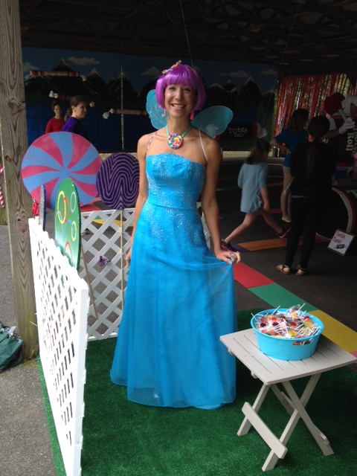

Slide 25
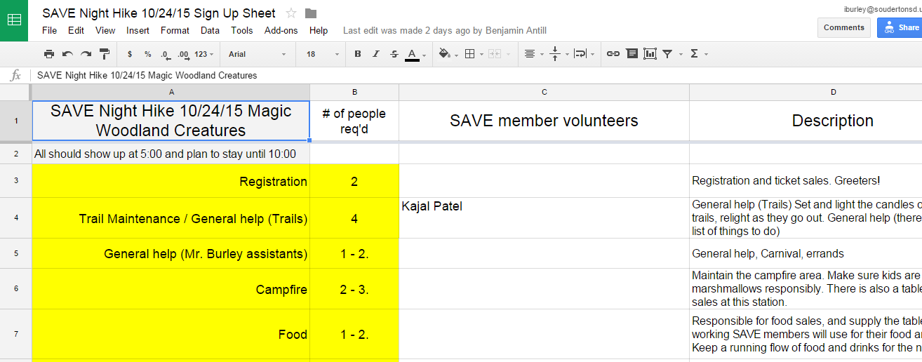

Slide 27
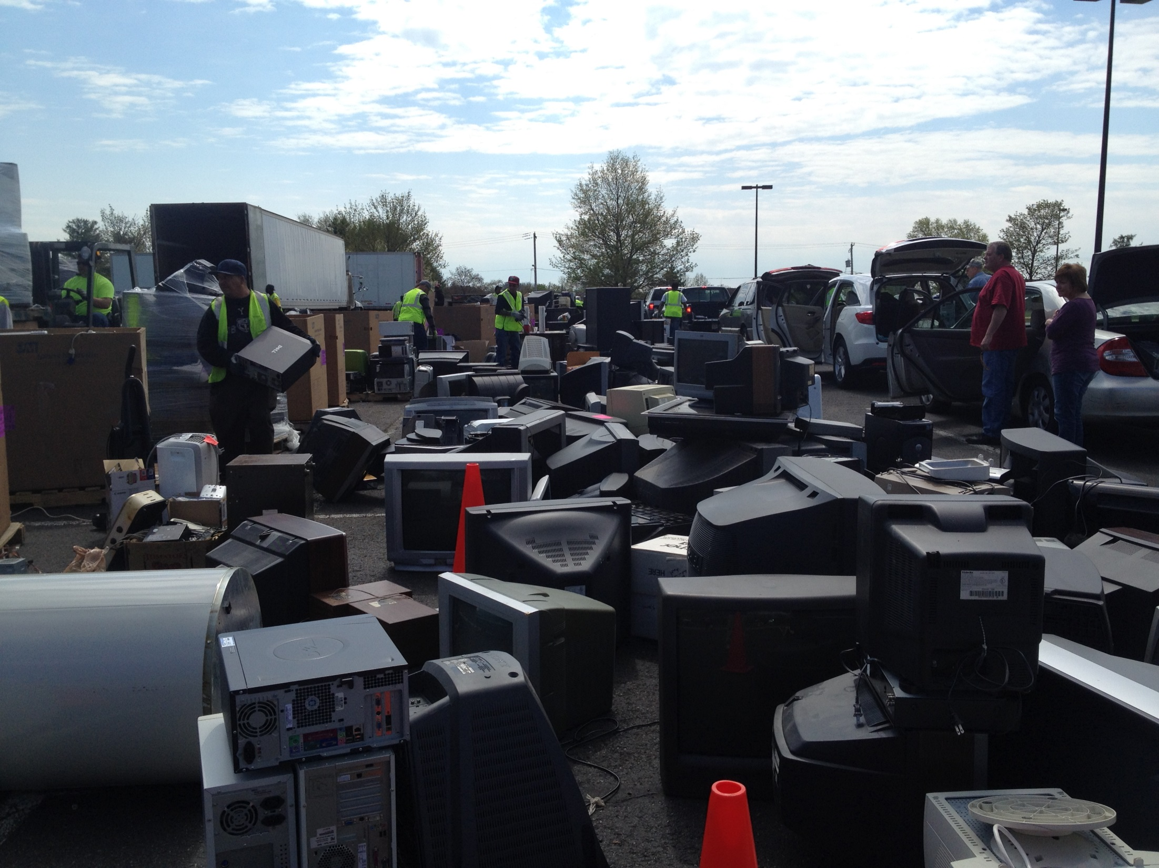

Slide 28
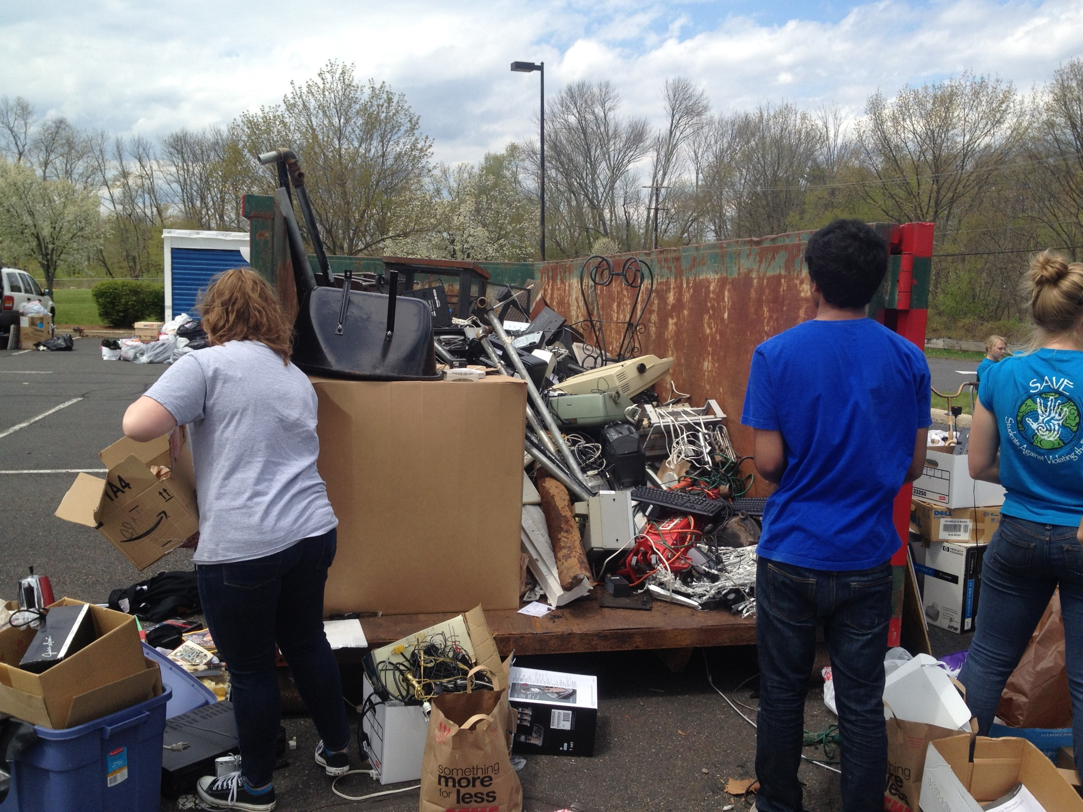

Slide 29
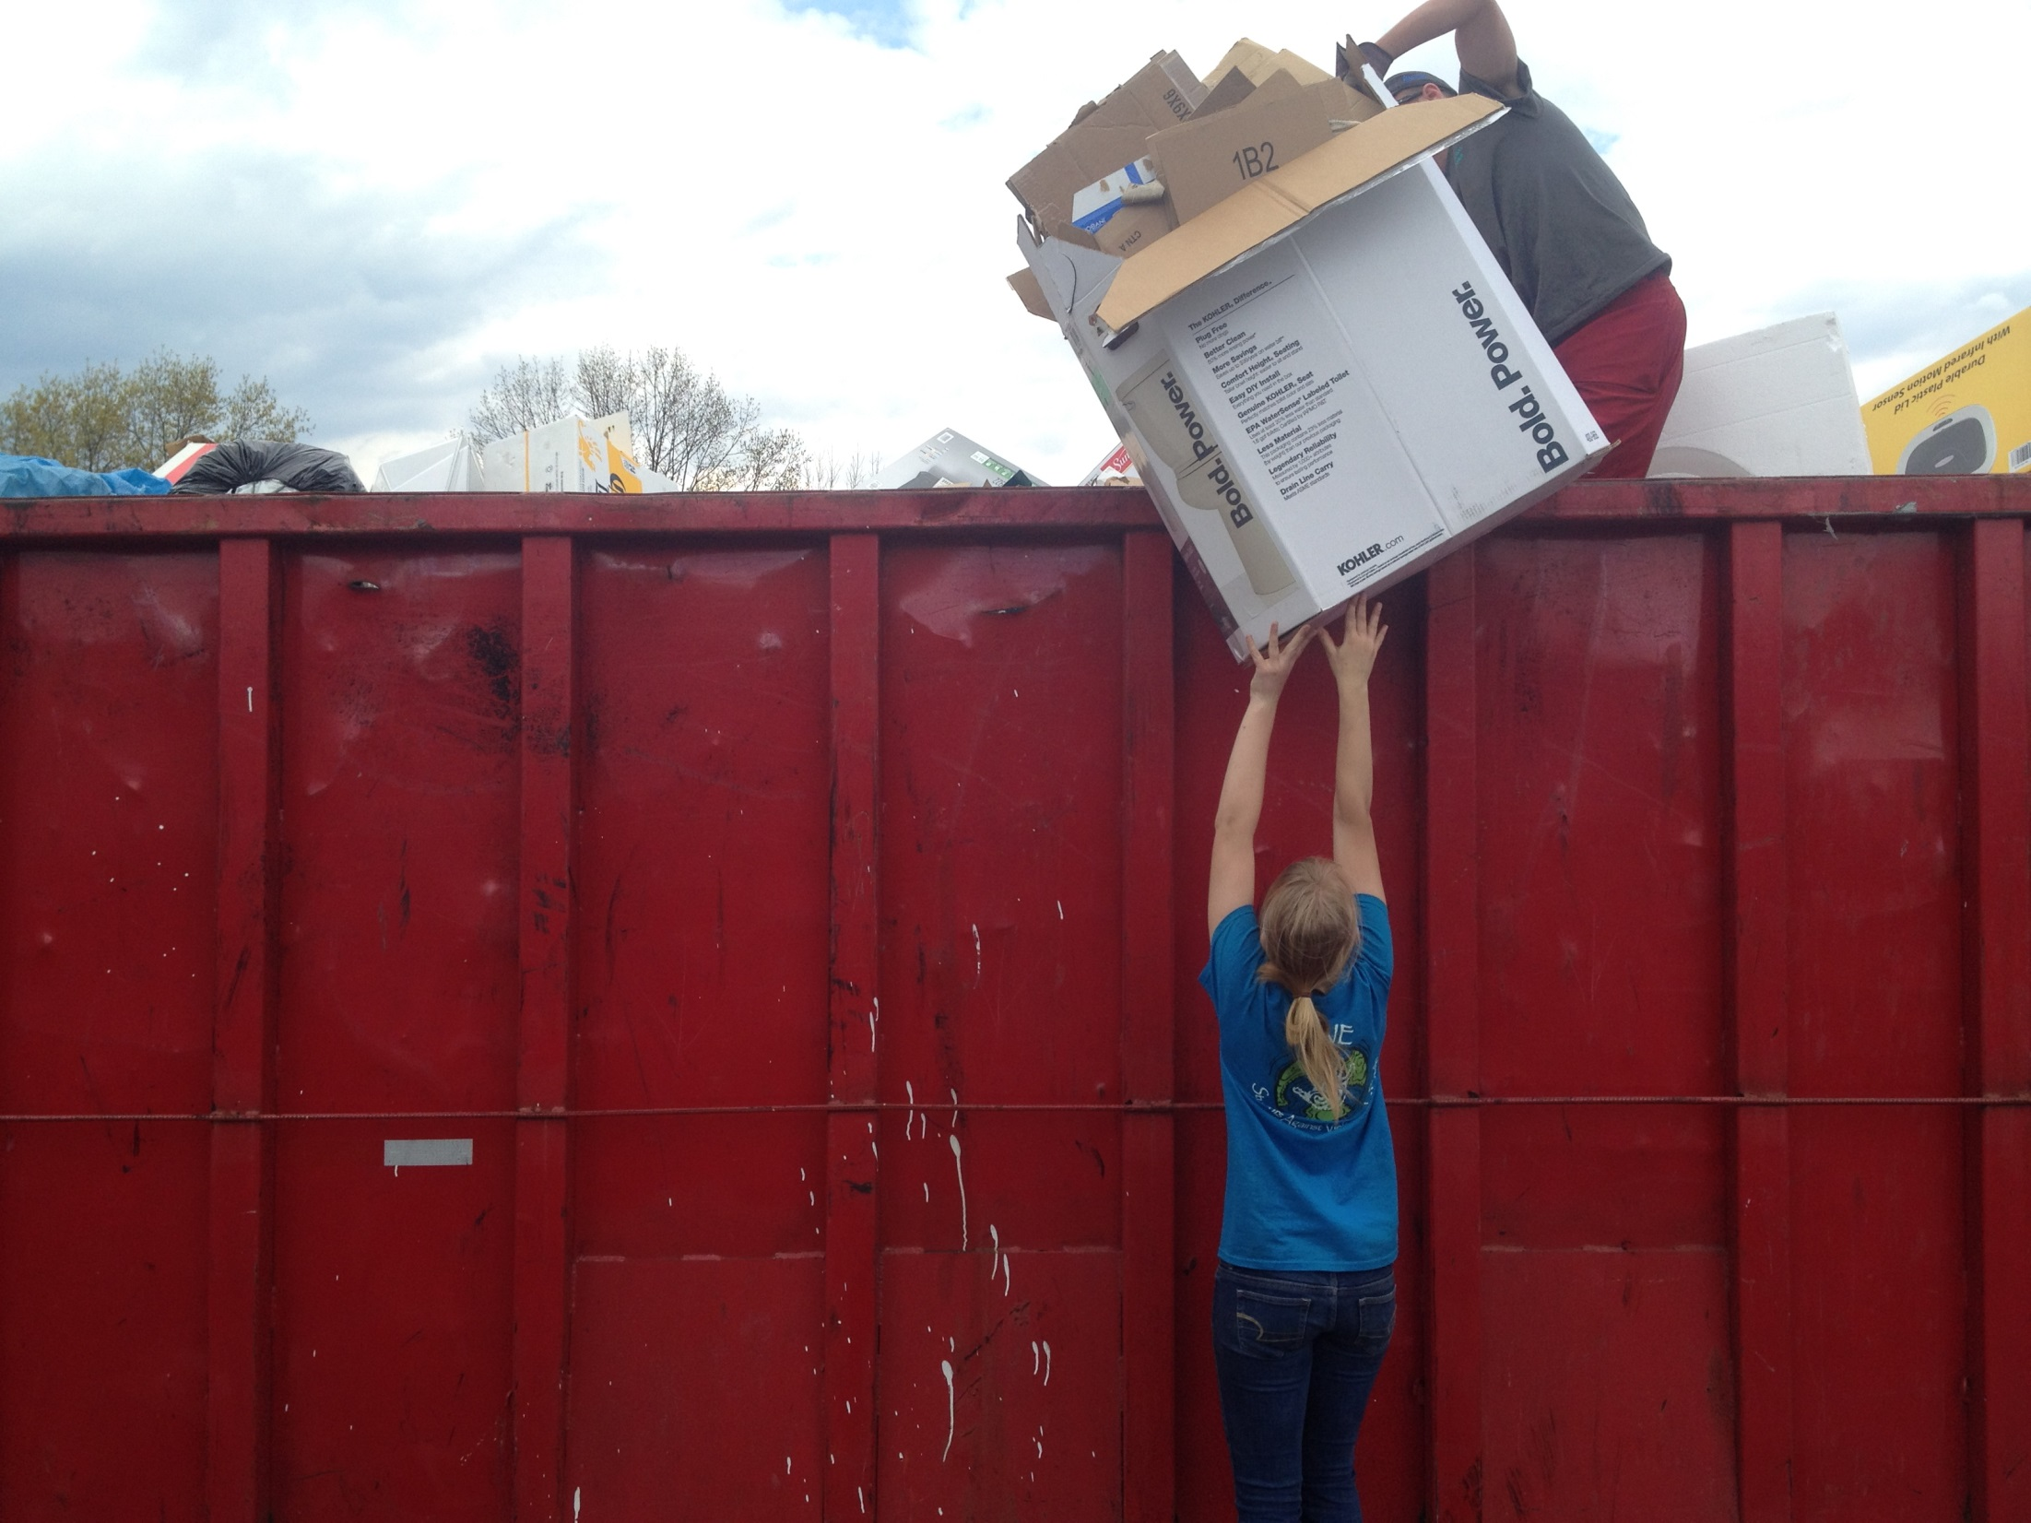

Slide 30
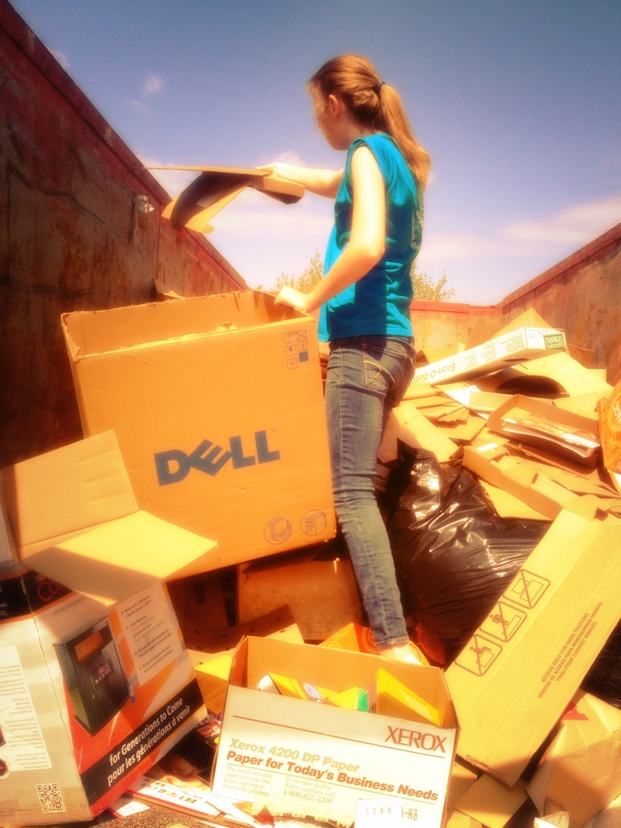

Slide 31
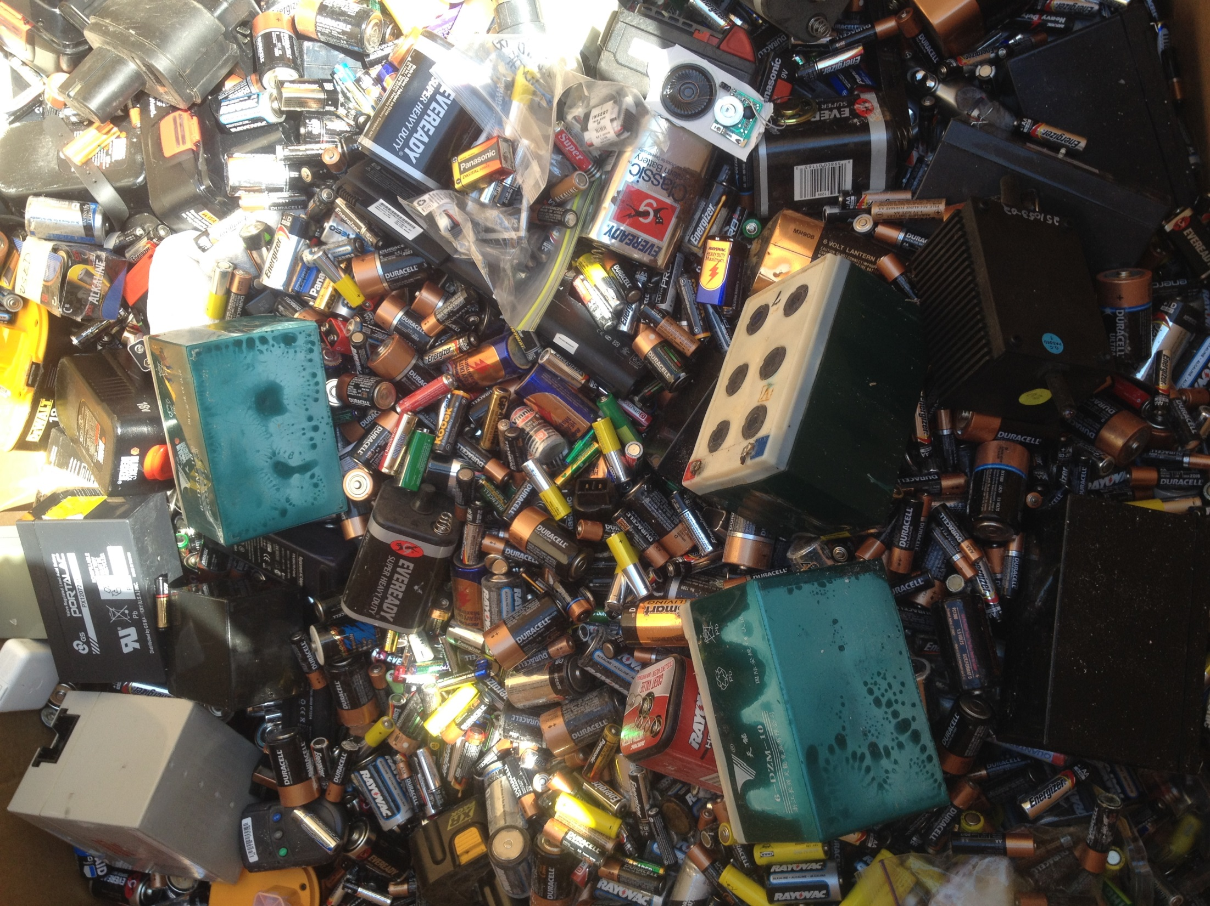

Slide 32
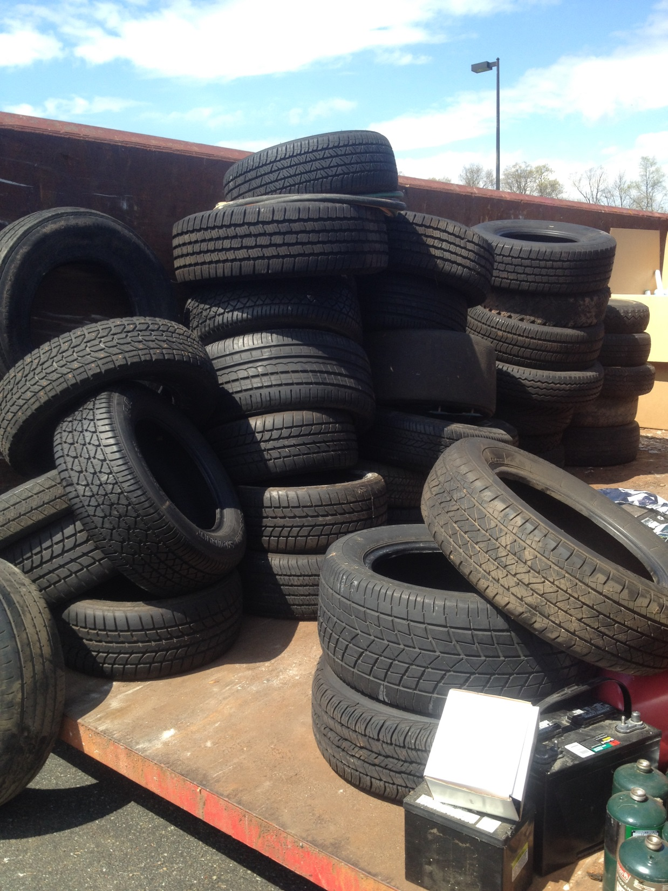

Slide 33
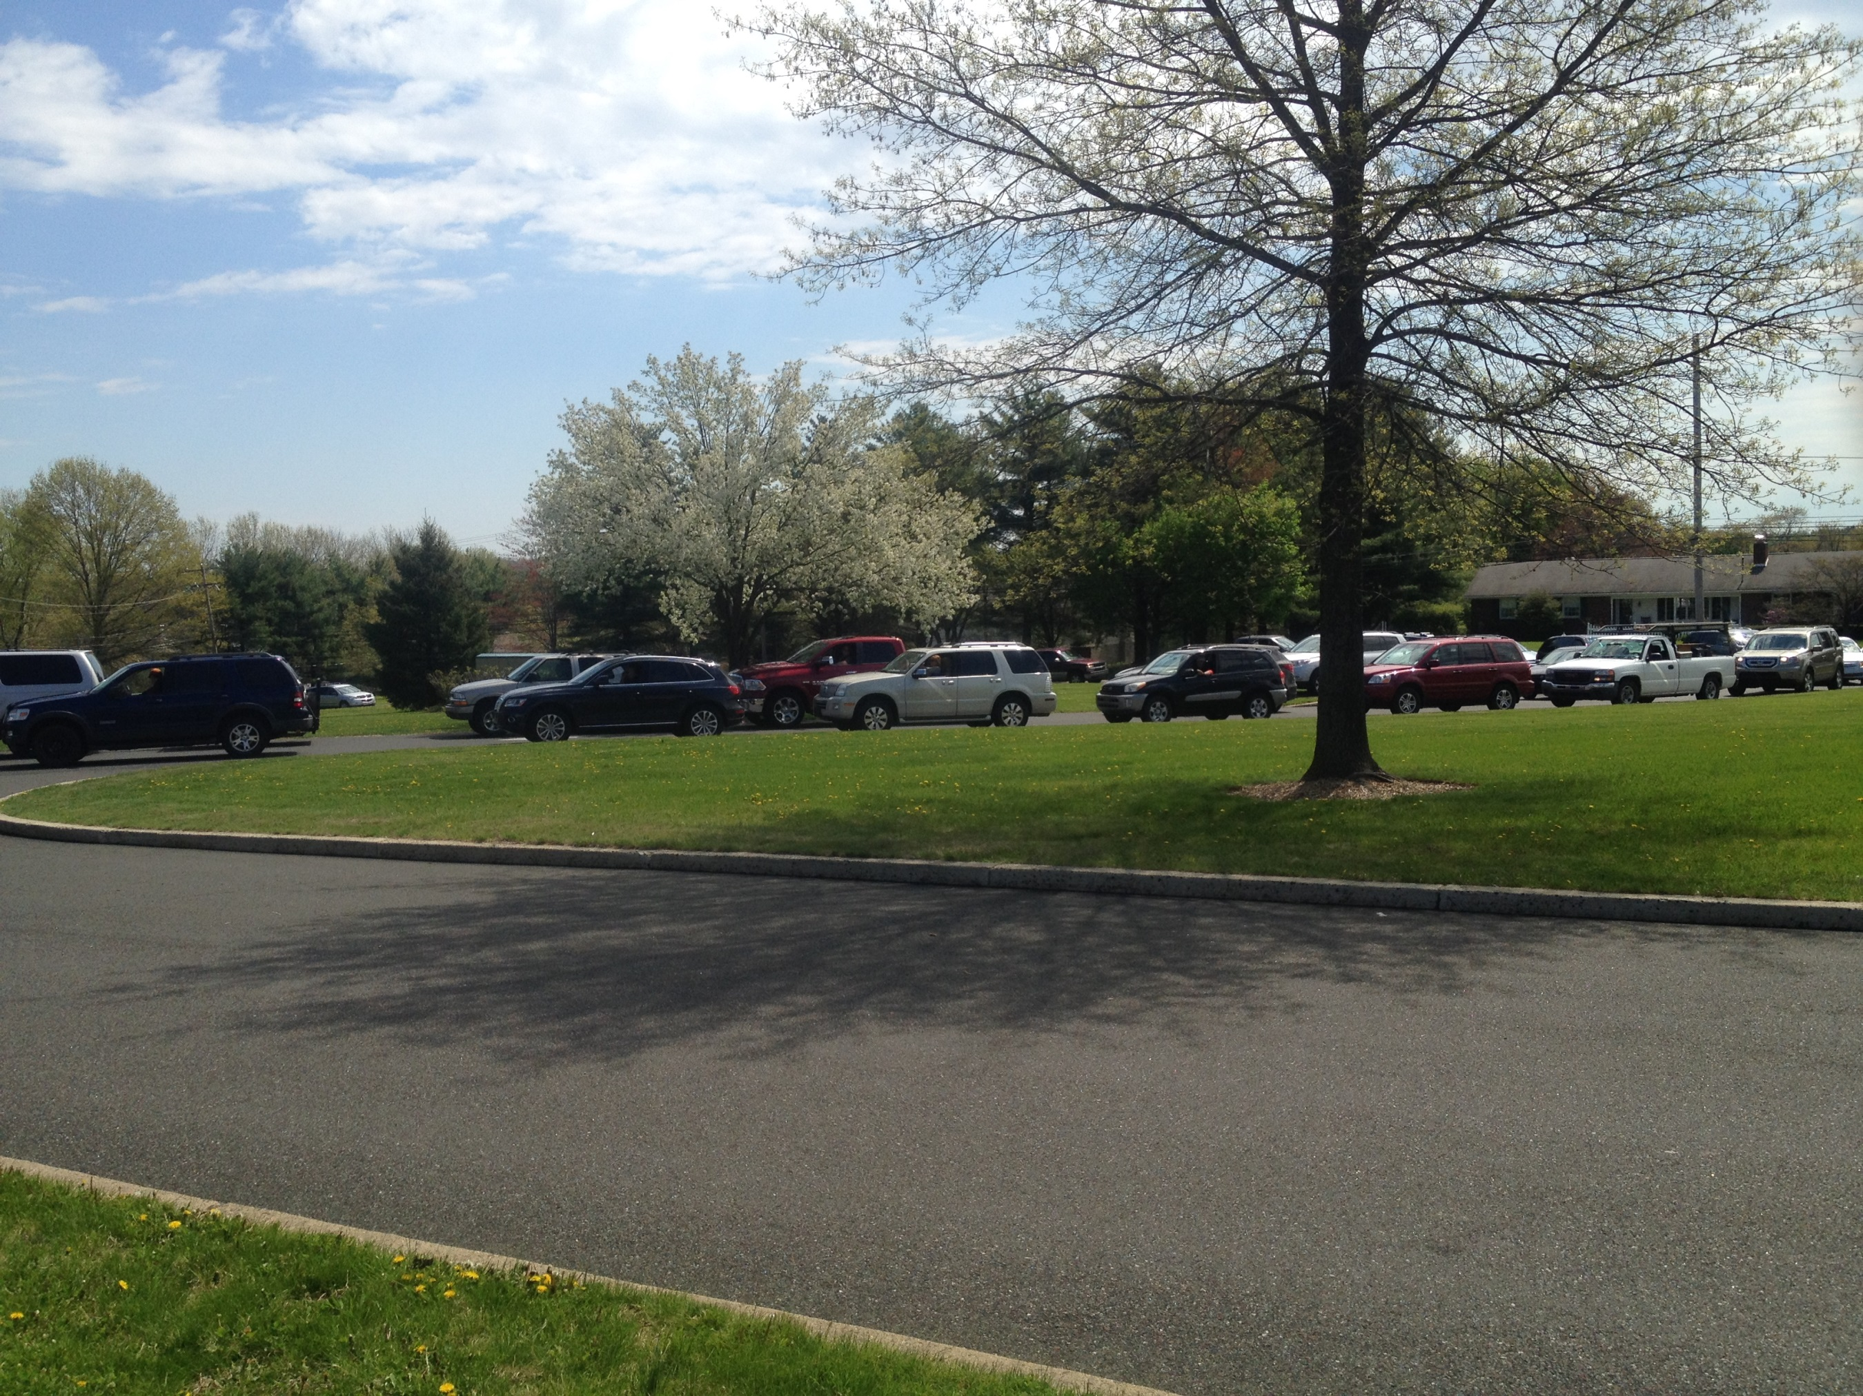

Slide 34
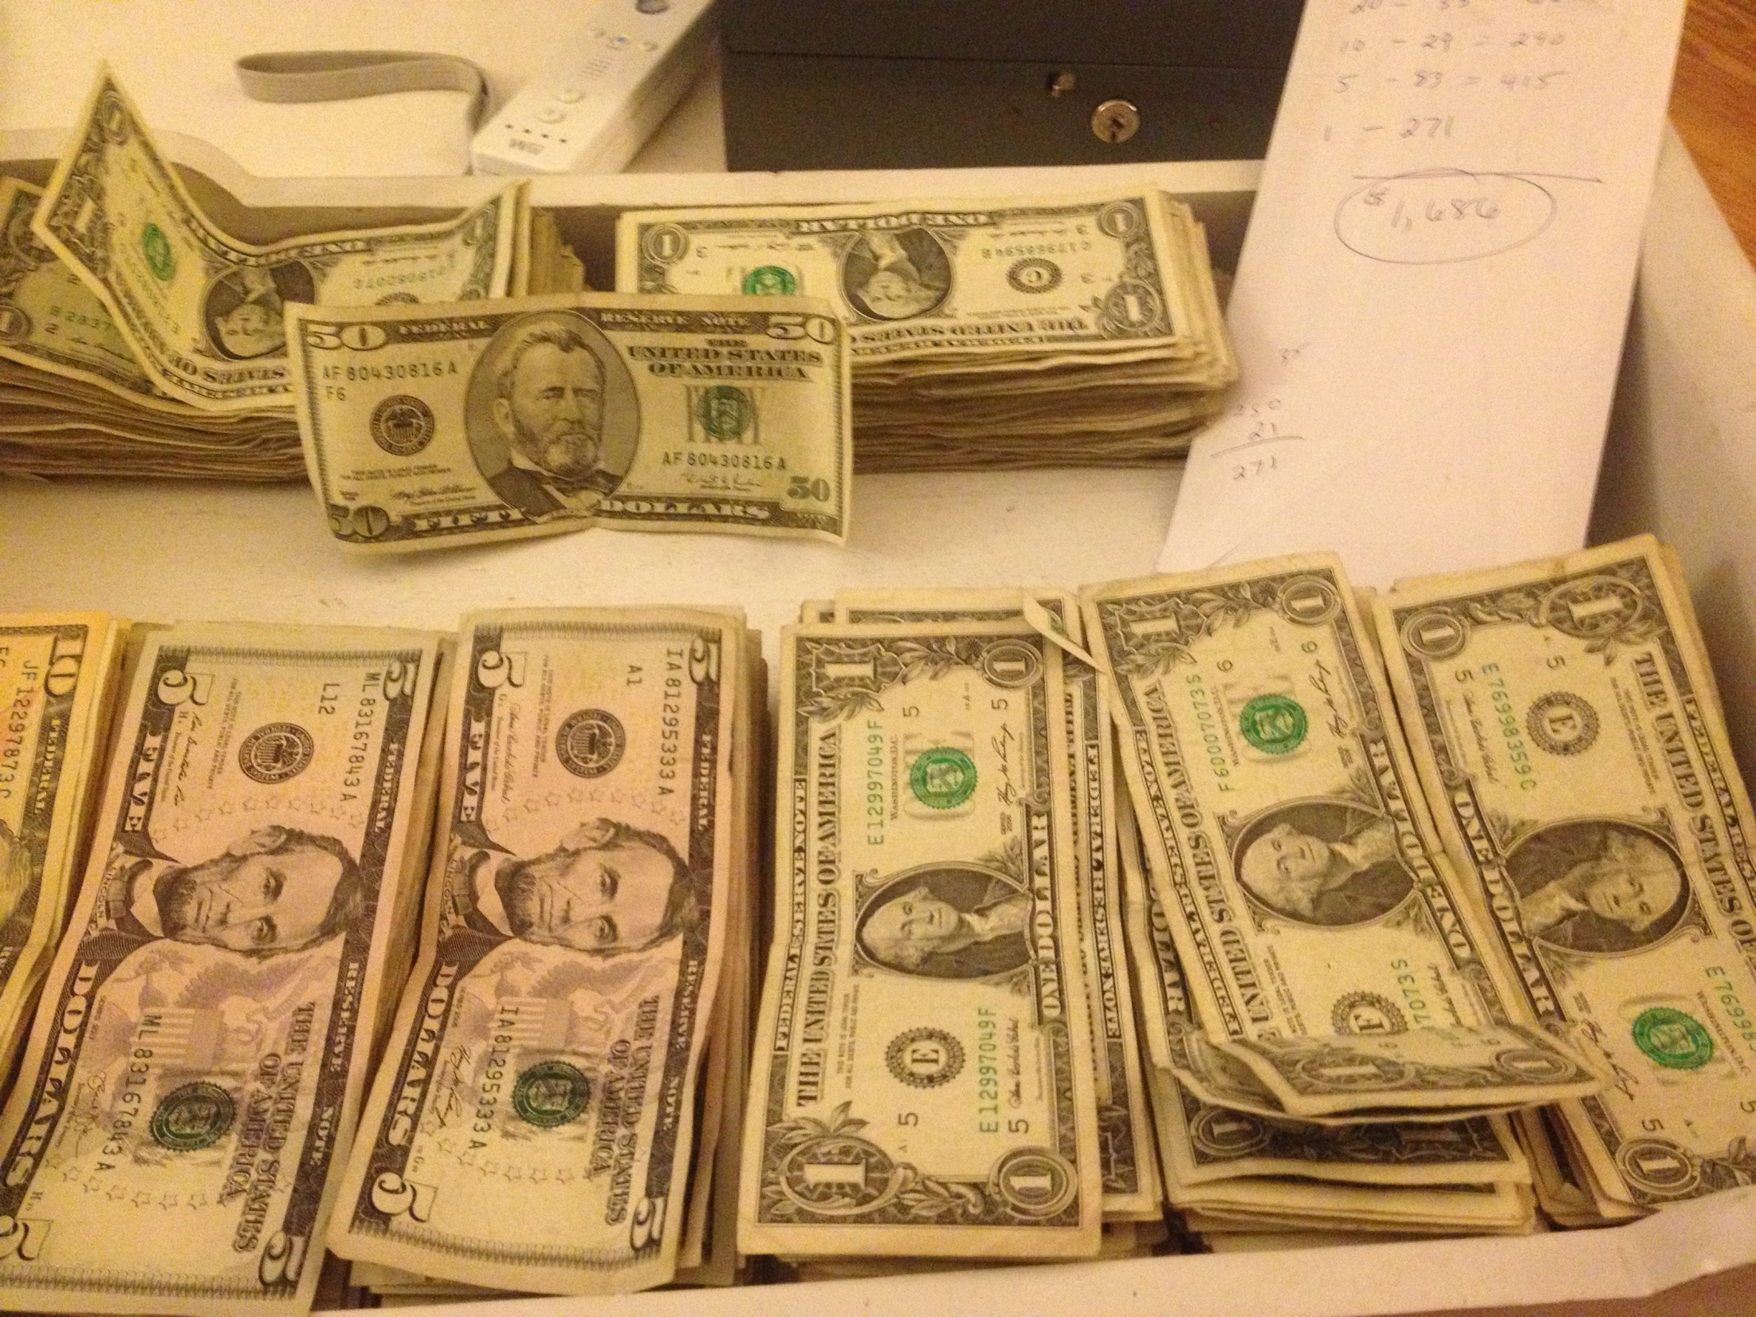

Slide 35
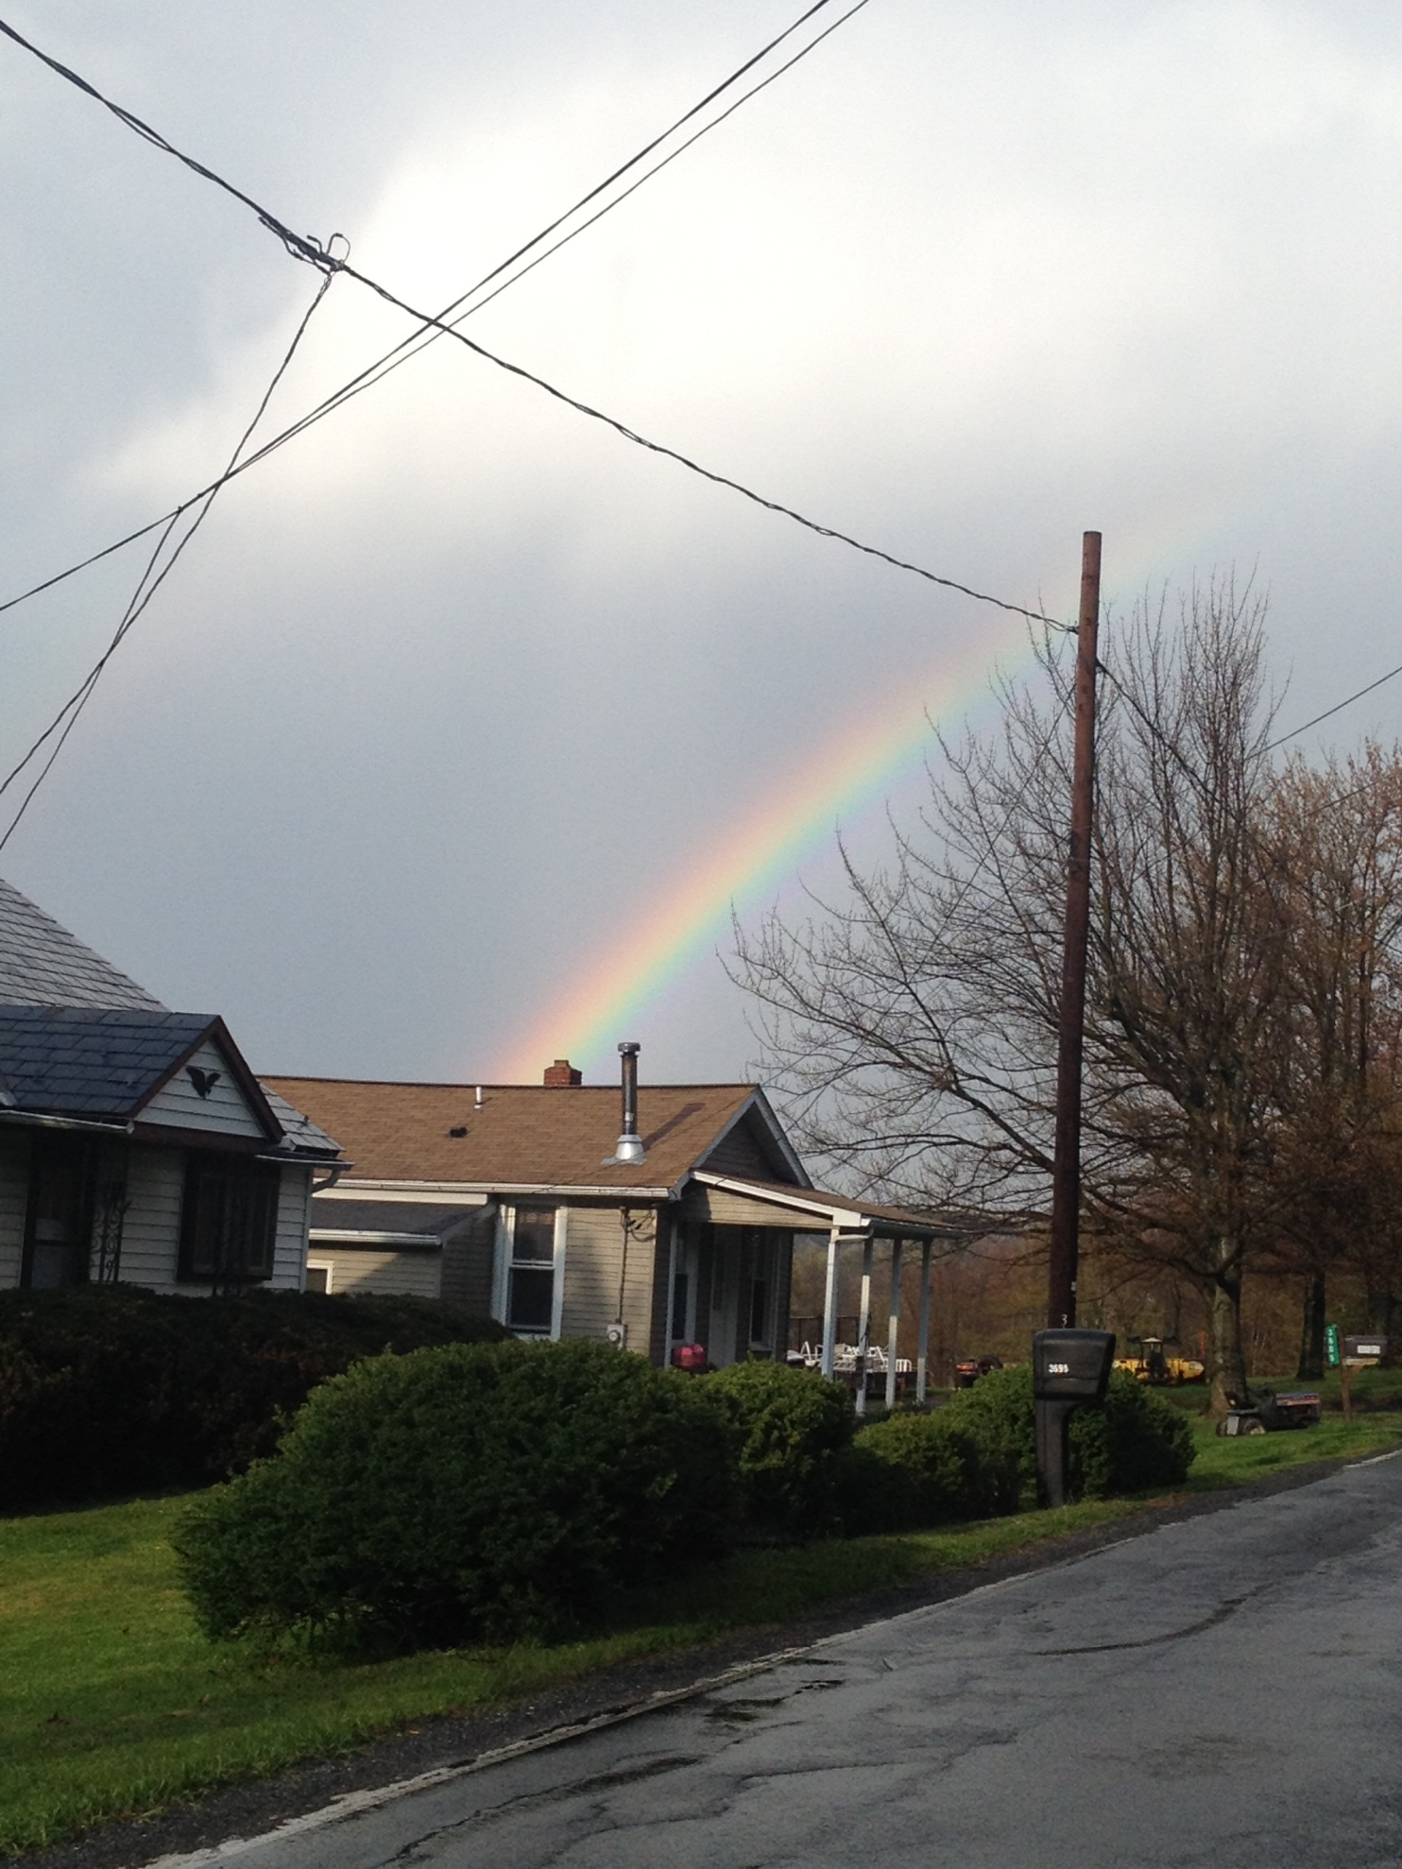

Slide 36
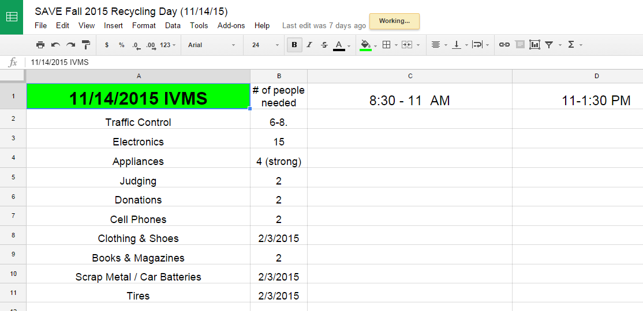

Slide 37
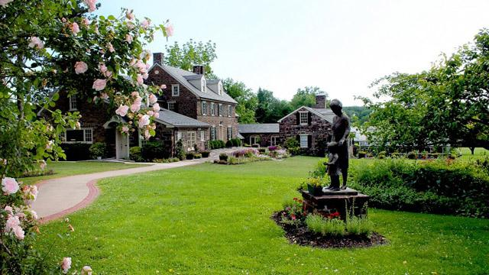
Pearl S. Buck Collaborative Earth Day Event

Slide 38
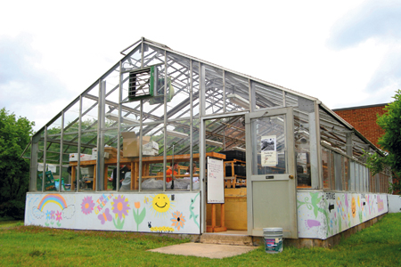

Slide 39
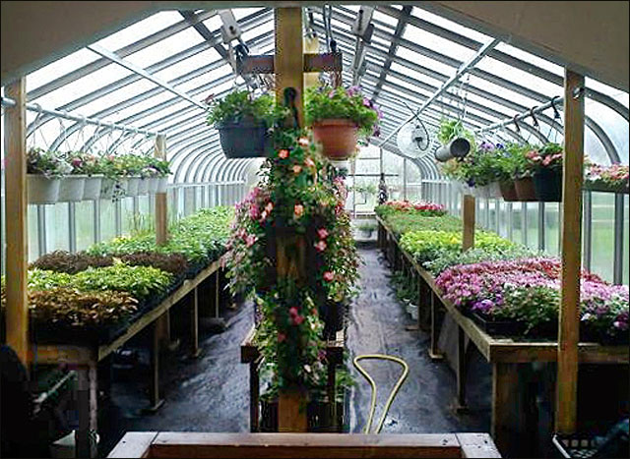

Slide 40
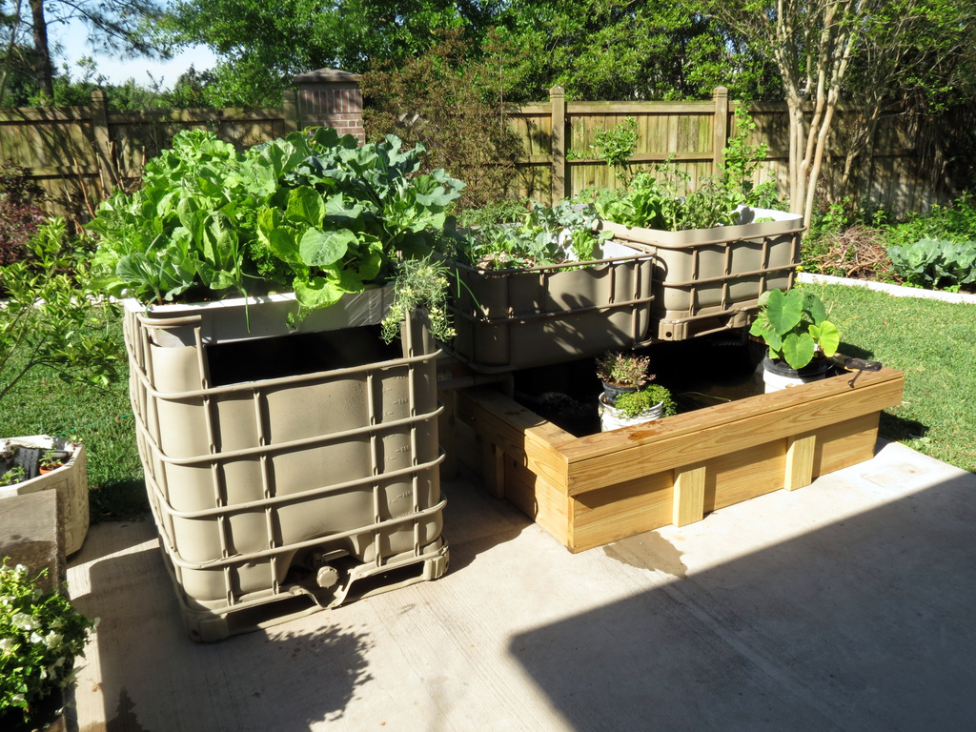
Hydroponics Team

Slide 42
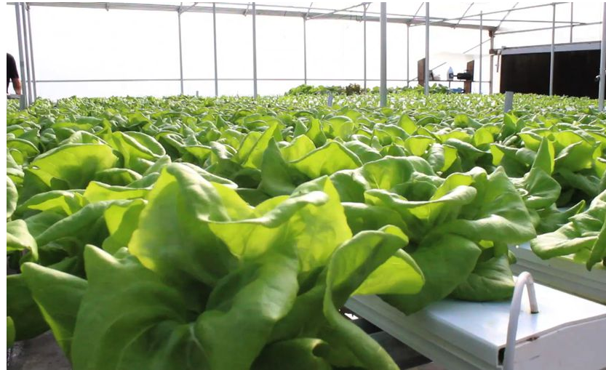

Slide 43
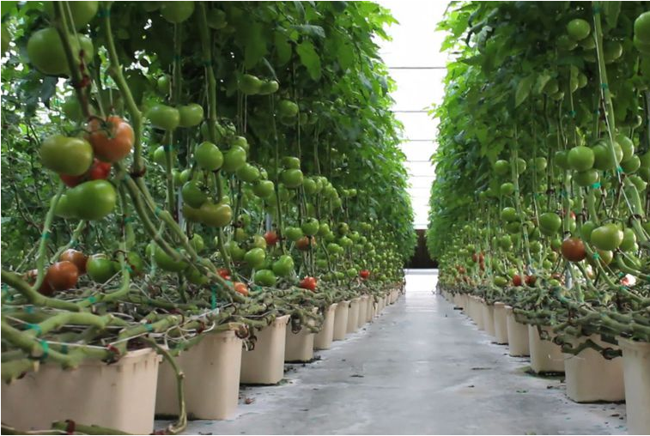

Slide 44
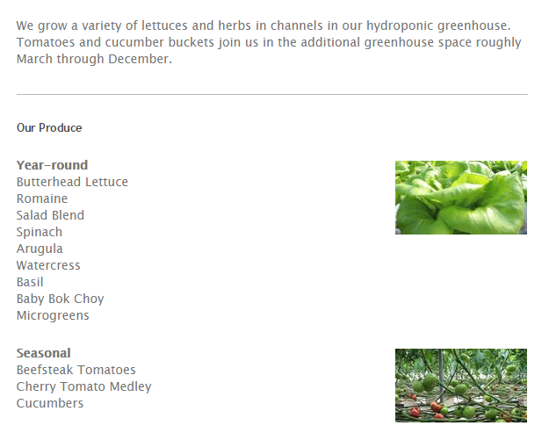

Slide 45
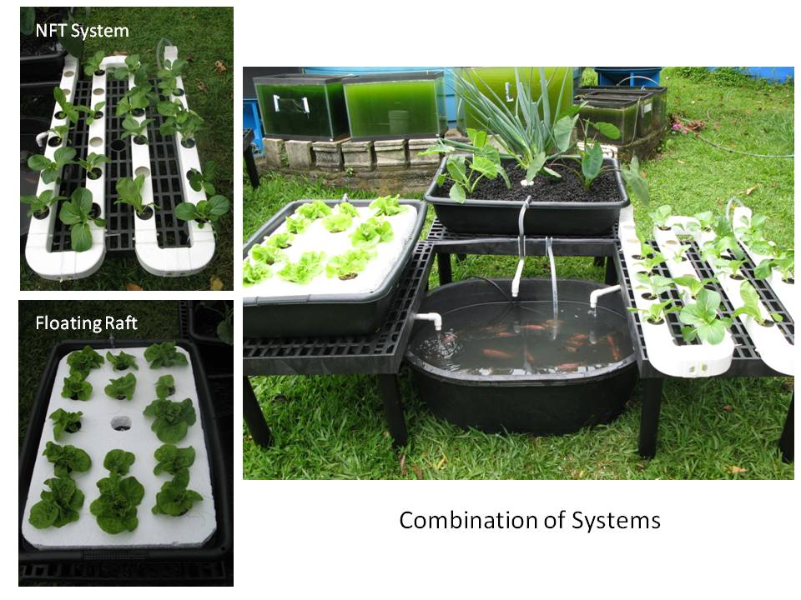

Slide 47
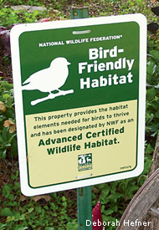
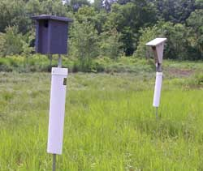
SEEC Certified Bird Habitat

Slide 48
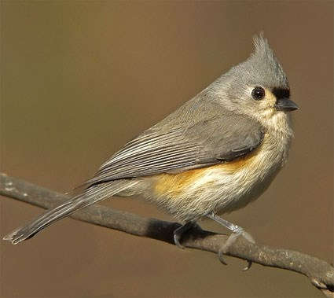
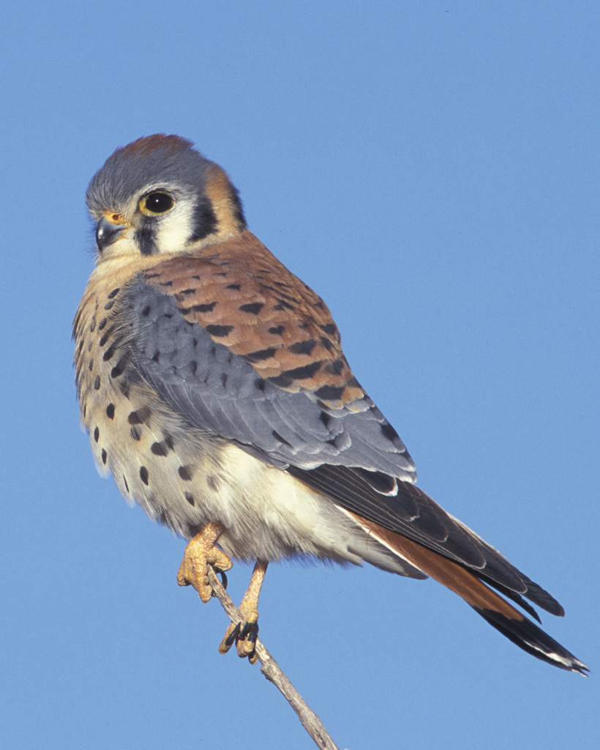
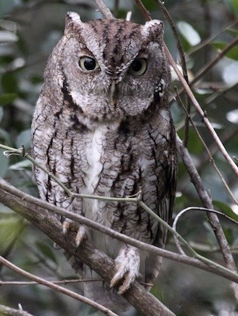
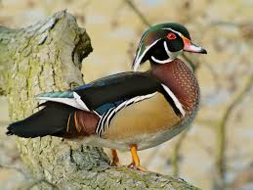
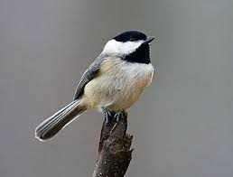

Slide 49
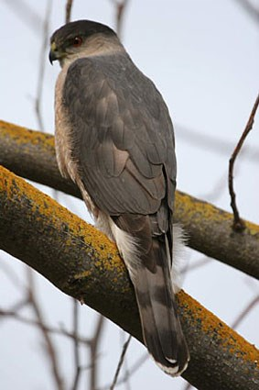
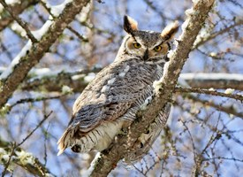
Platforms

Slide 50
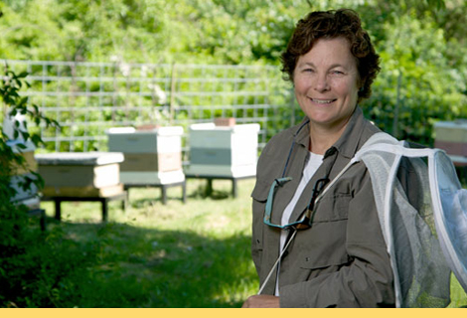

Slide 51
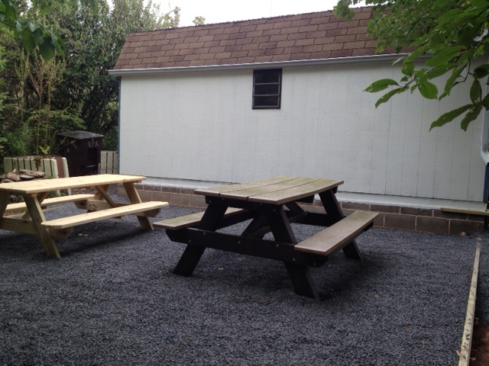
Nick Kroutheim – Eagle Scout Project

Slide 52
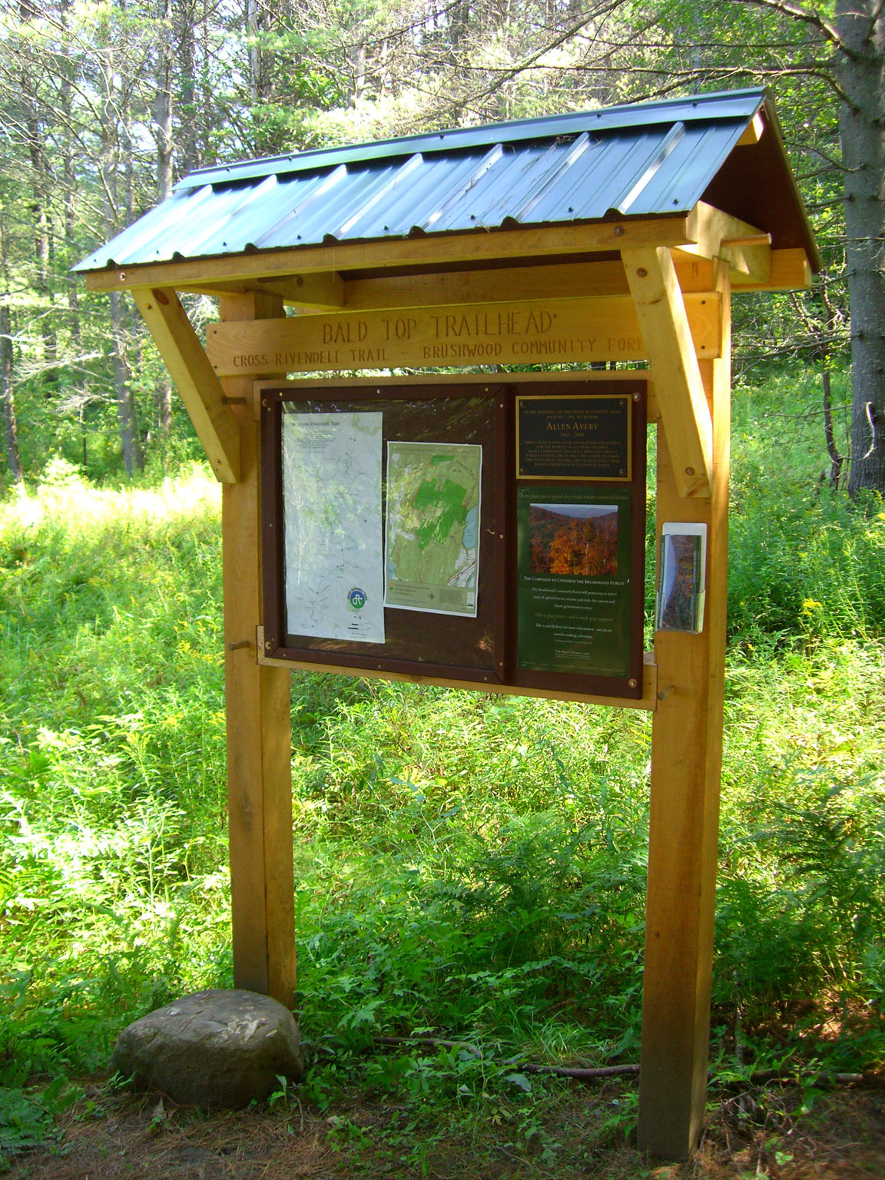
Trailhead signs

Slide 53
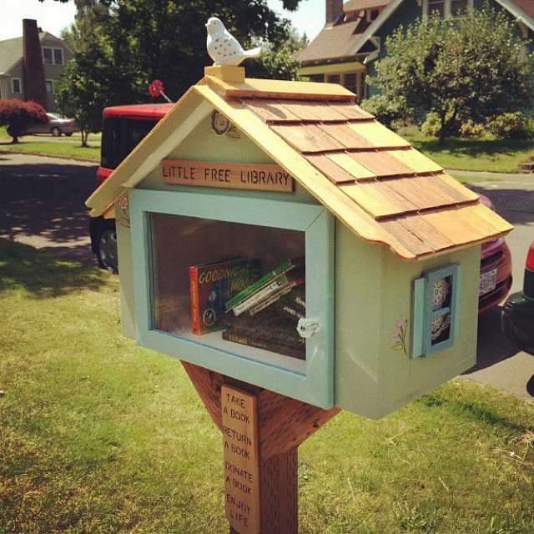

Slide 54
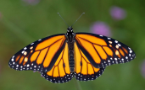
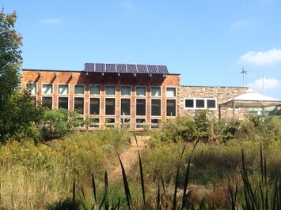
Butterfly Garden for Outside SEEC
Building a butterfly garden in front of SEEC to attract eight species of butterflies:
Monarch
Red Admiral
Black Swallowtail
Spicebush Swallowtail
Fritillary
Buckeye
Cabbage White
Question Mark
45 feet long by 3 feet wide

Slide 56
Plan for Attracting Butterflies
Plant host plants
A specific plant that a butterfly lays eggs on and caterpillars eat
Ex: Monarch’s host plant is milkweed
Plant nectar plants
Provide a source of energy for butterflies
Ex: Monarchs feed on nectar from a butterfly bush

Slide 57
A garden for education
Signs will be located within the garden describing each butterfly and its host plant
QR codes on the signs will link garden visitors to a message with further information about the butterflies and host plants

Slide 58
SAVE Member HELP NEEDED!!!
Come help us prepare the butterfly garden beds for planting!!!!
When? Thursday, September 24, 3-5pm at
SEEC
COME READY TO DIG--THE BUTTERFLIES ARE COUNTING ON YOU!!!

Slide 60
Get Involved!
Check your email often!!!!!!!
Attend Leadership Councils
Volunteer for a leadership position
Participate in our events
Look for field trips
Present your own ideas!
So many opportunities!

Slide 62
After Storms,
Oaks Take Deeper Roots

