Slide 1
SAVE Basics

Slide 2
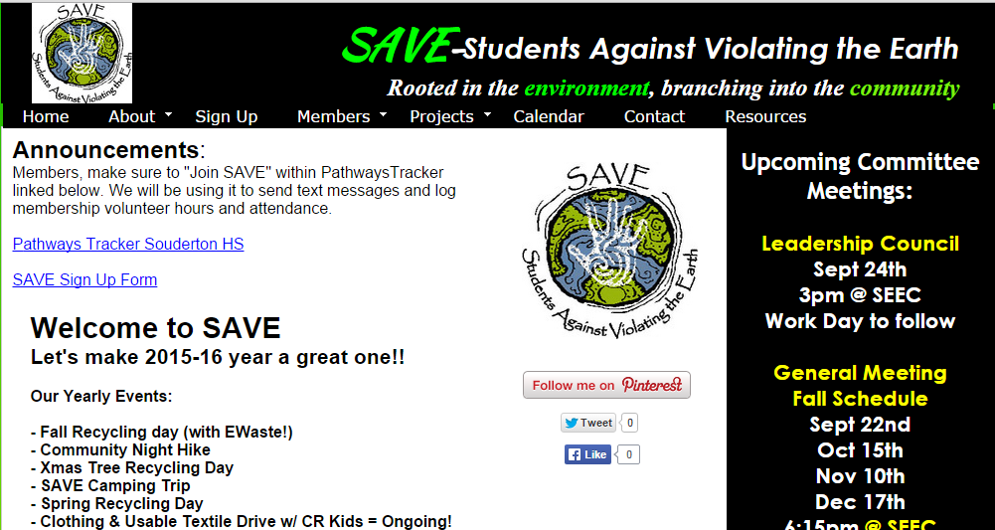
SAVE’s Website

Slide 3
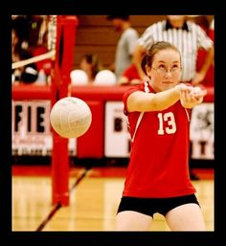
ICC Volleyball Tourney!
Monday 4/25
Games start at 6:30
music, fun, food
NO SCHOOL Tuesday!
SAVE needs a team
to represent!

Slide 4
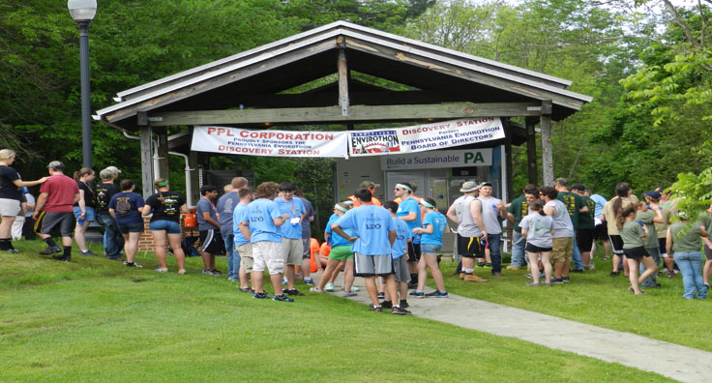
EnviroThon Competition
Wednesday - April 27th – during the school day
Teams 1 and 2
Zack Moyer
Ang Savoca
Lizzie Wilson
Alicia Bateman
Ashley Nguyen
Erin Matthews
Caroline Sene
Anthony Sims
Paulina Rice
Kajal Patel

Slide 5
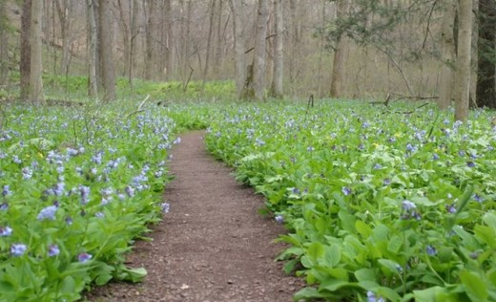
SAVE Toured Bowman’s Hill Wildflower Preserve!
Thursday, April 14

Slide 6
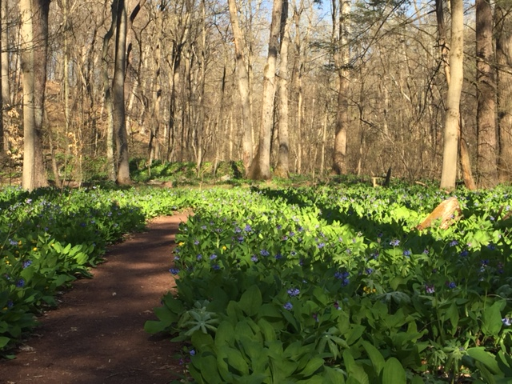

Slide 7
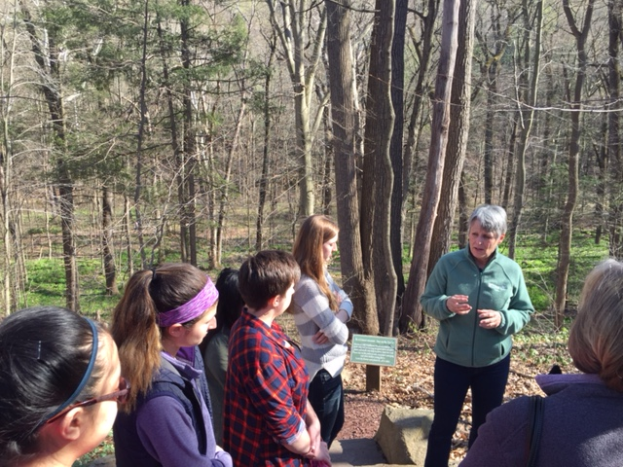

Slide 8
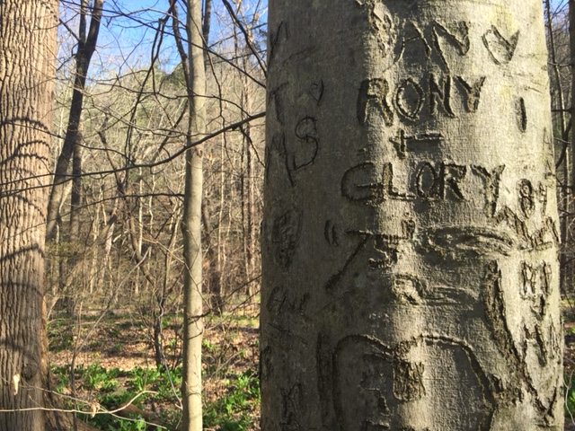

Slide 9
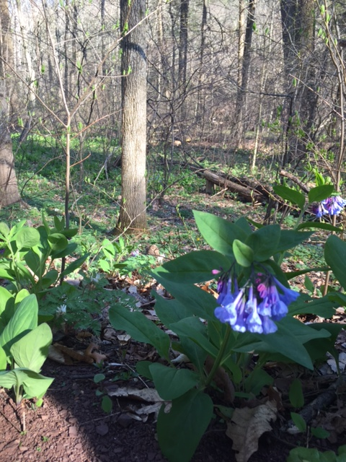

Slide 10
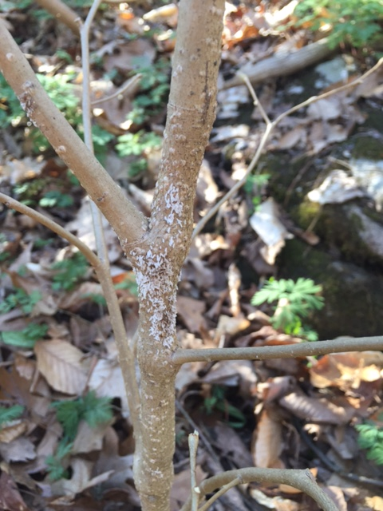

Slide 11
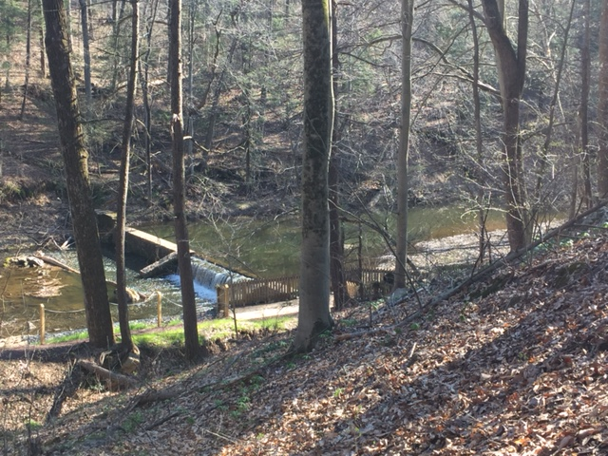

Slide 12
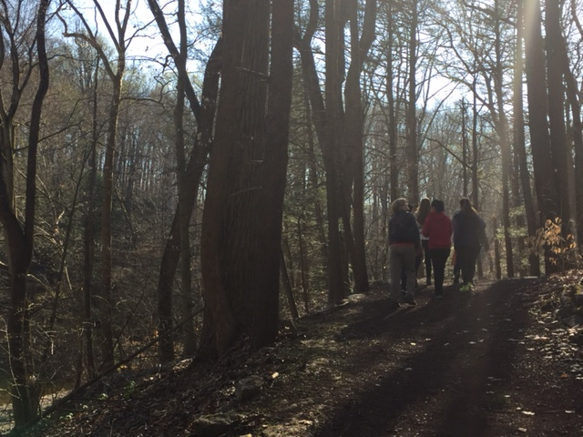

Slide 13
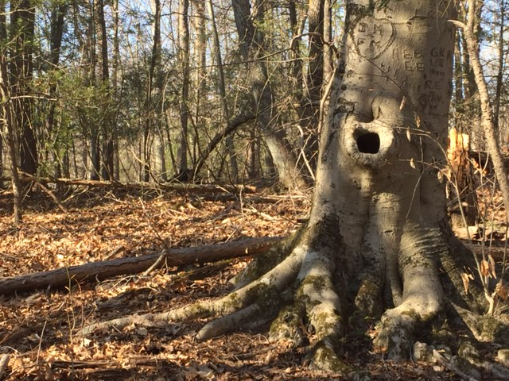

Slide 14
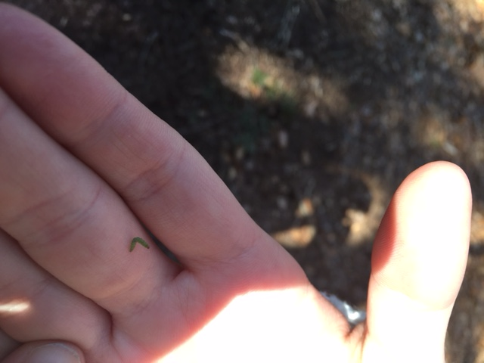

Slide 15
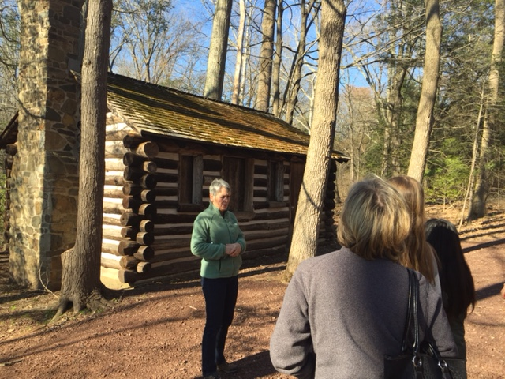

Slide 16
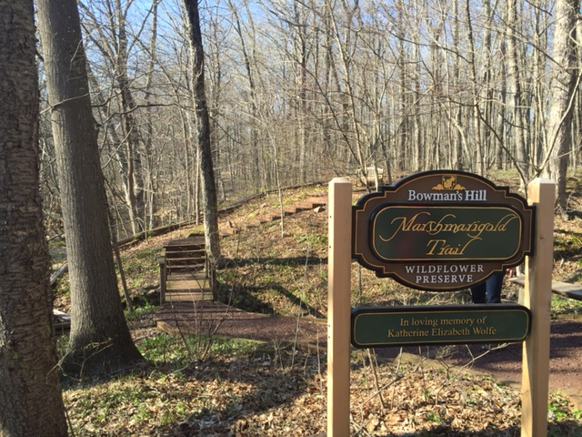

Slide 17
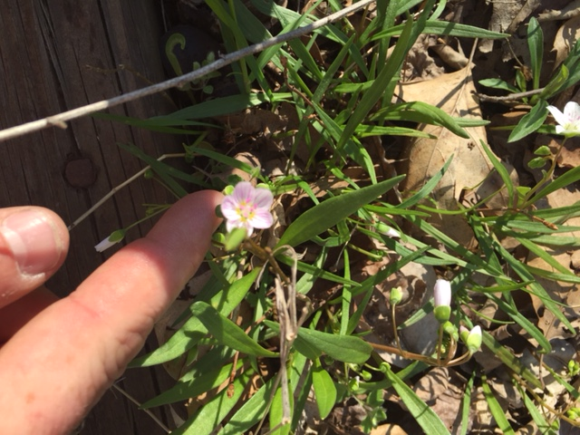

Slide 18
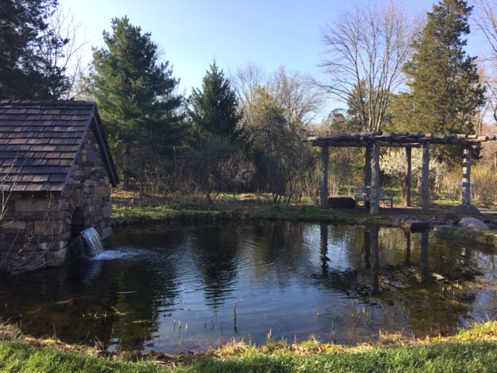

Slide 19
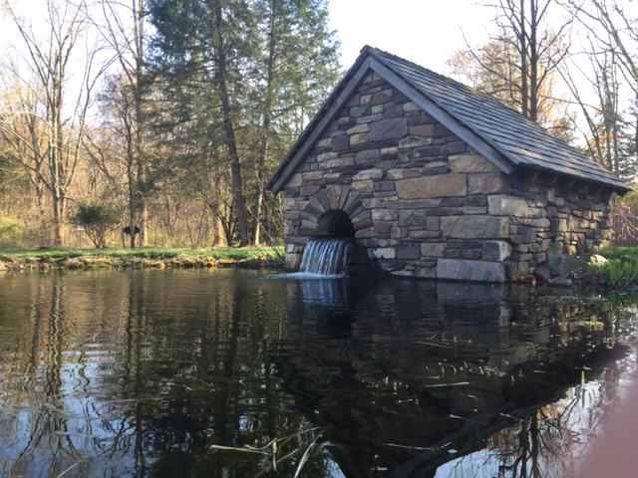

Slide 20
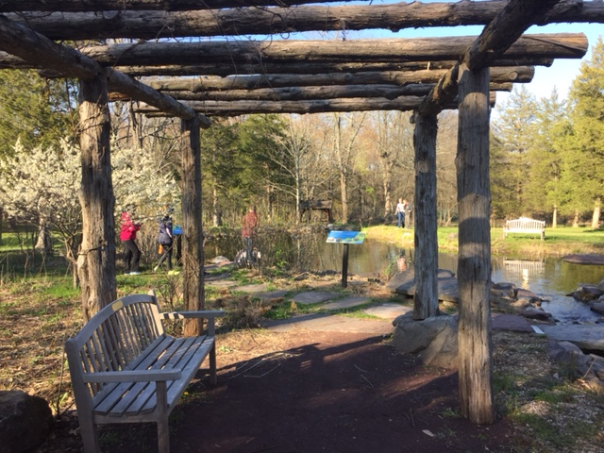

Slide 21
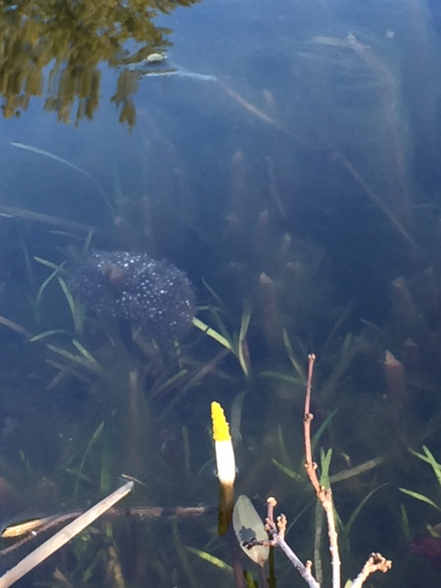

Slide 22
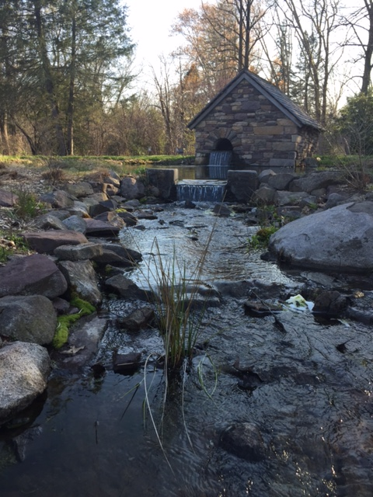

Slide 23
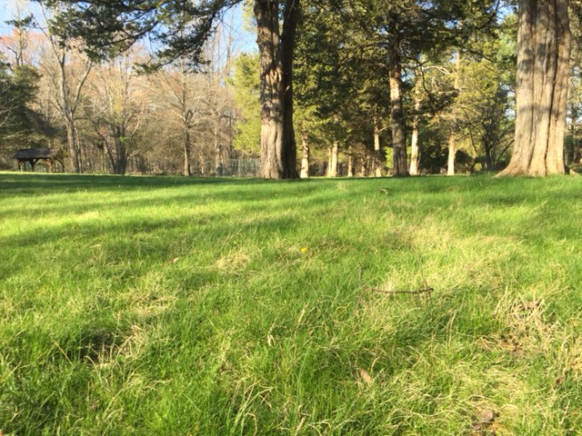

Slide 24
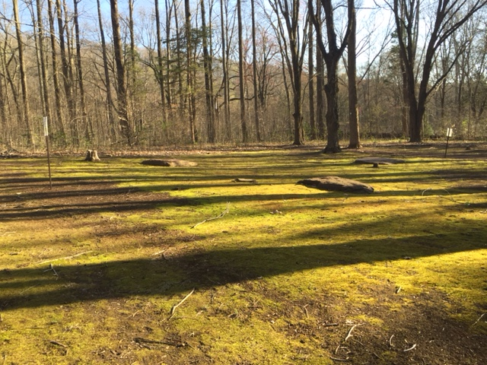

Slide 25
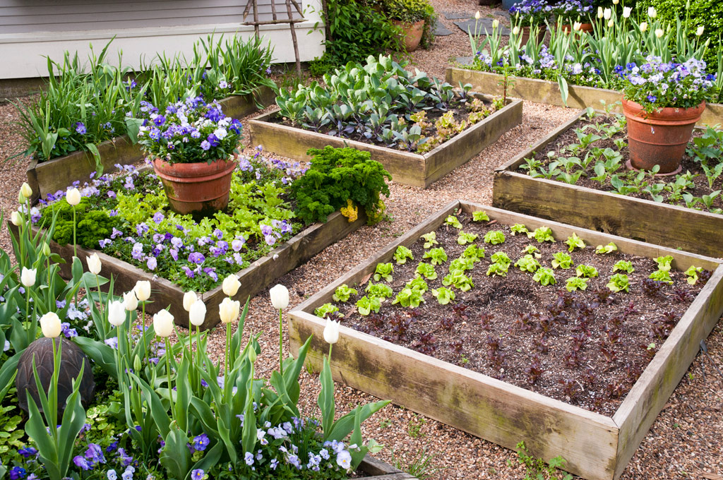
West Broad Street Gardening Club needs YOU!
Volunteers needed to help kids create and build a raised bed garden and participate in gardening activities
Wednesdays 3-4:30pm from now until May (sign up for one or more dates!!)
Meet at West Broad Street Elementary School
Help with the revitalization of the greenhouse area on SEEC campus!

Slide 26
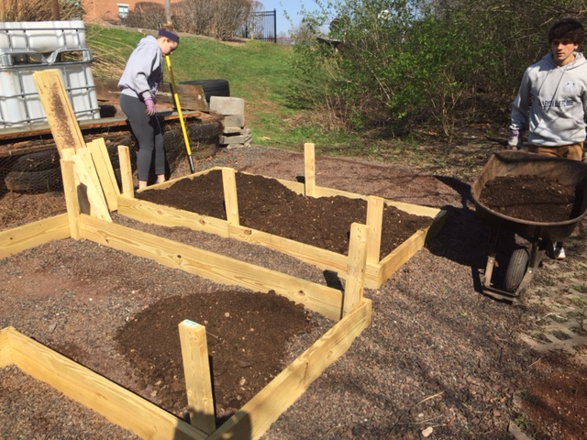

Slide 27
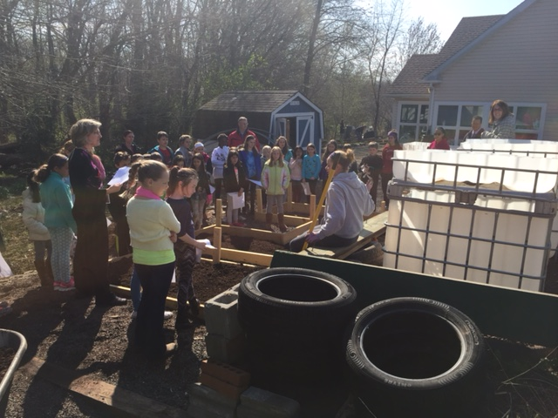

Slide 28
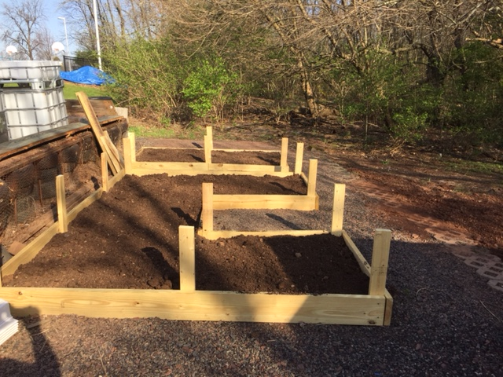

Slide 29
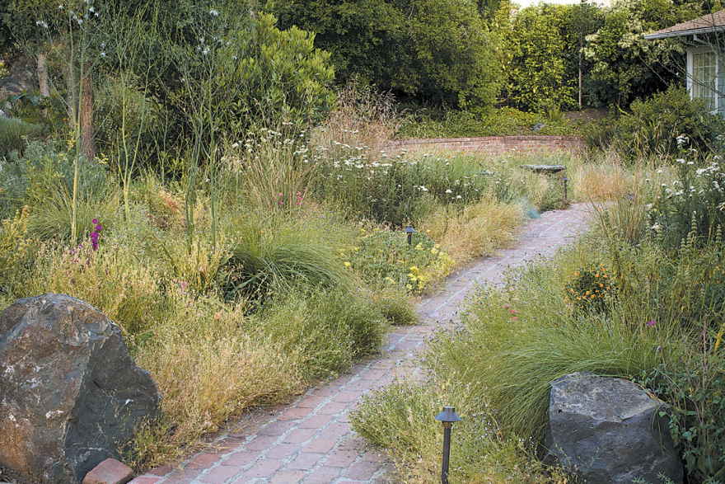
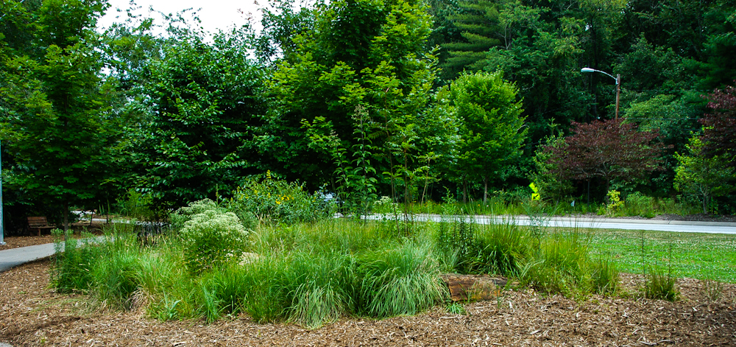
Pocket Meadow coming to SEEC
In conjunction with Bowman’s Hill Wildflower Preserve, we are planning to create a pocket meadow here at SEEC
Construction has begun!

Slide 30
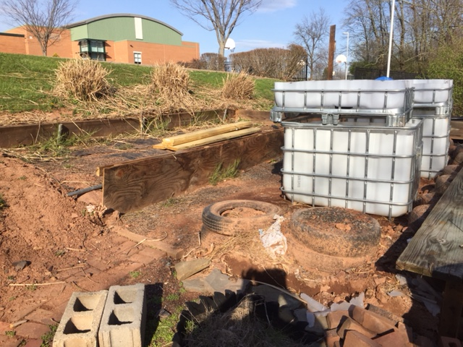

Slide 31
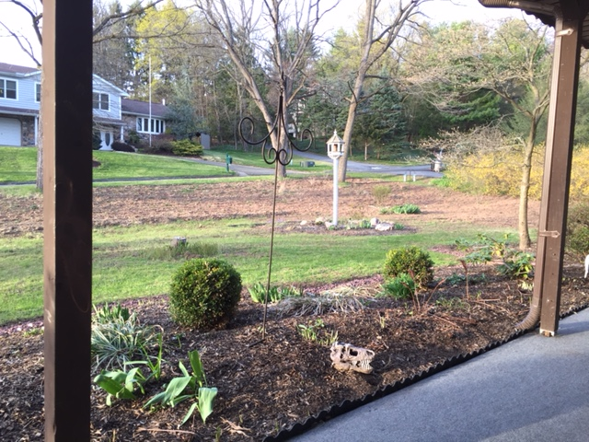

Slide 32
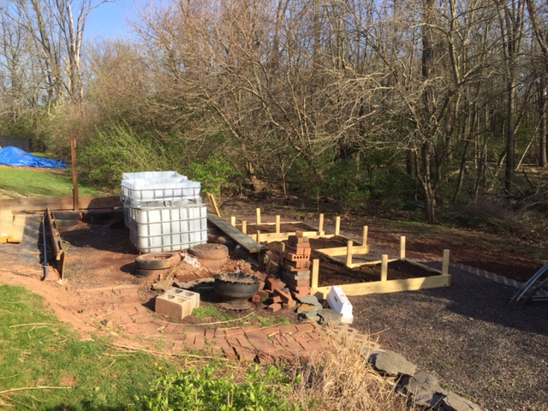

Slide 33
SEEC Upgrade – recognized as a certified wildlife habitat (food, shelter, place to raise young)

Slide 34
Make your house a certified habitat too!
Promote Biodiversity!

Slide 35
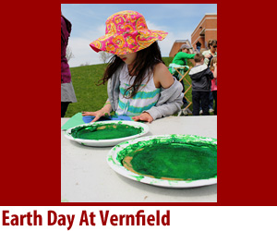
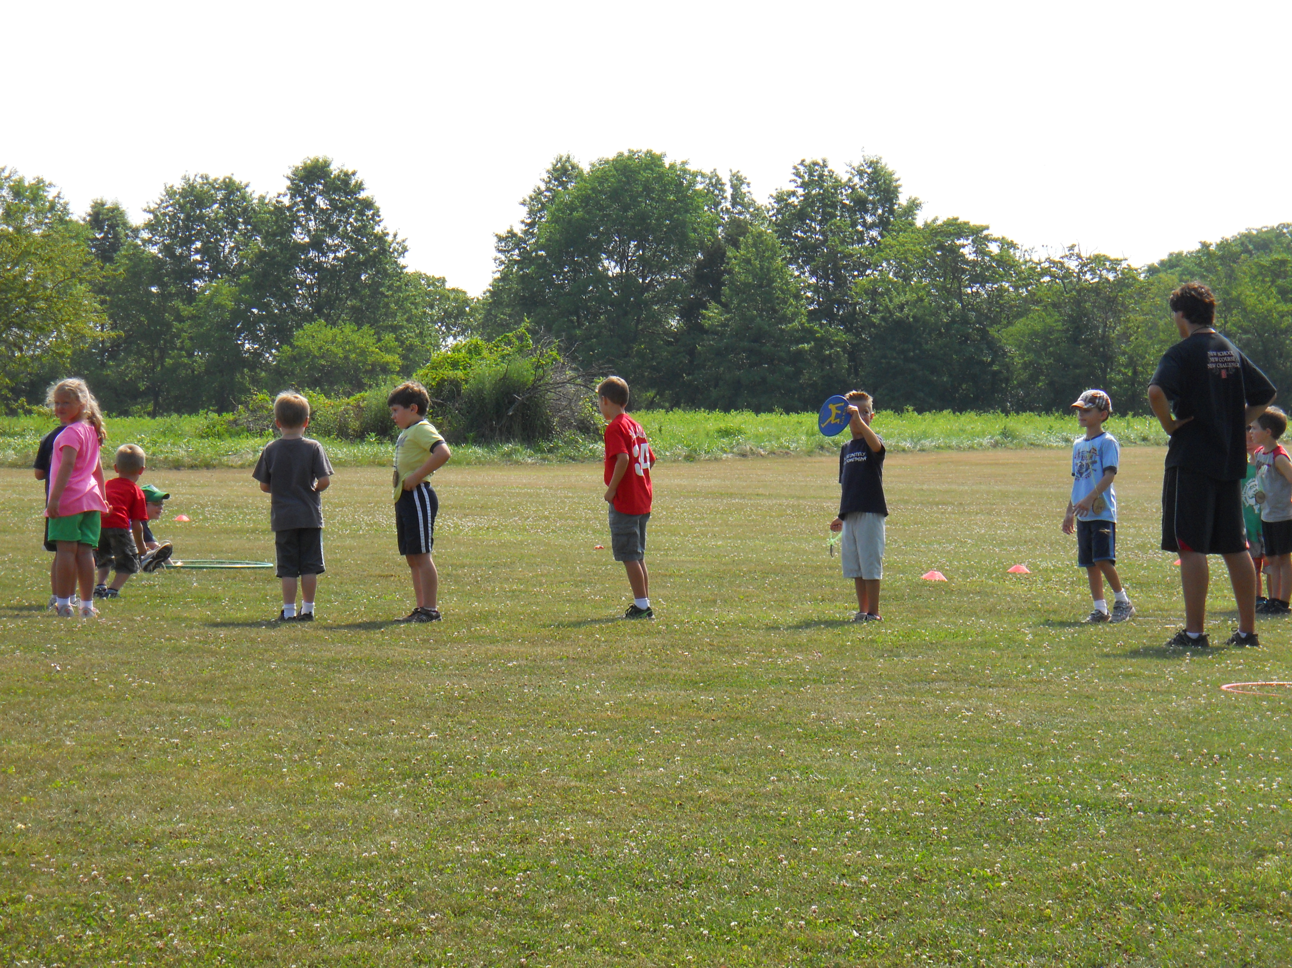
West Broad Field Day Event
Friday May 27th – during the school day
- Need a team to develop and run a workshop at the event.

Slide 36
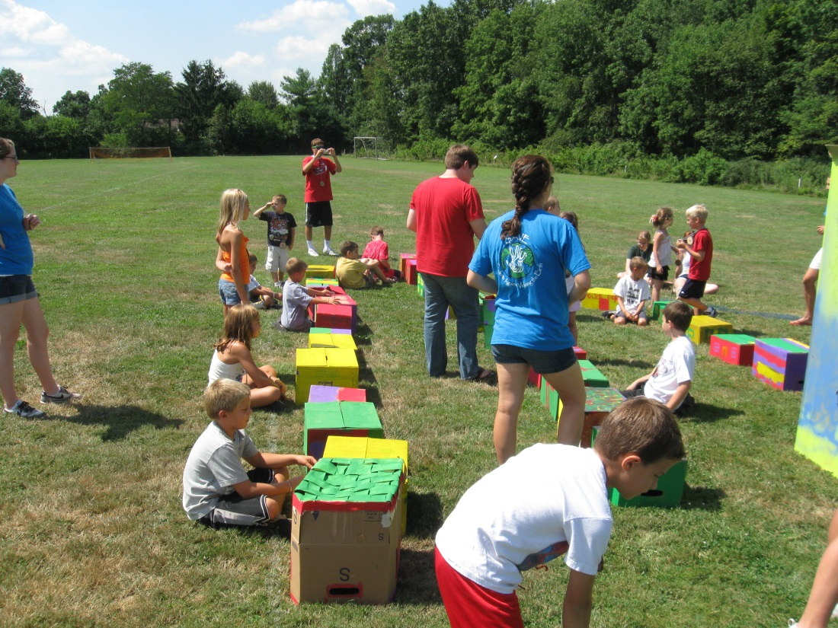
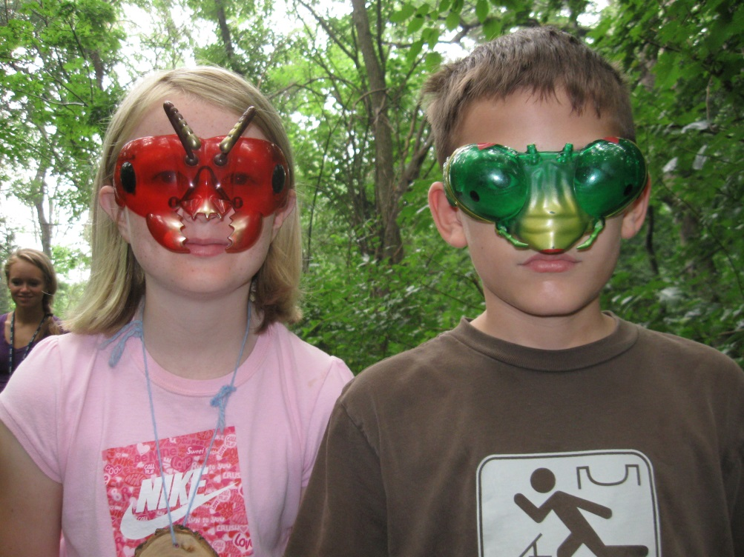
Summer Camp Day at SAVE
July 13th – 9am – 2pm
- Need a group of SAVE members to plan activities for a day of camp

Slide 37
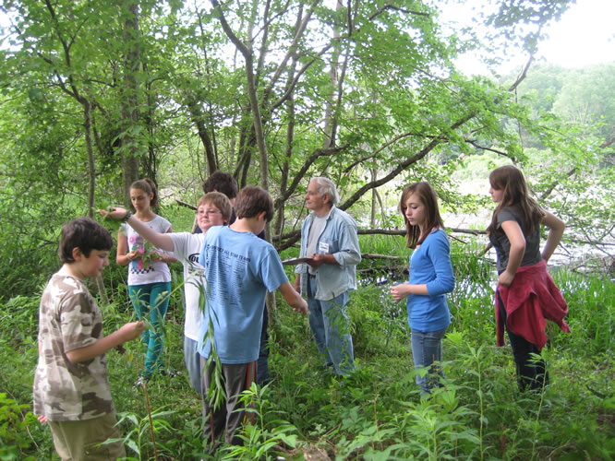
Next SAVE Work Day
Wednesday – April 27th – 3:30 – 5pm
Will be performing a “BioBlitz”
Will photograph and inventory the Spring ephemerals and plant/insect species at SEEC

Slide 38
LEAP Conference
Thursday, May 26th 9:30-2:00
Next planning meeting:
Wed, March 27
Right after school
In A321

Slide 39
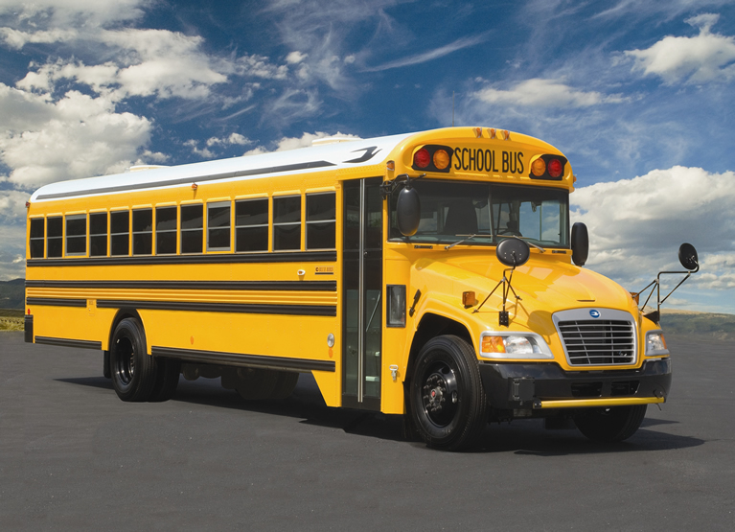

Slide 41
SAVE’s SPRING RECYCLING DAY IS SCHEDULED!!
SIGN UP ONLINE to help out!!

Slide 42
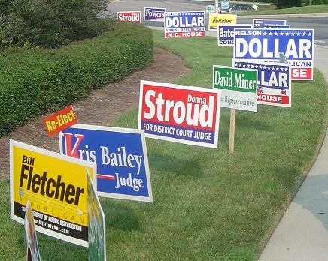

Slide 43
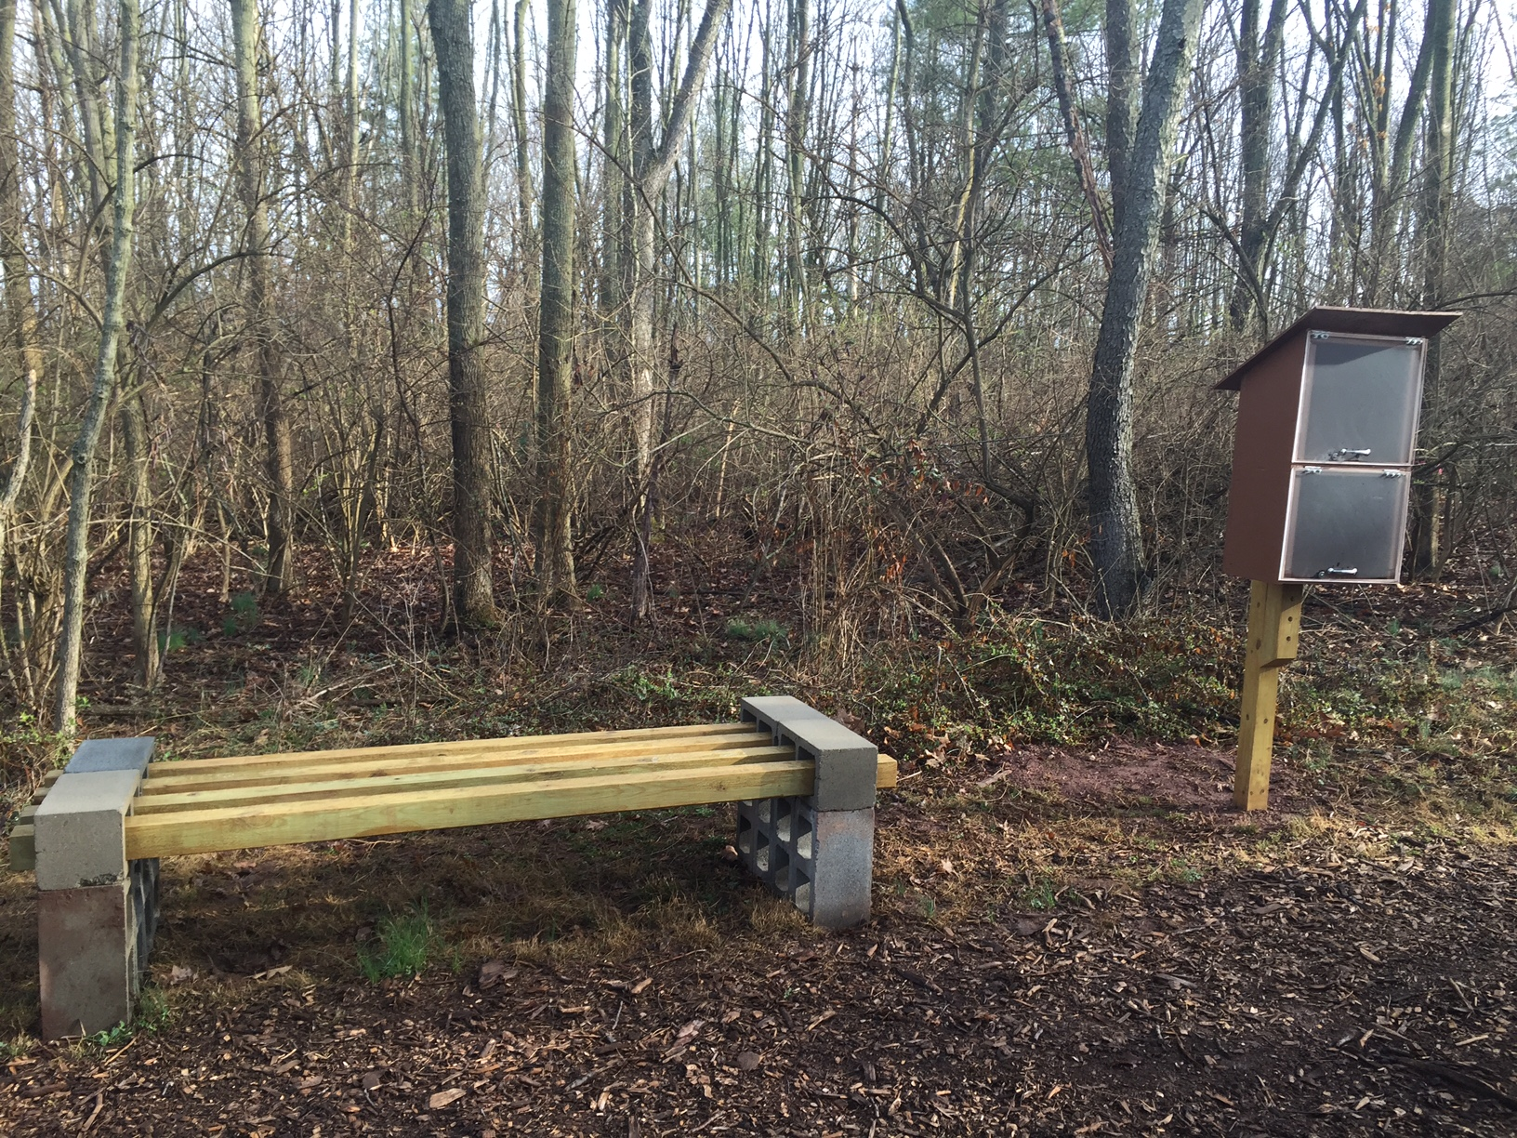

Slide 44
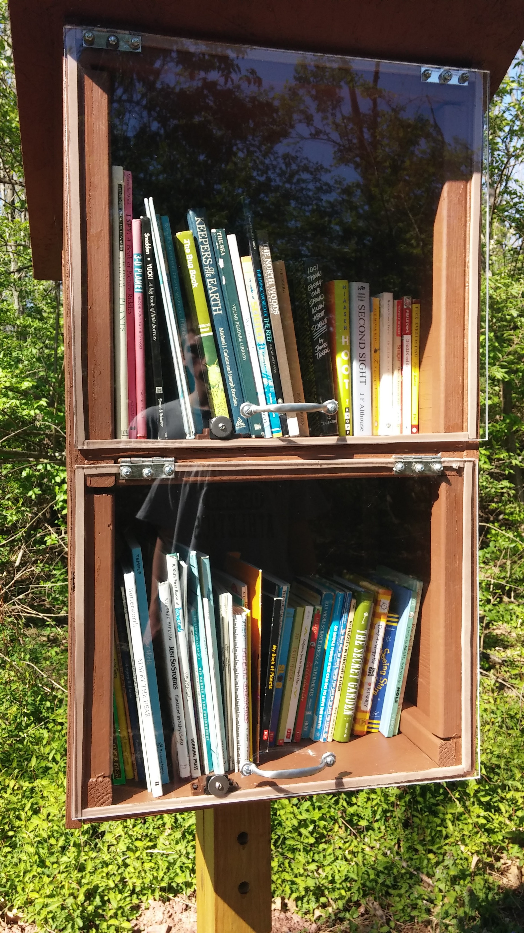
Little Free Library
is up and running!

Slide 45
SAVE Officers for 2016-17
Applications due Fri May 6th

Slide 46
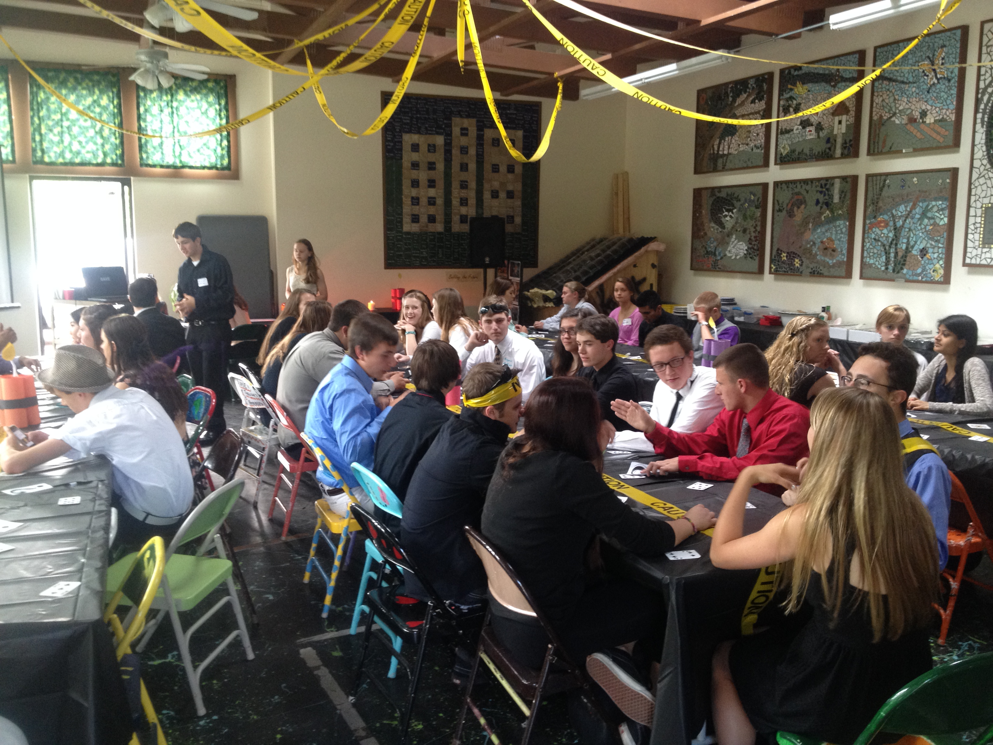
SAVE End of the Year Banquet
Wednesday May 18th at 6pm

