Slide 1
Signs In the Heavens: Star of Bethlehem, Revelations 12 and After
2016-2045

Slide 2
Introduction Video to Biblical Astronomy
https://www.youtube.com/watch?v=5rTi0Ai0_ew&t=0s
20mins

Slide 3
Non Bible Sources:
Biblical Integration:
Book of Jasher
Book of Enoch
Tim McHyde Know the Future
GodsRoadMaptotheEnd https://www.youtube.com/watch?v=aDRj3MsNNO0&feature=youtu.be
Scott Clarke Rev 12 https://www.youtube.com/channel/UC01LQqj9YtMTsSa4dxMHLdQ
Mark Wells https://www.youtube.com/channel/UCOc4Egc4IL89jP1cLFfRSFQ

Slide 4
Rev 12: The Sign of Yahushua
Rev 12:1 And a great sign was seen in the heaven: a woman clad with the sun, with the moon under her feet, and on her head a crown of twelve stars.
Rev 12:2 And being pregnant, she cried out in labour and in pain to give birth.
Rev 12:3 And another sign was seen in the heaven: and see, a great, fiery red dragon having seven heads and ten horns, and seven crowns on his heads.
Rev 12:4 And his tail draws a third of the stars of the heaven and throws them to the earth. And the dragon stood before the woman who was about to give birth, to devour her child as soon as it was born.
Rev 12:5 And she bore a male child¹ who was to shepherd all nations with a rod of iron. And her child was caught away to Elohim and to His throne. Footnote: ¹Isa. 66:7.
Rev 12:6 And the woman fled into the wilderness, where she has a place prepared by Elohim, to be nourished there one thousand two hundred and sixty days.
Rev 12:7 And there came to be fighting in the heaven: Miḵa’ĕl and his messengers fought against the dragon. And the dragon and his messengers fought,
Rev 12:8 but they were not strong enough, nor was a place found for them in the heaven any longer.
Rev 12:9 And the great dragon was thrown out, that serpent of old, called the Devil and Satan, who leads all the world astray. He was thrown to the earth, and his messengers were thrown out with him.
Rev 12:10 And I heard a loud voice saying in the heaven, “Now have come the deliverance and the power and the reign of our Elohim,¹ and the authority of His Messiah, for the accuser of our brothers, who accused them before our Elohim day and night, has been thrown down. Footnote: ¹See 11:15.
Rev 12:11 “And they overcame him because of the Blood of the Lamb, and because of the Word of their witness, and they did not love their lives to the death.
Rev 12:12 “Because of this rejoice, O heavens, and you who dwell in them! Woe to the earth and the sea, because the devil has come down to you, having great wrath, knowing that he has little time.”
Rev 12:13 And when the dragon saw that he had been thrown to the earth, he persecuted the woman who gave birth to the male child.
Rev 12:14 And the woman was given two wings of a great eagle, to fly into the wilderness to her place, where she is nourished for a time and times and half a time, from the presence of the serpent.
Rev 12:15 And out of his mouth the serpent spewed water like a river after the woman, to cause her to be swept away by the river.
Rev 12:16 And the earth helped the woman, and the earth opened its mouth and swallowed up the river which the dragon had spewed out of his mouth.
Rev 12:17 And the dragon was enraged with the woman, and he went to fight with the remnant of her seed, those guarding the commands of Elohim and possessing the witness of יהושע Messiah.
Physical signs with physical/spiritual meaning
The same in the beginning and the end……

Slide 5
Signs in the Heavens: Basics

Slide 6
Mazzeroth(12 Principle Constellations): For Signs, Appointed Times and Gospel
Gen 1:14 And Elohim said, “Let lights come to be in the expanse of the heavens to separate the day from the night, and let them be for signs and appointed times, and for days and years,
The Witness of the Stars EW Bullinger
Psalms 19:1-6 The heavens declare the gospel every night

Slide 7
Ecliptic: The Path of the Wandering Stars
All of the planets and moon travel this path around the sun in the same direction (East to West) through the principal constellations

Slide 8
The Lineage of Biblical Astronomy
Seth through Noah
Shem through Joseph
Israel
Daniel
Chaldean Astronomers
Wise men from the East
Where are they today?

Slide 9
The Solar System
Planetary Distance from the Sun (AU)
AU=Astronomical Units
AU=Distance Sun to Earth
Mercury | 0.4
Venus | 0.7
Earth | 1.0
Moon | na
Mars | 1.5
Start of Asteroid Belt | 2.1
End of Asteroid Belt | 3.5
Jupiter | 5.2
Saturn | 9.6
Uranus | 19.2
Neptune | 30.1
Pluto | 49.0
Kuiper Belt | 50.0
Biblical Perspective

Slide 10
Solar System Characterizations
Many Interpretations of the Characterizations: Interesting but not verifiable
Sun: YHWH, Light of the World
Mercury: Mashiach type: Son of Man
Notice the progression of Yahushua
Venus: Mashiach type: Spiritual Leader
Moon: Torah(Reflection of YHWH)/
Mashiach Living Torah
Mars: Mashiach type: Warrior
Jupiter: Mashiach type: King
Saturn: Satan, Beyond is Outer Darkness

Slide 11
Blood Moon Tetrads

Slide 12
Historic Blood Moon Tetrads
https://graceandtruth.me/2014/03/24/blood-moons-20142015-a-wake-up-call/
We are getting closer!!!

Slide 13
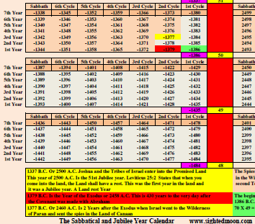
Historic Blood Moon Tetrad: Exodus
http://www.eclipsewise.com/lunar/LEcatalog/LE-0099-0000.html
Exodus:
1379BC, 7 years from the 1st Tetrad

Slide 14
Blood Moon Tetrad: Crucifixion
http://www.monachos.net/conversation/topic/32784-blood-moon-tetrads/
Crescent Moons indicate the beginning of the Messianic period

Slide 15
Blood Moon Tetrads 2010-2019
http://www.monachos.net/conversation/topic/32784-blood-moon-tetrads/
Notice the End of Month Crescent moons
The end of the Messianic age!

Slide 16
Future Blood Moons Tetrads
http://www.lovethesepics.com/2014/04/beautiful-blood-red-moons-tetrad-of-lunar-eclipses-20-pics/
120th Yovel Ends 2044
2nd Exodus Between 2014-2032 Tetrads?

Slide 17
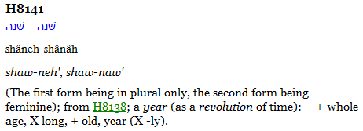
120th Jubilee Cycle/70th From Exodus
Gen 6:3 And Elohim said, “My spirit shall not dwell in man forever, because he is flesh; let his days be a hundred and twenty years/Jubilees”.
120th Yovel Ends 2044

Slide 18
120th Yovel 4th Shemitah Cycle 2017-2014

Slide 19
Shemitah Cycle 2017/24
We are starting the 4th of 7 cycles

Slide 20
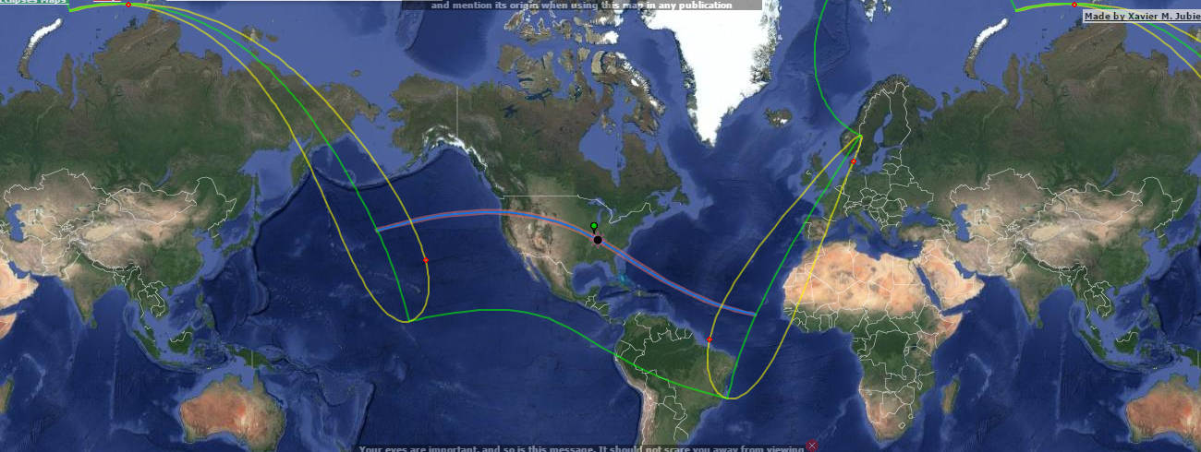
US Solar Eclipse Aug 21, 2017 Starts 40 Days of Teshuvah
8/22: Elul 2, Start of 40 days of Teshuva ending at Yom Kippur
Start and End Points at Potential Mega-Tsunami Sources
US represents the leader of the nations
Start of the Shemitah Cycle
1776: Last trans-continental solar eclipse

Slide 21
US Solar Eclipse Aug 21, 2017
Planets will be visible, Mercury, Venus(Gemini) & Mars Witness
Eclipse occurs in Regulus the King Star
Harbinger for the World, YHWH and the Royal Family are being blocked from access: Time is Up!!!
Notice Virgo and the coming King in the Womb

Slide 22
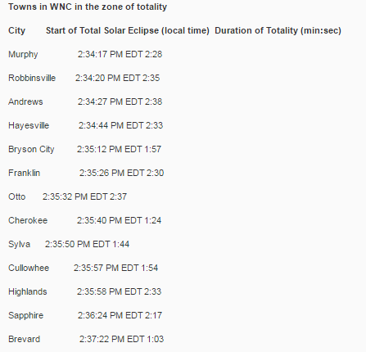
WNC Full Solar Eclipse Viewing Path
Full Eclipse Visible from Pisgah National Forest
http://www.citizen-times.com/story/life/2017/04/12/map-details-outdoor-recreation-path-solar-eclipse/100115136/

Slide 23
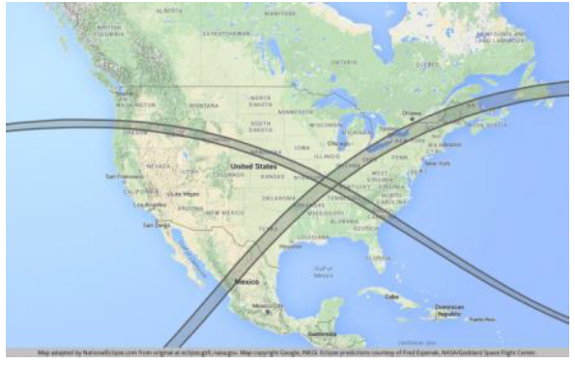
US Solar Eclipse Apr 8, 2024
7 years Later on the last day of Adar Bet and the 4th Shemitah Cycle
Eclipse travels from Southwest to Northeast
Intersection Point is the New Madrid Fault
Harbinger of Judgement for the World

Slide 24
US Solar Eclipse Apr 8, 2024
Planets will be visible: Venus Witness
Eclipse occurs in Pisces
Pisces: Redeemed are delivered from bondage
Announcement of the 2nd Exodus and Return to Israel

Slide 25
7 Year Period
Covenant with Many: 12/23/2016 Hanukah Eve
Confirmed 1/15/2017 in Paris with 70 Nations
Shemitah Cycle 2017-2024
Mid Point: 9/18/2020
12/21/2020
Immediately Following Hanukah Festival (12/10-18):
Kislev 24 or 25, Haggai Ch 2, Dec 10 & 11, 2020?
Saturn/Jupiter Conjunction in Capricorn
Satan/King in the Goat King Constellation (AntiChrist)
Visibility of Super Nova arrives for 2021-2023
http://www.reuters.com/article/us-israel-palestinians-france-idUSKBN14B1LN
Look Up! Your redemption draws nigh….

Slide 26
BREAK

Slide 27
Abraham: Signs in the Heavens

Slide 28
Abraham: Born 1889BC

Slide 29
Book of Jasher: Abraham’s Birth
2 Options: Mercury & Venus, Very Large Star is Venus(Brightest Planet)
Book of Enoch:
4 Stars from the 4 Corners of the Heavens are Equinox Constellations: Autumn Regulus(Leo), Winter Antares (Scorpio), Spring Fomalaut(Aquarius), Summer Aldebaran (Taurus)

Slide 30
The 4 Corners of Heaven
Spring: Fomalaut (Aquarius/Rueben) South
Summer: Aldebaran (Taurus/Ephraim) West
Autumn: Regulus (Leo/Judah) East
Winter: Antares (Scorpio/Dan) North

Slide 31
Book of Jasher: Additional Insight
The speed that it ran was the key characteristic

Slide 32
Which Constellation will Announce the Birth of the King and When?
Virgo: The virgin, Woman in Childbirth
The month of honor for that constellation
Tishri: When it goes into the sun
“Clothed in the sun”
Start of the month: Crescent moon
Announcement of the Royal Birth:
“At her feet”

Slide 33
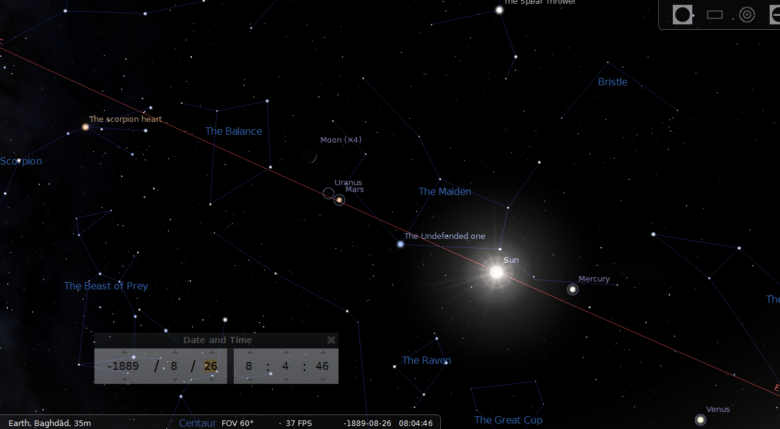
1890BC: 1 Year Before the Sign and Birth
Mercury starts the race ahead of Venus on the Ecliptic in Leo

Slide 34
Sign of the King’s Upcoming Birth 8/15/1889BC Yom Teruah
Virgo with Sun at Back and New Moon at Feet!
Venus “ran in the heavens” to beat Mercury!
Venus in the Womb!
Jupiter near conjunction with Regulus
Born 8/21, 8/30 Sukkot 1

Slide 35
Abraham: Star of Bethlehem 6/12/1889BC
Jupiter/Venus Conjunction before Leo
Mercury is near Regulus
Son of Man from the Royal Line is coming as Spiritual leader and King on Earth for YHWH to restart the Royal Line
Not as a Warrior

Slide 36
How often does Venus outrun Mercury in Virgo in the month of Tishri?
Year Mercury (days) Venus (days)
1890 to 1889 356 295
1889 to 1888 358 409
1888 to 1887 359 298
1887 to 1886 361 404
1886 to 1885 391 408
1885 to 1884 358 293
Mercury is steady
Venus ran faster in 1884 than in 1889
Is 1885 an Adar Bet year?

Slide 37
Why Not 1884bc?
Venus is already in the next constellation on the day of the sign

Slide 38
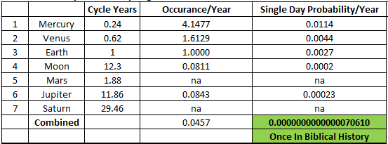
How Often Does this Planetary Alignment Happen?
Once in Biblical History

Slide 39
Creation: Signs in the Heavens

Slide 40
Creation: 3836BC

Slide 41
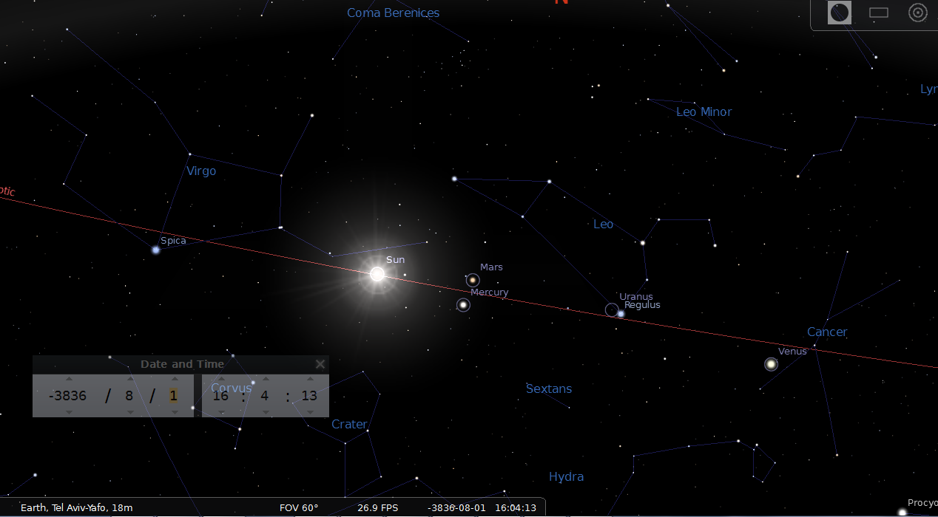
3637BC: 1 Year Before the Sign and Birth
Venus starts behind Mercury on the Ecliptic in Leo

Slide 42
Before Creation: Sign of the King’s Birth 8/1/3836BC
Venus Outruns Mercury!
Born in Virgo with the Sun back and New Moon at her feet
Venus is already born indicating the Spiritual leader is not man
Mercury is not in the womb, indicating a divine birth!
Mercury is born 8/28

Slide 43
Creation: Star of Bethlehem 6/12/3836BC
Mercury/Venus Conjunction near Regulus:
Son of Man is coming to start a Royal Line of Man for YHWH, Not king of world or warrior

Slide 44
How Often Does this Planetary Alignment Happen?
Once in Biblical History

Slide 45
Yahushua 1st Advent: Signs in the Heavens

Slide 46
1st Advent Timing:
http://hope-of-israel.org/herodsdeath.html
Yahushua born in 3/2BC

Slide 47
1st Advent Star of Bethlehem: 9/1/3BC
Mercury/Venus Conjunction with Jupiter near Regulus
Son of Man is coming from the Royal Line to be Spiritual Leader for YHWH but not King on Earth, Starting a new Royal Line separate from the old, Not coming as a Warrior

Slide 48
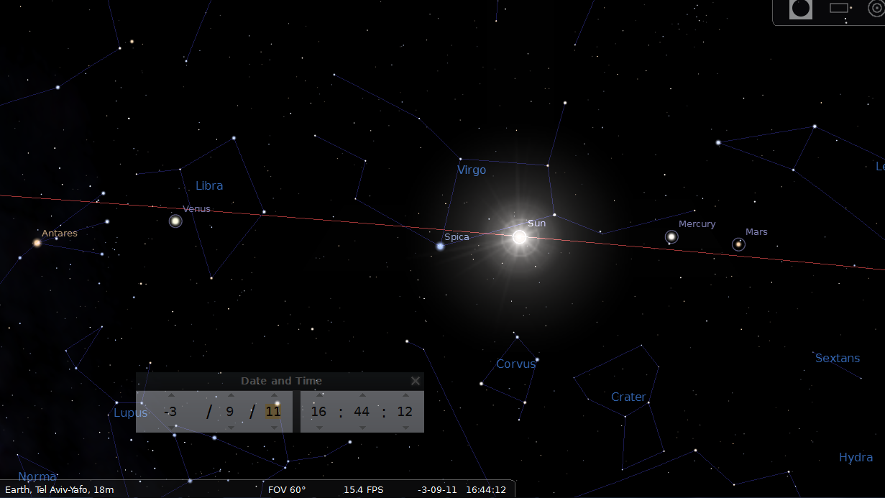
4BC: 1 Year Before the Sign and Birth
Mercury starts behind Venus on the Ecliptic in Virgo

Slide 49
1st Advent Sign of Yahushua: 9/11/3BC
9/10 Tishri 1, Yom Teruah: Jupiter in Conjunction with Regulus
Mercury runs in the Heavens to beat Venus!
Mercury not in the womb: Divine Birth!
Virgo with the Sun at back and New Moon at Feet
Mercury Born 9/25 (Tishri 15/Sukkot1)
Crown of 12 with Jupiter, Mercury, Venus

Slide 50
Sukkot 1: 9/25/3BC
http://studiesintheword.org/chart_6BC.htm
9/10 Tishri 1, 9/25 Tishri 15

Slide 51
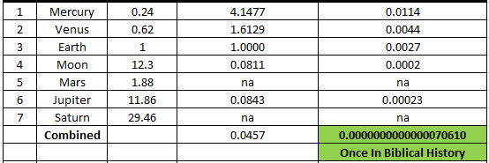
How Often Does this Planetary Alignment Happen?
Once in Biblical History

Slide 52
Yahushua 2nd Advent: Signs in the Heavens

Slide 53
Rev 12: The Sign of Yahushua
Rev 12:1 And a great sign was seen in the heaven: a woman clad with the sun, with the moon under her feet, and on her head a crown of twelve stars.
Rev 12:2 And being pregnant, she cried out in labour and in pain to give birth.
Rev 12:3 And another sign was seen in the heaven: and see, a great, fiery red dragon having seven heads and ten horns, and seven crowns on his heads.
Rev 12:4 And his tail draws a third of the stars of the heaven and throws them to the earth. And the dragon stood before the woman who was about to give birth, to devour her child as soon as it was born.
Rev 12:5 And she bore a male child¹ who was to shepherd all nations with a rod of iron. And her child was caught away to Elohim and to His throne. Footnote: ¹Isa. 66:7.
Rev 12:6 And the woman fled into the wilderness, where she has a place prepared by Elohim, to be nourished there one thousand two hundred and sixty days.
Rev 12:7 And there came to be fighting in the heaven: Miḵa’ĕl and his messengers fought against the dragon. And the dragon and his messengers fought,
Rev 12:8 but they were not strong enough, nor was a place found for them in the heaven any longer.
Rev 12:9 And the great dragon was thrown out, that serpent of old, called the Devil and Satan, who leads all the world astray. He was thrown to the earth, and his messengers were thrown out with him.
Rev 12:10 And I heard a loud voice saying in the heaven, “Now have come the deliverance and the power and the reign of our Elohim,¹ and the authority of His Messiah, for the accuser of our brothers, who accused them before our Elohim day and night, has been thrown down. Footnote: ¹See 11:15.
Rev 12:11 “And they overcame him because of the Blood of the Lamb, and because of the Word of their witness, and they did not love their lives to the death.
Rev 12:12 “Because of this rejoice, O heavens, and you who dwell in them! Woe to the earth and the sea, because the devil has come down to you, having great wrath, knowing that he has little time.”
Rev 12:13 And when the dragon saw that he had been thrown to the earth, he persecuted the woman who gave birth to the male child.
Rev 12:14 And the woman was given two wings of a great eagle, to fly into the wilderness to her place, where she is nourished for a time and times and half a time, from the presence of the serpent.
Rev 12:15 And out of his mouth the serpent spewed water like a river after the woman, to cause her to be swept away by the river.
Rev 12:16 And the earth helped the woman, and the earth opened its mouth and swallowed up the river which the dragon had spewed out of his mouth.
Rev 12:17 And the dragon was enraged with the woman, and he went to fight with the remnant of her seed, those guarding the commands of Elohim and possessing the witness of יהושע Messiah.
Man Child: 2nd Birth=Born Again
Physical signs with physical/spiritual meaning
The same as the beginning

Slide 54
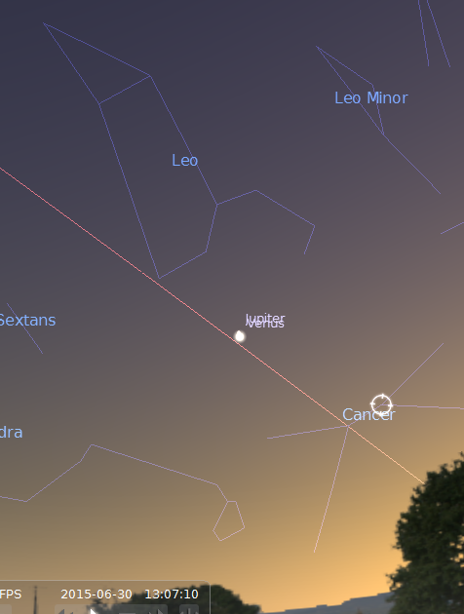
We are Forewarned! Star of Bethlehem 2015/16
http://www.timesofisrael.com/star-of-bethlehem-shines-again/
http://www.inquisitr.com/2215471/star-of-bethlehem-returns-celestial-phenomenon-will-appear-the-clearest-its-been-since-birth-of-jesus-christ/
2016: Jupiter, Venus, Mercury Conjunction in Virgo
2015: Jupiter, Venus in Leo
July, Aug, ….Sept 2017

Slide 55
Pesach: 4/11/2017
Full Moon in Virgo with Jupiter
The Righteous King is coming!
He is the reflection of YHWH!

Slide 56
Shavuot: 6/4/2017
Full Moon in Virgo with Jupiter
The Righteous King is coming!
He is the reflection of YHWH!

Slide 57
2nd Advent Star of Bethlehem: 9/16/2017
Mercury/Mars Conjunction with Venus near Regulus
Son of Man is coming from the new Royal Line to be Spiritual Leader for YHWH and King on Earth, He returns as a warrior
Jupiter is in the Womb!

Slide 58
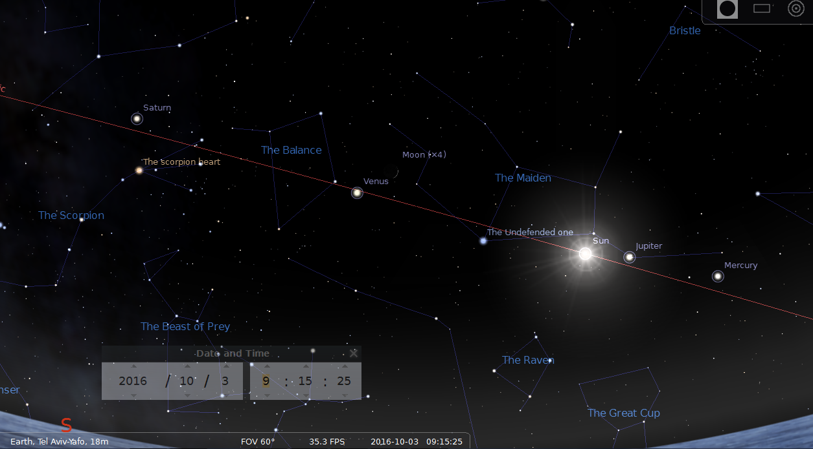
2016: 1 Year Before the Sign and Birth
Jupiter moves 31 degrees/days on the ecliptic per year
Should be in Libra next year…

Slide 59
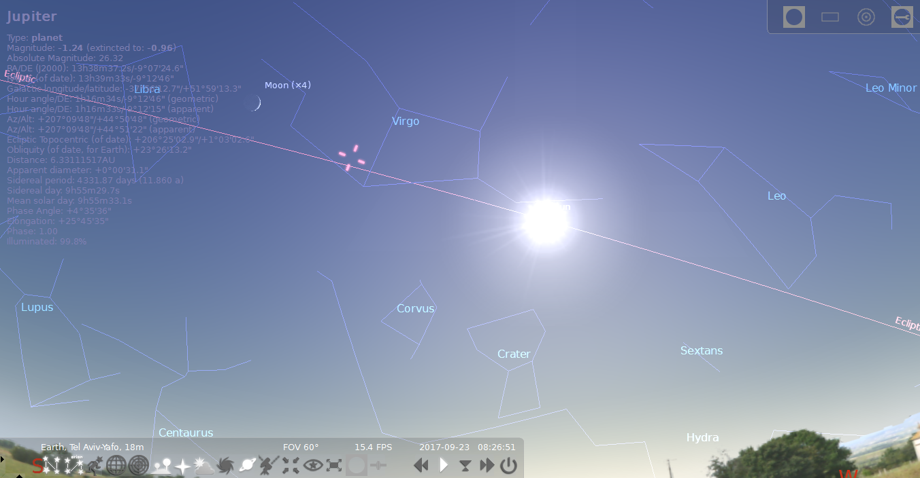
View From Tel Aviv 9/23/2017
This Happens Once a Year, Who Cares?

Slide 60
2nd Advent Sign of Yahushua
Venus, Mars, Mercury, Jupiter and Saturn
9/21 Tishri 1, Yom Teruah:
Virgo with the Sun at back and New Crescent Moon at Feet
Crown of 12 with Mars, Mercury, Venus

Slide 61
Conjunction Overload
9/5 Mars Conjunction Regulus, 9/10 Mercury Conjunction Regulus, 9/16 Mars Mercury Conjunction, 9/19 Venus Conjunction Regulus, 10/5 Mars Venus Conjunction, 10/8 Mercury Sun Conjunction (Day of Birth), 10/18 Jupiter Mercury Conjunction, 10/26 Sun Jupiter Conjunction, 11/13 Jupiter Venus Conjunction, 1/16/18 Jupiter Mars Conjunction in Libra
Refer back to the characterization of each object

Slide 62
The Woman: Virgo/Betulah
Betulah (Virgin), Physical Israel and Adopted Israel
Betulah (Arabic) Breakdown:
Beit or House
And
ulah or God,
House of God
Betulah (Hebrew) Breakdown:
Beit or House
And alma (virgin) abbreviated,
House of Virgins

Slide 63
Clothed in the Sun
Illuminated by YHWH’s glory, The month she goes into the sun

Slide 64
The Moon at Her Feet
Tishri 1-3

Slide 65
Crown of 12 Stars
Leo: Tribe of Judah, The Royal Line
Regulus: The Royal Star, The Planets Travel Through Regulus on the ecliptic
Extras: Mercury, Mars and Venus

Slide 66
Pregnant and About to Give Birth
Retrograde motion starting 1/20 and ending 7/1
Jupiter/Tzedik: The Righteous King
Birthday: October 4, 2017, Sukkot 1

Slide 67
Cried Out in Labor
Jupiter enters Virgo 11/22/2016
Enters womb 1/1/2017
40 weeks in the womb(Jupiter Retrograde)
Born 10/4/2017
Sukkot 1
Increasing heard on Earth
Increasing spiritual chaos on Earth
Heavenly Sounds
http://allnewspipeline.com/Whole_Earth_Ringing_Like_A_Bell.php
Heavenly Sounds?

Slide 68
Dragon Standing Before the Woman: View From Tel Aviv 9/23/17
Blocked Sun View
Serpens/ Ophiucus: Flying, horned serpent of Babylon with forelegs
Corona Borealis: 7 stars
Satan is thrown out of heaven and incarnates the beast, Physically incarnates the leader of the world?
Saturn/Satan is in Serpens: Just like Gan Eden

Slide 69
Serpens/Basmu

Slide 70
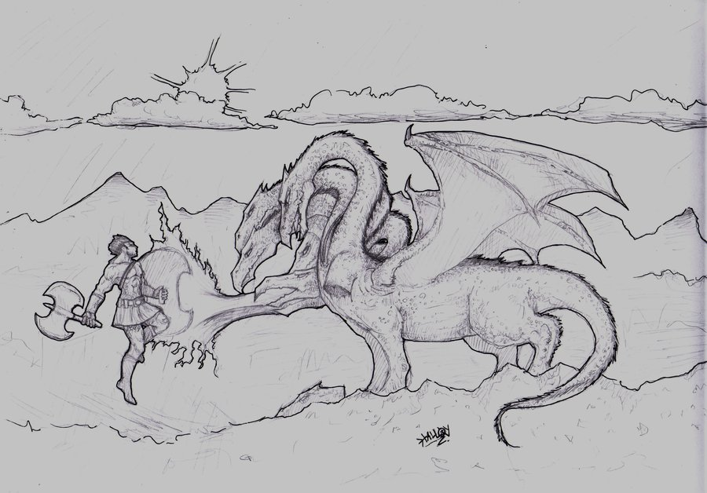
Serpens/Basmu/Mushmahhu

Slide 71
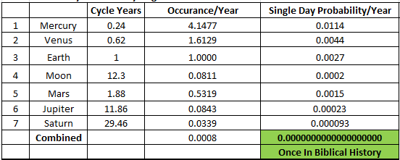
How Often Does this Planetary Alignment Happen?
Once in Biblical History

Slide 72
What’s Missing?
?

Slide 73
The Fiery Red Dragon of Old:
What will cause the fiery red?
Nemisis, comet, other?
Is the sun darkened?

Slide 74
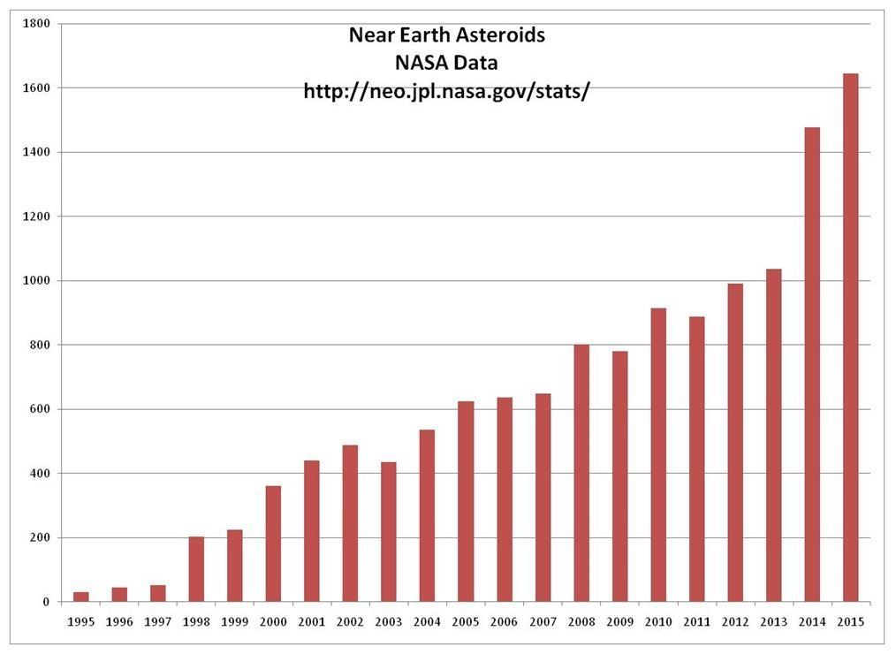
Tail Throws 1/3 of the Stars of the Heaven to Earth
Meteor Showers from tail every Dec 18 & 25
Fireballs/Asteroids
Fireball Video
Fireballs/Asteroids

Slide 75
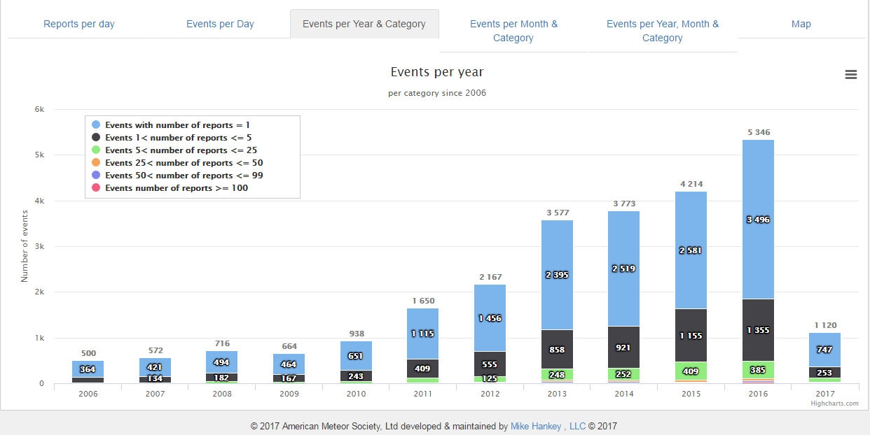
Fireballs
2016: Trend Continues

Slide 76
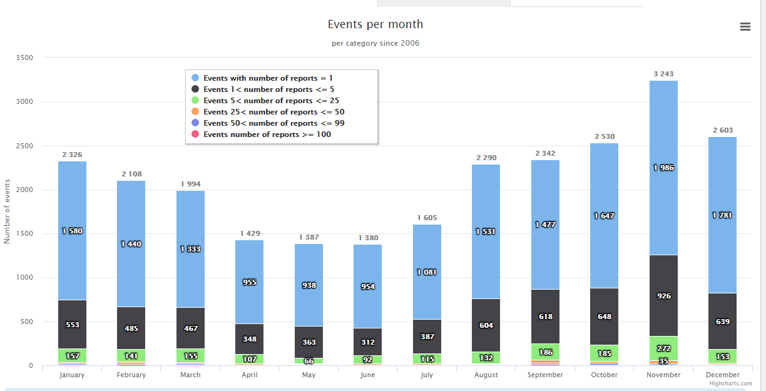
Fireballs
November is Peak Month

Slide 77
New Insight? Tail Throws 1/3 of the Stars of the Heaven to Earth
Remaining Fallen Angels thrown from Heaven
Span 1/3 of the heavens or 4 constellations
Also, Indicates start of firebals is 4 months prior to Rev 12 Event
https://www.youtube.com/watch?v=IB-jKUcHKos
https://www.youtube.com/watch?v=zlOerAP9oJk&t=44s
Shavuot, June 4, 2017
Does the tail appear?
Does the meteor showers begin from the tail of Serpens/Basmus?

Slide 78
View From Tel Aviv 9/23/17
??? provides the fiery red to Serpens
http://earthsky.org/astronomy-essentials/august-21-2017-solar-eclipse-4-planets-bright-stars?utm_content=bufferead67&utm_medium=social&utm_source=twitter.com&utm_campaign=buffer
The Sun is darkened ???
Reference points:
Darkness Lasted 3 days in Exodus,
3 hours at Yahushua’s crucifixion,
Two Darkness Events in Revelations

Slide 79
Shavuot 2024
Is this the start of the Exodus?
The unified King is at war to free Ephraim from bondage

Slide 80
Shavuot 2031
Is this the end of the Exodus?
HaSatan is being pushed around by Ephraim who is led by the Son of Man
Does it take 14yrs to return? Jacob weds Leah/Rachel?

Slide 81
What Should We Do?

Slide 82
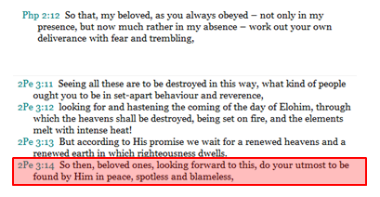
Repent! The Kingdom is at Hand!
1st: Repentance/Freedom Ministry!
2nd: Obey Torah in Truth And Spirit!
3rd: Praise YHWH!

Slide 83
Where are we on the Biblical Timeline?

Slide 84
Where are we on the Biblical Timeline?
Genesis 6: 3, YHWH will contend with man for 120 revolutions of time
Daniel 9:24, The Anointed will have 70 sevens(plural) to complete the vision for man
Currently in the 120th Yovel since creation, 70th Yovel since the Exodus

Slide 85
Fig Tree Generation
Eretz Israel: Born 1948
1 Generation = 70 yrs
Ends 2018
Matthew 24:32-35 This generation will not pass until all of these things have happened

Slide 86
Is the House of Israel Exile Over?
Prayed Daniel’s Prayer for the House of Israel:
Shavuot 2012
Request to come home based on YHWH’s promise
Shavuot 2017!
To be fullfilled 2024!

Slide 87
Biblical Feasts Timeline
Current Time: Counting the Omer for the Early Harvest, Shavuot (1st Resurrection)
Elijah show up at Pesach(2nd?)
Be in Yerushalayim by 2nd Pesach of that year
Seal #6
144000 in Yerushalayim on Shavuot to be sealed
Seal #7

Slide 88
What happens to us?
Pesach/Shavuot at time of Nemesis: 144,000 Virgins from the 12 tribes meet in Yerushalayim
Preparing for the 2 witness ministry
Elijah and Moses
Woman in the Wilderness, the Remnant
Yerushalayim to Jordan
Exodus: Moses vs Pharaoh Showdown
Abib 1, 2024
Gathered from the 4 corners
Delivered from the Beast System
Alternative: Captivity, Sword
Some will survive without the deliverance events

Slide 89
Disclaimer
Truths, Facts, Leading of the Ruach, Interpretations, Opinions…..
Controversial, A matter of faith…
Evaluation Required:
Discernment, Judgement, Prayer and Faith
Not a predication, an admonishment!

Slide 90
Appendix

Slide 91
The Sign of Yahushua: Matthew 24
Mat 24:1 And going out, יהושע went away from the Set-apart Place, and His taught ones came near to point out to Him the buildings of the Set-apart Place.
Mat 24:2 And יהושע said to them, “Do you not see all these? Truly, I say to you, not one stone shall be left here upon another, at all, which shall not be thrown down.”
Mat 24:3 And as He sat on the Mount of Olives, the taught ones came to Him separately, saying, “Say to us, when shall this be, and what is the sign of Your coming, and of the end of the age?”
Mat 24:4 And יהושע answering, said to them, “Take heed that no one leads you astray.
Mat 24:5 “For many shall come in My Name, saying, ‘I am the Messiah,’ and they shall lead many astray.
Mat 24:6 “And you shall begin to hear of fightings and reports of fightings. See that you are not troubled, for these have to take place, but the end is not yet.
Mat 24:7 “For nation shall rise against nation, and reign against reign. And there shall be scarcities of food, and deadly diseases, and earthquakes in places.
Mat 24:8 “And all these are the beginning of birth pains.
Mat 24:9 “Then they shall deliver you up to affliction and kill you, and you shall be hated by all nations for My Name’s sake.
Mat 24:10 “And then many shall stumble, and they shall deliver up one another, and shall hate one another.
Mat 24:11 “And many false prophets shall rise up and lead many astray.
Mat 24:12 “And because of the increase in lawlessness, the love of many shall become cold.
Mat 24:13 “But he who shall have endured to the end shall be saved.¹ Footnote:¹See 10:22.
Mat 24:14 “And this Good News of the reign shall be proclaimed in all the world as a witness to all the nations, and then the end shall come.
Mat 24:15 “So when you see the ‘abomination that lays waste,’¹ spoken of by Dani’ĕl the prophet, set up in the set-apart place” – he who reads, let him understand – Footnote:¹See Abomination that lays waste in Explanatory Notes.
Mat 24:16 “then let those who are in Yehuḏah flee to the mountains.
Mat 24:17 “Let him who is on the house-top not come down to take whatever out of his house.
Mat 24:18 “And let him who is in the field not turn back to get his garments.
Mat 24:19 “And woe to those who are pregnant and to those who are nursing children in those days!
Mat 24:20 “And pray that your flight does not take place in winter or on the Sabbath.
Mat 24:21 “For then there shall be great distress,¹ such as has not been since the beginning of the world until this time, no, nor ever shall be. Footnote:¹Or great pressure, or great affliction.
Mat 24:22 “And if those days were not shortened, no flesh would be saved, but for the sake of the chosen ones those days shall be shortened.
Mat 24:23 “If anyone then says to you, ‘Look, here is the Messiah!’ or ‘There!’ do not believe.
Mat 24:24 “For false messiahs and false prophets shall arise, and they shall show great signs and wonders, so as to lead astray, if possible, even the chosen ones.
Mat 24:25 “See, I have forewarned you. he Coming of Yahushua

Slide 92
The Sign of Yahushua: Matthew 24
Mat 24:26 “So if they say to you, ‘Look, He is in the desert!’ do not go out; or ‘Look, He is in the inner rooms!’ do not believe.
Mat 24:27 “For as the lightning comes from the east and shines to the west, so also shall the coming of the Son of Aḏam be.
Mat 24:28 “For wherever the dead body is, there the eagles shall be gathered together.¹ Footnote:¹Lk. 17:37.
Mat 24:29 “And immediately after the distress¹ of those days the sun shall be darkened, and the moon shall not give its light, and the stars shall fall from the heaven, and the powers of the heavens shall be shaken. Footnote:¹Or pressure.
Mat 24:30 “And then the sign of the Son of Aḏam shall appear in the heaven, and then all the tribes of the earth shall mourn, and they shall see the Son of Aḏam coming on the clouds of the heaven with power and much esteem.
Mat 24:31 “And He shall send His messengers with a great sound of a trumpet, and they shall gather together His chosen ones from the four winds, from one end of the heavens to the other.
Mat 24:32 “And learn this parable from the fig tree: When its branch has already become tender and puts forth leaves, you know that the summer is near.
Mat 24:33 “So you also, when you see all these, know that He is near, at the doors.
Mat 24:34 “Truly, I say to you, this generation shall by no means pass away until all this takes place.
Mat 24:35 “The heaven and the earth shall pass away, but My words shall by no means pass away.
Mat 24:36 “But concerning that day and the hour no one knows, not even the messengers of the heavens, but My Father only.¹ Footnote:¹Mk. 13:32.
Mat 24:37 “And as the days of Noaḥ, so also shall the coming of the Son of Aḏam be.
Mat 24:38 “For as they were in the days before the flood, eating and drinking, marrying and giving in marriage, until the day that Noaḥ entered into the ark,
Mat 24:39 and they did not know until the flood came and took them all away, so also shall the coming of the Son of Aḏam be.
Mat 24:40 “Then two shall be in the field, the one is taken and the one is left.
Mat 24:41 “Two shall be grinding at the mill, one is taken and one is left.
Mat 24:42 “Watch therefore, for you do not know what hour your Master is coming.
Mat 24:43 “And know this, that if the master of the house had known what hour the thief would come, he would have watched and not allowed his house to be broken into.
Mat 24:44 “Because of this, be ready too, for the Son of Aḏam is coming at an hour when you do not expect Him.
Mat 24:45 “Who then is a trustworthy and wise servant, whom his master set over his household, to give them food in season?
Mat 24:46 “Blessed is that servant whom his master, having come, shall find so doing.
Mat 24:47 “Truly, I say to you that he shall set him over all his possessions.
Mat 24:48 “But if that evil servant says in his heart, ‘My master is delaying his coming,’
Mat 24:49 and begins to beat his fellow servants, and to eat and drink with the drunkards,
Mat 24:50 the master of that servant shall come on a day when he does not expect it, and at an hour he does not know,
Mat 24:51 and shall cut him in two and appoint him his portion with the hypocrites – there shall be weeping and gnashing of teeth.

Slide 93
Daniel 9 Prayer of Repentance
Dan 9:1 In the first year of Dareyawesh the son of Aḥashwĕrosh, of the seed of the Medes, who was set up as sovereign over the reign of the Chaldeans –
Dan 9:2 in the first year of his reign I, Dani’ĕl, observed from the Scriptures the number of the years, according to the word of יהוה given to Yirmeyah the prophet, for the completion of the wastes of Yerushalayim would be seventy years.
Dan 9:3 So I set my face toward יהוה the Elohim to seek by prayer and supplications, with fasting, and sackcloth, and ashes.
Dan 9:4 And I prayed to יהוה my Elohim, and made confession, and said, “O יהוה, great and awesome Ěl, guarding the covenant and the kindness to those who love Him, and to those who guard His commands.
Dan 9:5 “We have sinned and did crookedness, and did wrong and rebelled, to turn aside from Your commands and from Your right-rulings.
Dan 9:6 “And we have not listened to Your servants the prophets, who spoke in Your Name to our sovereigns, our heads, and our fathers, and to all the people of the land.
Dan 9:7 “O יהוה, to You is the righteousness, and to us the shame of face, as it is this day – to the men of Yehuḏah, to the inhabitants of Yerushalayim and all Yisra’ĕl, those near and those far off in all the lands to which You have driven them, because of their trespass which they have trespassed against You.
Dan 9:8 “O Master, to us is the shame of face, to our sovereigns, to our heads, and to our fathers, because we have sinned against You.
Dan 9:9 “To יהוה our Elohim are the compassions and forgivenesses, for we have rebelled against Him.
Dan 9:10 “And we have not obeyed the voice of יהוה our Elohim, to walk in His Torot, which He set before us through His servants the prophets.
Dan 9:11 “And all Yisra’ĕl have transgressed Your Torah, and turned aside, so as not to obey Your voice. So the curse and the oath written in the Torah of Mosheh the servant of Elohim have been poured out on us, for we have sinned against Him.
Dan 9:12 “And He has confirmed His words, which He spoke against us and against our rulers who judged us, by bringing upon us great evil. For under all the heavens there has not been done like what was done to Yerushalayim.
Dan 9:13 “As it is written in the Torah of Mosheh, all this evil has come upon us, and we have not entreated the face of יהוה our Elohim, to turn back from our crookednesses, and to study Your truth.
Dan 9:14 “Hence יהוה has watched over the evil and has brought it upon us. For יהוה our Elohim is righteous in all the works which He has done, but we have not obeyed His voice.
Dan 9:15 “And now, O יהוה our Elohim, who brought Your people out of the land of Mitsrayim with a strong hand, and made Yourself a Name, as it is this day – we have sinned, we have done wrong!
Dan 9:16 “O יהוה, according to all Your righteousness, I pray, let Your displeasure and Your wrath be turned away from Your city Yerushalayim, Your set-apart mountain. For, because of our sins, and because of the crookednesses of our fathers, Yerushalayim and Your people have become a reproach to all those around us.
Dan 9:17 “And now, our Elohim, hear the prayer of Your servant, and his supplications, and for the sake of יהוה cause Your face to shine on Your set-apart place, which is laid waste.
Dan 9:18 “O my Elohim, incline Your ear and hear. Open Your eyes and see our wastes, and the city which is called by Your Name. For we do not present our supplications before You because of our righteous deeds, but because of Your great compassions.
Dan 9:19 “O יהוה, hear! O יהוה, forgive! O יהוה, listen and act! Do not delay for Your own sake, my Elohim, for Your city and Your people are called by Your Name.”
Dan 9:20 And while I was speaking, and praying, and confessing my sin and the sin of my people Yisra’ĕl, and presenting my supplication before יהוה my Elohim for the set-apart mountain of my Elohim,
Dan 9:21 while I was still speaking in prayer, the man Gaḇri’ĕl, whom I had seen in the vision at the beginning, came close to me, in swift flight about the time of the evening offering.
Dan 9:22 And he made me understand, and talked with me, and said, “O Dani’ĕl, I have now come forth to make you wise concerning understanding.
Dan 9:23 “At the beginning of your supplications a word went out, and I have come to make it known, for you are greatly appreciated. So consider the word and understand the vision:
Dan 9:24 “Seventy weeks are decreed for your people and for your set-apart city, to put an end to the transgression, and to seal up sins, and to cover crookedness, and to bring in everlasting righteousness, and to seal up vision and prophet, and to anoint the Most Set-apart.
Dan 9:25 “Know, then, and understand: from the going forth of the command to restore and build Yerushalayim until Messiah the Prince is seven weeks and sixty-two weeks. It shall be built again, with streets and a trench, but in times of affliction.
Dan 9:26 “And after the sixty-two weeks Messiah shall be cut off and have naught. And the people of a coming prince shall destroy the city and the set-apart place. And the end of it is with a flood. And wastes are decreed, and fighting until the end.
Dan 9:27 “And he shall confirm a covenant with many for one week. And in the middle of the week he shall put an end to slaughtering and meal offering. And on the wing of abominations he shall lay waste, even until the complete end and that which is decreed is poured out on the one who lays waste¹.” Footnote: ¹Mt. 24:15.

