Slide 1
Romans 11 Israel or Replacement Theology?

Slide 2
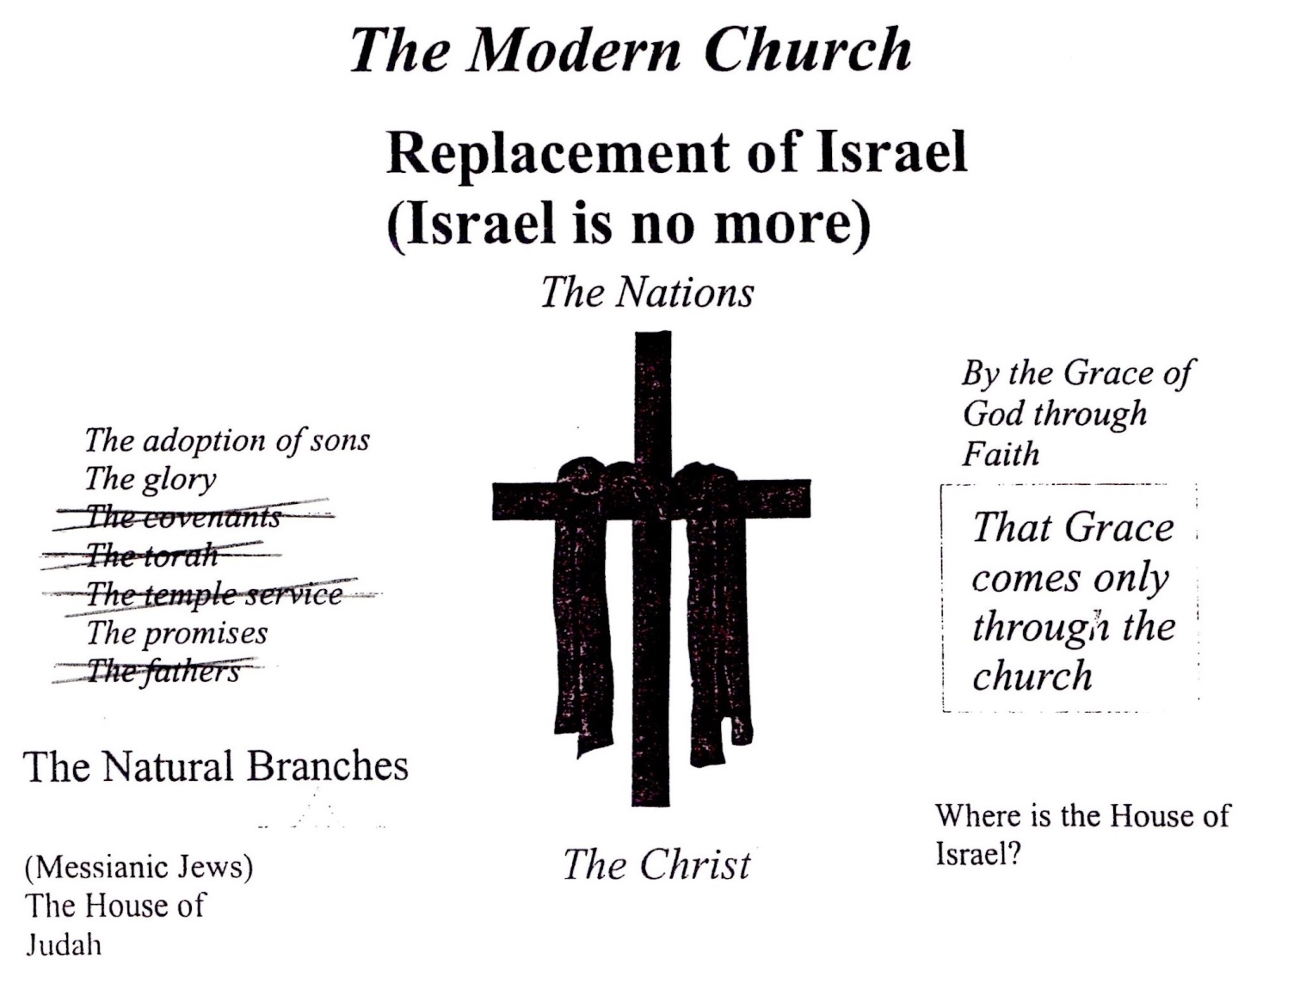
Modern Day Christianity

Slide 3
Prof. C. A. L. (Charles Adelle Lewis) Totten, of Yale University, says: "I can never be too thankful to the Almighty that in my youth he used the late Professor Wilson to show me the difference between the two houses. The very understanding of this difference is the KEY by which almost the entire Bible becomes intelligible, and I cannot state too strongly that the man who has not yet seen that Israel of the Scripture is totally distinct from the Jewish people, is yet in the very infancy, the mere alphabet, of Biblical study, and that to this day the meaning of seven-eighths of the Bible is shut to his understanding." (1851-1908)

Slide 4
CONTEXT! CONTEXT! CONTEXT!
Romans 9: Paul’s commission to call out Ephraim
Paul is speaking about the original people of God who repent from their Idolatry and return to their God and their land from the nations where they had been scattered
Rom 9:3 For I (Paul) could wish that myself were accursed from Christ for my brethren, my kinsmen according to the flesh:
Rom 9:4 Who are Israelites; to whom pertaineth the adoption, and the glory, and the covenants, and the giving of the law, and the service of God, and the promises;
“accursed”: Greek word ‘Anathema’= means what has been dedicated or a consecrated gift (to God).
“from” : Greek word ‘Apo’ = means from (a source) –OR- of, because of, by…
Lev 27:28 Notwithstanding no devoted (Anathema) thing, that a man shall devote (Anathema) unto YHWH of (Apo) all that he hath, both of (Apo) man and beast, and of (Apo) the field of his possession, shall be sold or redeemed: every devoted (Anathema) thing most holy unto YHWH.

Slide 5
Rom 9:3 For I (Paul) could wish that myself were accursed from [devoted of]/ [devoted because of] Christ for my brethren, my kinsmen according to the flesh:
Rom 9:4 Who are Israelites; to whom pertaineth the adoption, and the glory, and the covenants, and the giving of the law, and the service of God, and the promises; [Reference: Frank Houtz]
In verse 3, Paul is pouring out his life for his people- offering his whole being in service to Yahweh on their behaf.
Rom 9:6 BUT THEY ARE NOT ALL ISRAEL WHO ARE FROM ISRAEL (Jacob).
Rom 9:6-8- Paul is saying that not all Israelites after the flesh (physically born) are the Israel of Elohim. It is not the children of the flesh who are the people of Elohim, rather, the children of the promise who are accounted for the seed. The seed of promise are those who enter into the Kingdom of Yah through Yeshua and permit Torah to be written on their hearts [Roth: Aramaic English N.T.]

Slide 6
Romans 10- Has Israel Been Forgotten?
Rom 10:1 Brethren, my heart's desire and prayer to God for Israel is, [that they might be saved] – or [for their salvation]. (what does your Bible have? Israel or them?)
Romans 10:6-8. Paul is midrashing Deuteronomy 30:11-14 [Read]. Paul is expressing Yeshua as the living Torah through the writings of Torah. Paul is literally interchanging Yeshua with Torah here. Yeshua said in John 6:51 – “I am the Living Bread who has descended from Heaven”.
Rom 10:21 But to Israel he (YHWH) saith, All day long I have stretched forth my hands unto a disobedient and gainsaying (stubborn) people. (Isa 65:1)
Paul’s Commission- Act 9:15 But the Lord (Yeshua) said unto him (Ananias), Go thy way: for he (Paul) is a chosen vessel unto me, to bear my name before the Gentiles [Nations], and kings, and the children of Israel:

Slide 7
Israel or Replacement Theology?
Eph 2:12 That at that time ye (gentiles/those of the nations) were without Christ, being aliens from the commonwealth (citizenship) of Israel, and strangers from the covenants of promise, having no hope, and without God in the world: (see Romans 9:4)
Eph 2:13 But now in Christ Jesus ye who sometimes were far off are made nigh (drawn near [korban]) by the blood of Christ.
Rom 11:1 I say then, Hath God cast away his people? God forbid. For I also am an Israelite, of the seed of Abraham, of the tribe of Benjamin.
Rom 11:11 I say then, Have they (Israel) stumbled that they should fall? God forbid: but rather through their fall (transgression/disobedience to YHWH) salvation is come unto the gentiles (Nations), for to provoke them (Judah/Israel) to jealousy.
Rom 11:14 If by any means I may provoke to jealousy my fellow countrymen (Israel (of the flesh) who are disobedient/disbelieving [Rom 10:21] ), and might save some of them.

Slide 8
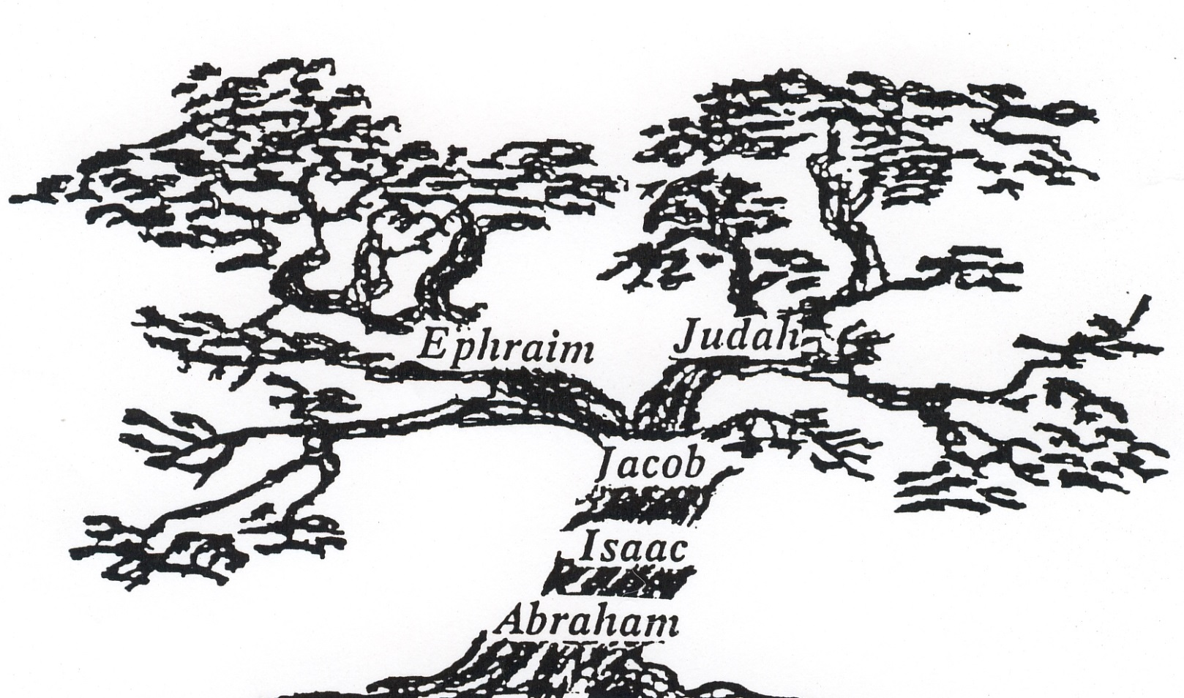
Romans 11: Understanding the ‘Olive Tree’
Jer 11:10,16 Yahweh called your name (Israel and Judah) a green olive tree.

Slide 9
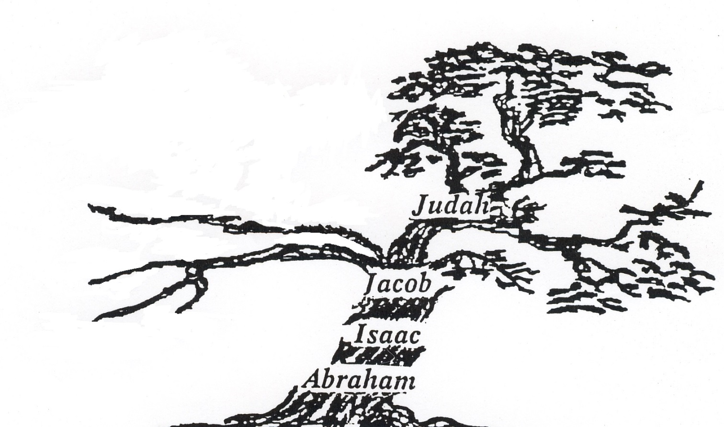
Understanding the ‘Olive Tree’
Hos 1-2, 8:8; Amo 9:9 Ephraim/Israel’s branches first to be broken off- Dispersed among the nations (721 BC)

Slide 10
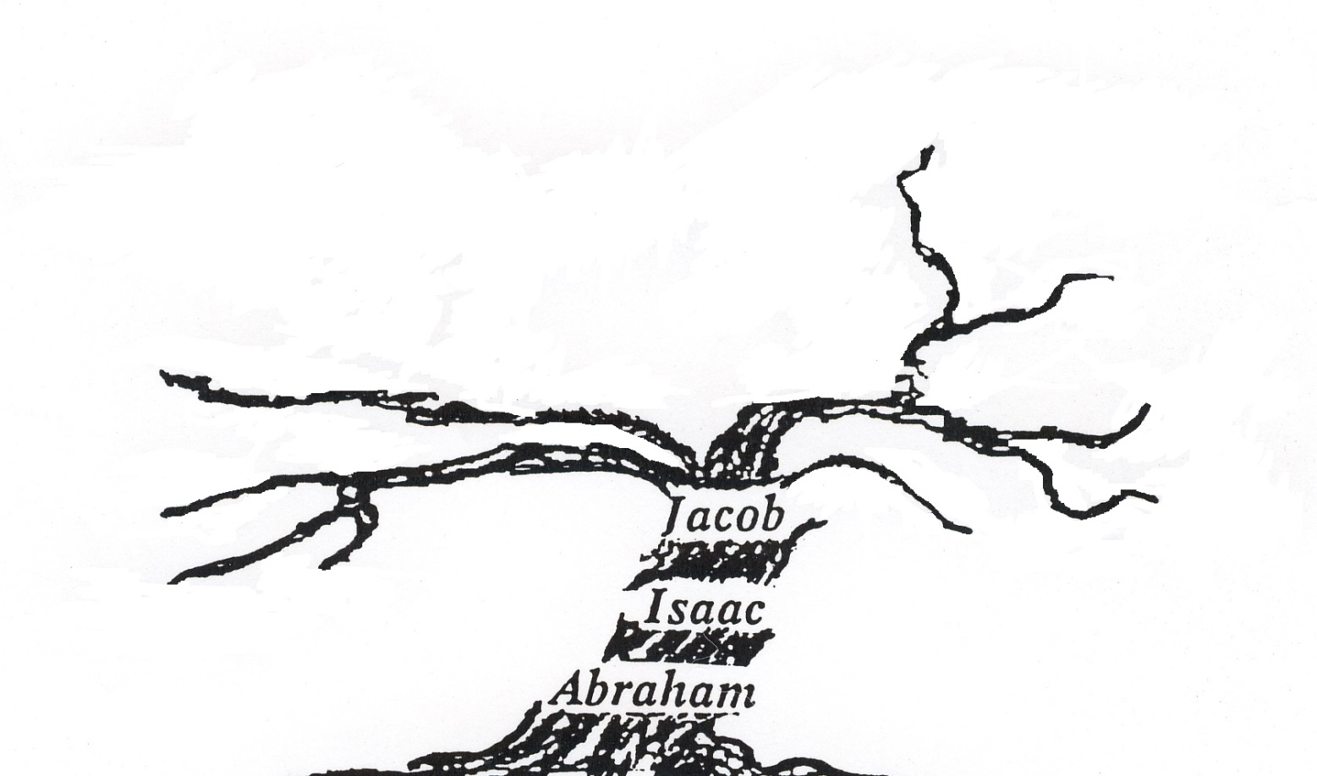
Understanding the ‘Olive Tree’
2 Kin 20:17, 2 Kin 24:11-15, 2 Kin 25: Judah’s branches broken off- Dispersed to Babylon (586 BC)

Slide 11
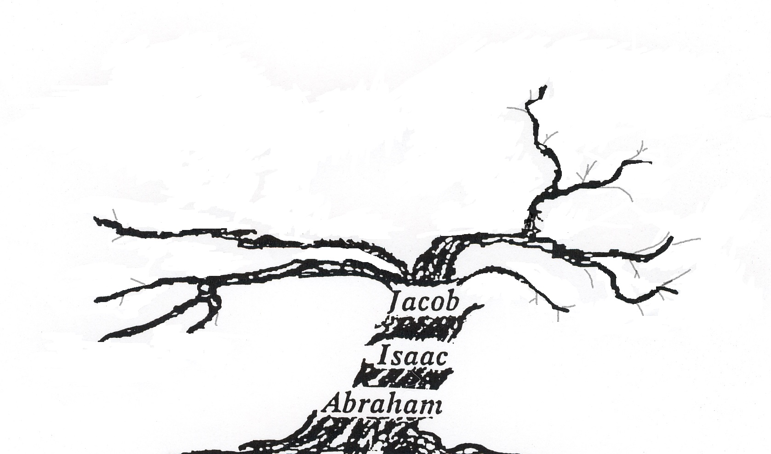
Understanding the ‘Olive Tree’
Only a remnant left on the earth with some returning from Babylon (42,360 – Ezra 2:64).

Slide 12
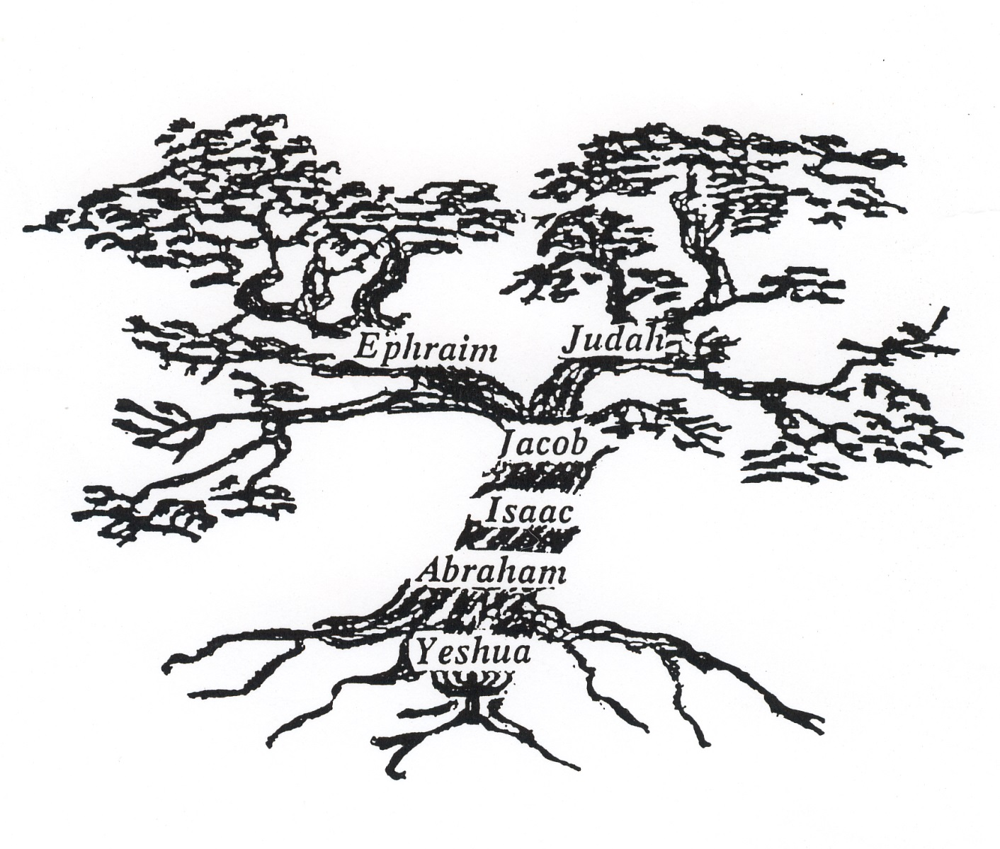
Understanding the ‘Olive Tree’
Restored Israel Olive Tree. Both ‘branches’ made ONE in the Father’s Hand: Eze 37:15-28

Slide 13
Identifying ‘terms’: Romans11:16-25
Rom 11:16 root = Messiah, branches = the whole house of Israel
Rom 11:17 wild olive/branches = of the nations [Not fleshly Israel]
Rom 11:17 wild olive branch grafted in to the natural olive tree = Cornelius for example
Rom 11:21-23 ‘God’ – ‘When Paul uses ‘God’ (theos), it is almost always referring to the Father. God is the Husbandman (see John 15)

Slide 14
Joh 15:1 I am the true vine, and my Father is the husbandman.
Joh 15:2 Every branch in me that beareth not fruit He taketh away: and every branch that beareth fruit, He purgeth it, that it may bring forth more fruit.
Joh 15:3 Now ye are clean through the word which I have spoken unto you.
Joh 15:4 Abide in me, and I in you. As the branch cannot bear fruit of itself, except it abide in the vine; no more can ye, except ye abide in me.
Joh 15:5 I am the vine, ye are the branches: He that abideth in me, and I in him, the same bringeth forth much fruit: for without me ye can do nothing.
Joh 15:6 If a man abide not in me, he is cast forth as a branch, and is withered; and men gather them, and cast them into the fire, and they are burned.
Joh 15:7 If ye abide in me, and my words abide in you, ye shall ask what ye will, and it shall be done unto you.
Joh 15:8 Herein is my Father glorified, that ye bear much fruit; so shall ye be my disciples.
Joh 15:9 As the Father hath loved me, so have I loved you: continue ye in my love.
Joh 15:10 If ye keep my commandments, ye shall abide in my love; even as I have kept my Father's commandments, and abide in his love.
Joh 15:11 These things have I spoken unto you, that my joy might remain in you, and that your joy might be full.
Joh 15:12 This is my commandment, That ye love one another, as I have loved you.

Slide 15
Rom 11:17 And if some of the branches be broken off, and thou, being a wild olive (G65) tree, wert graffed in among them, and with them partakest of the root and fatness of the olive tree;
Rom 11:24 For if thou wert cut out of the olive tree which is wild by nature, and wert graffed contrary to nature into a good olive (G2565) tree: how much more shall these, which be the natural branches, be graffed into their own olive tree?
G65
ἀγριέλαιος
agrielaios
ag-ree-el'-ah-yos
From G66 and G1636; an oleaster: - olive tree (which is) wild.
G2565
καλλιέλαιος
kallielaios
kal-le-el'-ah-yos
From the base of G2566 and G1636; a cultivated olive tree, that is, a domesticated or improved one: - good olive tree.

Slide 16
Romans 11:17
In ANE times, it was very common to graft olive trees. A branch from a good olive tree was taken and grafted onto a wild olive tree. The wild olive tree, called agrielaios, did not produce very good fruit. But the good cultivated olive tree, called kallielaios, did produce very good fruit. Wild olive trees would grow up and take up space with it's root system. To keep from having to cut down a tree and plant a new seedling, a branch from the good tree would be grafted onto the wild tree. This good branch would then produce fruit while getting nourishment from the wild tree root system. Several branches would be grafted onto a wild tree.
God was using the grafting process to make a very important point. Instead of grafting a good branch onto a bad tree, God took a bad branch and grafted it onto a good tree. This was opposite of the way the first century people grafted olive trees. God had a good tree with a good root system. The Israelite nation was the tree with the covenants and promises of God (Eph 2:12) with the root of Messiah. The Nations were represented by the wild olive tree. God took the wild olive tree, the Nations, and grafted them into the good tree and it's root system. [Reference: www.oldpaths.org]

Slide 17
“Grafted in”
Rom 11:17 And if some of the branches be broken off, and thou, being a wild olive tree, were graffed (G1461) in among them, and with them partakest of the root and fatness of the olive tree;
G1461
ἐγκεντρίζω
egkentrizō
Thayer Definition:
1) to cut into for the sake of inserting a scion
2) to inoculate, ingraft, graft in
Part of Speech: verb
A Related Word by Thayer’s/Strong’s Number: from G1722 and a derivative of G2759

Slide 18
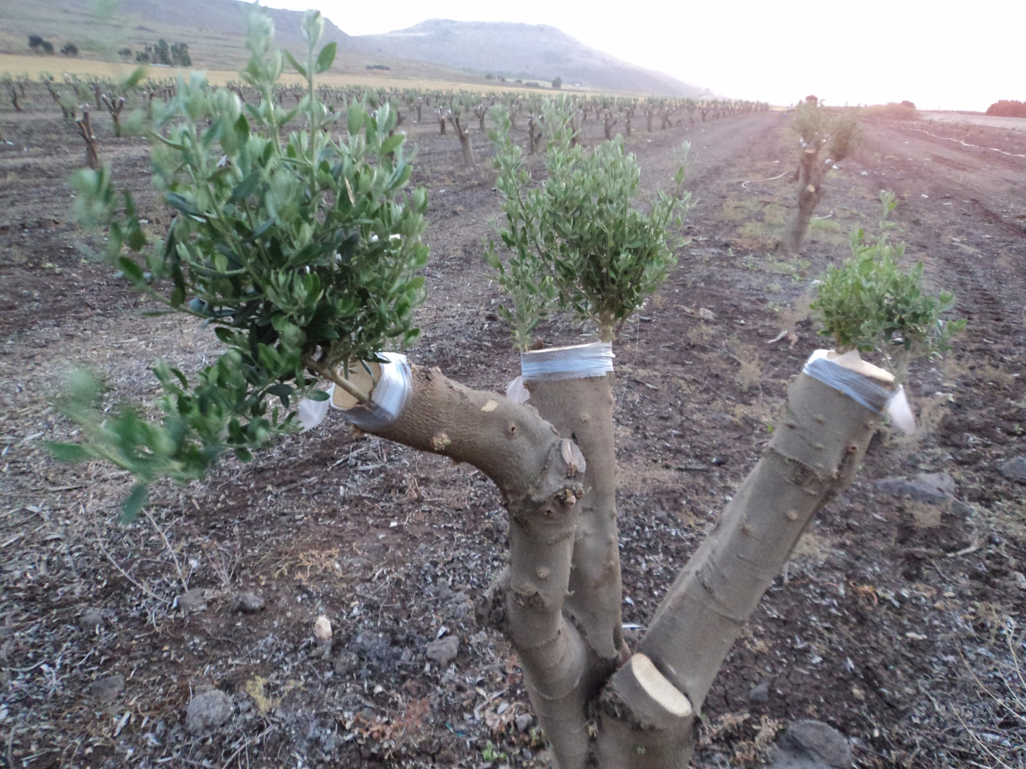

Slide 19
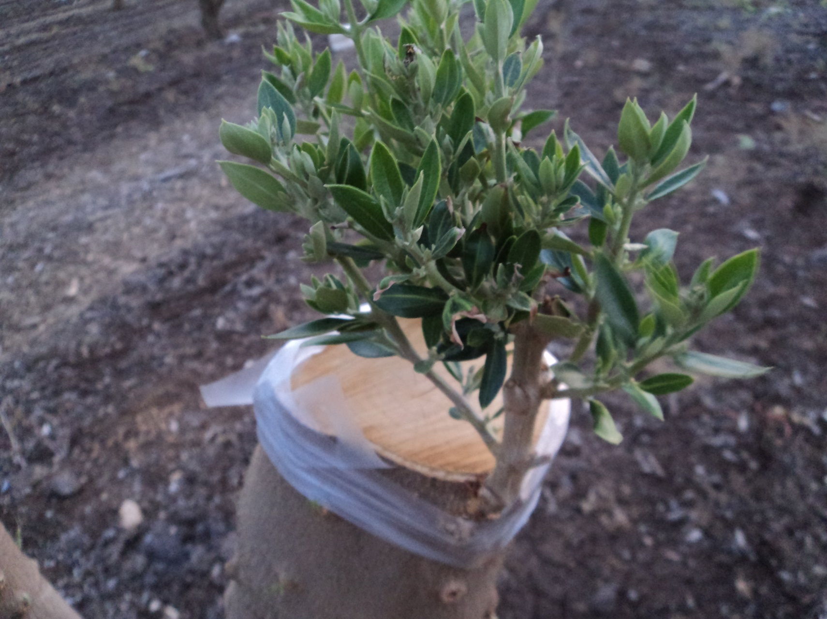

Slide 20
Scion: Definition (Merriam Webster)
1. a detached living portion of a plant (as a bud or shoot) joined to a stock in grafting and usually supplying solely aerial parts to a graft
2. a : DESCENDANT, CHILD; especially : a descendant of a wealthy, aristocratic, or influential family
b : HEIR
Gal 3:29 And if you be Messiah's, then you are Abraham's seed, and heirs according to the promise.

Slide 21
Side note Rom 11:17 : not a ‘rabbi- trail’
Gen 12:3 And I will bless them (H1288 – Va’abarakah) that bless thee (H1288 – m’barakeikha), and curse him that curseth thee: and in thee shall all families of the earth be blessed (H1288 – v’nivreku).
Indeed, the root word ‘barak’ (H1288) meaning to bless or kneel appears three times in this passage but the form of the last ‘blessing’- nivreku is in the form of the future tense (one completed act yet still future in this case).
The word v’nivreku (in that form) only appears three times in scripture: Gen 12:3, 18:18 and 28:14 – all in regards to how Abraham (12:3 & 18:18) and Jacob (28:14) will affect the nations of the earth.
The sages of old are of the opinion that the verb v’nivreku has the meaning of mixing, intermingle, or more importantly “grafted-in”.

Slide 22
Side note Rom 11:17 : not a ‘rabbi- trail’
Gen 12:3 And I will bless them that bless thee, and curse him that curseth thee: and in thee shall all families of the earth be ‘grafted in’ (blessed) .
Gen 18:18 Seeing that Abraham shall surely become a great and mighty nation, and all the nations of the earth shall be ‘grafted in’ (blessed in him) ?
Gen 28:12-14 And he dreamed, and behold a ladder set up on the earth, and the top of it reached to heaven: and behold the angels of God ascending and descending on it. And, behold, YHWH stood above it, and said, I am YHWH Elohim of Abraham thy father, and the Elohim of Isaac: the land whereon thou (Jacob ‘Israel’) liest, to thee will I give it, and to thy seed; And thy seed shall be as the dust of the earth, and thou shalt spread abroad to the west, and to the east, and to the north, and to the south: and in thee and in thy seed shall all the families of the earth be ‘grafted in’ (blessed) .
Was Paul doing a midrash in Rom 11:17 on Gen 12:3, 18:18, and 28:14 with a typical rabbinic style of 1st century Judea?
Rom 11:17 And if some of the branches be broken off, and thou, being a wild olive tree (nations), were graffed in among them (Israel: seed of Abraham), and with them (Israel) partakest of the root and fatness of the olive tree;

Slide 23
‘Grafting in- not a new concept’
Exo 12:37 And the children of Israel journeyed from Rameses to Succoth, about six hundred thousand on foot that were men, beside children.
Exo 12:38 And a mixed multitude went up also with them; and flocks, and herds, even very much cattle.
Exo 12:47 All the congregation of Israel shall keep it (Passover).
Exo 12:48 And when a stranger shall sojourn with thee, and will keep the Passover to YHWH, let all his males be circumcised, and then let him come near and keep it; and he shall be as one that is born in the land: for no uncircumcised person shall eat thereof.
Exo 12:49 One law shall be to him that is homeborn, and unto the stranger that sojourneth among you.
Act 10:34 Then Peter opened his mouth, and said, Of a truth I perceive that God is no respecter of persons:
Act 10:35 But in every nation he that feareth him, and worketh righteousness, is accepted with him.

Slide 24
What does it mean to ‘Work Righteousness’
Act 10:35 But in every nation he that feareth (reveres) him (YHWH), and worketh (does) righteousness (G1343), is accepted with him.
[G1343] dikaiosunē :
1) in a broad sense: state of him who is as he ought to be, righteousness, the condition acceptable to God 1a) the doctrine concerning the way in which man may attain a state approved of God
1b) integrity, virtue, purity of life, rightness, correctness of thinking feeling, and acting 2) in a narrower sense, justice or the virtue which gives each his due LXX related word(s): [tsaddiq, tsedeq]
Deu 6:25 And it shall be our righteousness [tsadaqah], if we observe to do all these commandments before YHWH our God, as he hath commanded us.
Psa 119:172 My tongue shall speak of thy word: for all thy commandments are righteousness [tsadeq].
Rev 14:12 Here is the patience of the saints: here are they that keep the commandments of God, and the faith of Yeshua.

Slide 25
Romans 11:25
Rom 11:25 For I would not, brethren, that ye should be ignorant of this mystery, lest ye should be wise in your own conceits; that blindness (hardness) in part is happened to Israel, until the fulness of the Gentiles [multitude of nations] be come in.
fulness^{G4138} of the^{G3588} Gentiles^{G1484}
LXX related word(s): Greek to Hebrew
G4138 play’ro-mah : H4393 melo
G3588 + G1484 eth’nos: H1471 Hagoyim
Gen 48:19 And his father refused, and said, I know it, my son, I know it: he (Manasseh) also shall become a people, and he also shall be great: but truly his younger (Ephraim) brother shall be greater than he, and his seed shall become a multitude^{H4393} of nations.^{H1471}
^{H4393}
הגוים׃^{H1471}
מלא

Slide 26
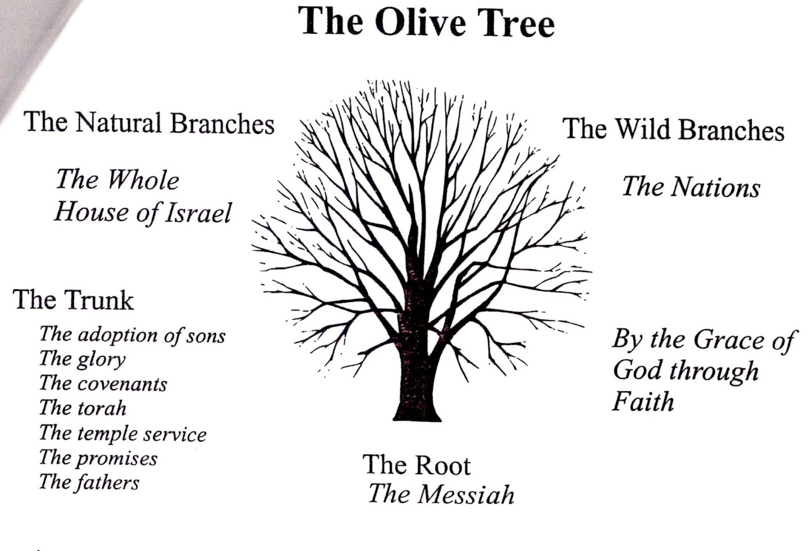
The Biblical Basis for the Olive Tree

Slide 27
Romans 11:26
“…and so all Israel shall be saved…”
Of course it was and is to the nation of Israel that the Almighty made both the Old and renewed Covenants with (Jer 31:33; Heb 8:10). And as Paul tells us, everything: the adoption as sons, the covenants, and the promises all belong to Israel “according to the flesh“ (Rom 9:1-4), and those of the gentiles/nations that would join themselves (grafted in) to Israel (Rom 11:16-26; Eph 2:11-13).

Slide 28
Romans 11:27
Vs 27 ‘This is my covenant with them, when I take away their sins’.
Only time this word ‘covenant’ is used within the book of Romans.
Read Psalm 89:3, 34-37.

Slide 29
Romans 11:32
Vs 32 ‘For God hath shut up all unto disobedience, that he might have mercy upon all’.
This is the summary Paul made of the preceding explanation; and this shows that the subject of God's intrinsic righteousness was principally in view.
‘Shut up all unto disobedience ...’ means that with the hardening of Israel, God has thus hardened or "shut up" the whole world unto disobedience, the Gentiles [Nations] and Israel (including Judah), in order that his mercy might be extended to all, equally, and without partiality.
"Mercy upon all" has reference to that mercy is being extended impartially, and under the same conditions, to all alike. Moreover, it is "mercy upon all" in that it is truly available to all. Everyone on earth "may" receive it, in the sense that he has permission and is invited to receive it. This aspect of meaning is quite clear in Romans 11:31, where it is said, "They MAY now obtain mercy," not "WILL obtain mercy.“ (Studylight.org)
Again, YHWH is stretching forth His hand in mercy to you, will you ‘turn from your ways’ and ‘turn back to Him’ by accepting His mercy through keeping His commandments and having faith in His son, Messiah Yeshua (Rev 14:12) ?

Slide 30
Romans 11 Recap
All about Israel (12 Tribes) and those who come out from among the nations who are ‘grafted in’ to the whole house of Israel.
Has nothing to do with man-made religion. Israel has not been replaced by ‘the church’.
Israel has always been and always will be God’s people- the whole house of Israel: all 12 tribes.
Mat 15:24 But he (Yeshua) answered and said, I am not sent but unto the lost sheep of the house of Israel.
Mat 10:6 [Yeshua commanded his disciples saying] But go rather to the lost sheep of the house of Israel.
Act 9:15 [Paul’s commission:] But the Lord said unto him, Go thy way: for he (Paul) is a chosen vessel unto me, to bear my name before the Gentiles, and kings, and the children of Israel:
Rev 21:12 And had a wall great and high, and had twelve gates, and at the gates twelve angels, and names written thereon, which are the names of the twelve tribes of the children of Israel:

