Slide 1
Haftarah: Isaiah 1:1-27
This Haftarah is the last of three Haftarahs read between the 17th day of Tammuz (when the Babylonians breached the city walls of Jerusalem) and the 9th of Av (when the Babylonians razed the Holy Temple).
Traditionally these three Haftarahs are known as the ‘three haftarot of affliction (also called the ‘three haftarot of punishment’)’.
This Haftarah is read on the Shabbat preceding or on Tisha b’Av (9th of Av) and, because it begins with the Hebrew word ‘chazon’ (meaning vision), this Shabbat is called ‘Shabbat Chazon’.
This Shabbat is also referred to in Judaism as ‘Black Sabbath’ due to its status as the saddest Shabbat of the year.

Slide 2
Within the Haftarah reading of Isaiah 1:1-27 is a particular verse worth taking note of. In Isaiah 1:18 it is written:
“Come now, and let us reason together, saith YHWH: though your sins be as scarlet, they shall be as white as snow; though they be red like crimson, they shall be as wool.” (emphasis mine)
During the day of Yom Kippur in the first and second temple times a miracle would occur. A piece of wool dyed crimson in color would be tied to the scapegoat and another piece dyed crimson would be tied to the entrance of the temple sanctuary for all to see. The sage rabbi Yishmael taught that when the scapegoat reached its destination in the desert this wool would miraculously turn white before the people of Israel and providing a Heavenly sign that the sins of the people had been atoned for (Talmud: Yoma 6, 8).

Slide 3
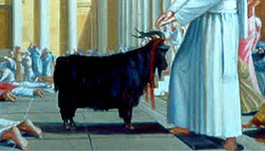
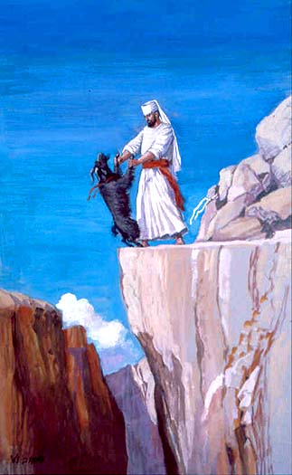
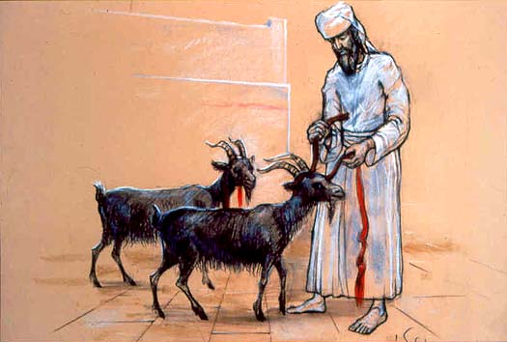

Slide 4
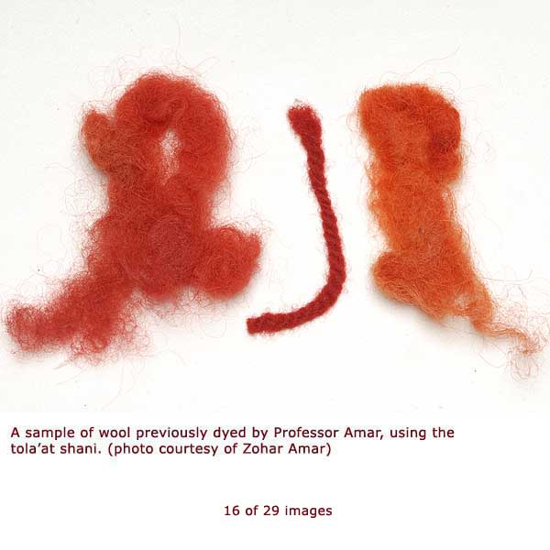
What ‘vision’ can we see through the Isaiah 1:18 scripture? Take note of the words ‘scarlet’ and ‘crimson’. The Hebrew word (according to the Brown-Driver-Briggs Hebrew and English Lexicon) for ‘scarlet’ is שׁני pronounced ‘sha-nee’ (H8144) and has the meaning of scarlet (as in color). This scarlet color comes from an insect ‘coccus ilicis’ which looks more like a grub. The dye from the female grub is used to
make the red/scarlet dye. The Hebrew word for ‘crimson’ is תּולע pronounced 'tow-lah’ (H8438) and is defined as: worm, scarlet, crimson, the dye made from the dried body of the female worm ‘coccus ilicis’. In layman’s terms: a scarlet worm or a crimson worm. This is what was used to dye the wool crimson for the Yom Kippur Temple service and also used in building the tabernacle and priestly garments !

Slide 5
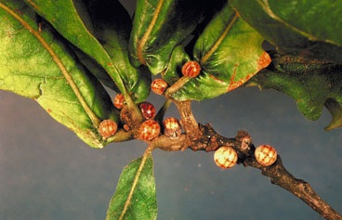
‘coccus ilicis’- the Kermes Insect found on several species of oak near the Mediterranean

Slide 6
One can also see the same word ‘tow-lah’ (crimson/ scarlet worm) used in Psalm 22:1-6.
“My El, my El, why hast thou forsaken me? why art thou so far from helping me, and from the words of my roaring? O my Elohim, I cry in the daytime, but thou hearest not; and in the night season, and am not silent. But thou art holy, O thou that inhabitest the praises of Israel. Our fathers trusted in thee: they trusted, and thou didst deliver them. They cried unto thee, and were delivered: they trusted in thee, and were not confounded. But I am a worm, and no man; a reproach of men, and despised of the people. All they that see me laugh me to scorn: they shoot out the lip, they shake the head, saying, He trusted on YHWH that he would deliver him: let him deliver him, seeing he delighted in him.”
In the Gospels of Matthew 27:46 and in Mark 15:34, Messiah Yeshua cried out the same words of Psalm 22:1 while hanging on the tree:
“And about the ninth hour Yeshua cried with a loud voice, saying, Eli, Eli, lama sabachthani? that is to say, My El, my El, why hast thou forsaken me?”

Slide 7
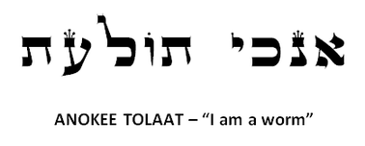
Indeed if Psalm 22 is a Psalm concerning Messiah, then what was meant by verse 6: “But I am a worm, and no man.” What is meant here by this saying? Usually in the Bible, the English word for worm comes from the Hebrew word ‘rimmah’ רמּה meaning 'maggot or worm’, but in this particular verse the Hebrew word used is תּולע, again meaning a scarlet or crimson worm. This again is the same word used for ‘crimson’ in Isaiah 1:18. Both scarlet and crimson are a deep red color very similar to the color of blood. Let’s take a deeper look into this ‘coccus ilicis’.
According to Webster’s Revised Unabridged Dictionary (1913):
Kermes \Ker"mes\, n. [Ar. & Per. girmiz. See Crimson, and cf. Alkermes.]
1. (Zo["o]l.) The dried bodies of the females of a scale insect (Coccus ilicis), allied to the cochineal insect, and found on several species of oak near the
Mediterranean. They are round, about the size of a pea, contain coloring matter analogous to carmine, and are used in dyeing. They were anciently thought to be of a vegetable nature, and were used in medicine. [Written also chermes.]
2. (Bot.) A small European evergreen oak (Quercus coccifera) on which the kermes insect (Coccus ilicis) feeds. --J. Smith (Dict. Econ. Plants).

Slide 8
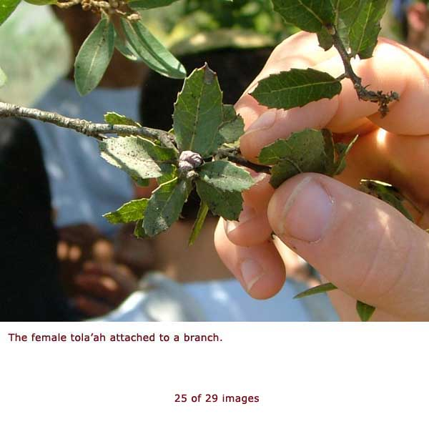

Slide 9
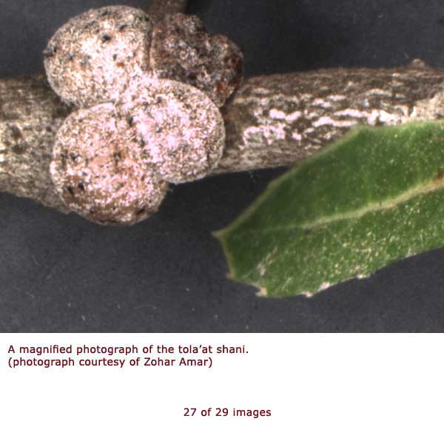

Slide 10
Other interesting facts regarding the crimson worm include:
• In ancient days, the dead bodies of the female crimson worms were scraped from a tree, dried, and then ground into a powder that was used to dye their cloth garments red or crimson color. The crimson color dye would also have been used in the fabric of the priestly garments and tabernacle.
• The crimson worm is found throughout the Mediterranean including Israel.
• In 2008, the Temple Institute in Jerusalem conducted the first harvest for the tola’at shani (crimson worm) in nearly two thousand years.
• After three days, the dead mother crimson worm’s body loses its crimson color and turns into a white wax which falls to the ground like snow.
• The crimson worm does not look like a worm, some people thought they were part of a plant.

Slide 11
• A female crimson worm will have offspring only once in her lifetime. When she does, she finds a tree or wooden item and attaches her body to it making a hard crimson shell. Once attached, she will be permanently stuck to the wood that the shell cannot be removed without tearing her body apart and killing her. The crimson worm then lays her eggs under her body and protective shell. When the larvae hatch, they stay under the shell. The mother gives protection to the larvae under her hard shell and feeds them as her young will feed on her living body! In a few days, once the larvae are mature enough to take care of themselves, the mother dies. As she dies, she oozes out a crimson color dye which not only stains the wood she is attached to, but also her offspring. Her offspring are colored crimson for the rest of their lives.

Slide 12
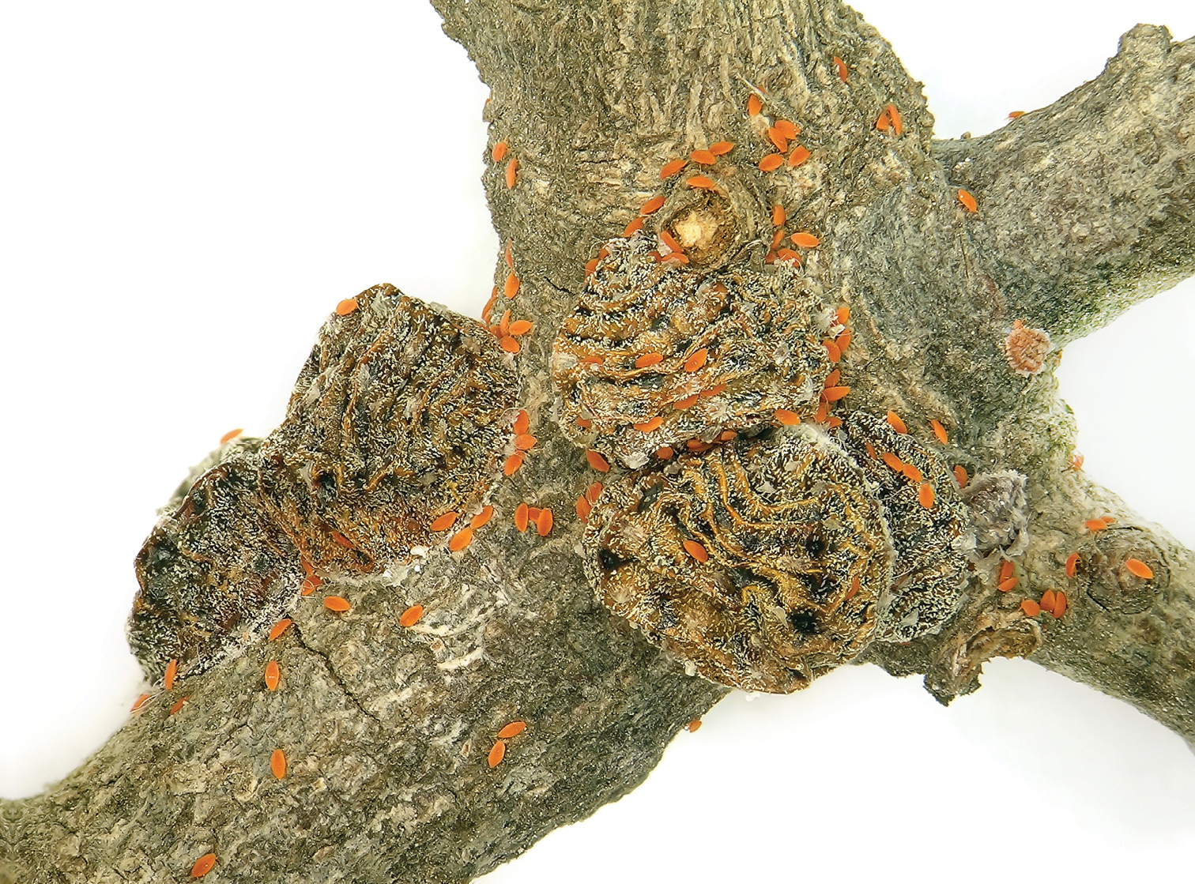

Slide 13
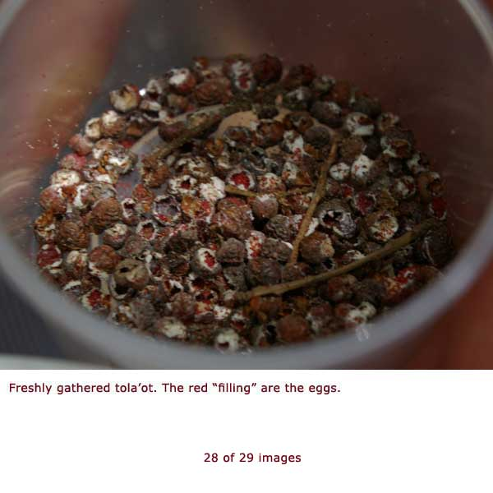

Slide 14
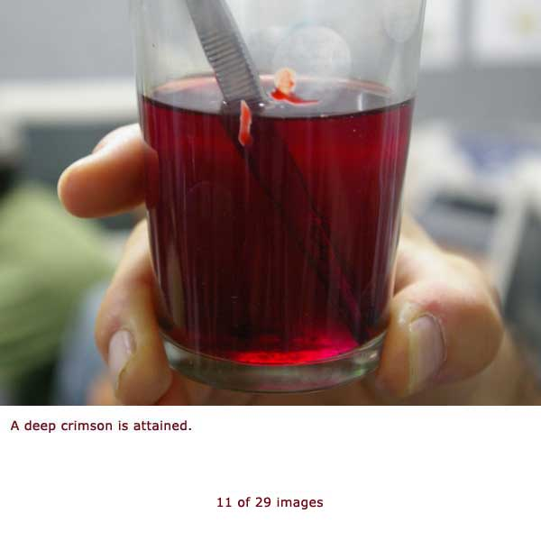

Slide 15
Let’s see if we can look at the deeper meaning here. Is there any connection with this worm and Messiah?
Messiah Yeshua came ONCE to pay the atonement for sin, yours and mine. He willfully laid down his life (John 10:18), allowing himself to be ATTACHED to the TREE. He could not be removed without his BODY being TORN. He was CRUSHED in order to pay the redemption price of his people, Israel. When Yeshua DIED on the tree, a Roman soldier pierced his side and BLOOD and water OOZED OUT, STAINING the tree. We who believe in Messiah Yeshua are also washed in HIS BLOOD for forgiveness of sins. After being in the grave for THREE days, he ascended to the right hand of the Father in heaven. In Revelation, John sees Messiah Yeshua and describes him as “…like unto the Son of man, clothed with a garment down to the foot, and girt about the paps with a golden girdle. His head and his hairs were WHITE like wool, as WHITE as snow; and his eyes were as a flame of fire…” (Rev 1:14-15). We who endure the great tribulation will have our robes washed WHITE in the blood of the Lamb (Rev 7:14)!

Slide 16
Continuing on, the female crimson worm is a rather unattractive grub. As stated earlier, many people in ancient times believed that they were a part of the plant and did not recognize them to be living creatures. Compare that statement with the following verse:
“Behold, my servant shall deal prudently, he shall be exalted and extolled, and be very high. As many were astonished at thee; his visage was so marred more than any man, and his form more than the sons of men: So shall he sprinkle many nations; the kings shall shut their mouths at him: for that which had not been told them shall they see; and that which they had not heard shall they consider.” Isaiah 52:13-15
The above verse is clearly Messianic and the ‘he’ is referring to Messiah Yeshua. Just as the crimson worm could hardly be recognized, the Messiah would be so marred that he could barely be recognized as a man.

Slide 17
Crimson in the following verse equates to the red color of BLOOD (symbolic), scarlet symbolizes SIN. Remember Isaiah 1:18 from the Haftarah of Vision (chazon)?
“Come now, and let us reason together, saith YHWH though your sins be as scarlet (Sha’nee), they shall be as white as snow; though they be red like crimson (tow’lah), they shall be as wool.” Isaiah 1:18
Crimson worm = Messiah on the TREE !
Praise YHWH that we have been redeemed and forgiveness of sins has been atoned for through the blood of Messiah Yeshua, the Lamb of Elohim! As mentioned earlier, Psalm 22:6 & Isaiah 1:18 tells of a worm- more specifically, a crimson/scarlet worm (coccus ilicus). How incredible is that for our Heavenly Father to reveal to us Messiah Yeshua- hinted at in a prophecy concerning the life cycle of a female ‘crimson worm’?!

Slide 18
A Theory: Messiah was crucified and stoned
Crime of Blasphemy was punished by DEATH through STONING
Deuteronomy 13:1-10, Leviticus 24:15-18
Religious authorities wished to stone (kill) Yeshua.
John 8:59, Mark 14:64, Matthew 26:65-66, John 19:7
Yeshua’s disciples realized the danger Yeshua was in.
John 11:7-8
The common people of Judea understood that stoning was the means for execution under Torah.
John 10:31-33
“As many were astonished at thee; his visage was so marred more than any man, and his form more than the sons of men.” Isa 52:14 The scourging that Yeshua was subjected to before his crucifixion cannot account for such mangling since Pilate intended to let him go after the soldiers had chastised him, and from this it shows that Pilate believed he would recover- Luke 23:22
Ernest Martin: Secrets of Golgatha

Slide 19
A Theory: Messiah was crucified and stoned
* It should be remembered that the crime which the authorities in Jerusalem charged against Yeshua was that of blasphemy (Mark 14:64). And the official judgment against him made him worthy of death in the most despicable fashion (Matthew 26:65,66). Yeshua’s claim that he was the Son of Elohim is what made the authorities proclaim him a blasphemer. With that charge against him, the religious leaders went to Pilate and asked him to allow Yeshua to be killed in the manner prescribed by Torah (John 19:7). To the leaders, Yeshua’s appraisal of himself was tantamount to blasphemy (Lev 24:16). In the time when Yeshua was put to death, the Roman authority forbade the people of Judea from applying the death penalty on anyone.
* In Sanhedrin 43a of the Talmud we have an interesting account of the crucifixion of Yeshua: “On the eve of the Passover Yeshua the Nazarean was hanged. For forty days before the execution took place, a herald went forth and cried, ‘He is going forth TO BE STONED because he as practiced sorcery and enticed Israel to apostasy. Any one who can say anything in his favour, let him come forward and plead on his behalf.’ But since nothing was brought forward in his favour he was hanged on the eve of Passover.” -True enough, Jewish authorites knew that Yeshua was hanged, but they also were aware that he was also stoned to satisfy the Law of Moshe…
Ernest Martin: Secrets of Golgatha

Slide 20
A Theory: Messiah was crucified and stoned
In my opinion, Yeshua was first sentenced to die by crucifixion (Roman decree) and then while alive on the execution stake (tree), he was stoned (by Judeans) in accordance with Torah law. Recall also that Pilate wondered why Yeshua had died so early because it was at least an hour before sundown that the legs of those crucified were broken in order to kill them more quickly. But it was reported to Pilate that Yeshua had died earlier than this (Mark 15:44). Something else caused Yeshua to die more quickly, and it presents us with a terrifying spectacle of what actually happened to him.
“AS MANY WERE ASTONISHED AT THEE; HIS VISAGE WAS SO MARRED MORE THAN ANY MAN, AND HIS FORM MORE THAT THE SONS OF MEN.” Isa 52:14
“BUT I AM A WORM (TOLA’AT), AND NO MAN; A REPROACH OF MEN, AND DESPISED OF THE PEOPLE.” Psa 22:6
Ernest Martin: Secrets of Golgatha

Slide 21
SOURCES:
Temple Institute: www.templeinstitute.org
‘Secrets of Golgotha (2nd Edition)’ Ernest Martin

