Slide 1
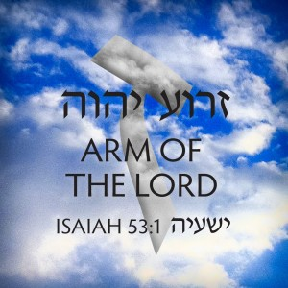
Pic: Discipledaily.com

Slide 2
The ‘arm’ of YHWH
Exo 6:5 And I (YHWH) have also heard the groaning of the children of Israel, whom the Egyptians keep in bondage; and I have remembered my covenant. Exo 6:6 Wherefore say unto the children of Israel, I am YHWH, and I will bring you out from under the burdens of the Egyptians, and I will rid you out of their bondage, and I will redeem you with a stretched out ARM (H2220 –Zeroah), and with great judgments: Exo 6:7 And I will take you to me for a people, and I shall be your Elohim: and ye shall know that I am YHWH your Elohim, which bringeth you out from under the burdens of the Egyptians.
First occurrence: Gen 49:24 (blessing of Joseph), First time here when YHWH uses this word…

Slide 3
The Hebrew word for ‘Arm’
זרוע / זרעה / זרועה / זרע
zerôa‛ / zerô‛âh
BDB Definition:
arm, forearm, shoulder, strength;
1a) arm;
1b) arm (as symbol of strength);
1c) forces (political and military);
1d) shoulder (of animal sacrificed)
Strongs Definition: From H2232; the arm (as stretched out), or (of animals) the foreleg; figuratively force: - arm, + help, mighty, power, shoulder, strength.

Slide 4
Other related scriptures
Deu 5:15 And remember that thou wast a servant in the land of Egypt, and that YHWH thy Elohim brought thee out thence through a mighty hand and by a stretched out ARM (zeroah): therefore YHWH thy Elohim commanded thee to keep the sabbath day.
Psa 98:1 O sing unto YHWH a new song; for he hath done marvellous things: his right hand, and his holy arm (zeroah), hath gotten him the victory.
Psa 98:2 YHWH hath made known his salvation: his righteousness hath he openly shewed in the sight of the heathen.

Slide 5
Zeroah = ‘Arm of YHWH’ = Messiah
If we study out this Hebrew word ‘zeroah’ at the literal interpretative level of scripture, the ‘arm of YHWH’ or ‘zeroah’ is a metaphor for the power of YHWH. At the hidden level of scripture, it is a metaphor for the Messiah, who is the mediator of the mighty acts of YHWH — creation, judgment, and salvation. The Heavenly Father is the master designer and absolute cause of all things, and the Messiah is the one who mediates the will of the Heavenly Father.

Slide 6
At the hidden level of scripture, statements that YHWH did something with “a strong hand (Hebrew= ‘yad’) and an outstretched arm (‘zeroah’)” teaches us that He (YHWH) did it through the Messiah. When we understand this concept, the Tanakh teaches us that Messiah is the mediator of creation, judgment, and salvation. Here are a few interesting scriptures that this Hebrew word ‘zeroah’, which is translated into English as ‘arm’, can be found:
Jer 32:17 Ah Lord GOD (Adonai YHWH) ! behold, thou hast made the heaven and the earth by thy great power and stretched out arm, and there is nothing too hard for thee:
The scripture above relates to the creation account. YHWH is using His arm or ‘zeroah’ to create the heaven and the earth.

Slide 7
Compare that with the following proof texts:
1Sa 2:31 Behold, the days come, that I will cut off thine arm (H2220- Zeroah), and the arm (H2220- Zeroah) of thy father's house, that there shall not be an old man in thine house.
This scripture is in regards to A man of Elohim came to Eli and said ‘thus saith YHWH’ regarding his priesthood and that of his two sons. This prophecy came to pass when Eli’s sons, Hophni and Phineas, died in a battle against the Philistines. When news of their deaths came to Eli, he fell over and died.

Slide 8
Eze 30:21-25 Son of man, I have broken the arm of Pharaoh king of Egypt; and, lo, it shall not be bound up to be healed, to put a roller to bind it, to make it strong to hold the sword. 22 Therefore thus saith the Lord GOD; Behold, I am against Pharaoh king of Egypt, and will break his arms, the strong, and that which was broken; and I will cause the sword to fall out of his hand. 23 And I will scatter the Egyptians among the nations, and will disperse them through the countries. 24 And I will strengthen the arms of the king of Babylon, and put my sword in his hand: but I will break Pharaoh's arms, and he shall groan before him with the groanings of a deadly wounded man. 25 But I will strengthen the arms of the king of Babylon, and the arms of Pharaoh shall fall down; and they shall know that I am the LORD, when I shall put my sword into the hand of the king of Babylon, and he shall stretch it out upon the land of Egypt.

Slide 9
So what is being said in the previous verses concerning Eli’s “arm” and Pharaoh’s “arm”?
Was the prophecies concerning their actual ‘arm’ or what their arm ‘represented’ ? In these cases, as throughout much of the Bible, this is speaking of the ‘power’ or ‘authority’ (of Eli’s priesthood and that of his sons – and also Pharaoh’s Kingship).
This is a perfect example of where words can be used ‘allegorically’ (figurative) NOT literally.

Slide 10
Perhaps the Jeremiah 32:17 scripture is what the Apostle Paul was commenting on when he said:
Col 1:16 For through him (Messiah Yeshua) were all things created, that are in heaven, and that are in earth, visible and invisible, whether they be thrones, or dominions, or principalities, or powers: all things were created through him (Yeshua), and for him:
Eph 3:9 And to make all men see what is the fellowship of the mystery, which from the beginning of the world hath been hid in Elohim (the Father), who created all things through Messiah Yeshua: (Read Heb: 1:1-2)
Jer 32:17 Oh Adonai YHWH ! behold, thou hast made the heaven and the earth by thy great power and stretched out arm (zeroah), and there is nothing too hard for thee:

Slide 11
Continuing on, do we see the ‘zeroah’ or ‘arm’ of YHWH performing redemption or salvation?
Psa 77:15 Thou hast with thine arm redeemed thy people, the sons of Jacob and Joseph. Selah.
Deu 5:15 And remember that thou wast a servant in the land of Egypt, and that YHWH your Elohim brought thee out thence through a mighty hand and by a stretched out arm(H2220 –Zeroah)… (Ex 6:6 – I will redeem you with a stretched out arm, and with great judgments.)
Psa 98:1-2 O sing unto YHWH a new song; for he hath done marvellous things: his right hand, and his holy arm, hath gotten him the victory. YHWH hath made known his salvation (H3444- YESHUA): his righteousness hath he openly shewed in the sight of the heathen.

Slide 12
Again, the ‘arm’ or ‘zeroah’ of YHWH redeems His people, Israel. Is there any scripture to validate the ‘arm’ of YHWH judging or punishing the nations or the people of Israel?
Isa 51:5 My righteousness is near; my salvation is gone forth, and my ARM shall judge the people; the isles shall wait upon me, and on mine ARM shall they trust.
Isa 30:30 And YHWH shall cause his glorious voice to be heard, and shall shew the lighting down (punishment) of his ARM, with the indignation of his anger, and with the flame of a devouring fire, with scattering, and tempest, and hailstones.

Slide 13
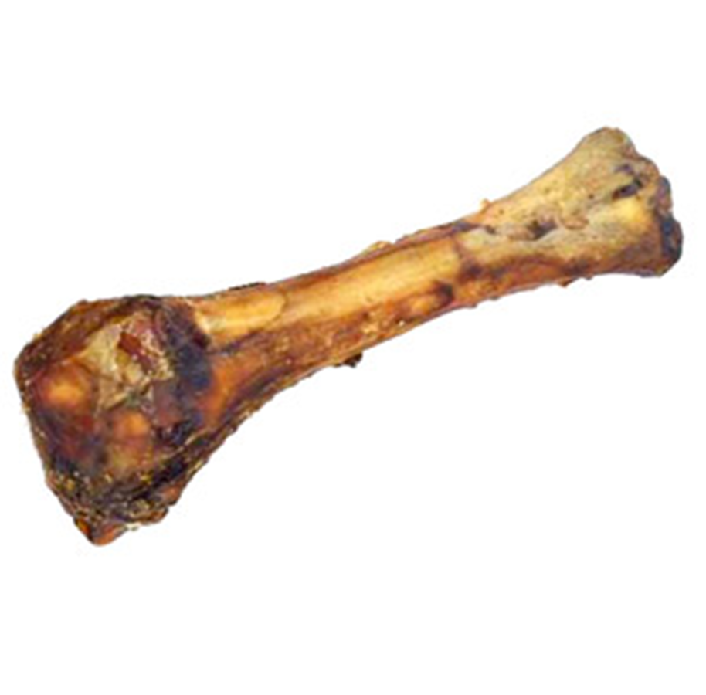
The Passover ‘Shankbone’

Slide 14
In the Passover Seder, the Shankbone commemorates the Lamb that was slain during the original Passover in Egypt.
This shankbone is also called the ‘Zeroah’; and because of this, the Passover Lamb is equated to the ‘Zeroah’
According to Torah, the Passover Lamb had to be a male of the first year.
The Passover Lamb had to be perfect, without blemish.
The blood of the Passover Lamb was needed to prevent the destroyer from killing the ‘first-born’ among Israel.

Slide 15
(Read Isaiah 53) Isaiah 53:1… the question: “…to whom is the arm (Zeroah) of Yahweh revealed? From this question we understand that the ‘Zeroah’ is not readily seen or comprehended, unless it is ‘revealed’- unless the Spirit of Yahweh reveals its identity. Let’s summarize:
The ZEROAH is the ‘He’ who was wounded because of our transgressions of Torah (Isa 53:5)
The ZEROAH is the ‘He’ by whose stripes/wounds, we are healed (Isa 53:5)
The ZEROAH is the ‘Him’ upon whom Yahweh has laid the iniquity of us all (Isa 53:6)
The ZEROAH is the unblemished Lamb slain at Passover
The Zeroah is the Messiah, according to the sages of old.

Slide 16
The suffering servant message of Isaiah 53: Our Heavenly Father laid on His only begotten Son, Messiah Yeshua, the iniquity of us all. Perhaps this is what Isaiah meant when he said:
Isa 52:10 YHWH hath made bare (revealed) his holy arm (‘zeroah’ = The Messiah) in the eyes of all the nations; and all the ends of the earth shall see the salvation (H3444 -Yeshua) of our Elohim.
Read Isaiah 52:13-15
Early Jewish interpretation of Isaiah 52 correctly identifies the servant of YHWH presented at the end of this chapter as the promised Messiah of HaShem:
'Behold, My servant, the Messiah, shall prosper.' — Targum Yonatan on Isaiah 52:13… What follows in Isa 53:1? zeroah

Slide 17
John, the disciple of Messiah Yahshua had similar words to say in this passage:
Joh 12:37-41 But though he had done so many miracles before them, yet they believed not on him: That the saying of Isaiah the prophet might be fulfilled, which he spoke, YHWH, who hath believed our report? and to whom hath the arm of the Lord (YHWH) been revealed [Isa 53:1]? Therefore they could not believe, because that Isaiah said again, He hath blinded their eyes, and hardened their heart; that they should not see with their eyes, nor understand with their heart, and be converted, and I should heal them. These things said Isaiah, when he saw his glory, and spake of him.

Slide 18
ISAIAH 53 – Clearly the Messiah- (Earlier Rabbinic Commentary)
ZOHAR
BABYLONIAN TALMUD – Sanhedrin 98b
TARGUM JONATHAN
MAIMONIDES
MOSHEH KOHN IBN CRISPIN
MIDRASH RUTH RABBAH
THE SONGS OF THE SERVANT – Henry Blocher, InterVarsity Press
THE MESSIANIC HOPE – Dr. Arthur Kac, Baker Book House
THE MESSIAH TEXTS – Raphael Patai, Avon Books
THE FIFTY-THIRD CHAPTER OF ISAIAH ACCORDING TO THE JEWISH INTERPRETERS, Ktav Publishing House
…and many others!

Slide 19
#1 Sages of old believed the text referred to the Messiah
#2 The ‘pronouns’ within the text
#3 Innocence of the ‘sufferer’
-many more connections-
One source: Dr Michael Rydelnik, Chairman of the Jewish Studies Dept, Moody bible institute.
No way is this particular text referring to Israel as the ‘suffering servant’, only Messiah fits this particular reading.

Slide 20
The ‘Arm’ of YHWH in the Brit Chadasha
Where else do we see this arm in the Brit Chadasha?
Luk 1:51 He hath shewed strength with his arm (G1023); he hath scattered the proud in the imagination of their hearts.
Act 13:17 The God of this people of Israel chose our fathers, and exalted the people when they dwelt as strangers in the land of Egypt, and with an high arm (G1023) brought he them out of it.

Slide 21
G1023 brachion
G1023 (Thayer’s Greek Lexicon)
Βραχίων brachiōn
Thayer Definition:
1) the arm
1a) the arm of Elohim is a Hebrew idiom for the might and power of Elohim.
G1023 (Strong’s)
Βραχίων brachiōn brakh-ee'-own
Properly a compound of G1024, but apparently in the sense of βράσσω brassō (to wield); the arm, that is, (figuratively) strength: - arm.
One of the Septuagint related words in Hebrew is H2220 – Zeroah= Ex 6:6,Dt 5:15, Ps 98:1, Isa 30:30;40:10;52:10;53:1…

Slide 22
After everything we have looked at today, what can we conclude from the following verse?
Isa 40:10 Behold, the Adonai YHWH will come with strong hand, and his arm shall rule for him: behold, his reward is with him, and his work before him.
That our Heavenly Father will send His Son, Messiah Yeshua, who will bring the reward of the Father with him and Messiah Yeshua has been given the authority from the Father to rule and reign. Does this statement line up with the following scriptures?

Slide 23
Mat 2:6 And thou Bethlehem, in the land of Juda, art not the least among the princes of Juda: for out of thee shall come a Governor, that shall rule my people Israel. [Matthew is quoting a scripture from Micah 5:2]
Eze 20:33-34 As I live, saith Adonai YHWH, surely with a mighty hand, and with a stretched out arm, and with fury poured out, will I rule over you: And I will bring you out from the people, and will gather you out of the countries wherein ye are scattered, with a mighty hand, and with a stretched out arm, and with fury poured out.
(This is a prophecy concerning the second coming of Messiah.)

Slide 24
Isa 40:10 “Behold, Adonai YHWH will come with strong hand, and his arm shall rule for him: behold, his reward is with him, and his work before him.”
Based on what we know, here is one interpretation:
Isa 40:10 “Behold, Adonai YHWH will come with strong hand, and his Son, Messiah Yeshua shall rule for his Heavenly Father- Almighty YHWH (Rev 20:4): behold, the Heavenly Father’s reward is with his Son, Messiah Yeshua (Rev 22:12), and his work before him.”
Does Yeshua talk about this prophecy in the Brit Chadasha?

Slide 25
Mat 16:27 For the Son of man shall come in the glory of his Father with his angels; and then he shall reward every man according to his works.
Rev 19:15 And out of his (Yeshua) mouth goes a sharp sword, that with it he (Yeshua) should smite the nations: and he (Yeshua) shall rule them with a rod of iron: and he (Yeshua) treadeth the winepress of the fierceness and wrath of Almighty God (Our Heavenly Father).
Rev 2:27 And he (overcomers) shall rule them (nations) with a rod of iron; as the vessels of a potter shall they be broken to shivers: even as I (Yeshua) received (rulership) of my Father.

Slide 26
Rev 20:6 Blessed and holy is he that hath part in the first resurrection: on such the second death hath no power, but they shall be priests of Elohim (the Father) and of Messiah (the Son), and shall reign with him (Messiah Yeshua) a thousand years.
1Co 15:24-28 Then cometh the end, when he (Yeshua) shall have delivered up the kingdom to God, even the Father; when he (Yeshua) shall have put down all rule and all authority and power. For he (Yeshua) must reign, till he (Yeshua) hath put all enemies under his (Yeshua’s) feet. The last enemy that shall be destroyed is death. For he hath put all things under his feet. But when he saith all things are put under him, it is manifest that he is excepted, which did put all things under him. And when all things shall be subdued unto him (Yeshua), then shall the Son (Yeshua) also himself be subject unto him (Heavenly Father) that put all things under him (Yeshua), that God (Heavenly Father) may be all in all.
(Messiah will rule and reign for a set time until all enemies are under his feet (Psalm 110), then he will be subject to the rule and reign of his Heavenly Father and our Heavenly Father)

Slide 27
Our Heavenly Father will send his Son Messiah Yeshua, a second time, to console and redeem Israel. He will return as Moshiach Ben David- executing judgment and justice on the ungodly (Jude 1:14-16) and bringing the reward of salvation unto those who believe and practice righteousness (Rev 14:12). These are comforting words to those who love and embrace our Heavenly Father- His Word and His Son, Messiah Yahshua, who is the ‘zeroah’ of YHWH!
Psa 98:1 O sing unto YHWH a new song; for he hath done marvellous things: his right hand, and his holy arm (Yeshua), hath gotten him the victory. !!!
HalelluYah & Amein !

