Slide 1
Navigating Tests
A Guide to the SAT, PSAT, and the ACT

Slide 2
Understanding the Tests
SAT= Scholastic Aptitude test
Promoted by CollegeBoard
PSAT = Pre-SAT
Can predict SAT Scores
ACT = American College Test
NOT associated with College Board

Slide 3
Understanding the Tests
SAT= Scholastic Aptitude test
Not to be confused with the other SAT=
Stanford Achievement Test
Taken in school along with FCAT

Slide 4
PSAT
Promoted as early as middle school
BIG DEAL because this test is what qualifies students to be a National Merit Scholar
(= major scholarships!)
Also called the NMSQT = National Merit Scholar Qualifying Test

Slide 5
NMSQT…Say What?
1.5 Million take the test
50,000 earn recognition
16,000 are Semifinalists
15,000 Finalists
8,300 Winners

Slide 6
SAT
Required for Bright Futures!
Still needed, even if you were in Duke TIPs!
Colleges want to see your SAT scores from high school
Scores will likely increase from grade 7

Slide 7
SAT
Old Scale: Critical Reading
Mathematics
Both on an 800-point scale
All individual scores are added together to make your total score
200 = minimum score
1600 = perfect score

Slide 8
SAT
NEW Scale: Critical Reading
Mathematics
Writing
All subtests on an 800-point scale
All individual scores are added together to make your total score
2400 = perfect score

Slide 9
SAT
The SAT and PSAT are graded on a VERY similar scale, but the SAT score is x10. So…
Sample score: (PSAT)
Critical Reading = 53
Math = 60
Writing = 46
COMPOSITE SCORE = 159

Slide 10
SAT
The SAT and PSAT are graded on a VERY similar scale, but the SAT score is x10. So…
Sample score: (SAT)
Critical Reading = 530
Math = 600
Writing = 460
COMPOSITE SCORE = 1590

Slide 11
A Note about writing scores…
Some universities and scholarships still don’t consider writing scores, but some do!
When trying to improve your SAT score, it’s ok to focus more on the Reading and Math Sections. But don’t completely ignore writing because it still shows up as part of your score. Just don’t lose as much sleep over it…

Slide 12
A Note about writing scores…
Furthermore, the writing score is still VERY important with the PSAT. To be considered a National Merit Scholar, all 3 scores are included.
Instead, when trying to determine if your score is a good score or not, it’s ok to take out the writing score and look at your composite score from Reading and Math only.

Slide 13
What is a good score?
PSAT: For National Merit Scholars, remember that all 3 parts are considered. There is no exact cutoff score; it changes slightly every year. Instead, it’s based on everyone who took the test that year, and they look at the top 4%.
What is the top 4% for the PSAT to be a National Merit Scholar?
200+ (Usually 215+)
Remember, perfect score = 240

Slide 14
What is a good score?
What is the top 4% for the PSAT to be a National Merit Scholar?
200+ (Usually 215+)
Remember, perfect score = 240
That means that a good SAT Score will look the same, but you don’t HAVE to shoot for the top 4%...

Slide 15
By The Numbers
Range | PSAT | SAT-1600 | SAT-2400
MINIMUMS for College (Not PSAT) | 132 | 880 | 1320
Good | 180 | 1200 | 1800
Great | 198 | 1300 | 1980
NMS range (PSAT ONLY) | 200+ | 1340 | 2000
Excellent | 210 | 1400 | 2100
Superior | 227 | 1500 | 2270
Perfect | 240 | 1600 | 2400

Slide 16
Bright Futures
Graduation Year | FAS SAT | FAS ACT | FMS SAT | FMS ACT
Class of 2012 | 1270 | 28 | 980 | 21
Class of 2013 | 1280 | 28 | 1020 | 22
Class of 2014 and After | 1290 | 29 | 1170 | 26
FAS = Florida Academic Scholar
Up to $101 per semester hour paid for
FMS = Florida Medallion Scholar
Up to $76 per semester hour paid for

Slide 17
Indicator | SAT (Prior to Writing Test Addition) | SAT (With Writing Test Addition) | ACT Composite Score
 | 1600 | 2400 | 36
 | 1560–1590 | 2340–2390 | 35
 | 1520–1550 | 2280–2330 | 34
 | 1480–1510 | 2220–2270 | 33
 | 1440–1470 | 2160–2210 | 32
 | 1400–1430 | 2100–2150 | 31
 | 1360–1390 | 2040–2090 | 30
 | 1320–1350 | 1980–2030 | 29
Minimum for FAS, 2013-14 | 1280–1310 | 1920–1970 | 28
Minimum for FAS, 2012 | 1240–1270 | 1860–1910 | 27
 | 1200–1230 | 1800–1850 | 26
Minimum for FMS, 2014 | 1160–1190 | 1740–1790 | 25
 | 1120–1150 | 1680–1730 | 24
 | 1080–1110 | 1620–1670 | 23
 | 1040–1070 | 1560–1610 | 22
Minimum for FMS, 2013 | 1000–1030 | 1500–1550 | 21
Minimum for FMS, 2012 | 960–990 | 1440–1490 | 20
 | 920–950 | 1380–1430 | 19
Minimum for college | 880–910 | 1320–1370 | 18
 | 840–870 | 1260–1310 | 17
 | 800–830 | 1200–1250 | 16
 | 760–790 | 1140–1190 | 15
 | 720–750 | 1080–1130 | 14
 | 680–710 | 1020–1070 | 13
 | 640–670 | 960–1010 | 12
 | 600–630 | 900–950 | 11

Slide 18
The SAT II
SAT Subject Tests
Not always necessary; wait until you know what college(s) you want to go to AND what you want to major in before you sign up. Most don’t require it.

Slide 19
The SAT II: Available Tests
Chinese
French
German
Modern Hebrew
Japanese
Korean
Spanish
Literature
U.S. History
World History
Mathematics Level 1
Mathematics Level 2
Biology
Chemistry
Physics

Slide 20
ACT Test
English
Math
Reading
Science
Writing (Optional)

Slide 21
ACT Test
English, Math, Reading, Science
All are on a 36-point scale. You get a score for each Subtest. Your composite score is the average of all your subscores.
Writing (Optional)
When taken, makes up 1/3 of your English Subscore
Perfect Score = 36; Bright Futures Cutoff = 28

Slide 22
How to sign up
PSAT: Done in schools every October. Students do not have to sign up.
SAT & ACT: Sign up online. Tests are given (on average) ONE Saturday each month during the school year
SAT.CollegeBoard.org
ACTstudent.org

Slide 23
Fees
PSAT: Always FREE
SAT:
$49 for Reading, Math, and Writing
$22 additional for subject tests
FREE for all Juniors ONCE. Students will register at school (bulk registration) in January/February and students get to pick their test date. They can choose from March, May, or June.
ACT:
$34 without Writing section
$49.50 with Writing section; Writing is optional and cannot be taken separately

Slide 24
Fees
Fee waivers are available for bot the SAT and ACT
You must be on free or reduced lunch
Limit 4 total
You must get the fee waiver BEFORE you register. The waiver has a code you must enter with your online registration!

Slide 25
More about signing up
Score Reports
Standard score reports are always free. You have the option to order more detailed score reports that give expanded information on your score, including wrong answers

Slide 26
More about signing up
Score Reports
Standard score reports are always free. You have the option to order more detailed score reports that give expanded information on your score, including wrong answers
Know your high school code!
All high schools have 5 AND 6 digit codes…
One for the site you’re testing at
One for the school you attend
You only need these for registration

Slide 27
More about signing up
Required/Permitted Materials (Check online for full list)
Acceptable calculators and extra batteries
PHOTO ID (or you won’t be able to test!)
#2 Pencils (none are provided!)
Water

Slide 28
Sending your scores
You can have your scores sent to up to 4 colleges for free! Any scores sent past the first four will cost extra.
Know your college codes!
Or leave it blank. Scores can be sent separately at a later time.
Also only needed when you register.

Slide 29
How To Prepare: ACT & SAT
For a fee:
Princeton Review
Kaplan
Huntington & Sylvan
Test Prep Books
Online, or from any major bookstore
Best when used DAILY!

Slide 30
How To Prepare: SAT
SAT Online
Need a code to get started.
See Mr. Delgado in the Success Lab
Quick to sign up, then practice as much as you want at home.
Practice tests with INSTANT score results
Study skills and lesson plans

Slide 31
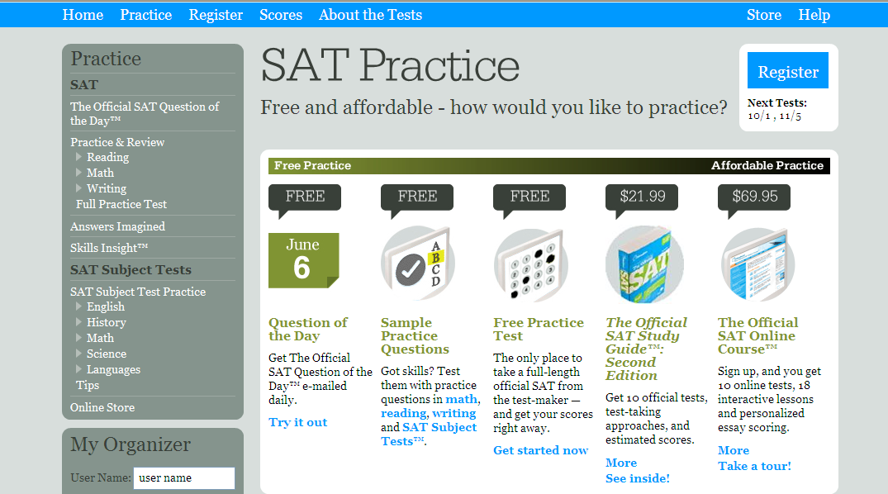
How To Prepare: SAT
College Board’s Website

Slide 32
How To Prepare: SAT
SAT Prep Classes with the district
4 weeks each
4 consecutive Saturdays, 9:00 – 1:00
4 sessions a year: September, October, February, April
Multiple sites throughout the county, including:
Bloomingdale, Brandon, East Bay, Newsome, Durant, Plant City, & Riverview
Also offered in summer at SCHS!

Slide 33
How To Prepare: SAT & ACT
Countless other sites online!
Search for Free SAT/ACT Practice and many results come up!
Number2.com

Slide 34
How To Prepare: ACT
Free help from www.act.org

Slide 35
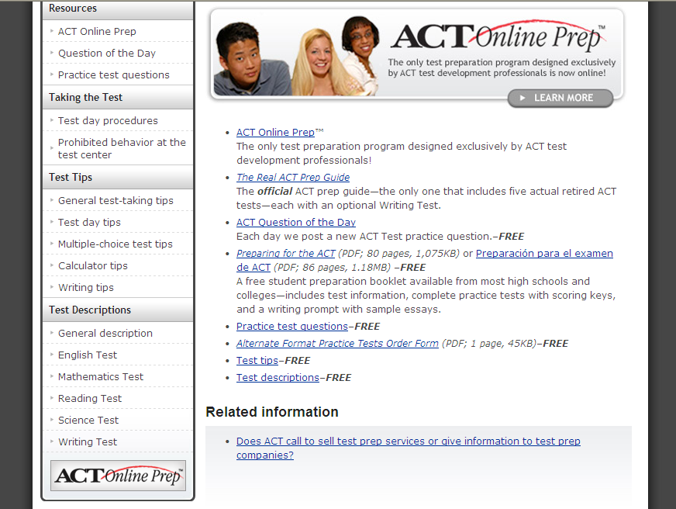
.

Slide 36
Test Dates: 2011-2012
SAT Test Dates | Registration Deadline | Late Registration (Fee Required)
October 1, 2011 | September 9, 2011 | September 21, 2011
November 5, 2011 | October 7, 2011 | October 21, 2011
December 3, 2011 | November 8, 2011 | November 20, 2011
January 28, 2012 | December 30, 2011 | January 13, 2012
March 10, 2012 | February 10, 2012 | February 24, 2012
May 5, 2012 | April 6, 2012 | April 20, 2012
June 2, 2012 | May 8, 2012 | May 22, 2012
ACT Test Dates | Registration Deadline | Late Registration (Fee Required)
September 10, 2011 | August 12, 2011 | August 13 – 26, 2011
October 22, 2011 | September 16, 2011 | September 17 – 30, 2011
December 10, 2011 | November 4, 2011 | November 5 – 18, 2011
February 11, 2012 | January 13, 2012 | January 14 – 20, 2012
April 14, 2012 | March 9, 2012 | March 10 – 23, 2012
June 9, 2012 | May 4, 2012 | May 5 – 18, 2012

Slide 37
So what’s the difference?
Why take one or the other?
Why take both?

Slide 38
Indicator | SAT | ACT
General | Some non-multiple choice included | Entirely multiple choice
Guessing | Guessing penalty | No guessing penalty
Difficulty | Questions go from easy to hard in most sections | Easy and hard questions mixed within sections
Measures | Measures achievement in reading, math, and writing | Measures achievement in English, math, science, and writing
Reading | Includes sentence level reading | Includes Humanities, Natural Science, Prose, Fiction, & social studies
Math | Includes numbers & operations, Algebra I & II, geometry, statistics, probability, & data analysis | Includes Pre-Algebra, Elementary algebra, Geometry (Coordinate & Plane), Trigonometry
Writing | Includes multiple choice grammar & usage | Added in to English score
Science | No Science Portion | Science: Biology, Chemistry, Physics, & earth/space science
English | No “English” Portion | English: Usage & Mechanics (grammar, punctuation, & syntax); rhetoric skills (styles & strategies)
Time | Approx. 4 hours | Approx. 4 hours (longer if writing portion is added)
SAT

Slide 39
Why take both?
Sometimes, students can score slightly higher on one test than another. This is especially helpful if you’re close to a cutoff score. Sometimes just sitting for the other test is enough for you to qualify.
But if you get a score you’re happy with, taking additional tests isn’t necessary.

Slide 40
Why retake the SAT?
Remember, you can use your best subscores to make your composite score, even if they didn’t come from the same test!
Taking the SAT multiple times can help improve your composite score by using subscores from different tests.

Slide 41
An example:
SAT (Prior to Writing Test Addition) | SAT (With Writing Test Addition) | ACT Composite Score
1600 | 2400 | 36
1560–1590 | 2340–2390 | 35
1520–1550 | 2280–2330 | 34
1480–1510 | 2220–2270 | 33
1440–1470 | 2160–2210 | 32
1400–1430 | 2100–2150 | 31
1360–1390 | 2040–2090 | 30
1320–1350 | 1980–2030 | 29
1280–1310 | 1920–1970 | 28
1240–1270 | 1860–1910 | 27
1200–1230 | 1800–1850 | 26
1160–1190 | 1740–1790 | 25
1120–1150 | 1680–1730 | 24
1080–1110 | 1620–1670 | 23
1040–1070 | 1560–1610 | 22
1000–1030 | 1500–1550 | 21
One student’s scores:
SAT = 1130 (out of 1600)
ACT Score = 25
Different Levels!
This is not always the case, but worth a try!

Slide 42
GOOD LUCK!

Slide 43
SAT (Prior to Writing Test Addition) | SAT (With Writing Test Addition) | ACT Composite Score
1600 | 2400 | 36
1560–1590 | 2340–2390 | 35
1520–1550 | 2280–2330 | 34
1480–1510 | 2220–2270 | 33
1440–1470 | 2160–2210 | 32
1400–1430 | 2100–2150 | 31
1360–1390 | 2040–2090 | 30
1320–1350 | 1980–2030 | 29
1280–1310 | 1920–1970 | 28
1240–1270 | 1860–1910 | 27
1200–1230 | 1800–1850 | 26
1160–1190 | 1740–1790 | 25
1120–1150 | 1680–1730 | 24
1080–1110 | 1620–1670 | 23
1040–1070 | 1560–1610 | 22
1000–1030 | 1500–1550 | 21
960–990 | 1440–1490 | 20
920–950 | 1380–1430 | 19
880–910 | 1320–1370 | 18
840–870 | 1260–1310 | 17
800–830 | 1200–1250 | 16
760–790 | 1140–1190 | 15
720–750 | 1080–1130 | 14
680–710 | 1020–1070 | 13
640–670 | 960–1010 | 12
600–630 | 900–950 | 11

