Slide 1
Reggae Music

Slide 2
Reggae music is...
The music of Jamaica
Developed from two other Jamaican styles called ska and rocksteady.
Characterized by rhythmic accents on the offbeat usually played by the guitar or another chording instrument

Slide 3
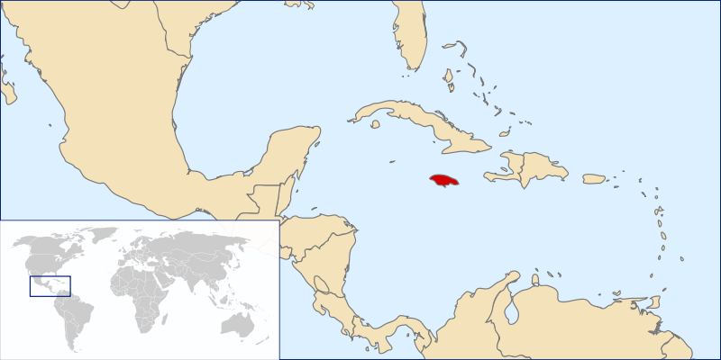
Here is Jamaica on a map

Slide 4


