Slide 1
Kecak
Music of the World

Slide 2
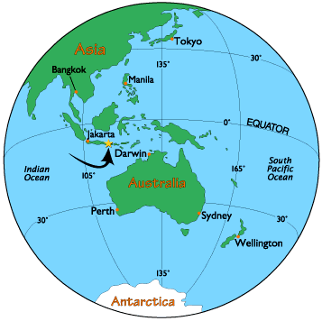
Kecak is...
From Bali

Slide 3
Activity:
Two groups:
Group 1 clap this rhythm:
Ta, rest, ta, rest
Group 2 clap this rhythm:
Rest, ta, rest, ta
Four Groups
Group 1 clap : ta, rest, rest, rest
Group 2 clap : rest, ta, rest, rest
Group 3 clap : rest, rest, ta, rest
Group 4 clap : rest, rest, rest, ta

Slide 4
What you just did is the basis of Kecak except the people of Bali do it much quicker and with much more difficult rhythms.

Slide 5
Hear the sound of Kecak.

Slide 6
Kecak is a type of music that tells a story about the Hindu Prince Rama and his friend, the King of the Monkeys.
The monkey sound you hear is them imitating the King of the Monkeys.
There is one narrator that tells them what to do.

