Slide 1
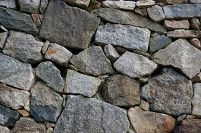
ROCKS
The ROCK Cycle

Slide 2
Volcano
Erupts
Metamorphic
Rocks Pushed to the Mantle
Lava
Cools
Holes
Metamorphic
Rocks are
Formed
Specks
Igneous
Rocks are
Formed
Rock are
Pushed down through Crust
Sedimentary
Rock are
Formed
Rocks
Erode
Sediment settles
Rocks under
Heat and Pressure
Stripes

