Slide 1
Effective Business Communication
608BOL: Managing Engineering Professionals
Professor: Dr. Mark Rajai
Fall 2010

Slide 2
Agenda
The Communication Process
Definition and Overview
Communication Process Flowchart
Effective Communication Principles.
Communication For Women vs. Men
Presentations
Preparing Effective Presentation
Delivering Effective Presentation
Email & Writing
Writing Effective Email
Meetings
Conducting Effective Meeting
Summary

Slide 3
The Communication Process
Q: What is Communication?
A: The transfer and exchange of information and understanding from one person to another through meaningful symbols.
The comm. process consists of :
Sender
Receiver
Message

Slide 4
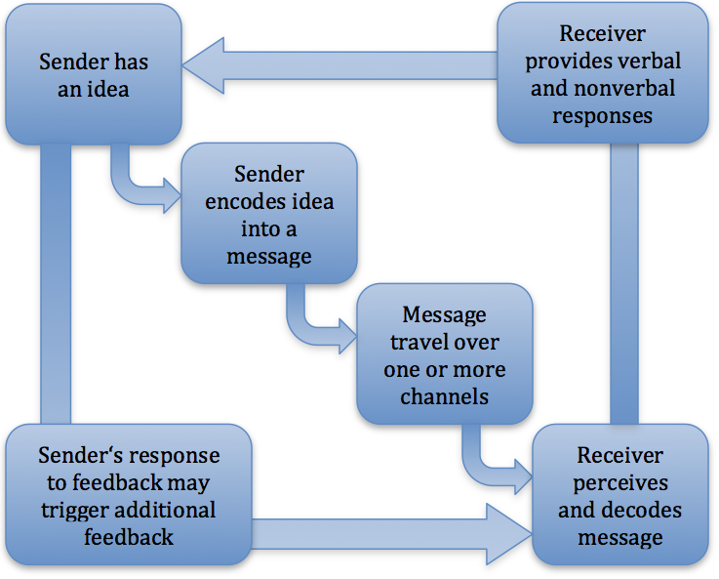
The Comm. Process Flowchart

Slide 5
Communication for Managers
Effective communication enables managers to effectively:
Plan
Organize
Lead
Control

Slide 6
Effective Communication Principles
Effective Communication
Principles
Relevancy
Simplicity
Organization
Repetition
Focus

Slide 7
Communication for Women vs. Men
Women | Men
Apologize Even they did nothing wrong | Avoid apologies
Accept blames to smooth tense situations | Ignore blames and place it elsewhere
Criticize indirectly | Criticize directly
Use soft voice to persuade | Speak loudly to gain attention and control
Thank | Avoid thanking

Slide 8
Presentations & Public Speaking

Slide 9
Effective Presentation
The two-step process:
Prepare:
Identify audience and their needs.
Develop the purpose of presentation.
Create a thorough outline.
Anticipate questions and challenges.
Rehearse.
Deliver:
Dress up.
Posture, body language, and facial gestures.

Slide 10
Preparing Effective Presentation
Identify audience and their needs
Different people require different approaches to persuade.
E.g., females vs. top executives vs. foreigners.
Develop the purpose of presentation
It gives coherence and direction to the focus of the presentation.
It should be crisp and clear in order identify further discussion points of the presentation.

Slide 11
Preparing Effective Presentation
Create a thorough outline:
It serves a road map to deliver an effective presentation.
It portrays the major points.
Anticipate challenges and questions:
Audience can be critical to the presenter’s ideas.
Prepare for the Q & A section by referring to the outline and specifying the points the audience will not expect.

Slide 12
Preparing Effective Presentation
Rehearse:
Presentation is often timed (e.g. 10 – 15 min.)
Deliver the presentation to yourself, a camera, or a group of friends.
Address any arising mistakes before the actual presentation is delivered.
That ensures the optimal feedback from the audience.

Slide 13
Delivering Presentation
Dressing to present:
The appearance of the presenter tells a lot him/her.
A general rule: dress in standard business professional grab.
Posture, body language, and facial gestures:
Not looking at the audience in the eye indicates a lack of confidence.
That may generate doubts about your message.
Stand straight, make periodical eye contact with the audience.

Slide 14
Email and Writing
Face-to-face communication is not always feasible.
Technology enables real-time communication globally.
Email is a 21st century communication tool.
Failing to communicate effectively using email is a pitfall of of professionalism in today’s business life.

Slide 15
Writing Effective Email
Capitalize on the subject line:
make the subject eye-catching and easy to spot in the inbox.
Use keywords like “Urgent” to prompt faster response.
Use professional font, size, and color:
It must be easy to read for anyone.
A rule of thumb:
Font: Times Roman
Color: Black.
Size: 12.

Slide 16
Writing Effective Email
Be concise:
Business professionals a re very busy people.
They tend to scan emails, not read them.
Sending several messages in a single email:
Some managers mistakenly send emails containing several important messages within a single email.
It creates a burden on the receiver.

Slide 17
Meetings
it is common to attend at least one meeting on a daily basis.
Purposes of meetings differ.
Meetings foster team work.

Slide 18
Conducting Effective Meetings
Identify the purpose of the meeting:
The objective of the meeting must understood by all attendants.
Create an agenda to facilitate the meeting:
The agenda serves as a roadmap to drive the meeting toward achieving its goal.
The objective is broken down into small issues to discuss by the participants.

Slide 19
Conducting Effective Meetings
Sample meeting agenda:
Introduction: Discuss purpose of meeting (whether to invest in solar power)
The Reasons why to pursue solar power
Tax breaks
Good for the community
Reasons why not to pursue solar power
Untested technology
Expensive
Open floor discussion

Slide 20
Conducting Effective Meetings
Introduce the purpose of the meeting:
Handout a copy of the meeting agenda to each participants.
It helps keep the participants focused during the meeting.
Encourage participants to share ideas:
E.g., say “I value your input.”
It makes staff members feel appreciated.
Facilitates achieving the meeting’s objective.

Slide 21
Summary
Communicating effectively is an indispensible factor for success in personal and professional lives.
Communication involves one or more sender of a message, and one or more receiver.
This research paper explores the ways in which a person can practice communication effectively.
Effective communication means delivering and receiving information with other people to achieve an objective successfully.

Slide 22
Thank You!

