Slide 1
MSE 608B (online)
Midterm Exam
Prepared By:
Aljaohra Alshubaili
Professor:
Dr. Mark Rajai

Slide 2
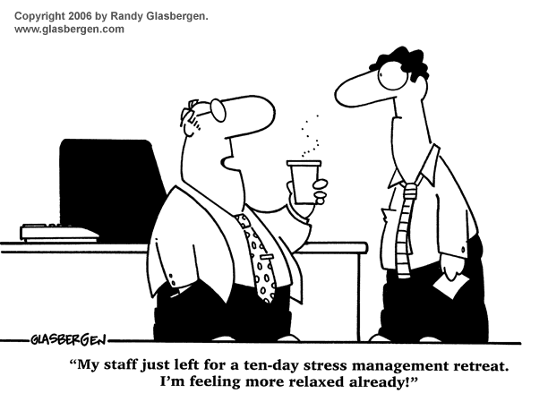
MANAGING PERSONAL STRESS

Slide 3
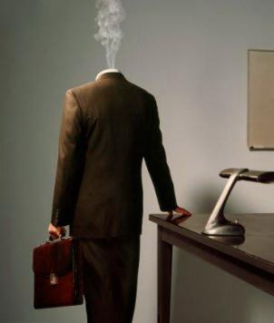
CONTENTS
Improving The Management of Stress & Time
Major Elements of Stress
Reactions to Stress
Coping With Stress
Managing Stress
Stressors
Eliminating Stressors
Eliminating Time Stressors
Eliminating Encounter Stressors
Eliminating Situational Stressors
Eliminating Anticipatory Stressors
Developing Resiliency
Physiological Resiliency
Psychological Resiliency
Social Resiliency
Balancing Life Activities
Temporary Stress-Reduction Techniques

Slide 4
IMPROVING THE MANAGEMENT OF STRESS & TIME
500 Billion Loss From the Nation’s Economy Due to STRESS
Mismanagement is No. 1 cause of stress in workplace
Stress-related Facts
Medical issues
•The workforce of America has numerous health issues due to stress.
•Percentage of “highly stressed” workers doubled from 1985 to 1990, and doubled again in the 90’s.
•75%-90% of all Primary Care Physician visits are stress-related.
Legal issues
•60%-80% of industrial accidents are stress-related.
•90% of worker compensation lawsuits are successful.
Efficiency issues
•1 Million workers are absent on an average working day.
•550 Million workdays are lost yearly due to stress.
•40% worker turnover in the US is stress-related.

Slide 5
MAJOR ELEMENTS OF STRESS
Kurt Lewin’s Analysis in 1951:
a study which proposed that any given work environment is changed by multiple forces:
Productive Forces which improve employees’ performance.
Counter-productive Forces which produce serious diseases such as mental breakdowns and heart attacks.
Elements of Stress Include:
Reactions to stress.
Coping with stress.

Slide 6
Reactions to Stress
Reaction to Stress Has Three Stages:
1) ALARM STAGE
Anxiety & fear The stressor is “threat”
Sorrow or depression The stressor is “loss”
2) RESISTANCE STAGE
The Five Defense Mechanisms of a worker are:
Aggression: toward an object or an individual.
Regression: adopting a childish behavior.
Repression: denial of the existence of stress or
minimizing its magnitude.
Withdrawal: not interacting with others.
Fixation: persistence of an action which is not productive.
3) EXHAUSTION STAGE
Which result in:
Psychological problems: confusion and shock.
Physiological problems: increase in blood pressure & heart rate.

Slide 7
Coping With Stress
Major Strategies for Handling Stress:
Enactive: placing the worker in a different environment to eliminate stress.
Proactive: increasing resiliency to have higher capacity for handling stress.
Reactive: short-term techniques to handle stress which is temporary.
 | Enactive Strategies | Proactive Strategies | Reactive Strategies
Purpose | Eliminate stressors | Develop resiliency | Temporary coping mechanisms
Effects | Permanent | Long term | Short term
Approach | Enactive | Proactive | Reactive
Time Required | Long time | Moderate time | Immediate

Slide 8
MANAGING STRESS
Types of Stressors
Time
Stressors
Encounter
Stressors
Situational
Stressors
Anticipatory
Stressors
Result from having a lot to do in too little time, which leads to work overload & lack of control.
Result from interactions between individuals.
Result from unfavorable home or work conditions.
Result from potential unpleasant or dangerous events.

Slide 9
ELIMINATING STRESSORS
Eliminating Time Stressors
Effective Time Management
Spending adequate time on important matters as well as urgent matters.
Clarity of vision to see what is urgent and what is important.
Focusing on results and not on methods.
Ability to say “NO” and not feeling guilty about it.
Efficient Time Management (For Managers)
Some are listed below:
Holding morning meetings since the energy level of an individual is at its highest early in the day.
Setting a time limit for a meeting.
Starting meeting on time.
Insisting on decision making by the subordinates.
Not being slave to the phone to create free time for other important tasks.

Slide 10
Efficient Time Management (For Workers)
Being productive while waiting for work to be done.
Tracking time: by keeping an eye on time, a certain task could be managed more efficiently.
Periodically reading different time management hints.
No procrastination: start with a task as soon as possible, so that it is accomplished in a timely fashion.
Creating priorities from the most important tasks to the least important ones.
Making a “To-do list” each day of work.

Slide 11
Eliminating Encounter Stressors
Collaboration
Working in Close-knit groups:
Relieves stress related illnesses.
Builds up resources from support group to
counteract abrasive individuals.
Develops sense of self-worth.
Social and Emotional Intelligence
Managers must process emotional intelligence,
this is to say:
Having a good grasp of understanding on other people's personalities.
Comprehend the emotional state of others.
Possessing the knowledge of what is and what is not an acceptable behavior.
Being able to resolve conflict amongst coworkers.

Slide 12
Eliminating Situational Stressors
Usually Accomplished Through Job Redesign
Combining tasks to be less repetitive.
Forming teams for tasks – workers feel sense of completion; Tasks rotated.
Establishing customer relationships.
Increasing decision making ability – increased feeling of control.
Opening feedback channels- how workers are doing.

Slide 13
Eliminating Anticipatory Stressors
Prioritizing
It is all about doing the most important tasks first.
Goal Setting
It is very important to set a goal to achieve an objective.
Small Wins
Major goals must be divides into smaller goals, smaller goals are easier to achieve; and together they add up and become the realization of the final objective.
1. Establish a Goal
4. Identify Criteria of Success and a Reward
2. Specify Actions and Behavioral Requirements
3. Generate Accountability & Reporting Mechanisms

Slide 14
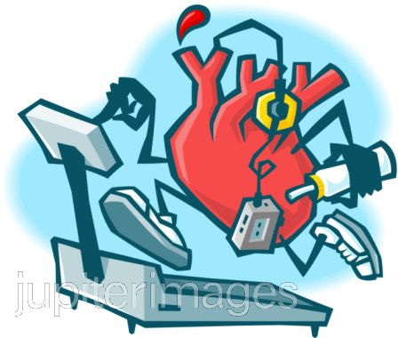
DEVELOPING RESILIENCY
Developing a Balanced Life is Achieved Through..
It combines two aspects of physical conditions:
Cardiovascular Conditioning
Relieves stress.
Increases energy.
Improves mental state.
Lowers cholesterol and blood pressure.
Dietary Control
Getting proper amount from all food groups.
Maintaining ideal weight.
Reducing fats, sugars, sodium, alcohol, and caffeine.
Taking vitamins and minerals.
Relaxing during meals.
Physiological Resiliency

Slide 15
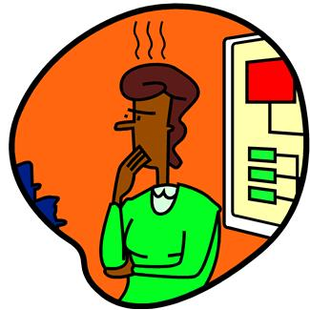
Psychological Resiliency
It combines Two examples of psychological conditions:
Hardiness
Feeling in control.
Handling situations which are very stressful.
Involved in what he or she does.
The Type A Personality
Extremely competitive.
Achievement driven.
Angry and aggressive.
Impatient.
Feels guilty when relaxed.

Slide 16
Psychological Resiliency (Con.)
Solutions for Type A Personality
The Small-Wins Strategy
Makes them aware of accomplishments.
Reduces stress.
Deep Relaxation Strategies
Meditation.
Yoga.
Self-hypnosis.
Bio-feedback.

Slide 17
Social Resiliency
Developing Close Social Relationships.
Mentor Relationship & Working In Teams
Encouraging participation
Sharing resources broadly
Focusing on team rather than individual rewards.

Slide 18
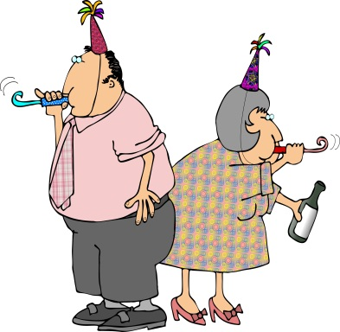
Balancing Life Activities

Slide 19
TEMPORARY STRESS-REDUCTION TECHNIQUES
Muscle relaxation
Deep breathing
Imagery and fantasy
Rehearsal
Reframing

Slide 20
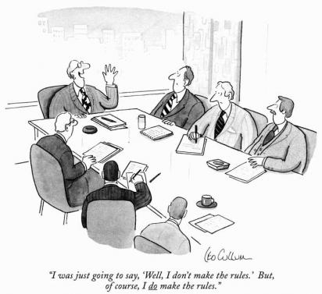
GAINING POWER & INFLUENCE

Slide 21
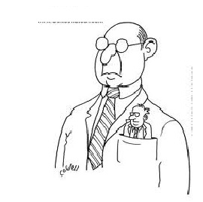
CONTENTS
Building a Strong Power Base & Using Influence Wisely
A Balanced View of Power
The Relationship Between Power
& Personal Effectiveness
Strategies For Gaining Organizational power
The Necessity of Power & Empowerment
Sources of Personal Power
Sources of Position-Power
Transforming Power Into Influence
Influence Strategies: The Three Rs
Comparison Among Influence Strategies
Exercising Upward Influence
Acting Assertively: Neutralizing Influence Attempts
Neutralizing Retribution Strategies Used By Others
Neutralizing Reciprocity Strategies Used By Others
Neutralizing Reason Strategies Used By Others
Model of Power and Influence

Slide 22
BUILDING A STRONG POWER BASE & USING INFLUENCE WISELY
For The Acceptance of Your Project and Achieving it
Having political competence to influence
others to accept your agenda .
Making others feel powerful.
Good Leadership is Based On
Not abusing power and giving others the
power to operate efficiently.
Not to be afraid to use power.

Slide 23
A BALANCED VIEW OF POWER
An Efficient And Productive Organization Possess a Leader That Has:
The ability to exercise power.
The understanding that true power is not having authority over others but being able to get things done.
The ability to empower others.
The competence to eliminate frustration due to lack of getting ideas and expertise valued and promoted.
Abuse of power Involves:
Overblown sense of value, ego.
Betraying others trust.
Using people & abandon them when expedient.
Inability to delegate to others or to build a team.
Being abrasive and intimidating.

Slide 24
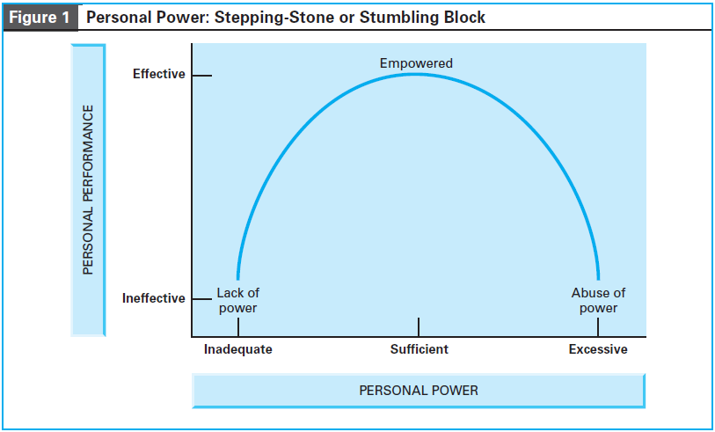
THE RELATIONSHIP BETWEEN POWER & PERSONAL EFFECTIVENESS

Slide 25
STRATEGIES FOR GAINING ORGANIZATIONAL POWER
The Necessity of Power & Empowerment
Organizations are becoming less hierarchical as they downsize layers of management.
Information technology is helping to decentralize the flow of information to lower levels of the organizational hierarchy.
Traditional boundaries within and between organizations.
The percentage of the workforce working in companies with fewer than 100 employees is increasing.

Slide 26
Sources of Personal Power
One Can Gain Personal Power By:
Being an expert in a given field.
Making an outstanding effort.
Being physically attractive, and having a pleasant personality.
Making decision that are perceived to be credible to others.

Slide 27
Sources of Position-Power
Centrality
Establishing a central network.
Having a position that facilitates acquisition of necessary information.
Having informal relationships.
Flexibility
Having freedom to use own judgment.
Being able to practice power.
Being able not to seek out a superior before handling a task.
Visibility
Being visible most of the times, with excellent performance, especially to the people who are influential.
Relevance
Being associated with activities that are critical to the functionality of the organization.

Slide 28
TRANSFORMING POWER INTO INFLUENCE
Influence Strategies “The 3 Rs”
Retribution
DEFINITION
a threat that is characterized by coercion and intimidation
DRAWBACK
Constant usage creates animosity and affects performance in long run.
Reason
DEFINITION
a Persuasion that is characterized by showing the merit of the request and proving that what is being asked is reasonable.
DRAWBACK
hard to apply since it must be performed by someone who could effectively use the power of logic and deduction.
Reciprocity
DEFINITION
a bargain or negotiation that is characterized by exchange and ingratiation.
DRAWBACK
a delicate method since it must be presented with a good use of deductive and inductive reasoning.

Slide 29
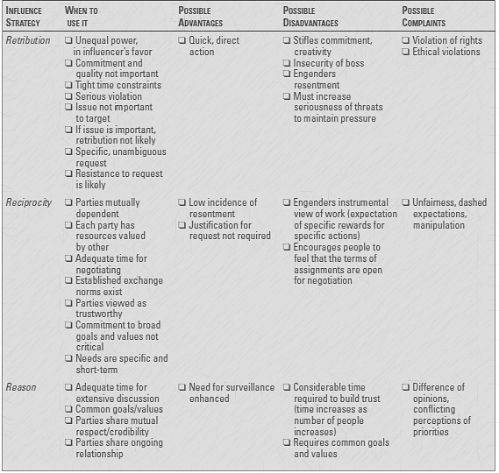
Comparison Among Influence Strategies

Slide 30
Exercising Upward Influence
Going beyond "The Rules"
A good leader is the one who evaluates a situation wisely and make necessary exceptions to the rules-if needed.
A good manager is like a good Platoon Leader in an army:
which means he would protect the members of the unit; hence not only creating a good unity within the group, but also would demonstrate to the "General" his worthiness.

Slide 31
Acting Assertively: Neutralizing Influence Attempts
First: Neutralizing Retribution Strategies Used By Others
Avoid dependence and empower yourself to make choices.
Point out the negative aspect of this methodology.
Directly confront the people who would try to exploit you.
As the last resort, fight fire with fire.

Slide 32
Neutralizing Influence Attempts (Con.)
Second: Neutralizing Reciprocity Strategies Used By Others
Examine the motivation behind a gift or a favor.
Do not negotiate with people who manipulate.
Refuse to bargain with people who use high pressure tactics.

Slide 33
Neutralizing Influence Attempts (con.)
Third: Neutralizing Reason Strategies Used By Others
Explain logically the adverse effects of what has been proposed.
Defend your personal rights.
Refuse Firmly to comply with a request.

Slide 34
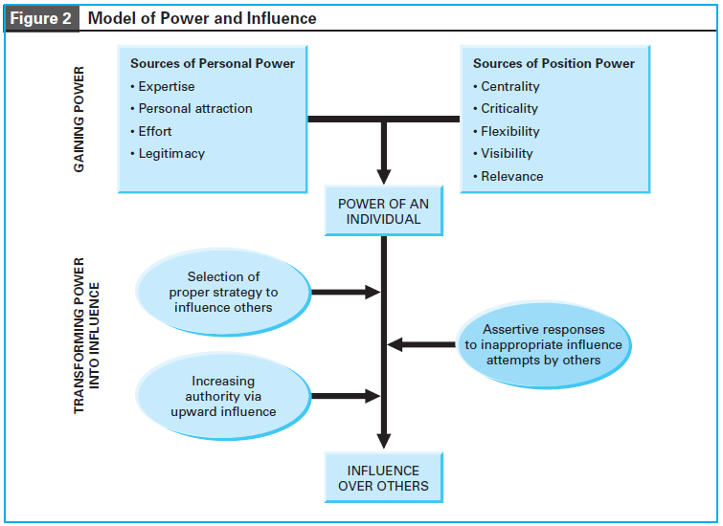
MODEL OF POWER AND INFLUENCE

Slide 35
The End

