Slide 1
SPEED RACER!
-Learn and Apply Functions in a Real Setting
-Recognizing the STEM in mathematics
-Supporting Common Core & Mathematical Practices

Slide 2
Ellen Falk
High School Mathematics Teacher
North Salem Middle High School
Teaching and Learning since 1985
You name it …. We probably taught it!
Been searching for ways to make mathematics meaningful, and to put the meaning into mathematics.

Slide 3
Hear, See, Do
I forget,
I remember,
I understand !
Inquiry Based Learning
  Involvement that leads to questioning and comprehending.
5 E’s
  Engage, explore, explain, elaborate, evaluate.

Slide 4
Hear, See, Do
A person gathers , discovers or creates knowledge in the course of some purposeful activity set in a meaningful context.
Improve understanding.

Slide 5
Pose meaningful questions.
Provide the background and knowledge students will need to solve their problem.

Slide 6
Mathematical Practice
From the Common Core Document under
Mathematics: Standards for Mathematical Practice p 5
4. Model with mathematics.
“Mathematically proficient students can apply the mathematics they know to solve problems arising in everyday life,
society, and the workplace. “

Slide 7
Context
“They routinely interpret their mathematical results in the context of the situation and reflect on whether the results make sense, possibly improving the model if it has not
served its purpose.”

Slide 8
Appendix A (STEM Opps)
‘…content standards must also be connected to the Standards for Mathematical Practice to ensure that the skills needed for later success are developed. In particular, Modeling (defined by a * in the CCSS) is defined as both a conceptual category for high school mathematics and a mathematical practice and is an important avenue for motivating students to study mathematics, for building their understanding of mathematics, and for preparing them for future success. “

Slide 9
Rules of Engagement
Loss of: Depth
Efficiency
Elegance
FOCUS
MATH IN CONTEXT
LOSS of :
Width,
Motivation, Applications
MATH WITH MATH

Slide 10
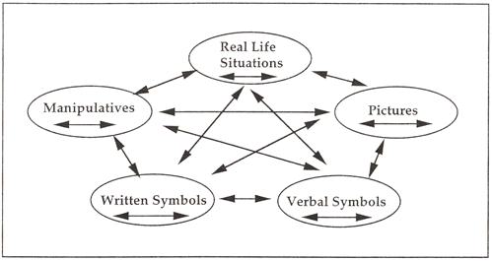
Representational Fluency
The Lesh translation model suggests that elementary mathematical ideas can be represented in five different modes: manipulatives, pictures, real-life contexts, verbal symbols, and written symbols. It emphasizes that translations within and between various modes of representation make ideas meaningful for students.

Slide 11
Performance Tasks
Designed to reveal a learner's understanding of a problem/task and her/his mathematical approach to it.
Can be a problem or a project, performance.
It can be an individual, group or class-wide exercise.

Slide 12
A good performance task usually has eight characteristics (outlined by Steve Leinwand and Grant Wiggins and printed in the NCTM Mathematics Assessment book).
Good tasks are: essential, authentic, rich, engaging, active, feasible, equitable and open.

Slide 13
Project Based Learning
Investigations and meaningful tasks.
Construct knowledge through inquiry.
Culminates in a realistic hands –on project.
5 Es Instructional Model.

Slide 14
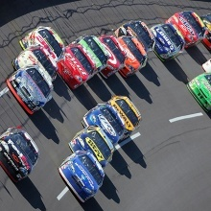
SPEED RACER
Problem: Design and build a car so as to determine its acceleration using a variety of methods.
  Functions
    Constant, Linear, Quadratic. Function notation as it applies to physics.
  Technology
    Authentic Data Collection, graphing calculators, motion detectors.
  Physics
    1-Dimensional Kinematics

Slide 15
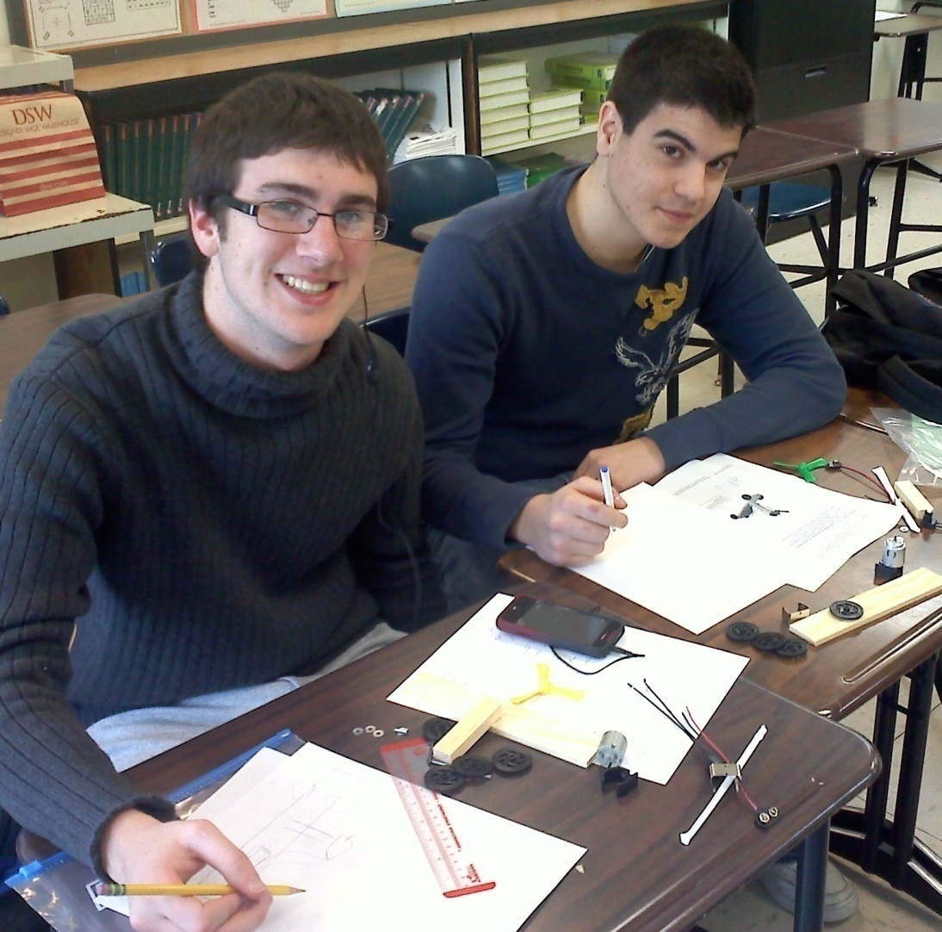
Students often just want to get to building without thoughtful planning
…keep them on track.
Building the Car
Kelvin.com is a wonderful source for technology and finding cool things to build. You can get great ideas there too!

Slide 16
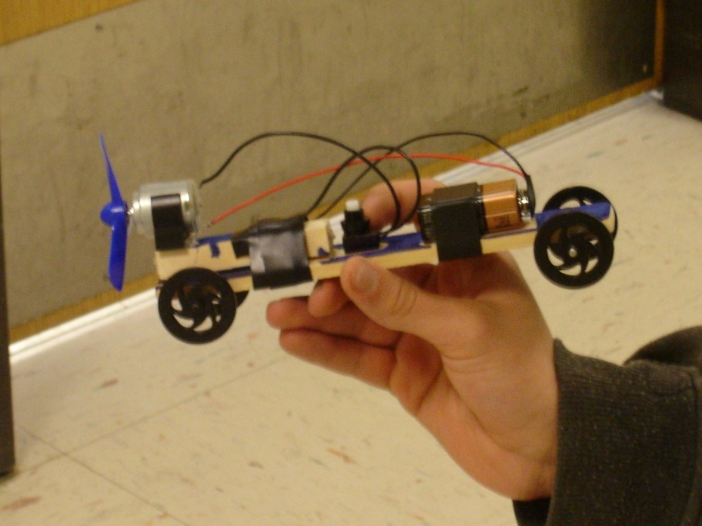
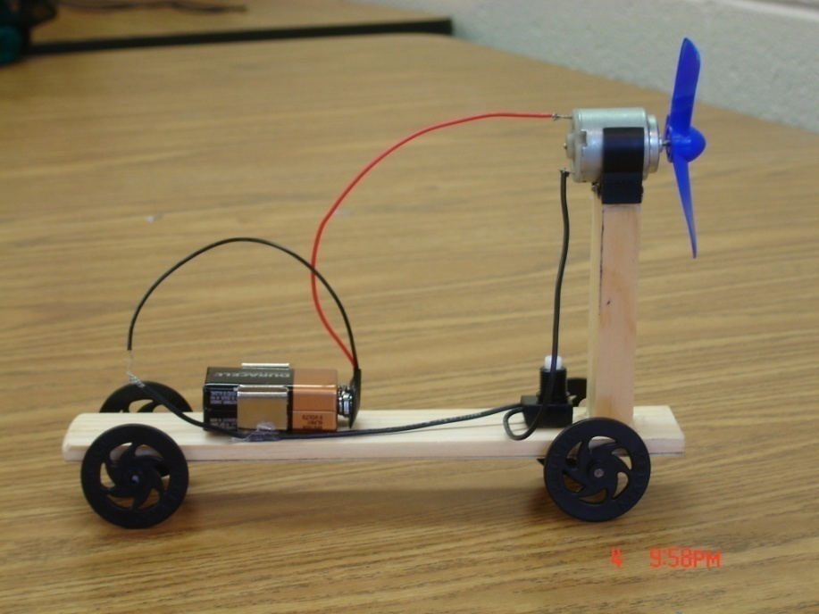
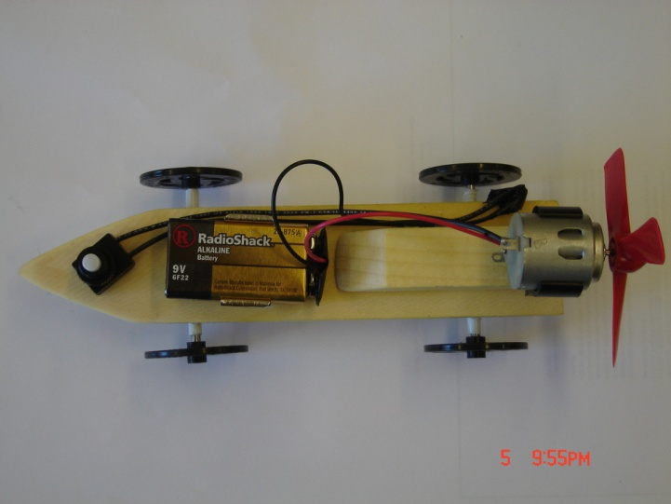
Variation in Design

Slide 17
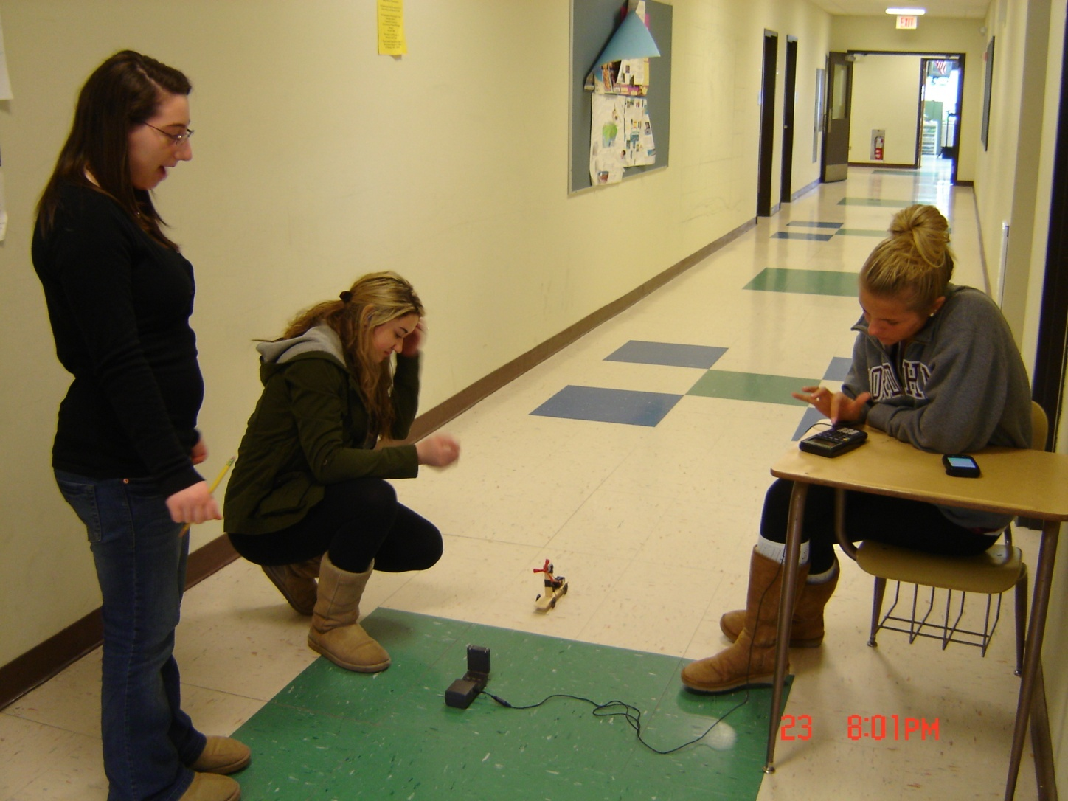
The Set Up
It’s a team effort. After data is collected students decide through applying their new skills and knowledge if the data is “good” data.

Slide 18
Data Analysis
How do you know you have “good” data?
The following are from student reports.

Slide 19
Collecting & Analyzing Data
Distance time graph
Velocity time graph
Acceleration Graph
As time increases on a distance time graph, so does the distance, quadratically.
Linear graph, when time increases, velocity does also at a constant rate.
Constant graph, as time increases, acceleration remained the same.

Slide 20
Distance Time Graph
D(T)= ½aT^2 + V0T + D0
a (lead coefficient) = acceleration V0 = initial velocity
T = time D0 = initial distance
My Data
D(T)= (.31)T^2 + (-.51)T + .62
Acceleration = .62 m/s/s
Doubled lead coefficient to find this.

Slide 21
Velocity Time Graph
V(T) = aT + V0
a = acceleration V0 = initial velocity
T = time
My Data
V(T) = .63T + (-.534)
Slope = .63 m/s/s
Acceleration = change in velocity/change in time

Slide 22
Average Acceleration
_
X = ave acceleration
Constant function
Average Acceleration = .62 m/s/s

Slide 23
Unexpected Results ?
Look at the next slide carefully…
What do you notice?
What do you think happened?

Slide 24
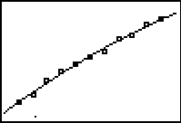
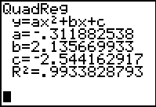
Distance(Time)
D(T)= -.312T²+2.136T-.993
Quadratic Equation
Acceleration = a(2) = -.624 m/s

Slide 25
Built It!
  Excellent Source – Kelvin
  Kits are very inexpensive.
  Motion Detectors and Graphing Calculators
  Let’s build it. Glueguns, rulers and some light hammers are all that you will need

Slide 26
Closing-
STEM/Mathematical Modeling can answer the age old question…
“When am I ever going to use this?”
STEM/Mathematical Modeling can generate motivation.’
  “I want to know more about…”

Slide 27
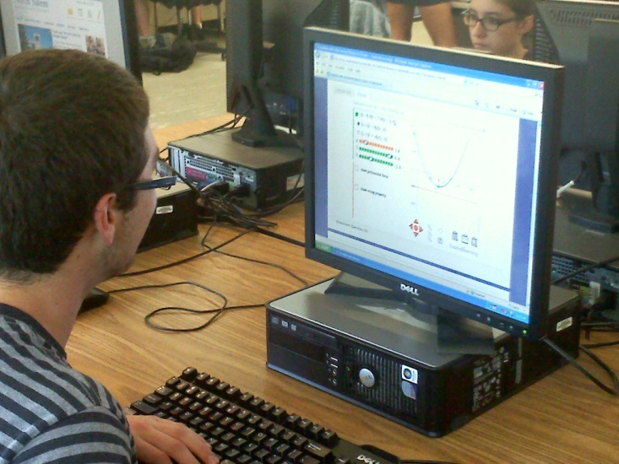
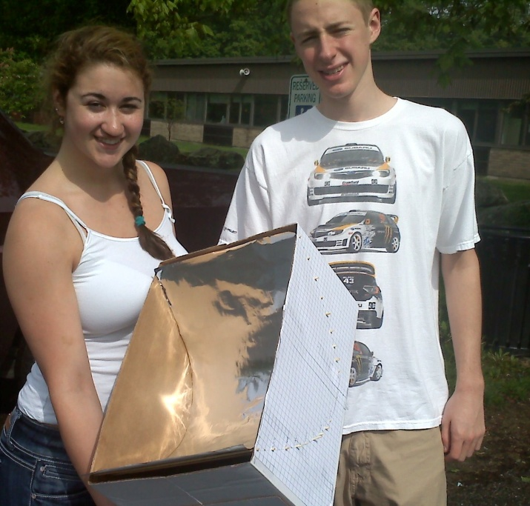
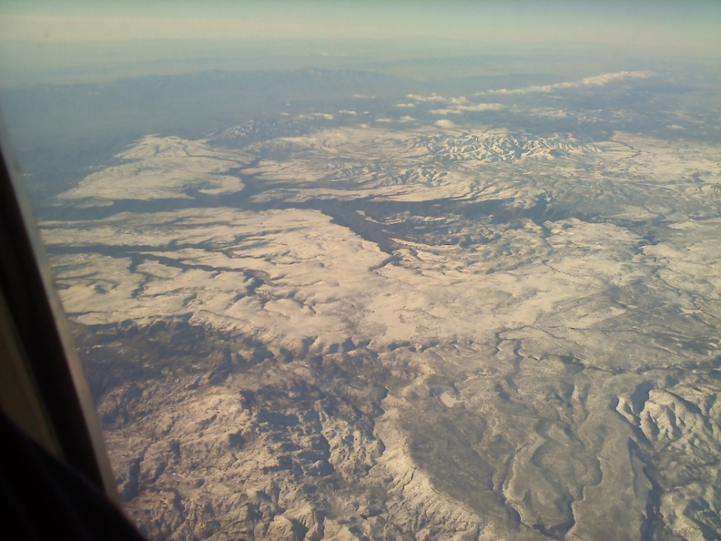

At the heart of it…

Slide 28
Activity !
Questions?

