Slide 1
AP Calculus BC 2015
Free Response #3
by Catherine Budd

Slide 2
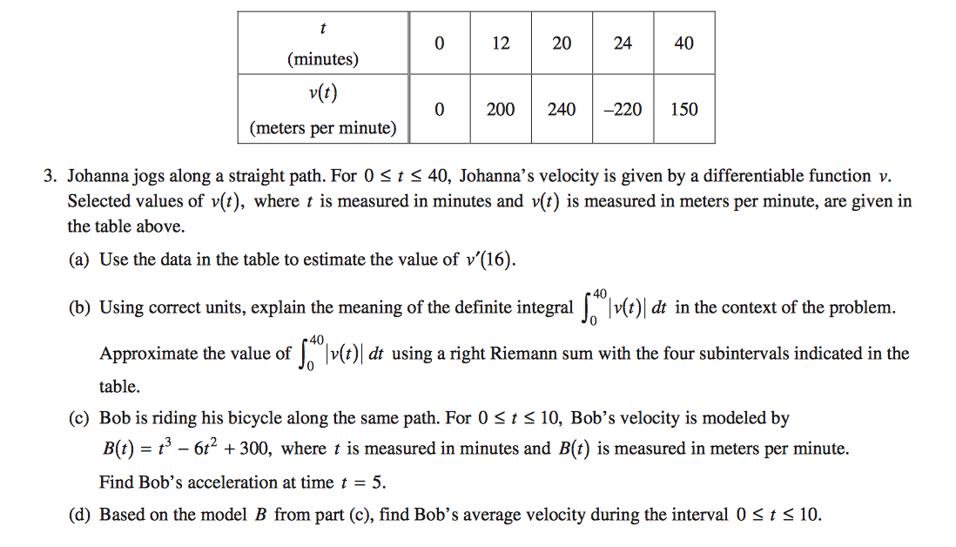
Question #3

Slide 3
Topic
This question can be answered entirely with knowledge from the AB curriculum. The question requires knowledge on derivative estimation from a table, the definition of a definite integral, Riemann sums, velocity and acceleration derivatives, and the average value integral formula and application. It requires the student to be able to understand what a derivative is and how to estimate it from a table, what an integral means in context with velocity, how to compose a Riemann sum by adding the area of rectangles, what the derivative means in context with velocity and acceleration, and how the average value function is applied.

Slide 4
Part a
Process:
-The derivative can be estimated by finding the rate of change between the nearest two values that encompasses the point that was given for the estimation
-Find the rate of change by subtracting the value of the smaller velocity from the value of the greater velocity and divide by the difference of the times at which these velocities occurred.
-That rate of change is the correct estimate for the derivative of the velocity at a certain time between those two times. Remember units as the velocity has the units meters per minute and time is measured in units so the final units should be meters per minute per minute.
Solution:

Slide 5
Analyzation
This medium level question asks the student to estimate the value of a derivative using data from the table. It asks for the estimation at a certain time where the position is not given. The student must use the position values and time values closest to the given time to estimate the derivative. A student could struggle with the question if they did not recognize that an estimation of the derivative could be found by finding the rate of change between the two values that encompassed the value that is being estimated. In this instance, the student should reason that a derivative is the rate of change and that could be found by using the given values for the closest times as the rate of change between them would be nearest to the rate of change of the specific time.
Explanation of estimation using data from a table: http://math.ucsd.edu/~ashenk/Section2_5.pdf

Slide 6
Part b
Process:
Understand that a definite integral of velocity is the total distance traveled over the interval by the relationships between position, velocity, and acceleration. Include the units given for position: meters.
Recognize that a Riemann sum with four subintervals is the sum of the area of four rectangles with heights equal to the velocity at the right-most point of the rectangle. Compose the equation and compute. Include units, meters.
Solution:

Slide 7
Analyzation
Part b, an easy level question, requires the student to know the relationship between position, velocity, and acceleration, velocity is the derivative of position and acceleration is the derivative of velocity, and to know how to use a Riemann sum to estimate an integral. A student can struggle if they do not understand these concepts or do not realize that they need to be applied to the question. The student could also make a mistake if they used a left Riemann sum instead of a right Riemann sum or forgot a part of the summation, such as only having three subintervals instead of four. This can be handled by realizing the relationship of velocity and position as velocity is the rate of change of the position which would be the derivative. A student should try to estimate the integral by realizing it would be easier to divide it into sections, like rectangles, to compute. Also, double-check that the correct Riemann sum was used.
Explanation of Riemann Sums: http://mathinsight.org/calculating_area_under_curve_riemann_sums

Slide 8
Part c
Process:
Realize that acceleration is the derivative of velocity
Take the derivative of the velocity function to find the acceleration function
Substitute 5 for t in the equation to find the acceleration of B at time t=5
Remember units: meters per minute per minute
Solution:

Slide 9
Analyzation
This easy question tests whether the student knows that acceleration is the derivative of velocity and whether the student can take the derivative of an equation. The student must also know when to apply these methods to the problem. Misconceptions can happen when the student does not realize that acceleration is the rate of change of velocity and that the derivative should be taken. It can also happen when the student does not understand that once the function is found, the value for t should be plugged in and the value for acceleration at that point could be found. These problems can be handled if the student reasons that acceleration is the rate that the velocity is changing and that is the derivative so the function the derivative provides will allow the acceleration to be determined on the interval [0,10].
Explanation of position, velocity, and acceleration relationship:
https://www.khanacademy.org/math/integral-calculus/indefinite-definite-integrals/indefinite_integrals/v/antiderivative-acceleration

Slide 10
Part d
Process:
Recognize that the question is asking for the average value of the function B(t) given in part c on the interval [0,10]
Write and apply the formula for the average value function
Solve the function for the average velocity and the answer of the part
Solution:

Slide 11
Analyzation
This medium level question is designed to test whether the student can recognize the application of the average value function and correctly use it to answer the question. A student could go wrong if they do not recognize the application of the average value function, do not remember what the function is and cannot derive it, and do not realize what the bounds are for the integral. These misconceptions can be corrected by realizing how to derive the average value function by thinking of the Mean Value Theorem for integrals and reading the problem thoroughly to see that the question specifically asks for the average value and provides the bounds for the integral. It would be easiest if the student just remembered the function to apply it.
Explanation of the Average Value Function: http://calculusapplets.com/aveval.html

Slide 12
Connection
The question tests in general whether the student understands how position, velocity, and acceleration are related and whether the student understands how to estimate and find derivatives and integrals. Part a asks for the student to understand how the derivative applies to the table of data and how to estimate the derivative, which is compared to part c where the relationship between velocity and acceleration is again mentioned but a function is provided so the exact value of the derivative must be calculated. Part b test the student on the relationship between velocity and position and whether he/she can estimate an integral. Part d tests whether the student can solve an integral within the context of the average value function. The parts combine to test a variety of aspects of the subject to gain a larger understanding of the student’s knowledge.

Slide 13
Summary
The AP Calculus BC Free Response #3 focuses on derivatives and integrals in the context of position, velocity, and acceleration. It asks questions which requires students to remember formulas and relationships and to be able to apply them correctly. Overall, it was not the most difficult question on the test but it was representative of the material we learned during the year and if one studied and knew the methods they most likely did well.

