Slide 1
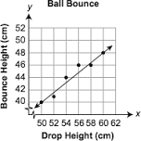
Synergy of NGSS & CCSS for Mathematics
Drop a tennis ball from various heights and record bounce height.
Drop height verses Bounce height.
Develop a model to predict the bounce height given a drop height.
Are there limitations on the prediction?
In other words, is the model reliable? How would you test it?
Domain and Range
Linear models, regression
Connect to NGSS http://www.nextgenscience.org/sites/default/files/HS-PS3%205.15.13With%20Footer.pdf
Potential energy, energy absorbed by the floor, etc.

Slide 2
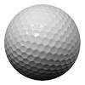
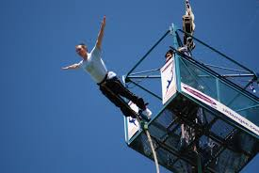
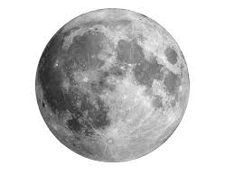
Brainstorm variations to the problem
What if we varied the type of ball we used? What aspect of the model ( graph) would change? Why?
What if we ran this experiment on the moon? What aspect of the model would change and why?
Bungee Jumping- How safe is it?

