Slide 1
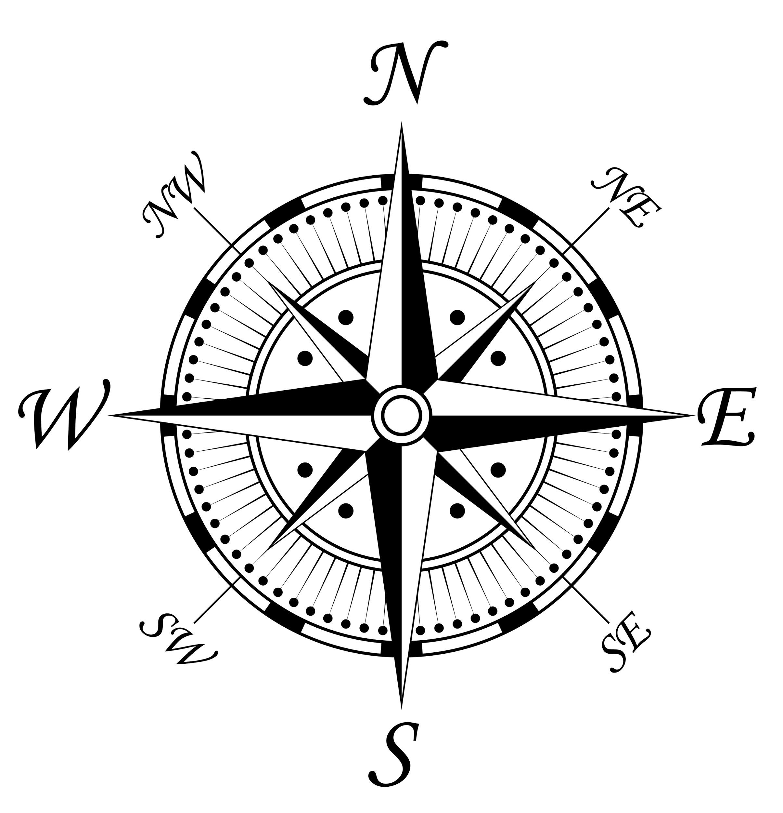
What’s Your Bearing?
Haley Vermette & Muiread Heffernan

Slide 2
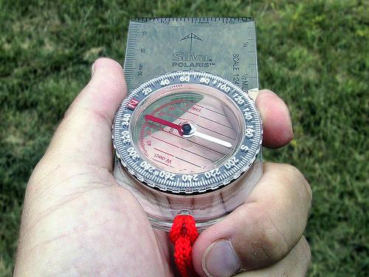
The Task at Hand
Surveyors locate property lines, find the length of boundaries and calculate area of land parcels. During this project we were given the task of creating a 5 point plot of land for a client. We must complete a detailed survey map and determine the number of acres in that plot of land.

Slide 3
Our First Steps
We began by picking a starting point (Point 1).
From there we chose our second point (Point 2).
Then we used the compass to get our first bearing.
Next we counted our paces from Point 1 to Point 2.
We recorded our data for each step and repeated throughout the project.

Slide 4
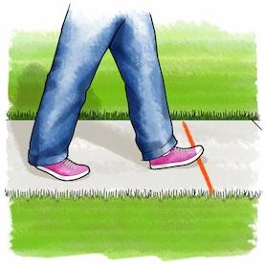
What’s a Pace?
During this project we use a pace as a measurement. Every person has a different pace so we had to keep our pace’s consistent throughout the project. We used my pace of 50 inches. A pace is measured by standing with your feet together then stepping forward with your right foot then your left.

Slide 5
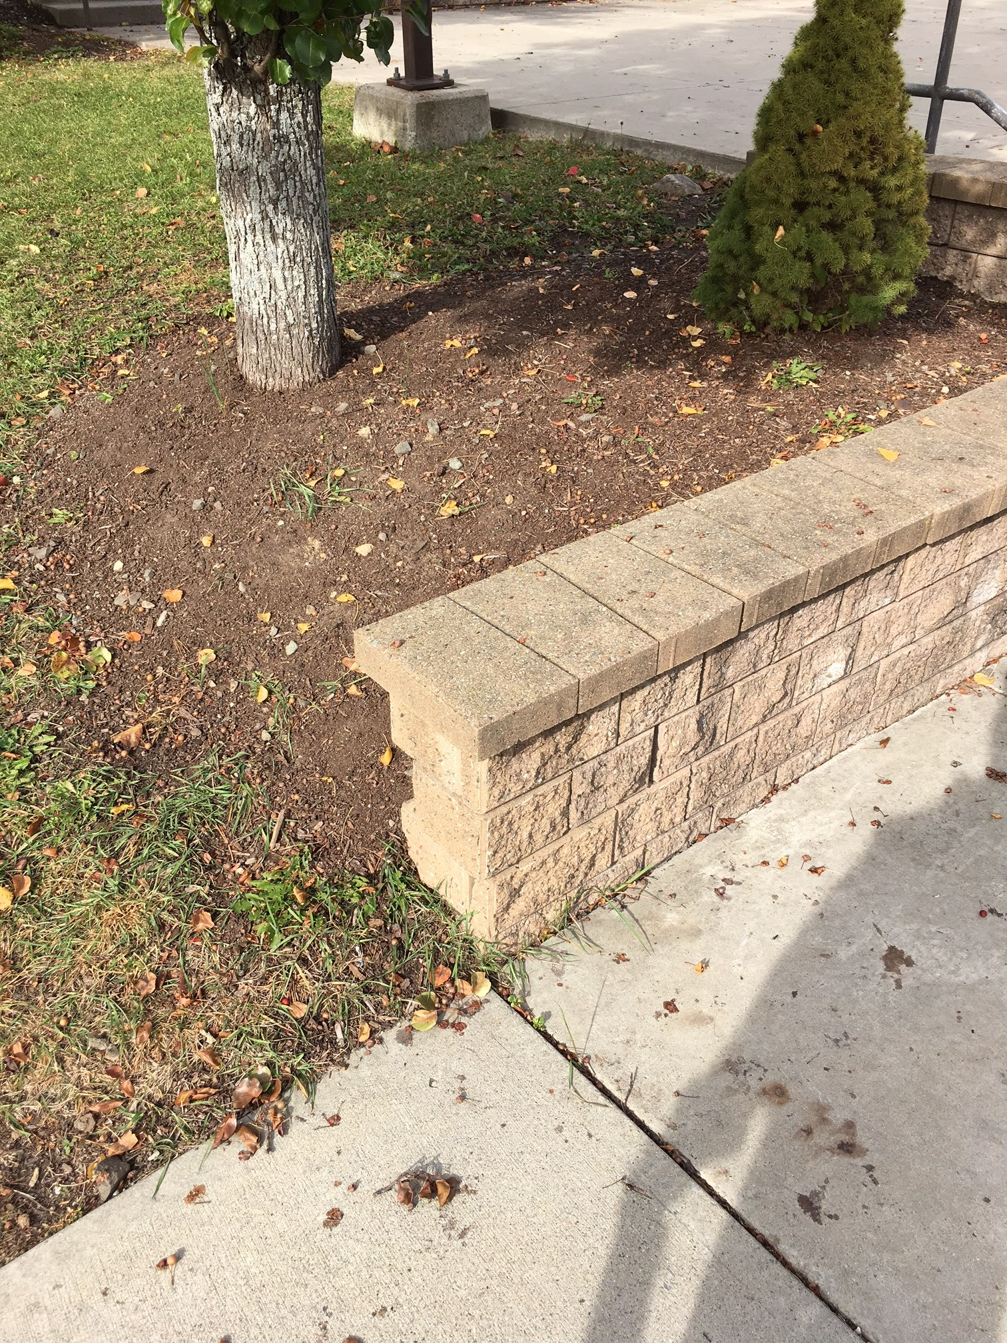
Point 1
- Location: This point is located in the front of the school near the student drop off and the edge of the rock wall in front of a tree.
Next:
- Compass Bearing: 98°
- Distance: 31 paces which is 129.2ft

Slide 6
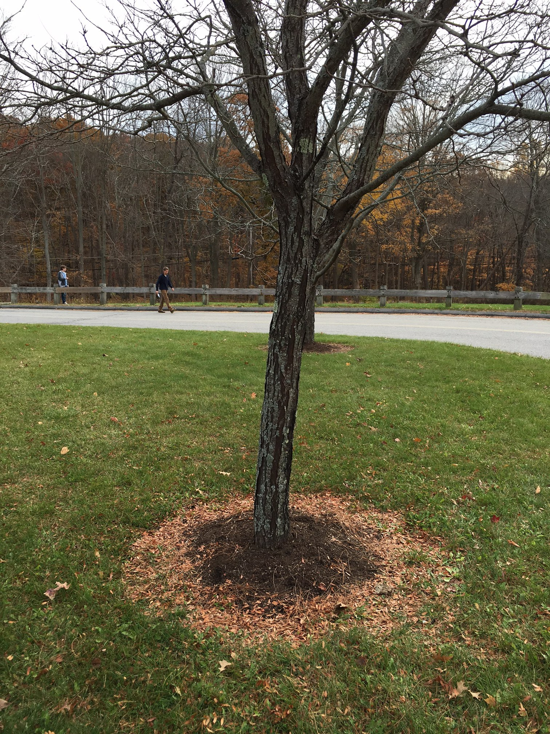
Point 2
- Location: After walking 31 paces you should end up at a tree between the sidewalk and the road.
Next:
- Compass Bearing: 182°
- Distance: 50 paces which is 208.3 ft

Slide 7
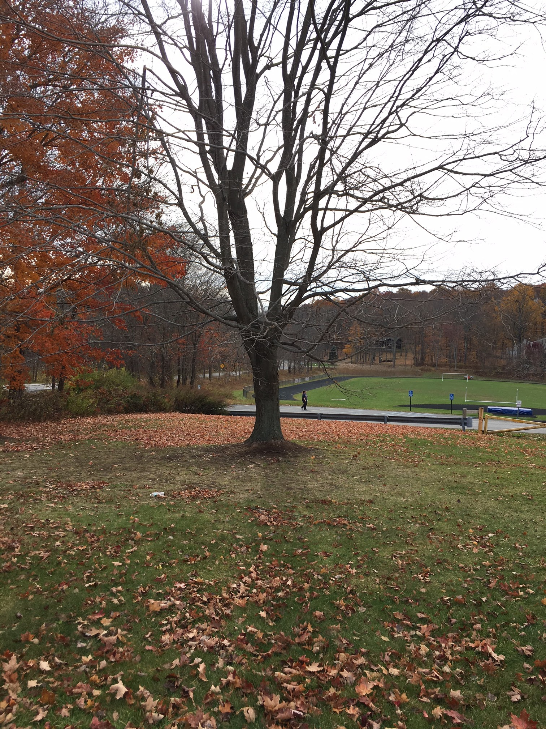
Point 3
- Location: Once you have walked 50 paces you should end up next to a tree at the bottom of the hill.
Next:
- Compass Bearing: 313°
- Distance: 27 paces 112.5 ft.

Slide 8
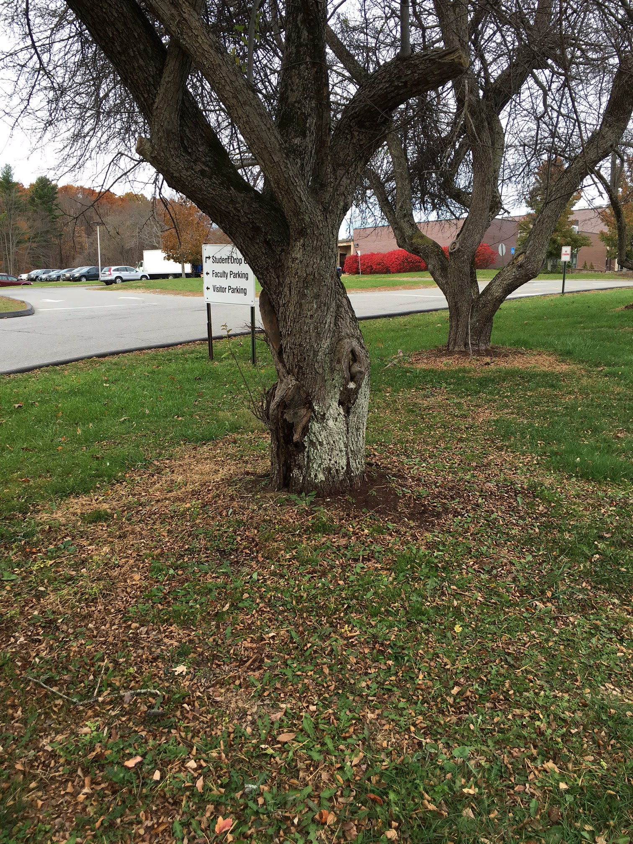
Point 4
- Location: This point is located at the third tree in a line of trees.
Next:
- Compass Bearing: 282°
- Distance: 29 paces which is 120.8 ft

Slide 9
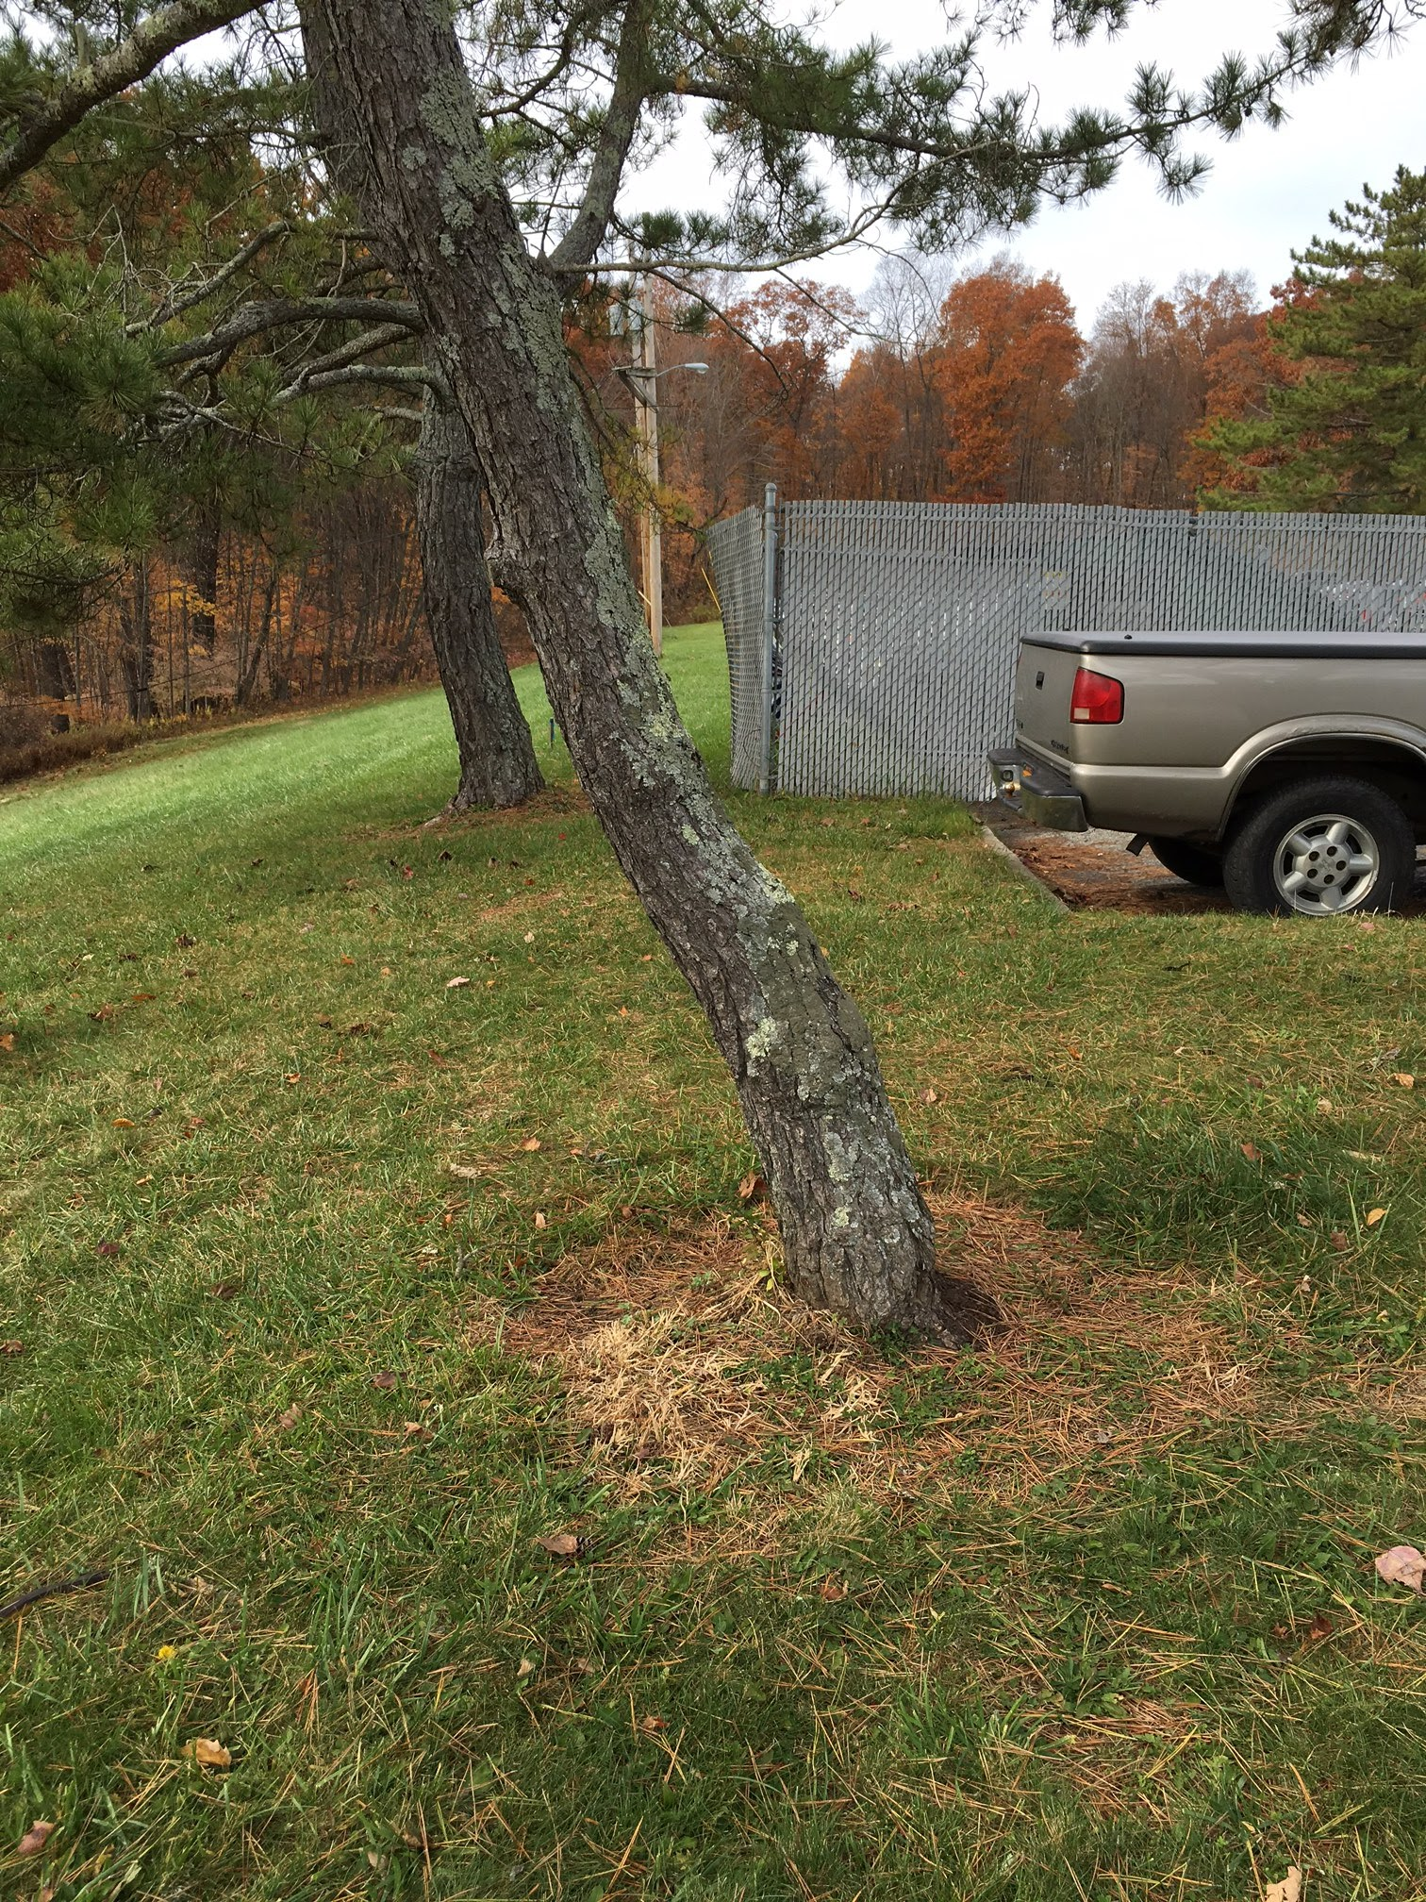
Point 5
- Location: The final point is located at the curved tree right before the senior parking lot.
Next:
- Compass Bearing: 38°
- Distance: 32 paces which is 133.3 ft

Slide 10
Time to Get to Work!
Once we completed our work outside we were left with our notecard. For this project we were required to use a variety of math skills to find out all the different elements of a survey map. Some of these skills were:
SOH CAH TOA
Law of Sines
Law of Cosines
Once we learned how to apply these in class the project really began to come together. We used the process of triangulation to figure out the total number of acres in the surveyed area. Triangulation uses all of these processes at different times.

Slide 11
Some Bumps in the Road...
When we first began this project we thought it was going to be easy but then after the first three failed attempts at mapping the points this was a little harder then what we originally thought. We also thought all of our measurements were going to be perfect and line us but over time we realized there would be some errors and that was ok as long as they were minimal.

Slide 12
Our Final Product
Once we were able to work out all the problems and use all our new math skills we could complete the survey with all required fields. Overall, I think this project was a great learning experience and has showed me how math is used in the real world. Our map was completed with drawings of the roads, grass, trees, buildings and other important landmarks that surrounded the surveyed area. We also made a company name and signed our map before handing it in.

