Slide 1
Modeling the Story
of GEOMETRY
Presenter: Ellen Falk
efalk@northsalemschools.org
www.mathizaverb.com
North Salem , NY

Slide 2
INFLUENCERS
Pedagogy and Practice
Notes:
An influencer is an individual who has the power to affect purchase decisions of others because of his/her authority, knowledge, position or relationship with his/her audience. An individual who has a following in a particular niche, which they actively engage with.Feb 1, 2019

Slide 3
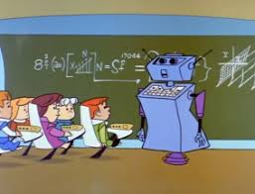
Mathematical Practice Standards
Mathematical Content Standards
Notes:
Common Core document- math practice #4 page 5 We are bounded above and below by MPS and MCS
4. Model with mathematics.
“Mathematically proficient students can apply the mathematics they know to solve problems arising in everyday life, society, and the workplace. “

Slide 4
Understanding By Design
• Developed by Jay McTighe and Grant Wiggins.
“Transfer of knowledge is our greatest challenge.”
Only deep understanding leads to transfer.
Project Based Learning
Investigations and meaningful tasks.
Construct knowledge through inquiry.
Culminates in a realistic hands –on project.
5 Es Instructional Model
Empowering students
Notes:
At the end of the day … ALL are varients of the learning cycle. 1962

Slide 5
Modeling Behaviors
Identifying Variables
Formulate Models based on the above
Performing operations on those models
Interpret those results.
Validate conclusions.
Construct knowledge and meaning through
meaningful tasks.
Constructivism
Notes:
Seee math modeling article at my website by Dan Meyer

Slide 6
Rules of Engagement
Loss of: Depth
Efficiency
Elegance
FOCUS
MATH IN CONTEXT
Test Items
LOSS of :
Width,
Motivation, Applications
MATH WITH MATH
Notes:
Keep a healthy focus. Where is your focus? What do you value?

Slide 7
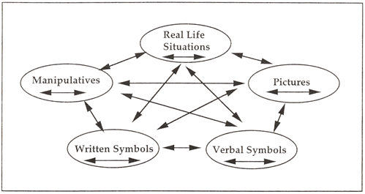
Representational Fluency
The Lesh translation model suggests that elementary mathematical ideas can be represented in five different modes: manipulatives, pictures, real-life contexts, verbal symbols, and written symbols. It emphasizes that translations within and between various modes of representation make ideas meaningful for students.
Notes:
Provide opportunities of fluency through problem solving process.

Slide 8
Performance Tasks
Designed to reveal a learner's understanding of a problem/task and her/his mathematical approach to it. Math MODELING behaviors.
Can be a problem or a project, performance.
It can be an individual, group or class-wide exercise.
Notes:
Demonstrate understanding or lack of – Beyond test item like questions. PT should reveal mathematical modeling behaviors. Performance tasks good ones support the FOCUS pathway

Slide 9
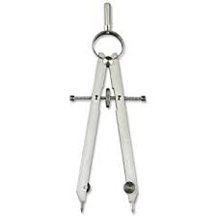
Favorite Construction?
THINK
Why?
How does it connect to Prior Knowledge?
What are future connections?
What understandings does it support?
Math Connections to STEM? BONUS
PAIR - SHARE
Notes:
Add another slide with a pic of perpendi construction

Slide 10
The Placement of Constructions
Perpendicular Bisector is the WINNER!!!
Rich connections THROUGHOUT! Brainstorm
-language and symbolic representations, isosceles triangles, properties of rhombus, transformations, congruence,…
Empowering students early in the modeling of geometry.
Critical Thinking - Eddie Goes Fishing, Fermat’s theorem of least time, miniature golf
Notes:
CONGRUENT TRIANGLES, isosceles triangles , transformations, rhombus properties IMERSION

Slide 11
( Commoncore Geometry Mike Patterson), etc.

Slide 13
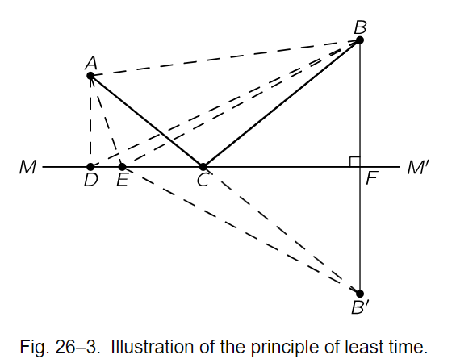
Fermat’s Principle of Least Time
The first way of thinking that made the law about the behavior of
light evident was discovered by Fermat in about 1650, and it is
called the principle of least time, or Fermat’s principle.
His idea is this: that out of all possible paths that it might take to get from one
point to another, light takes the path which requires the shortest time.
STEM
Notice ? Wonder ?
Extend the problem to calculus, ALG 2, Pre Calc.
Notes:
Calc , pre cal students can prove it!

Slide 14
What’s the Balance Point?
From Novice to Expert
Notes:
This project can be found on my website

Slide 15
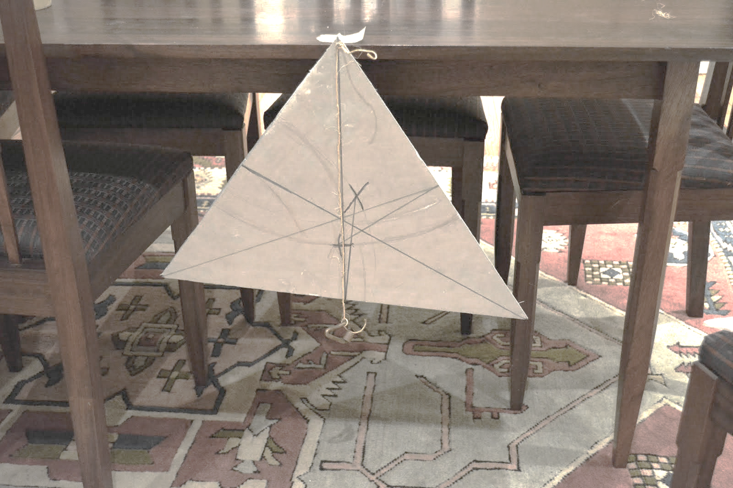
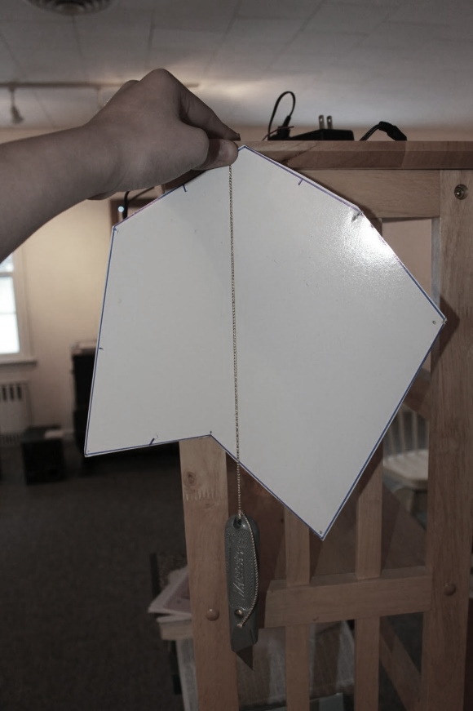
Modeling Critical and Creative Thinking with the CENTROID Theorem

Slide 16
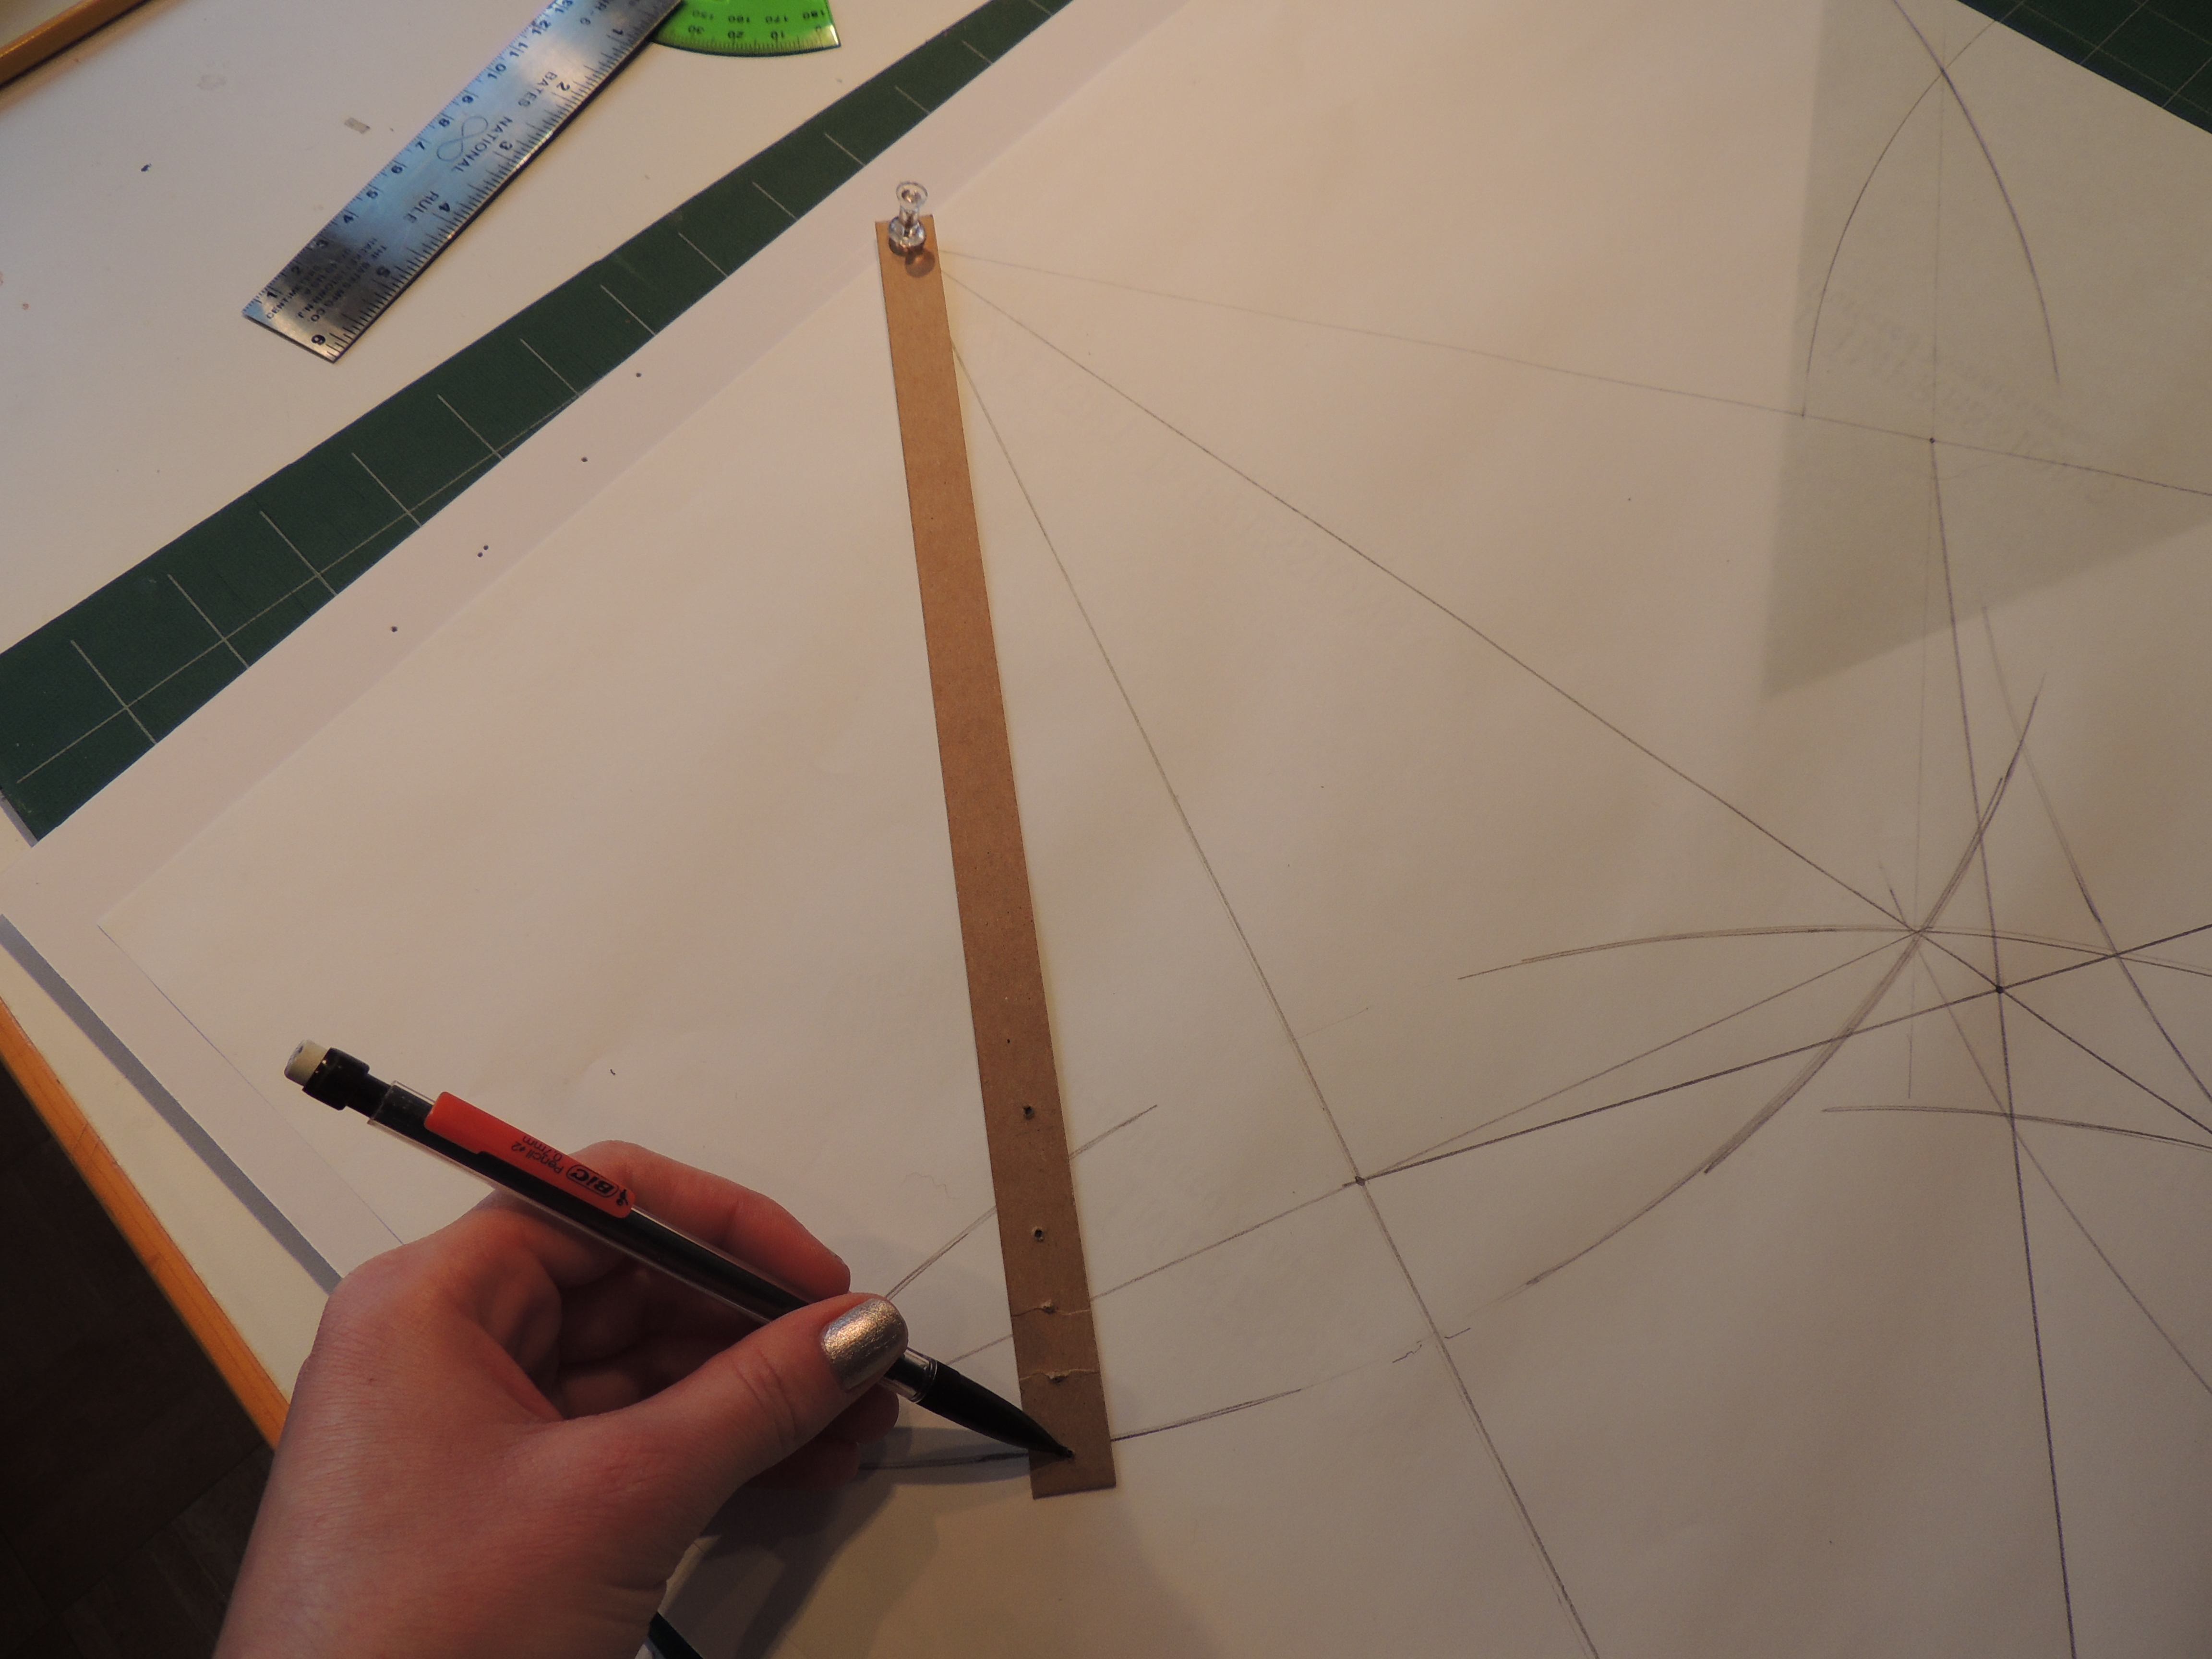
Method 2: Homemade compass and construction
The second method I used for the triangle was to do a construction using a homemade compass. I made the compass out of a thumb tack, a piece of cardboard, and a pencil. I traced the triangle onto a piece of paper and did the construction on there. First, I found the midpoint of each side by making marks above and below the sides of the triangle, and drawing a light line through where they intersected.
Then I drew the medians connecting the midpoint and the opposite angle. I made sure the centroid theorem held by measuring the lines and lining up the original triangle with the first method on it. This method also worked, but it was a little hard to fit all of the compass marks on one piece of paper and not that easy to use the compass. This method was also more time consuming than the first method.

Slide 17
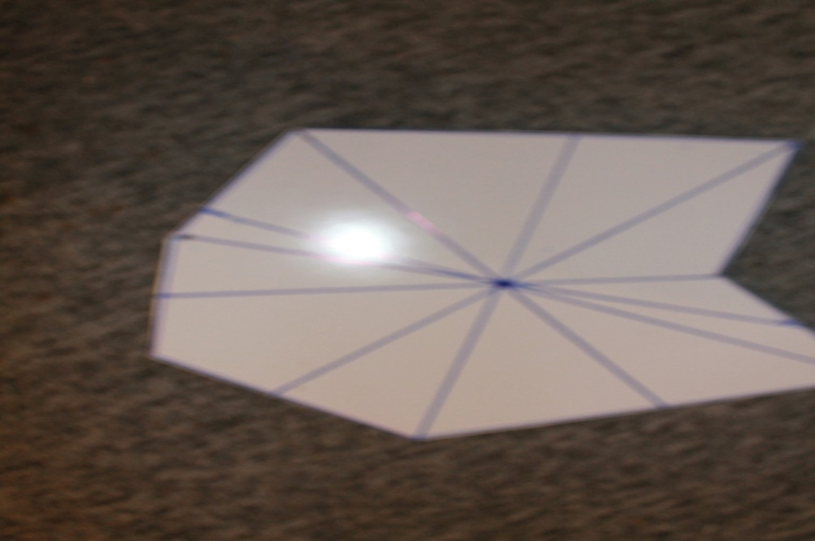
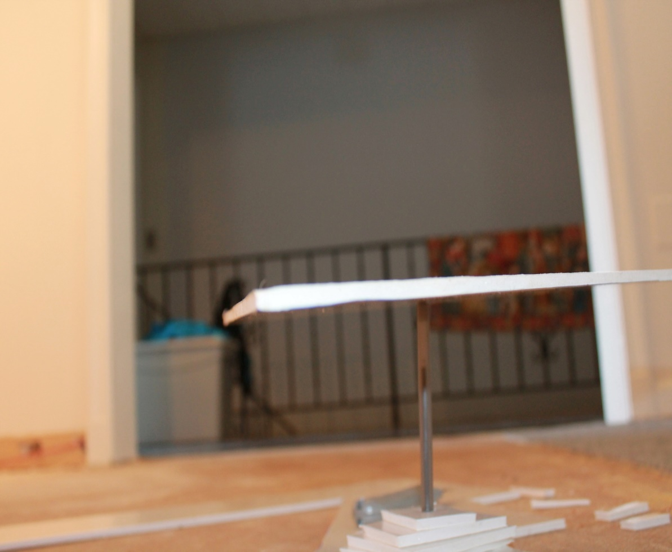
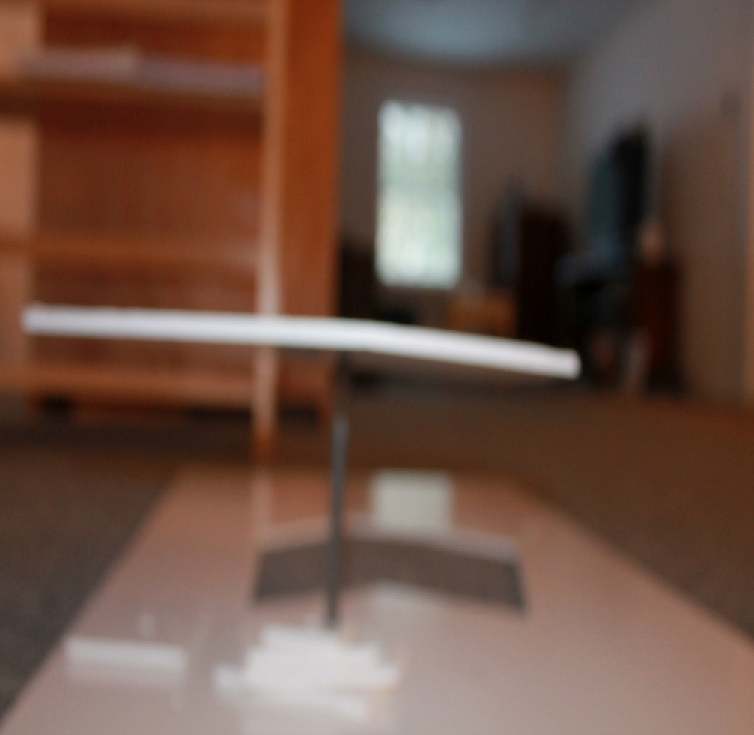

Slide 18
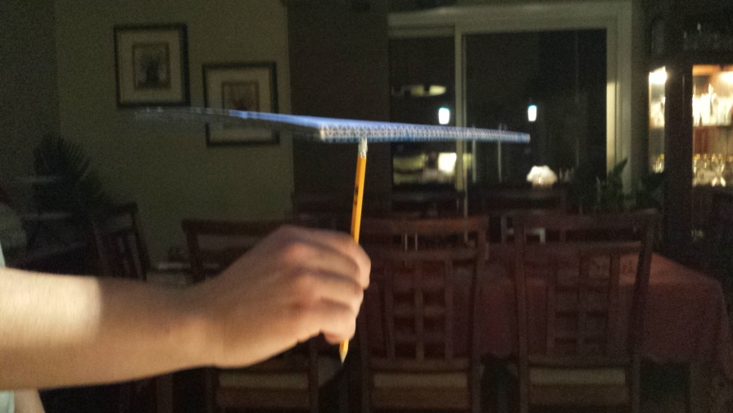
Conclusion
-Dear Mr. Artist,
I have tried out a few methods on different shapes and concluded that there is a better method for each different shape. For triangles, the best and easiest method is to simply measure using a ruler. This gives you the most accurate results and you don’t need to do much. However, for any other shape, the best method is the plumb bob method. This is because you can measure every side with it and the string lines up perfectly with the midpoint if you let gravity do its work. So use the plumb bob method for any shape that is not a triangle.
Notes:
Communicating what we know and how we know it.

Slide 19
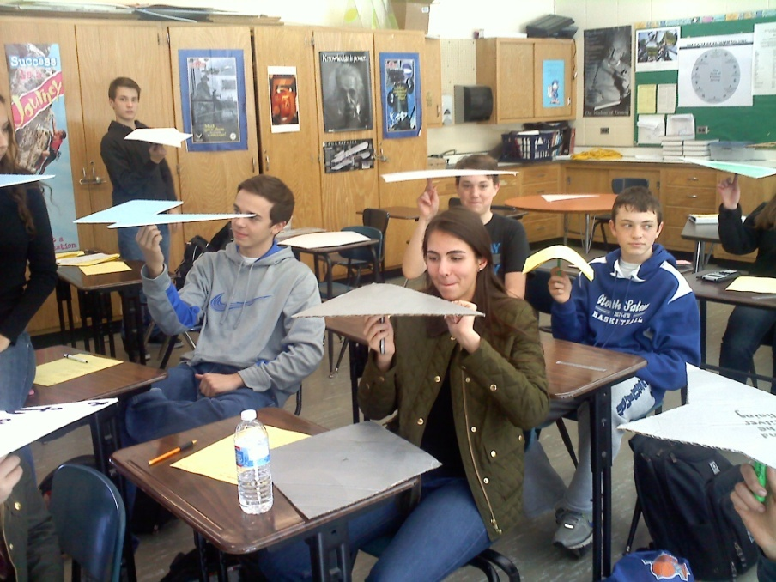
Pride in what they accomplished…

Slide 20
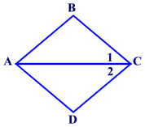
Two Truths and a Lie
Statement 1
Statement 2
Statement 3
AC= AC :
Construct viable arguments and critique the reasoning of others

Slide 21
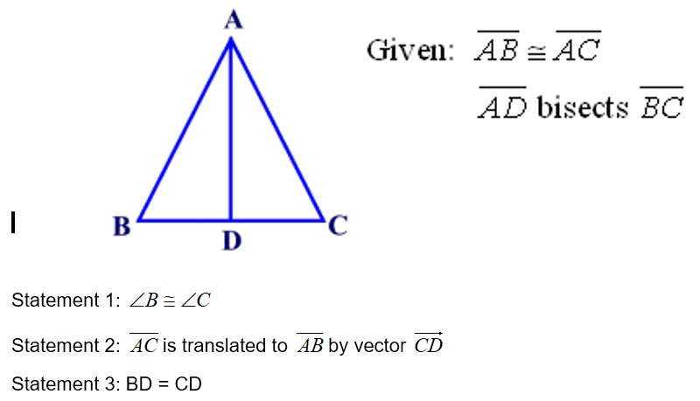
Two Truths and a Lie
Communication and Collaboration.

Slide 22
Two Truths and a Lie
Communication
Collaboration
Improve writing in mathematics
Deepen understandings
Thinking Flexibly
Critique the Reasoning of others
Notes:
Add student exemplars

Slide 23
Notice and Wonder
Notes:
Brain storm the math that comes to mind. SRT

Slide 24
Integrate math with math
https://www.geogebra.org/m/VU4SUVUp
Radicals
SSE
4
4√2
Special
Rights
8
Notes:
Pythagorean thm , special right triangles, REPLACE WITH GRAPH PAPER IMAGE

Slide 25
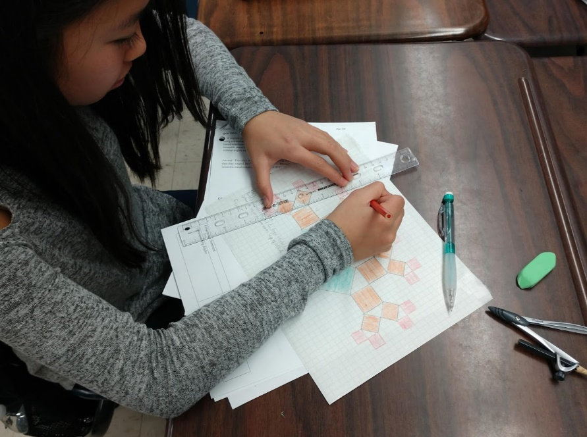
PYTHAGOREAN TREES
What‘s the math in that ? Brainstorm!
Is it valuable?
Do a RISK assessment
-Clarity about priorities
Notes:
Perform on grid paper . Find patterns- abstraction

Slide 26
Modeling Our Thinking
Cultural Forces (8) that Shape the Classroom
Modeling(1) of who we are as thinkers and learners so that the process of our thinking is discussed , shared and made visible.
Partitioning a line segment.
Placement in curriculum ?
Examine Exemplars.
Any misconceptions revealed?
Math-language-meaning
Notes:
Student exemplars – have a discussion. Do we give enough time to modeling our thinking ?

Slide 27
H.O.M. & Abstract Thinking
Sphere in Cone
Notes:
The problem necessitates the WHY we need CROSS SECTIONS. Think of the Regents cross section questions, now lets USE it!

Slide 28
Smart Board to the RESCUE!

Slide 29
Collaboration!

Slide 30
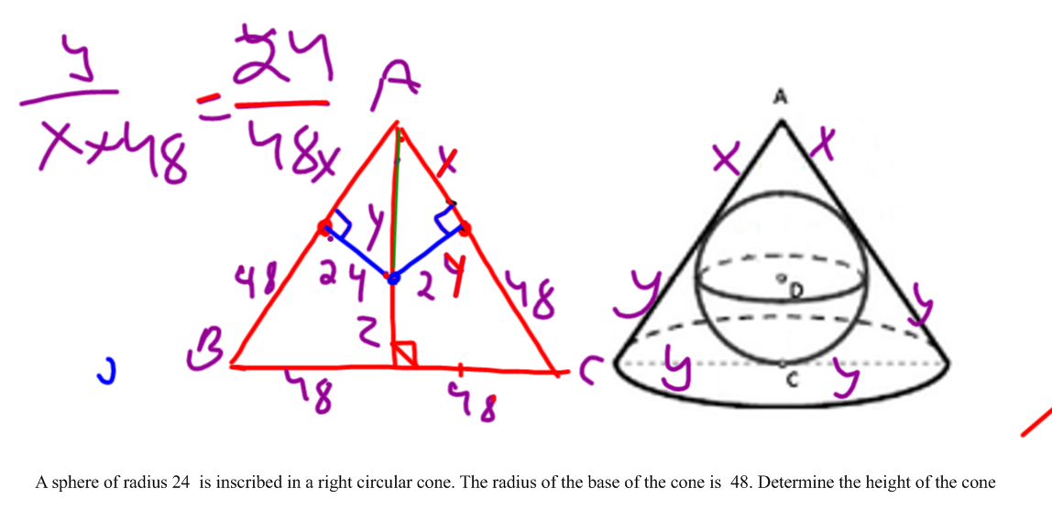

Slide 31
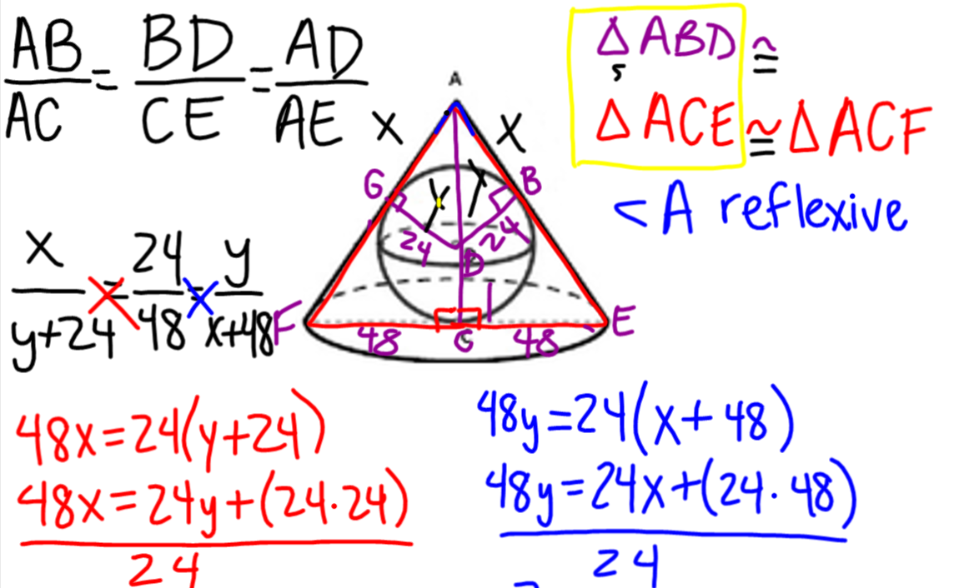

Slide 33
Summary Points
Let them think! Let them LINK.
Building Knowledge , Know –How and Know -Why.
The goal is for Ss to be able to Transfer knowledge!
Create connected opportunities.
Be positive problem solvers.

Slide 34
Summary Points/Questions
How do we construct meaningful ( messy) tasks?
Where/when do I start?
Risk Assessment- Clarity about priorities.
What am I willing to let go of?
Model thinking routines. NAME IT.
Instructional model that works for YOU !

Slide 35
Sources/Videos
Dan Meyer-math class needs a makeover.
Dan Meyer- 3 Acts-
RSA Animate-Ken Robinson
Illustrative Math-Geometry
CPALMS – Sine CoSine
Pixar – Numberphile
NASA- Exploring Space through Math
David McCandless turns complex data sets (like worldwide military spending, media buzz, into beautiful, simple diagrams that tease out unseen patterns and connections

Slide 36
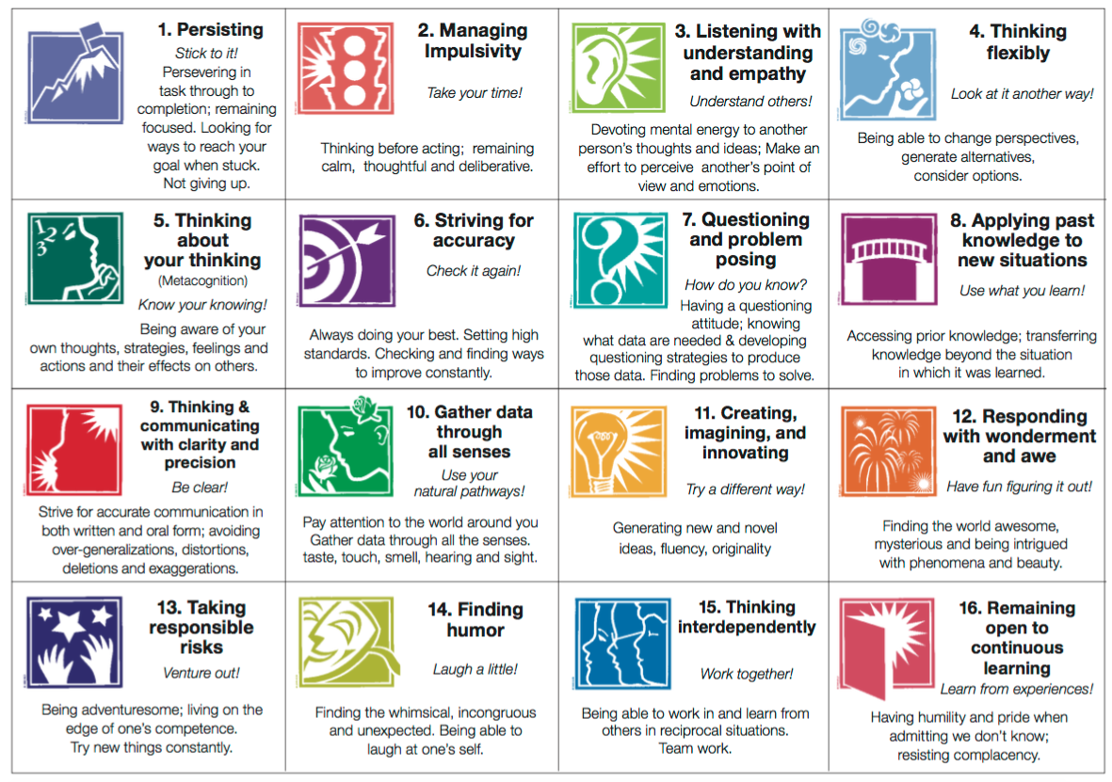
Part B- Motivation

Slide 37
Engagement through
Easy to set up.
Opportunity for inclusive communication.
Start a dialogue, give a quiz, or poll question.
Upload assignments, videos, anything!
Create a level of comradery and support.
FREE- but can be quirky.
Engage in assessment connects to ck12.org

Slide 38
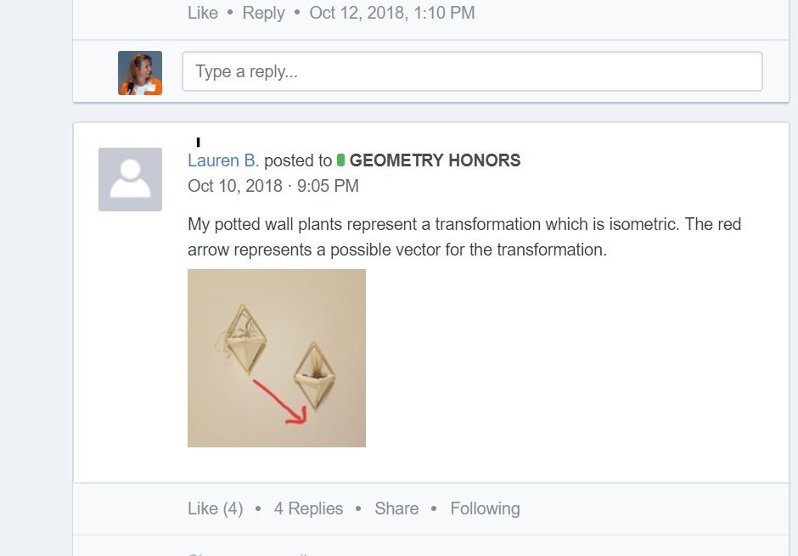
Other exemplars….

Slide 39
Geogebra
FREE!!!
Excellent support.
Strong Twitter community- Tim Brzezinski
Steve Phelps @geogebra
Can be overwhelming! So powerful.
Very intuitive for students.
Use only what you need. Geogebra classic!
Provides a dynamic platform to model and connect challenging topics that are hard to do by hand.

Slide 40
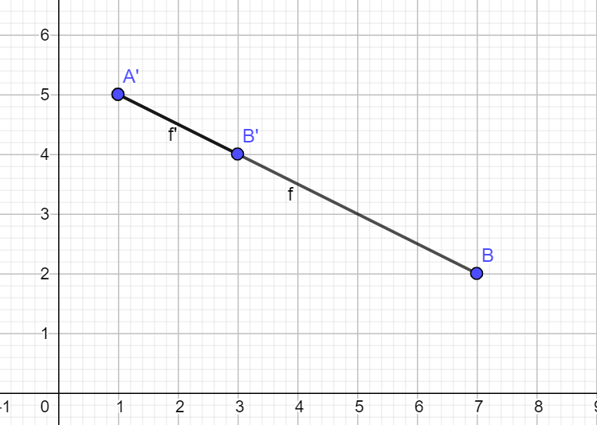
Connecting Topics
Connecting Partitions to Dilations through Geogebra:
Partition segment AB so that AP:PB = 1:2
A(1,5)
B(7,2)
k=1/3
Point of
dilation is A.

Slide 41
Khan Academy
I am no expert!
Tried in GEO, used in STATs.
Easy to set up.
Connects to Google Classroom.
Hard to communicate to Ss directly.
Assessments provide useful data.
Standards driven.
Test and Retest …
Platform for differentiated instruction.
Jury is out…

Slide 42
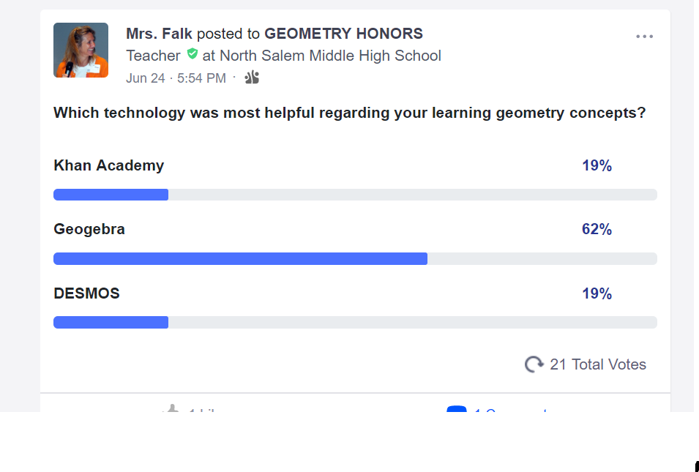
Poll Questions

Slide 43
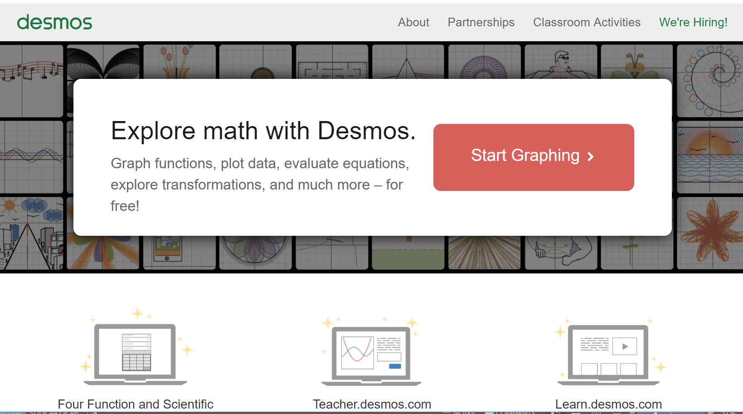
DESMOS
FREE!!!
I am no expert! Useful in nearly every course!
But…. Was not my go to for GEO.

Slide 44
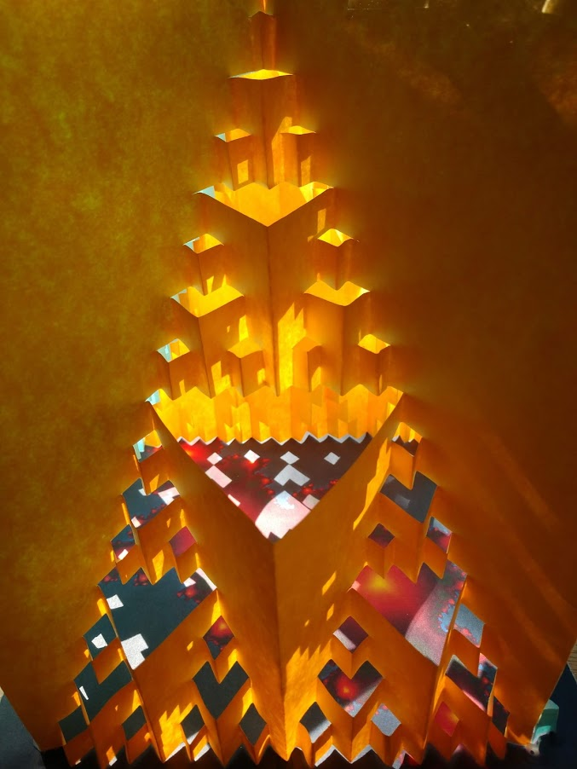
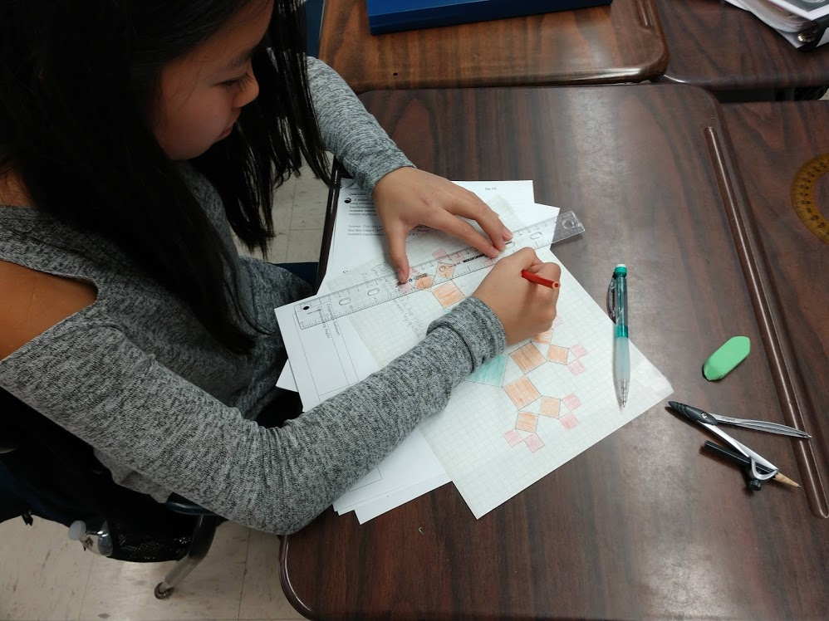
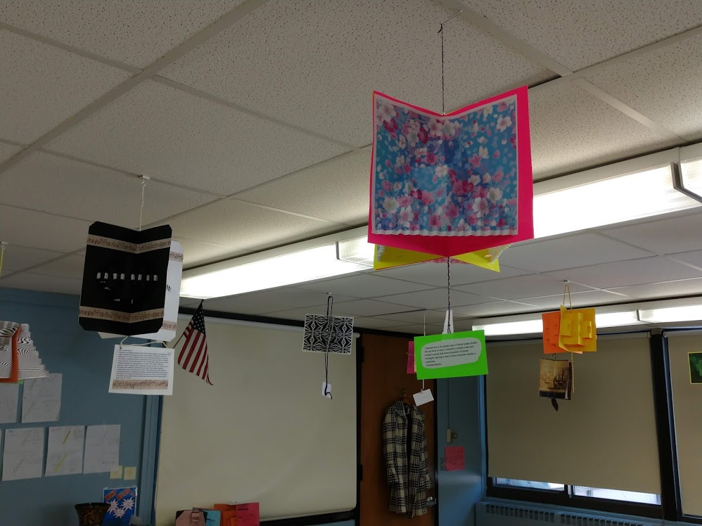
Thanks!

Slide 45
Sources
Rational Number Project
Lesh, R., Cramer, K., Doerr, H., Post, T., Zawojewski, J., (2003) Using a translation model for curriculum development and classroom instruction. In Lesh, R., Doerr, H. (Eds.) Beyond Constructivism. Models and Modeling Perspectives on Mathematics Problem Solving, Learning, and Teaching. Lawrence Erlbaum Associates, Mahwah, New Jersey.
Cramer, K., (2001) Using Models to Build Middle-Grade Students' Understanding of Functions. Mathematics Teaching in the Middle School. 6 (5), 310-318.mber Project
Davis, Robert, developer. Madison Project Independent Exploration Materials. Danbury Conn.: Math Media, 1966.

