Slide 1
FORESTRY Study notes for 2013 competition
Richie Bamlet, Senior Forester
Florida Forest Service
772-778-5067
Serving Highlands, Glades, Okeechobee, Martin, St. Lucie, & Indian River Counties

Slide 2
Note:
This study guide does not replace the online forestry guides found at :
http://irlenvirothon.net/forestry_resources.html

Slide 3
Envirothon Forestry Study guide The online study guide: If it’s in bold face, underlined, and italicized, it’s fair game for the test!
Crown - The crown is the site of active food making and growth. Leaves are the main component of the crown and are responsible for manufacturing the tree’s food. This process is called photosynthesis. Photosynthesis is a chemical process that utilizes energy from the sun and converts water, minerals, and carbon dioxide into sugars.

Slide 4
Dendrology - tree identification
Below is a short example of a dichotomous key. Refer to the study guide for the key that may be used in the test.
Students may be expected to use the key to identify tree samples or photographs of trees.
Hardwood Key
1. Leaves and twigs are opposite 2
1. Leaves and twigs are alternate 3
2. Leaves are compound and 7-12 inches long; 5-7
leaflets per leaf CAROLINA ASH (Fraxinus caroliniana)
2. Leaves are simple 11
3. Leaves are lobed 4
3. Leaves are unlobed 6
4. Lobes on leaves are V-shaped 5
4. Lobes on leaves are U-shaped, toothed leaf
margins RED MULBERRY (Morus rubra)
5. Leaves 3-5 lobes, 4-9 inches long and broad, light green and
smooth above and paler below SYCAMORE (Platanus occidentalis)
5. Leaves star-shaped, 5-7 lobes SWEET GUM (Liquidambar stryaciflua)

Slide 5
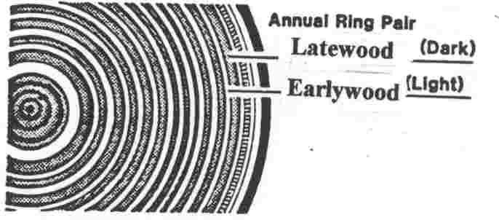
Determining a tree’s age

Slide 6
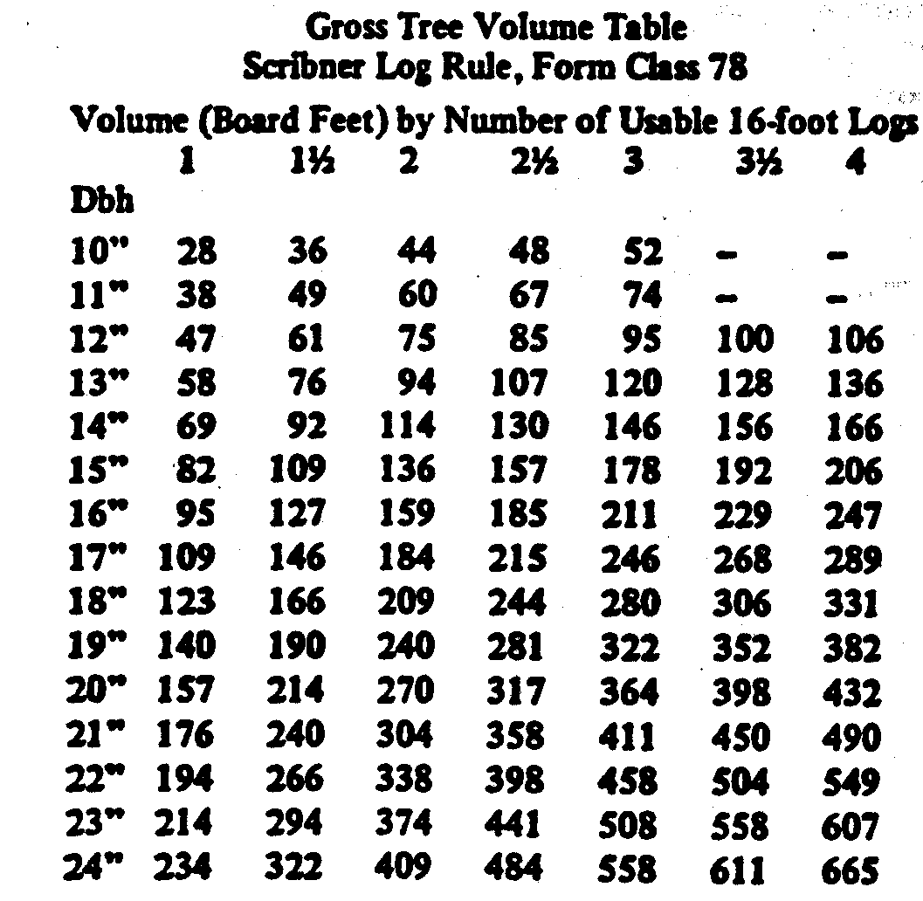
Timber volume determination
Sawtimber – Typically pine trees whose diameter is greater than 9.6 inches.
Q: What is the volume of a tree whose diameter is 16.5 inches and merchantable height is 47 feet?
A: 185 board feet
185

Slide 7
Calculating tree planting needs
Mrs. Donnelly wants to plant 100 acres of Slash pine near Ft Pierce. The forester recommends she plant each seedling on a 6’ x 12’ spacing. How many trees will be needed? (Hint: there are 43,560 sq. ft. per acre)
6’ x 12’ = 72 sq ft per tree
100 acres 43,560 sq ft 1 tree
1 ^{X} acre ^{X} 72 sq ft ^{= 60,500 trees}

Slide 8
FORESTRY
Pacing
1 pace = 2 steps
The standard unit of distance measurement is the chain or Gunter’s chain, which equals 66 feet. How many of your paces are in one chain?
Several forestry tools are calibrated to be accurate from a distance of one chain.
There are 10 sq chains in an acre. Students should be able to pace an area to determine its acreage as in the next example.

Slide 9
Area determination
How many acres are in the polygon? (Hint: there are 10 square chains per acre)
Area of the square (base x height)
10 chains x 9 chains = 90 sq chains
90 sq chains / 10 sq chains per acre = 9.0 acres
Area of the triangle (base x height)/2
(10 chains x 3 chains) / 2 =15 sq chains
15 sq chains / 10 sq chains per acre =1.5 acres
Total area = 9 acres + 1.5 acres = 10.5 acres
12 - 9=3
9 chains
12 chains
10 chains

Slide 10
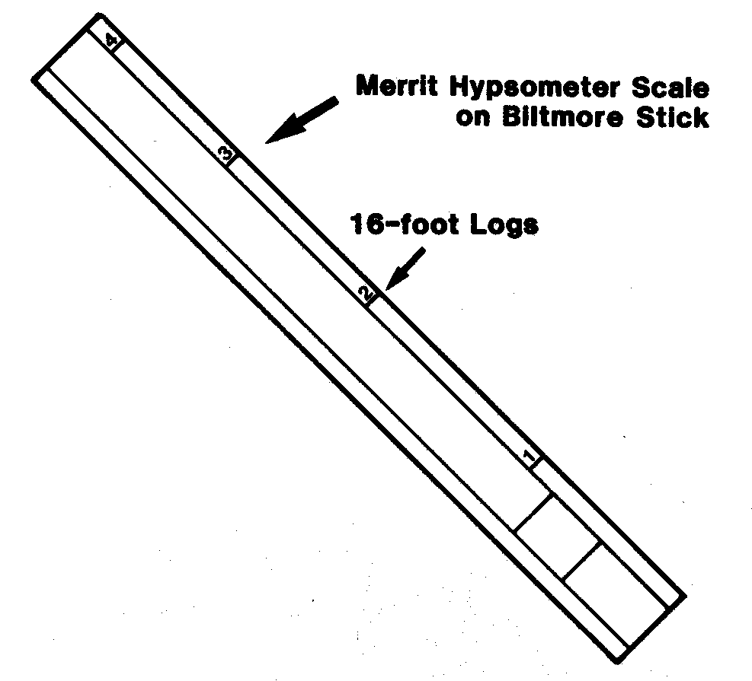
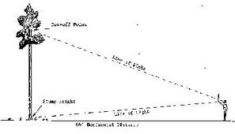
FORESTRY
Biltmore Stick
Used to measure height
Stands 66ft away from the tree
Hold 25’ from eye
Hold the stick straight and keep it still.
Line up the bottom of the stick
With the base of the tree.
Read off the number of 16ft logs with your head still!
Note: Read the question carefully- e.g. are you measuring total height, height to first branch, merchantable height?
Follow instructions regarding rounding errors- e.g. down to nearest ½ log, ¼ log? Do you have to convert to feet??

Slide 11
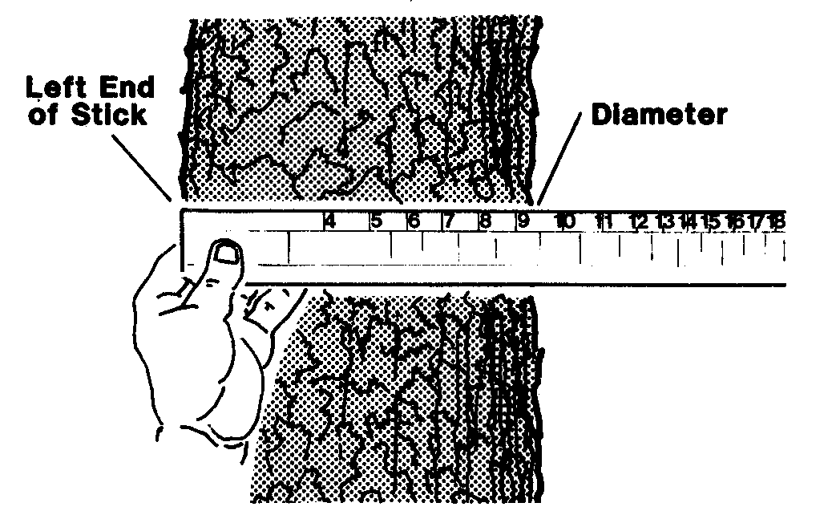
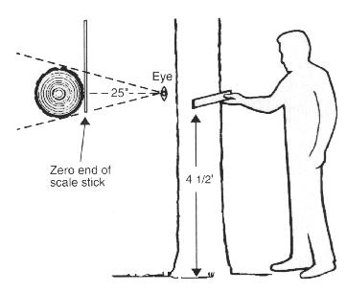
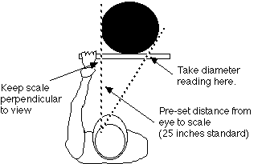
FORESTRY
Biltmore Stick

Slide 12
To measure diameter with a Biltmore stick
The stick is held against the tree trunk at arm's length (about 25 inches from the eye- practice to get it the right distance!).
The stick should be perpendicular to your arm, and should just touch the trunk.
Align the "0" (zero) mark with the edge of the trunk, so it appears they are in line.
Without moving your head, look at the far end of the stick, and note where the other side of the trunk crosses the stick.
Read the measurement directly from the stick.
That's all there is! The key is to practice for accuracy and consistency.
The points to remember are:
Keep the stick perpendicular to your reach.
Hold the stick the right distance from your eye (25 inches is standard, but you can customize your stick)
Do not move your head when reading the far end (this causes a shift in the intersect with the tree trunk)
Accuracy is not guaranteed. Practice helps. The nearest two-inch diameter class is acceptable.

Slide 13
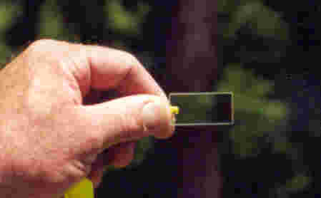
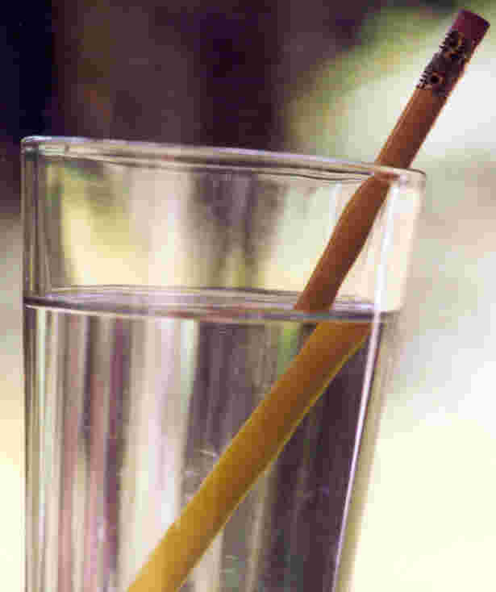
FORESTRY
Basal Area

Slide 14
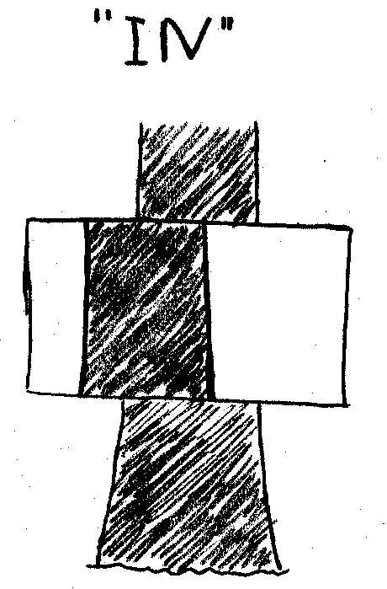
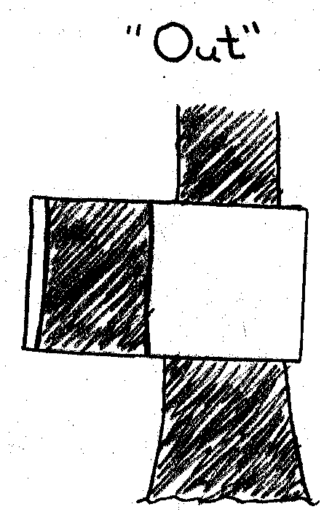
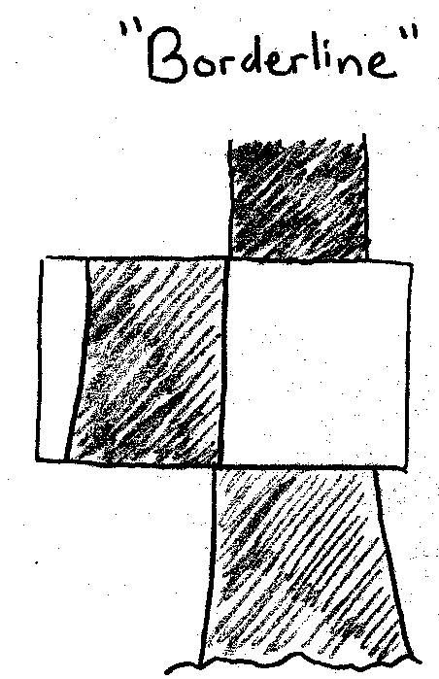
FORESTRY
Basal Area
Foresters view of trees as viewed through a prism
Students should be
able to identify a
tree that is “in”,
“out” or “borderline”.

Slide 15
Good resource to look at!
http://www.sites.ext.vt.edu/virtualforest/
Look at the “Lets cruise” link

Slide 16
Oral question
Oral question:
2013 Current Issue is
“Sustainable Rangeland Management: Achieving a
balance between Traditional Agricultural Uses with Non-Agricultural uses on Montana Rangelands"
The Forestry Oral question will focus on the current issue.
Whilst using the study materials and links for the current issue,
students should keep in mind the role and significance of forested rangelands in managing a multi-use rangeland ecosystem.

