Slide 1
IRL Envirothon 2016
Forestry
There will be 4 section :
- Written
- Poster/Map
- Demonstration
- Oral presentation

Slide 2
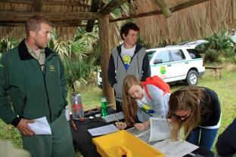
Writen Section
Based on Forestry study material found on IRL envirothon web site (http://www.irlenvirothon.org/resources.html)
there will be questions student will have to answer ( multiple choice / short answer /fill in blank )

Slide 3
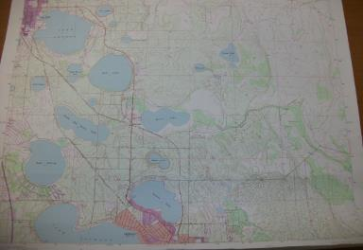
Poster / Map
Competing teams will have to answer questions based on a map interpretation.
Map most likely will be one produced by US geological survey.

Slide 4
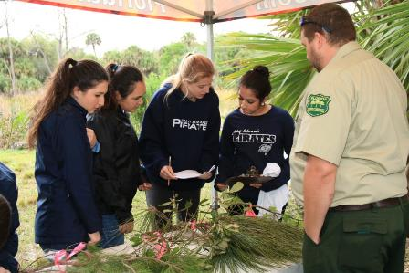
Demonstration
Demonstration section will include some tree measurement, equipment ID or tree ID

Slide 5
Oral Presentation
Each team will be asked to have a short presentation based on a forestry subject .
Each member of team must participate.

