Slide 1
Sharing the Excellence: Challenges, Successes, & Lessons Learned
Connie C. Morrow, MAEd-AET
Training Program Administrator,
DCOE Outreach
Wilford Hall Ambulatory Surgical Center
JB San Antonio--Lackland, Texas
November 30, 2017
Notes:
Thank you for having me speak at this conference. I am honored to be here. I would love to share with you some excellence from the Diabetes Center.

Slide 2

Notes:
Who is in the audience? Educators/teachers, technicians, clinicians? I would challenge you that we’re ALL teachers and we’re ALL learners.
The DCOE Outreach has been helping to bridge the gap a little at a time, course by course, webinar by webinar, and training by training through face to face and virtual platforms.

Slide 3
Sharing the Excellence
through Outreach, Education, and Knowledge
Notes:
Our main goal is sharing the excellence through outreach, education and our collective knowledge.
We have purpose—and so are bridging the gap between small clinics and specialty medicine, and primary care providers and patient outcomes.
We strongly believe in sharing this excellence; but it’s not without it’s challenges.
Here’s a little background on the DCOE.

Slide 4
Background
DoD culture requires educational flexibility and resources in remote locations
Diabetes Center of Excellence
  Bridges gap between remote clinics and specialty medicine
  Fulfills ever-changing need for on-demand training
  Higher accessibility to resources
  Facilitates learning
Notes:
Such a transitory population needs flexible and easily accessible resources for providers, staff and patients.
The DCOE helps to fill the gap by using technology to extend education to physicians, nurses, pharmacists, dieticians, technicians, and also patients, dependents, and family members.

Slide 5
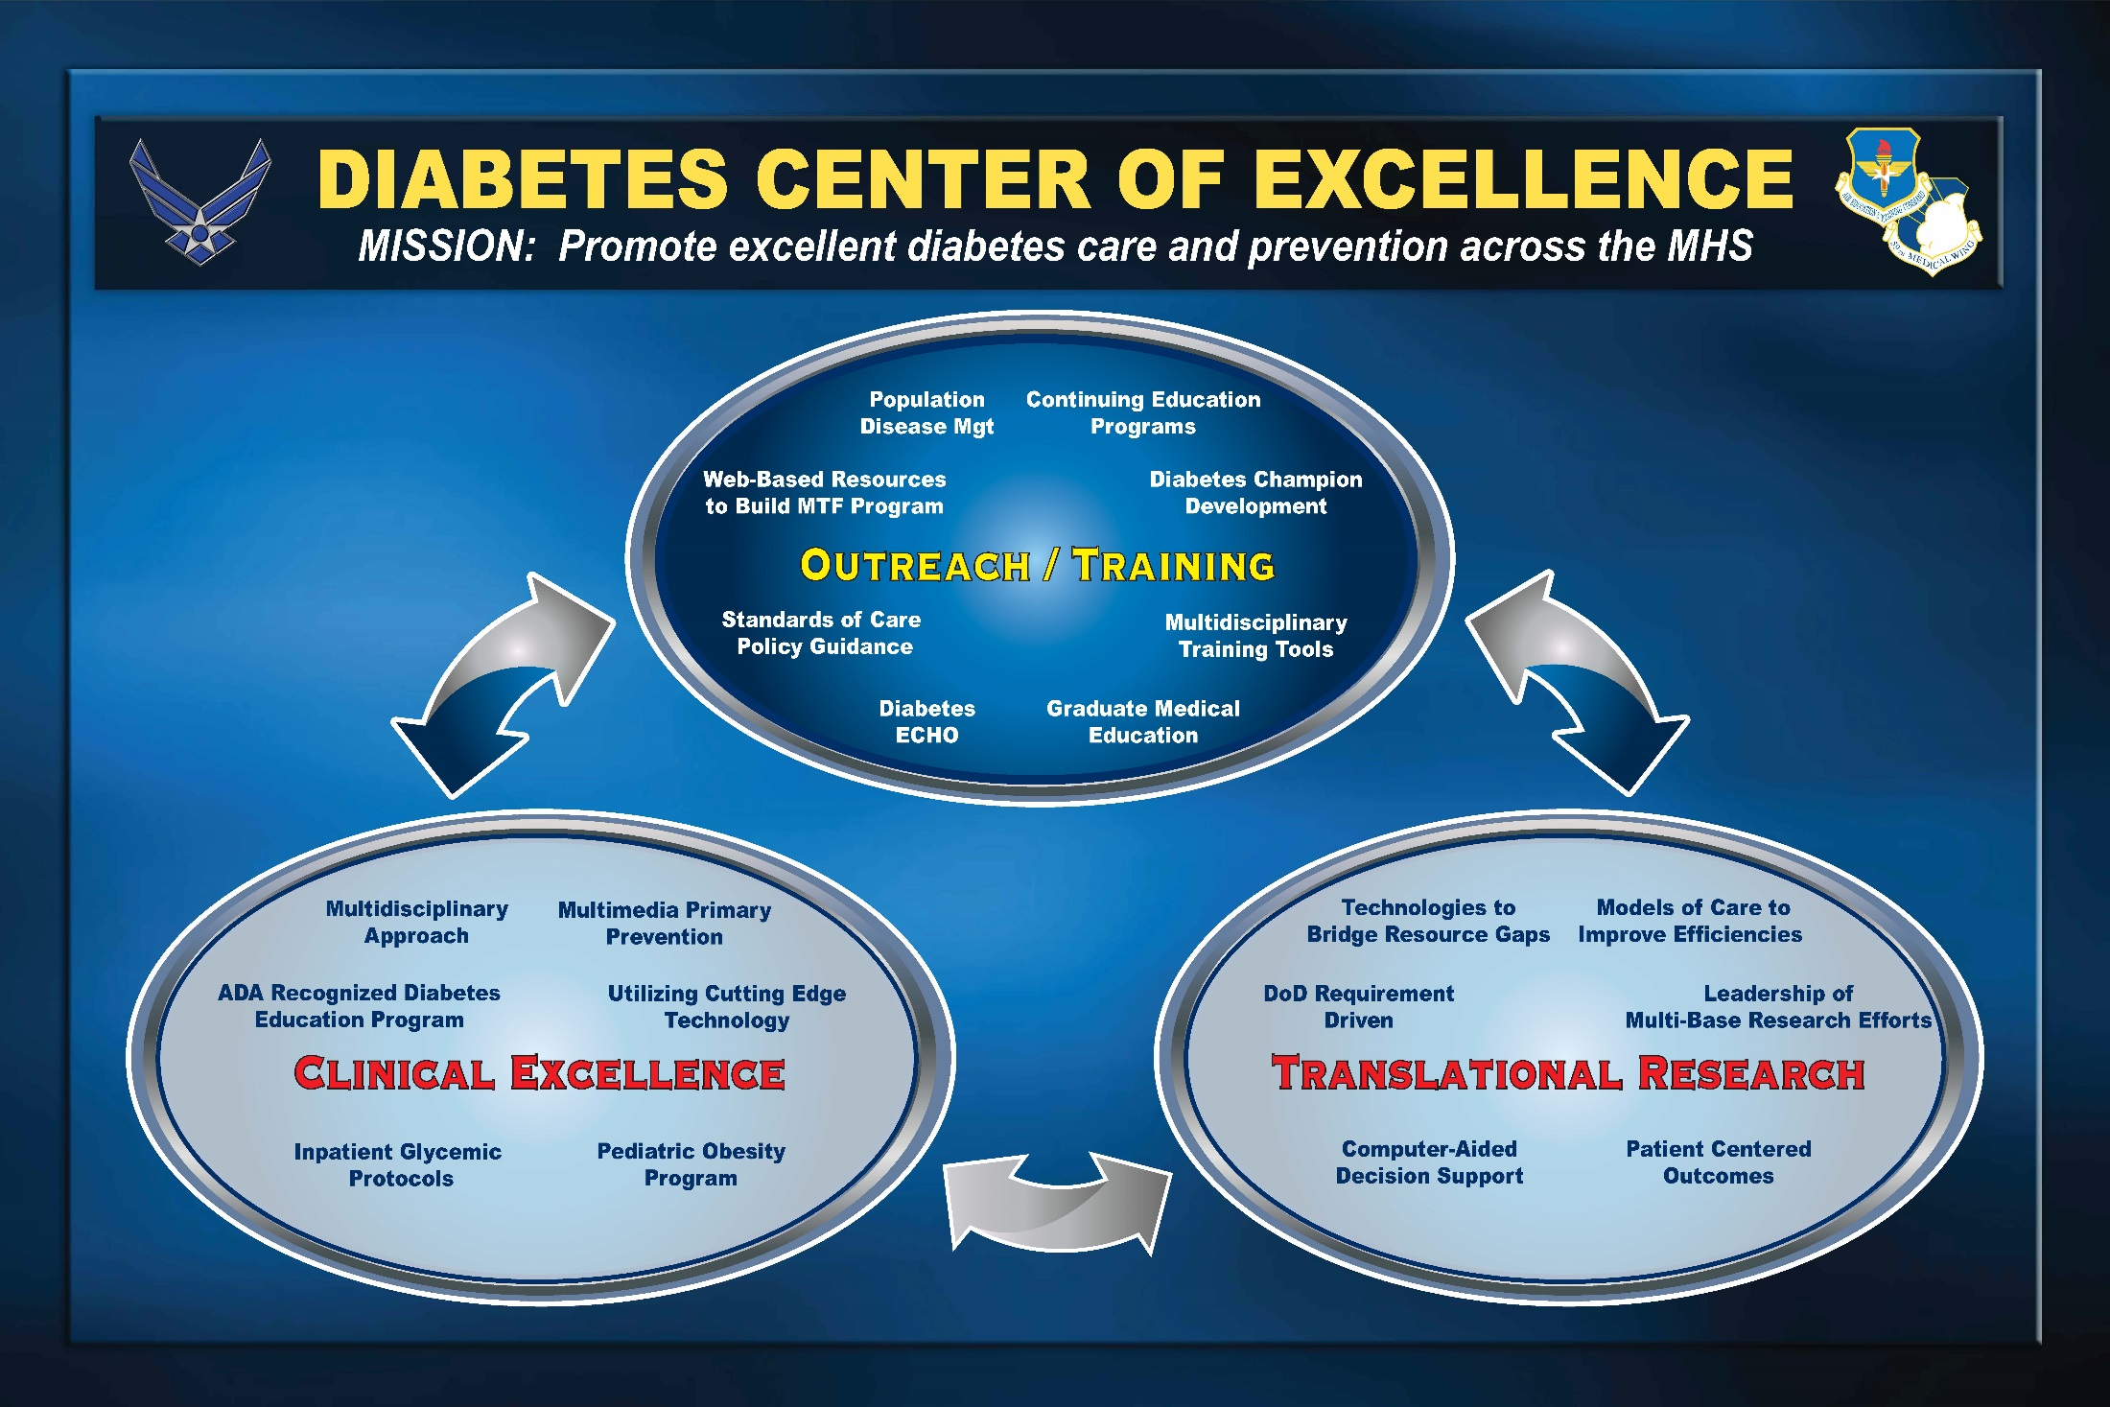
Notes:
This poster displays each segment of our center, yet depicts how each arm division may overlap or interact with the other. Our goal is to promote excellent diabetes care and prevention across the military health system.
How do we do this?

Slide 6
Diabetes Center of Excellence
The Research Team provides translational research and evidence-based studies to support diabetes prevention and management protocols and validation of DCOE projects
The Clinical Team provides cutting edge diabetes prevention, education and management to the any TRICARE beneficiary within the San Antonio medical community
Notes:
Here is a bit more explanation of the three segments/divisions of the DCOE. All pieces of the DCOE work together and constantly strive for excellence in all we do.

Slide 7
DCOE cont’d.
The Outreach Team provides a conduit for promoting best practice through programs
  Diabetes-ECHO/Prevention ECHO
  Diabetes Management Webinars
  Diabetes Champion Course
  Diabetes Central

Slide 8

Notes:
“Our mission is to promote excellent diabetes care and prevention across the Military Health System.”
We admit we’re not perfect, and as a small unit, we depend on each other to collaboratively strive for excellence.
Just how small is our clinic? 15. (2 are Outreach staff, 1 MD, 1 NP, 1 MIST staff, 2 Research staff, 2 RNs, 1 exercise physiologist, 1 Dexa tech, 4 AD (1 RN, 2 admin, 1 tech).

Slide 9
Overview of DCOE’s Outreach
Outreach Education/Training
  Create, develop, implement worldwide diabetes training
    Physicians
    Staff
    Patients
  Core Collaboration with Military Medical Community
    Extending DCOE Expertise and Resources
      Army
      Air Force
      Navy
      Veterans Affairs
  Use of multiple avenues
    In-person
    DCS
    VTC
    MIST
Notes:
The two of us (grown to 3 since July 2017) in Outreach have created, designed, implemented, and maintained significant training and resources for the DoD.
Technology has permitted the DCOE to extend its resources and expertise worldwide, and to all services (including the VA).

Slide 10
Overview, cont’d.
Pertinent Resources and Tools are a MUST
Accessibility is Essential in Providing Staff, Provider, and Patient Education
Successes
Challenges
Lessons Learned
Notes:
Having the right tools and sufficient resources are necessary for providing appropriate education to the audiences we serve.
We have many successes, not without many challenges—but certainly the lessons learned are worth sharing.

Slide 11

Pearls
Everyone can share knowledge
Everyone teaches, everyone learns
Everyone can share excellence (not necessarily perfection)
Notes:
Here’s a few things I would like you to take away from this session and implement in your environment.
We are constantly striving for excellence in our outcomes: product, procedure, and process. In doing so, this has become a journey rather than a destination or an end-point. We believe our goal is fluid and will not have an end-point, as we are life-long learners as well as deliverers/facilitators/educators/teachers…
Let’s look how we do it at the DCOE.

Slide 12
Adult Education Foundational Principles
Adults need to know “why”
  Ensure they know “why”
    Most of them want to learn something new
    They need continuing education
They want to learn in their own way
It has to be the right time for them to learn
  It must apply to their situation
  What’s in it for me?
The environment needs to be positive and encouraging
  Need variety
  Consistent structure
  Knowledge of expectations
Notes:
Why should we care how they learn or if they know why or why not? We can tell them, give them, mandate they have the information, but it will not ensure they have processed it nor learned anything. Malcolm Knowles, (known as the father of education) theorized the adult learner needs to be prepared in order to succeed.
“Interaction and engagement of the adult learner is a primary factor to his or her educational success. The adult learning process is different than a child’s.”

Slide 13

Why, What, & How
Why we do what we do and how we do it
  Teaching Adults
  Teaching Patients
  Teaching Styles
Notes:
Remember those pertinent resource tools being more than necessary and essential? We use technology (primarily Defense Collaboration Services--DCS platform) to deliver training to remote Military Treatment Facilities (MTFs). We want our participants to have a learning “experience” and walk away with significant information to implement in their personal and professional lives.

Slide 14
Learning by Experiencing
Our participants “experience” their learning
  Role Play (dialogue between presenters, “playing” or “enacting” patient and provider)
  Interactive Case Studies
  Games played by Individual Teams Per Base
  Hands on breakout sessions
Notes:
Everyone learns differently, so we incorporate different ways to learn. We specifically use case studies in our ECHO sessions and webinars.
As an example, we utilize all of these variations of learning in our Champion course. Role play helps the participants learn how to interact with their patients by hearing patient/provider dialogue about common issues and concerns.
Specialty physicians/providers share case studies and involve participants (both face-to-face and virtually) to help treat the patient.
Live games, such as Nutrition Jeopardy, engage both the face-to-face and virtual audiences as the facilitator solicits response.
4. Hand-on breakout sessions give a more intimate learning experience in small group fashion. The virtual participants are able to view the facilitator demonstrating equipment and technique through web cameras via webinar.
**Not only are we bridging the knowledge gap on managing diabetes, we are bridging any learning style gap by offering our activities in different learning formats and platforms.

Slide 15



Experiences
Challenges
Successes
Lessons Learned
Diabetes Central
Notes:
The remaining time here will be looking at each of the DCOE’s unique educational offerings: the challenges, successes, and lessons learned regarding online meeting rooms, chat rooms, video teleconference rooms, and blended learning.

Slide 16
ECHO
Description
  Extending Community Healthcare Outcomes (ECHO)
  Virtual Physician Grand Rounds
  Diabetes ECHO—2nd Friday
  Prevention ECHO—4th Friday
Delivery Method
  Initially via Video Teleconferencing Center (VTC)
  Changed to Defense Connect Online (DCO)
    Desktop Virtual Meeting Room
  Currently via Defense Collaborative Services (DCS)
    Desktop Virtual Meeting Room
Data
Notes:
One goal of ECHO is to impart specialized knowledge to providers that may not otherwise have access. These providers may in turn become local experts; also the goal is to improve the lives of provider as well as patients. Participation in ECHO is intended to increase providers’ knowledge and provide access to a network of practitioners, a “community of practice.” .
There is a new bill that was passed (97 to 0 in the Senate) called the ECHO Act (2015-2016) which is looking to make ECHO the telehealth standard (By Dec 2018, data will be collected and reviewed to support it’s transition to law.
https://www.senate.gov/legislative/LIS/roll_call_lists/roll_call_vote_cfm.cfm?congress=114&session=2&vote=00154
https://www.congress.gov/bill/114th-congress/senate-bill/2873
Sec. 3) This bill requires the Department of Health and Human Services (HHS) to report on technology-enabled collaborative learning and capacity building models, which connect specialists to primary care providers through videoconferencing to facilitate case-based learning, dissemination of best practices, and evaluation of outcomes.
The report must include: (1) an analysis of the use, integration, and impact of such models; (2) a list of such models recently funded by HHS; (3) recommendations to reduce barriers to adoption of such models; (4) opportunities for adoption of such models into HHS programs; and (5) recommendations regarding the role of such models in continuing medical education.
[26 Oct 2016] Briefed Health and Human Performance Cell at AFMOS on DCOE outreach mission. Planned expansion of ECHO to include GLB/Prevention component monthly – Feb 2017.
[17 May 2017] Connie Morrow as consulting member to DHA-MSH ECHO Working Group, discussed/advocated the USAF and DCOE role(s) in the DHA “Procedural Instruction” manual. Ongoing discussion on concurrence and determination about demographic data elements, for all ECHO specialty sessions, in all services.

Slide 17
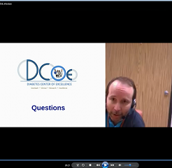
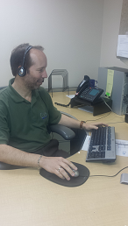
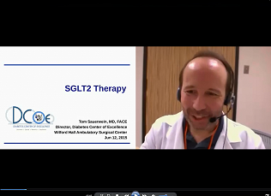
Notes:
This is our Director of the DCOE, Dr. Tom Sauerwein. He is a retired Lt Col for the USAF and facilitates several online sessions.
Let’s look a few pieces of data from our ECHO Survey Monkey Feedback.

Slide 18
Diabetes ECHO
Source: Project ECHO-Diabetes Feedback, Survey Monkey™ (March-October 2017)
Notes:
Out of 118 responses, this chart shows the majority (about 75%) strongly agree the DCS is appropriate for ECHO delivery, and even 21% are just under that at moderately agreeing. Less than 1% were less than satisfied citing technology issues, indicating on the survey that their network was down or in and out at times, or that their computer speakers were not up to standard.

Slide 19
Diabetes ECHO, cont’d.
Source: Project ECHO-Diabetes Feedback, Survey Monkey™ (March-October 2017)
Notes:
While each session covers a different topic (Renal Disease and DM, Behavioral Change, Cardiac Issues and DM), the likelihood of change to their tx practice (out of 118 who responded) is high. Though self-reported, it certainly appears they are learning something in this virtual setting.

Slide 20
Prevention ECHO
Source: Project ECHO-Prevention Feedback, Survey Monkey™ (March-October 2017)
Notes:
Again, with Prevention, the majority (55%) are in agreement that the delivery method seems appropriate for ECHO. The few (17%) in the slightly agree category down to less than 1% who strongly disagree indicated connectivity was poor on their end.

Slide 21
Prevention ECHO, cont’d.
Source: Project ECHO-Prevention Feedback, Survey Monkey™ (March-October 2017)
Notes:
These sessions indicate the majority of these participants agree to make changes to help prevent diabetes. Some of these topics include Flexibility and Aging, Motivational Interviewing for Obesity, Setting up a GLB program.

Slide 22
Diabetes Management Webinar
Description
  Launched in Nov 2013
  30-minute didactic on current diabetes-related topics
  Focused on primary care nurses/staff (Certified Diabetes Educators, disease managers)
Delivery Method
  Initially DCO
  Currently DCS
  Desktop Virtual Meeting Room
Data
Notes:
This webinar was the result of a needs analysis sent out to the USAF disease managers in the Summer of 2013. These are 30 minute briefs offered at 0900 Central Time, permitting many a larger number to attend and offers a half credit of continuing nursing education.

Slide 23
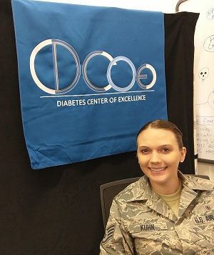
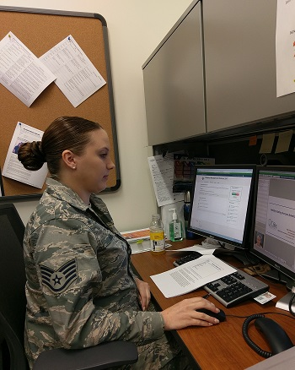
DM Webinar, cont’d.
Notes:
Nov 16, 2017—SSgt Brittany Kuhn, Diet Tech, in seen here in our new office delivering a webinar on Healthy Holiday Eating Across America.

Slide 24
DM Webinar, cont’d.
  260 Participants
  45-50 Average Monthly Participants
  Audience—Nurses, Pharmacists, Dietitians, Physicians, Administrative Staff
Notes:
We have 260 registered participants since these webinars began in the Fall of 2013. We have consistently averaged 45-50 every session.

Slide 25
Diabetes Champion Course (DCC)
Description
  Extension of diabetes training to remote MTFs
  Launched in Oct 2012
  Offered twice per year
Delivery Method
  In-residence
  Video Teleconference (VTC)
  Defense Collaboration Services (DCS)
Data
Notes:
This course is offered twice per year and is three days in length. We prefer it be attended in person, but with decreased funding of education and training for some MTFs, we’ve expanded our audience by allowing attendance via VTC and DCS. There were learners from all three branches of service and several were from as far away as England. In addition, the DCOE began a collaborative effort with the Navy and Marine Corps Public Health to promote standardized comprehensive diabetes self-management education through Diabetes Central on the Air Force Knowledge Exchange.
-DM Champion Course 9-11 September 2015. 96 learners/26 MTFs. All three branches.

Slide 26
DCC, cont’d.
Oct 2012—First Diabetes Champion Course
  18 Attendees
  In-residence
  2 MTFs
Sept 2016—Largest Diabetes Champion Course
  104 learners
    57 In-residence
    28 DCS
    19 VTC
  36 MTFs
Notes:
Our first course in the Fall of 2012 was only in-person. As we then grew in attendance, we expanded to VTC. This was definitely not without its challenges. In order to participate via VTC, the distance group would need to certify their VTC room way in advance with USAMITC. Their equipment would need to be up to date. What we found with several courses was an increasingly difficult challenge to achieve this which resulted in frustrated parties on both ends. Several backing out because they could not come in person and failed to get registered/certified on time and even when they did, found their equipment to be out of date. This led to us trying to incorporate the DCS via VTC via the in-person course. Did I tell you that there were only two of us orchestrating this?....
By September 2016, we had grown from only 18, to 104 learners! In the past two courses, we have just gone to in-person with an optional DCS platform for those who are denied TDY funding.

Slide 27
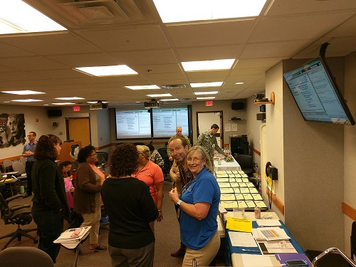
September 2017
Notes:
Sept 2017—We were between old and new buildings: smaller audience due to DCS network issues (no VTC participants).
55 total
39 in person
16 DCS
20 MTFs
Diabetes Champion Course VTC classroom delivered via DCS to online participants
No other VTC attendees were represented here in this course.

Slide 28
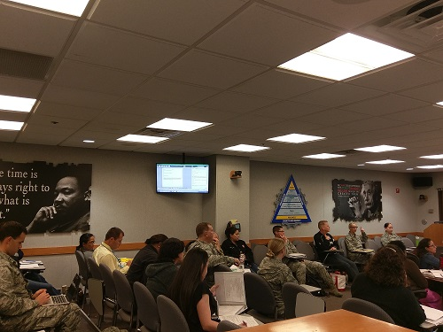
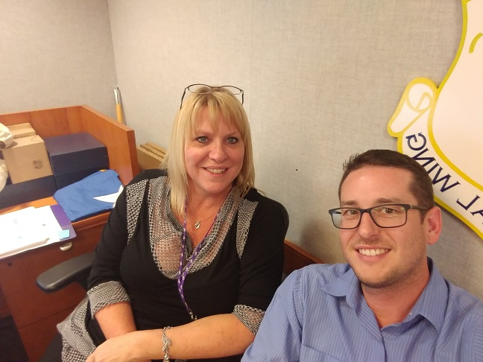
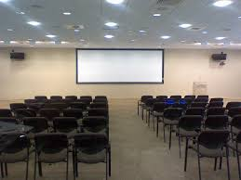
Video Teleconference Center (VTC)
Notes:
At the helm—our exercise physiologist, Austin Hoover, and Outreach Training Program Administrator, Connie Morrow
Dec 2017:
The new WHASC has 10 VTC rooms. We will be utilizing the larger ones to host our Diabetes Champion Course in April.

Slide 29

DCS GLB Master Trainer
Description—Specialty certification training in becoming a facilitator of a Group Lifestyle Balance (GLB) Program in a military treatment facility
Delivery Method:
  In-residence
  Defense Collaboration Services (DCS)
Comments from Participants:
  “Love the chat box where I can get immediate feedback.”
  “The format of the training provided an easy learning environment.”
  “This [training] allows me to help patients live longer, healthier lives.”
Source: After Action Report, Continuing Nursing Education—Air Force Nursing Services, May 3, 2017. https://education.mods.army.mil/AFNCNE/Default.aspx
Notes:
Also offered via the DCS is our Group Lifestyle Balance Master Trainer course. Initially, the DCOE offered this training as only in-person; but with funding for travel often denied, we are able to offer it at least twice per year up to four times per year. This permits specialty nurses to attend virtually and become GLB Trainers at their MTF/base, where they would otherwise not get the training.
There have been five GLB Master Trainer courses conducted; the initial course was in-residence only, then a virtual option was added to the next, and the last three have all been virtual.

Slide 30
Diabetes Central
https://kx.afms.mil/kj/kx4/DiabetesCentral/Pages/home.aspx
AFMS Knowledge Exchange
  Medical resource database
  Diabetes Central: Repository of all things diabetes
    Centralized Resource
    Hundreds of tools and links
    Addresses multiple levels of professional practice
  2016 October - 2017 October: 16,000+ hits
Notes:
Not to dismiss our medical resource database: Diabetes Central on the Knowledge Exchange (a multi-medical resource for providers and clinicians) as less important. This diabetes repository is a virtual jewel on its own.

Slide 31
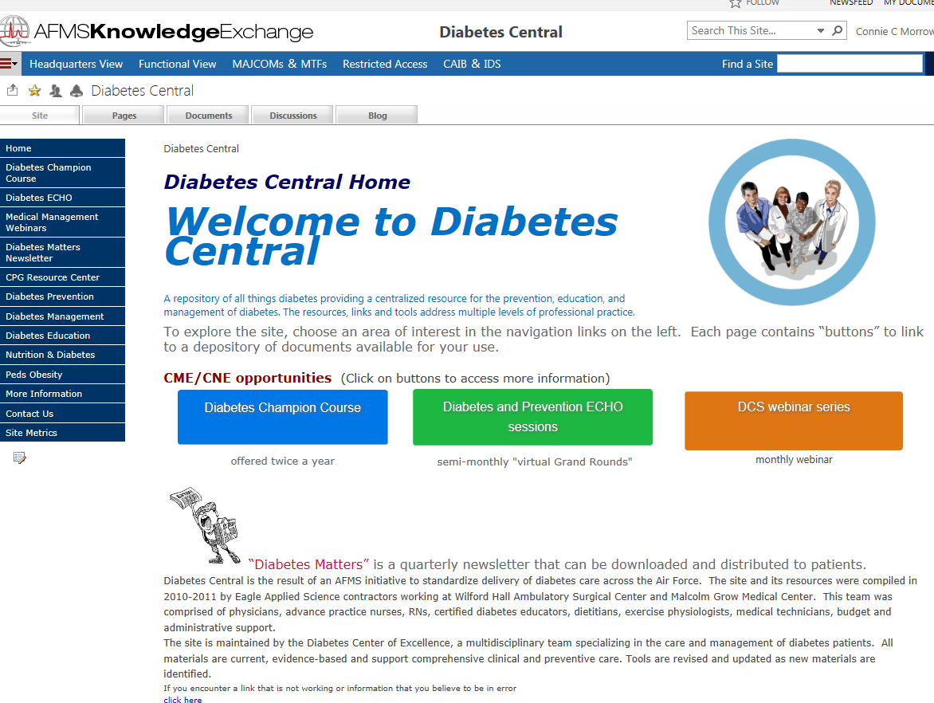
Notes:
Here’s a screenshot of the home page. There are literally hundreds of documents and resources here, including some of the previous years’ recorded ECHO and DM webinar sessions.

Slide 32
MIST
Description
  Medical Interagency Satellite Training (MIST)
  Studio-based
  Two-way audio/one-way video
Delivery Method
  VTC rooms used currently
Extension of Diabetes Self-Management Education/Support (DSMES) services for patients
Notes:
Next we come to our MIST room. I originally spoke with Alex Autry about using MIST for our ECHO sessions, but determined it was a better fit for patient education. We were approved for a broadcast suite in March of 2016.
Jan 2016:
[5 Jan] – First VTC DSME class at Randolph, pre-MIST broadcasting
[16 Jan 2017] MIST studio installed
Currently in new Wilford Hall bldg awaiting final connections/wiring.

Slide 33
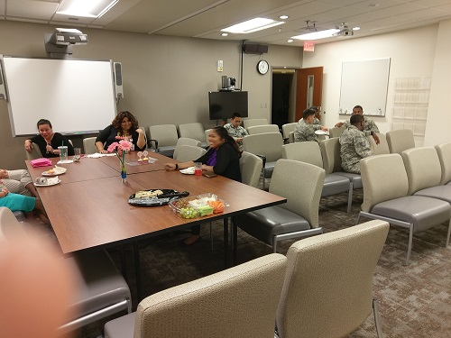
MIST (Medical Interagency Satellite Training)
Notes:
Jana Wardian, PhD., DCOE Research Administrator, [13 Oct 2017] submitted a pre-proposal for a grant which was approved and will hopefully be funded the first of February 2018. The Wilford Hall Science and Technology department will fund a DSME study, and expand that program via the telemedicine model throughout the DoD.

Slide 34
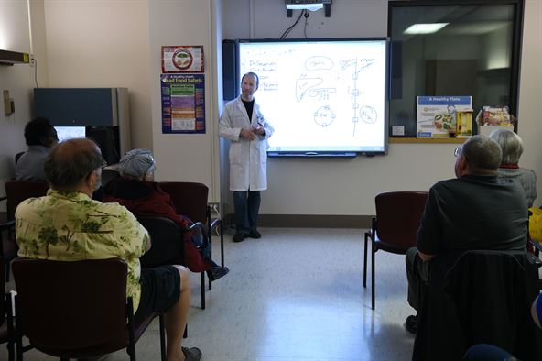
Diabetes Self-Management Education
http://www.airforcemedicine.af.mil/MTF/Randolph/News-Events/Article/1051495/wing-pioneers-innovative-diabetes-education-program/
59TH MEDICAL WING NEWS
Wing pioneers innovative diabetes education program
By Staff Sgt. Kevin Iinuma, 59th Medical Wing Public Affairs / Published January 17, 2017
Dr. Tom Sauerwein, director of the 59th Medical Wing’s Diabetes Center of Excellence, teaches patients to self-manage diabetes during a classroom session at the Wilford Hall Ambulatory Surgical Center, Joint Base San Antonio-Lackland, Texas. The DCOE is a premier Air Force Medical Service specialty clinic dedicated to providing standardized diabetes care to beneficiaries across the military health care system. The clinical component provides diabetes management, diabetes education, and diabetes prevention programs through referral care to more than 50,000 TRICARE beneficiaries. (U.S. Air Force photo/Staff Sgt. Jason Huddleston)
Notes:
This article was published this past January, stating the DCOE a premier AF specialty clinic dedicated to providing standardized care. This picture shows Dr. Sauerwein during one of the lectures on self-management to a group of patients with diabetes. We now use MIST for DSME and soon to be expanding it DoD-wide. In the near future, GLB classes will be available for pre-diabetes patients.

Slide 35
Future
Description—Group Lifestyle Balance is for pre-diabetes patients
Offered in-person
Future for patient delivery through MIST

Slide 36
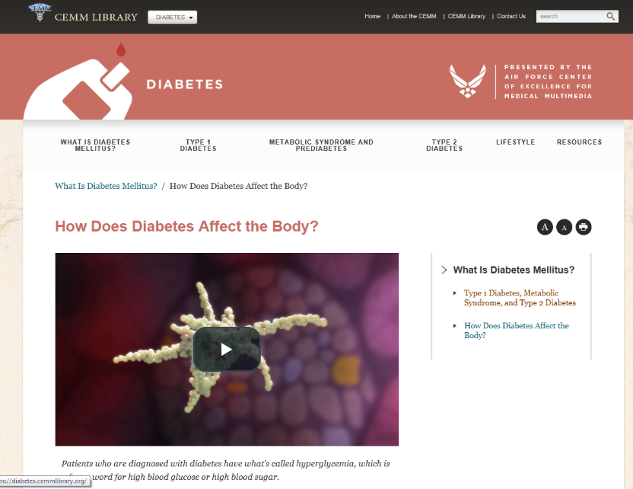
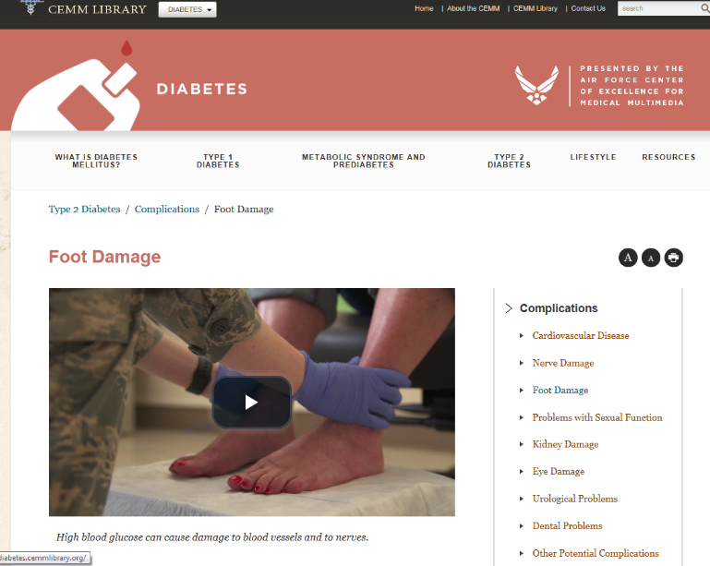
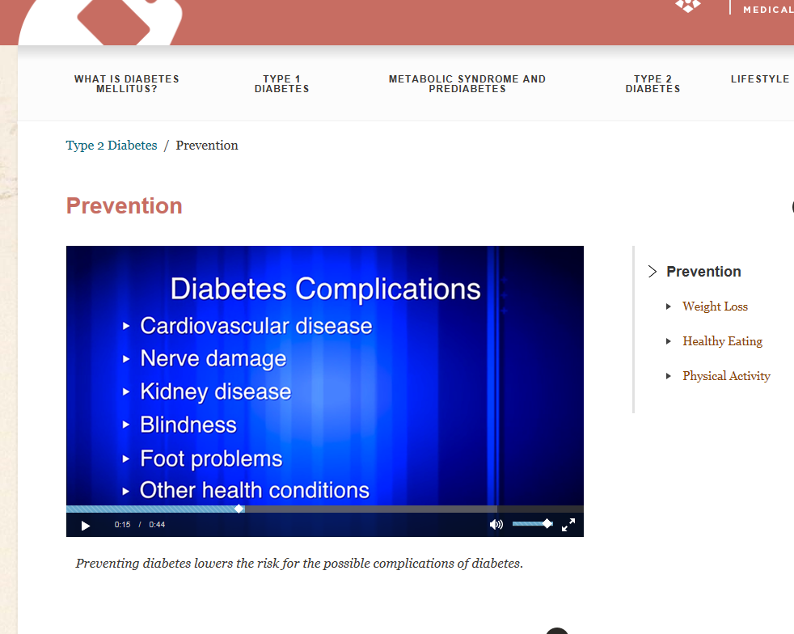
Center of Excellence in Medical Multimedia (CEMM)
https://diabetes.cemmlibrary.org/
Notes:
The DCOE continues to be a resource, itself, through another virtual collaborative arm: the CEMM (The Center of Excellence for Medical Multimedia). The CEMM is an incredible Air Force resource that provides educational tools which can positively impact and empower both patients and providers and, ultimately, improve patient outcomes. Just this past Spring, the DCOE participated in development and production of diabetes related videos for the Air Force Center of Excellence in Medical Multimedia.
[30 Sep 2016] Updated 1st draft of CEMM’s 100 page comprehensive Diabetes Mellitus Video
[30 Jan-2 Feb 2017] CEMM filming at DCOE

Slide 37
Sharing Our Knowledge
PUBLICATIONS
  Cobb, E., Watson, N., Wardian, J., Morrow, C., & Sauerwein, T. (2017). Glucagon kits: Are your patients prepared for a hypoglycemic emergency?. AADE in Practice, 5(1), 12-17.
  Sauerwein, T. J., & True, M. W. (2016). The Diabetes Center of Excellence: A model to emulate. Military medicine, 181(5), 407.
  Swigert, T. J., True, M. W., Sauerwein, T. J., & Dai, H. (2014). US air force telehealth initiative to assist primary care providers in the management of diabetes. Clinical Diabetes, 32(2), 78-80.
Notes:
Just a few other ways we are sharing our knowledge (publications).

Slide 38
Sharing Our Knowledge, cont’d.
POSTERS
  Carlsen, D. R., True, M. W., & Morrow, C. C. (2014, June). The Diabetes Champion Course: A novel outreach program with global impact. In Diabetes (Vol. 63, pp. A311-A311). Alexandria, VA, USA: American Diabetes Association.
  Davis, R., Sauerwein, T., Morrow, C., Watson, N., & True, M. (2015, June). Air Force Diabetes Center of Excellence Project ECHO: Successful Telemedicine with a Global Reach. In Diabetes (Vol. 64, pp. A197-A197). Alexandria, VA, USA: American Diabetes Association.
  Beckman, D., True, M., Wardian, J., Watson, N., Morrow, C., Sauerwein, T. (2016, May). Building Diabetes Champions in primary care: The Air Force experience. SURF Symposium, San Antonio, TX.
Notes:
Posters, too many to list here, but some I pulled that specifically deal with technology and virtual success.

Slide 39
Sharing Our Knowledge, cont’d.
PRESENTATIONS
  [20 May 2016] SURF (SAMHS Universities Research Forum) Conference. Using Technology to Provide Specialty Consultation, Current Clinical Practice Guideline (CPG) Education, and Resource Tools to Primary Care Clinics [Connie Morrow] – presentation
  [20 May 2016] SURF (SAMHS Universities Research Forum) Conference. Challenges and Successes in Providing Diabetes Self-Management Education via Telehealth [Nina Watson, Doris Acuna] – presentation
  [6 August 2016] Diabetes Self-Management Education via Telemedicine in the Air Force. American Association of Diabetes Annual Conference (AADE16) [Nina Watson, Ellen Cobb, Doris Acuna] – presentation
Notes:
And a few presentations on DCOE telehealth involvement.

Slide 40
Summary
Successes
  Increases in participant satisfaction
  Greater number of participants in each course
  Further educational reach—globally, DoD-wide
Challenges
  Dropped calls and video sessions
  Difficulty signing in due to network
  Functionality decreased
Lessons Learned
  Make the best of it
  Which platform is best for which activity?
Future Plans
  Increased patient education via MIST (more MTFs, GLB classes)
  Continue to research better delivery platforms
Notes:
The DCOE has had great success with using technology to extend training to the Department of Defense. We’ve used what was available in addition to searching for and implementing new platforms. Throughout this presentation you have seen many of our successes.
Some challenges occur with each method of delivery; and of course, being able to attend in person has its funding issues. VTC as a primary platform when we started the ECHO sessions showed that many bases did not certify or register their VTC classroom with DISA and so would be unable to join the session. Additionally, they would not have updated equipment would ensue another issue. You can imagine how frustrating this was on both ends.
With the implementation of DCO, many were dissatisfied due to dropped calls and connections or just not being familiar with the online meeting room and its function. Once we managed and overcame the DCO obstacle, were told DISA was discontinuing it in June 2015, and would be replaced with DCS (a less efficient product with fewer functions).
Lessons learned: Make the best with what you have. DCS has been our primary platform for the past two years, interwoven with VTC and in-person blended sessions. With VTC, we have learned to use it as a last resort for specific courses or webinars, and only as a conduit for the new MIST-delivered classes.
We just recently came across “ZOOM” at the Project ECHO conference, but found it was not compatible with the security levels we need to maintain within the DoD. Looks like a great product, though. I’ve listed a link if you want to research.

Slide 41
Technology Virtual Handouts
ZOOM Video Conferencing and Web Conferencing Service
  https://zoom.us/
DCS: Defense Collaboration Services (via Defense Information Systems Agency—DISA)
  https://www.disa.mil/enterprise-services/applications/defense-collaboration-services
DCO: Defense Connect Online
  http://www.adobe.com/government/dco/pdfs/dco_quick_ref_guide.pdf
MIST: Medical Interagency Satellite Training
  https://detn.govdl.org/docs/Mist_brochure1.pdf
“The views expressed are those of the {author(s)] [presenter(s)] and do not reflect the official views or policy of the Department of Defense or its Components.”
Notes:
DCS—open source platform, free or minimum fee to keep up site maintenance, permits recording, but unable to access videos easily
DCO—proprietary software—must purchase licenses to access, allows you to file-share, record, playback
MIST—Satellite technology, must have equipment at both primary and distance locations (studio is not optional for primary broadcasting)
Zoom—basic is minimal fee, but has several packages in which to upgrade

Slide 42
References
Dadich, K. A. (1997). Hospital nursing: practical tips for patient teaching. Nursing2016, 27(8), 32hn20.
Defense Collaboration Services (DCS) Online Tool. Http://www.defense.gov/News-Article-View/Article/604059
https://echo.unm.edu/
https://kx2.afms.mil/kj/kx4/diabetescentral
http://www.adobe.com/government/dco/pdfs/dco_quick_ref_guide.pdf
http://www.airforcemedicine.af.mil/MTF/Randolph/News-Events/Article/1051495/wing-pioneers-innovative-diabetes-education-program/
https://www.congress.gov/bill/114th-congress/senate-bill/2873
http://www.diabetesprevention.pitt.edu/index.php/for-the-public/
https://www.senate.gov/legislative/LIS/roll_call_lists/roll_call_vote_cfm.cfm?congress=114&session=2&vote=00154
http://www.wpafb.af.mil/News/Article-Display/Article/818720/wing-debuts-new-long-distance-learning-opportunity/
Peterson, D. (5). 5 Principles for the Teacher of Adults. Teaching adult learners, About. com Guide.
Video teleconference. (n.d.) McGraw-Hill Dictionary of Scientific & Technical Terms, 6E. (2003). Retrieved from http://encyclopedia2.thefreedictionary.com/Video+teleconference

Slide 43
Outreach Contact Information
  Connie C. Morrow, MAEd-AET, CRT
    Training Program Administrator
    connie.c.morrow.ctr@mail.mil 210-292-4414
  Nina Watson, MSN, RN, CDE
    Training Programs/CDE
    nina.a.watson.ctr@mail.mil 210-292-0307
  David Beavers, MA-CIS, MA-HR, BSN, RN
    MIST Programs
    david.a.beavers.ctr@mail.mil 210-292-6920

Slide 44
Questions
Notes:
Through multiple sharing of ideas, we also created our own DCOE logo. Very proud of the excellence in which we strive.

