Slide 1
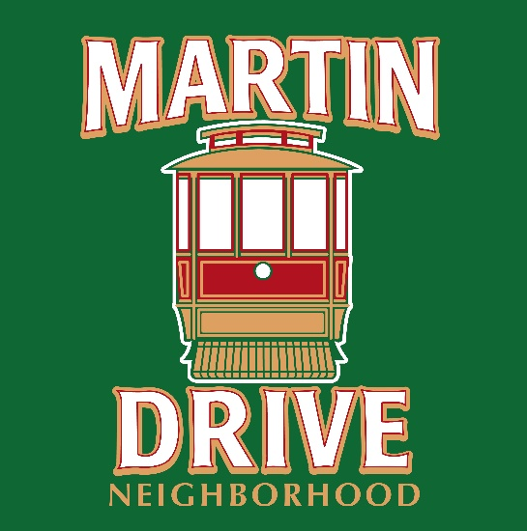
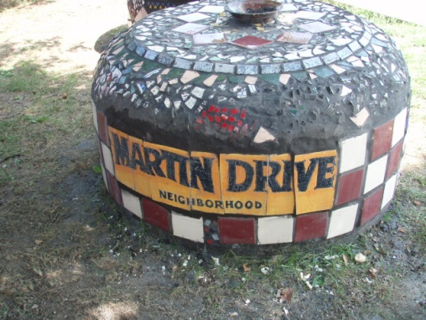
The Martin Drive Neighborhood
www.martin-drive.org
Milwaukee’s best kept secret!
The Martin Drive Neighborhood is a small, ​safe and affordable neighborhood on the west side of Milwaukee, fortuitously ​located between beautiful Washington Park to the north and historic Miller ​Valley to the south.

Slide 2
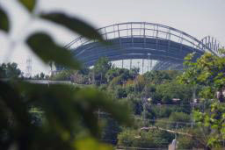
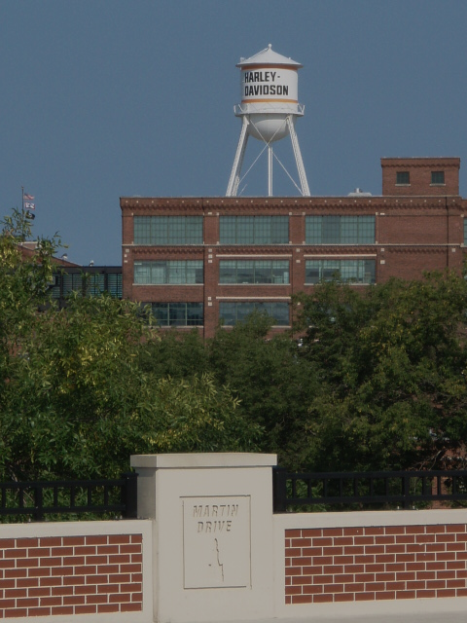
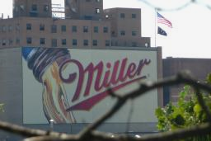
Great Location
Very accessible and centrally located
Minutes from downtown and Miller Park
Easy access to Hwy 41 and public transportation
Walk to Washington Park – beautiful Ohlmsted Park with a playground, walking trails, a pool, library, senior center and the Urban Ecology Center
Walk / bike to Wick Field, Oak Leaf Trail / Hank Aaron Trail
Near many cafes, restaurants and a number of unique shops
Great corporate neighbors – Harley Davidson, Miller Brewing Company

Slide 3
Why should you buy or rent in the Martin Drive Neighborhood?
Quality housing & neighborhood - beautiful and stylish!
Exceptional value
Active and caring Neighborhood Association
Extremely safe neighborhood with low crime cate
Accepting and Diverse residents
Neighbors know and watch out for each other
Great sense of pride in our neighborhood

Slide 4
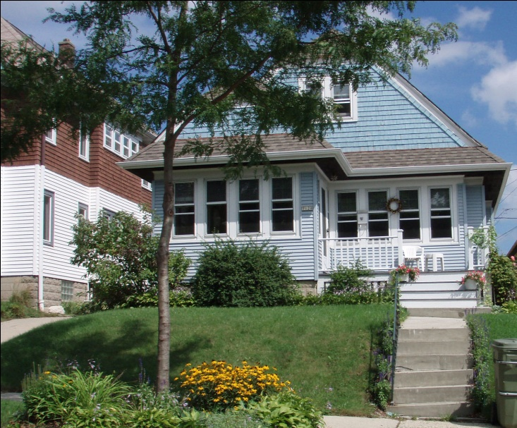
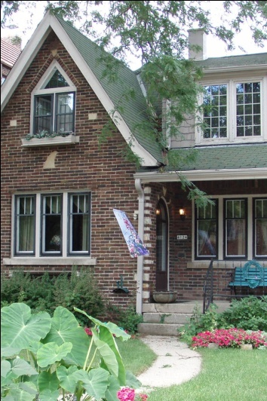
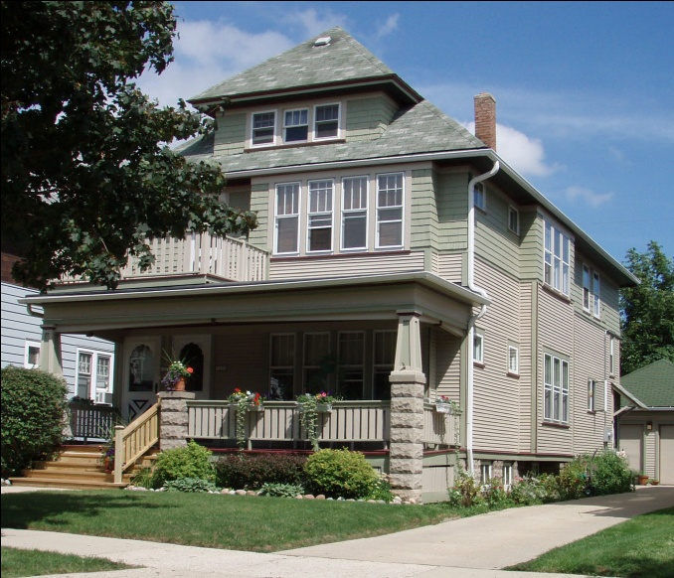
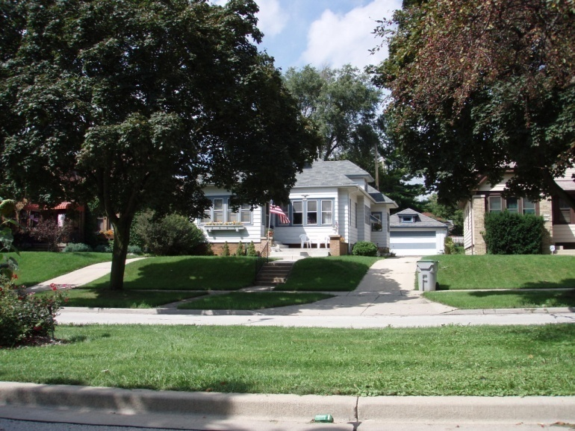
Quality Housing & Neighborhood Exceptional Value

Slide 5
The Martin Drive Neighborhood Association
Mission: Martin Drive Neighborhood Association, through programs and projects, will embrace and foster a sense of belonging and common purpose, resulting in a neighborhood that is beautiful, diverse, secure, and fun for everyone!
Neighbors coming together to support the future of the neighborhood and our neighbors.
Active, meeting monthly for 20+ years
Experience working with our community partners to keep the neighborhood thriving and vibrant

Slide 6
The Martin Drive Neighborhood Association
Monthly meetings -- everyone is welcome
Website, Facebook and newsletters to keep in touch with current happenings
Responsive Alderman and other elected officials
Organized and safe activities for kids and adults – i.e. Halloween Night Time Trick and Treating
Proactively address neighborhood problems and celebrate accomplishments

Slide 7
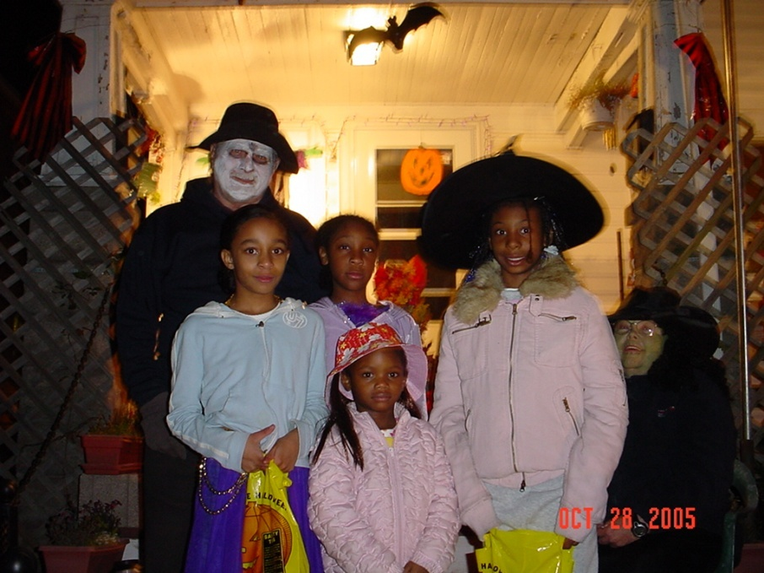
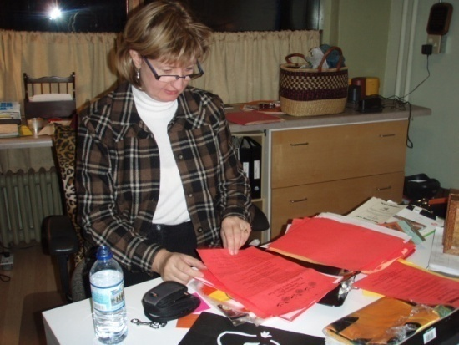
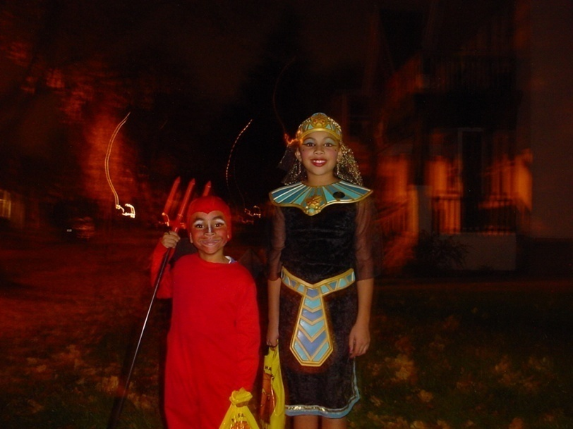
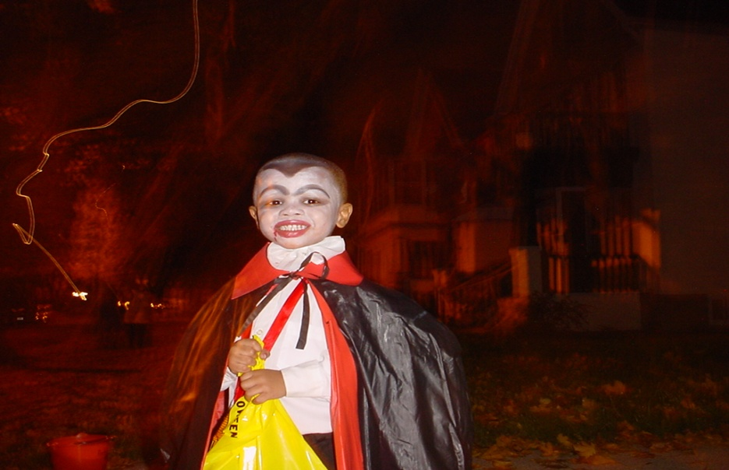
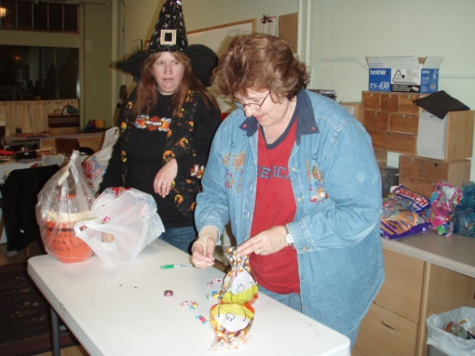
Night Time Trick or Treat

Slide 8
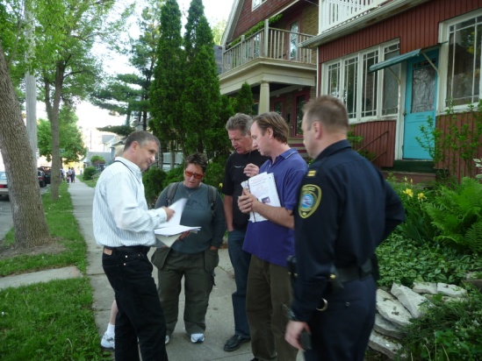
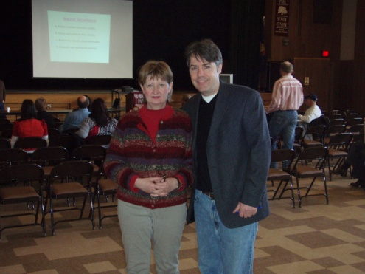
The Martin Drive Neighborhood is extremely safe
Neighbors are serious about safety
Active in blockwatch and MPD District Block Watch
Residents enjoy a very low crime rate
No alleys in the neighborhood make it safer
The Martin Drive Neighborhood has experience in partnering with the Police Department, Alderman Murphy, Harley Davidson and other community partners to ensure a voice and solve our issues
“I am happy you have been so successful in your efforts at turning the block around. It has become a near showcase (perhaps case study) of an example of what can be done with the power of residents.”
James C. Harpole, Assistant Chief of Police

Slide 9
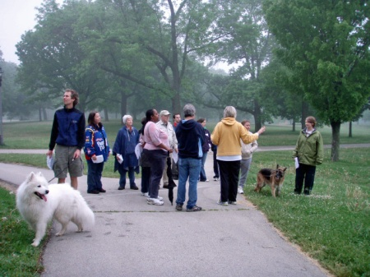
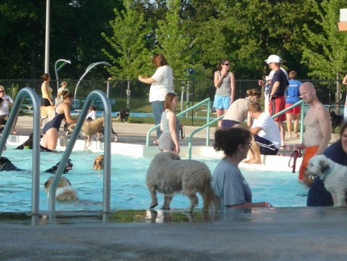
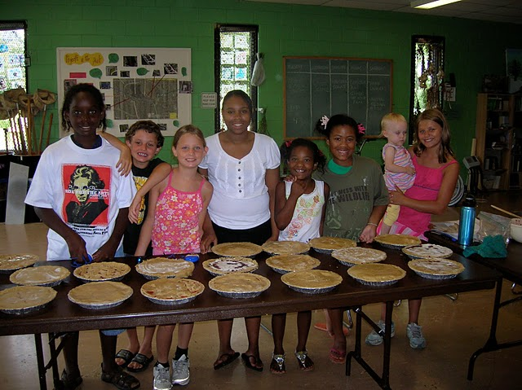
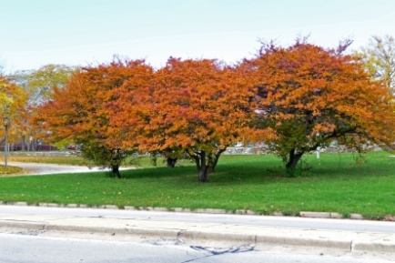
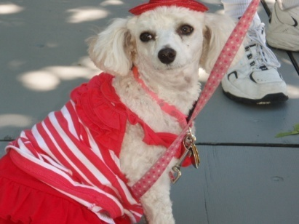
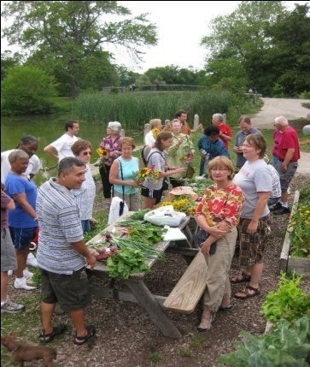
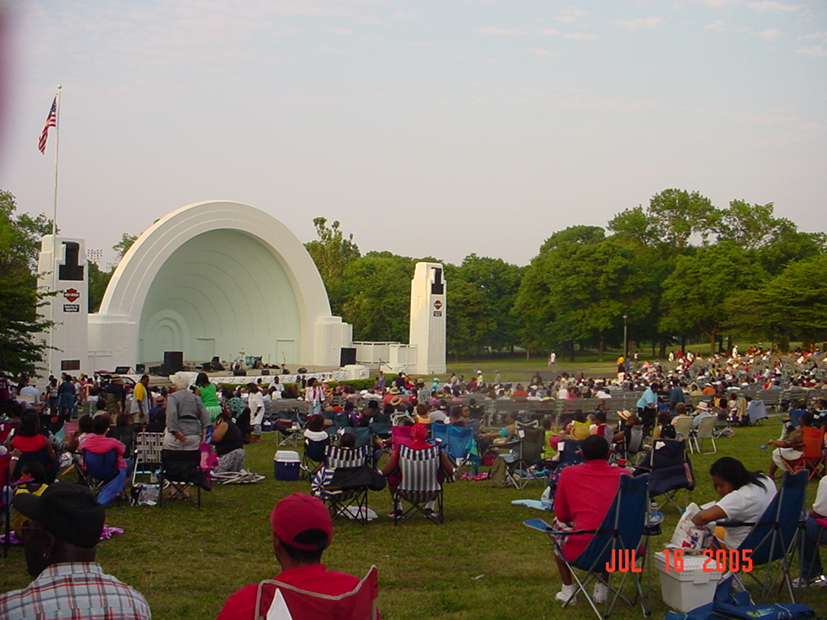
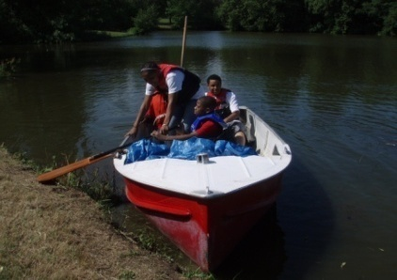
Walk to Washington Park
Beautiful Olmsted Park with a playground, walking trails, a pool, basketball courts, paddle boat rides & beautiful lagoons
New home of the Urban Ecology Center at Washington Park
Band Shell features free outdoor summer concerts including blues, jazz and the Symphony

Slide 10
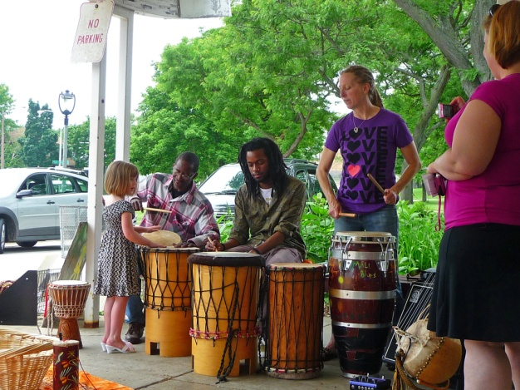
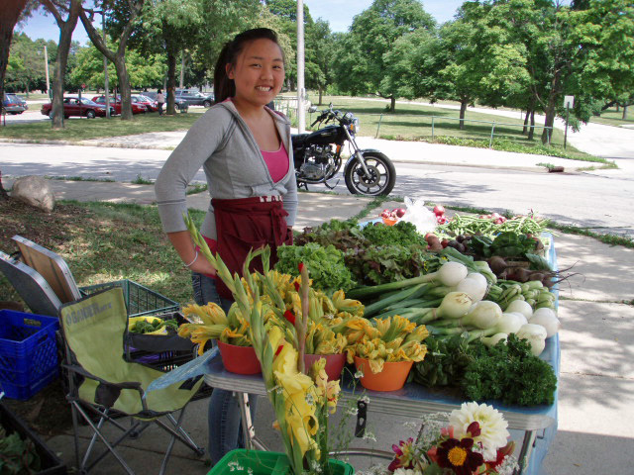
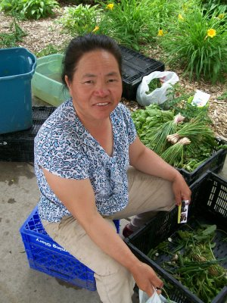
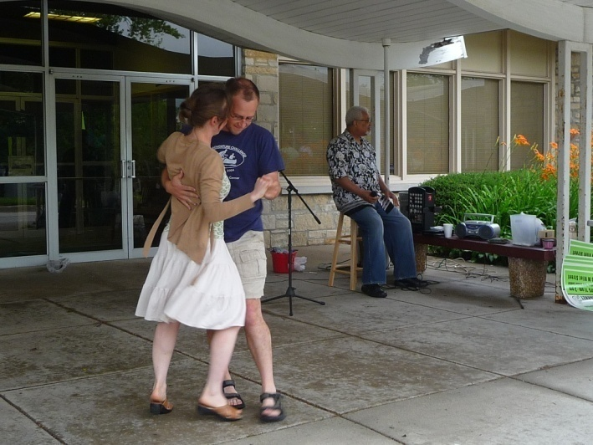
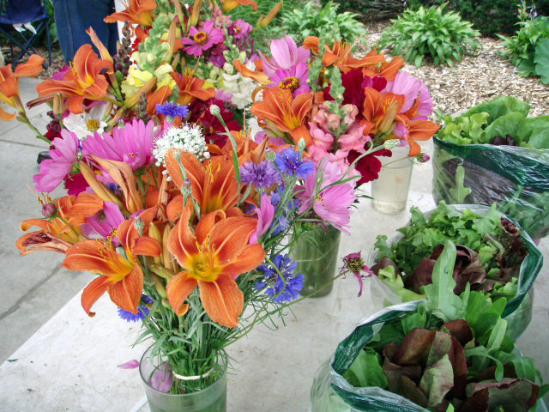
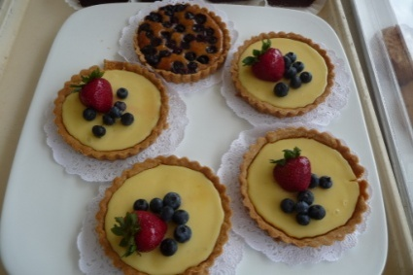
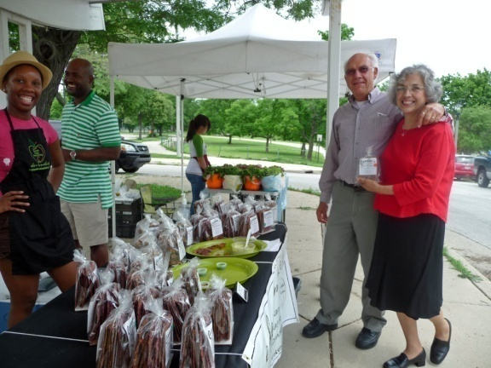
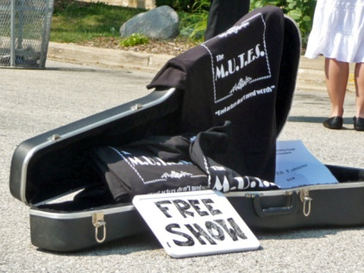
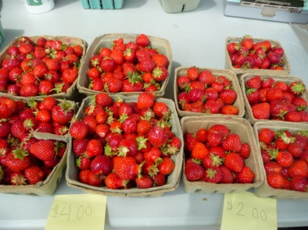
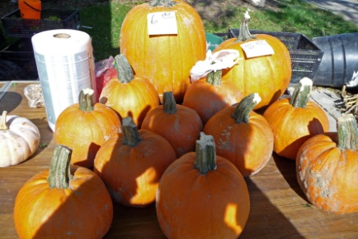
Vliet Street Community Green Market

Slide 11
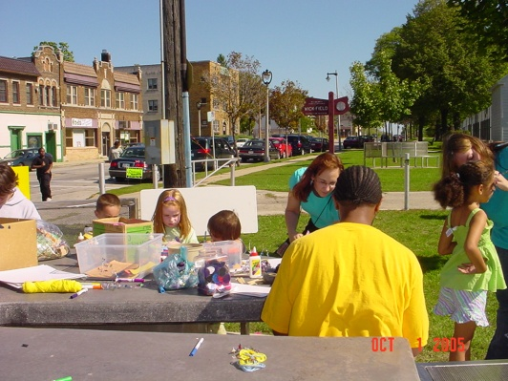
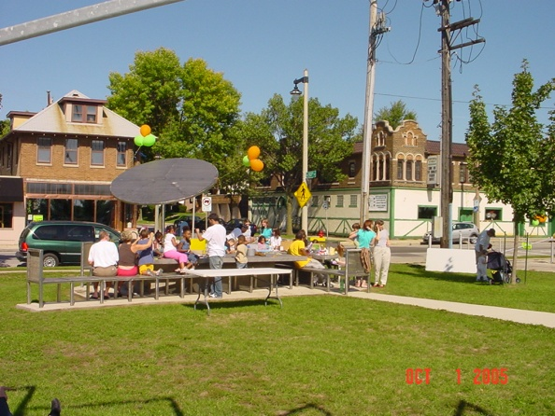
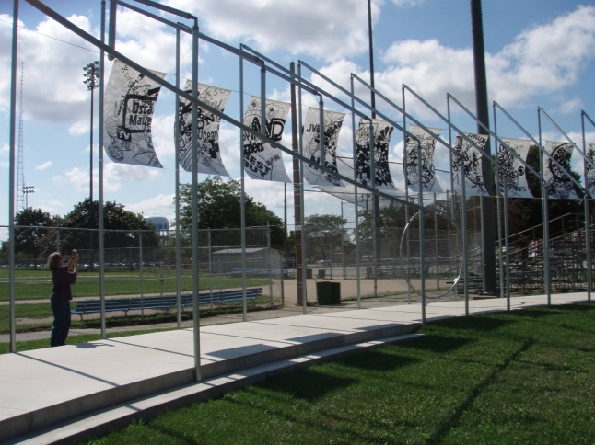
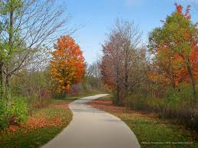
Walk / bike to other recreational opportunities
Wick Field
Home of softball, baseball and football fields
Tennis
Oak Leaf / Hank Aaron Bike Trail

Slide 12
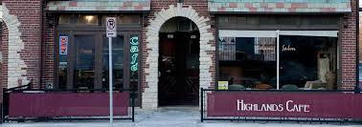
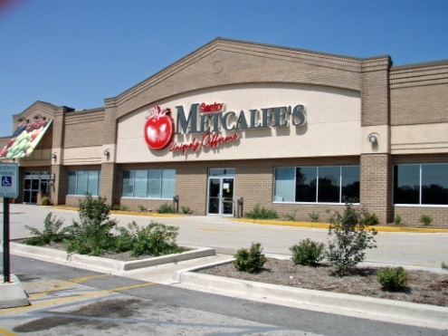
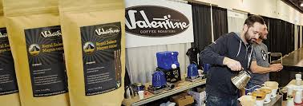
Near many cafes, restaurants, shops and essentials
Large variety of places to relax and eat
Great diversity of shopping on Vliet St
Very close to essentials; groceries, dry cleaning, pharmacies

Slide 13
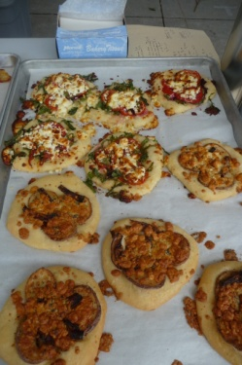
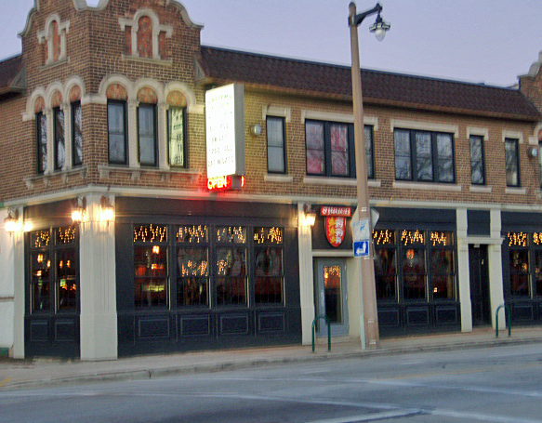
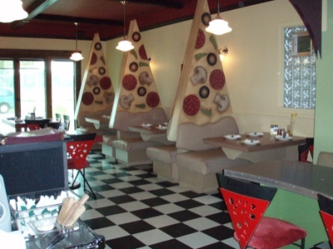
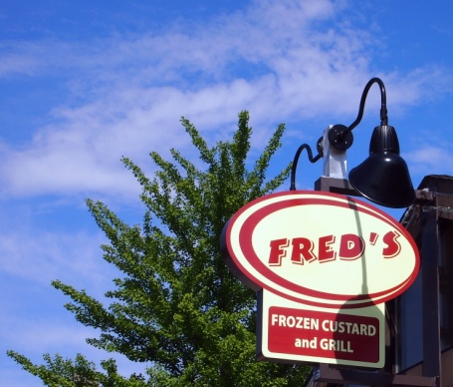
Nearby Restaurants
O'Brien's Irish Pub – 50th & Vliet
Fred’s Drive-In – 49th & Vliet Street
Caradaro Club– 50th & Vliet
The Soup Market – 53rd & Vliet
Cold Spoons Gelato – 59th & Vliet
Meritage – 59th & Vliet
Highlands Café, 60th & Vliet
Amaranth Café – 32nd & Lisbon
Spitfire State Street
Caradaro Club
Amaranth
Bakery
O’Brien’s Pub

Slide 14
Why did you move to the Martin Drive Neighborhood?
Neighbors shared these quotes:
“Great central location – easy to get anywhere.”
“Nice neighborhood at an affordable price.”
“I like that there is a neighborhood organization.”
“Low crime rate.”
“We wanted to live in a neighborhood that had solid, established families and was near schools and a park.”
“I like the diversity in the neighborhood.”
“A community garden and the neighbors take price in the neighborhood.”

