Slide 1
Ghana
Mei Chen
Meagan Frances Ayers
Notes:
Welcome to our presentation designed to prepare you for your business travels abroad to Ghana.

Slide 2
Introduction
Better prepare you for your travels abroad
Location
Major Shaping Forces
Cultural Awareness
12 Core Cultural Values
Notes:
This orientation holds the purpose of introducing you to the culture, society, economy, forces and cultural values of Ghana to better prepare you for your travels abroad.

Slide 3
Relative Location
Notes:
Ghana is located in West Africa and borders the Gulf of Guinea and lies between Cote d'Ivoire and Togo.

Slide 4
Ghana
Notes:
The capital of Ghana is Accra (pronounced e-kra) located just along the Gulf of Guinea. The other major cities include Bolgatanga, Tamale, Sunyani, Kumasi, Obuasi, Koforidua, Tema, Ho, Cape Coast, and Takoradi.

Slide 5
Major Shaping Forces
The History
Political Power
Religion
Physical Surroundings
Economy/Economic Status
Notes:
There are five major forces that shape the 12 cultural values of Ghana. We will address each of these forces and then discuss them as they apply to specific cultural values.

Slide 6
History
Gold Coast Period
The Portuguese
The Dutch
The British
The Colonial Period
The British
The Independence Period
The First Republic
The Second Republic
The Third Republic
The Fourth republic
Notes:
The history of Ghana can be split into three main periods of time: the Gold Coast period, the Colonial period, and the Independence period. First the Gold Coast period takes place from the 15th century to the 19th century. Next the Colonial period takes place from 1902-1957. Then finally the Independence period began in 1957. (Ghana.gov)
Very little was known about Ghana until the Portueguese arrived in the 15th century. They were the first Europeans to arrives in Ghana and they found mass amounts of gold along the coast of Ghana, thus the original name of Ghana the “Gold Coast.” The Portuguese named Ghana “da Mina” meaning “The Mine” and built the first castle in Elmina to be a trading post. Soon the trade would expand to slaves as well. (Ghana.gov)
In 1598 the Dutch also came to the Gold Coast to trade. They built many forts along the coast, and by 1642 they took the castle in Elmina from the Portuguese. Other Europeans including the British, Danes, and Swedes came to trade and would frequently have conflicts over dominance. By 1872 the Dutch gave their coastal forts to the British and left. (Ghana.gov)
The British and the natives fought many wars against each other for control of the trade. The British finally won the trade after defeating the Ashanti in the “Sagrenti War,” thus beginning the colonial rule. The Capital was moved from Cape Coast to Accra in 1876. (Ghana.gov)
There were little issues under the colonial rule until after World War II. The first political party was formed in 1947 and was named the “United Gold Coast Convention.” Dr. Kwame Nkrumah became the general secretary for the UGCC that was fighting for a share of the executive power. Nkrumah became impatient with the UGCC’s way of doing things and formed his own political party, the Convention People’s Party, in 1949. Nkrumah along with other’s believing in “ Self-government now” organized boycotts and ended up in jail. In 1952 Nkrumah became the prime minister to the colony’s first African government after his release. In 1953 he introduced a constitution for self government and after many elections the Gold Coast won the battle for independence on March 6, 1957. Ghana became the “first country in Africa south of the Sahara to regain its independence from colonial rule.” (Ghana.gov)
The years following Ghana’s independence was rather unstable leadership-wise due to parties being overthrown by other parties.
The First Republic began in 1960, but was overthrown by a National Liberation Council.
The Second Republic begin in 1969 when the Progress Party won the elections of that year, but was then overthrown in 1972 the National Redemption Council which was later changed to the Supreme Military Council.
The Third Republic began with the SMC being overthrown in 1979 by the Armed Forces Revolutionary Council. AFRC was only in power for three months before it handed it over to the People’s National Party. PNP was then overthrown in 1981 by the Provisional National Defense Council. PNDC’s power lasted until 1993 under Fit. Lt. Rawlings.
The Fourth Republic began with Rawlings and he was reelected in 1996.
In the election of 2000 and 2004 the National Patriotic Party won the office.
Professor John Evans Atta Mills under the National Democratic Congress party won the office in 2009. (Ghana.gov)

Slide 7
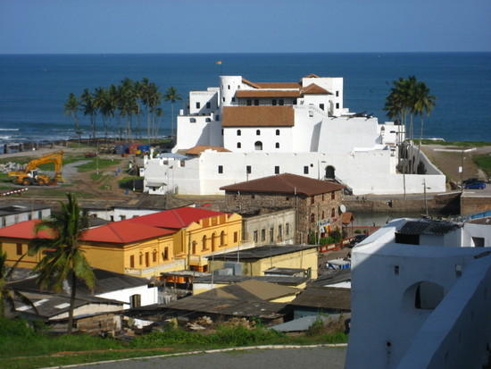
Castle at Elmina
Notes:
"Elmina Castle from Fort, Elmina, Ghana." Travel Blog - TravelPod" Web. 30 Mar. 2010. <http://www.travelpod.com/travel-photo/kimber1974/ghana_-_2007/1176166800/elmina_castle_from_fort.jpg/tpod.html>.

Slide 8
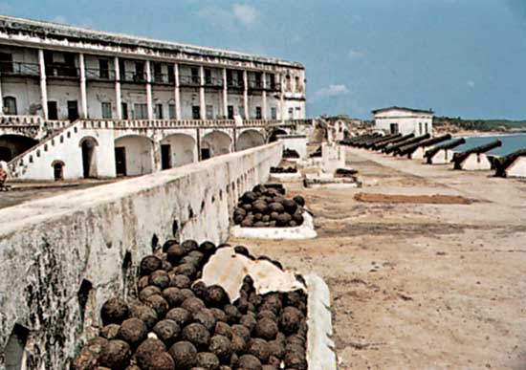
Cape Coast Castle
Notes:
"Ghana: Cape Coast Castle :: Ghana -- Britannica Online Encyclopedia." Encyclopedia - Britannica Online Encyclopedia. Web. 30 Mar. 2010. <http://www.britannica.com/EBchecked/topic-art/232376/36562/Cape-Coast-Castle-Ghana>.

Slide 9
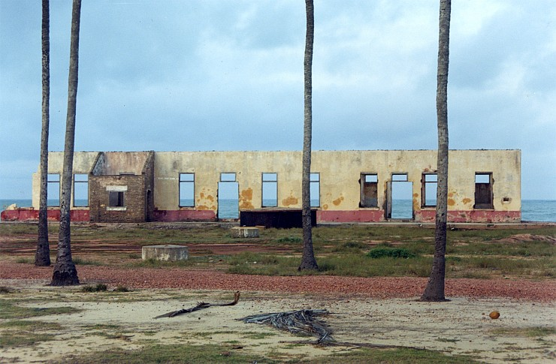
Remains of a British Fort
Notes:
"Everywhere: Photos: Old British Fort, Ghana." Everywhere: Travel Is All Around You. Web. 30 Mar. 2010. <http://everywheremag.com/photos/15059>.

Slide 10
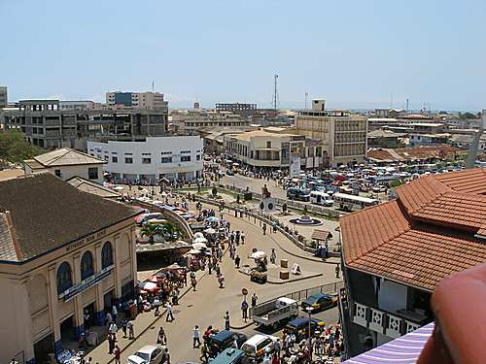
Capital- Accra
Notes:
"Accra, Ghana's Capital City - Accra Facts and Information." Africa Travel. Web. 30 Mar. 2010. <http://goafrica.about.com/od/africatraveltips/ig/Africa-s-Capital-Cities/Accra--Ghana-s-Capital-City.htm>.

Slide 11
Physical Surroundings
Tropical
Southeast, southwest and northern climates
Low plains and plateaus
Natural disasters
Drought
Other environmental issues
Notes:
Ghana’s climate is very tropical and in the:
Southeast it is very warm and moderately dry along the coast,
Southwest it is rather hot and humid, and
North it is hot and dry.
The mean temperature of 26 to 29 degrees Celsius (79 to 84 degrees Fahrenheit) according to Verle. You will see mostly low plains with dissected plateau in south-central areas.
The natural disasters Ghana faces includes dry and dusty winds from January to March and droughts all year round.
Ghanaian people face the reality of recurrent drought in the north which severely affects agricultural activities which accounts for 56% of the workforce according to Visual Geography and The World Factbook. There is a problem with deforestation, overgrazing, soil erosion, poaching and habitat destruction of wildlife, water pollution, and inadequate supply of drinkable water. (www.cia.gov)
While overseas in Ghana, you need to be aware of your water usage so as to not contribute to this already imperative issue.

Slide 12
Drought and Unclean Water

Slide 13
Economy/Economic Status
Natural Resources
Deficit
Imports/Exports and major Importers/Exporters
Debt relief
Unemployment
Poverty
Human rights issues
Notes:
Ghana is abundant in natural resources including: gold, timber, industrial diamonds, bauxite, manganese, fish, rubber, hydropower, petroleum, silver, salt and limestone. The major resources for foreign exchange include gold and cocoa and oil production is predicted to expand in lat 2010 or early 2011. Regardless of this, the economy revolves around agriculture which accounts for 35% of GDP and employs 56% of the workforce and Ghana still remains dependent on international financial and technical assistance. (www.cia.gov)
Their imports are reported at $9.807 billion and yet their exports are only reported at $5.737 billion (2009 estimates); that a deficit of $4.07 billion dollars. Their major exports are gold, cocoa, timber, tuna, bauxite, aluminum, manganese ore, diamonds and horticulture. Their main exports are received by the Netherlands (13.4%), Ukraine (11.7%), Frances (5.7%) and the US (5.1%). The main imports of Ghana are capital equipment, petroleum and foodstuffs and these products are imported from China (16%), Nigeria (15%), India (5.6%, US (5.6%), France (4.5%) and the UK (4.5%). (www.cia.gov)
In 2002, Ghana actually opted for debt relief under the Heavily Indebted Poor Country (HIPC) program and is benefiting from the Multilateral Debt Relief Initiative that took place in 2006. Their unemployment rate is 11% (2000 estimate) and the population living below the poverty line is 28.5% (2007 estimate) according to www.cia.gov. Poverty is such a huge issue that it is estimated by the Ghana Review that 20% of the population is living on $1 a day and 44.8% of the population is living on $2 a day.
Issues faced by Ghanaian people:
“Use of excessive force by security agencies that has led to cases of severe injuries and even deaths in recent years,
Prison conditions are often inhumane and life-threatening,
Journalists and human rights activists who try to report stories or fight for rights containing views contrary to those of the government sometimes face arrest, detention, and in some cases, even threats of violence and death,
There are restrictions on the freedoms of assembly, speech and press,
Widespread corruption and a trend toward vigilante justice,
Societal discrimination and violence against disabled persons, homosexuals, people with HIV/AIDS, and ethnic minorities, and
Child labor and trafficking of children.” (Ghana Review 2010)

Slide 14
Poverty
Notes:
"Ghana." Flicker's Finest, n.d. Web. 2 Apr. 2010. <http://www.flickrsfinest.com/wp-content/uploads/ghana2.jpg>.

Slide 15
Religion
68.8% Christian
24.1% Pentecostal/Charismatic
18.6% Protestant
15.1% Catholic
11% Other
15.9% Muslim
8.5% Traditional (Aboriginal)
0.7% Other
6.1% None
Notes:
There are a few dominant religions which account for the Ghanaian people. Africa Guide explains that Ghana actually has the highest percentage of Christians in West Africa and according to The World Factbook, the dominant religions are as follows as of 2000:
68.8% Christian
24.1% Pentecostal/Charismatic
18.6% Protestant
15.1% Catholic
11% Other
15.9% Muslim
8.5% Traditional (Aboriginal)
0.7% Other
6.1% None

Slide 16
Political Power
Government type: Constitutional democracy
Party in power: National Democratic Congress
Executive branch: President, Vice President, Cabinet
Legislative branch: Unicameral Parliament
Judicial branch: Supreme Court
Current:
President- John Atta Mills
Vice President- John Mahama
Notes:
The current government is a constitutional democracy and the current constitution was approved in April 28, 1992. There are three branches, the executive, the legislative, and the judicial. The Executive branch is made up of the president, the vice president, and the cabinet of ministers. The legislative branch is composed of a unicameral Parliament, and the judicial branch is made up of the Supreme Court. (worldfacts)
The country is divided into ten regions. The regions are then divided into local districts run by the district assemblies. (Everyculture)
The current president is John Atta Mills, and the vice president is John Mahama. (U.S. Dept. of State)

Slide 17
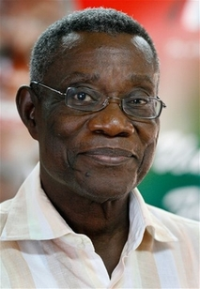
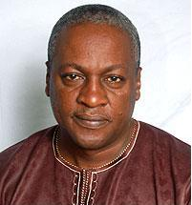
President and Vice President
President John Atta Mills
Vice President John Mahama
Notes:
"John Atta Mills--The New Stongman of Ghana - African Path Village." African Path Village - Connecting African Culture. Web. 30 Mar. 2010. <http://africanpath.ning.com/notes/John_Atta_Mills--The_New_Stongman_of_Ghana>.
"The Executive." Ghana Homepage | Government of Ghana Official Website. Web. 30 Mar. 2010. <http://www.ghana.gov.gh/index.php?option=com_content&view=category&layout=blog&id=42&Itemid=181>.

Slide 18
People of Ghana
98.5% black Africans
Indigenous groups:
Akan
Moshi-Dagomba
Ewe
Ga
Guan
Notes:
The Ethnic make up of Ghana includes 98.5 % black Africans and 1.5% Europeans or others (Worldfacts). There is a diversity of groups that make up the indigenous population, but the largest groups based on important linguistics include the Akan, Guan, Ga and Ewe, and Moshi-Dagomba (U.S. Dept. of State).
The Akan include the people along the coast and in the forest region north of the coast. The Guans live in the plains of the Volta River. The Ga and Ewe live in in the south and southeast. The Moshi-Dagomba live in the northern regions. (U.S. Dept. of State)

Slide 19
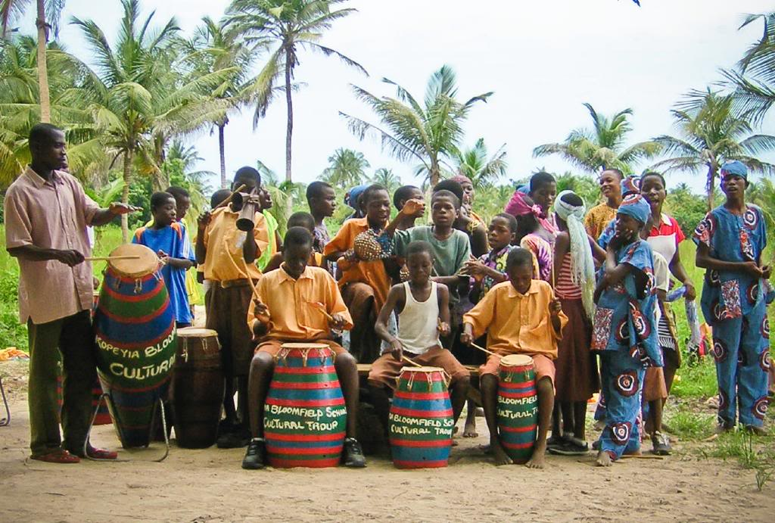
Cultural Awareness
Ghanaian holidays http://holidayyear.com/Ghana-2010-list.php
Getting involved with the local community http://touringghana.com
Notes:
When dealing with employees of another country, you should be aware that holidays will not coincide with the same holidays we celebrate here in the US. Please refer to http://holidayyear.com/Ghana-2010-list.php to determine when Ghanaian holidays lie to ensure that you do not set up meetings on days that are celebrated by the local people.
Please visit http://touringghana.com to find local celebrations and festivals and to get an idea of how to become involved in the community and get closer to that local people.

Slide 20
Cultural Awareness
Ghanaian traditional music and dance
http://www.youtube.com/watch?v=Bq7IqE9vnuE
President Obama’s visit to Ghana
http://www.youtube.com/watch?v=wXPlV9UWNhc
Notes:
These are just a couple of videos to actually show a little bit of the culture in action.

Slide 21
12 Core Cultural Values
Human Nature
Purpose In Life (Doing or Being)
Societal Role
Nature/Fate
Time
Communication (Preferred Modes)
Power Distance
Uncertainty Avoidance
Masculinity/Femininity
Universalistic/Particularistic
Specific/Diffuse
Status

Slide 22
Human Nature
Kluckhohn: Mix of good and evil
Check people to find out what they are
Moderate controls; avoid temptations around employees
Good work needs to be recognized and rewarded
Enter negotiations with caution; analyze other parties during initial stages of interaction
Shaped by cultural forces
History
Religion
Developing a relationship is of utmost importance
Notes:
Human nature is the value that considers whether a culture believes people to be good, evil, or neutral as well as whether they are
changeable or unchangeable. Ghanaians believe that people are a mix of good and evil. The Kluckhohn Model lists
characterizes the mix as
Check people to find out what they are
Moderate controls; avoid temptations around employees
Good work needs to be recognized and rewarded
Enter negotiations with caution; analyze other parties during initial stages of interaction (Kluckhohn)
This value has probably been shaped largely by history. With so many countries coming in an taking power in the past and multiple
overthrowing of the government, it would make sense that the people of Ghana are cautious. Ghanaians prefer to develop a
relationship first to determine whether or not you are trustworthy and your personality fits the necessary standards to do business
(Kwintessential).
Another force that shapes this value may be the religion. Over half the population of Ghana are Christians. The “notion of good and
virtue” are believed to be the “first quality of God (Yale).” Ghanaians wants “society to be together in prosperity and peace (Yale).”
For Automotive Glass, Inc. this means that relationship developing is necessary before even starting business negotiations with
Ghanaians.

Slide 23
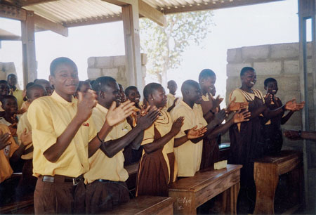
Purpose In Life (Doing or Being)
Kluckhohn: Developing- between doing and being
Purpose on earth is for inner development
High cultural and educational level is a criterion for success
Balance work and leisure activity to develop self
Importance of education to develop self
Gain higher status by education
Shaped by cultural force- economy
Notes:
According to the kluckhohn Model, the purpose in life can be classified as “being, being-in becoming (developing), or doing (Kluckhohn).” Ghana would be considered as developing in this value. This means that the Ghanaians believe that
Purpose on earth is for inner development
High cultural and educational level is a criterion for success
Balance work and leisure activity to develop self (Kluckhohn)
It may seem as though the people would rather be a “being” culture, however their economic status has them working hard in order to live. Education is also very important to the Ghanaians. In 1996 a program was launched and was said to be “ one of the most ambitious pre-tertiary education programs in West Africa (State).” Only a small percentage of the population has the opportunity to go to high education, so those who do receive a high status (everyculture). Ghana believe that status is very important, so the students try to obtain a higher education to better themselves (everyculture).
This value seems to be shaped by economics. As I stated earlier, because of the economic status of the country, the people have to work hard in order to survive. Along with the education program, the people have a better chance to obtain a higher education and thus improve their living conditions as well as their status.
The photo is just an example of a classroom of students in Ghana.
"FORWARD in Ghana | FORWARD." FORWARD - Safeguarding the Health and Rights of African Women. Web. 01 Apr. 2010. <http://www.forwarduk.org.uk/what-we-do/african-programmes/ghana>.

Slide 24
Societal Roles
Hofstede individualism ranking: 39-41
Kluckhohn: Group
Consulting family or close friends when difficulties arise
Group or and decision; look to group with questions and submit to group consensus
Hire or promote relative or friend of self or another employee
Importance of family
Shaped by cultural forces
History
Economy
Implications for business
Importance of developing a relationship
Notes:
Societal roles has to do with whether a society is individualistic or collectivists. According to Hofstede, West Africa is ranked as 39-41 for individualism. This means that the countries in West Africa, which includes Ghana, are relatively collectivist societies.
Social relationships in the Kluckhohn Model consider the society is authoritarian, group or individualistic. Ghana is under the group category. The Kluckhohn Model describes characteristics of a group as
Consulting family or close friends when difficulties arise
Group or and decision; look to group with questions and submit to group consensus
Hire or promote relative or friend of self or another employee (Kluckhohn)
This value can be illustrated by the importance of family to the Ghanaian culture. The family is considered the source of “identity, loyalty, and identity (Kwintessential). The individual is expected to uphold the family honor, and the eldest of the group makes the decisions and is expected to make decisions that will be beneficial to the entire group. (Kwintessential)
The major cultural force shaping this value is probably the history and economic situations of Ghana. Ghana has been under the rule of multiple countries since the 13th century before gaining independence in 1957, so the natives of the country only had their group to rely on to survive. This value is also shaped by the economy. As stated before the Ghanaian economy is largely made up of agriculture (CIA). Agricultural work involves people working together to make everything work properly, so it would only make sense that Ghana is so group oriented.
This value just further proves that a relationship is necessary before Automotive Glass, Inc. can begin its business negotiations.

Slide 25
Nature/Fate
Kluckhohn: Man should be at harmony with nature
Man should live in balance with nature
People are dependent upon earth’s resources; exercise caution when disposing of waste
Use technology to maximize man’s ability to adapt to nature
Shaped by cultural forces
Religion
Being at harmony with everything
Economy
Majority rely on agriculture to survive
Notes:
This value determines whether a culture believe that their fate is controllable or uncontrollable. Ghanaians lie somewhere in the middle of this spectrum as well. They believe that man is at harmony with nature. According to the Kluckhohn Model, people with this value believe that
Man should live in balance with nature
People are dependent upon earth’s resources; exercise caution when disposing of waste
Use technology to maximize man’s ability to adapt to nature (Kluckhohn)
This value may be largely affected by the cultural forces religion and economics. Over half the population are Christians, so their belief is that man should be living in harmony (Yale). The economy may have a larger influence on this value though. The majority of the country has to do with agriculture, so the people rely on the earth for their survival. Obviously the country’s exports are their natural resources, so they are dependent on nature.
However, they do not completely rely on fate. Education is important to them, so they believe that they can better themselves if they try. Thus, they are in the middle of the spectrum when it comes to the value of nature/fate.

Slide 26
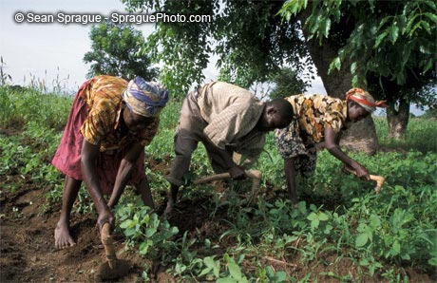
Importance of agriculture
Notes:
This is a photo of some Ghanaian farmers working in their fields.
"Sprague Photo Stock: 7642 - Farming - Family Cultivating Soya Beans Bongo Village Bolgatanga." Sprague Photo Stock: Society, Health, and the Environment Worldwide. Web. 01 Apr. 2010. <http://www.spraguephoto.com/imageresponse.lasso?id=10332&-token.caption=Family%20cultivating%20soya%20beans%20Bongo%20village%20Bolgatanga>.

Slide 27
Time
Kluckhohn: present oriented
Making the most of the present; not worrying about yesterday or tomorrow
Form methods to take care of present concerns
Analyze present market for product needs
Hire employees to solve present needs
Lack of time awareness in smaller areas
May be up to 2 hours late
Growth in time awareness in larger areas
More timeliness
Shaped by cultural force- economy
Notes:
According to the Kluckhohn Model, the culture’s value of time is characterized as past oriented, present oriented, or future oriented. Ghana is in between believing that time is abundant and time is a commodity making them a present oriented culture. Kluckhohn describes this group as
Making the most of the present; not worrying about yesterday or tomorrow
Form methods to take care of present concerns
Analyze present market for product needs
Hire employees to solve present needs (Kluckhohn)
Ghana still has a lot of traditions from the past, but it seems as though many of the large cities are starting to modernize as they try to improve their economic situation. In regards to time, it seems as though those from smaller villages and towns are a little less concerned with time. In fact they are said to “poke fun of themselves… in regards to the lack of awareness of time (Culturecrossing).” It is also said that “Ghanaians are known to be late to meetings, up to 2 or more hours late is common (Culturecrossing).” However it seems as though larger cities and business are becoming more aware of timeliness. (Culturecrossing)
It seems as though this value is largely affected by the economy. As the world is globalizing, it would make sense that Ghana would like to as well. Their economic status is growing, so in order to continue growing, they will have to become more aware of time among other things. Although their traditions will always be important to them, they know that they have to start looking into the future for changes and growth. However, they may not know exactly what their future holds, so they will worry about the present time. Also, with the country being largely agricultural, the people are more worried about being able to survive today rather than about the past or the future.

Slide 28
Mode of Communication
High context- indirect
Example: “You look fat today.”
Avoid confrontations
Example: “If an Akan names his dog 'My neighbor is ungrateful,' and he happens to pass by that neighbor's house, he could call the dog's name and shower it with insults. Of course, the neighbor knows perfectly well that he is the target of these insults…”
Shaped by cultural force- history
Notes:
The mode of communication determines whether a culture has a high context or low context- either direct or indirect respectively.
Ghanaians have high context, meaning they are rather indirect when is comes to communication (Kwintessential). For examples a
Ghanaian may say “you look fat today.” This is not meant to be an insult as one from the U.S. may think. This is actually a
compliment implying that you have a lot of money and are successful to be able to eat well (Ghanaweb).
Ghanaians also avoid confrontations that might lead to the loss of face. Instead they may use an indirect method to get their point
across. (Kwintessential) an example of this: "If an Akan names his dog 'My neighbor is ungrateful,' and he happens to pass by that
neighbor's house, he could call the dog's name and shower it with insults. Of course, the neighbor knows perfectly well that he is the
target of these insults, but he cannot respond, because after all, it is the dog being spoken to, not him (Indiana).“
This value may have been shaped by history; especially the avoidance of confrontations. The natives may not have been able to
express their feelings directly for fear of the “government’s” power, so they had to be indirect about what they said. As the example
points out, the one being insulted knows he is being insulted, but if he were to confront the dog owner, he may just say that he’s
yelling at his dog. Ghana is considered a “polite society” because they believe that confrontations disturbs the “social harmony
(Indiana).”
As an employee of Automotive Glass, Inc. be sure not to offend the Ghanaians by making him or her lose face. Also, an employee will
need to realize that what the Ghanaians say may have a different meaning.

Slide 29
Power Distance
High Power Distance (Hierarchical Society)
Inequality of power is accepted and respected
Assert status without arrogance
Inequality is expected, avoid making decisions democratically
Don’t question the boss
Be careful who you send to make negotiations and always keep the status of your people in mind
Expect tension
Closely supervise your subordinates
Notes:
Ghana has a relatively high power distance according to Hofstede’s Cultural Dimensions; receiving a 77 power distance index (Boyd). Power distance determines how accepting a culture or society is of inequality of power among people of that society. According to MindTools.com, “A high Power Distance score indicates that society accepts an unequal distribution of power and people understand "their place" in the system while a low power distance means that power is shared and well dispersed. It also means that society members view themselves as equals.” What this means to Automotive Glass Inc. is that we will need to take into consideration that structure, hierarchies and authority are very important within the Ghanaian society. MindTools.com notes that within hierarchical societies, “companies are more centralized, there are strong hierarchies, there large gaps in compensation, authority & respect and one must acknowledge a leaders power and be aware that you may need to go to the top for answers.”
As a company taking on joint venture in a hierarchical society, we must be careful not to impose our cultural values on the people of this society and respect their ways. According to Ferraro, there are many ways in which we can ensure that we are taking their hierarchical societal values into consideration while conducting business. The following are concepts and tips noted in Ferraro’s text on page 110 and should be keep in mind:
You must assert your status when talking to people, and expect that they will do the same, so that you are both aware of the appropriate ways to interact with one another. “Thus communicate your status, authority, credentials, expertise, and the like, but without arrogance or boasting.
While it may seem wrong to us, it is expected of hierarchical societies that equality is not imposed and democratic treatment is seen as negative. To them, a boss must be treated as a boss and those lower in the hierarchical structure should be treated as such.
Decisions in this type of society are made more quickly because they are not as interested in getting everyone’s opinion and/or approval.
A boss’s decision should not be questioned and will be seen as highly disrespectful; avoid this mistake.
Keep in mind the social status of the people you are dealing with. For example: when negotiating contracts or business, those of lower-status will not be able to negotiate with those of higher-status.
“Don’t assume that all people have equal access to information.”
“Use high-status individuals (third parties) as you agents, contacts, and intermediaries.”
You must expect daily tension between those of high-status and lower-status as well as between those with vast age differences.
You subordinates expect you to be their boss and closely supervise them and provide them with much direction.
“Expect that subordinates will more frequently smile and repress negative emotions.”

Slide 30
Uncertainty Avoidance
Relatively Low Uncertainty Avoidance (Similar to the US)
Comfortable with situations that are uncertain and unpredictable
Open to new technologies and ideas
Willingness to make uncertain investments
You should not be threatening to your new employees
Less rigid meetings
Low employer loyalty
Broad guidelines rather than formal rules
Teams are efficient
Leaders are innovative and creative
Notes:
Uncertainty Avoidance refers to how comfortable the people of a society are with uncertain situations and how much anxiety an unpredictable future presents (Ferraro). Ghana has an uncertainty avoidance level that is in the middle, however, we will consider it a low level of uncertainty avoidance since it is very close to the United States on Hofstede’s cultural dimensions with regards to uncertainty avoidance. Ghana has an uncertainty avoidance index of 54 which is not too far ahead of the United States who scored a 46 and, according to ClearlyCultural.com, ended up in the same bracket for the uncertainty avoidance index. According to Ferraro, “in terms of engaging in negotiations, people from societies with low uncertainty avoidance are much more comfortable in negotiating situations in which the outcome is not a foregone conclusion.”
What this means to Automotive Glass Inc. is that we can consider a couple of things while conducting our business abroad in Ghana. According to Ferraro:
Employees should be more open to experimenting, using new technologies, and following new procedures. Countries with low uncertainty avoidance are also more likely to be leaders of innovation.
Employees are willing to invest their pensions in the uncertain stock market rather than interest-earning accounts in hope of maximizing their investments.
Employees will not be as threatened by outsiders (including foreigners).
Employees will functions better in meetings which are held in a less rigid manner.
Employees do not have a very high loyalty to their employers.
“Employees prefer a broad set of guidelines rather than a formal set of rules and regulations.”
Employees are likely to function more efficiently in teams.
“Leaders are more likely to be innovative and creative.”

Slide 31
Masculinity/Femininity
Tender Society (US is more tough)
Women in the workforce (rising equality)
Importance of family roles
Parental leave programs
Less working hours
Family Issues considered in decision making
Teamwork/collective efforts versus individual praise
Notes:
Ghana is a more feminine (tender) society than the US which is more masculine (tough). Ghana scored a low 46 while the US scored a 62; therefore, you will see some differences in your time abroad with regards to this part of Hofstede’s model. Masculinity/Femininity refers to how gender roles of the society are divided. MindTools.com explains that, “High MAS scores are found in countries where men are expected to be tough, to be the provider, to be assertive and to be strong. If women work outside the home, they have separate professions from men. Low MAS scores do not reverse the gender roles. In a low MAS society, the roles are simply blurred. You see women and men working together equally across many professions. Men are allowed to be sensitive and women can work hard for professional success.”
According to Boadu, “Women in Ghana have traditionally sustained an active and productive economic role and at the same time, they have carried a very heavy reproductive and domestic work burden.” She explains that within Ghana, women take on more responsibility than men because they are expected to perform within the workplace and then come home to take care of their families. While women do have access and a much higher sense of equality within the workplace, they still receive lower wages and have less access to education.
What this means for Glass Automotive Inc. is that (according to Ferraro):
Employers (like ourselves) should provide parental-leave programs for both parents.
People of tender societies prefer less hours to higher salaries.
Men and women are likely to study the same subjects and hold similar jobs within the workplace.
People will prefer smaller companies to larger companies.
Family issues are considered in the decision-making process and employees are not only seen as employees of the company but as family members outside of the workforce. Thus, parental leaves are generous and vacations are preserved.
Achievements of the company and are not usually attributed to one person but rather to the cooperation of everyone working together. Teamwork is expected and individuals do not take credit for accomplishments. This must be taken into consideration considering our own society is very focused on individual accomplishments.

Slide 32
Universalistic/Particularistic
Universalistic (Collectivist) Society
Interest of group before individual interests
Do not give individual praise
Long-term relationships
Say “we” instead of “I”
Utilize third parties to make contacts and introductions
Loyalty
Social welfare before the good of the company
Greetings
Notes:
Ghana is a Particularistic (Collectivist) country which is very different from the US which is Universalistic (Individualistic) country. Ghana only scored a 20 while the US scored a total of 92 on a scale of 1 to 120 on Hofstede’s model. Therefore, Ghana is very different from the United States in how the people of the culture see themselves situated within that culture. Countries that are more of a collectivist society like Ghana encourages the people to “put the interest of the group above their own, maintain strong ties and obligations to the group members, and value long-term social relationships above short-term accomplishments (Ferraro).” This is quite the contrary to Individualist countries such as our own US where our culture emphasizes “the worth and dignity of the individual over the group, independence rather than interdependence, and relatively few social obligations (Ferraro).”
What this means for Glass Automotive Inc. is that (according to Ferraro):
Do not praise individuals for a job well done, praise the group as a whole. This is because their responsibility is to their group, not their own personal advancements and to single out an individual for praise will not only be embarrassing for that employee, but will demoralize others on their team.
You will need to build long-term relationships that will take a lot of time to create; executives will not do business with individuals whom they do not know or trust. So, take your time building these relationships.
Refrain form saying “I”, rather say “we” so that you employees do not get the impression that you are out for yourself rather than having the good of the group at heart.
Use third parties you both trust to make contacts and introductions.
Loyalty to families, nationality, tribes, etc… are very strong.
Favoritism may be considered “both functional and ethical” in a collectivist society; whereas, we are opposed to it.
Be sure to address social welfare such as the society or environment, as these things are very important to cultures who value the good of the whole community over the good of the company.
Be sure to assert your loyalty to the company.
It is also expected that you always greet a person otherwise it may seem as if you do not care about other’s welfare (touringhana.com)

Slide 33
Specific/Diffuse
Diffuse culture
Face and relationships
Intentions vs. specifics
Everything is interrelated
Study the history, background and future vision (what this PowerPoint aims to do)
Let meetings flow with slight nudges
Respect status of the people you are dealing with (titles, age, background, etc…)
Notes:
Ghana is a diffuse culture.
A specific culture “has a small area of privacy which is clearly separated from public life (via-web.de)” such as the US. A diffuse culture is more concerned with face and relationships are very important. In a business situation with a country that is diffuse culture, they are more concerned with your intentions rather than the specifics of what you have to tell them and subsequently trust is a very important aspect of making a deal and therefore, you will see the long-term relationships as essential to the Ghanaian people.
In a diffuse culture, it is accepted that everything is related and therefore it is difficult to for people of this culture to separate their work life from their home life. As a result, people are very concerned with the welfare of others and a boss will take a true interest in their employee’s personal life.
“Take a research group as an example. In specific-oriented cultures, the project leader would segregate out the task relationship he/she has with a subordinate, and insulates this "work relationship" from other dealings. Therefore, the leader's authority only reaches where his/her work relationship with the subordinate is defined, and each area in which the two persons encounter each other is considered apart from the other. Work and life are sharply separated in specific-oriented cultures life the U.S. In diffuse cultures, however, life space and every level of personality tends to permeate all others. For example, a teacher would be treated by the student not only as an instructor in the classroom, but also has certain influence on the student's home life. The boss-subordinate relationship usually does not stop only in the office; the boss is likely to have a say in other aspects of his/her employee's personal life. Because of the importance of loyalty and the multiplicity of human bonds, diffuse cultures tend to have lower turnover and employee mobility. “ (www.stanford.edu)
Some tips given by www.stanford.edu in how to deal with a diffuse culture include:
“Study the history, background and future vision of the diffuse-oriented people,
Let the meeting flow, occasionally nudging its process, and
Respect a person's title, age, background connections”

Slide 34
Status
Based on education and wealth
Status is marked by expensive western and traditional items
Luxury cars
Status must be demonstrated publicly
Women held high status in pre-colonial days
Women’s status has lessened since colonialism
Notes:
“Contemporary stratification is based on education and, to a lesser degree, wealth, both of which have led to significant social mobility since independence. Northerners, however, form a noticeable underclass, occupying low status jobs. In modern times, expenditure on Western consumer items has become the dominant status marker. Clothing, both expensive Western and traditional items, is an important symbol of education and wealth. Luxury cars are also significant—a Mercedes-Benz is the most dominant marker of high rank. Status must also be demonstrated in public display, especially in lavish funerals that acclaim both the deceased and their descendants.”
“In traditional society, women had considerable economic and political powers which derived in part from their ability to control their own income and property without male oversight. They also regularly assumed high statuses within the lineage and the kingdom, even though their authority was often confined to women's affairs. Colonialism and modernization has changed women's position in complex ways. Women have retained and expanded their trading opportunities and can sometimes acquire great wealth through their businesses. Men have received wider educational opportunities, however, and are better represented in government and formal sector employment. A modest women's movement has developed to address gender differences and advance women's causes.”

Slide 35
Ghana Woman
Notes:
Exploring Africa. African Studies Center, n.d. Web. 2 Apr. 2010. <http://exploringafrica.matrix.msu.edu/teachers/curriculum/m9/activity2.php>.

Slide 36
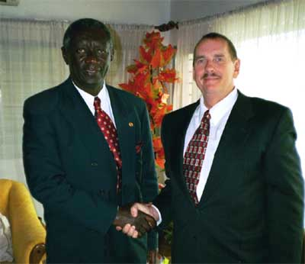
Thank You
We appreciate your time
Notes:
Thank you for you attention. We appreciate your time and patience and hope this information proves to be invaluable to your experiences abroad in Ghana. Good luck in your business endeavors with Ghana.
Price, Steven M. Business Trip To Ghana Africa Report. N.p., 2001. Web. 2 Apr. 2010. <http://www.hpmc.com/ghana/>.

Slide 37
Citations
Please see attached note to view all citations
Notes:
Boyd Ph.D., H. M. "Hofstede’s Cultural Attitudes Research -- Cultural Dimensions." Global Human Resource Management. N.p., n.d. Web. 27 Mar. 2010. <http://www.boydassociates.net/Stonehill/Global/hofstede-plus.pdf>.
"Hofstede's Cultural Dimensions." MindTools. Mind Tools Ltd., n.d. Web. 27 Mar. 2010. <http://www.mindtools.com/pages/article/newLDR_66.htm>.
Ferraro, Gary P. The Cultural Dimension of International Business. 5th ed. Upper Saddle River, NJ: Pearson Education, 2006. N. pag. Print.
Geert Hofstede Cultural Dimensions. ClearlyCultural.com, 2009. Web. 27 Mar. 2010. <http://www.clearlycultural.com/geert-hofstede-cultural-dimensions/>.
Boadu, Eric A. "Gender Disparities in Education, Health, and Labour Force Participation in Ghana." ClearlyCultural.com, n.d. Web. 27 Mar. 2010. <http://www.iussp.org/Brazil2001/s60/S63_P06_Boadu.pdf>.
"Africa: Ghana." The World Factbook. Central Intelligence Agency, 24 Mar. 2010. Web. 27 Mar. 2010. <https://www.cia.gov/library/publications/the-world-factbook/geos/gh.html>.
Berry, La Verle. "Ghana." Ghana: A Country Study. Washington: GPO for the Library of Congress, 1994. Web. 27 Mar. 2010. <http://countrystudies.us/ghana/>.
"Ghana Review 2010." Political Overview: Human Rights. Country Watch, 2010. Web. 27 Mar. 2010. <www.countrywatch.com>.
"Ghana People and Culture." The Africa Guide. AfricaGuide.com, n.d. Web. 2 Apr. 2010. <http://www.africaguide.com/country/ghana/culture.htm>.
"Specific vs. Diffuse." Multicultural Impact. Stanford Chinese Institute of Engineers, 31 Jan. 1999. Web. 2 Apr. 2010. <http://www.stanford.edu/group/scie/Career/Wisdom/spec_dif.htm>.
"Specific vs. Diffuse Cultures." International Business Cultures. N.p., n.d. Web. 2 Apr. 2010. <http://www.via-web.de/specific-vs-diffuse-cultures/>.
Touring Ghana. N.p., 2009. Web. 2 Apr. 2010. <http://www.touringghana.com/>.
"Ghana." Countries and Their Culture. N.p., 2010. Web. 2 Apr. 2010. <http://www.everyculture.com/Ge-It/Ghana.html>.
"Know More About Ghana." Ghana Homepage | Government of Ghana Official Website. Web. 28 Mar. 2010. <http://ghana.gov.gh/index.php?option=com_content&view=article&id=1237:know-more-about-ghana&catid=92:ghana-at-a-glance&Itemid=238>.
World Facts. Web. 28 Mar. 2010. <http://worldfacts.us/ghana.htm>.
"Culture of Ghana - Traditional, History, People, Clothing, Traditions, Women, Beliefs, Food, Customs, Family, Social, Dress, Marriage, Men, Life, Population, Religion, Rituals." Countries and Their Cultures. Web. 28 Mar. 2010. <http://www.everyculture.com/Ge-It/Ghana.html>.
"Ghana (03/10)." U.S. Department of State. Web. 28 Mar. 2010. <http://www.state.gov/r/pa/ei/bgn/2860.htm>.
"Africa: Ghana." The World Factbook. Central Intelligence Agency, 24 Mar. 2010. Web. 27 Mar. 2010. <https://www.cia.gov/library/publications/the-world-factbook/geos/gh.html>.
"Ghana- Culture, Etiquette, Customs and Protocol." Translation Services | Interpreters | Intercultural Communication | Cross Cultural Training. Web. 30 Mar. 2010. <http://www.kwintessential.co.uk/resources/global-etiquette/ghana.html>.
"Pot Belly and Fat Waist Line | Feature Article 2009-09-16." Ghana HomePage, Resource for News, Sports, Facts, Opinions, Business and Entertainment. Web. 30 Mar. 2010. <http://www.ghanaweb.com/GhanaHomePage/NewsArchive/artikel.php?ID=168627>.
"Speaking the "Unspeakable"" Indiana University. Web. 30 Mar. 2010. <http://www.indiana.edu/~rcapub/v21n3/p10.html>.
"Culture Crossing." Country Guides to Culture, Etiquette, Customs & More! Web. 31 Mar. 2010. <http://www.culturecrossing.net/basics_business_student_details.php?Id=11&CID=80>.
Kluckhohn, F. R., & F. L. Strodtbeck. (1961). Variations in value orientations. Evanston, IL: Row, Peterson.

