Slide 1
Ghana
Mei Chen
Meagan Frances Ayers
Notes:
Welcome to part two of our presentation designed to prepare you for your business travels abroad to Ghana.

Slide 2
Cultural Metaphor
2 Steps:
Determine the 12 Core Cultural Values
Think of an activity, event, object, or phenomenon to personify these 12 Core Cultural Values
Notes:
There are two steps to determining a cultural metaphor:
You need to determine the 12 core cultural values
You need to determine an activity, event, object, or phenomenon that can personify these 12 core cultural values.
The cultural value must make sense to the that culture and not make sense to other cultures for it to work.

Slide 3
Step 1 - 12 Core Cultural Values
Human Nature
Purpose In Life (Doing or Being)
Societal Role
Nature/Fate
Time
Communication (Preferred Modes)
Power Distance
Uncertainty Avoidance
Masculinity/Femininity
Universalistic/Particularistic
Specific/Diffuse
Status
Notes:
The 12 core cultural values:
Human Nature
Purpose In Life (Doing or Being)
Societal Role
Nature/Fate
Time
Communication (Preferred Modes)
Power Distance
Uncertainty Avoidance
Masculinity/Femininity
Universalistic/Particularistic
Specific/Diffuse
Status

Slide 4
Verbalization of the Core Values
Most Ghanaians would agree that:
People are a mix of good and evil.
The purpose of life is a mix of doing and being.
Decisions are made collectively as a group rather than by individuals.
They cannot control everything but they believe the decisions they make determine their fate.
You should make the most of the present rather than focusing on yesterday of tomorrow.
Indirect communication is best to avoid confrontations.

Slide 5
Verbalization of the Core Values
Most Ghanaians would agree that:
Unequal distribution of power is necessary for all people of that society.
Unpredictable situations are seen as opportunities rather than hindrances.
Gender roles are blurred so men and women have the same opportunities and family is always a factor in decision making.
The good of the group always comes before the good of an individual.
Your intentions are more important that the specifics of a situation.
Status should be publicly demonstrated to show your place in society.

Slide 6
Step 2 - Cultural Metaphor
Kente
Notes:
“Asante weavers of Ghana convey history, philosophy, ethics, oral literature, moral values, codes of conduct and religious beliefs through ceremonial weaving of special patterns and colors called Kente. Kente cloth is hand woven on a horizontal loom. Strips about four inches wide are sewn together to make larger pieces of cloth. Yarn for the cloth is traditionally spun from cotton or silk. Various colors have different symbolic meanings and different combinations of silk, cotton, and colored yarn carry different levels of prestige.”
“There are more than 300 types of cloth design patterns. Each design has a name and a meaning; weaving the designs with different colors affects the meanings. Names for the patterns include:
The extended family is a force
One person does not rule a nation
An elderly woman
There is fire in the Oyoko nation
If you have something to say about me, let me first give you a stool to sit on
I alone did not cause it to happen” (Project Exploration)
These names for designs and the idea of the fabric itself is a metaphor worth using to explain the Ghanaian culture.

Slide 7
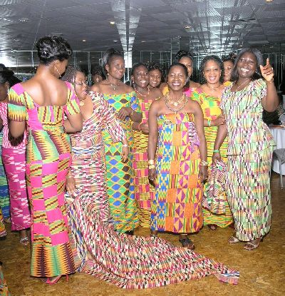
Kente
Notes:
(http://www.afrikboutik.com/kentescarfs/kente2.jpg)
(http://www.kentecloth.net/wp-content/uploads/2009/10/kente-pics222.jpg)

Slide 8
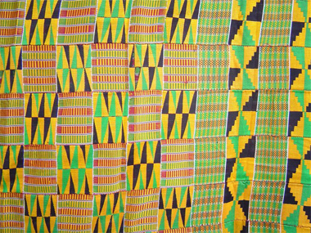
Kente
Notes:
(http://jd-associates.net/images/kente_22.jpg)
(http://www.marshall.edu/akanart/images/KENTESTORE.JPG)

Slide 9
Step 2 – Personify These Values
How does Kente personify the Ghanaian culture?

Slide 10
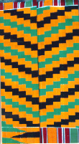
Step 2 – Personify These values
1. People are a mix of good and evil.
OBI NKYE OBI KWAN MU SI
“To err is human”
Notes:
The Ghanaian belief about human nature is that people are a mix of good and evil. The Kente personifies this thought through this pattern called “Obi Nkye Obi Kwan Mu Si” which literally translates to “sooner or later one would stray into the path of the other” (Marshall, 1998-2001).
The symbols of this pattern include:
Forgiveness
Conciliation
Tolerance
Patience
Fairness
This Kente represents the Ghanaian belief that although people in general may be good, there is always a chance for errors and mistakes. Thus there is a mix of good and evil in people.

Slide 11
Step 2 – Personify These values
2. The purpose of life is a mix of doing and being.
Notes:
The Ghanaians believe that their purpose in life involves a mix of doing (working) and being (living). Working is necessary for the Ghanaians to survive, but their hard work is balance with their ability to live life. Ghanaians attend many festivals and social events where their Kente is worn. The people wear their Kentes to “reflect the spirit of the occasion” (Midwest Global Group Inc.). The Kentes represent the Ghanians need to celebrate to balance out their work and social lives.

Slide 12
Step 2 – Personify These values
3. Decisions are made collectively as a group rather than by individuals.
OBAAKOFOO MMU MAN
“One person does not
rule a nation”
Notes:
Ghanaians make decisions as a group and consider the good of the group rather than the good of the individual. This pattern called “Obaakofoo Mmua Man” literally translates to “one person does not rule a nation (Marshall, 1998-2001).”
This Kente pattern is used to represent the Ghanaian belief that an individual cannot make “a nation,” but rather that a nation involves the work of multiple people. The symbols included in this pattern are:
Participatory democracy
Warning against dictatorial rule
Plurality of ideas

Slide 13
Step 2 – Personify These values
4. They cannot control everything but they believe the decisions they make determine their fate.
Notes:
Another pattern of Kente is named “I alone did not cause this to happen” ( African Journey, n.d.). This name exemplifies the Ghanaian belief that an individual cannot control his fate alone. The individual along with a higher being make up the fate of the individual.

Slide 14
Step 2 – Personify These values
5. You should live in the present rather than focusing on yesterday or tomorrow.
Notes:
Kente weaving is believed to have flourished in West Africa between 300 A.D. and 600 A.D., and were originally worn for important, special social, and religious events. However, the Kente has adjusted to common day use. The social changes and modern day living has changed how the Kente is used. There are now machine printed Kentes that are more accessible for people. This adjustment for the wearing of the Kente relates to how the Ghanaian people have adjusted for present day. Instead of focusing on the past meaning of the Kente, they have created new meanings for present day use (Midwest Global Group Inc., 2009).
However, it is important to note that the original loom woven Kentes are still made and are still used for special occasions rather than everyday use.

Slide 15
Step 2 – Personify These values
6. Indirect communication is best to avoid confrontations.
Notes:
Ghanaians use an indirect way to communicate with other. This is one of the main reasons why the Kente personifies the culture so well in terms of communication. The Kenta is made up of symbols and colors that all have a different story to tell. Some may tell about the history of the country, while others may explain a proverb that is widely used. A Kente is considered a “visual representation of history, philosophy, ethics, oral literature, religious belief, social values and political thought (Midwest Global Group Inc., 2009).”
The Kente is an indirect way of communicating a value or belief that the individual has to others around him or her.

Slide 16
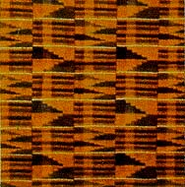
Step 2 – Personify These Values
Unequal distribution of power is necessary for all people of that society.
ADWINASA
“All motifs are used up”
Notes:
Ghanaians believe that the unequal distribution of power is necessary and they therefore embrace this idea; something not common to westerners. Many Ghanaians are inclined to show this power via their outward appearance. This design represents “royalty, wealth, elegance, excellence, and perfection” and was originally worn by the most prestigious with high status and power. By allowing only few to wear this cloth, it represents the uneven distribution of wealth and power among the Ghanaian people. (Boahene)

Slide 17
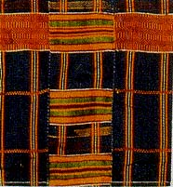
Step 2 – Personify These Values
Unpredictable situations are seen as opportunities rather than hindrances.
EMAA DA
“It has not happened
before"
Notes:
Ghanaians embrace unpredictable situations and are ready to take risks to receive a higher gain. This design represents exactly that attitude because it literally means “it has not happened yet” or “it has no precedent.” This Ghanaian core value is reflected in this cloth. (Boahene)

Slide 18
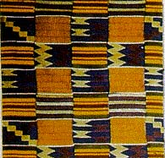
Step 2 – Personify These Values
Gender roles are blurred so men and women have the same opportunities and family is always a factor in decision making.
ABUSUA YE DOM
“The extended family
is a force"
Notes:
Ghanaian people do not have such rigid gender roles are we are familiar with in society. For this reason, family is a more prevalent topic/factor in decision making processes for Ghanaians. They have designed a cloth which proves this cultural value. This design represents “strong family bonds, the value of family unity, and responsibility.” (Boahene)

Slide 19
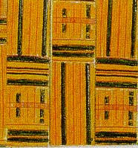
Step 2 – Personify These Values
The good of the group always comes before the good of an individual.
WOFRO DUA PA
A NA YEPIA WO
“One who climbs a
tree worth climbing
gets the help deserved"
Notes:
Ghanaians also believe that when making decisions, one must first consider the good of all within the society before considering ones own benefit. This particular cloth represents “aspiration, hope, mutual benefits, sharing, and noble deeds.” These are all attributes of a person who is willing to make sacrifices of themselves if it means better for all people. (Boahene)

Slide 20
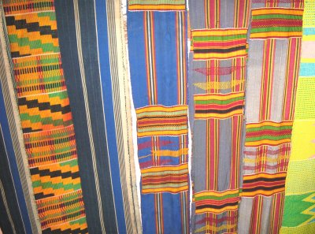
Step 2 – Personify These Values
Your intentions are more important that the specifics of a situation.
Silver Thread
Notes:
Ghanaians place a heavy emphasis on the fact that no matter what the deal is, your intentions about the deal are most important. They place a great deal of importance of being able to trust the person you are making a deal with. The symbolic meaning of the color silver within Kente cloth is that of serenity and purity which is associated with pure intentions and a pure heart. (Project Exploration)
There was no predominantly silver Kente but you can see some of the siver threads used for the piece above.

Slide 21
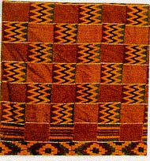
Step 2 – Personify These Values
12. Status should be publicly demonstrated to show your place in society.
SIKA FUTORO
“Gold dust”
Notes:
Ghanaians are firm believers of demonstrating and flaunting your status publicly. For this reason, some cloths are designed for those of high status and wealth to wear like the piece above. This cloth represents “wealth, royalty, elegance, and honorable achievement.” (Boahene)

Slide 22
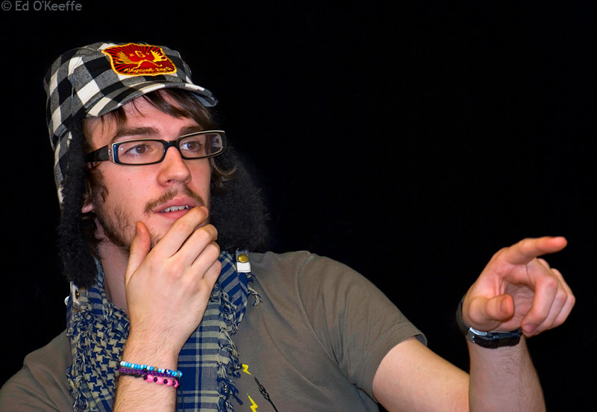
Taboos
Use of the left hand
Don’t call anyone silly
Don’t Do This
Notes:
Just as the Unites States has certain taboos we would not appreciate our visitors neglecting, such as using the middle finger, Ghana also has taboos which they expect you to respect while travelling abroad.
One taboo is the use of the left hand. “The left hand has limited functions in Ghana. In fact, the use of the left hand for certain activities is considered an abomination. In particular, avoid receiving or giving gifts, gesticulating in speech, waving at a person or pointing things out with the left hand.” (Touring Ghana)
Another less commonly known taboo of Ghana is calling an individual silly. To call someone this shows a sign of disrespect for that person and therefore should be avoided. (McGinnis)
(http://www.edwud.com/photos/pointing_portrait_mj_kov.jpg)

Slide 23
Etiquette
Dress Attire
Dress modestly
Wear business suits for formal meetings
Remove hats when speaking to an elderly person or chief to show respect
Notes:
While most attire is acceptable by most people of Ghana, one should dress fairly modestly. Shorts and t-shirts are acceptable everyday wear. However, some elderly may be offended by this type of dress. (Vayama.com)
You should wear business suits to formal meetings, such as a bank or with the government, but lightweight suits and cotton dresses are suitable otherwise. (Vayama.com)
If wearing a hat, one should remove it when speaking to an elderly person or someone of high importance, such as a chief. (Vayama.com)
(http://cdn.sheknows.com/articles/woman-business-suit.jpg)

Slide 24
Etiquette
Table Manners
Pay for a meal if you invited a person
Alcohol: You may drink, but do not get publicly intoxicated.
Put drink to lips, don’t sip, pour drink on ground
Don’t blow nose
Don’t use left hand
Don’t tip unless you had exceptional service (5%-10%)
Notes:
If you find yourself eating in Ghana (and you will) please keep a few things in mind.
If you invited a person, or group of people, out to eat with you, you should pick up those persons’ bills.
You are welcome to consume alcoholic beverages. However, do not get intoxicated in pubic. If you do not drink alcohol but were poured a drink, it is customary and socially acceptable for you to touch the glass to your lips without taking a sip and then pouring the drink on the ground. Thus, relieving you of feeling pressured into drinking.
Do not blow you nose at a table and refrain from eating with your left hand.
It is not customary in Ghana to tip for services. However, if you received truly exceptional service, you can give a small tip of around 5% to 10%.
(Vayama.com)

Slide 25
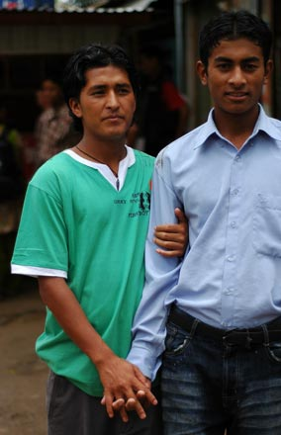
Etiquette
Body Gestures
Do not sit with legs crossed
Hand holding
Left hand
Notes:
While in Ghana, do not sit with your legs crossed while in the presence of elders or a chief. You should also remember to not make any gestures with your left hand such as pointing, waving or giving gifts. (Vamaya.com)
You should also be aware that in Ghana, it is common to see members of the same sex holding hands as a sign of friendship (unlike the very homophobic western culture). You should also be aware that members of the opposite sex should not hold hands in public. (Vamaya.com)
(http://www.cringel.com/files/images/adia-2007-07-12-DSC-9742-nepali-men-holding-hands-nepal-baglung-cringel.com.jpg)

Slide 26
Etiquette
Greetings
Handshake and Smile
Greet everyone; starting with the most elderly
Handshake upon departure
Don’t use left hand
Notes:
When greeting people, you should give a handshake and smile. But, NEVER use your left hand! Make sure to greet everyone present; starting with the elderly working your way to any children. You should also remember to shake hands again prior to departure (much like in the United States). (Vamaya.com)
(http://www.boyscouttrail.com/i/w_badge_images/shake.gif)

Slide 27
Etiquette
Photographs
Do not take pictures of scared grounds
Do not take pictures at state house, prisons, airports, etc…
Ask prior to capture
Notes:
You will probably be excited to capture your trip/adventure via photography. Please remember a few tips:
Do not under any circumstances take pictures of sacred grounds while in Ghana.
Do not take picture of sensitive areas such as the state house, prisons, airports, etc…
Always ask someone prior to taking their picture for permission. Due to religious beliefs, some people are afraid that you may capture their soul within your photo.
(Vayama.com)

Slide 28
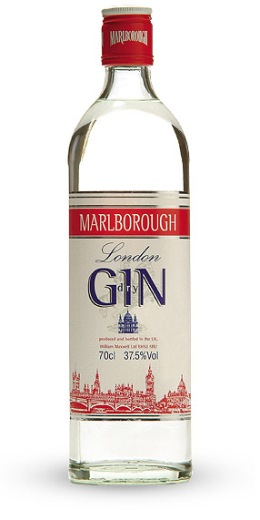
Etiquette
Miscellaneous
Do not be late for business appointments
Do not speak directly with a chief or king; use a third party linguist
Offer gifts such as Schnapps, gin, or money to chiefs, kings or hosts
Visitors will ask about you intention of visits, be honest
Notes:
Just a few more etiquette tips to keep in mind:
Always show up on time for business appointments
Do not speak directly with a chief or king. You should rather use a third party linguist to make that connection.
Offer gifts such as schnapps, gin, or money to a chief, king or host
When you are a visitor, expect a seat, water and the question of the intention of your visit. Be honest.
(Vamaya.com)
(http://www.ianmacleod.com/site/uploads/1175181839.9252.jpg)

Slide 29
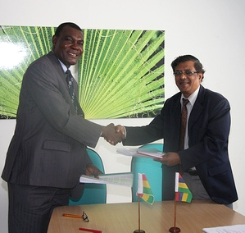
Recommendations for Automotive Glass, Inc.
Involving:
Communication
Management style
Organizational structure
Negotiating
Notes:
"Mauritius - Ghana Double Tax Treaty." Cim Global Business Company, IMM,. Web. 28 Apr. 2010. <http://www.imm.mu/page.php?page_id=83〈=1>.

Slide 30
Communication
Train employees to interpret what is being said
Avoid confrontational topics
“Yes” might be said to prevent embarrassment but may not be meant
Proverbs are used to convey a subtle message
Silence is appreciated
Notes:
As mentioned before under the 12 core cultural values, Ghana is a high context country when it comes to communication. They are rather indirect about what they say, so it would be best for the company to train its employees to be able to interpret the meaning of a conversation. This cultural value also plays into the fact that Ghanaians avoid confrontations. The idea of “face” is very important to the Ghanaians, so they avoid confrontational conversations that may bring up issues or having to refuse someone. (Kwintessential)
Proverbs are very important to the Ghanaian culture. Thus, individuals may use proverbs to convey a message, while at the same time seem wise. Also important is silence. If an individual is uncomfortable or does not think the other party wants a response, he or she will remain silent. (Kwintessential)

Slide 31
Management Style
Higher position- more power and decision making
Decision making does not require consulting with “lower” employees
Managers concern themselves with employee life outside of work
Deadlines have become more important
Avoid criticism publically and privately
Notes:
The management style in Ghana is that those with higher positions have more power and make the decisions. They believe that the supervisors have been chose because they have “more experience and greater knowledge” than those being managed, thus it is unnecessary for them to consult with the lower positions when making decisions. (Kwintessential)
However, managers may demonstrate concern for employees beyond typical workplace issues. Managers may take great interest in the employee’s family, health, and various other life issues that are not profession related. (Kwintessential)
Due to globalization, Ghanaians have place more importance on the idea of deadlines. They believe that strict standards and adhering to schedules are important. (Kwintessential)
Managers should take great caution in avoiding criticizing employees. Ghanaians view “face” with great importance, even in a private setting. It is best to understand that employees will not take well to criticism even if it is constructive.

Slide 32
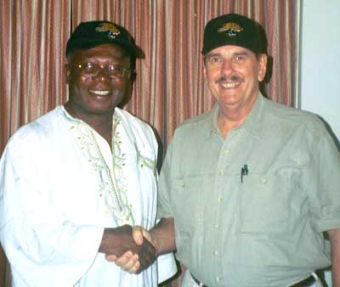
Organizational Structure
Hierarchy: “top down”
Respect elders and those in senior positions
Order is kept
Individuals that make up the group determine the success or failure of the project
Notes:
The organizational structure of businesses in Ghana go hand in hand with the management style. Ghana is a “top down” society meaning that there is a hierarchy and the decisions come from the top managers traveling to the bottom employees. To be successful in Ghana one must remember to be formal and courteous to older people and those with senior positions. Those at the top are to be treated with the utmost respect and reverence. (Kwintessential)
Each person in the company has a distinct role and is expected to play that role carefully to keep the order of the company. Managers tell the subordinates what needs to be done, and the subordinates get that accomplished. Although hierarchy is important, successful management is based on the ability of the individuals of the group to do their role and perform accordingly. (Kwintessential)
"Stephen M Price in Ghana." Web. 28 Apr. 2010. <http://www.hpmc.com/ghana/>.

Slide 33
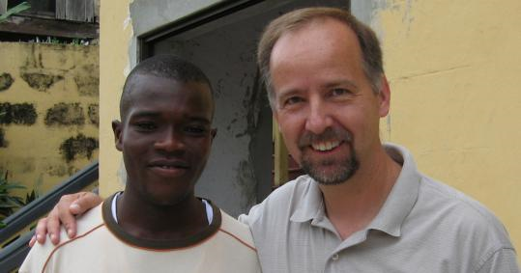
Negotiating
Build a relationship; it may take some time
Realize that negotiations will take time
Avoid rushing the other party
Avoid impatience and anger
Avoid assuming the negotiation is going well if there is a lack of disagreements or challenges
Notes:
In regards to negotiations, the higher positioned individuals will have the power to negotiate. Ghanaians also place great importance on relationships, so it would be best for Automotive Glass, Inc. employees to develop a relationship with the Ghanaians. It may take a lot of time to build this relationship, but in the end it will be for the best of the company. (Kwintessential)
Remember that the decision making lies with those in higher positions which usually means the CEO, thus expect the negotiation to take time. Avoid rushing the other party, otherwise it may cause offense and risk the entire business negotiation. Also avoid becoming impatient or becoming upset. Neither emotions will fair well in this negotiation. (Kwintessential)
As stated before, Ghanaians have a hard time disagreeing, so do not assume that the negotiation is going well because there are no disagreements or challenges. (Kwintessential)
"Babson Dean Teaches Business Skills in Ghana - The Boston Globe." Boston.com. Web. 28 Apr. 2010. <http://www.boston.com/news/local/articles/2008/02/10/a_start_up_bridge_to_ghana/>.

Slide 34
Summary Table of Differences
United States | Ghana
Purpose in life: live to work | Purpose in life: mix of doing and being
Societal role: individualistic | Societal role: collectivists
Mode of communication: direct, low context | Mode of communication: indirect, high context
Time: future oriented | Time: present oriented
Management style: group oriented, everyone has an input | Management style: higher position has more power and makes decisions
Negotiation: involves a contract | Negotiation: involves building a relationship
Confrontations: addressed if there are any | Confrontations: avoided
Work vs. Social life: professional and social life are kept separate | Work vs. Social life: mixed together

Slide 35
Summary Table of Differences
United States | Ghana
Low Power Distance: Inequalities of power are not acceptable | High Power Distance: Inequality in status and power are accepted and embraced
Low Uncertainty Avoidance: Risks and unpredictable situations are embraced | Low Uncertainty Avoidance: Risks and unpredictable situations are embraced
Masculine: Gender roles are clearly defined and adhered to while family in decision making is put on the back burner | Feminine: Gender roles are blurred and family is a major decision making factor
Universalistic/Individualistic: Interest of group over individual interest | Particularistic/Collectivist: Individual interest over group interest
Specific: We want you to just get to the point so we can make a decision | Diffuse: Intentions are more important than the situation
Status is not flaunted in public as everyone wants to be treated equally | Those of high wealth and status are expected to show it in public so people are aware

Slide 36
Summary Table of Differences
United States | Ghana
Attire: Less conservative | Attire: More conservative
Tip Generously | Don’t Usually Tip
Free use of both hands | Never use your left hand
Greeting: Greet everyone in no particular order | Greeting: Greet elderly first
Greeting: Handshake | Greeting: Handshake and smile
Hand Holding is acceptable only among opposite sex | Hand Holding is acceptable only among same sex
Speak directly with anyone | Do not speak directly to kings or chiefs; use a third party linguist
Photography: Capture anything | Photography: Ask permission and not sacred grounds

Slide 37
Thank You Again
Best wishes in your future travels to Ghana

Slide 38
Citations
Notes:
"Peoples of Niger." African Journey. Project Exploration, n.d. Web. 30 Apr. 2010. <http://projectexploration.org/jobaria/AfricanJourney.html>.
Boahene, Kwadwo. "History and Significance of Ghana's Kente Cloth." African Journey. Manchester Public Schools, 1995. Web. 30 Apr. 2010. <http://art-smart.ci.manchester.ct.us/fiber-kente/kente.html>.
Arthur, G.F. Kojo, and Robert Rowe. "Akan Kente Cloths." Akan Cultural Symbols Project. N.p., 2006. Web. 30 Apr. 2010. <http://www.marshall.edu/akanart/CLOTH_KENTE.HTML>.
"Ghana Etiquette Tips." Vayama. N.p., n.d. Web. 30 Apr. 2010. <http://www.vayama.com/etiquette/ghana/>.
"Travel Guide." Touring Ghana. N.p., n.d. Web. 30 Apr. 2010. <http://www.touringghana.com/traveltips.asp>.
"Akan Kente Cloth Symbols: Introduction." Marshall University - Huntington, WV. Web. 28 Apr. 2010. <http://www.marshall.edu/akanart/cloth_kente.html>.
"Akan Kente Cloths and Motifs." Marshall University - Huntington, WV. Web. 28 Apr. 2010. <http://www.marshall.edu/akanart/kentecloth_samples.html>.
"History of Ashanti Kente Cloth." Handcrafted African Textiles and Handicrafts. Web. 28 Apr. 2010. <http://kente.midwesttradegroup.com/history.html>.
"Ghana- Culture, Etiquette, Customs and Protocol." Translation Services | Interpreters | Intercultural Communication | Cross Cultural Training. Web. 30 Mar. 2010. <http://www.kwintessential.co.uk/resources/global-etiquette/ghana.html>.

