Slide 1
Extending God's kingdom,
one life at a time,
by making disciples, who make disciples

Slide 3
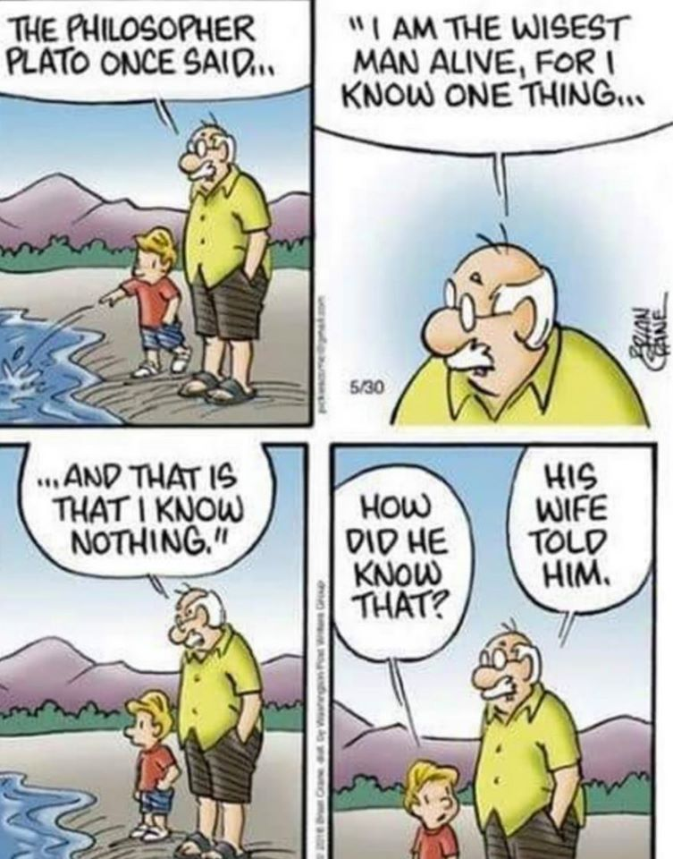

Slide 7
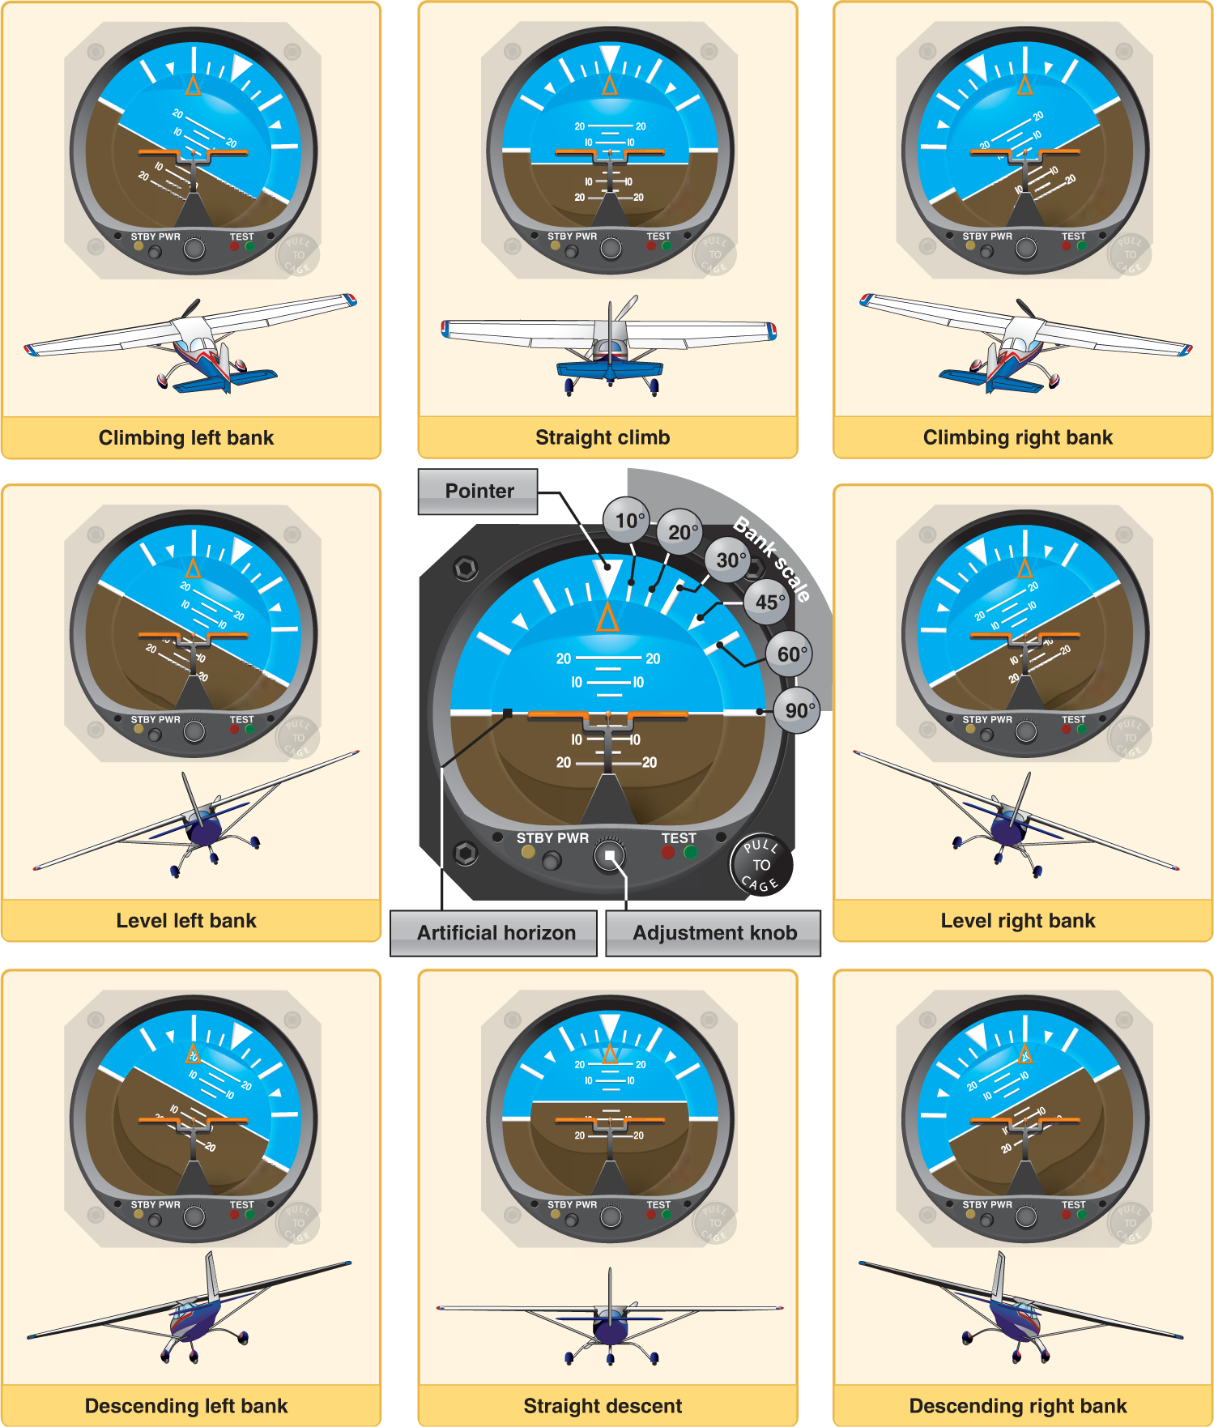
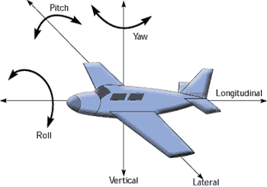
heading or yaw (around the yaw axis)
pitch (around the lateral axis)
roll or bank (around the longitudinal axis).

Slide 9
Your attitude is determined by the collection
of the dominant thoughts in your mind.
“WWJT” or “What would Jesus think.”
Before you ever do anything. . .you need to think. . .like He would think!
Napoleon Hill, once said:
“What the mind of man can conceive and believe, it can achieve."

Slide 10
1. Where do you get the right kind of attitude?
Ephesians 4:23 in the Amplified Bible says:
“And be constantly renewed in the spirit of your mind [having a fresh mental and spiritual attitude].”
Philippians 2:5 in the New Living Translation says:
“You must have the same attitude that Christ Jesus had.”
The Contemporary English Version of Philippians 2:5 puts it this way:
“And think the same way that Christ Jesus thought.”

Slide 11
Romans 12:2 says:
“And be not conformed to this world: but be ye transformed by the renewing of your mind, that ye may prove what is that good, and acceptable, and perfect, will of God.”
Read your Bible. . .do what it says.

Slide 12
2. Prepare your attitude for tomorrow.
Proverbs 3:24 says:
“When you lie down, you will not be afraid: yes, you will lie down, and your sleep shall be sweet.”

Slide 13
3. Begin your day with happy hour.
Psalm 5:3 in the New International Version which says:
“In the morning, O Lord, you hear my voice; in the morning I lay my requests before you and wait in expectation."
Begin each day filled with supernatural expectation about the manifestation of God’s presence, peace, protection, promises, power, promotion and provision.

Slide 14
4. “Keep the main thing. . .the main thing.”
The main thing. . .is another way of saying
“stay focused.”
Don’t spend time talking with negative people. . .if you have a choice.
Stay away from things that fill your mind with negative events.
Be careful of time vampires. . .who will suck the very time out of your day and life.

Slide 15
5. You are responsible for motivating and encouraging yourself.
1 Samuel 30:6 says:
“And David was greatly distressed; for the people spoke of stoning him, because the soul of all the people was grieved, every man for his sons and for his daughters: but David encouraged himself in the LORD his God.”

Slide 16
6. Be a doer. . .not a talker. . .not a tryer. . .but a doer.
James 1:22 in the Amplified Bible says:
“But be doers of the Word (obey the message), and not merely listening to it; betraying yourselves [into deception by reasoning contrary to the truth.].”
According to Strong’s Concordance the word doer is the Greek work poiētēs (G4163) and it means:
“a maker, a producer, author, a doer, performer.”

Slide 18
7. The God-kind of attitude will allow you
to do what others say can’t be done.
The right kind of attitude. . .the kind Jesus had. . .will allow you to persist through adversity until you gain the victory. No matter what the naysayers. . .say.

Slide 20
Wrong Attitudes Vs Right Attitudes

