Slide 1
Extending God's kingdom,
one life at a time,
by making disciples, who make disciples

Slide 2
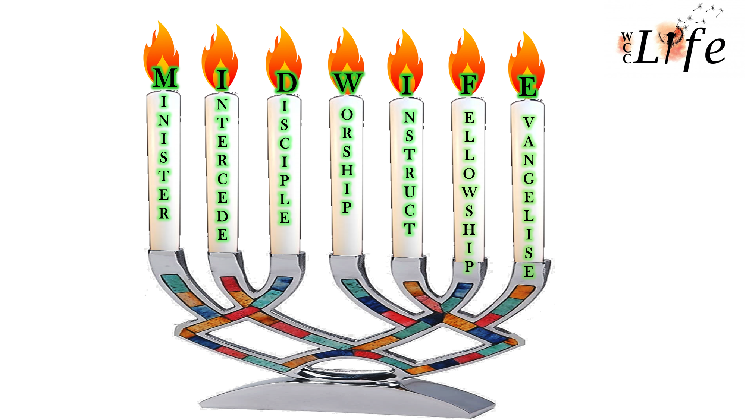

Slide 3
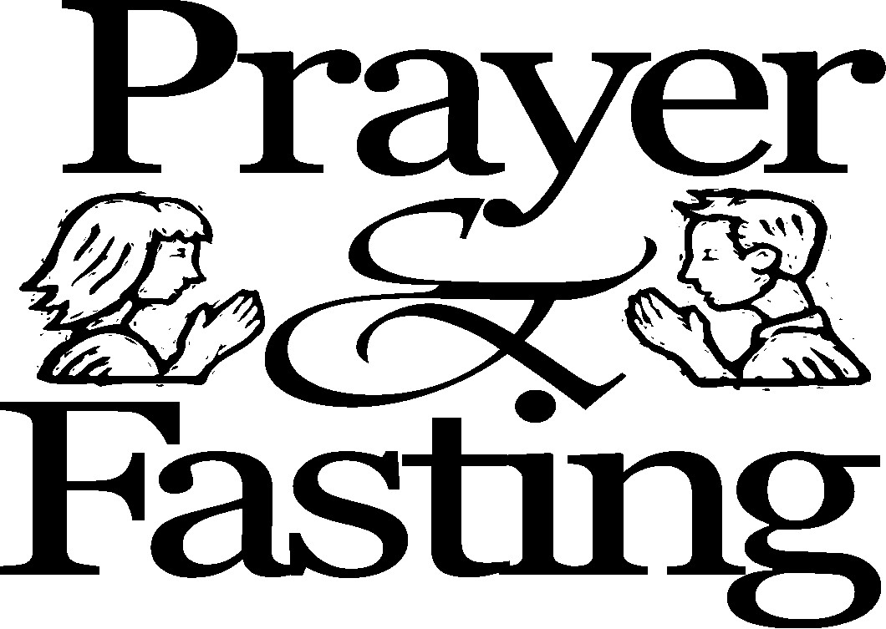
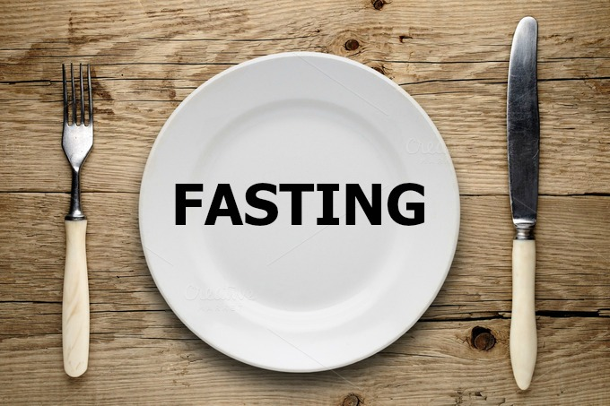
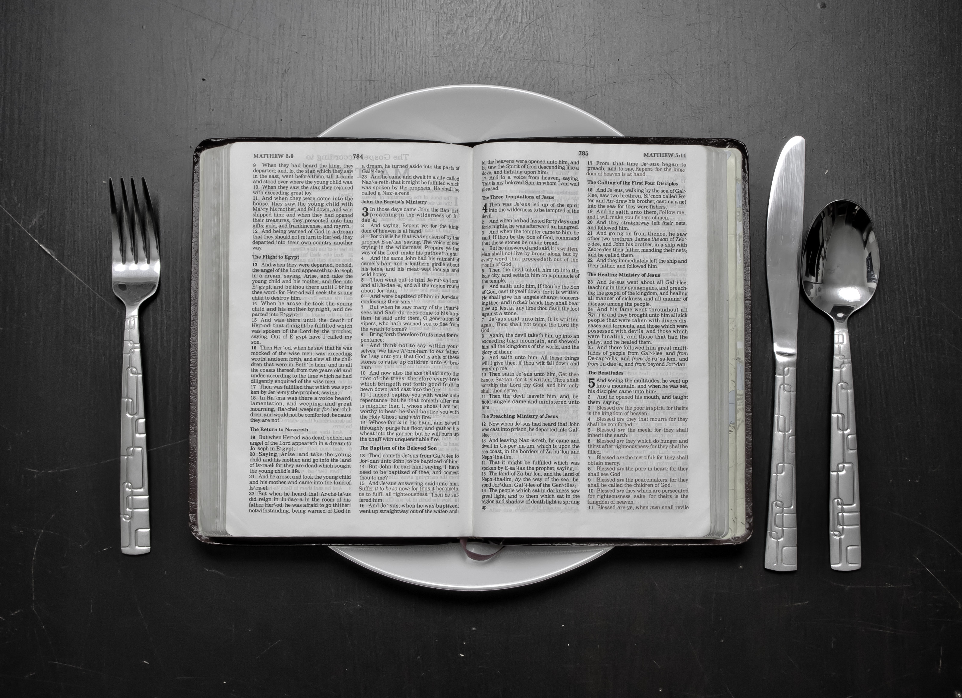

Slide 4
“We are a culture of abundance that indulges and abuses—fasting is a means of God’s grace to embrace someone greater than our appetites.” Keyan Soltani

Slide 5
In a culture where the landscape is dotted with shrines to the Golden Arches and an assortment of Pizza Temples, fasting seems out of place, out of step with the times.
Richard Foster

Slide 6
1. WHAT IS FASTING?
Fasting and prayer go hand in hand. Fasting is more than mere abstinence from food. It means putting God first; the seeker then abstains for the period of fasting. Fasting is clearly taught and demonstrated in the Holy Scriptures, although in some translations mention is only made in the footnotes: Esther 4:16, Jonah 3:7, Matthew 4:2, Mark 8:1-3, Luke 4:2, Acts 27:33.

Slide 7
Esther 4:16 (NKJV)
¹⁶ “Go, gather all the Jews who are present in Shushan, and fast for me; neither eat nor drink for three days, night or day. My maids and I will fast likewise. And so I will go to the king, which is against the law; and if I perish, I perish!”

Slide 8
Jonah 3:7 (NKJV)
⁷ And he caused it to be proclaimed and published throughout Nineveh by the decree of the king and his nobles, saying,
Let neither man nor beast, herd nor flock, taste anything; do not let them eat, or drink water.

Slide 9
Matthew 4:2 (NKJV)
² And when He had fasted forty days and forty nights, afterward He was hungry.

Slide 10
Acts 13:3 (NKJV)
³ Then, having fasted and prayed, and laid hands on them, they sent them away.

Slide 11
Matthew 6 (NKJV)
² Therefore, when you do a charitable deed…
⁵ “And when you pray…
¹⁶ “Moreover, when you fast…

Slide 12
2. DEFINITION
Fasting means abstinence from food, drink, pleasures of life, sex, business etc. so that the seeker can make
time for prayer, seeking the favour and mercy of God.
3. ORIGIN OF FASTING
Fasting has its origin in the Old Testament Law: Leviticus 16:29-31; Leviticus 23:27-32.
The Hebrews fasted on the Day of Atonement: Numbers 29:7.

Slide 13
4. WHY SHOULD WE FAST?
(a) The Holy Scriptures encourage us:
Leviticus 16:29-31, Matthew 5:6,
Mark 9:14-29, e.g. King of Nineveh appointed a fast in Jonah 3:7
Joel 1:14
Declare a holy fast; call a sacred assembly. Summon the elders and all who live in the land to the house of the LORD your God, and cry out to the LORD.

Slide 14
(b) The saints of old practised it.
Moses – Exodus 34:28
Jews – 1 Samuel 7:6
Elijah – 1 Kings 19:8
Ezra – Ezra 10:6
David – 2 Samuel 3:35
Daniel – Daniel 9:3

Slide 15
(c) The saints of the New Testament practised it.
Apostle Paul – Acts 9:9, 2 Corinthians 11:27
Leaders in Antioch – Acts 13:2-3
Paul & Barnabas – Acts 14:23
(d) The Lord Jesus Christ is our example: Luke 4:1-2, Matthew 6:16, 17:21 .
(e) Fasting puts down the flesh and increases our spiritual capacity: Isaiah 40:31.
Fasting enables us to be more alive to spiritual activities. Deliverance is brought to those in bondage: Esther 4:16, Jonah 3, 2 Chronicles 20:1-25.

Slide 16
(f) It’s a means of obtaining special favours from
the Lord in crucial times: Ezra 8:21-23.
(g) It helps to kindle and develop faith: Matthew 17:20-21.
(h) Prayer with fasting makes the seeker’s prayer life more effective. This is not to say that fasting itself will produce miraculous answers, but it prepares the heart through humility: Psalm 35:13.
(i) We also fast to express repentance and sorrow for sin committed: Jonah 3:3-10.

Slide 17
^{Matthew 17:20} So Jesus said to them, “Because of your unbelief; for assuredly, I say to you, if you have faith as a mustard seed, you will say to this mountain, ‘Move from here to there,’ and it will move; and nothing will be impossible for you. ²¹ However, this kind does not go out except by prayer and fasting.”

Slide 18
5. WHEN SHOULD WE FAST?
1. For personal needs: Matthew 7:11
2. When facing national crisis: 1 Samuel 7:1-6, 2 Chronicles 20:3, Ezra 8:21, Esther 4:3
3. During periods of distress: 2 Samuel 3:35
4. To make spiritual decisions: Matthew 4:2, Acts 13:2
5. In anticipation of Christ’s return: Luke 5:35
6. HOW TO OPERATE BIBLICAL FASTING
1. There must be a Purpose
2. There must be a Duration
3. There must be Prayers

Slide 19
There is no express command as regarding the duration or length of a fast. But the following are scriptural
examples.
1. 40 days: Exodus 34:28, 1 Kings 19:8, Luke 4:1
2. 21 days: Daniel 10:3
3. 7 days: 2 Samuel 12:16-18
4. 3 days: Esther 4:16
5. 1 day: Judges 20:26

Slide 20
TYPES OF FAST:
1. Absolute Fast – Abstinence from both food and water
2. Total Fast – Abstinence from food only; water taken
3. Partial Fast (e.g. Daniel)
4. Daily Fast

Slide 21
5. Wrong & Right Fasting:
Isaiah 58: 3-5 Wrong
Is this the kind of fast I have chosen, only a day for a man to humble himself? Is it only for bowing one’s head like a reed and for lying on sackcloth and ashes? Is that what you call a fast, a day acceptable to the Lord?
Isaiah 58: 6-9 Right
Is not this the kind of fasting I have chosen: to loose the chains of injustice and untie the cords of the yoke, to set the oppressed free and break every yoke? (Is 58: 6)

Slide 22
