Slide 1
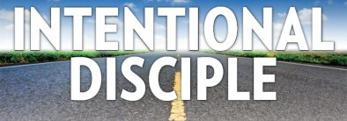
Disciples Making Disciples

Slide 3
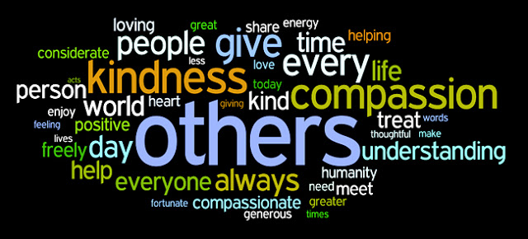

Slide 5
“If anyone desires to come after Me, let him deny himself, and take up his cross daily, and follow me” (Lk. 9:23).
A disciple is not above his teacher, nor a servant above his master. It is enough for a disciple that he be like his teacher, and a servant like his master…” (Mt. 10:24, 25a).
“You call Me Teacher and Lord, and you say well, for so I am. If I then, your Lord and Teacher have washed your feet, you also ought to wash one another’s feet. For I have given you an example, that you should do as I have done to you” (Jn. 13:13-15).

Slide 6
One of the fundamental aims of discipleship is to help others to become…

Slide 7
Disciples Making Disciples
At the heart of our mission as disciples is the reproduction in others of what Jesus has produced in us: faith, obedience, growth, compassion, love, and a bold, truthful message as his followers.

Slide 8
Then the eleven disciples went away into Galilee, to the mountain which Jesus had appointed for them. And when they saw Him, they worshiped Him; but some doubted. Then Jesus came and spoke to them, saying, “All authority has been given to Me in heaven and on earth. Go therefore and make disciples of all nations, baptizing them in the name of the Father and of the Son and of the Holy Spirit, teaching them to observe all things I have command you; and lo I am with you always, even to the end of age.” (Mt. 28:16-20).

Slide 9
“Go therefore and make disciples of all nations, baptizing them in the name of the Father and of the Son and of the Holy Spirit” (Mt. 28:19).
The word “go” is a present participle meaning (going or as you go). The only command in the entire great commission is to “make disciples.” In order to make disciples we must teach them what it means to be a disciple.

Slide 10
Pointing Others To Christ
The mission of the great commission is to lead men and women to the Saviour.
At the very heart of discipleship is a love for the souls and salvation of others.
To see others grow in Christ

Slide 11
What Making Disciples Is…
It is… serving with purpose and passion.
Taking the Lord’s words seriously
Taking the command personally
Taking on the mission passionately

Slide 12
If you watch a cooking show, One thing is very important, if you are going to duplicate the dish, you have to follow the recipe.
Making disciple of Christ is no different. It means following the Lord’s directions. (Acts 26:1-29)

Slide 13
We can’t make disciples by accident. It requires “going.” Jn. 4:32-35
Make the most of our opportunities. Phil. 1:12-14
Remember that it is God’s plan for making disciples. 1Cor. 3:3-9

Slide 14
God has given me the responsibility of serving his church by proclaiming his entire message to you. This message was kept secret for centuries and generations past, but now it has been revealed to God's people. For God wanted them to know that the riches and glory of Christ are for you Gentiles, too. And this is the secret: Christ lives in you. This gives you assurance of sharing his glory. So we tell others about Christ, warning everyone and teaching everyone with all the wisdom God has given us. We want to present them to God, perfect in their relationship to Christ. That's why I work and struggle so hard, depending on Christ's mighty power that works within me. (Col. 1:25-29).

Slide 16
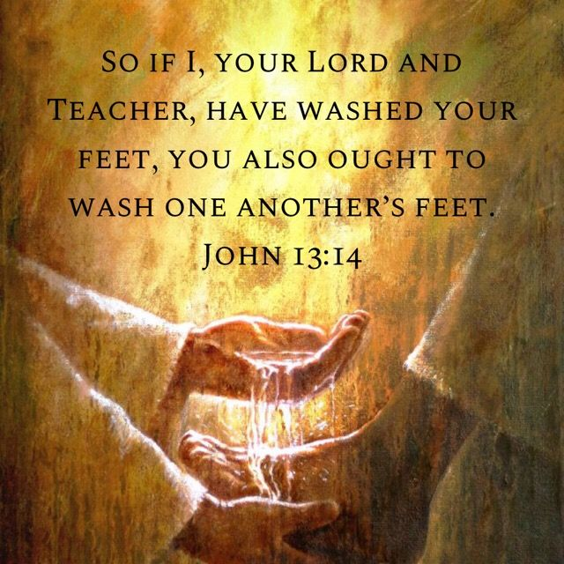

Slide 22
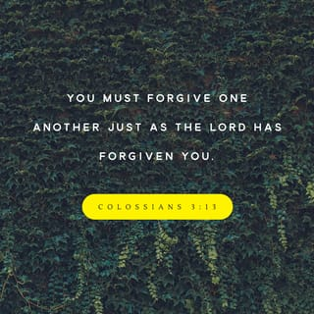

Slide 23
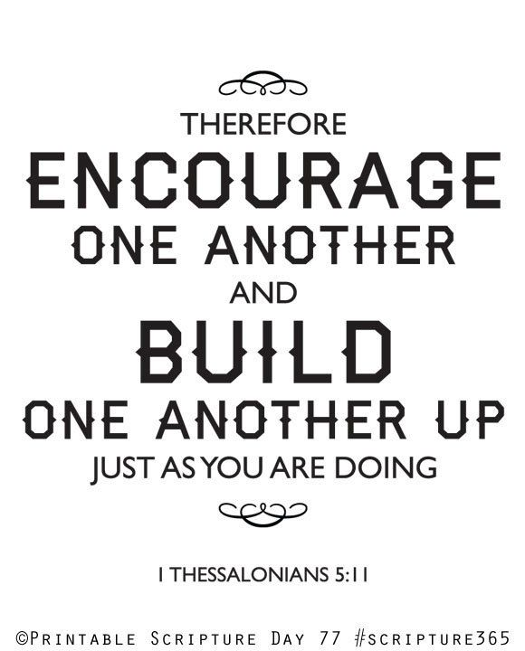

Slide 25
Be…
Intentional
Deliberate,
Purposeful and
Fearless!

Slide 26
In Colossians 1:28-29, “Him we proclaim, warning everyone and teaching everyone with all wisdom, that we may present everyone mature in Christ. For this I toil, struggling with all His energy that He powerfully works within me.”

Slide 27
1. The Heart of Discipleship: Proclaiming Jesus.
Temptation to fight: Proclaiming ourselves.
2. The Means of Discipleship: Teaching and Warning With Wisdom.
Temptations to fight: People-pleasing and harshness.
3. The Goal of Discipleship: To Present Everyone Mature in Christ.
Temptation to fight: Seeking fulfillment in being needed.
4. The Cost of Discipleship: Toil and Struggle.
Temptation to fight: Idolizing ease of life.
5. The Power of Discipleship: His Energy.
Temptation to fight: Dependence on self.

