Slide 1
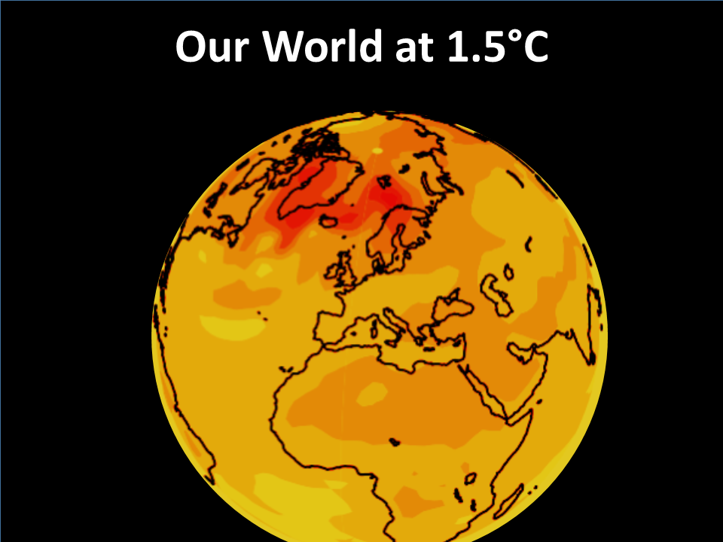

Slide 2
Content

Slide 3
NASA NEX maximum regional temperatures
What we need to know for most policy relevance is the regional maximum daily summer actual temperatures, that will occur at 1.5°C.
This is the big climate change impact on human health, ability to work outdoors and crop yields.
It is valuable information for risks of extreme intolerable heat to humans and livestock , drought and increased forest fires.
This is now (2015) provided by NASA NEX : NASA Earth Exchange (NEX) downscaled climate projections of maximum daily temperatures.

Slide 4
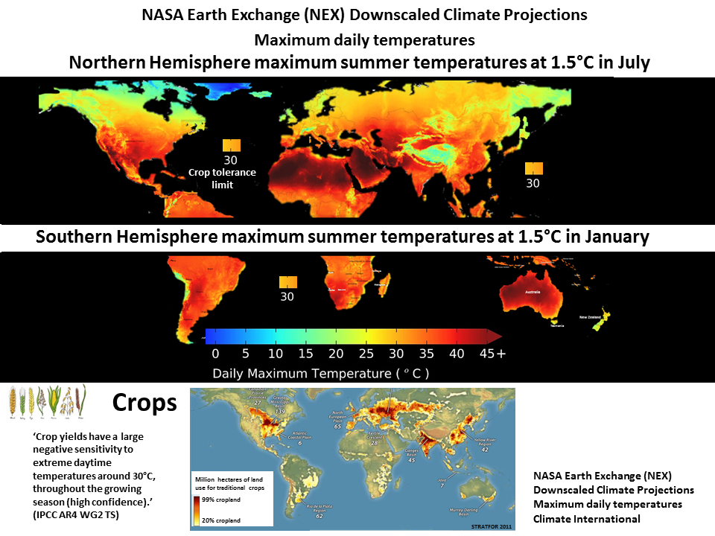

Slide 5
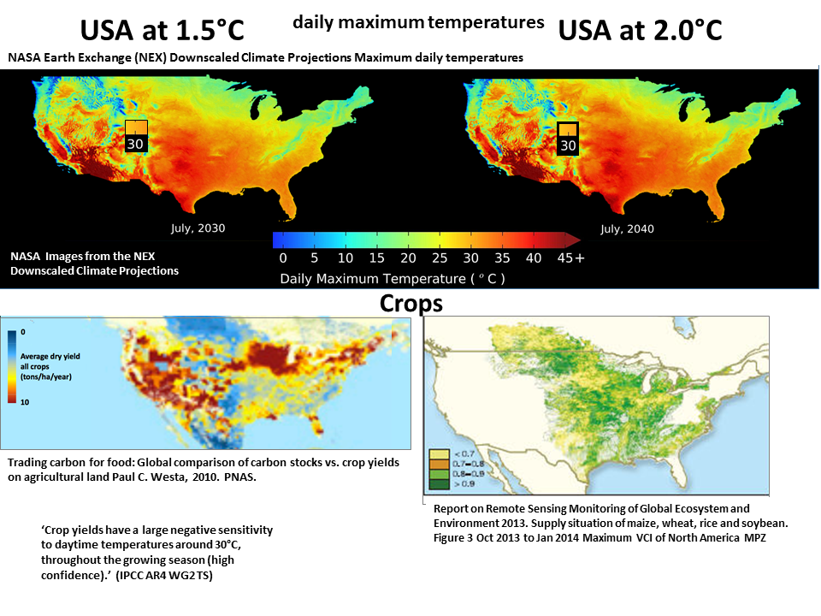

Slide 6
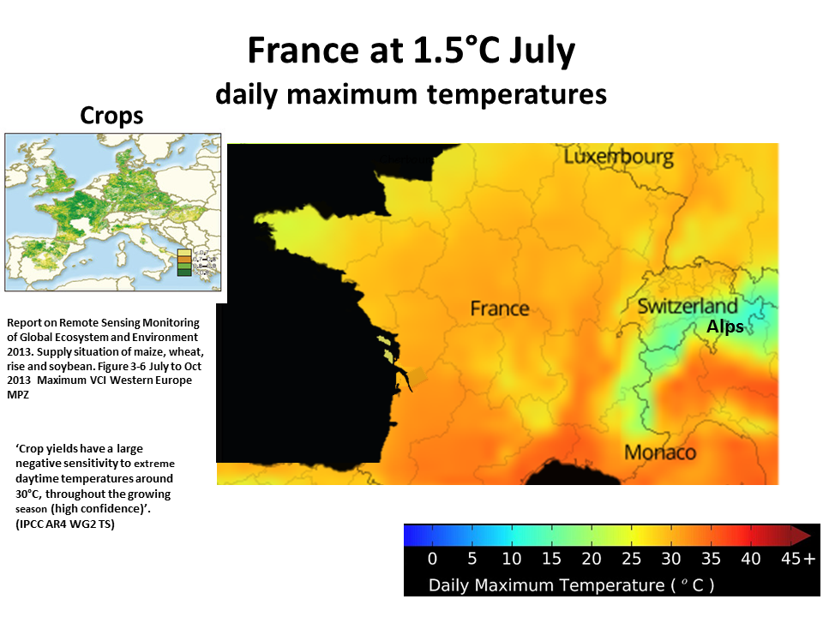

Slide 7
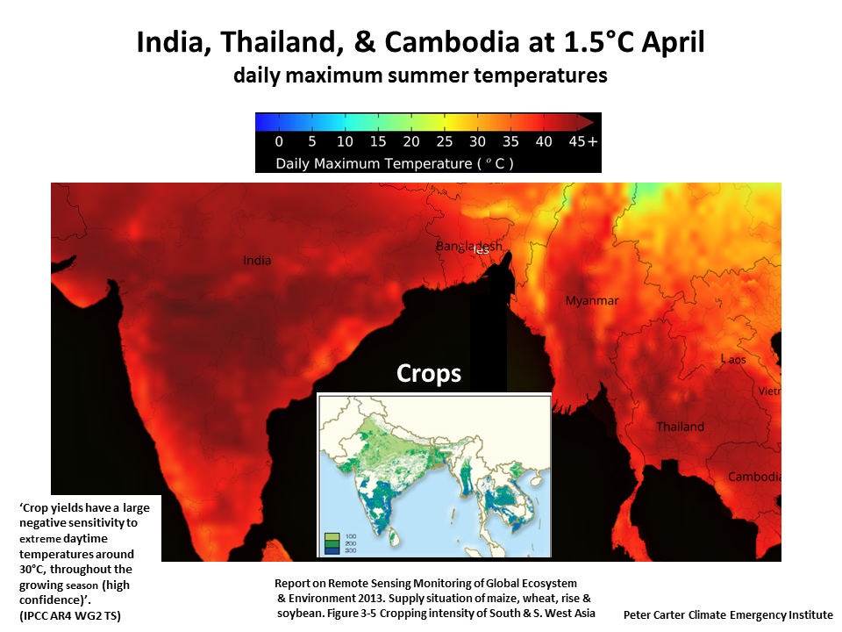

Slide 8
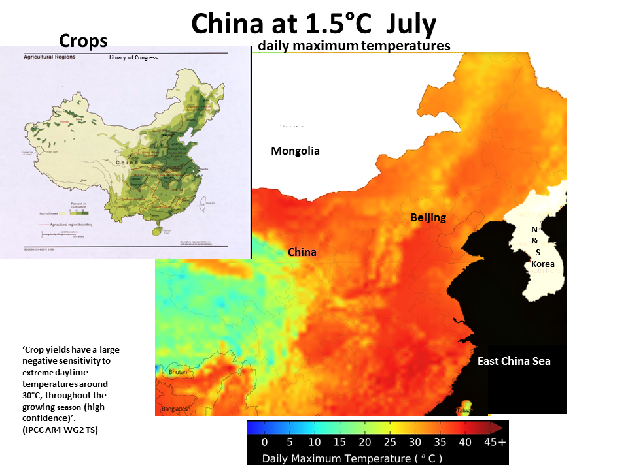

Slide 9
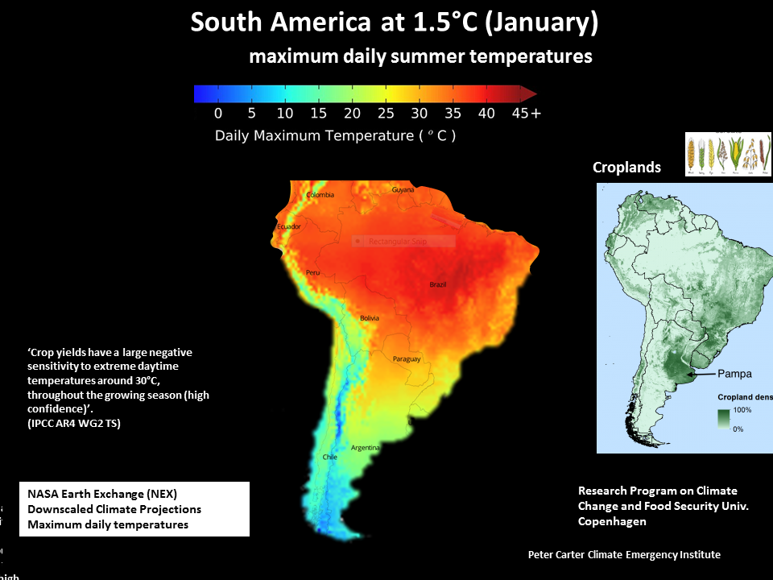

Slide 13
IPCC AR5
Projected impacts and changes at 1.5°C
Note: A warming of 1.5C is absolutely committed ( locked in) by climate system inertia.
Only immediate implementation of AR5 best case scenario (RCP 2.6) could possibly limit warming to 1.5°C and a >66% chance of 2.0°C by 2100.
(IPCC AR5 WG3, UN Climate Secretariat 2 May 2016 INDC Update)

Slide 14
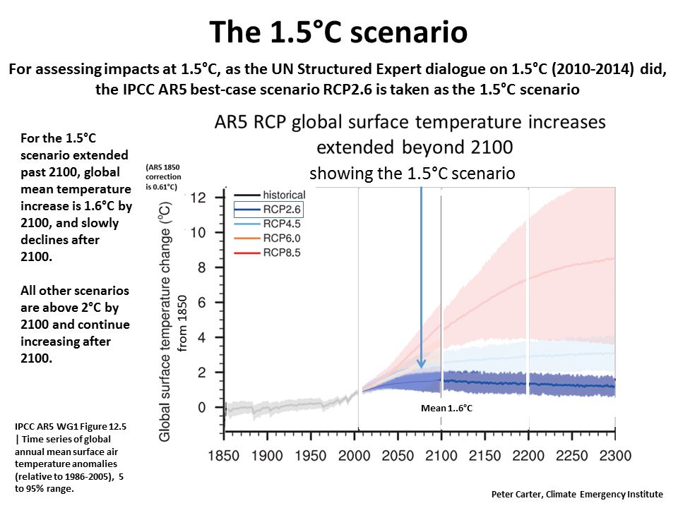

Slide 15
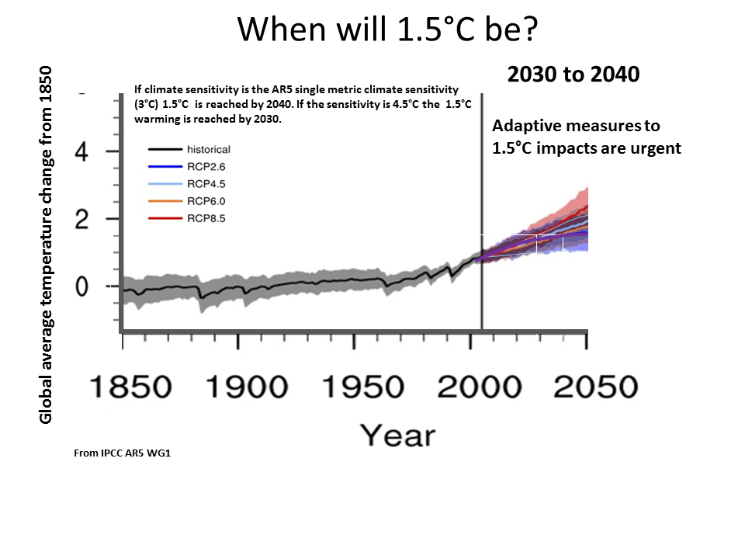

Slide 16
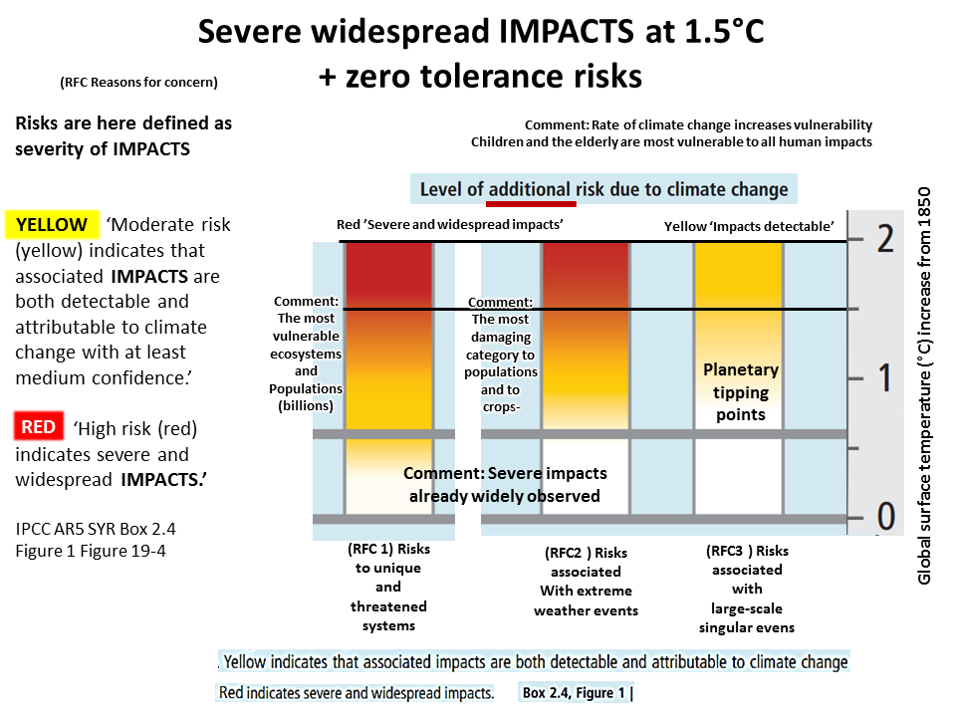

Slide 17
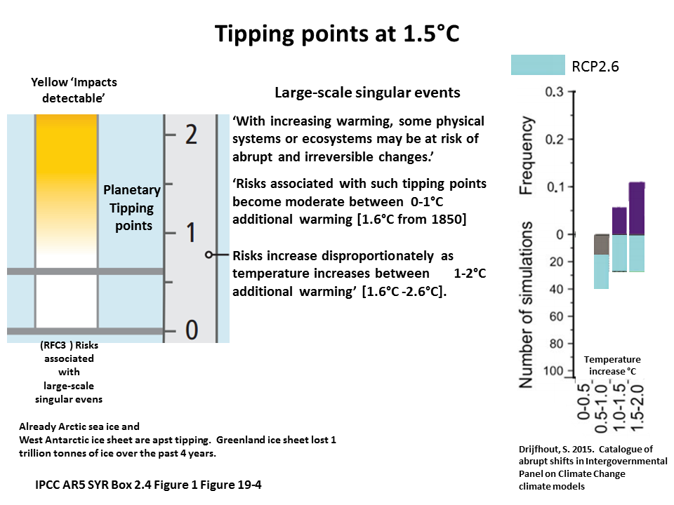

Slide 19
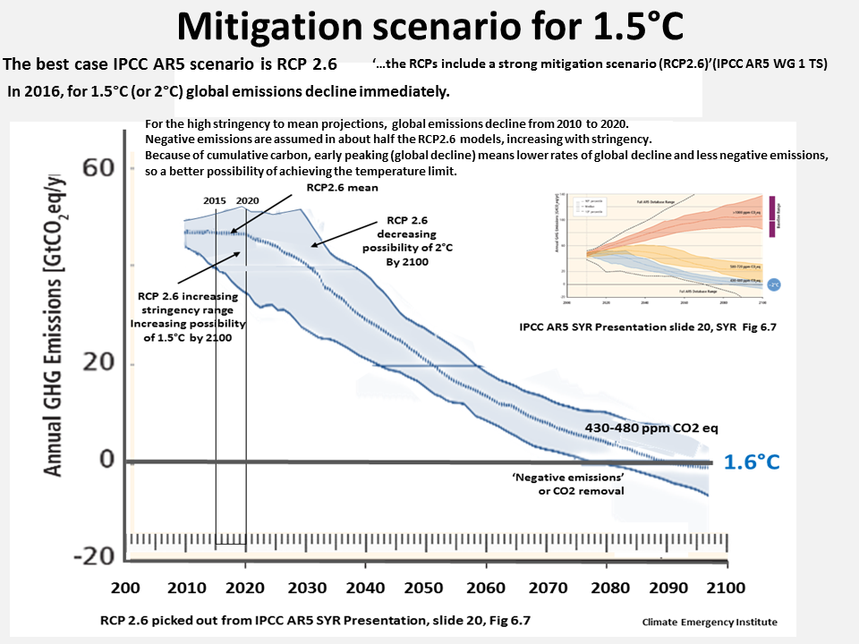

Slide 21
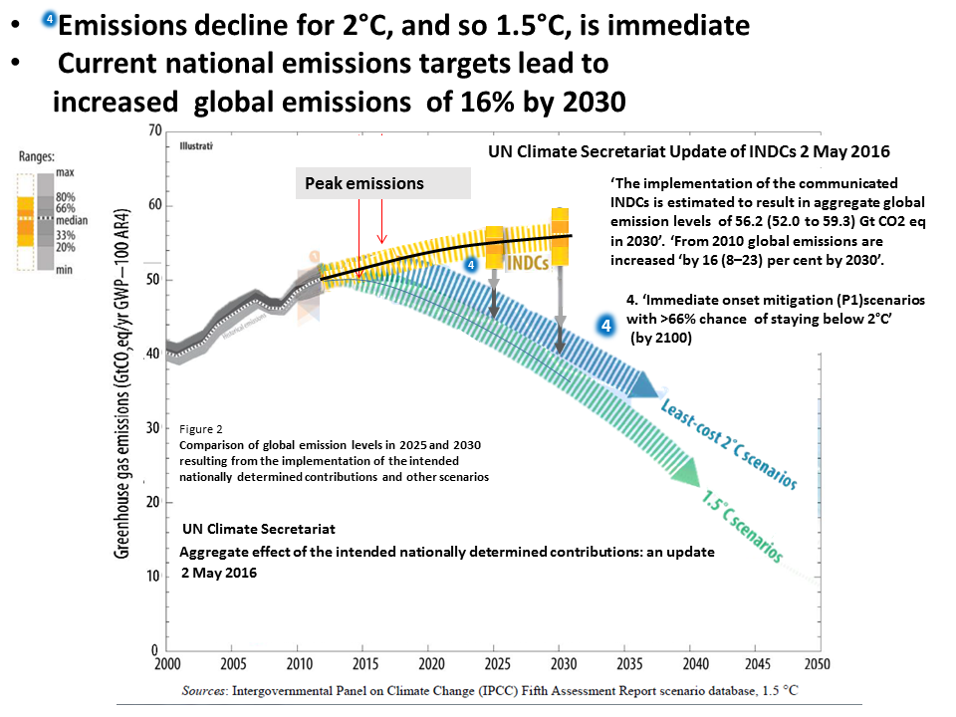

Slide 22
