Slide 1
Area of a triangle
LO: Can I find the area of a non right-angle triangle?

Slide 2
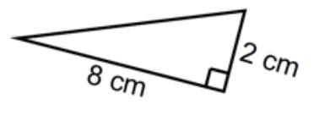
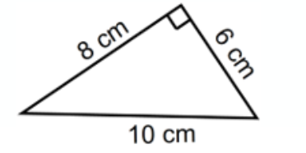
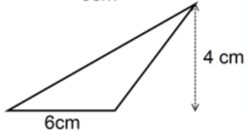
Area of a triangle
5cm
5cm
6cm

Slide 3
Area?
Is there an issue with working out the area of this triangle?
6cm
30$°$
12cm
Area = $\frac{1}{2}a b\sin\left(C\right)$
Where C is the angle wedged between two sides a and b.

Slide 4
Example
$$9$$
3cm
$$6.97$$
$$61°$$
$$10$$
59°
7cm

Slide 5
Worksheet

Slide 6
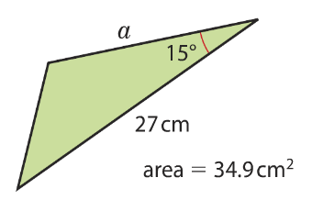
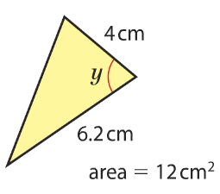
Using the area of a triangle

Slide 7
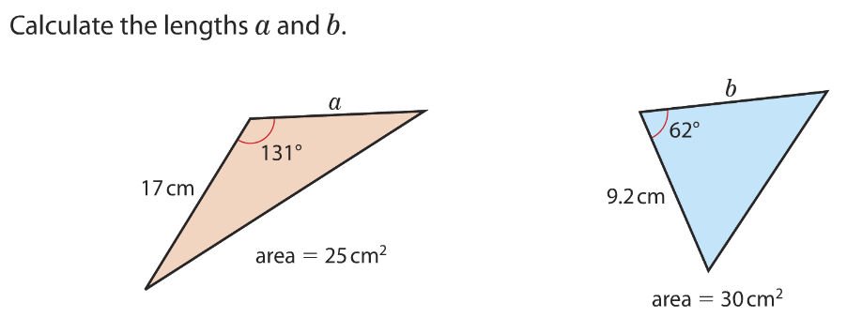
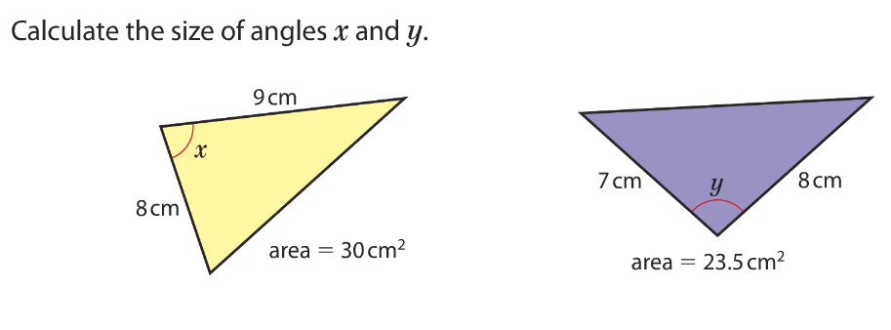
Questions
Give your answers to 3 significant figures
a = 3.90 cm
b = 7.39 cm
x = 56.4º
y = 57.1º

Slide 8
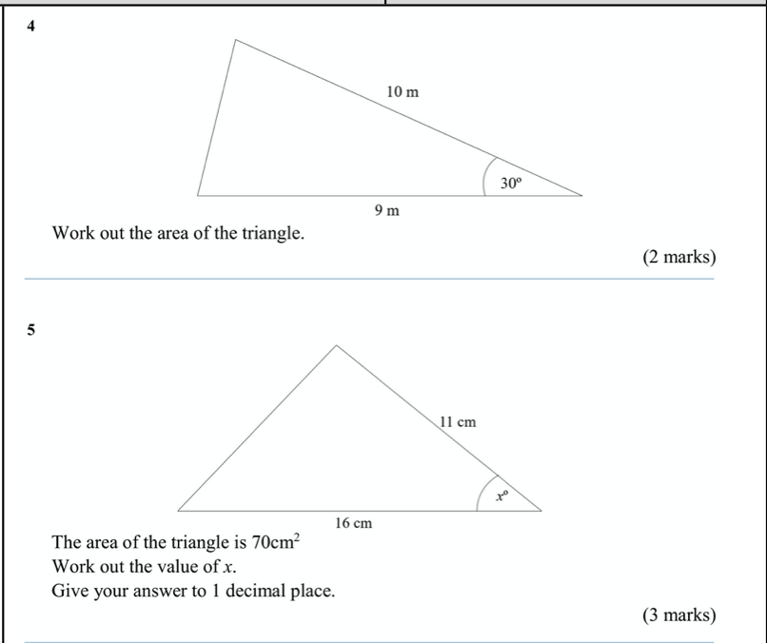
Exam questions

